Slide 1




PROJECT PRESENTATION
Inventory Management System
Presented by:
Project GP1 (COE-UA 4th Sem)
Mentor: Ms. Jahanvi

Slide 2


Time-Straps
Introduction
Problem Statement
Why This System?
Features
Tech Stack
Feasibility
UI Glance

Slide 3
Introduction
DealDepot is an Inventory Management System designed to simplify stock tracking, sales management, and report Generation. Employee Panel also Offers POS and PG for sales

Slide 4
Problem Statement
Many businesses struggle with inefficient inventory tracking, leading to stock mismanagement and financial losses. DealDepot aims to solve this with an automated system.

Slide 5




Why this System ?
This system is needed to streamline inventory operations, reduce human errors, and enhance business efficiency with real-time tracking and reporting.

Slide 6
Features
🔹 Admin Features:
Dashboard Overview
Sales Report Management
Attendance
Inventory Management
Employee Management
🔹 Employee Features:
Daily Attendance Marking
Point of Sale (POS) System
Custom Payment Gateway (PG)
Bill Printing Functionality.

Slide 7
TechStack
FrontEnd: HTML, CSS, JS, Bootstrap
BackEnd: Python, FastAPI, Pandas
Database: CSV
External Modules: Uvicorn, Sockets, JsPDF

Slide 8
Feasibility Check
1️⃣ Easy to Use
2️⃣ Cost-Effective
3️⃣ Lightweight & Fast
4️⃣ Automates Business Operations
5️⃣ Scalability & Flexibility
6️⃣ No Complex Setup Required

Slide 9

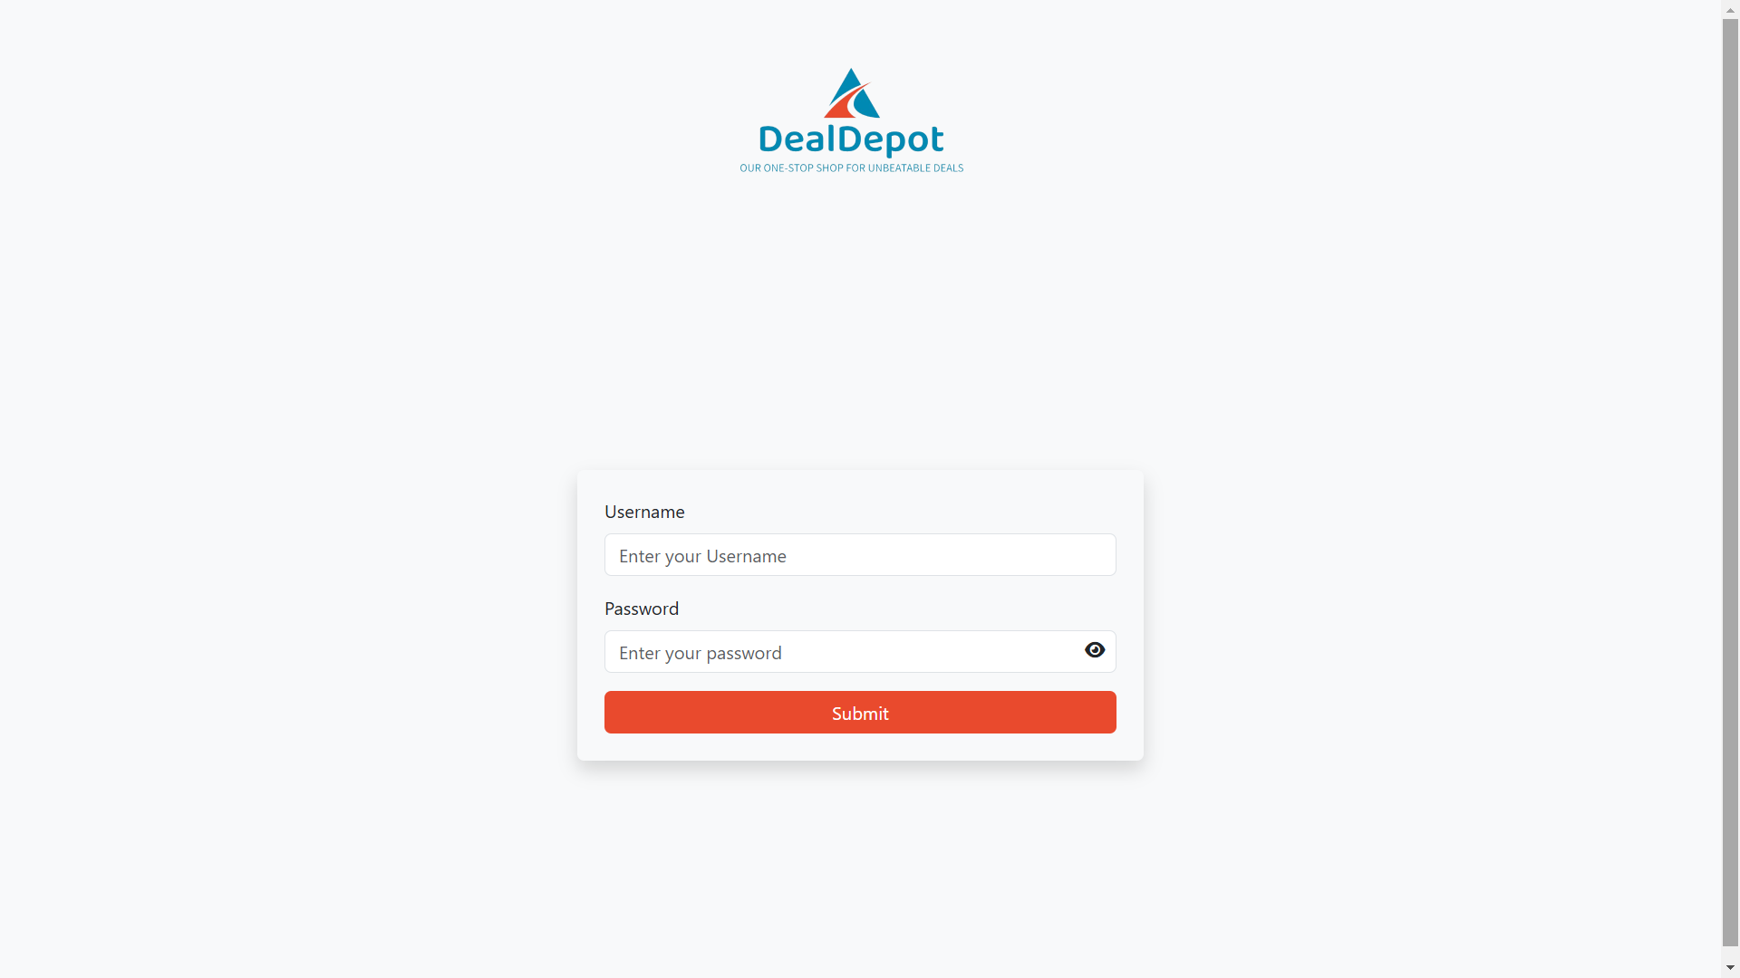
t
UI Glance

Slide 10
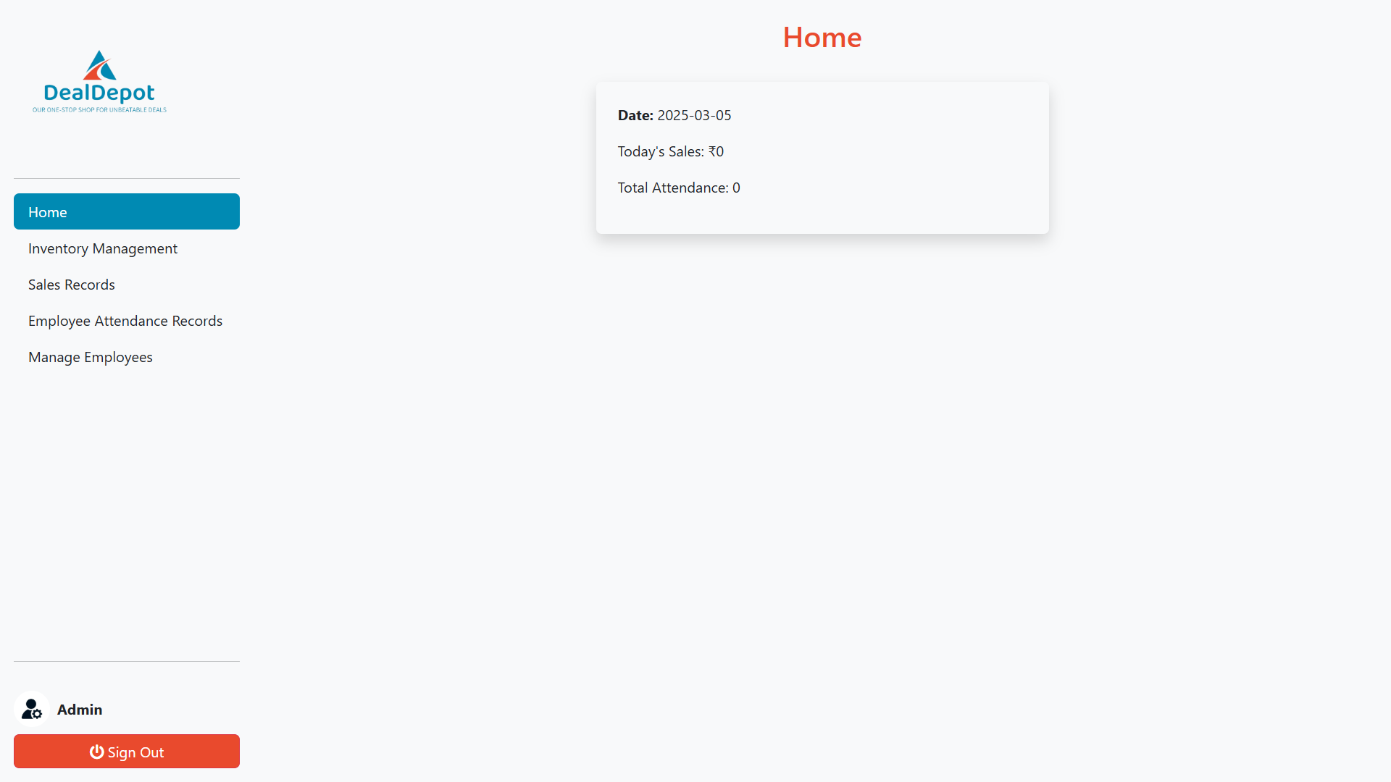
t

Slide 11
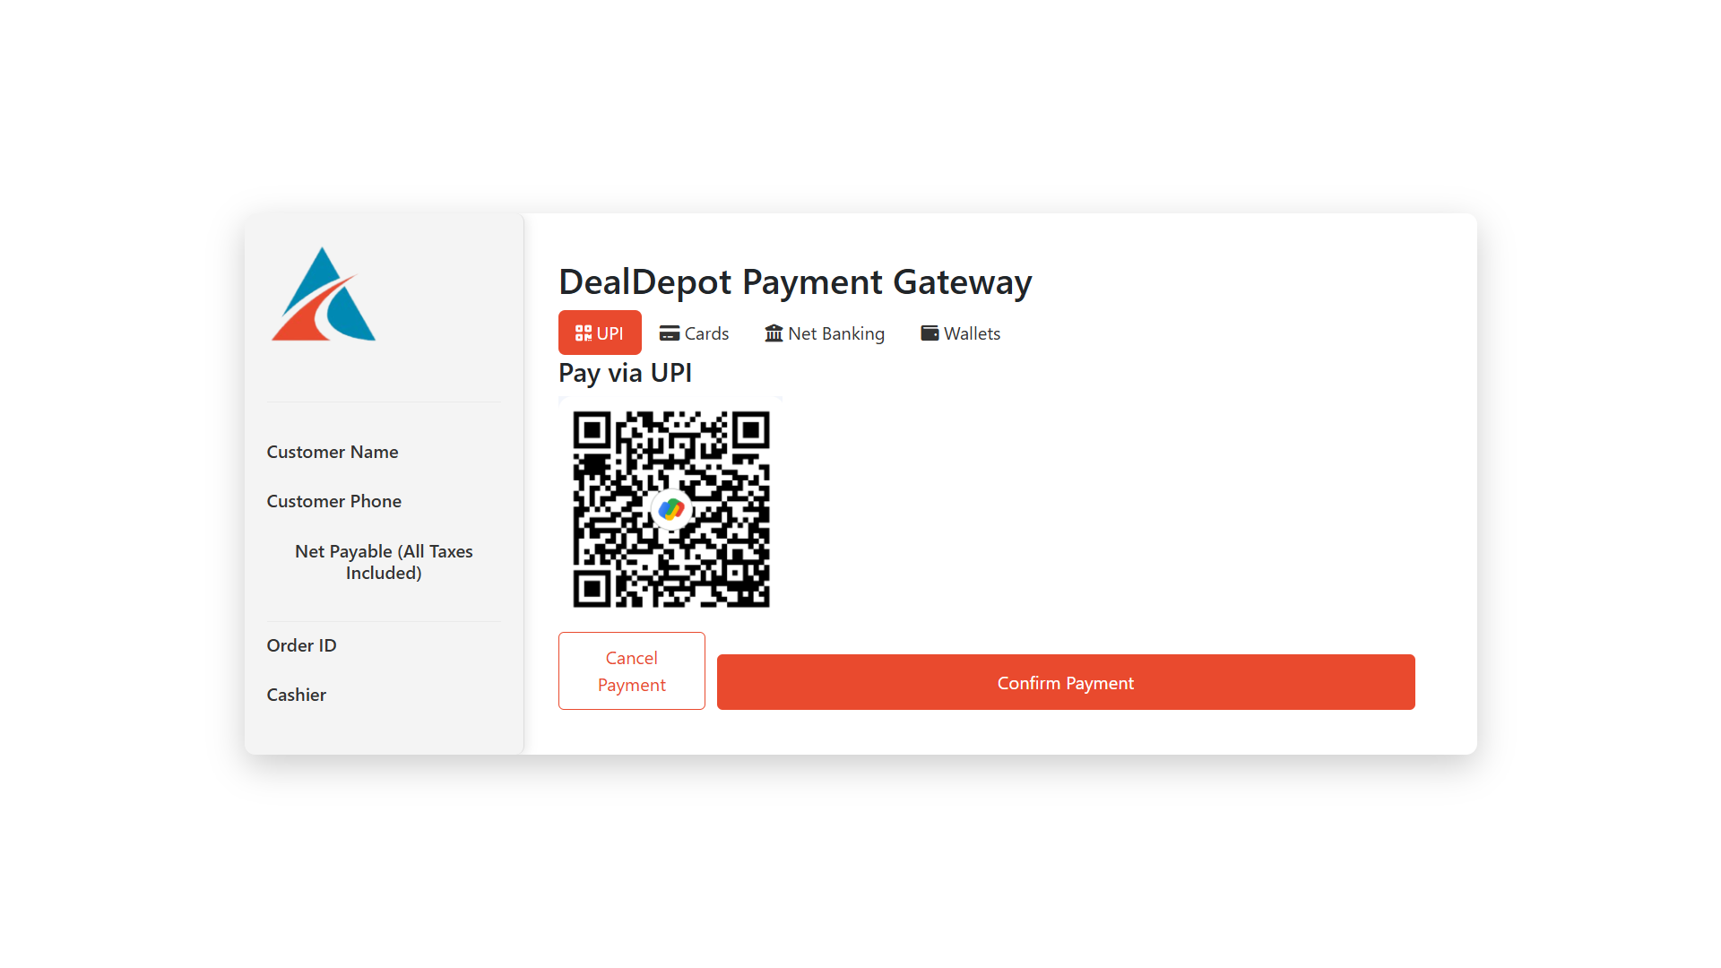
t

Slide 12
Our Team
1️⃣ Adarsh Dhiman - TL
2️⃣ Arsh
3️⃣ Bhumi
4️⃣ Abhinav
5️⃣ Himanshu

Slide 13
THANK YOU

