Slide 1
INTRODUCTION TO MACHINE LEARNING
Faiz Ahmad

Slide 2
Agenda
Introductions
Basics
Classification
Clustering
Regression
Use-Cases

Slide 3
Introduction
Machine learning is a method of data analysis that automates analytical model building. It is a branch of artificial intelligence based on the idea that systems can learn from data, identify patterns and make decisions with minimal human intervention.

Slide 4
Terminology
Features
The number of features or distinct traits that can be used to describe each item in a quantitative manner.
Samples
A sample is an item to process (e.g. classify). It can be a document, a picture, a sound, a video, a row in database or CSV file, or whatever you can describe with a fixed set of quantitative traits.
Feature vector
is an n-dimensional vector of numerical features that represent some object.
Feature extraction
Preparation of feature vector
transforms the data in the high-dimensional space to a space of fewer dimensions.
Training/Evolution set
Set of data to discover potentially predictive relationships

Slide 5
Learning (Training)
Features
1.Color: Redish/Red
2.Type : Fruits
3. Shape
Features
1. Grey
2. Logo
3. Shape
Features
1. Yellow
2. Fruit
3. Shape

Slide 6
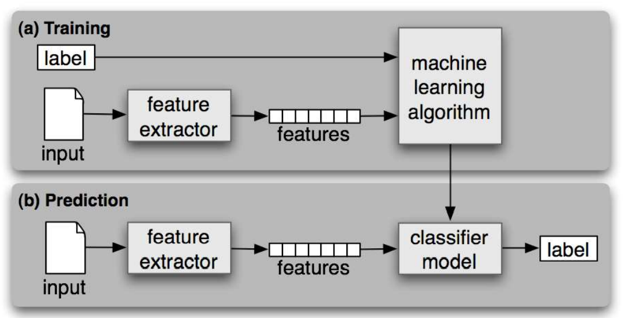
Workflow

Slide 7
Categories
Supervised Learning
Unsupervised Learning
Reinforcement Leaning

Slide 8
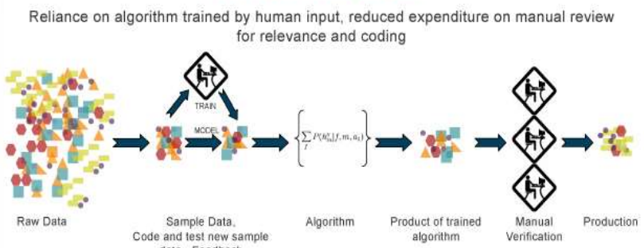
Supervised learning
The correct classes of the training data are known

Slide 9
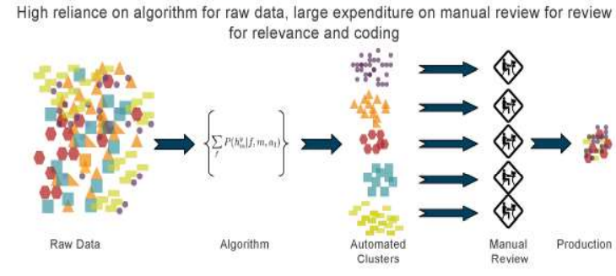
Unsupervised learning
The correct class of training in not known

Slide 10
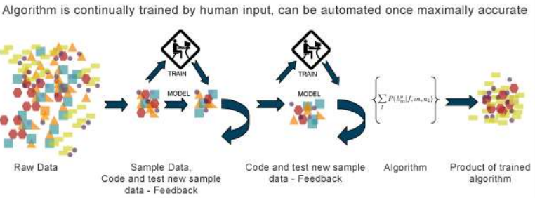
Reinforcement Learning
Allows the machine or software agent to learn its behaviour based on feedback from the environment
This behavior can be learnt once and for all, or keep on adapting as time goes by

