Slide 1

Machine Learning

Slide 2
Type of Machine Learning
Supervised
Machine Learning
Unsupervised
Reinforcement

Slide 3
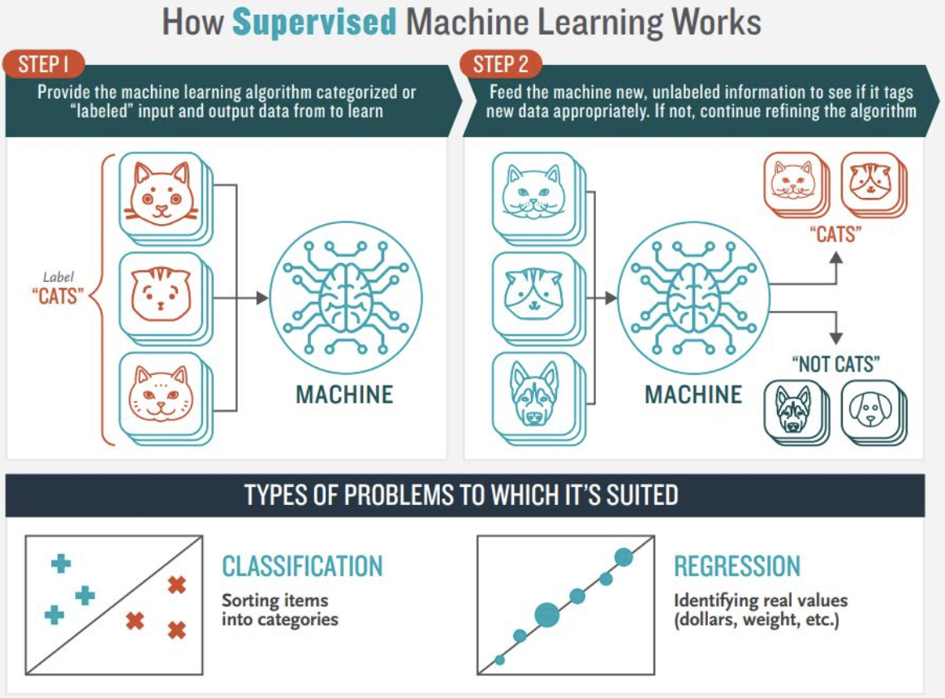
Supervised Learning

Slide 4
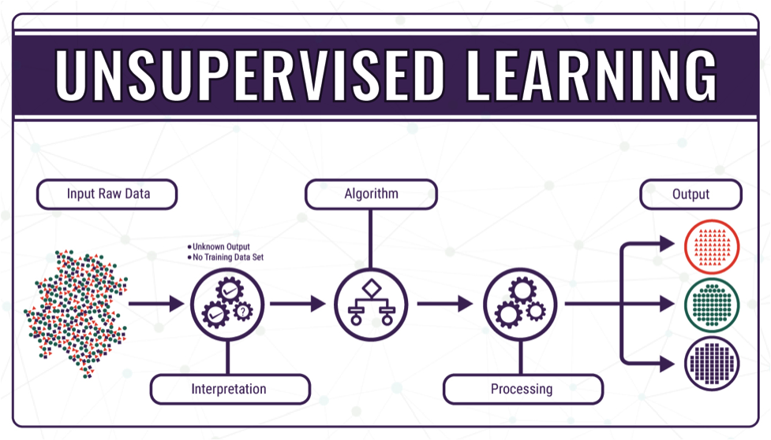
Unsupervised Learning

Slide 5
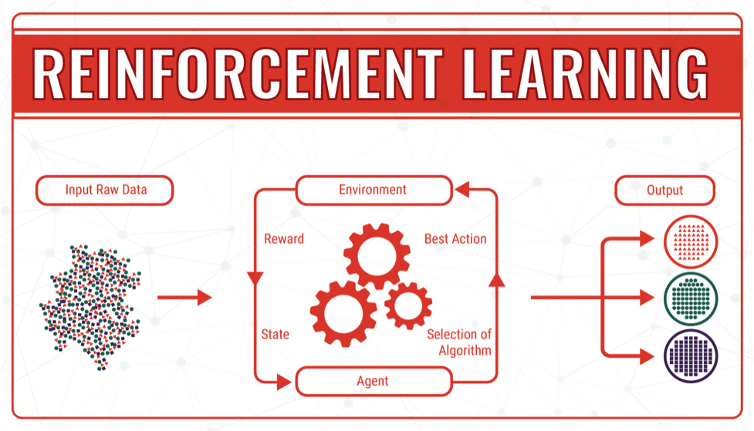
Reinforcement Learning

