Slide 1
Lead Conversion Analysis Using Logistic Regression
Predicting Lead Conversion Likelihood with Data Insights
Adarsh M Shetty B
Arnab Biswas
Bhavya Jain

Slide 2
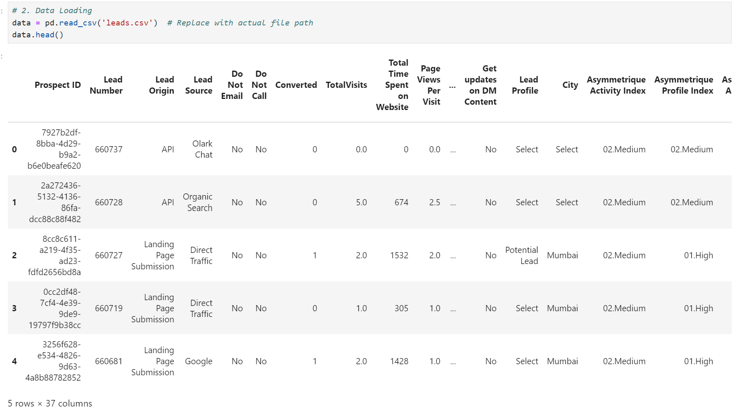
Problem Statement
Objective: To predict the likelihood of lead conversion based on historical data, enabling efficient lead prioritization and better resource allocation.
Expected Key Challenges After Initial Data Analysis:
Handling missing data in key features like Lead Quality and Last Activity.
Managing class imbalance with a conversion rate of 38.5%.
Identifying meaningful predictors from numerous features, including categorical variables.

Slide 3
Approach Overview
Data Understanding and Quality Checks: Addressed missing values, ensured data consistency, and removed redundant columns.
Exploratory Data Analysis (EDA): Analyzed conversion trends and identified key predictors.
Data Preprocessing: Imputed missing values, created dummy variables, and scaled numerical features.
Feature Engineering: Selected features based on logistic regression coefficients and domain-specific insights.
Model Building and Evaluation: Developed a logistic regression model and evaluated using metrics like accuracy, precision, recall, and ROC-AUC.
Lead Scoring: Assigned a lead score (0-100) to each lead based on the predicted probability of conversion.

Slide 4
Data Preparation
Missing Value Treatment:
Lead Quality and Last Activity were imputed with mode and placeholder values, respectively.
Applied "Not Available" placeholders for categorical null values.
Feature Transformation:
Dummy variables were created for categorical features like Lead Source and Tags.
Numerical columns like Total Time Spent on Website were scaled for model compatibility.

Slide 5
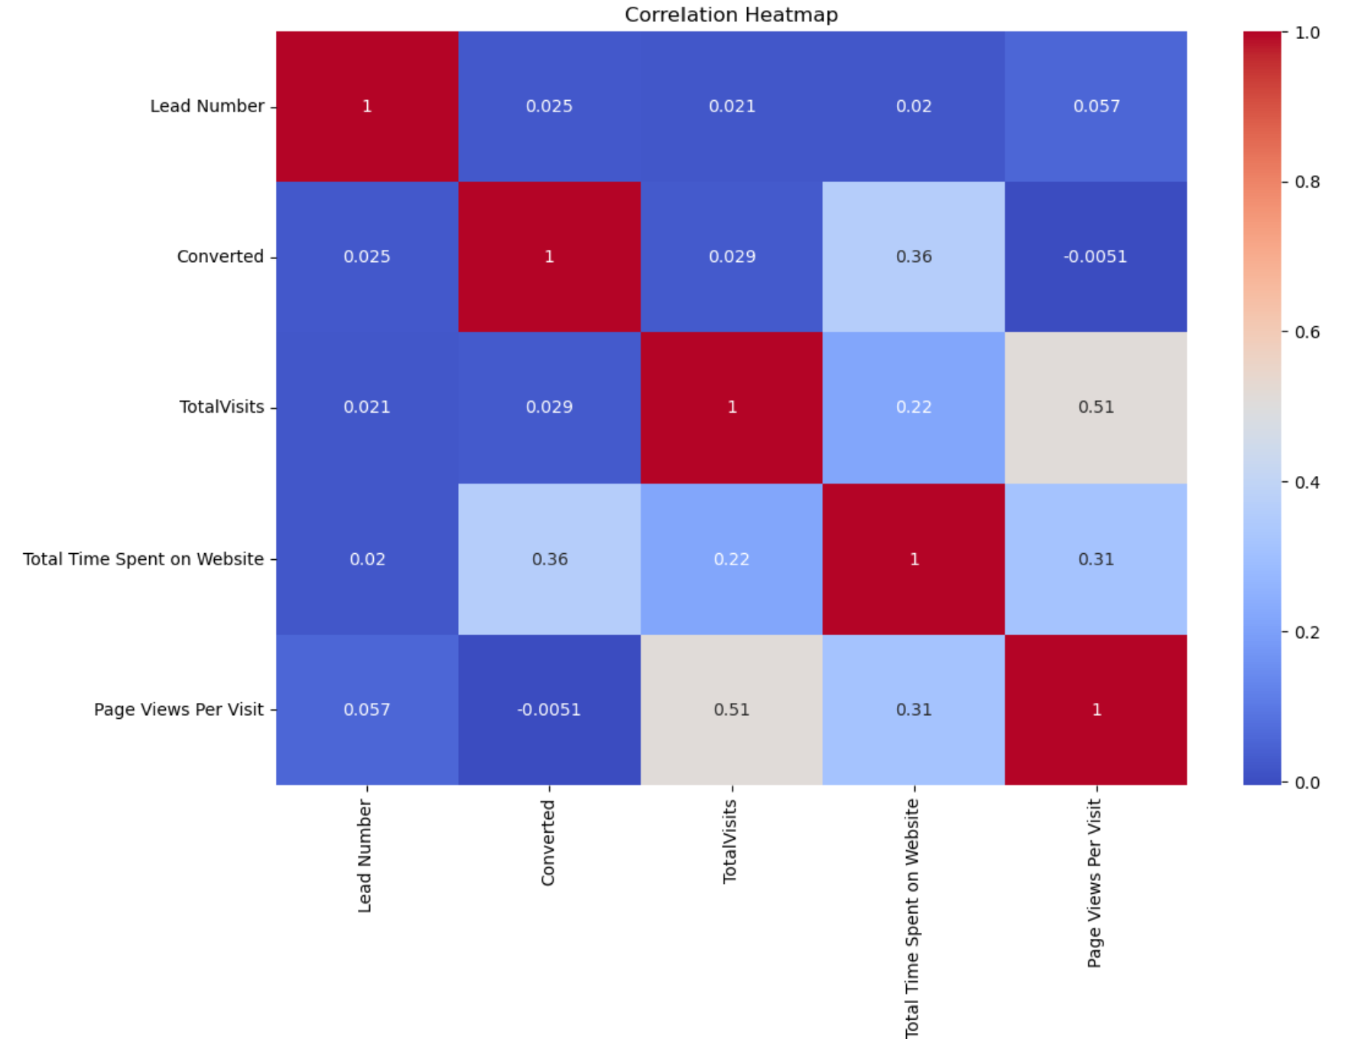
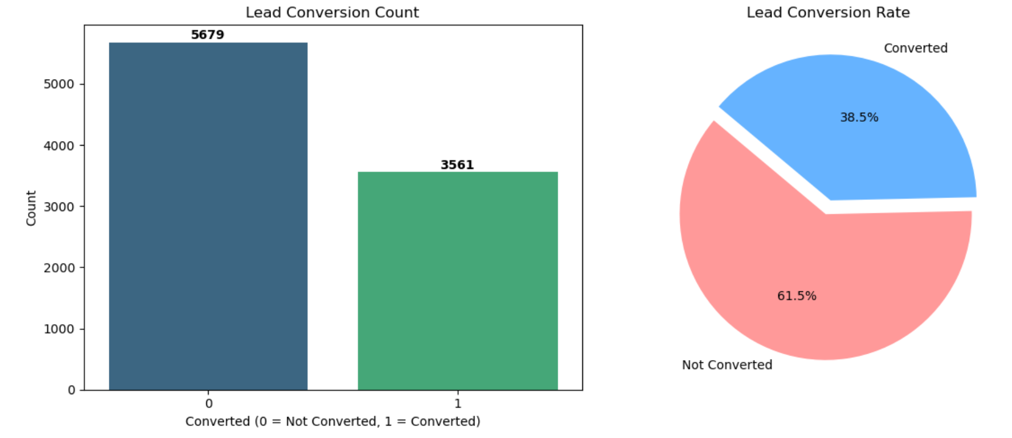
EDA Insights
Conversion rate = 38.5% (3561 out of 9240 leads).
No significant linear correlation between selected features

Slide 6
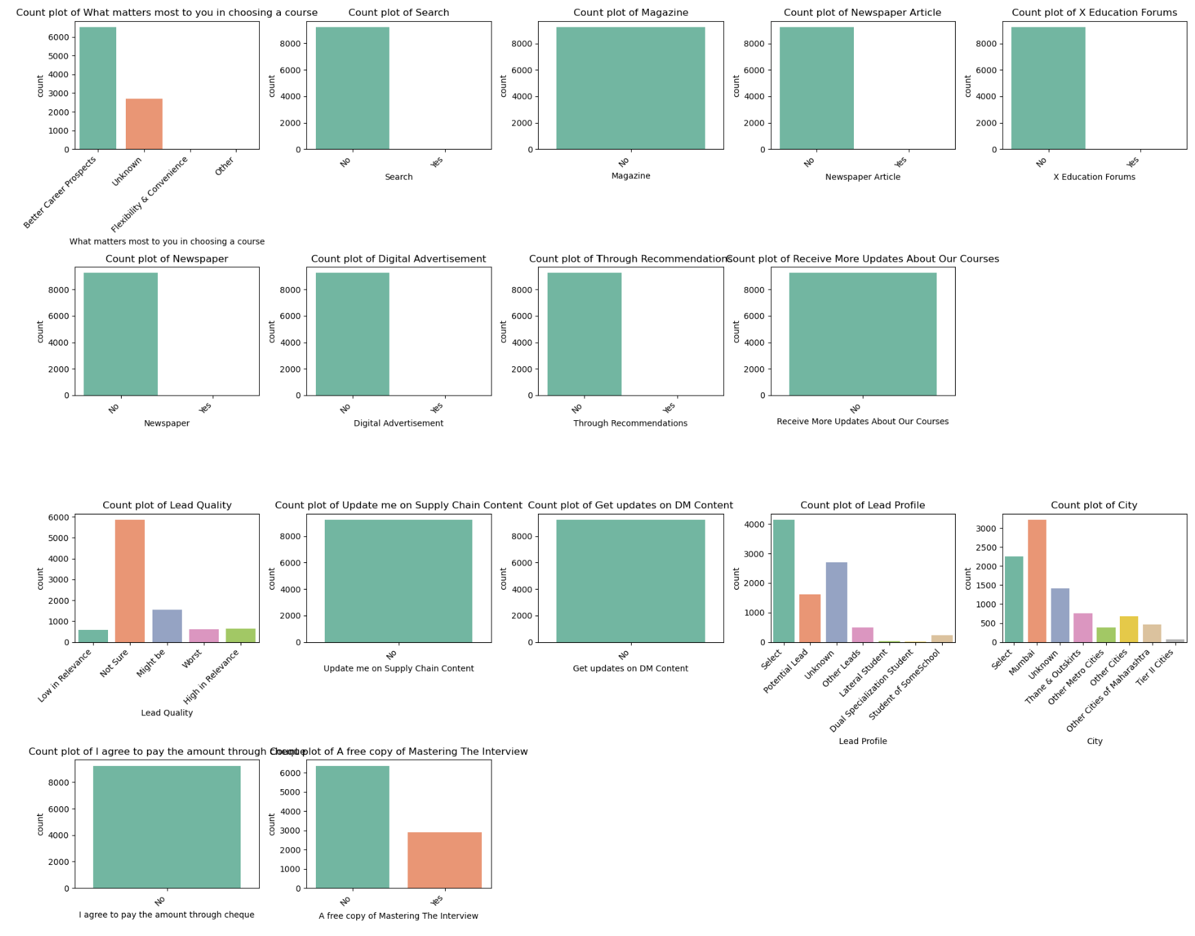
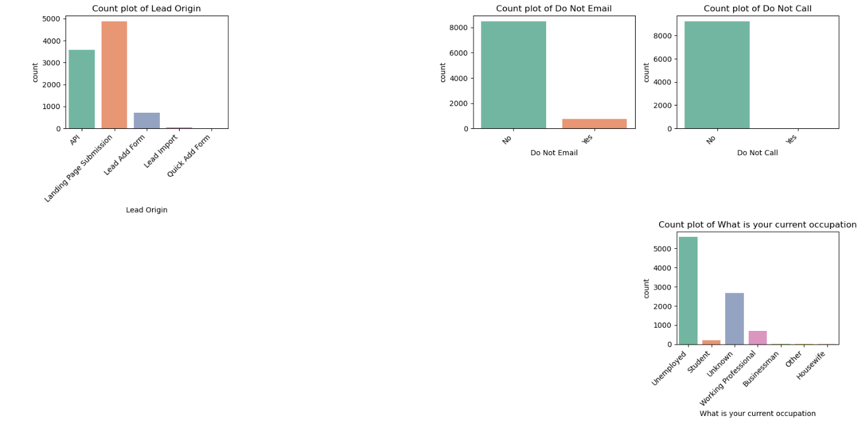
Visualizations [Categorical Features]

Slide 7
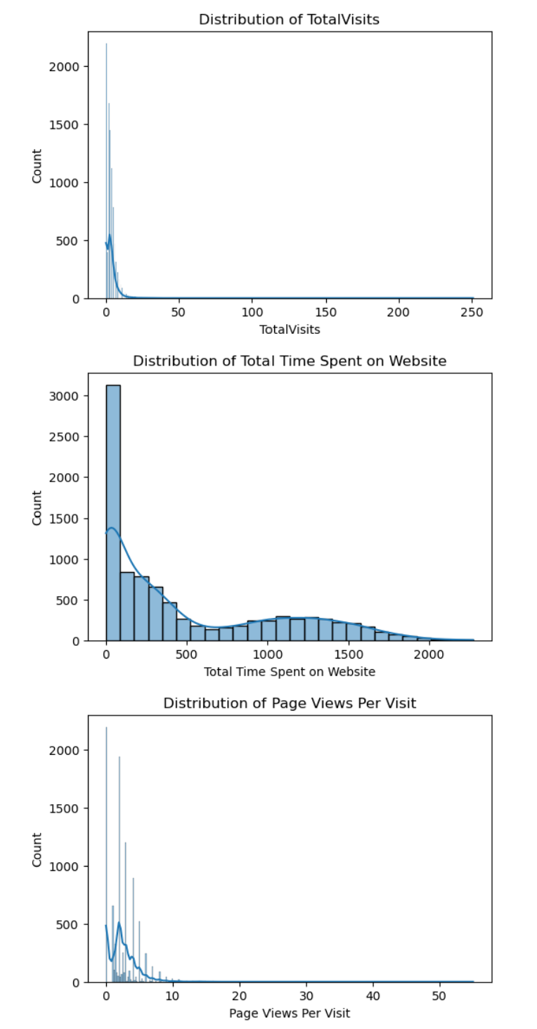
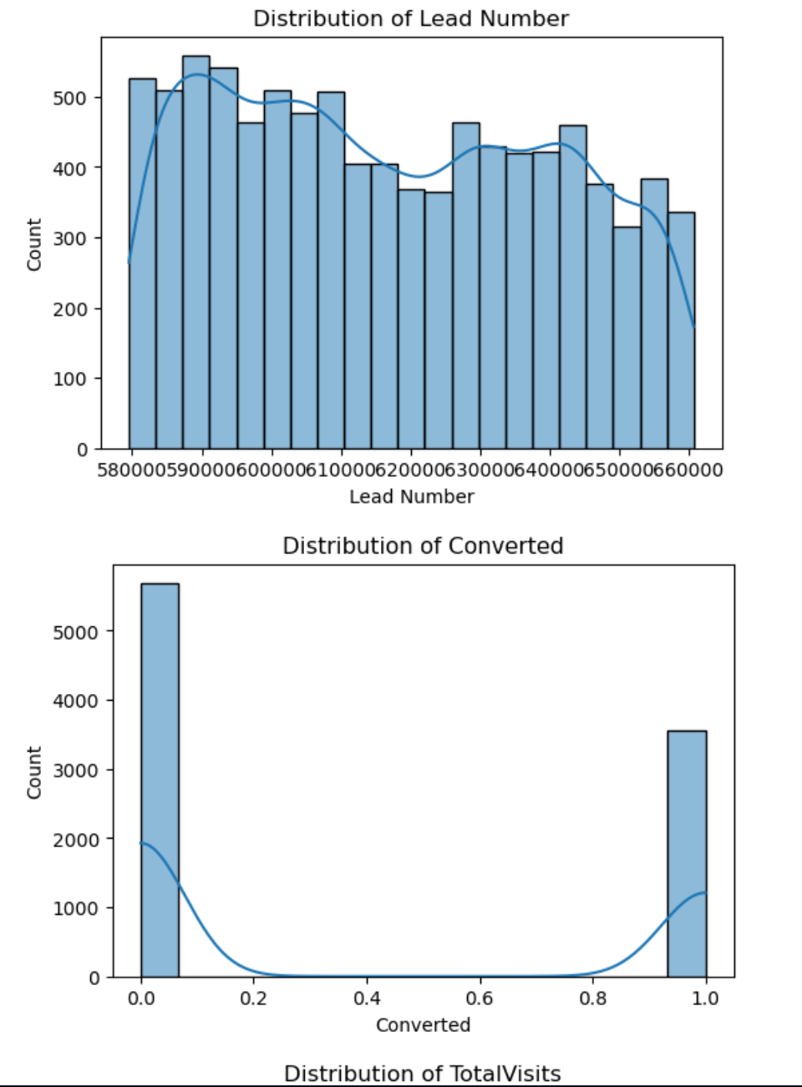
Visualizations[Numerical Features]

Slide 8
Model Development
Logistic regression was chosen for interpretability and efficiency.
Class imbalance addressed using weighted loss functions.
Lead scores were computed as:
lead_scores = y_pred_prob * 100
data_test['Lead Score'] = lead_scores
Thresholds adjusted for specific strategies:Aggressive conversion: Threshold = 0.3 (Targeted leads = 1123).
Minimized calls: Threshold = 0.7 (Targeted leads = 967).

Slide 9
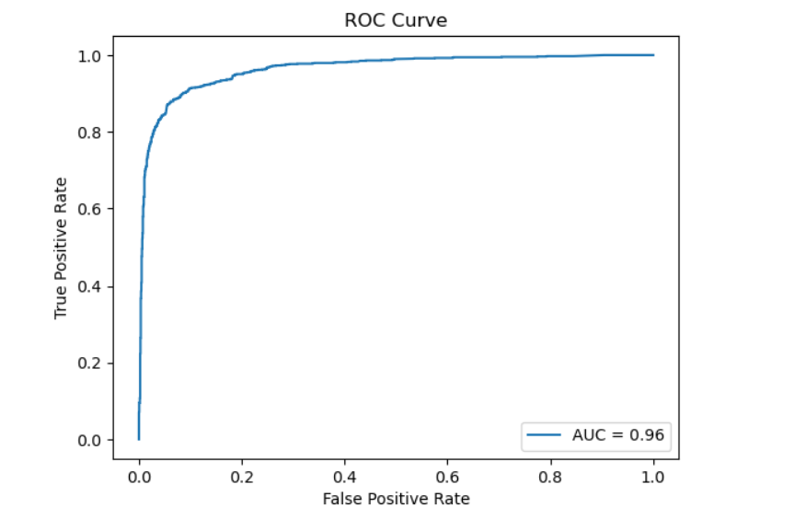
Model Evaluation
Confusion Matrix:
[[1571 133]
[ 118 950]]
Classification Report:
Accuracy: 91%
Precision (Converted Leads): 88%
Recall (Converted Leads): 89%
F1 Score (Converted Leads): 88%
ROC-AUC Score: 0.958
Threshold Impact (Customize on Need Basis):
Threshold = 0.3: Higher sensitivity for aggressive conversion.
Threshold = 0.7: Focused targeting with minimized waste.

Slide 10
Business Implications
Lead Scoring:
Assigning lead scores (0-100) for prioritization.
Example: Leads with scores >70 are "hot" and should be prioritized.
Actionable Insights:
Tags_Ringing: Indicates less promising leads; adjust follow-up strategies.
Total Time Spent on Website: Key metric for identifying engaged leads.
Campaign Optimization:
Reallocate resources to effective lead sources and Tags categories.

Slide 11
Business Key Insights after using prediction Model
Top Predictors (Numerical):
Total Time Spent on Website: Positively correlated with conversion (Coefficient: 1.35).
Top Predictors (Categorical):
Tags_Ringing: Strong negative impact on conversion (Coefficient: -1.71).
Tags_Will revert after reading the email: Positive correlation with conversion (Coefficient: 1.59).
Tags_Lost to EINS: Positive impact (Coefficient: 0.93).

Slide 12
Conclusion and Recommendations
Summary of Findings:
Logistic regression model achieved 91% accuracy and 0.958 ROC-AUC, providing actionable insights.
Top predictors (numerical and categorical) were identified to guide lead prioritization.
Recommendations:
Focus on leads with high scores for conversion campaigns.
Adjust follow-up intensity based on thresholds (e.g., aggressive vs. focused strategy).
Regularly retrain the model with new data to adapt to changing trends.

Slide 13
Thank You

