Slide 1

COMPILER DESIGN PROJECT
Automated LLM/Agent-Guided Compiler Code Optimization
Before (naive TAC)
t0 = 3
t1 = 5
t2 = t0 + t1
x = t2
print x
A multi-agent system for autonomous TAC analysis, transformation and verification
After (agent-optimized)
print 8
Team: NIRUPAM RAUT[24BAI0345]· ADARSH SHARMA BADHAI[24BCE2972]
gitlink:https://github.com/adarshhsharmaa-rgb/LLM-based-Compiler-Code-Optimization
October 2026
Notes:
Introduce the project and the team. One-line pitch: an agent that optimizes compiler intermediate code on its own, and never accepts a change it cannot verify.

Slide 2
Introduction
Modern compilers run fixed optimization passes. They don't reason about what to try next.
What if an agent could analyze code, propose optimizations, verify them, and keep improving the program on its own?
We built a multi-agent system that does this on Three-Address Code (TAC).
Every proposal must pass a correctness check and lower the cost before it is accepted.
500
programs tested across 7 categories
10,978
optimization proposals evaluated
0
incorrect changes accepted
Notes:
Emphasize the safety result: across 10,978 proposals no incorrect change was accepted. The system is autonomous end-to-end with no human in the loop.

Slide 3

Objectives
Agent architecture
Cost-gated acceptance
Separate components with clear responsibilities
Accept only if verified correct AND cheaper
Orchestrator loop
LLM proposer
Analyze → Propose → Verify → Evaluate → Accept/Reject
Google Gemini alongside the rule-based optimizer
6 optimization types
Full evaluation
Folding, algebraic, dead code, CSE, strength reduction, copy propagation
500 programs, the 6 required metrics, 7 charts
Dual verification
Differential testing (25+ input sets) + symbolic equivalence
Notes:
These are the project objectives; all seven have been implemented and evaluated.

Slide 4
Literature Review
Area | Key works | Relevance to our project
Classical compiler optimization | Aho, Lam, Sethi & Ullman: Compilers: Principles, Techniques, and Tools (2006) | Foundation for constant folding, DCE, CSE, copy propagation and dataflow analysis
Superoptimization | Massalin (1987); Schkufza, Sharma & Aiken: STOKE (2013); Phothilimthana et al. (2016) | Search for optimal instruction sequences; uses testing to check candidates
Translation validation | Pnueli, Siegel & Singerman (1998); Necula (2000) | Checking that compiler output matches the source: the idea behind our verifier
LLMs for code | Chen et al.: Codex (2021); Rozière et al.: Code Llama (2023) | Models that generate and transform code; we use Gemini as a proposer
LLM-assisted compilation | Cummins et al.: CompilerGym (2022); Cummins et al.: LLM Compiler (2024) | RL and LLM agents choosing compiler flags and pass orderings
Multi-agent systems | Wu et al.: AutoGen (2023) | Agent orchestration; inspired our Orchestrator + specialist design
Notes:
Our work combines classical compiler techniques with an LLM. Unlike LLM Compiler, which picks pass orderings, our agent proposes actual code transformations and checks each one before accepting it.

Slide 5

Research Gaps
1
Fixed pass order
Classical compilers don't decide which optimization to try or check whether it helped
2
Superoptimizers are slow
Our contribution
STOKE-style search is thorough but limited to small code blocks
An agent that decides what to optimize, proposes transformations (rule-based + LLM), and accepts a change only after it is verified and shown to lower cost.
3
No correctness guarantee
LLM code tools (Codex, Code Llama) can introduce bugs silently
4
Wrong level
LLM-for-compiler work targets pass ordering and flags, not code transformations
0
incorrect changes accepted in 10,978 proposals
5
No verification gate
Few systems check every LLM suggestion before accepting it
Notes:
Each gap is addressed by one part of the design: the agent loop (gap 1), cheap rule-based search (gap 2), the verifier (gaps 3 and 5), and code-level proposals (gap 4).

Slide 6

Proposed Methodology
1
2
3
4
5
6
7
Parse
Analyze
Propose
Verify
Evaluate
Repeat
Final check
Source → AST → Three-Address Code
Find optimization opportunities, ranked by priority
Apply the top rule; ask Gemini if rules fail or run out
Differential testing + symbolic check
Accept only if the weighted cost drops
Until nothing is left (max 50 iterations)
Re-verify the result against the original
Key design principle
The LLM is only a proposer. Its suggestions go through exactly the same verification and cost gates as the rule-based ones, so a wrong suggestion is caught and rejected.
Notes:
Walk through the seven steps. Stress that the verifier sits between every proposal and the program: nothing changes unless it passes.

Slide 7



Dataset: 500 Programs, 7 Categories
Category | Count | Example | Main optimization targets
Arithmetic | 60 | int k = 1 + 14; | Constant folding
Nested expressions | 60 | ((a+b)*(c-d)) | Constant folding, copy propagation
Repeated expressions | 60 | a*b computed twice | Common subexpression elimination
Dead code | 60 | int v = e*5; never used | Dead code elimination
Loops | 80 | for / while with invariant work | Folding inside loops, DCE
Conditionals | 80 | if / else with x*1, x+0 | Algebraic simplification, folding
Mixed | 100 | several of the above | All of the above
Total | 500
Generated by dataset/generator.py with a fixed random seed, so it is reproducible
Some programs read input variables, tested with random and boundary values
Covers straight-line, branching, looping and nested code
Notes:
The dataset is generated, not hand-written, so the experiment can be reproduced exactly from the fixed seed.

Slide 8
System Architecture
Source program
Lexer
Parser
AST
TAC Generator
TAC program
TAC enters the agent loop
Agent loop: Orchestrator, up to 50 iterations per program
Outputs (after final check)
1 Code Analyzer
find & rank opportunities
2 Proposer
rules (6 types) + Gemini
3 Verifier
differential + symbolic
Optimized TAC
Decision logs (.log + .json)
next iteration
Metrics (CSV + JSON)
5 Decision
accept only if verified AND cheaper
4 Cost Evaluator
weighted static cost
7 charts (PNG)
Notes:
Source code goes through a classic frontend to Three-Address Code. The agent loop of five components then works on the TAC; after a final check against the original, the run produces the optimized TAC, logs, metrics and charts.

Slide 9




Agent Workflow: The Optimization Loop
Analyze TAC: find opportunities
Max 50 iterations per program
Any untried opportunity?
No
Final check vs. original
END
On accept: clear the "already tried" list, since new opportunities may appear
Yes
Pick top priority and propose (rules or Gemini)
On reject: remember it and try the next opportunity
Verified correct?
Fail
REJECT: invalid
Gemini is asked when a rule is rejected or the rules run out
Pass
Cost lower?
No
REJECT: no cost gain
At the end: re-verify the optimized TAC against the original
Yes
rejected: try the next one
ACCEPT: update program
accepted: analyze again
Notes:
Follow the flowchart top to bottom. Point out the two rejection paths (invalid, and no cost gain) and that both loop back to analysis without changing the program.

Slide 10
Implementation: Tools & Technologies
Layer | Technology | Purpose
Language | Python 3.10+ | match statements, dataclasses, type hints
LLM provider | Google Gemini (gemini-3.1-flash-lite) | Free-tier LLM proposer via the google-genai SDK
Visualization | Matplotlib, Seaborn, Plotly | Bar, line, scatter, heatmap, pie, Sankey
Testing | pytest (190 tests) | Unit and integration tests for every component
Numerical | NumPy | Trend lines and statistics
Export | Kaleido | Saving Plotly charts as PNG
Project structure
src/frontend/
Lexer, Parser, AST,
TAC generator
src/tac/
Instructions, interpreter,
dataflow analysis
src/agents/
Orchestrator, Analyzer,
Rule + LLM optimizers,
Verifier, Cost Evaluator,
Decision Logger
src/visualization/
7 charts, metrics report
Notes:
Everything is plain Python. Gemini is accessed through Google's official SDK on the free tier.

Slide 11


Implementation: The Five Agents
1. Code Analyzer
2. Rule-Based Optimizer
3. LLM Optimizer (Gemini)
Dataflow analysis (CFG, liveness, available copies). Ranks 6 types: Fold 100 → Algebraic 90 → Dead Code 80 → CSE 70 → Strength 60 → Copy Prop 50
Copies the program and applies exactly one transformation. Copy propagation also removes the copy once unused
Sends TAC with a structured prompt; reads back <tac> and <reasoning>. 6.5 s between calls; retries on errors, stops when the quota runs out
4. Verifier
5. Cost Evaluator
Differential testing (20 random + 5 edge-case + boundary inputs) and symbolic checking for straight-line code
cost = 1.0·instructions + 2.0·arithmetic + 0.5·temps + 1.5·copies + 1.0·branches
Notes:
Each agent is a separate class with one job. The orchestrator connects them in the loop shown earlier.

Slide 12
Verification Deep Dive
Gate 1: Differential testing
Gate 2: Symbolic check
Gate 3: Cost
Run original and candidate on 25+ input sets. Compare printed output and failure behaviour (division by zero, timeout, undefined variable). Both timing out = rejected.
For straight-line code, values become canonical polynomials, so x*2 = x+x = x<<1 and a+b = b+a. Loops and branches rely on Gate 1.
A correct change is still rejected unless the weighted cost strictly drops.
Strength of the guarantee
10,978 proposals
0 incorrect changes accepted
Proven equivalent for programs with no inputs and for straight-line code. Tested thoroughly (including boundary values) for branching code with inputs. The finished program is re-verified against the original.
Notes:
Be precise about the guarantee: it is a proof for input-free and straight-line programs, and strong testing for branching programs with inputs. An independent re-check of all 500 final programs found no mismatches.

Slide 13
Results: Key Metrics
Metric | Rules only | Rules + Gemini
Average cost reduction | 82.49% | 91.50%
Programs with >30% reduction | 500 / 500 | 500 / 500
Verification pass rate | 100.00% | 99.76%
Acceptance rate (of verified) | 98.96% | 98.87%
Steps to convergence (mean) | 22.2 | 22.7
LLM validity rate | n/a | 92.35%
False positives | 0 | 0
Total proposals | 10,628 | 10,978
Accepted | 10,517 | 10,828
Average cost reduction
82.5% → 91.5%
rules only → rules + Gemini
False positives
0
target: must be 0%
Notes:
Gemini raised the average cost reduction by 9 percentage points, and the verifier blocked all 26 incorrect Gemini suggestions. Every target in the metrics table is met.

Slide 14

Results: Cost Reduction by Category
Category | Programs | Rules only | Rules + Gemini | Change
Arithmetic | 60 | 96.0% | 96.0% | —
Nested | 60 | 98.1% | 98.2% | +0.1
Repeated expressions | 60 | 80.7% | 81.7% | +1.0
Dead code | 60 | 97.4% | 97.4% | —
Loops | 80 | 65.1% | 93.3% | +28.2
Conditionals | 80 | 73.9% | 84.1% | +10.2
Mixed | 100 | 77.9% | 91.6% | +13.7
Key takeaway
Biggest gains on loops (+28) and conditionals (+10)
There the six rules can't remove branches
Gemini worked out whole constant loops, e.g. "adds −4 twelve times" → print -48
196 programs improved, none got worse
Notes:
Arithmetic and dead-code programs were already near-optimal after the rules, so the LLM had nothing to add there. Its value is in loops and branches.

Slide 15
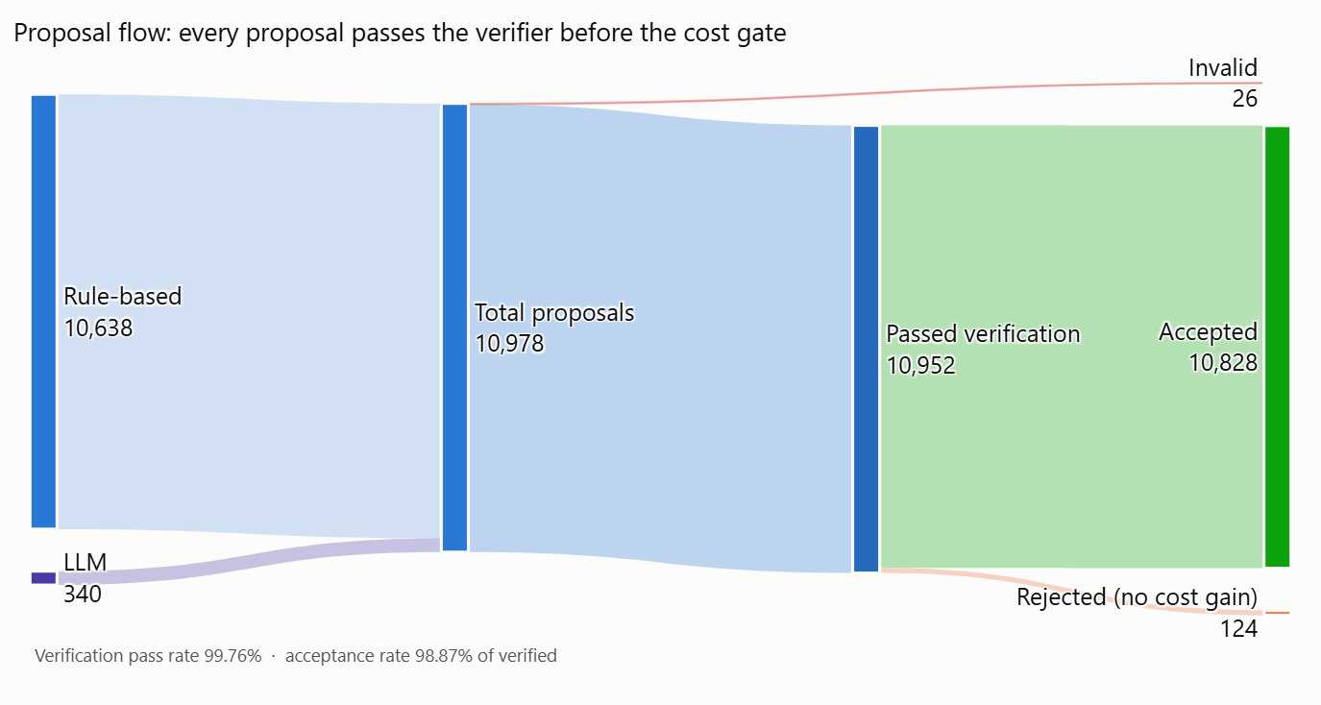
Results: Proposal Flow
What it shows
10,978 proposals in total (10,638 rule-based, 340 from Gemini)
10,952 passed verification; 26 were invalid
10,828 accepted; 124 rejected for no cost gain
All 26 invalid proposals came from the LLM and were blocked by the verifier
Notes:
Read the flow left to right: sources, verification, then the cost decision.

Slide 16
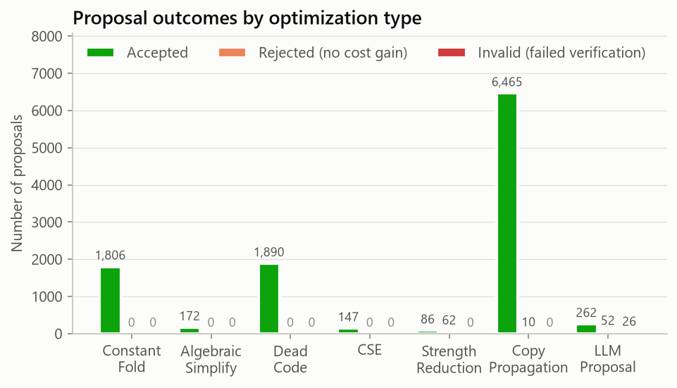
Results: Outcomes by Optimization Type
What it shows
Copy propagation dominates: 6,465 accepted, because naive TAC creates many temporary copies
Strength reduction has the most rule rejections (62): x*2 → x+x doesn't lower cost
LLM proposals: 262 accepted, 52 no gain, 26 invalid
Notes:
Rule-based proposals never failed verification; every invalid proposal came from the LLM.

Slide 17
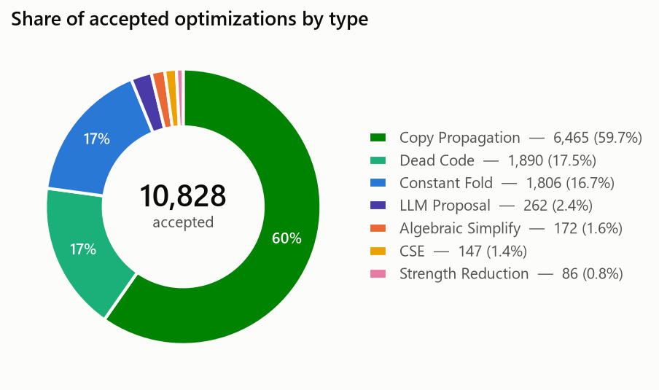
Results: Share of Accepted Optimizations
What it shows
Copy Propagation 59.7%
Dead Code 17.5%, Constant Fold 16.7%
LLM 2.4%, Algebraic 1.6%, CSE 1.4%, Strength Reduction 0.8%
LLM steps are few, but each one is large: a single step can replace a whole loop
Notes:
Out of 10,828 accepted changes, about 60% are copy propagation.

Slide 18
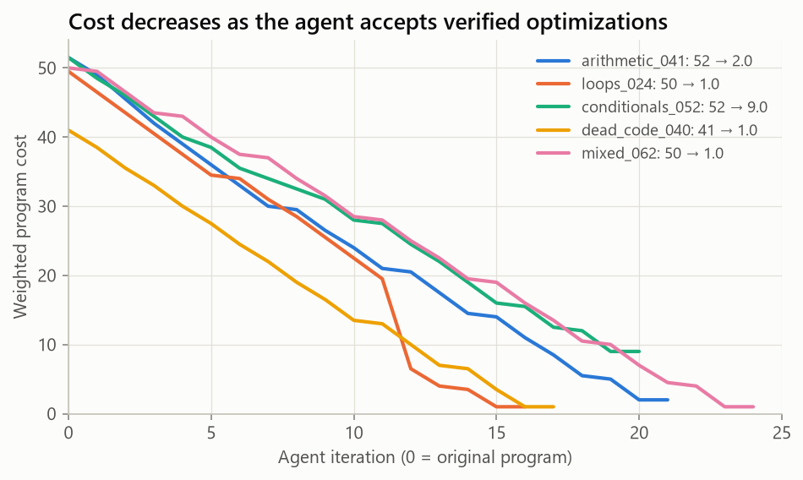
Results: Cost Over Iterations
What it shows
One representative program from each main category
Cost falls steadily with each accepted optimization until no opportunities remain
The sharp drop in loops_024 is a Gemini step: "adds −1 twelve times" → total − 12, cutting cost by 66.7% at once
Notes:
Each line ends when the agent finds nothing more to improve.

Slide 19
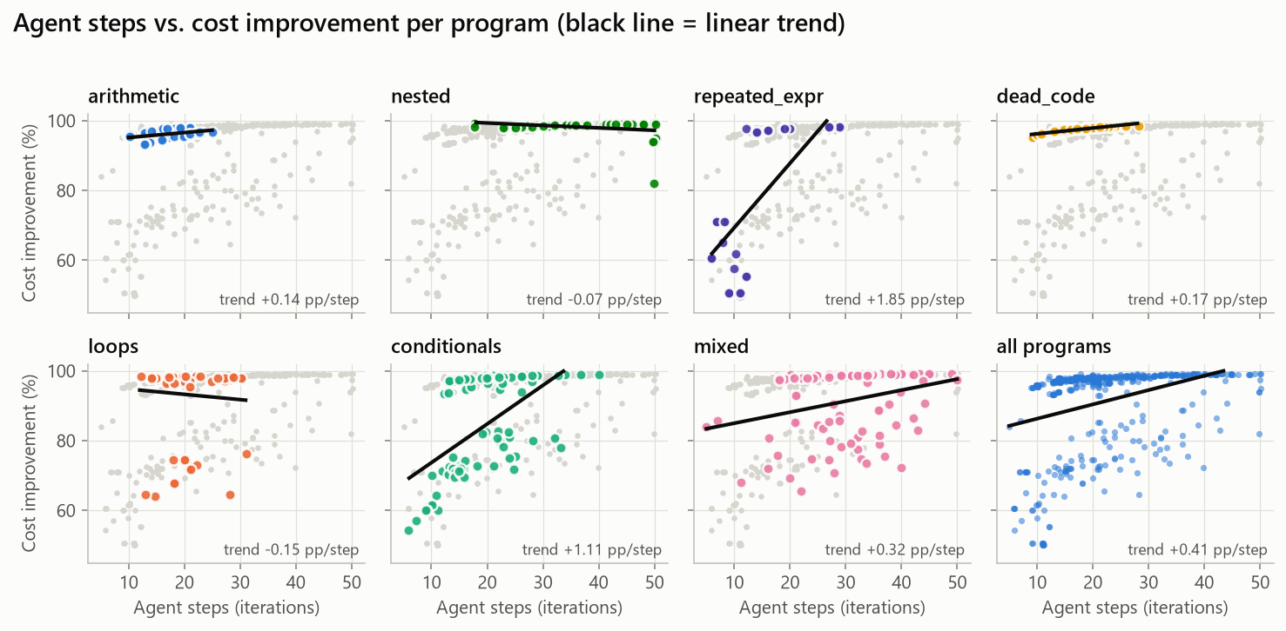
Results: Agent Steps vs. Improvement
What it shows
One panel per category; grey dots are all other programs
Overall trend: +0.41 percentage points per step
Programs that take more steps tend to reach higher reductions
Notes:
The black line in each panel is a linear trend fit.

Slide 20
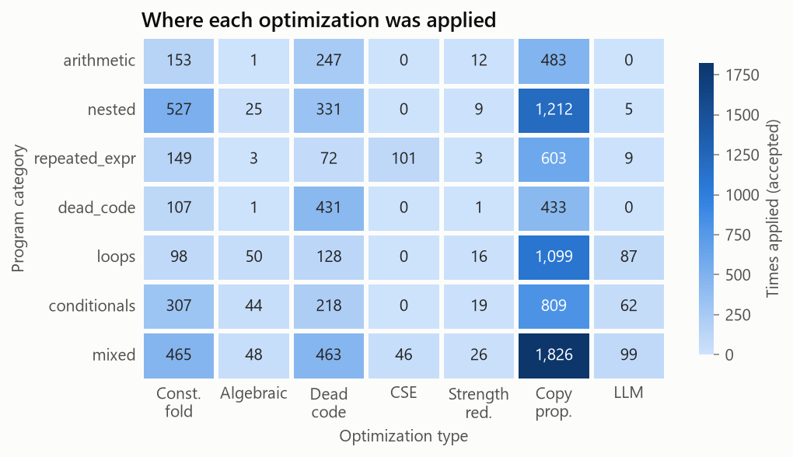
Results: Where Each Optimization Was Applied
What it shows
Copy propagation is the most applied in every category
Nested programs have the most constant folds (527)
Mixed programs have the most dead-code removals (463)
Gemini helped mostly in loops (87), conditionals (62) and mixed (99)
Notes:
Darker cells mean the optimization was applied more often in that category.

Slide 21
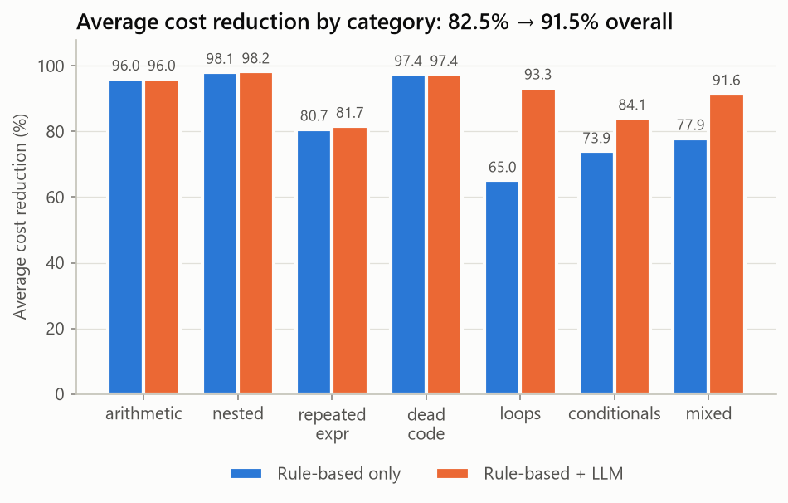
Results: Rules Only vs. Rules + Gemini
What it shows
Loops: 65.1% → 93.3%
Conditionals: 73.9% → 84.1%
Mixed: 77.9% → 91.6%
196 programs improved, none got worse
Notes:
The LLM adds most where the six rules are weakest: loops and branches.

Slide 22
Example: Agent Decision Log
=== Program: repeated_expr_009.src ===
--- Iteration 1 ---
[ANALYZE] Found 7 opportunities: CSE (priority=70), ...
[PROPOSE] CSE at instr 2: t1 = in_b + in_a → t1 = t0
[VERIFY] PASS (differential 25/25, symbolic: equivalent)
[COST] Before 19.0, After 18.5 (-2.6%)
[ACCEPT] Change accepted
--- Iteration 5 ---
[PROPOSE] COPY_PROP: t2 = t0 + t0; s = t2 → s = t0 + t0
[VERIFY] PASS (25/25, symbolic: equivalent)
[COST] Before 10.5, After 7.5 (-28.6%)
[ACCEPT] Change accepted
--- Iteration 6 ---
[ANALYZE] No more opportunities found.
=== RESULT === 19.0 → 7.5 (60.5% reduction) Output match: PASS
Original TAC (7)
t0 = in_b + in_a
a = t0
t1 = in_b + in_a
h = t1
t2 = a + h
s = t2
print s
Optimized TAC (3)
t0 = in_b + in_a
s = t0 + t0
print s
Notes:
This is the real log for one program. Each iteration shows the four phases; the result line confirms the optimized program prints the same output.

Slide 23

Project Status
Work completed
Currently working on
Next steps (planned)
Frontend: Lexer → Parser → AST → TAC
5 agent components as separate classes
Orchestrator loop + full decision logging
Dual verification (differential + symbolic)
Rule-based optimizer, 6 optimization types
Google Gemini integration (free tier)
500-program dataset, 7 categories
190 tests, all passing
7 charts + comparison metrics
Full runs: rules 82.5%, rules + Gemini 91.5%
Prompt tuning for Gemini
Offline mode
Few-shot examples and stricter output format to cut the 7.65% invalid rate (26 of 340)
A local model via Ollama: no internet or API key needed
Constant-loop rule
Deeper analysis
A rule-based pass that collapses constant loops without needing the LLM
Significance tests on the LLM gain and a taxonomy of failure cases
Project report
Larger programs
Writing up the design, experiments and results
Extend the language and test on bigger, real-world-style programs
Notes:
Completed work is everything shown in this presentation. 'Currently working on' and 'Next steps' are the team's plan; update them to match what you are actually doing before presenting.

Slide 24
Conclusion
82.5%
91.5%
0
average cost reduction with rules alone
with Gemini proposals, across all 500 programs
incorrect changes accepted in 10,978 proposals (re-checked: 3,776 runs)
+28 pts
26
Modular
on loops and +10 on conditionals thanks to the LLM
wrong Gemini suggestions (7.65%) caught by the verifier
new optimizations, verifiers or LLM providers plug in as classes
Key insight: LLMs propose useful, creative transformations, but they must be verified before being trusted.
Notes:
Close on the key insight: the combination of LLM creativity and strict verification is what makes the system both effective and safe.

Slide 25
References
[1] Aho, A.V., Lam, M.S., Sethi, R. & Ullman, J.D. (2006). Compilers: Principles, Techniques, and Tools (2nd ed.). Pearson.
[2] Massalin, H. (1987). Superoptimizer: A Look at the Smallest Program. ASPLOS.
[3] Schkufza, E., Sharma, R. & Aiken, A. (2013). Stochastic Superoptimization. ASPLOS.
[4] Phothilimthana, P.M. et al. (2016). Scaling up Superoptimization. ASPLOS.
[5] Pnueli, A., Siegel, M. & Singerman, E. (1998). Translation Validation. TACAS.
[6] Necula, G.C. (2000). Translation Validation for an Optimizing Compiler. PLDI.
[7] Chen, M. et al. (2021). Evaluating Large Language Models Trained on Code. arXiv:2107.03374.
[8] Rozière, B. et al. (2023). Code Llama: Open Foundation Models for Code. arXiv:2308.12950.
[9] Cummins, C. et al. (2022). CompilerGym: Robust, Performant Compiler Optimization Environments for AI Research. CGO.
[10] Cummins, C. et al. (2024). Meta Large Language Model Compiler: Foundation Models of Compiler Optimization. arXiv:2407.02524.
[11] Wu, Q. et al. (2023). AutoGen: Enabling Next-Gen LLM Applications via Multi-Agent Conversation. arXiv:2308.08155.
[12] Gemini Team, Google (2023). Gemini: A Family of Highly Capable Multimodal Models. arXiv:2312.11805.

