Slide 1

COMPILER DESIGN PROJECT
Automated LLM/Agent-Guided Compiler Code Optimization
Before (naive TAC)
t0 = 3
t1 = 5
t2 = t0 + t1
x = t2
print x
A multi-agent system for autonomous TAC analysis, transformation and verification
After (agent-optimized)
print 8
Team: ADARSH SHARMA BADHAI[24BCE2972] · NIRUPAM RAUT[24BAI0345]
October 2026
Notes:
Introduce the project and the team. One-line pitch: an agent that optimizes compiler intermediate code on its own, and never accepts a change it cannot verify.

Slide 2



Review-01 Comments and Our Response
Comment 1: Edit the system architecture to incorporate the features of its components
Response / action: The architecture slide and the report figure now list the components inside every agent and show where a run ends: final check, outputs, end.
Comment 2: Add more LLMs
Response / action: Three LLM backends now sit behind one router: Google Gemini, Groq, and a local Ollama model that works offline.
Comment 3: Add more analysing figures
Response / action: Added the class and data-flow diagrams, a comparison chart for each LLM against the rules, analysis charts for the Groq and Ollama runs in the report, and result tables for all four configurations.

Slide 3

Objectives
Agent architecture
Cost-gated acceptance
Five components as separate classes with clear interfaces
Accept only if verified correct AND cheaper
Orchestrator loop
LLM proposers
Analyze → Propose → Verify → Evaluate → Accept/Reject
Gemini, Groq and a local Ollama model behind one router
6 optimization types
Offline mode
Folding, algebraic, dead code, CSE, strength reduction, copy propagation
The whole agent runs with no internet connection
Dual verification
Full evaluation
Differential testing on hundreds of input sets + symbolic equivalence
500 programs, the 6 required metrics, 7 charts, 4 configurations

Slide 4
Literature Review
Area | Key works | Relevance to our project
Classical compiler optimization | Aho, Lam, Sethi & Ullman: Compilers: Principles, Techniques, and Tools (2006) | Foundation for constant folding, DCE, CSE, copy propagation and dataflow analysis
Superoptimization | Massalin (1987); Schkufza, Sharma & Aiken: STOKE (2013); Phothilimthana et al. (2016) | Search for optimal instruction sequences; uses testing to check candidates
Translation validation | Pnueli, Siegel & Singerman (1998); Necula (2000) | Checking that compiler output matches the source: the idea behind our verifier
LLMs for code | Chen et al.: Codex (2021); Rozière et al.: Code Llama (2023) | Models that generate and transform code; we use Gemini as a proposer
LLM-assisted compilation | Cummins et al.: CompilerGym (2022); Cummins et al.: LLM Compiler (2024) | RL and LLM agents choosing compiler flags and pass orderings
Multi-agent systems | Wu et al.: AutoGen (2023) | Agent orchestration; inspired our Orchestrator + specialist design
Notes:
Our work combines classical compiler techniques with an LLM. Unlike LLM Compiler, which picks pass orderings, our agent proposes actual code transformations and checks each one before accepting it.

Slide 5

Research Gaps
1
Fixed pass order
Classical compilers don't decide which optimization to try or check whether it helped
2
Superoptimizers are slow
Our contribution
STOKE-style search is thorough but limited to small code blocks
An agent that decides what to optimize, proposes transformations (rule-based + LLM), and accepts a change only after it is verified and shown to lower cost.
3
No correctness guarantee
LLM code tools (Codex, Code Llama) can introduce bugs silently
4
Wrong level
LLM-for-compiler work targets pass ordering and flags, not code transformations
0
incorrect changes accepted in 10,978 proposals
5
No verification gate
Few systems check every LLM suggestion before accepting it
Notes:
Each gap is addressed by one part of the design: the agent loop (gap 1), cheap rule-based search (gap 2), the verifier (gaps 3 and 5), and code-level proposals (gap 4).

Slide 6

Proposed Methodology
1
2
3
4
5
6
7
Parse
Analyze
Propose
Verify
Evaluate
Repeat
Final check
Source → AST → Three-Address Code
Find optimization opportunities, ranked by priority
Apply the top rule; or ask the LLM, as the router decides
Differential testing + symbolic check
Accept only if the weighted cost drops
Until nothing is left (max 50 iterations)
Re-verify the result against the original
Key design principle
The LLM is only a proposer. Its suggestions go through exactly the same verification and cost gates as the rule-based ones, so a wrong suggestion is caught and rejected.
Notes:
Walk through the seven steps. Stress that the verifier sits between every proposal and the program: nothing changes unless it passes.

Slide 7


Dataset: 500 Programs, 7 Categories
Category | Count | Example | Main optimization targets
Arithmetic | 60 | int k = 1 + 14; | Constant folding
Nested expressions | 60 | ((a+b)*(c-d)) | Constant folding, copy propagation
Repeated expressions | 60 | a*b computed twice | Common subexpression elimination
Dead code | 60 | int v = e*5; never used | Dead code elimination
Loops | 80 | for / while with invariant work | Folding inside loops, DCE
Conditionals | 80 | if / else with x*1, x+0 | Algebraic simplification, folding
Mixed | 100 | several of the above | All of the above
Total | 500
Generated by dataset/generator.py with a fixed random seed, so it is reproducible
Some programs read input variables, tested with random and boundary values
Covers straight-line, branching, looping and nested code
Notes:
The dataset is generated, not hand-written, so the experiment can be reproduced exactly from the fixed seed.

Slide 8
System Architecture
Source program
Lexer
Parser
AST
TAC Generator
TAC program
Orchestrator (orchestrator.py) Components: loop controller (up to 50 iterations), memory of the opportunities already tried, decision logger, final checker
1 Code Analysis Specialist
2 Optimization Specialist
3 Verification Module
4 Cost Evaluator
code_analyzer.py
optimization_specialist.py
verifier.py
cost_evaluator.py
In: the current TAC program
In: the program and its opportunities
In: current program + candidate
In: program + verified candidate
Components
Components
Components
Components
Control-flow graph builder
Liveness analysis
Available-copies analysis
Six detectors: constant fold, algebraic, dead code, CSE, strength reduction, copy propagation
Priority ranker
Router: rule, hybrid or llm mode
Rule-based optimizer (optimizer_rule.py)
LLM optimizer (optimizer_llm.py)
LLM backends: Gemini, Groq, Ollama
Prompt builder and TAC reply parser
Input-set generator: random, edge, boundary, small-scope, pairwise
Reference TAC interpreter
Differential tester
Symbolic polynomial checker
Counters: instructions, arithmetic ops, temporaries, copies, branches
Weight table: 1.0, 2.0, 0.5, 1.5, 1.0
Weighted-cost calculator
Improvement comparator
Out: opportunities ranked by priority
Out: one candidate program
Out: PASS or FAIL, with the reason
Out: cheaper, or no cost gain
5 Decision. ACCEPT: the candidate becomes the current program. REJECT: the next opportunity is tried, or the same step goes to the other proposer. Either way the loop returns to the Code Analysis Specialist.
when nothing is left to try
Outputs of the run
Final check: optimized vs. original
Optimized TAC
Decision log
Metrics
7 charts
End

Slide 9
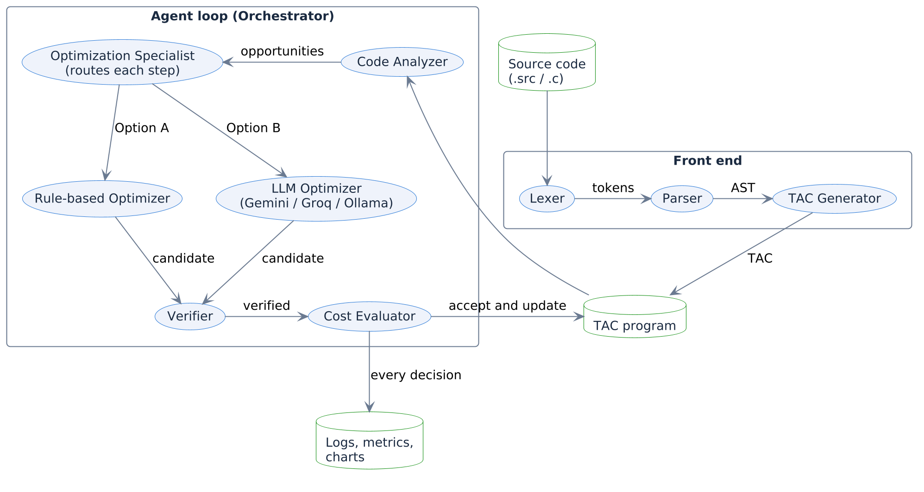
Data Flow Diagram
What it shows
Source code becomes a TAC program in the front end
The Code Analyzer sends ranked opportunities to the Optimization Specialist
The Specialist routes the step: Option A the rules, Option B an LLM
Each candidate passes the Verifier, then the Cost Evaluator

Slide 10
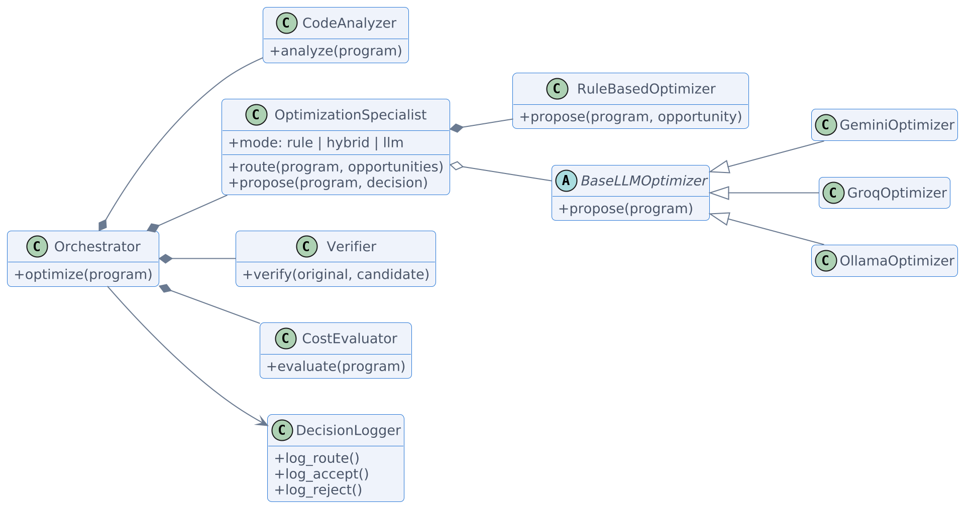
Class Diagram
What it shows
The Orchestrator owns the four other components and writes to the Decision Logger
The Optimization Specialist owns the rule-based optimizer and holds one LLM backend
Gemini, Groq and Ollama share one base class: same prompt, same reply parser

Slide 11



Agent Workflow: The Optimization Loop
Analyze TAC: find opportunities
Max 50 iterations per program
Any untried opportunity?
No
Final check vs. original
END
On accept: clear the "already tried" list, since new opportunities may appear
Yes
Pick top priority and propose (rules or an LLM)
On reject: remember it and try the next opportunity
Verified correct?
Fail
REJECT: invalid
In hybrid mode the LLM is asked when a rule is rejected or the rules run out
Pass
Cost lower?
No
REJECT: no cost gain
At the end: re-verify the optimized TAC against the original
Yes
rejected: try the next one
ACCEPT: update program
accepted: analyze again
Notes:
Follow the flowchart top to bottom. Point out the two rejection paths (invalid, and no cost gain) and that both loop back to analysis without changing the program.

Slide 12


Routing: Rule-Based or LLM
--optimizer rule
--optimizer hybrid
--optimizer llm
Rule-based only
Rules first, LLM second
LLM first, rules second
Always the highest-priority opportunity from the analyzer. The default: instant and deterministic.
The LLM is asked when a rule proposal is turned down, or when the rules have nothing left to try.
The rules take over when the LLM is not running, out of call budget, or its proposal is turned down.
Every routing decision is written to the decision log with its reason
--- Iteration 21 ---
[ANALYZE] No more opportunities found.
[ROUTE] LLM optimizer (groq openai/gpt-oss-120b): the rules have nothing left to try
[LLM] LLM proposal: Dead code elimination: the loop only assigns the constant 42 to acc repeatedly ...
[VERIFY] PASS (differential: 25/25 inputs matched, symbolic: skipped (control flow))
[COST] Before: 20.0, After: 4.5 (reduction: 77.5%)
[ACCEPT] Change accepted

Slide 13
Three LLM Backends, One Interface
Gemini
Groq
Ollama
gemini-3.1-flash-lite
openai/gpt-oss-120b
qwen2.5-coder:7b
Runs in Google's cloud
Free API key (.gemini_key)
Called through the google-genai SDK
Strongest results so far: 91.5%
Runs in Groq's cloud
Free API key (.groq_key)
Plain HTTP, no SDK to install
Moves to the next model when a daily quota is spent
Runs on this laptop
No key and no internet
Plain HTTP to the local server
Falls back to the CPU if the GPU runner crashes
--llm-provider auto tries Gemini, then Groq, then Ollama, and uses the first one that is configured and reachable. --offline always uses Ollama.
All three share one prompt, one reply parser and the same verification and cost gates.

Slide 14
Implementation: Tools & Technologies
Layer | Technology | Purpose
Language | Python 3.10+ | match statements, dataclasses, type hints
Cloud LLMs | Gemini, Groq | Free-tier proposers (SDK and plain HTTP)
Local LLM | Ollama + qwen2.5-coder:7b | Offline proposer, no key needed
Visualization | Matplotlib, Seaborn, Plotly | Bar, line, scatter, heatmap, pie, Sankey
Testing | pytest (336 tests) | Unit, integration, stand-in LLM servers
Live demo | demo.py (C subset) | Walks a real C program through the loop
Numerical | NumPy | Trend lines and statistics
Project structure
src/frontend/ Lexer, Parser, AST, TAC generator, C front end
src/tac/ Instructions, interpreter, dataflow analysis
src/agents/ Orchestrator, Code Analyzer, Optimization Specialist, rule + LLM optimizers, Verifier, Cost Evaluator, Decision Logger
src/visualization/ 7 charts, metrics report
tests/ 336 tests, one module per component

Slide 15

Implementation: The Five Components
1. Orchestrator
2. Code Analysis Specialist
3. Optimization Specialist
Runs the loop, logs every decision, stops when nothing is left (or after 50 iterations), then re-verifies the result against the original
Dataflow analysis (CFG, liveness, available copies). Ranks 6 types: Fold 100 → Algebraic 90 → Dead Code 80 → CSE 70 → Strength 60 → Copy Prop 50
Routes each step to the rule-based optimizer or to an LLM (Gemini, Groq or Ollama) and returns one candidate program
4. Verification Module
5. Cost Evaluator
Differential testing on random, edge, boundary, small-scope and pairwise inputs, plus a symbolic check for straight-line code
cost = 1.0·instructions + 2.0·arithmetic + 0.5·temps + 1.5·copies + 1.0·branches. A change must strictly lower it

Slide 16
Code: The Orchestrator Loop
# src/agents/orchestrator.py (trimmed)
for iteration in range(1, self.max_iterations + 1):
# 1. ANALYZE (leaving out opportunities already turned down)
opportunities = [o for o in self.analyzer.analyze(current)
if self._opportunity_key(o) not in attempted]
logger.log_analysis(iteration, opportunities)
# 2-5. PROPOSE -> VERIFY -> EVALUATE -> ACCEPT/REJECT
tried, outcome = [], None
while outcome not in ("accepted", "unverifiable"):
decision = specialist.route(current, opportunities, llm_calls, tried)
if decision.route is None:
break # nobody can propose anything more
tried.append(decision.route)
proposal = specialist.propose(current, decision, opportunities)
outcome = self._judge(iteration, current, proposal, logger, proposals)
if outcome == "accepted":
current = proposal.candidate
attempted.clear() # new opportunities may appear
if outcome != "accepted" and not opportunities:
break # converged: nothing left to try
How it works
One iteration is one step: analyze, propose, verify, evaluate, decide
The specialist picks the route; if that proposal is turned down it may hand the same step to the other proposer
An accepted change becomes the current program and clears the "already tried" list
The loop ends when nothing was accepted and no opportunity is left

Slide 17
Code: The Verify and Cost Gates
# src/agents/orchestrator.py (trimmed)
def _judge(self, iteration, current, proposal, logger, proposals):
# 3. VERIFY: the same gate for rule-based and LLM proposals
ver_result = self.verifier.verify(current, proposal.candidate)
logger.log_verification(iteration, ver_result)
if not ver_result.passed:
logger.log_reject(iteration, "Verification failed")
return "invalid"
# 4. EVALUATE
old_cost = self.cost_evaluator.evaluate(current)
new_cost = self.cost_evaluator.evaluate(proposal.candidate)
logger.log_cost(iteration, old_cost, new_cost)
# 5. ACCEPT / REJECT: the cost must strictly drop
if not self.cost_evaluator.is_improvement(old_cost, new_cost):
logger.log_reject(iteration, "No cost improvement")
return "rejected"
logger.log_accept(iteration, "Cost reduced")
return "accepted"
# src/agents/cost_evaluator.py
WEIGHTS = {
"instruction_count": 1.0,
"arithmetic_ops": 2.0,
"temp_vars": 0.5,
"memory_ops": 1.5,
"branch_ops": 1.0,
}
def is_improvement(self, old, new):
return (new.weighted_total
< old.weighted_total)
Rule-based and LLM proposals share this path: an LLM answer gets no shortcut
A correct change that is not cheaper is still rejected

Slide 18
Code: The Routing Decision
# src/agents/optimization_specialist.py (trimmed)
def route(self, program, opportunities, llm_calls=0, tried=()):
"""Decide who proposes next for ``program``."""
order = ([Route.RULE, Route.LLM] if self.mode != "llm"
else [Route.LLM, Route.RULE])
if not self.llm_attached:
order = [Route.RULE]
passed_over, llm_note = [], ""
for route in order:
if route in tried:
name = "rule-based" if route is Route.RULE else "LLM"
passed_over.append(f"the {name} proposal was turned down")
elif route is Route.RULE and not opportunities:
passed_over.append("the rules have nothing left to try")
elif route is Route.LLM and (
llm_note := self._llm_blocker(program, llm_calls)):
passed_over.append(f"LLM not used, {llm_note}")
else:
reason = self._reason(route, opportunities, passed_over)
return RoutingDecision(route, reason, llm_note)
return RoutingDecision(None, "; ".join(passed_over), llm_note)
How it works
The mode sets the order: rules first (hybrid) or LLM first (llm)
A route is skipped if its proposal was just turned down, the rules have nothing, or the LLM is blocked
LLM blockers: not running, call budget used up, or the program is already provably minimal
Each decision carries its reason, which becomes a [ROUTE] line in the log

Slide 19
Code: Finding an Opportunity
# src/agents/code_analyzer.py (trimmed)
def _strength_reduction(self, instrs):
out = []
for i, ins in enumerate(instrs):
if ins.op != TACOp.BINARY or ins.operator != "*":
continue
if is_literal(ins.arg2) and is_variable(ins.arg1):
var, const = ins.arg1, int(ins.arg2)
elif is_literal(ins.arg1) and is_variable(ins.arg2):
var, const = ins.arg2, int(ins.arg1)
else:
continue
if const < 2 or const & (const - 1):
continue # not a power of two
k = const.bit_length() - 1
if k > MAX_SHIFT:
continue # x << k would be an invalid shift
if k == 1:
new = {"operator": "+", "arg1": var, "arg2": var} # x*2 -> x+x
else:
new = {"operator": "<<", "arg1": var, "arg2": str(k)}
out.append(_make(OpportunityType.STRENGTH_REDUCTION, i, ...))
return out
How it works
Each of the six detectors returns Opportunity objects: type, priority, location, description
Here: x × 2 becomes x + x, and x × 2^k becomes a shift
The k > 64 guard came out of fuzz testing: the interpreter rejects larger shifts
The rule-based optimizer then applies exactly one opportunity to a copy of the program

Slide 20
Code: The Prompt Sent to the LLM
You are a compiler optimization expert. Given this Three-Address Code (TAC),
propose exactly ONE semantics-preserving optimization.
Original TAC:
{tac_string}
Rules:
1. The optimized code MUST produce identical output for ALL possible inputs.
2. Apply exactly one optimization: constant folding, dead code elimination,
common subexpression elimination, algebraic simplification, strength
reduction, or copy propagation.
3. Return ONLY the modified TAC inside <tac> tags, nothing else outside.
4. Explain your optimization in one line inside <reasoning> tags.
TAC syntax (one instruction per line, keep exactly this syntax):
x = y x = a op b (op: + - * / % << == != < > <= >= && ||)
x = -a x = !a L0: goto L0
if a goto L0 ifFalse a goto L0 print a
Variables that are read before being written are program inputs. Integer
division truncates toward zero; dividing by zero is a runtime error.
Format:
<reasoning>your explanation</reasoning>
<tac>
modified TAC here
</tac>
How it works
One prompt for all three LLMs, so their results are comparable
It asks for exactly one change, in strict TAC syntax
The reply must carry <reasoning> and <tac> blocks; anything else is discarded
The model's answer is only a suggestion: it still has to pass the verifier
Blank lines are removed here to fit the slide

Slide 21
Code: Calling the LLM
# src/agents/optimizer_llm.py (trimmed)
def propose(self, program):
if not self.available:
return None, f"LLM unavailable: {self.unavailable_reason}"
try:
text = self._complete(self._build_prompt(program))
except _LLMUnavailable as exc: # quota spent, server gone
self._disable(str(exc))
return None, f"LLM unavailable: {self.unavailable_reason}"
except _LLMSkip as exc: # only this call failed
return None, str(exc)
return self._parse_text(text, program)
def _parse_text(text, original):
tac_match = _TAC_RE.search(text)
if not tac_match:
return None, "no <tac> block in LLM response"
candidate = parse_llm_tac(tac_match.group(1))
if candidate is None:
return None, "could not parse LLM TAC"
if candidate == original:
return None, "LLM returned unchanged TAC"
return candidate, reasoning
How it works
A backend only implements _complete(prompt): Gemini through its SDK, Groq and Ollama through plain HTTP
Two kinds of failure: skip this one proposal, or switch the LLM off for the rest of the run
Unparseable or unchanged TAC never reaches the verifier
If the LLM switches off, the run continues rule-based

Slide 22
Code: The Verifier's Input Sets
# src/agents/verifier.py (trimmed)
def input_sets(self, variables, constants=None):
rng = random.Random(self.seed)
lo, hi = self.value_range # -100 .. 100
sets = [{v: rng.randint(lo, hi) for v in variables}
for _ in range(self.num_random)] # 20 random sets
for edge in (0, 1, -1, 99, -99): # 5 edge cases
sets.append({v: edge for v in variables})
pool = []
if variables and constants: # c-1, c, c+1
pool = sorted({k for c in sorted(constants)
for k in (c - 1, c, c + 1)})
sets.extend({v: k for v in variables} for k in pool)
sets.extend(self._small_scope_sets(variables, rng))
sets.extend(self._pairwise_sets(variables, pool))
return sets
def _small_scope_sets(self, variables, rng):
for values in SMALL_SCOPES: # widest range first
if len(values) ** len(variables) <= self.max_small_scope:
return [dict(zip(variables, combo)) for combo in
itertools.product(values, repeat=len(variables))]
How it works
Original and candidate run on every set; printed output and failure mode must match
Small scope: every combination of small values, so one input can be zero while another is not
Pairwise: every two inputs meet every two boundary values
No inputs at all: one execution, so a match is a proof

Slide 23
Verification Deep Dive
Input sets | What is tried | What it catches
Random | 20 sets, values in -100..100 | General differences
Edge cases | All inputs 0, 1, -1, 99, -99 | Zero and sign handling
Boundary | c-1, c, c+1 for every literal c | Off-by-one comparisons
Small scope | Every combination of small values (one input: -128..128) | && against ||, a branch on a flag
Pairwise | Every two inputs × every two boundary values | Two inputs that must line up
Differential testing
1
Output and failure mode must match on every input set
Symbolic check
2
Straight-line code: canonical polynomials, so x·2 = x+x = x<<1
Cost
3
A correct change is still rejected unless the cost strictly drops
Small scope and pairwise were added after mutation testing exposed a gap.
Strength of the guarantee: proven for programs with no inputs and for straight-line code; tested on hundreds of input sets for branching code with inputs. The finished program is re-verified against the original.

Slide 24
Validation: Testing the System Itself
5,100
800
64,620
383
random TAC programs: 20,968 rule proposals checked on inputs the verifier does not use, none unsound
deliberately broken programs: none slips past the verifier now (13 of the first 400 did before)
re-executions of the Gemini results on small-scope and random inputs, no mismatch
recorded Gemini replies replayed through the stronger verifier: the same decision every time
Bugs found and fixed
Verifier input gap
Strength reduction
Wrong changes that only showed for certain zero / non-zero input mixes could pass
x × 2^k was rewritten to a shift even for k > 64, which fails at run time
Ollama on old GPU drivers
Metrics table
The GPU runner crashed on load; the call now repeats on the CPU
The LLM validity rate read "n/a %" when an LLM made no proposals

Slide 25
Demo: A Real C Program
1 The C program (demo_programs/3_loop.c)
2 Front end: C → AST → Three-Address Code
#include <stdio.h>
/* A loop with work that does not need
to be redone every time. */
int main() {
int sum = 0;
for (int i = 0; i < 10; i++) {
int step = 2 + 3;
sum += step * 1;
}
printf("%d\n", sum);
return 0;
}
0 | t0 = 0
1 | sum = t0
2 | t1 = 0
3 | i = t1
4 | L0:
5 | t2 = 10
6 | t3 = i < t2
7 | ifFalse t3 goto L1
8 | t4 = 2
9 | t5 = 3
10 | t6 = t4 + t5
11 | step = t6
12 | t7 = 1
13 | t8 = step * t7
14 | t9 = sum + t8
15 | sum = t9
16 | t10 = 1
17 | t11 = i + t10
18 | i = t11
19 | goto L0
20 | L1:
21 | print sum
22 instructions · 4 arithmetic · 12 temporaries
12 copies · 2 branches · weighted cost = 56.0
py demo.py demo_programs/3_loop.c --use-llm --llm-provider groq
The demo walks one program through all six stages, pausing between them. What follows is a real run.

Slide 26
Demo: The Agent at Work
STAGE 3 Agent loop: Analyze -> Propose -> Verify -> Evaluate -> Accept/Reject
Routing: hybrid (rules first, the LLM when they are turned down or run out)
LLM: groq openai/gpt-oss-120b
[ 1] COPY_PROPAGATION t0 = 0 -> uses of t0 -> 0 at instr 1
verified cost 56.0 -> 53.0 ACCEPTED
[ 6] CONSTANT_FOLD t6 = 2 + 3 -> t6 = 5
verified cost 41.0 -> 40.5 ACCEPTED
... steps 2 to 13: copy propagation and folding, each verified and accepted
[14] COPY_PROPAGATION t11 = i + 1; i = t11 -> i = i + 1
verified cost 22.5 -> 19.5 ACCEPTED
No more opportunities found.
route to LLM optimizer (groq openai/gpt-oss-120b): the rules have nothing left to try
[15] LLM (Groq)
Algebraic simplification: the loop adds a constant 5 exactly ten times,
so replace it with sum = 5*10 = 50 and eliminate the dead loop.
verified cost 19.5 -> 3.5 ACCEPTED
[16] COPY_PROPAGATION sum = 50 -> uses of sum -> 50 at instr 1
verified cost 3.5 -> 1.0 ACCEPTED
LLM not consulted: program is only constant prints (provably minimal)
finished in 17 iterations (0.9 s)

Slide 27
Demo: Result and Proof
4 Suggestions made by the agent
56.0 → 1.0
Source | Suggested | Verified | Accepted | Invalid
Rule-based | 15 | 15 | 15 | 0
LLM (Groq) | 1 | 1 | 1 | 0
Total | 16 | 16 | 16 | 0
weighted cost
98.2%
6 Proof: both versions are run and compared
cost reduction, 22 instructions down to 1
STAGE 6 Proof: the optimized program behaves the same
original : prints [50]
optimized: prints [50]
identical output
verifier, final check against the original: PASS
Optimized TAC
print 50

Slide 28
Results: Key Metrics
Metric | Rules only | Rules + Gemini | Rules + Groq | Rules + Ollama
Average cost reduction | 82.49% | 91.50% | 90.89% | 83.28%
Programs with >30% reduction | 500 / 500 | 500 / 500 | 500 / 500 | 500 / 500
Total proposals | 10,628 | 10,978 | 11,085 | 10,805
Accepted | 10,517 | 10,828 | 10,925 | 10,579
Verification pass rate | 100.00% | 99.76% | 99.95% | 98.95%
Acceptance rate (of verified) | 98.96% | 98.87% | 98.61% | 98.94%
Steps to convergence (mean) | 22.2 | 22.7 | 22.9 | 22.3
LLM validity rate | n/a | 92.35% | 98.11% | 42.93%
Wrong LLM proposals blocked | n/a | 26 | 6 | 113
False positives | 0 | 0 | 0 | 0

Slide 29
Results: Cost Reduction by Category
Category | Programs | Rules only | Rules + Gemini | Rules + Groq | Rules + Ollama
Arithmetic | 60 | 96.0% | 96.0% | 96.0% | 96.0%
Nested | 60 | 98.1% | 98.2% | 98.3% | 98.2%
Repeated expr. | 60 | 80.7% | 81.7% | 80.9% | 80.7%
Dead code | 60 | 97.4% | 97.4% | 97.4% | 97.4%
Loops | 80 | 65.0% | 93.3% | 93.4% | 66.1%
Conditionals | 80 | 73.9% | 84.1% | 83.5% | 75.2%
Mixed | 100 | 77.9% | 91.6% | 89.3% | 80.0%
All | 500 | 82.5% | 91.5% | 90.9% | 83.3%
The rules alone already do well on straight-line code. LLMs matter where the rules cannot remove a loop or a branch.
Programs improved over rules only: Gemini 196 · Groq 181 · Ollama 32 · none worse in any run

Slide 30
Results: Four Configurations Compared
Average cost reduction per category. Loops, conditionals and mixed programs are where an LLM adds the most.

Slide 31
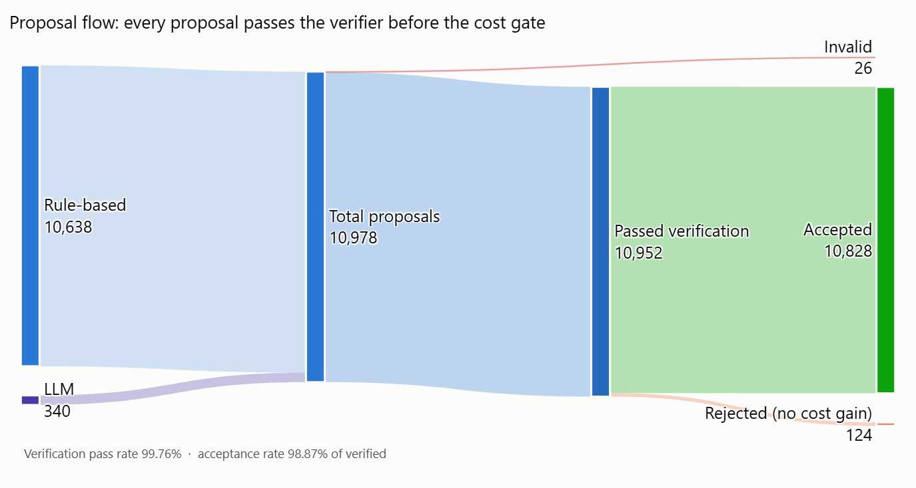
Results: Proposal Flow (Gemini Run)
What it shows
10,978 proposals in total (10,638 rule-based, 340 from Gemini)
10,952 passed verification; 26 were invalid
10,828 accepted; 124 rejected for no cost gain
All 26 invalid proposals came from the LLM and were blocked by the verifier
Notes:
Read the flow left to right: sources, verification, then the cost decision.

Slide 32
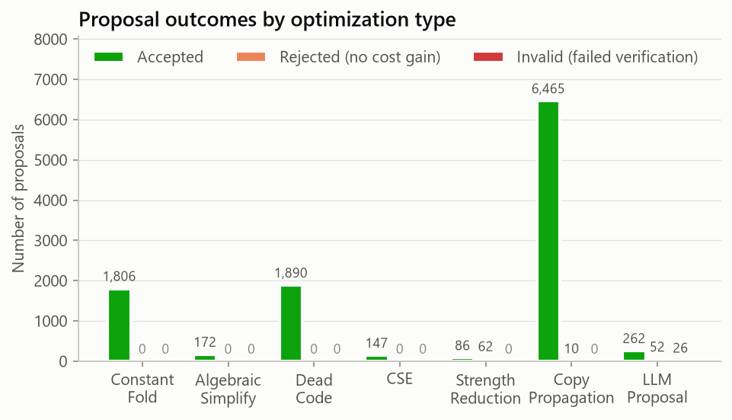
Results: Outcomes by Type (Gemini Run)
What it shows
Copy propagation dominates: 6,465 accepted, because naive TAC creates many temporary copies
Strength reduction has the most rule rejections (62): x*2 → x+x doesn't lower cost
LLM proposals: 262 accepted, 52 no gain, 26 invalid
Notes:
Rule-based proposals never failed verification; every invalid proposal came from the LLM.

Slide 33
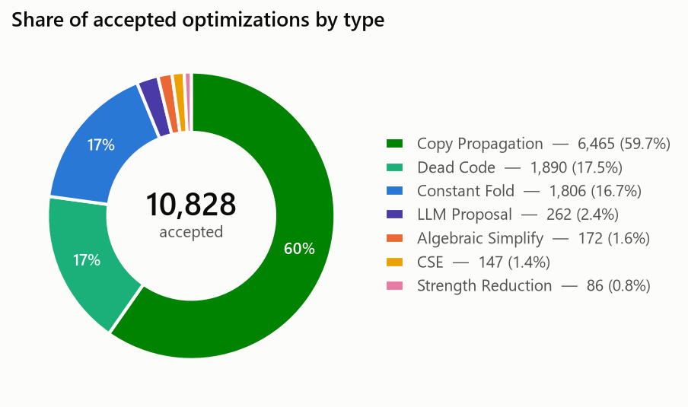
Results: Accepted Optimizations (Gemini Run)
What it shows
Copy Propagation 59.7%
Dead Code 17.5%, Constant Fold 16.7%
LLM 2.4%, Algebraic 1.6%, CSE 1.4%, Strength Reduction 0.8%
LLM steps are few, but each one is large: a single step can replace a whole loop
Notes:
Out of 10,828 accepted changes, about 60% are copy propagation.

Slide 34
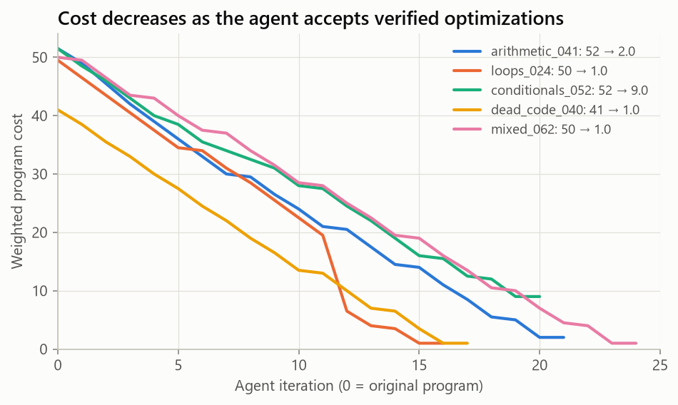
Results: Cost Over Iterations (Gemini Run)
What it shows
One representative program from each main category
Cost falls steadily with each accepted optimization until no opportunities remain
The sharp drop in loops_024 is a Gemini step: "adds −1 twelve times" → total − 12, cutting cost by 66.7% at once
Notes:
Each line ends when the agent finds nothing more to improve.

Slide 35
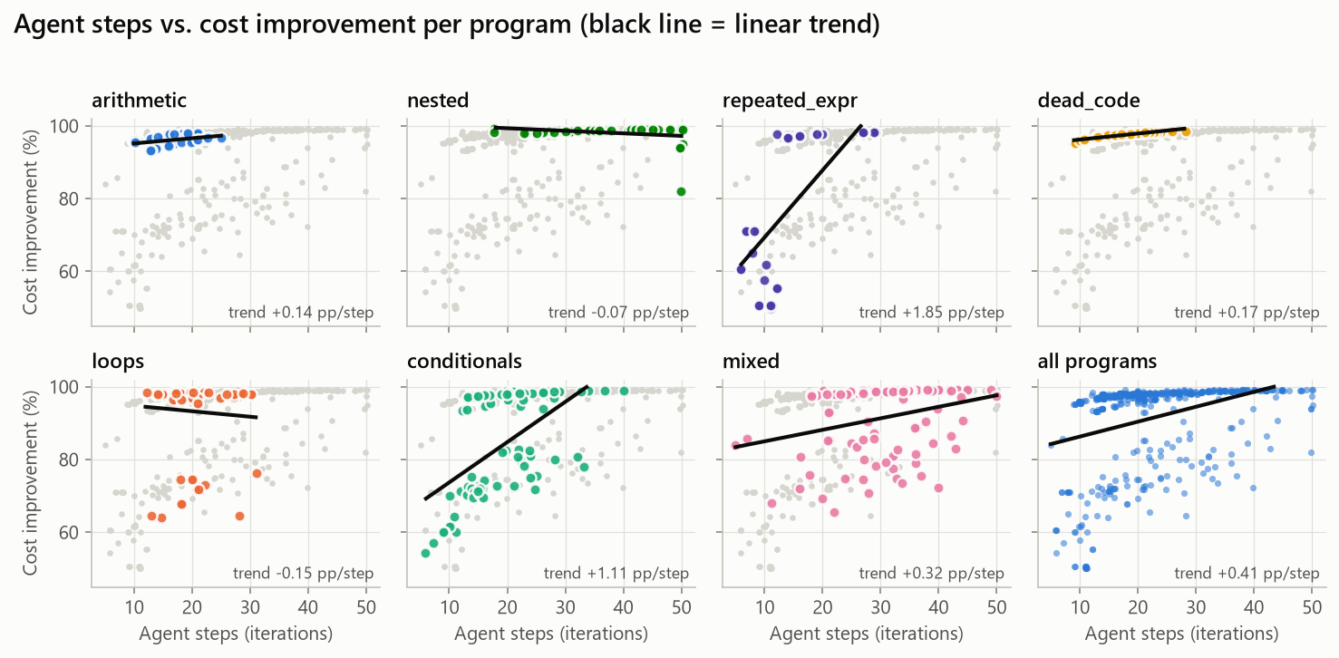
Results: Steps vs. Improvement (Gemini Run)
What it shows
One panel per category; grey dots are all other programs
Overall trend: +0.41 percentage points per step
Programs that take more steps tend to reach higher reductions
Notes:
The black line in each panel is a linear trend fit.

Slide 36
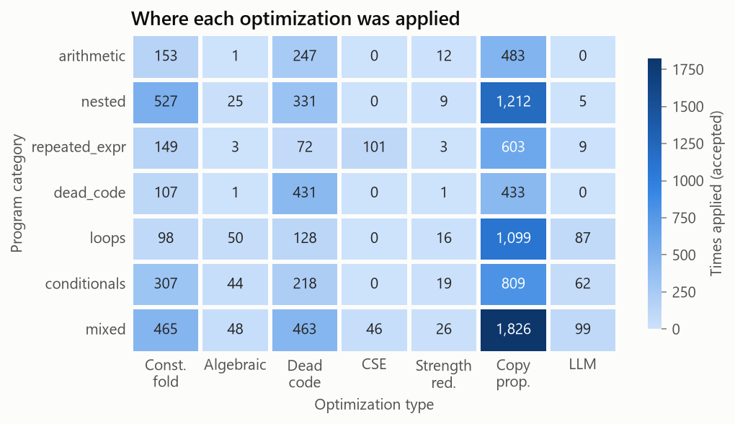
Results: Where Optimizations Applied (Gemini Run)
What it shows
Copy propagation is the most applied in every category
Nested programs have the most constant folds (527)
Mixed programs have the most dead-code removals (463)
Gemini helped mostly in loops (87), conditionals (62) and mixed (99)
Notes:
Darker cells mean the optimization was applied more often in that category.

Slide 37
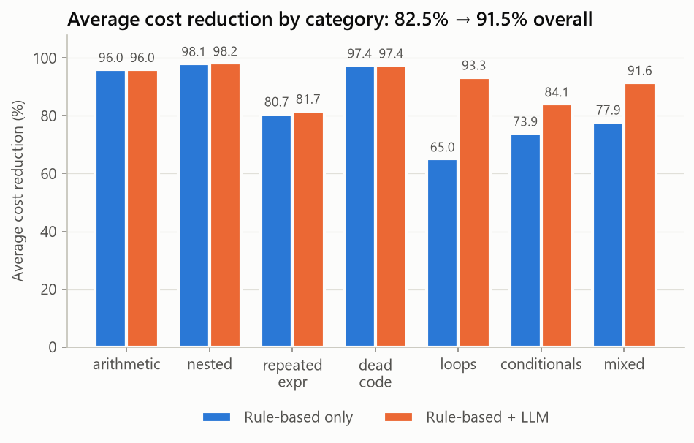
Results: Rules Only vs. Rules + Gemini
What it shows
Loops: 65.1% → 93.3%
Conditionals: 73.9% → 84.1%
Mixed: 77.9% → 91.6%
196 programs improved, none got worse
Notes:
The LLM adds most where the six rules are weakest: loops and branches.

Slide 38
Results: Rules Only vs. Rules + Groq
What it shows
Loops: 65.0% → 93.4%
Conditionals: 73.9% → 83.5%
Mixed: 77.9% → 89.3%
181 programs improved, none got worse

Slide 39
Results: Rules Only vs. Rules + Ollama
What it shows
Loops: 65.0% → 66.1%
Conditionals: 73.9% → 75.2%
Mixed: 77.9% → 80.0%
32 programs improved, none got worse
A small local model: modest gains, but with no internet at all

Slide 40
Results: Comparing the Three LLMs
 | Gemini | Groq | Ollama
Model | gemini-3.1-flash-lite | gpt-oss-120b (+1 fallback) | qwen2.5-coder:7b
Runs on | Google cloud | Groq cloud | This laptop (CPU)
Average cost reduction | 91.50% | 90.89% | 83.28%
Programs improved over rules | 196 | 181 | 32
Calls to the model | 383 | 359 | 328
Usable proposals | 340 | 318 | 198
Accepted | 262 | 248 | 60
Wrong, blocked by the verifier | 26 | 6 | 113
Validity rate | 92.35% | 98.11% | 42.93%
Full-run time | 43 min | 42 min | 2 h 14 min
False positives | 0 | 0 | 0

Slide 41
Example: Agent Decision Log with Routing
=== Program: loops_001.src ===
--- Iteration 20 ---
[ANALYZE] Found 1 opportunity: COPY_PROPAGATION (priority=50)
[ROUTE] Rule-based optimizer: highest-priority opportunity is COPY_PROPAGATION
[PROPOSE] COPY_PROPAGATION at instr 10: t15 = acc -> uses of t15 -> acc
[VERIFY] PASS (differential: 25/25 inputs matched)
[COST] Before: 23.0, After: 20.0 (reduction: 13.0%)
[ACCEPT] Change accepted
--- Iteration 21 ---
[ANALYZE] No more opportunities found.
[ROUTE] LLM optimizer (groq openai/gpt-oss-120b): the rules have nothing left to try
[LLM] Dead code elimination: the loop only assigns the constant 42 to acc
repeatedly, so it can be replaced by a single assignment.
[VERIFY] PASS (differential: 25/25 inputs matched)
[COST] Before: 20.0, After: 4.5 (reduction: 77.5%)
[ACCEPT] Change accepted
--- Iteration 23 ---
[ANALYZE] No more opportunities found.
[INFO] LLM not consulted: program is only constant prints (provably minimal)
=== RESULT === 72.5 -> 2.0 (97.2% reduction) Output match: PASS
Original TAC (28)
t0 = 0
acc = t0
t1 = 0
i = t1
L0:
t2 = 11
t3 = i < t2
ifFalse t3 goto L1
t4 = 2
t5 = 1
t6 = t4 + t5
h = t6
... (16 more)
Optimized TAC (2)
print 42
print 42

Slide 42
Project Status
System built
Tested and measured
Possible next steps
Front end: C and mini-language to TAC
Orchestrator loop + decision logging
Code Analyzer with 6 optimization types
Optimization Specialist router
Three LLM backends: Gemini, Groq, Ollama
Offline mode with a local model
Live C demo front end
Differential + symbolic verification
Small-scope and pairwise inputs
336 automated tests, all passing
5,100 random programs fuzzed
800 mutation tests: none slips through
500-program dataset, 4 full runs
7 charts and the 6 required metrics
Execution time in the cost model
Prompt tuning for small local models
Ollama on the GPU (driver update)
Larger, real-world-style programs

Slide 43
Conclusion
82.5%
91.5%
90.9%
average cost reduction with the rules alone
with Gemini proposals, the best configuration so far
with Groq's gpt-oss models
83.3%
0
13 → 0
with a local model, completely offline
incorrect changes accepted in any run, re-checked on about 64,000 executions per run
wrong changes slipping past the verifier once mutation testing exposed the gap
Key insight: an LLM is a useful proposer whether it runs in the cloud or on a laptop, as long as every suggestion is verified before it is trusted.

Slide 44
References
[1] Aho, A.V., Lam, M.S., Sethi, R. & Ullman, J.D. (2006). Compilers: Principles, Techniques, and Tools (2nd ed.). Pearson.
[2] Massalin, H. (1987). Superoptimizer: A Look at the Smallest Program. ASPLOS.
[3] Schkufza, E., Sharma, R. & Aiken, A. (2013). Stochastic Superoptimization. ASPLOS.
[4] Phothilimthana, P.M. et al. (2016). Scaling up Superoptimization. ASPLOS.
[5] Pnueli, A., Siegel, M. & Singerman, E. (1998). Translation Validation. TACAS.
[6] Necula, G.C. (2000). Translation Validation for an Optimizing Compiler. PLDI.
[7] Chen, M. et al. (2021). Evaluating Large Language Models Trained on Code. arXiv:2107.03374.
[8] Rozière, B. et al. (2023). Code Llama: Open Foundation Models for Code. arXiv:2308.12950.
[9] Cummins, C. et al. (2022). CompilerGym: Robust, Performant Compiler Optimization Environments for AI Research. CGO.
[10] Cummins, C. et al. (2024). Meta Large Language Model Compiler: Foundation Models of Compiler Optimization. arXiv:2407.02524.
[11] Wu, Q. et al. (2023). AutoGen: Enabling Next-Gen LLM Applications via Multi-Agent Conversation. arXiv:2308.08155.
[12] Gemini Team, Google (2023). Gemini: A Family of Highly Capable Multimodal Models. arXiv:2312.11805.
[13] Ollama (2026). Ollama: run large language models locally. https://ollama.com
[14] Groq (2026). GroqCloud API documentation. https://console.groq.com/docs

