Slide 1

Flux Hyperlocal Delivery Intelligence Platform
Data Warehousing & Mining Analytics Project
Team Flux | Adarsh Dubey (0117) | Roshan Binoj (0009) | Mohammed Siraj (0132) | Hafiz (0006) Generated: 2026-03-21

Slide 2

🎯 Problem Statement
• Hyperlocal delivery platforms face continuous operational challenges:
• Fluctuating demand, traffic congestion, adverse weather, festival surges
• Rider availability issues & inventory shortages impact delivery times
• Raw datasets are fragmented across multiple sources, not structured for analysis
• Decision-makers lack an integrated BI system for real-time monitoring
•
• GOAL: Design an end-to-end analytics platform that transforms raw
• supply-chain and customer-experience data into actionable insights
• through data warehousing, data mining, and BI visualization.

Slide 3
💡 Solution & Objectives
• Star-schema data warehouse for hyperlocal delivery operations
• ETL pipeline in R to clean, transform, and integrate raw datasets
• OLAP analysis: delivery performance across cities, time, traffic, weather
• Predictive models to classify delayed vs on-time deliveries
• Clustering to segment agents, customers, and cities
• Association-rule mining for service-quality patterns
• Outlier analysis for anomalous / suspicious delivery records
• Interactive dashboards for executive decision support
•
• Technologies: R, SQLite, tidyverse, caret, arules, ggplot2, plotly, Power BI

Slide 4
📊 Executive Summary
• Total Orders Analyzed: 100 across 5 cities (Mumbai, Kolkata, Delhi, Bangalore, Chennai)
• Overall Delay Rate: 47% | Complaint Rate: 26%
• Best Classification Model: Decision Tree (78.9% accuracy)
• Anomalies Detected: 5 suspicious delivery records
• Association Rules Discovered: 45 actionable patterns
•
• Key Finding: The primary predictor of customer complaints is traffic_level
• Clustering Insight: Cluster 1 has been identified as the highest-risk segment for delivery delays.

Slide 5
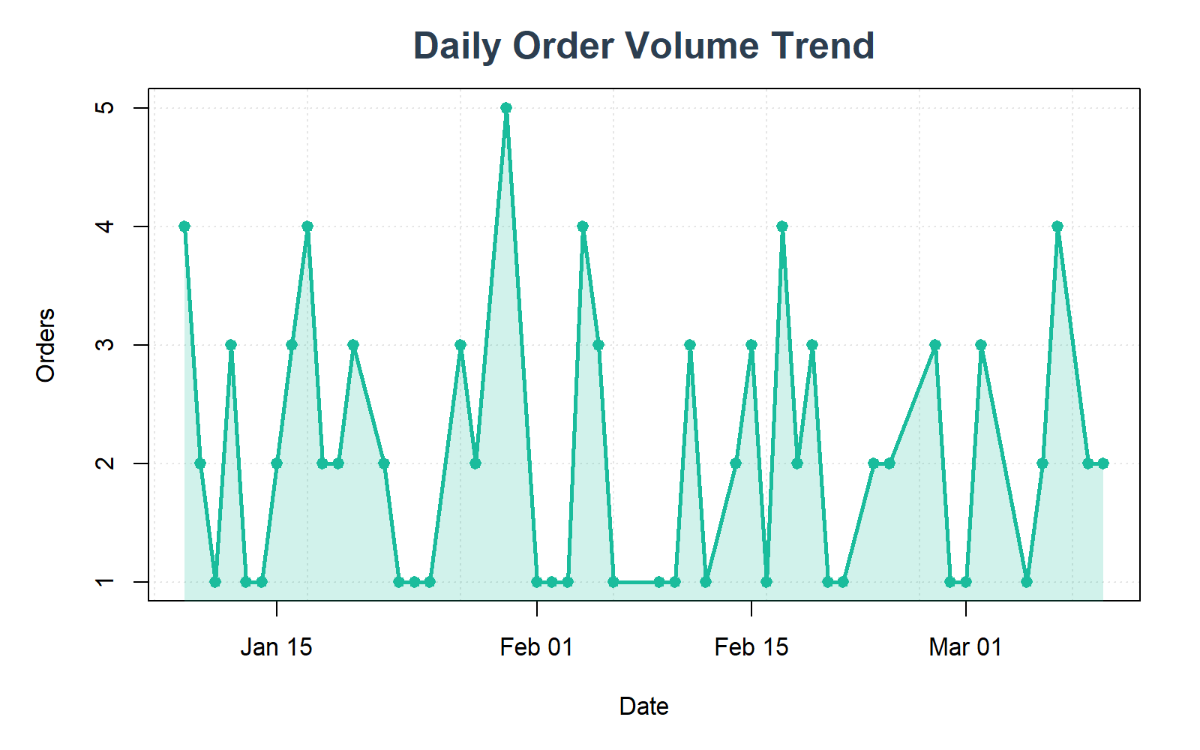
📈 Platform Overview: Delivery Trend
• Shows daily order volume over the analysis period
• Visible peaks and troughs indicate demand patterns (weekday vs weekend)
• INFERENCE: 47% delay rate highlights logistics optimization as critical priority
• Sudden dips may indicate weather disruptions or supply shortages

Slide 6
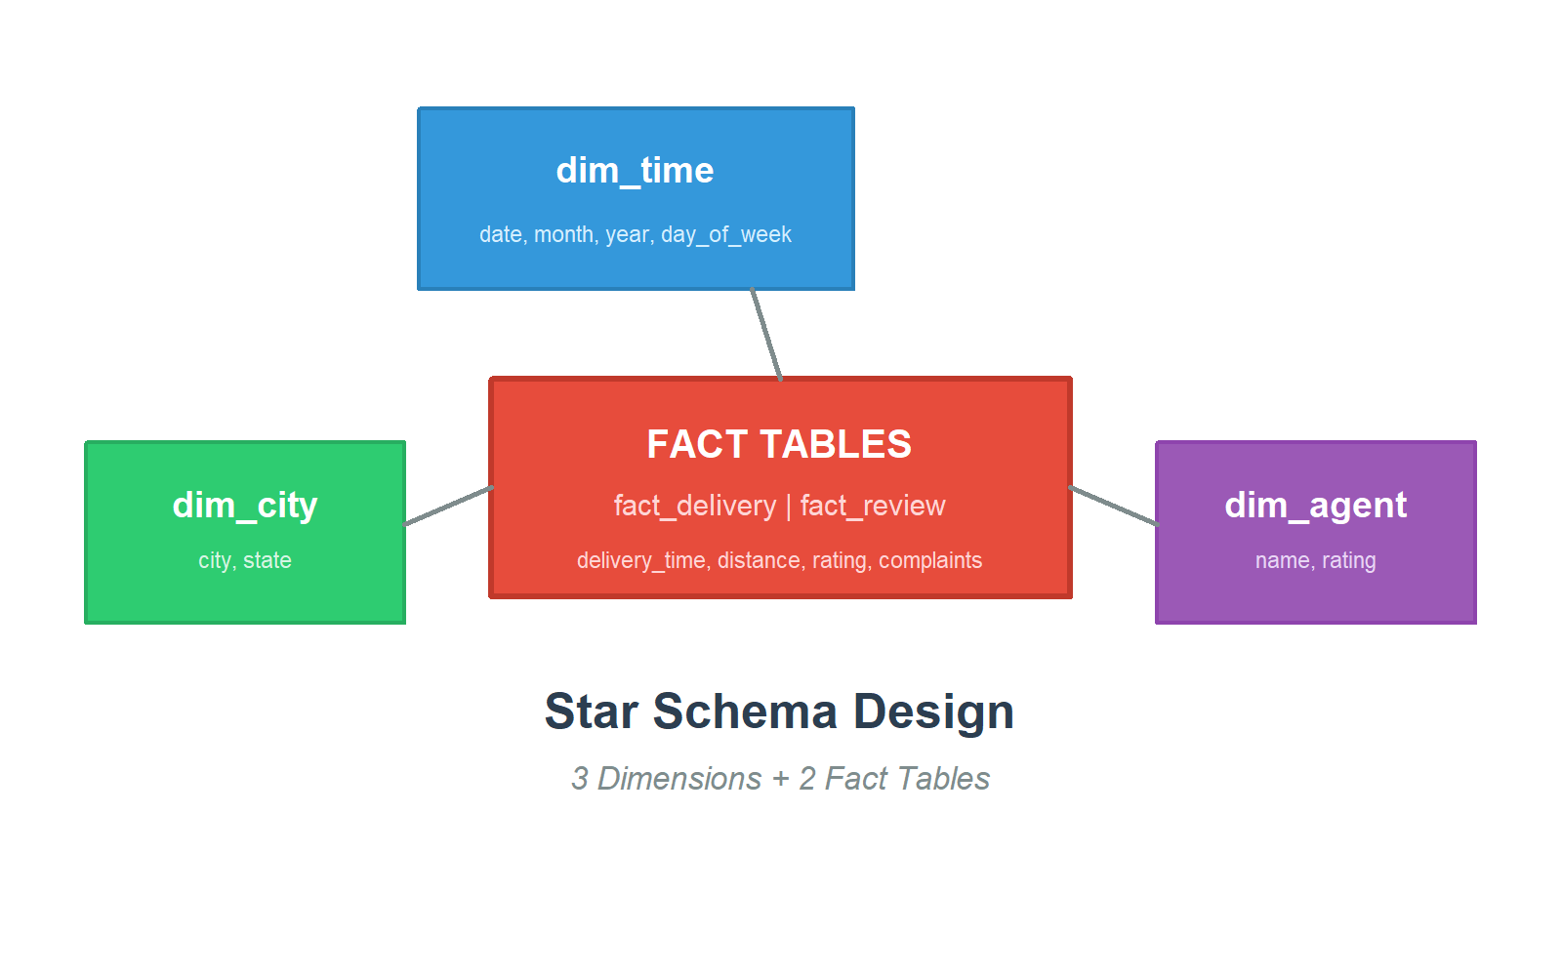
🏗 Data Warehouse: Star Schema Architecture
• Central fact tables: fact_delivery & fact_review
• 3 dimension tables: dim_time, dim_city, dim_agent
• INFERENCE: Enables efficient OLAP operations (roll-up, drill-down, slice, dice)
• Supports temporal, geographic, and agent-level multi-dimensional analysis

Slide 7
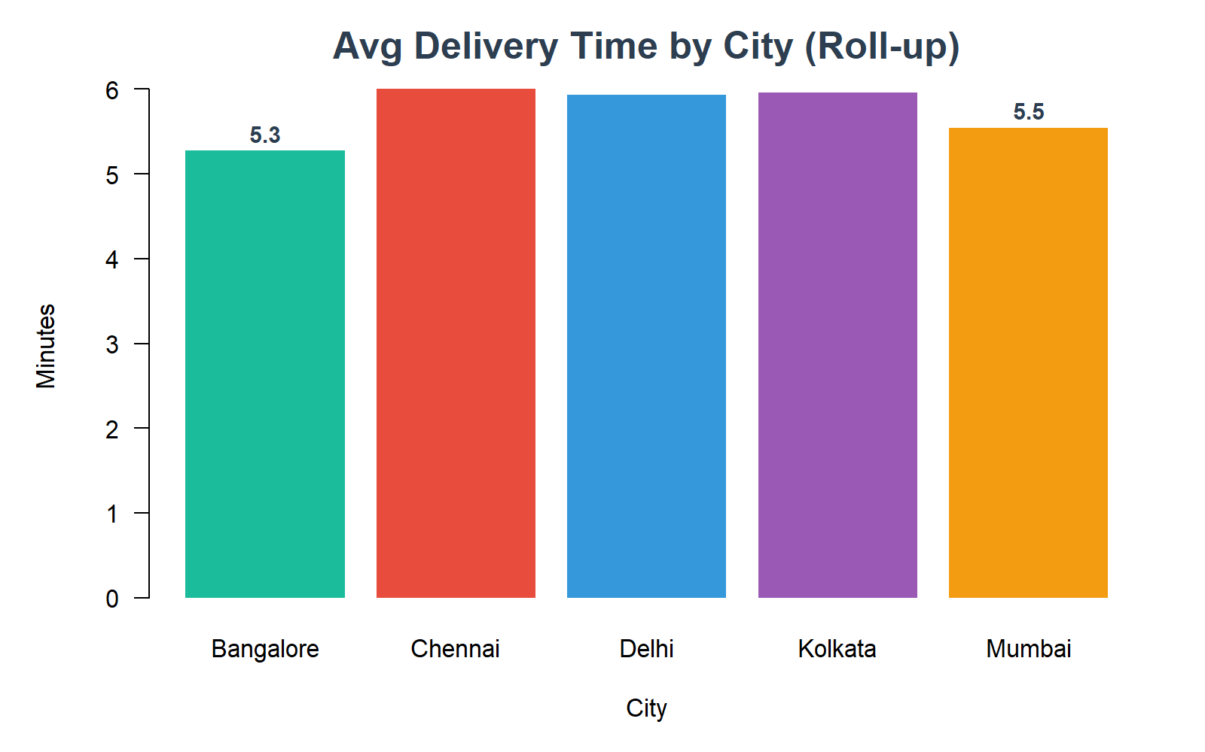
🔍 OLAP: Roll-up / Drill-down Analysis
• Roll-up aggregation: Average delivery time at city level
• FINDING: Bangalore = fastest delivery | Chennai = slowest delivery
• INFERENCE: City-specific logistics strategies needed, not one-size-fits-all
• Drill-down to agent level reveals individual performance bottlenecks

Slide 8
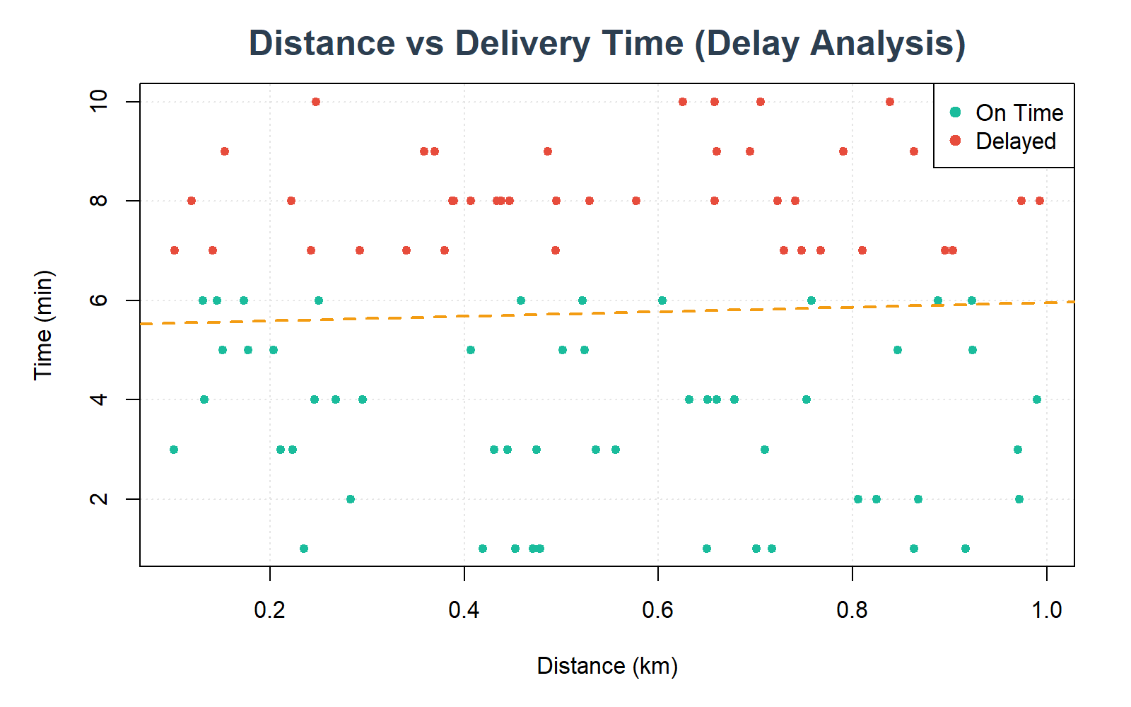
🧊 Multi-dimensional & Slice/Pick Analysis
• Scatter: Distance vs Delivery Time, colored by delay status
• Positive correlation exists, but delays occur even at short distances
• Slice & Pick enables dynamic filtering by traffic level.

Slide 9
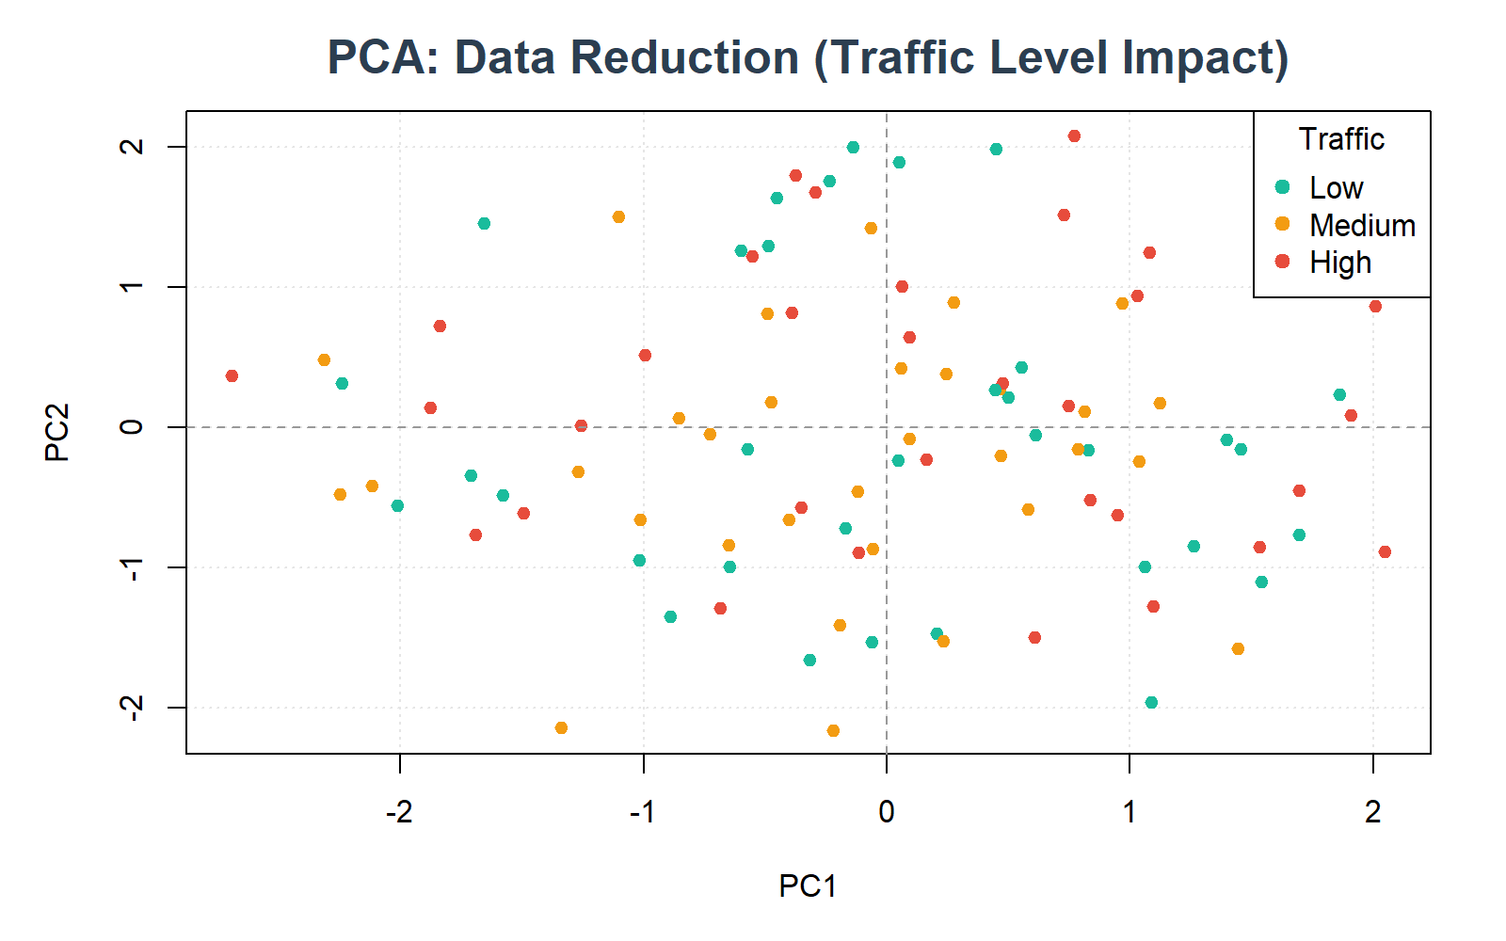
🧹 Data Preprocessing: PCA & Discretization
• PCA reduces multi-dimensional features into 2 interpretable components
• PCA reveals how traffic density and distance cluster in the feature space
• INFERENCE: Dimensionality reduction is essential before clustering/classification
• Discretization: High Value (47%) | Medium Value (32%) | Low Value (21%)

Slide 10
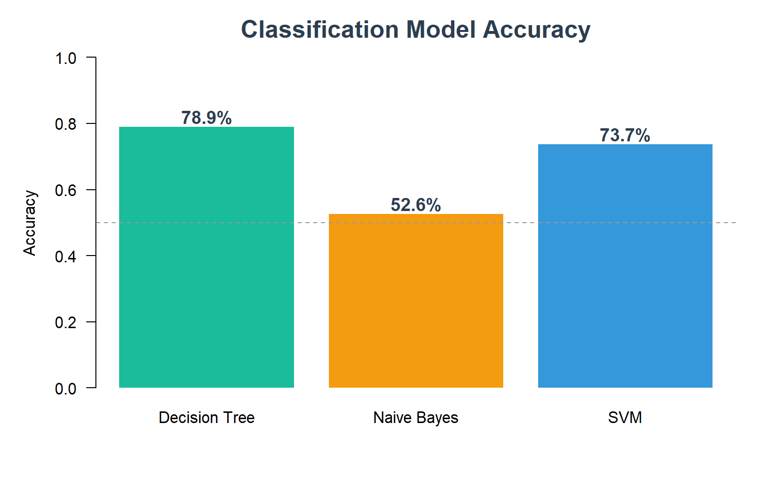
🧠 Classification: Model Performance
• Three models compared: Decision Tree, Naive Bayes, SVM
• Best model: Decision Tree at 78.9% accuracy for complaint prediction
• INFERENCE: Non-linear boundaries (DT/SVM) outperform Naive Bayes assumptions
• Deploying the best model enables proactive customer complaint prevention

Slide 11
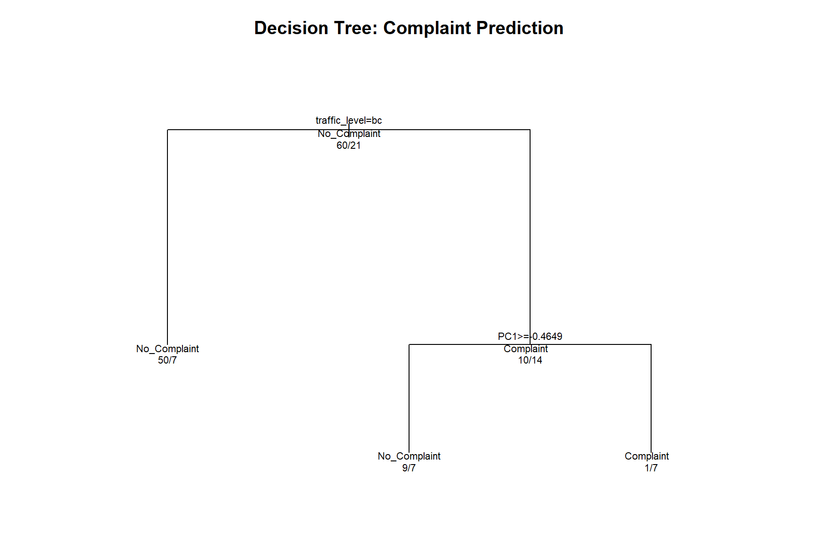
🌳 Decision Tree: Complaint Prediction
• traffic_level is the ROOT predictor - most important feature
• High traffic -> delays -> higher complaint probability
• INFERENCE: Provides interpretable business rules for operational alerts
• Rule: IF traffic=high AND distance>threshold THEN proactively notify customer

Slide 12
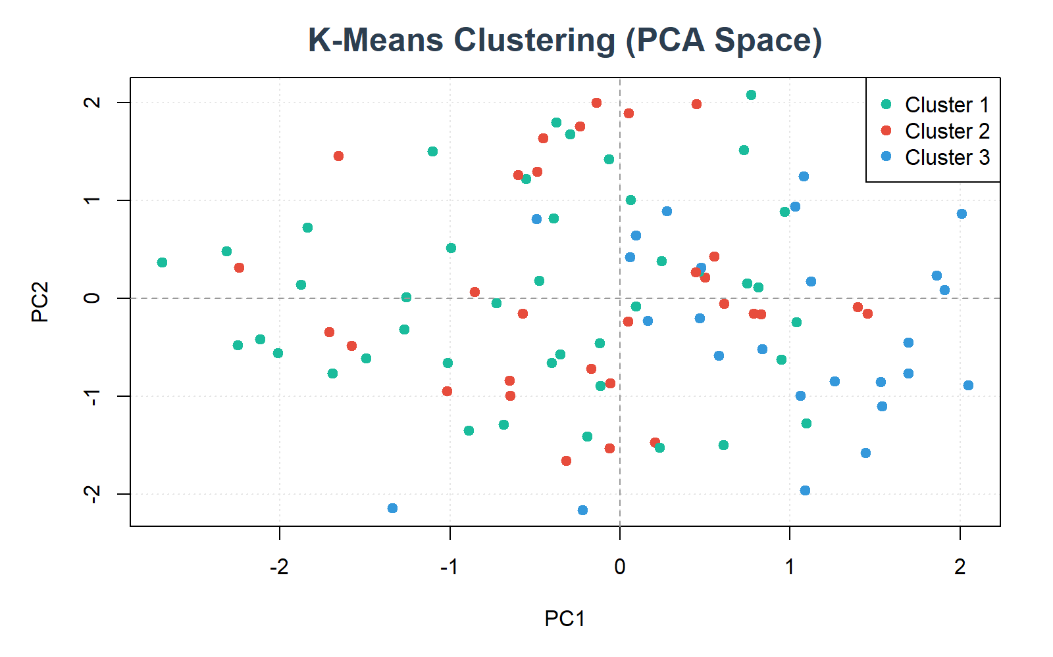
📊 Cluster & Outlier Analysis
• K-Means reveals natural delivery behavior segments (K=3)
• Cluster 1 identified as highest-risk for delivery delays
• Outlier Detection: 5 anomalous deliveries flagged
• INFERENCE: Segmented strategies for each cluster + automated outlier alerts

Slide 13
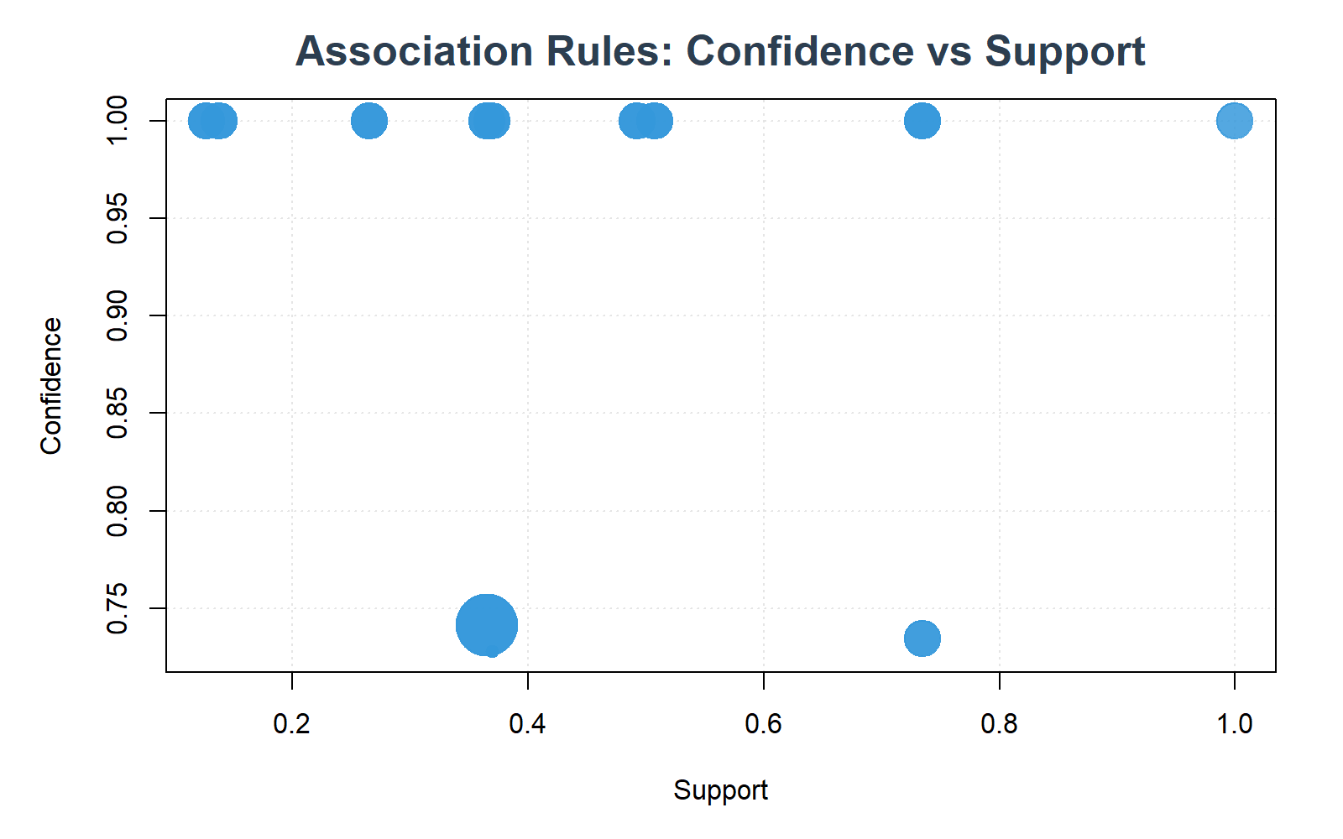
🔗 Association Rule Mining (Apriori)
• 45 association rules discovered from delivery and review data
• Key: {no discount} => {low rating} - discounts critical for satisfaction
• Key: {low availability} => {low rating} - agent scheduling matters
• INFERENCE: Implement targeted discounts & improve peak-hour agent scheduling

Slide 14
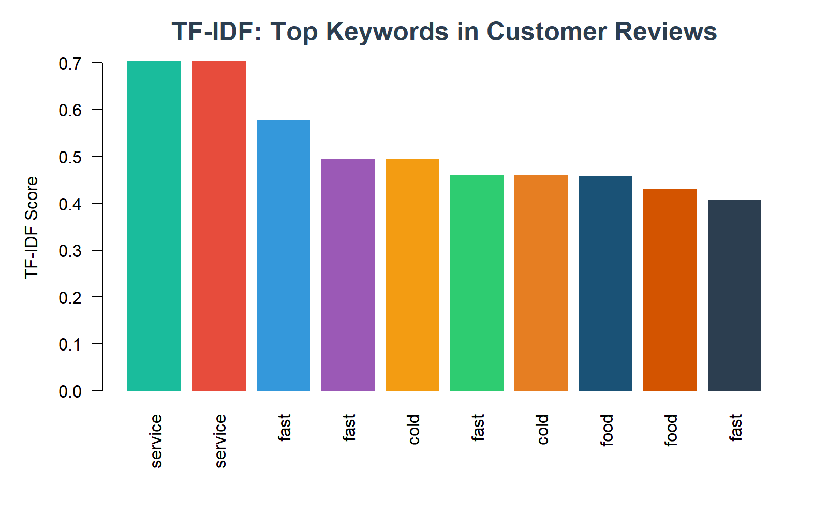
🌐 Text Mining & Web Mining Intelligence
• TF-IDF reveals top customer review keywords: speed, food quality, service
• Web Mining: 'fast delivery' and 'cheap food' dominate search trends
• INFERENCE: Speed and price are PRIMARY customer concerns
• 'Late night snack' searches highlight demand for extended service hours

Slide 15
🏆 Conclusion & Recommendations
• 1. TRAFFIC MANAGEMENT: #1 predictor of complaints - implement dynamic routing
• 2. CITY-SPECIFIC: Deploy localized optimization per-city, not uniform policies
• 3. DISCOUNT STRATEGY: No-discount => low rating; targeted discounts boost satisfaction
• 4. AGENT SCHEDULING: Use clustering insights to predict demand spikes
• 5. PROACTIVE ALERTS: Deploy Decision Tree model for real-time complaint prediction
• 6. EXTENDED HOURS: Web mining reveals 'late night' demand opportunity
•
• This system helps companies reduce delays, save costs, and improve
• customer experience through data-driven decision-making.

