Slide 1
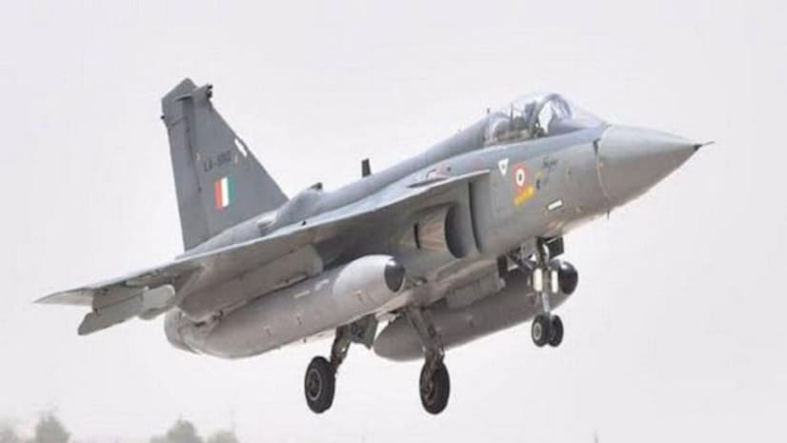

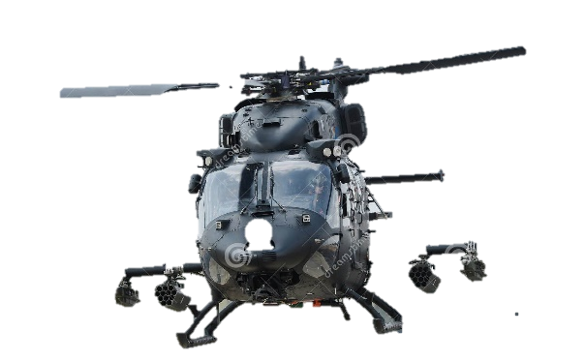


Society of Indian Aerospace
Technologies & Industries
Our Mission
The growth of aerospace infrastructure and capabilities in India,
Creating useful interaction among Indian and International aerospace industries, R&D, academia , Quality and Regulatory agencies for development and production of aircraft materials, components, structures, equipment and systems,
Enhancing Private Industry participation with special focus on SMEs and International co operation for the benefit of all concerned, developing global opportunities, greater employment, wealth and welfare.

Slide 2









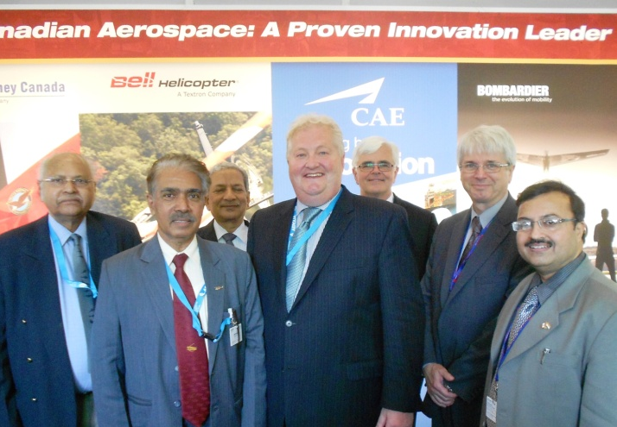
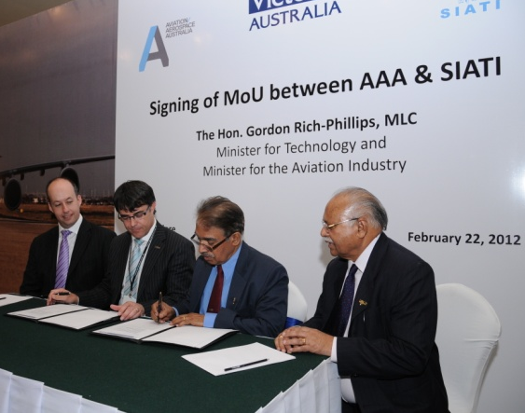
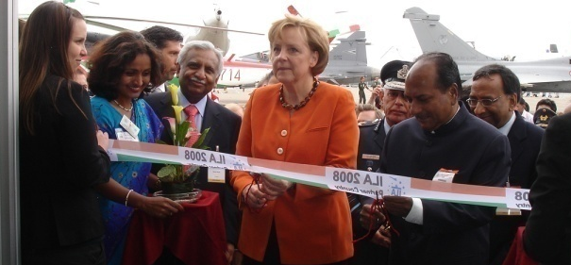
INTERNATIONAL CO OPERATION
SIATI has co-operation with Global Aerospace Industry Associations like:
The Society of Japanese Aerospace
Companies (SJAC)
Groupement des Industries Francaises Aeronautiques
et Spatiqles (GIFAS)
German Aerospace Industries
Association (BDLI)
Society of British Aerospace Companies
(SBAC) UK / currently ADS
Aerospace Industries Association of
Canada (AIAC)
North West Aerospace Alliance (NWAA)
Aviation Aerospace Australia (AAA)
Skywin Wallonie, Belgium

Slide 3
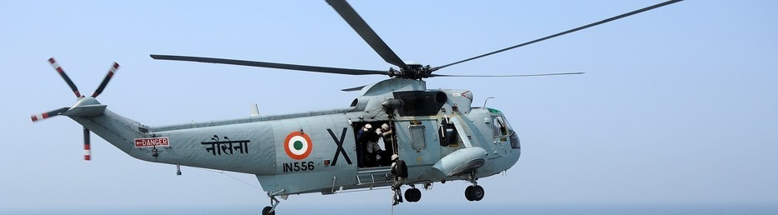
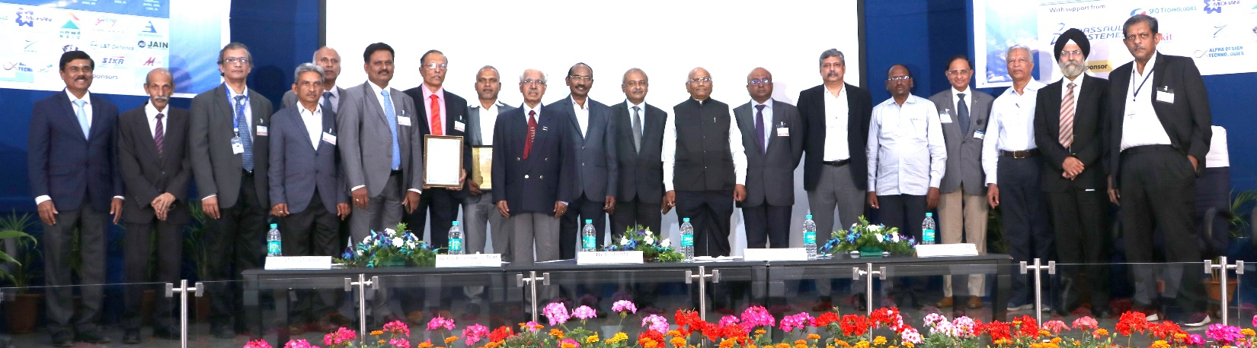
SIATI ANNUAL AWARDS
1. SIATI AWARD FOR EXCELLENCE IN AEROSPACE
INDIGENISATION”
(To selected companies nominated by the users.)
2. SIATI AWARD FOR OUTSTANDING CONTRIBUTION &
ACHIEVEMENT IN AEROSPACE”
To selected individuals for their outstanding contribution.
3. SIATI AWARD FOR WOMEN ACHIEVERS IN AEROSPACE”
( to the selected individuals on their merit)
MEMBERSHIP –INDIAN ORGANISATIONS
SIATI membership is open to Industry/Institution engaged in any or all fields of aerospace, such as Research, Design & Development, Manufacturing, Maintenance, Airline, Airport and Infrastructure Business & Management, Education and Training etc. Membership is restricted to industries / institutions only.
. Industries / Institutions engaged in the aerospace field in countries other than India are invited to join as International members. SIATI will be an important link between overseas and Indian Entrepreneurs / Industry / Institutions and various regulatory agencies and policy makers to establish collaborations and development of technology and business. There is considerable potential for collaboration in Research, Design, Technology development, Joint Venture, Co-production and partnership in Offset/Counter Trade Programs.
OVERSEAS ORGANISATION

