Slide 1

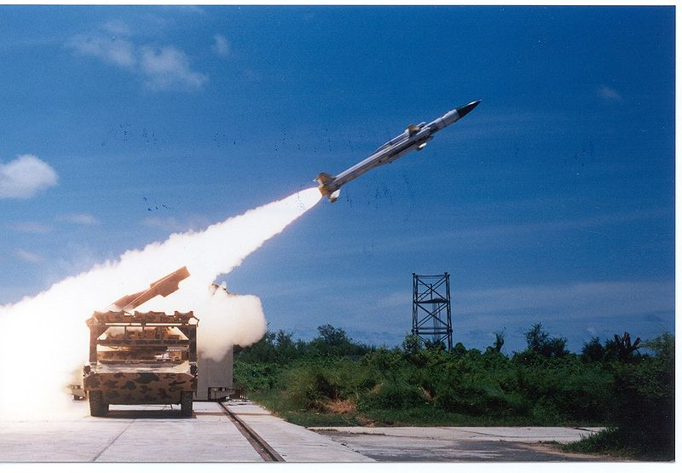







ADVANCED TECHNOLOGY PRODUCTS & SOLUTIONS FOR DEMANDING APPLICATIONS
Listed on the Bombay Stock Exchange, Sika is a qualified Indian Offset Partner (IOP) with nearly two decades of experience in executing advanced engineering projects, including in collaboration with international technology partners, for Aerospace, Defence and Space customers in India.
CRITICAL AIRBORNE SYSTEMS/LRUs
Advanced technology projects with International Partners
Landing gear system build-to-print manufacture, assembly & testing
Engine ignition systems
Cargo hooks including accessories like nets, slings, long lines, etc.
Fire and overheat detection/warning systems
Winches for cargo handling, parachute line retrieval and dipping sonar
Actuators including Hydraulic, Servo-hydraulic and Electro-mechanical
AIRBORNE SEARCH & RESCUE
Helicopter rescue hoists/winches
‘Quick conversion’ air ambulance modules, modifications & accessories
Emergency Locator Transmitters (ELTs)
Underwater Locator Beacons (ULBs)
Aerial fire-fighting equipment
(IE)² SOLUTIONS
Interconnect Solutions: MIL grade cable assemblies, wiring harnesses & aircraft looms
Electro-mechanical Assemblies: panel assemblies, box builds / wiring, etc.
Electronic module/LRU Integration: ATEs, racks/ATRs, cabinets, consoles, etc.
Environmental Stress Screening (ESS)
MOTION & FLUID CONTROL COMPONENTS
MIL-grade Fans for Electronics/Rack Cooling, etc.
Motors, Drive Controllers, Slip Rings, Rotary Joints, Feedback Devices, etc.
Sensors and Transducers for pressure, temperature, etc.
Valves and Filters for a variety of media
MAINTENANCE, REPAIR & OVERHAUL
Dedicated facilities in place for MRO of LRUs/systems
Repair Management solutions for C-130J, UH-3H, etc.
Ground handling & support equipment
DESIGN APPROVAL SINCE 1999
Sika Interplant Systems Limited Please send RFQs/RFIs to:
3 Gangadharchetty Road E-mail: nbd@sikaglobal.com
Bangalore 560 042, India Tel: +91-80-4929-9144
www.sikaglobal.com Fax: +91-80-2559-9501
ENGINEERING | PROJECTS & SYSTEMS | INTERCONNECT SYSTEMS | MAINTENANCE, REPAIR & OVERHAUL | DISTRIBUTION

