Slide 1

HOSPITAL SQL ANALYSIS

Slide 2
Objective
To analyze data from the Hospital. Hospital Dataset analyze using SQL and solving the problem related to the Hospital
. Manage patient and doctor information efficiently
. Track appointments and treatments
. Record diagnoses and prescriptions
. Generate and manage bills
. Analyze hospital data using SQL
The aim is to extract insights that supports business decisions.

Slide 3
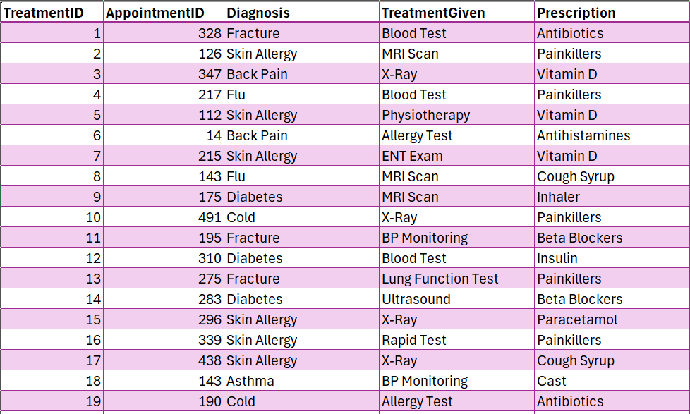
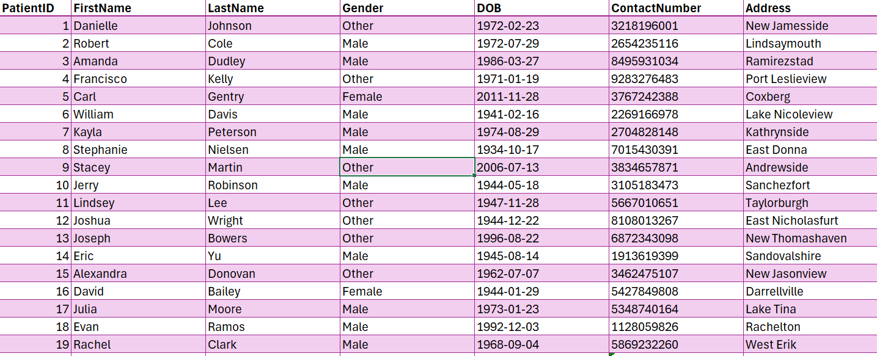
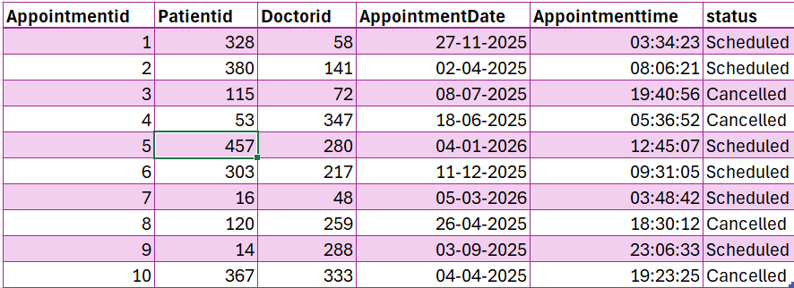
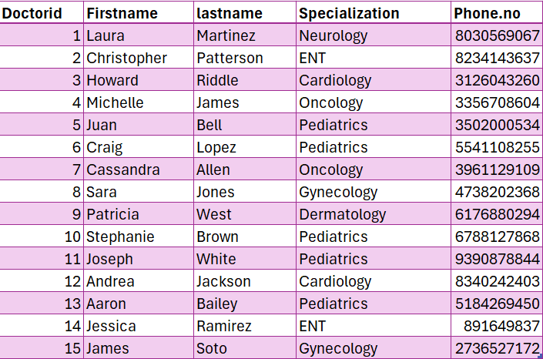
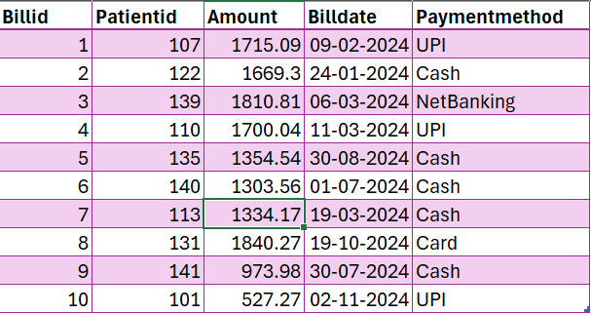
Tables Used
Treatment Table
Patients Table
Bill_Table
Appointment Table
Doctors Table
.

Slide 4


1 - KPIS: Total revenue generated by all doctors (or hospital)

Slide 5

2 - KPIS: Total Appointments in the hospital BY Doctor

Slide 6


3 - KPIS : Total Treatment given in the Hospital

Slide 7

4 – KPIS: Total_Patients admit in the hospital

Slide 8
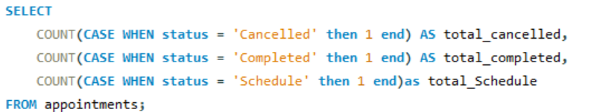

5 - KPIS : Count Status check in the hospital

Slide 9
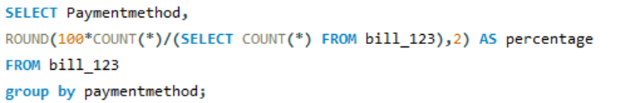
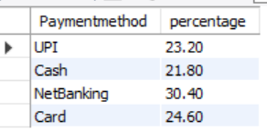
5 – Describe the payment method and share the percentage for contribute to the payment..

Slide 10
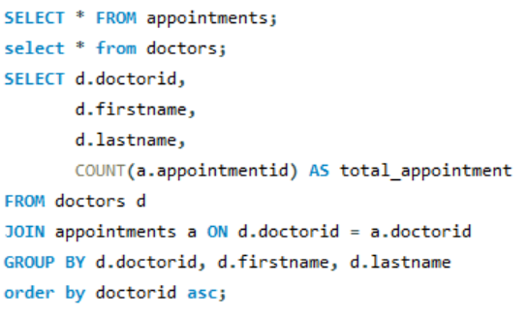
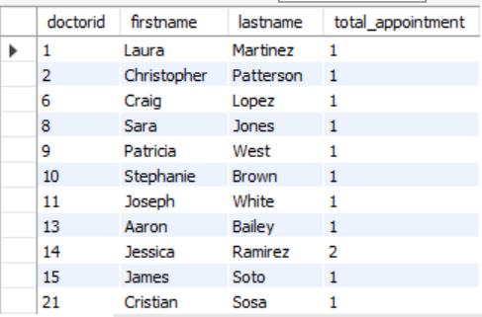
6: List the total number of appointments for each doctor.

Slide 11
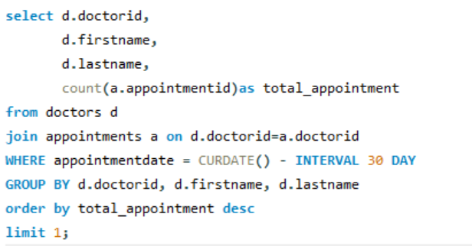

7: Find the doctor who had the maximum appointments in the last 30 days.

Slide 12
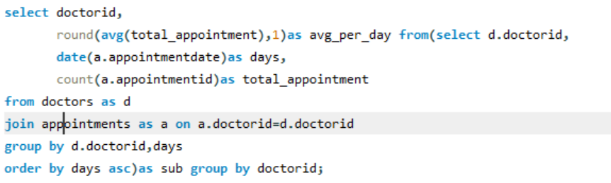
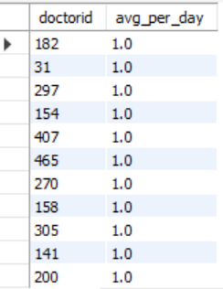
8: Show the average number of appointments per doctor per day.

Slide 13
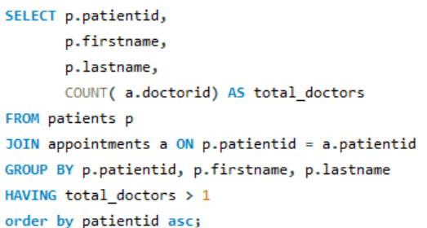
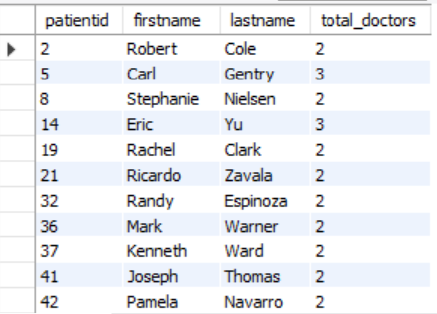
9: Find all patients who had appointments with more than one doctor.

Slide 14
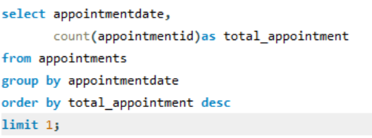

10: Find the day with the maximum total appointments.

Slide 15
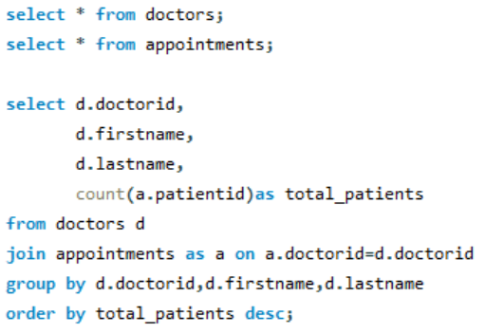
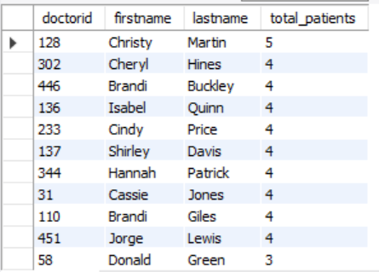
11: Show the total number of patients treated by each doctor.

Slide 16
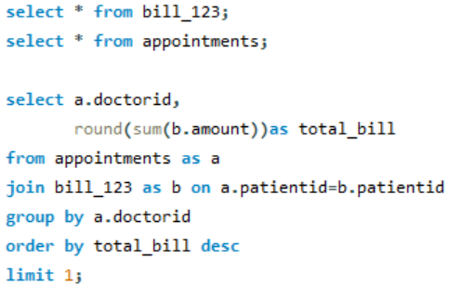

12: Find the doctor who generated the highest billing amount.

Slide 17
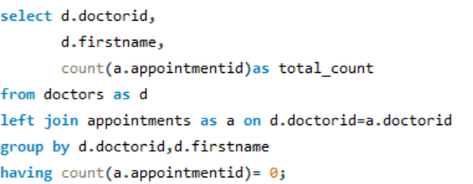
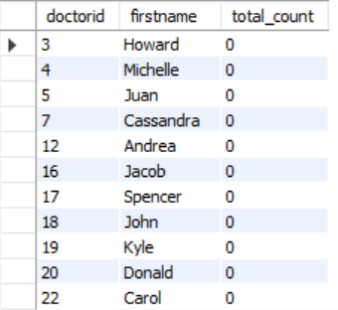
13: List doctors who have not had any appointments.

Slide 18
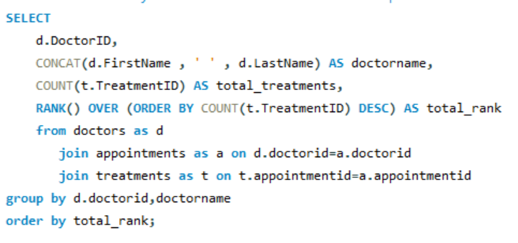
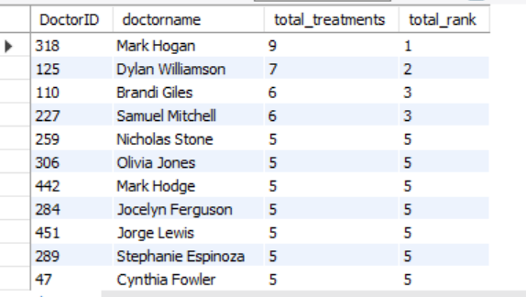
14: Rank doctors by the total number of treatments performed.

Slide 19
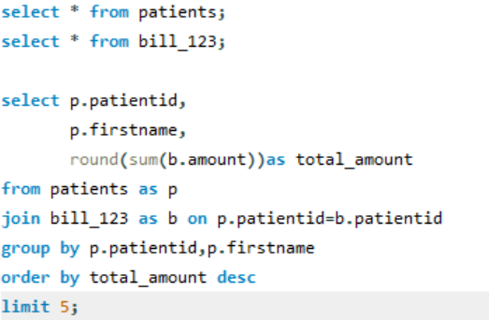
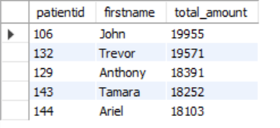
15: Find the top 5 patients by total billing amount.

Slide 20
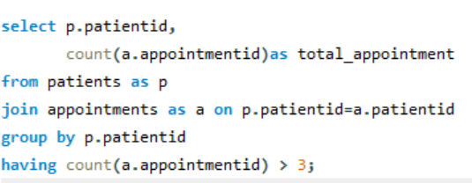
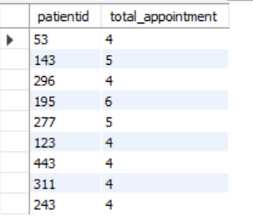
16: Show patients who had more than 3 appointments.

Slide 21
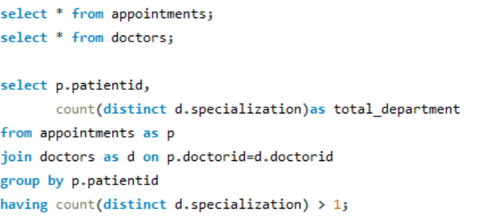
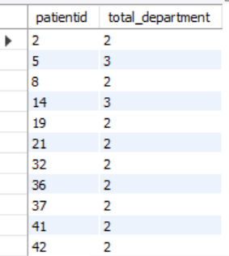
17: List patients who visited more than 1 department.

Slide 22
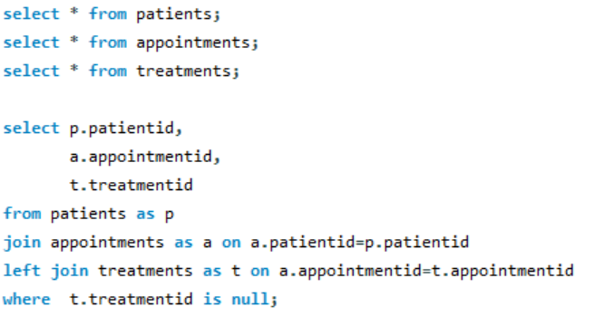
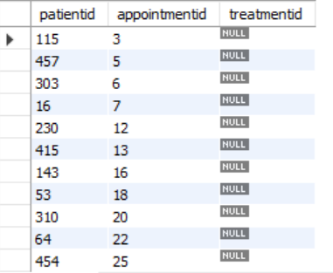
18: Find patients who had an appointment but no treatment recorded.

Slide 23
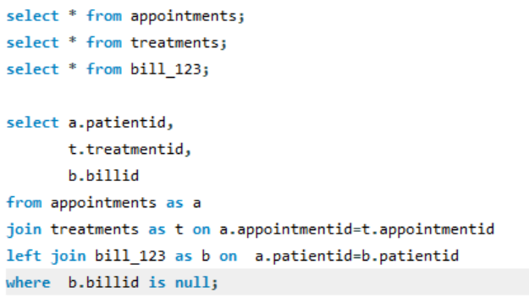
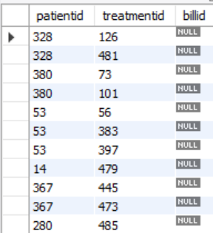
19 : Find patients who had a treatment but no billing record.

Slide 24
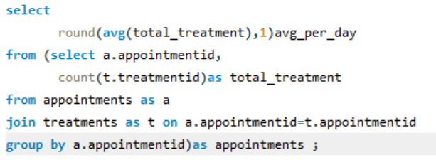

20 : Find the average number of treatments per appointment.

Slide 25
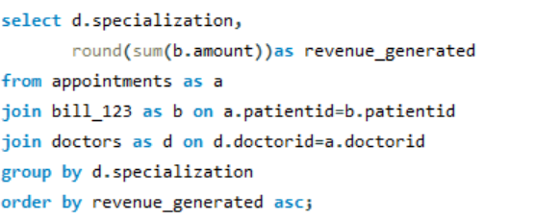
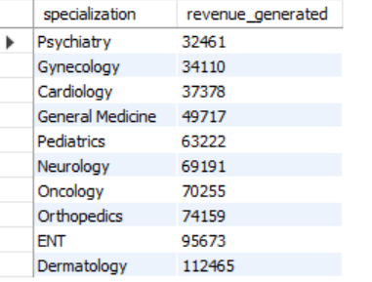
21 : Find the total revenue generated per department.

Slide 26
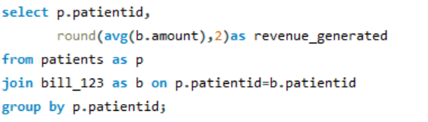
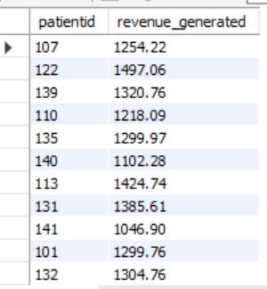
22 : Show the average revenue per patient.

Slide 27
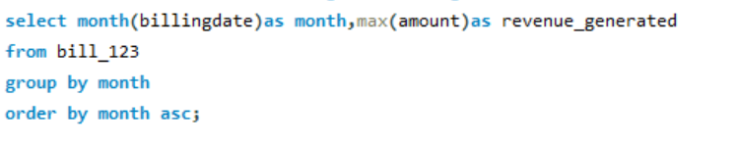
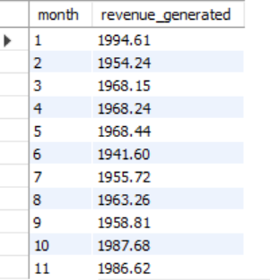
23 : Find the month wise the highest billing amount.

Slide 28
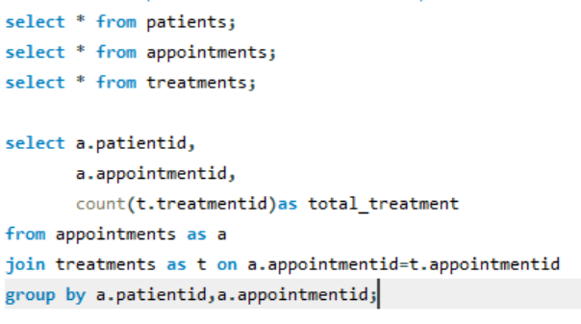
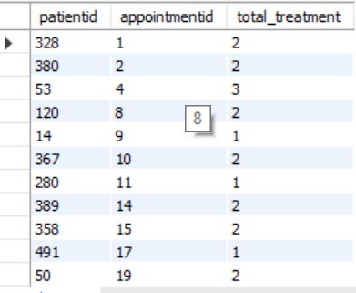
24 : Find the patients who received multiple treatments in the same appointment.

Slide 29
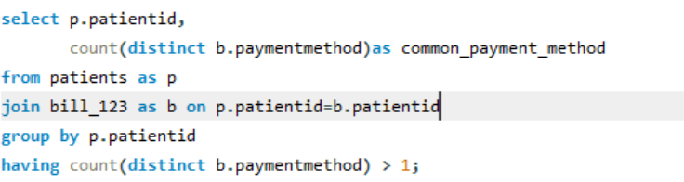
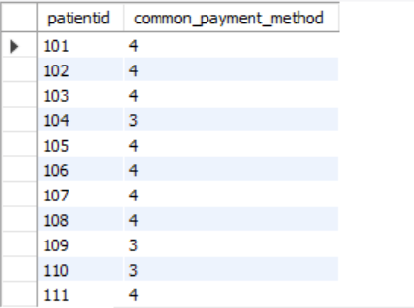
25 :Identify patients who used multiple payment methods.

Slide 30
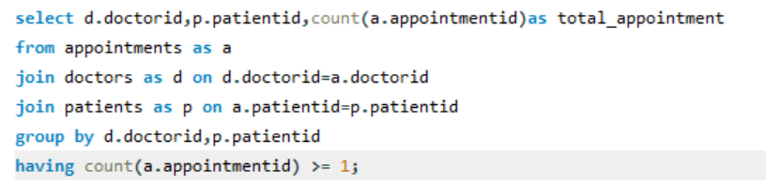
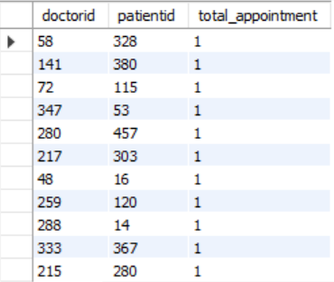
26 : Find the doctor-patient pairs who had equal or more than 1 appointments.

Slide 31

Thank you

