Slide 1


ADARSH JHA
Date: October 2025
Tool Used: MySQL, Power BI / Excel

Slide 2
PROJECT OVERVIEW
This project provides a comprehensive analysis of Uber ride data for the NCR region 2024 using SQL & Power BI. The analysis covers key business metrics, trends, and insights including bookings, cancellations, performance, revenue, and customer/driver ratings. The goal is to help Uber or ride-hailing stakeholders make data-driven decisions by identifying trends, peak times, common cancellation reasons, revenue patterns, and service performance

Slide 3
PART 1: Advanced SQL Analysis Conducted an in-depth analysis of Uber ride data using Advanced SQL queries to extract meaningful business insights and identify key performance trends.

Slide 4
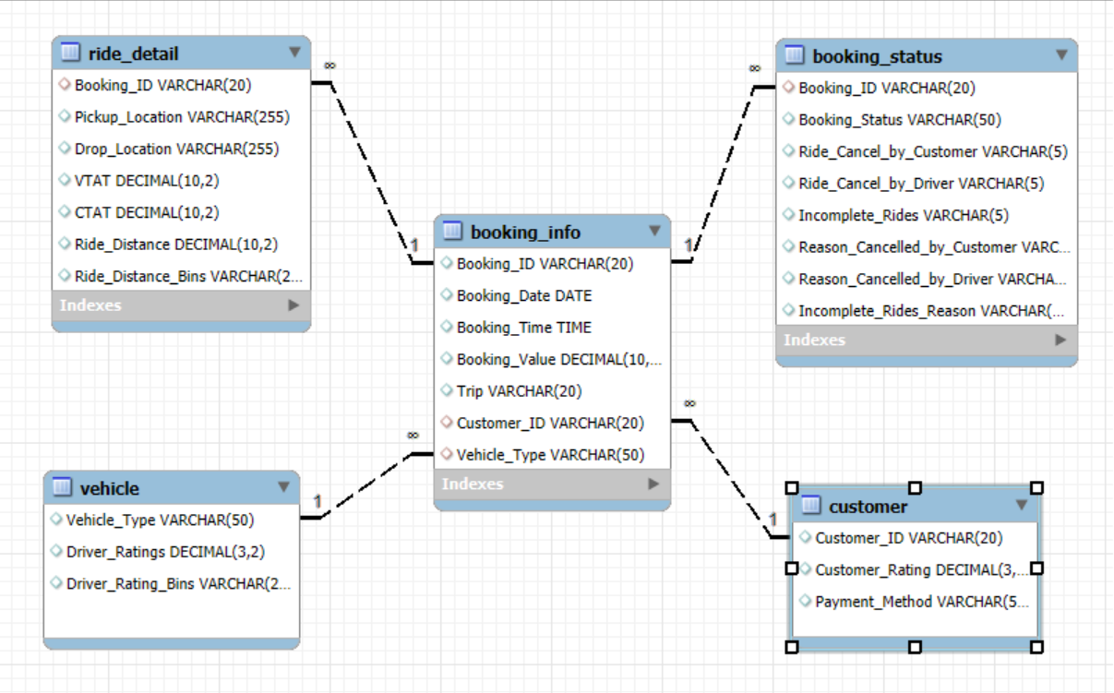

Slide 5
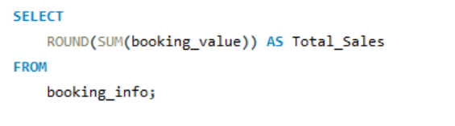

What is the total revenue generated from all bookings

Slide 6
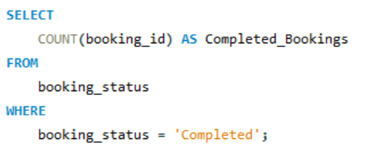

How many bookings were successfully completed

Slide 7
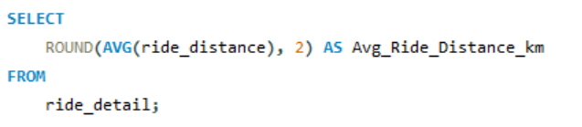

What is the average ride distance (in kilometers)

Slide 8
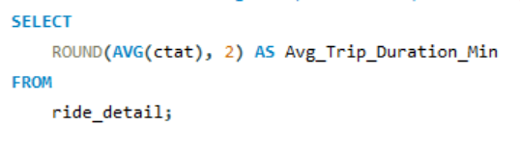

What is the average trip duration (in minutes)

Slide 9
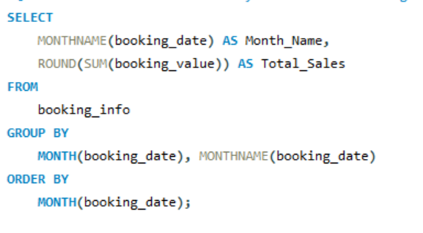
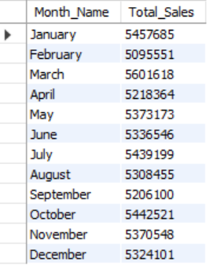
What are the total monthly sales trends throughout the year
What are the total monthly sales trends throughout the year

Slide 10
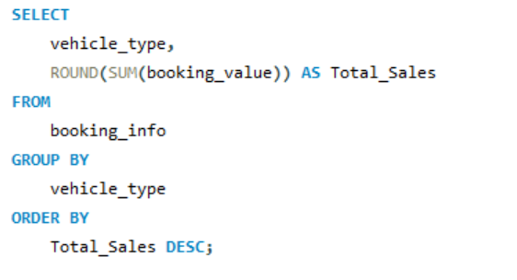
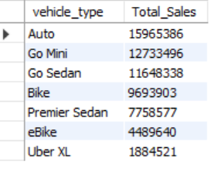
What is the total revenue contribution by each vehicle type
What is the total revenue contribution by each vehicle type

Slide 11
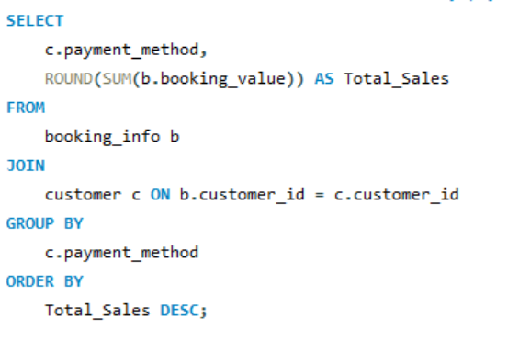
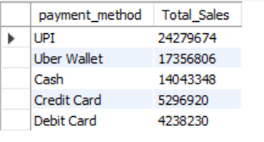
What is the total revenue distribution by payment method

Slide 12
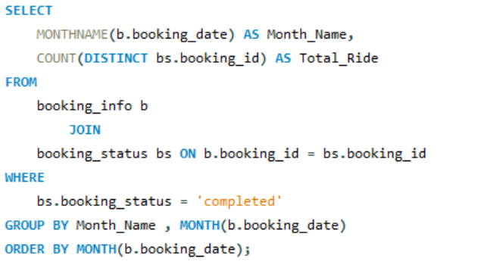
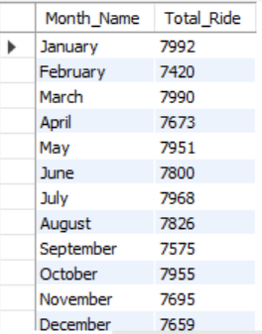
What is the total number of completed rides for each month

Slide 13

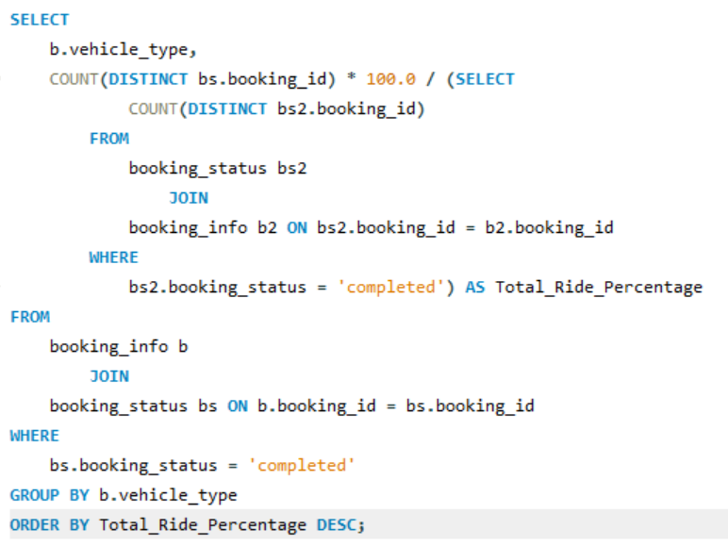
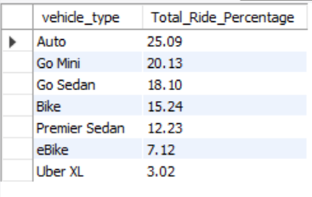
What percentage of total completed rides belong to each vehicle type

Slide 14
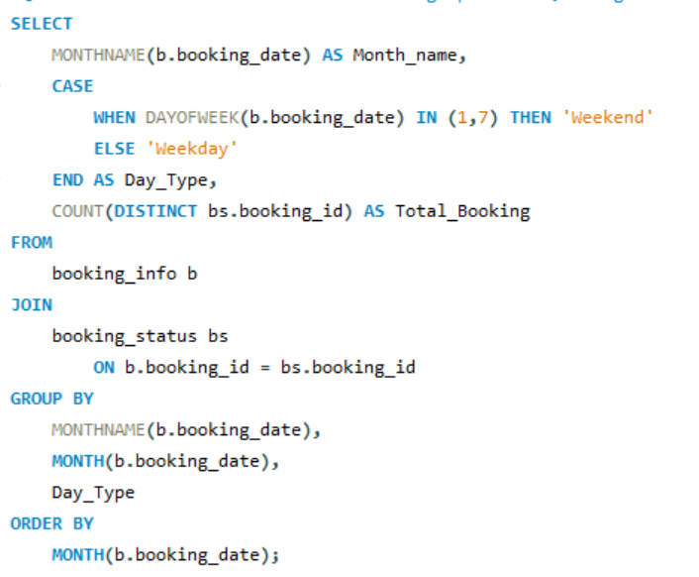
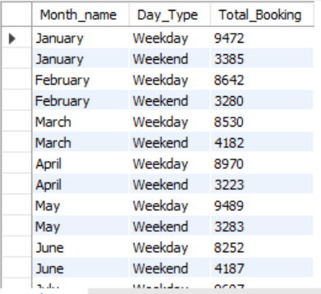
What is the total number of bookings per month, categorized by weekday and weekend

Slide 15
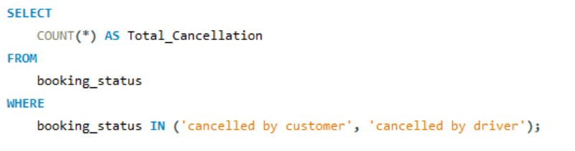

What is the total number of cancellations (both customer & driver)

Slide 16
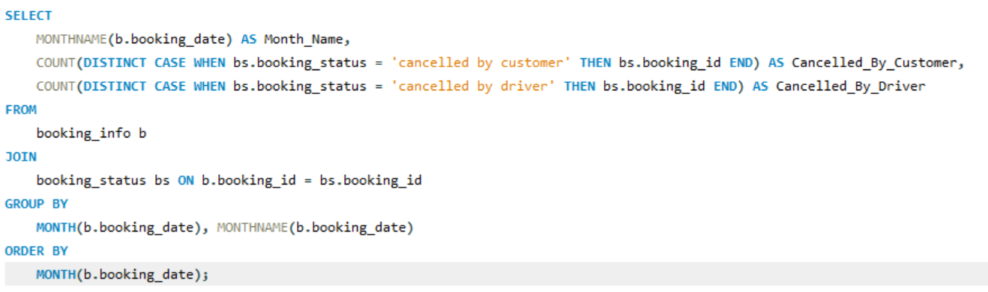
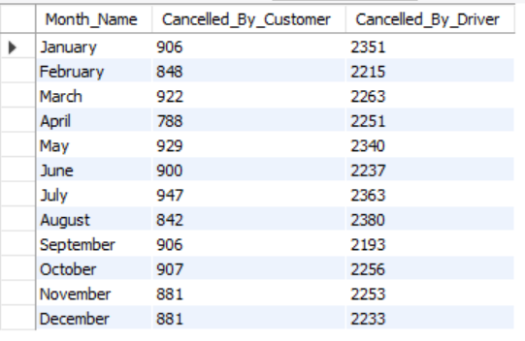
How many cancellations occurred each month, segmented by customer and driver

Slide 17
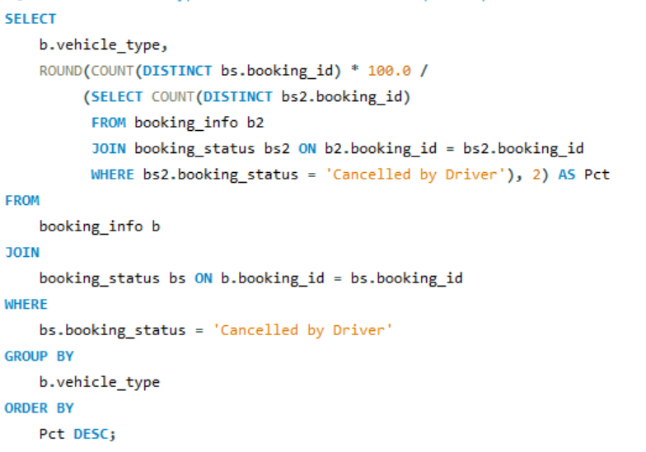
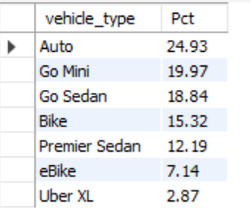
Which vehicle type of driver cancellations(in PCT)

Slide 18
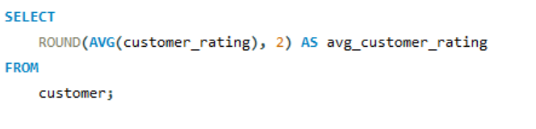

What is the average customer rating across all rides

Slide 19
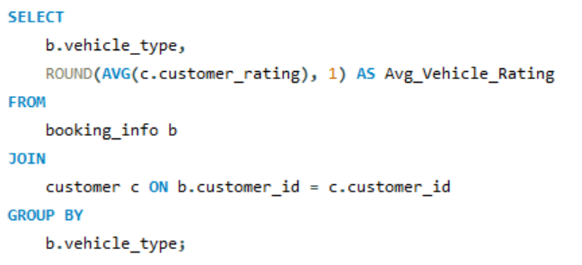
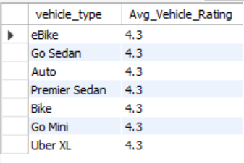
What is the average customer rating by vehicle type

Slide 20
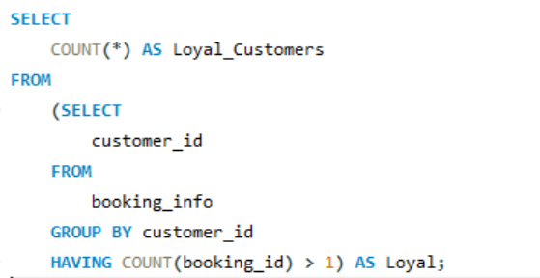

How many loyal customers have taken more than one ride

Slide 21
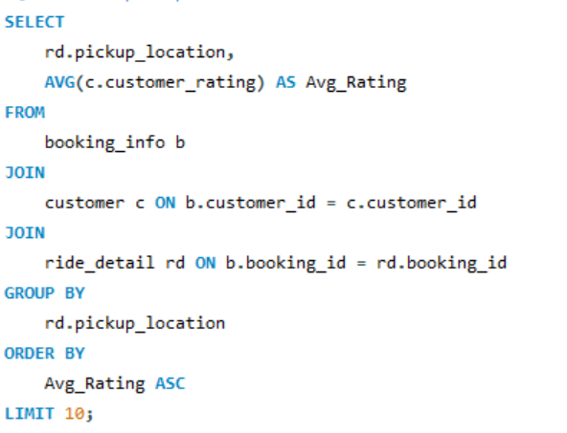
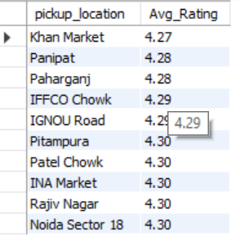
Which pickup locations have the lowest customer ratings (Bad Experience Area)

Slide 22
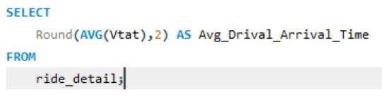

What is the average driver arrival time

Slide 23
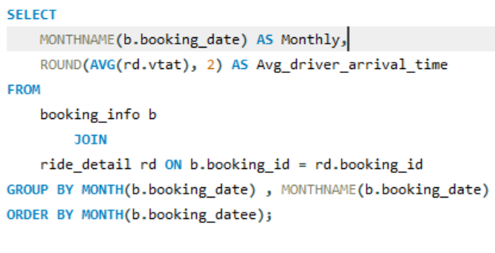
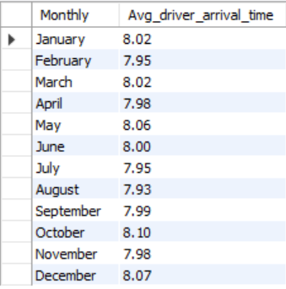
What is the monthly average driver arrival time trend

Slide 24
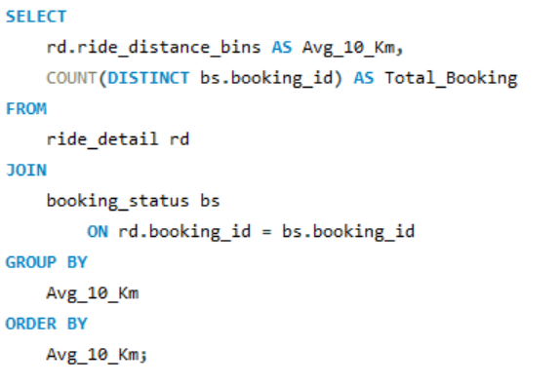
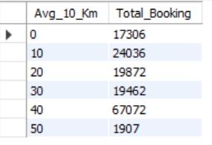
How many total bookings fall within each ride distance
range (in 10 km bins)

Slide 25
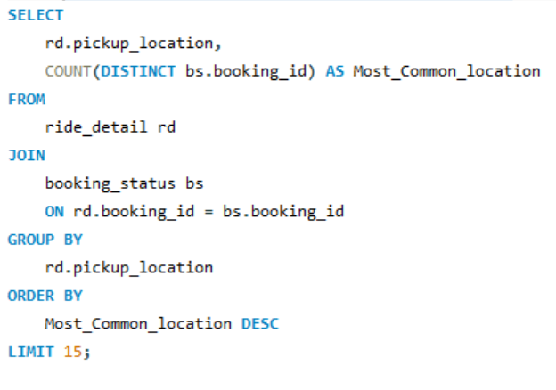
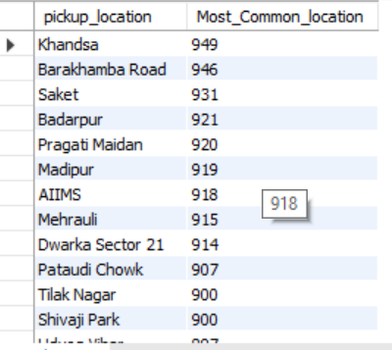
What are the top 15 most common pickup locations

Slide 26
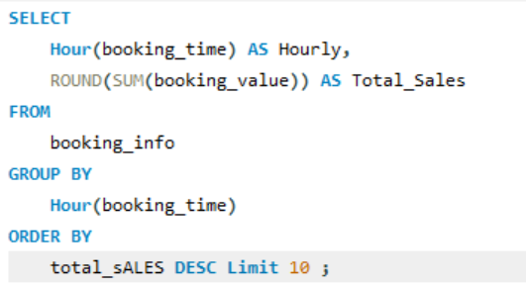
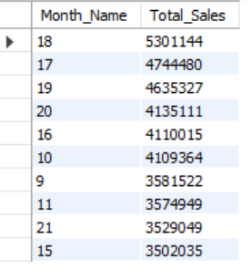
What are the peak hours that generate the highest total sales

Slide 27
PART 2: Power BI Report Developed an interactive Power BI dashboard to visualize Uber ride data, highlight key business insights, and track performance trends for better decision-making.

Slide 28
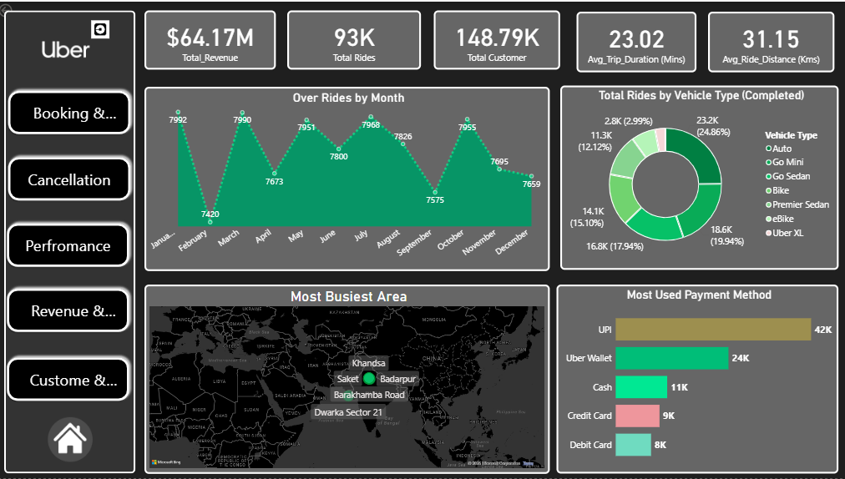

Slide 29
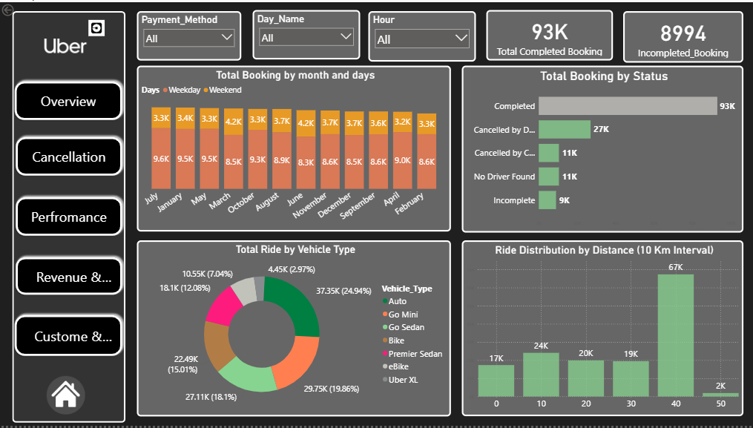

Slide 30
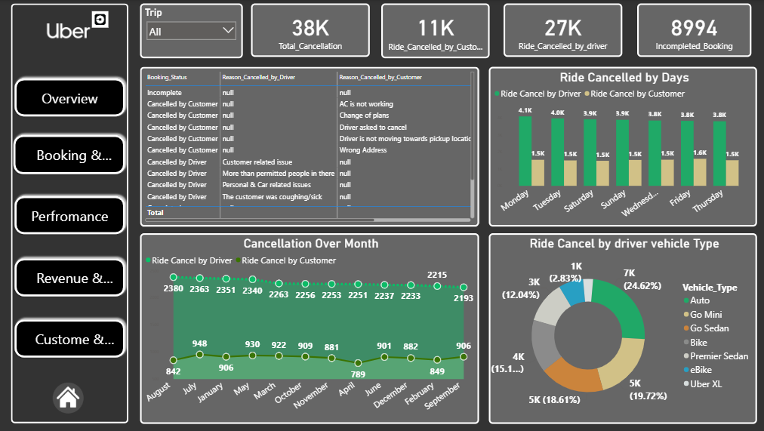

Slide 31
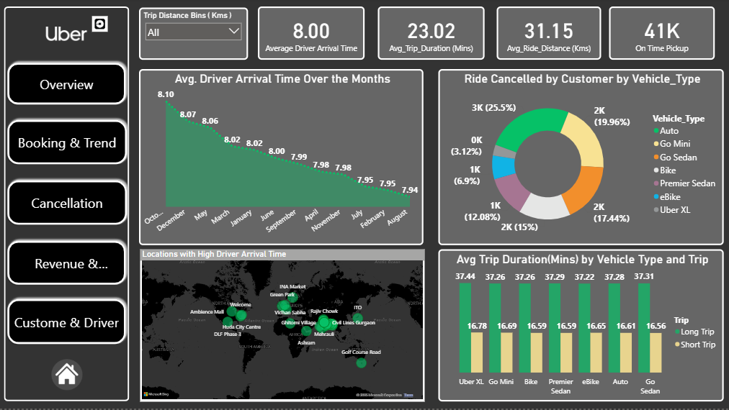

Slide 32
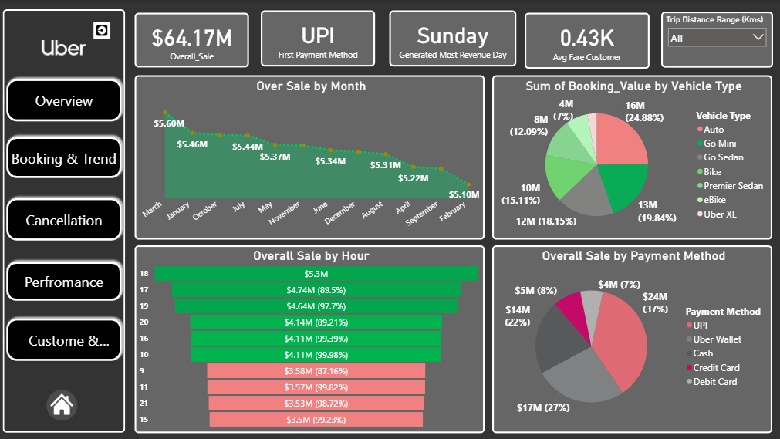

Slide 33
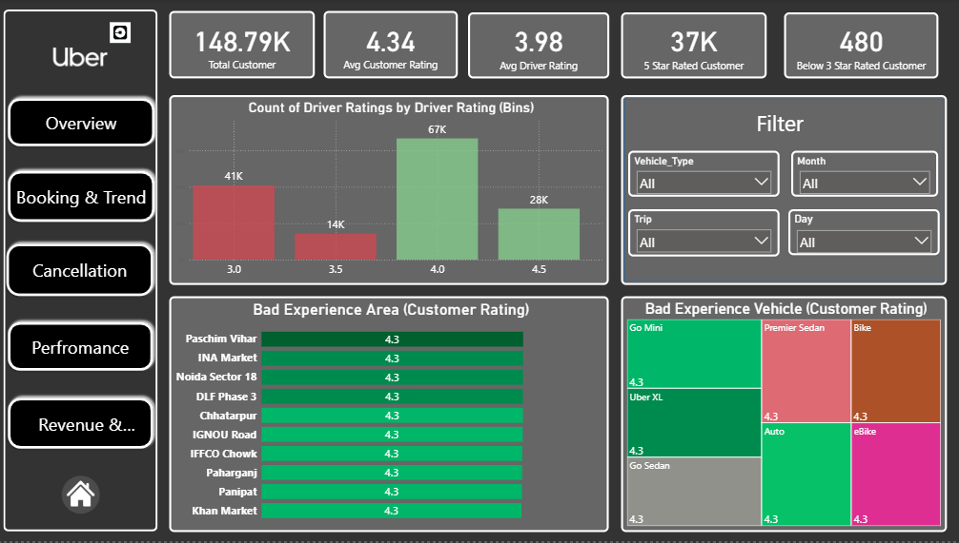

Slide 34
Thank You

