Slide 1


Team-12
Hand Gesture Controlled Mobile Robot
Team Members
K Adarsh Sagar- BL.EN.U4CSE21075
N Abdul Khadar Jilani-BL.EN.U4CSE21135

Slide 2
Contents
Introduction
Motivation
Problem Statement
Related Work
Research Gap
Methodology
Results
Conclusion
References

Slide 3
Introduction
In today’s world, smart technology is everywhere, making our lives easier and more efficient. It uses things like IoT, artificial intelligence, and machine learning to help us do tasks better. From smart homes that adjust lighting automatically to industries using smart systems to improve production, this technology is all about reducing mistakes and making things work faster. Our project is about a special kind of car: one you can control with just your hand movements. We're using advanced sensors to understand how you move your hands and then tell the car where to go without needing a remote control. This is a big step in making machines work more like we do, making tasks easier and helping people who might find traditional controls difficult to use.

Slide 4
Motivation
Our work here is to make a “Hand Gesture Controlled Robot”. we aim to create this system because it minimizes human effort and maximizes efficiency and this device basically uses sensors to capture and interpret hand movements. Gestures are wirelessly transmitted to direct the car, eliminating traditional remote controls. This technology offers precise control, benefiting individuals with disabilities.

Slide 5
Problem statement
In today's fast-paced world, there is a growing need for easy and efficient ways to control robots. Traditional methods like remote controls and manual interfaces can be difficult to use, especially for people with physical disabilities. These methods can also cause mistakes and reduce efficiency, limiting the benefits of using robots. The challenge is to create a more user-friendly, precise, and accessible control system that works well with modern robots. Our goal is to develop a gesture-controlled mobile robot using sensors to interpret and follow hand gestures, making robot control easier and more efficient for everyone.

Slide 6
Related Work
[1] Azhari et al. employ MPU-6050, Arduino Nano, L298N Motor Driver, and NRF24L01 for robot operation, emphasizing hand gesture and wireless motion control and they utilize a combination of MPU-6050, Arduino Nano, L298N Motor Driver, and NRF24L01 to enable robot control. They establish communication via NRF24L01 and control robot movement through signals from the MPU-6050 sensor.
[2] Swarnika Shruti et al. simplify robotic operation through hand gesture recognition with ZigBee wireless connection. They utilize image algorithms to interpret gestures for commands, enabling seamless human-robot interaction without external hardware.
[3] Udit Kumar et al. focus on advancing laptop control by integrating Arduino Uno and ultrasonic sensors for gesture detection. The system is designed to cater to paralyzed individuals, allowing them to control laptops without power gadgets through hand gestures.
[4] Sriram Anbalagan et al. merge Arduino, RF module, and voice recognition to facilitate human-robot interaction. Their system enables control of robots via hand gestures and voice commands, leveraging RF technology for wireless communication.
[5] Rutwik Shah et al. develop a gesture-controlled car using accelerometer, Arduino Uno, HT12E encoder, RF433 transmitter, and IoT technology. They aim for comfort and convenience in remote object control, utilizing accelerometer readings and RF communication for direction control.

Slide 7
Related Work
[6] Gurkirat Singh et al. utilize Arduino and nRF2401L for hand gesture-controlled robot operation, focusing on enhancing human-machine interaction and removing conventional control methods.
[7] D. Jessintha et al. integrate gesture recognition and RF modules into social service robots in food industries to benefit individuals with hearing and speech impairments, improving robot performance through gesture commands.
[8] Dhanashree Wadaye et al. design gesture-based robotic arm and all-terrain car controlled via flex sensors and hand gestures, exploring integration of FPV cameras, VR, and gesture control for enhanced surveillance and locomotion efficiency.
[9] Mihai – Bebe Simion et al. develop a distributed search engine prototype using mobile agents for content extraction, integrating mobile software agents for image databases and security enhancements with SeMoA mobile agent server, significantly reducing costs and improving user-friendliness, reliability, and robustness of image search engines.
[10] Dhruv Agarwal et al. employ a distributed search engine prototype using mobile agents for content extraction, integrating security enhancements with SeMoA mobile agent server, improving cost-effectiveness, user-friendliness, reliability, and robustness of image search engines while mitigating security risks.

Slide 8
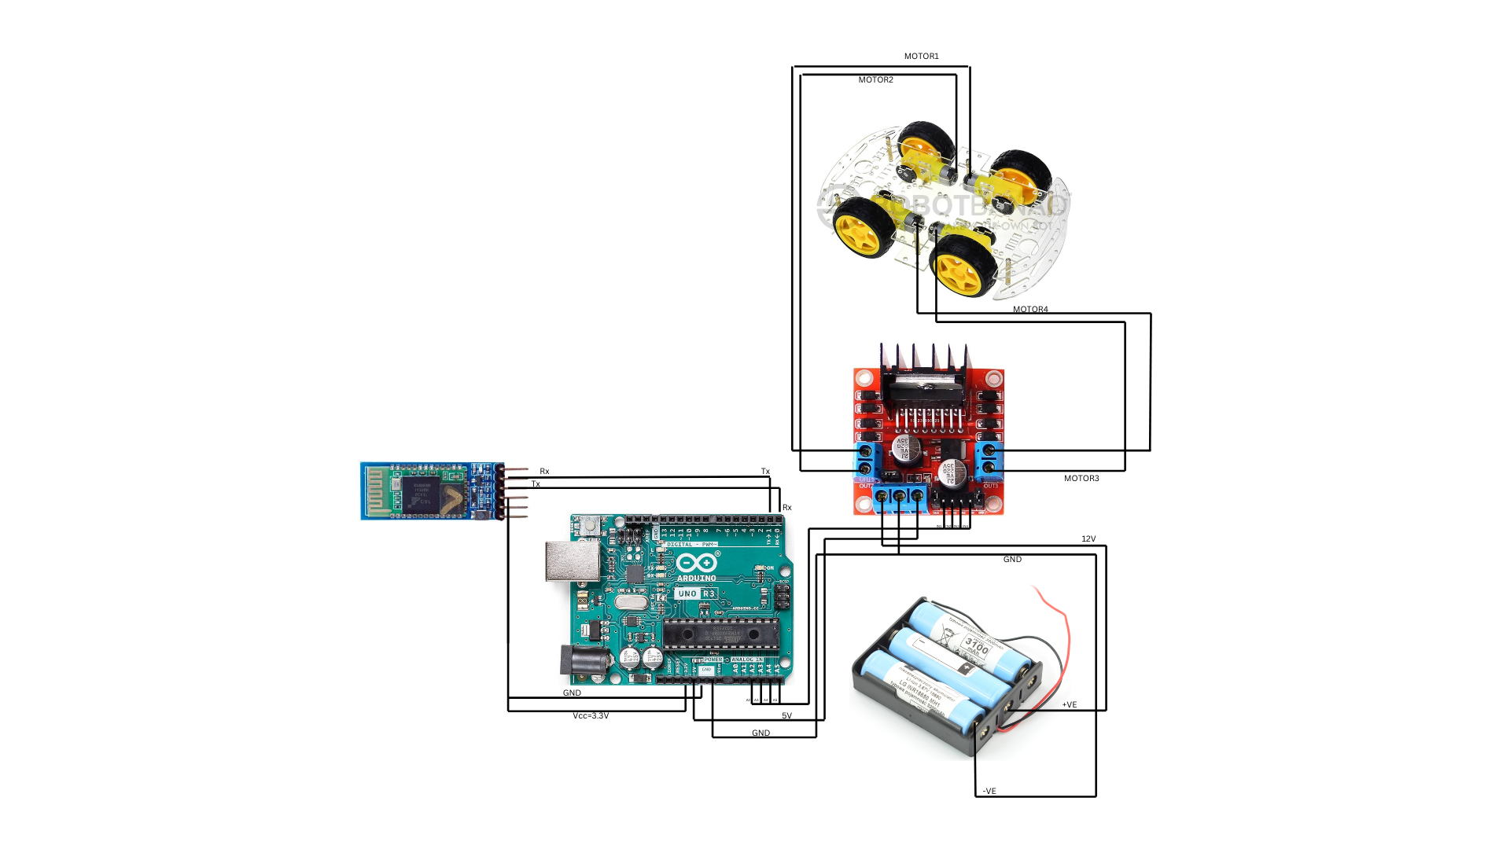
Methodology
Our work basically contains two parts one is the receiver part and another one is the transmitter part
Receiver part:

Slide 9
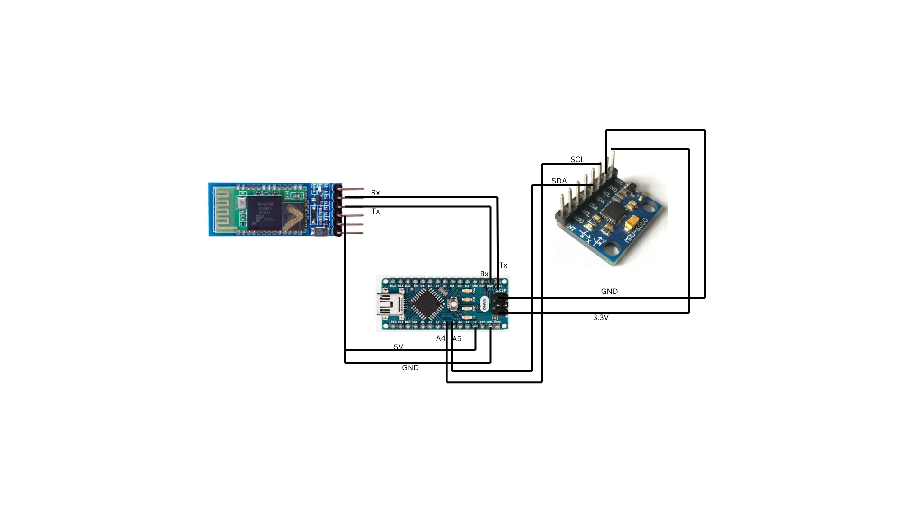
Methodology
Transmitter part:

Slide 10
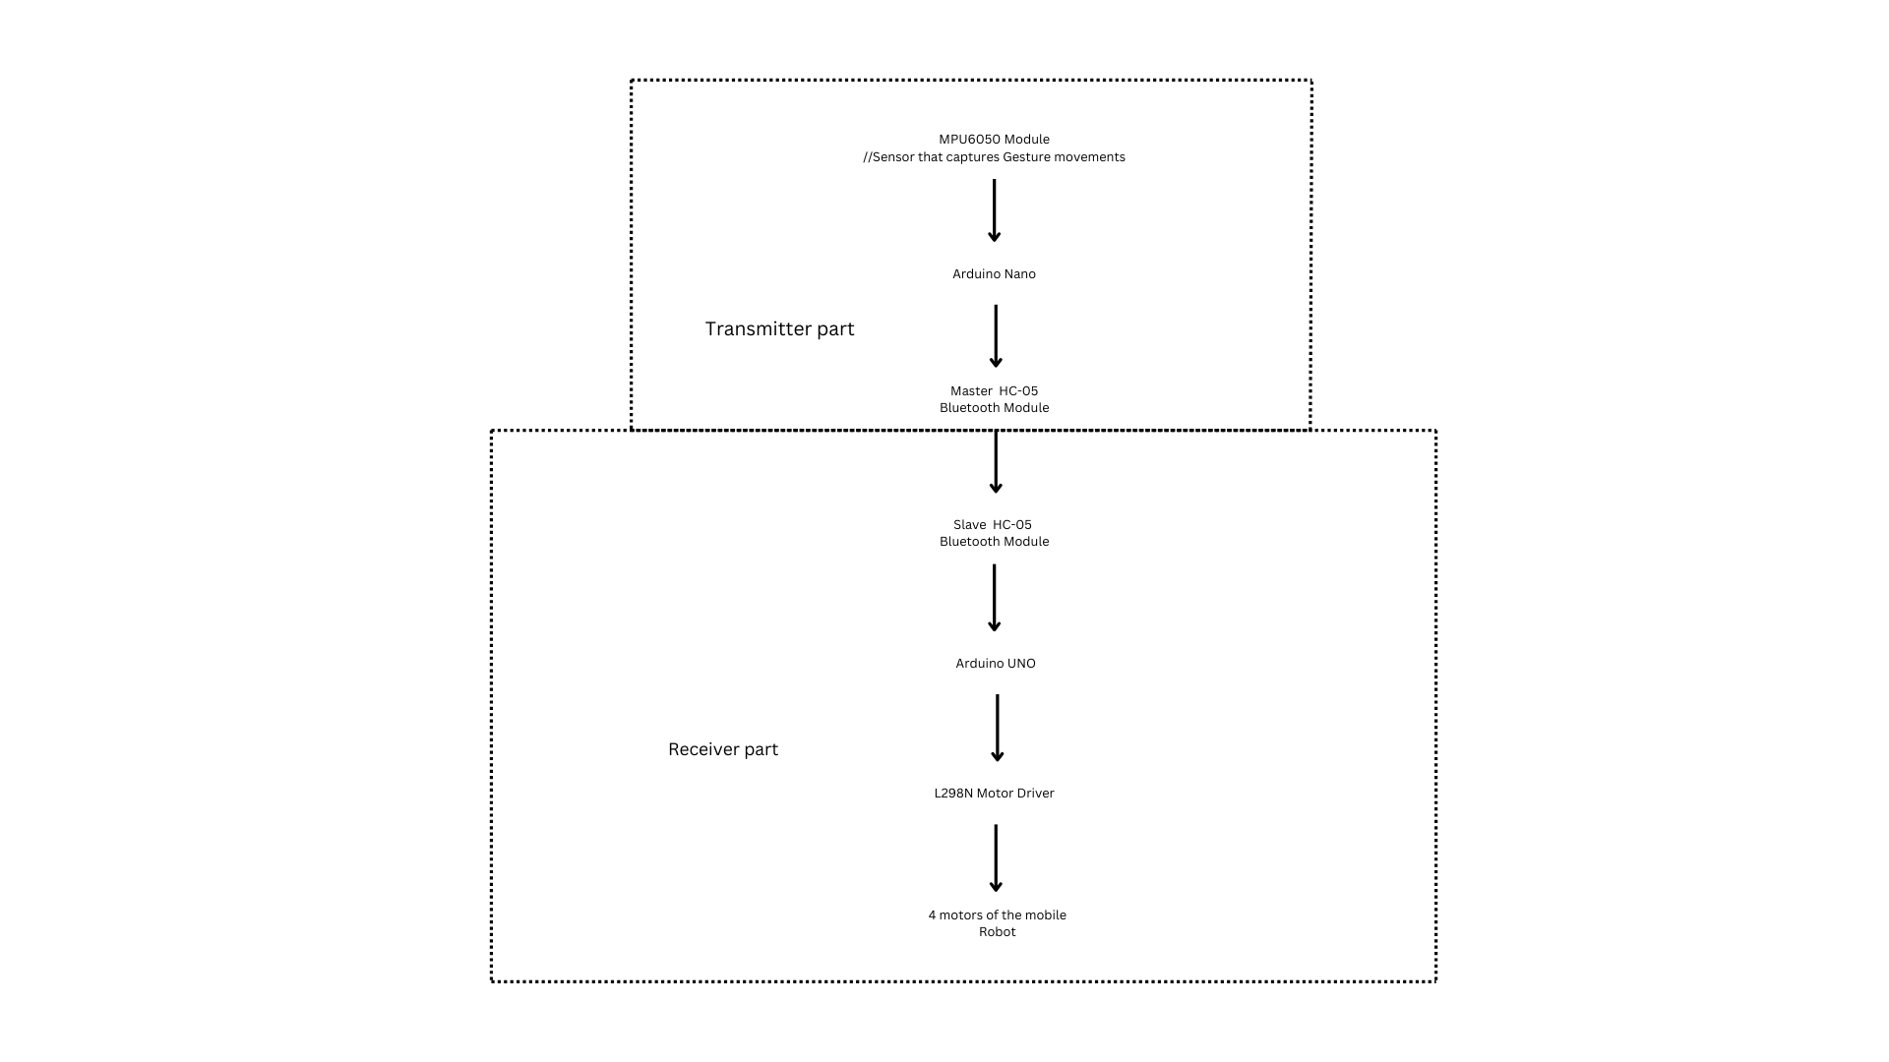
Methodology
Implementation

Slide 11
Methodology
Implementation

Slide 12
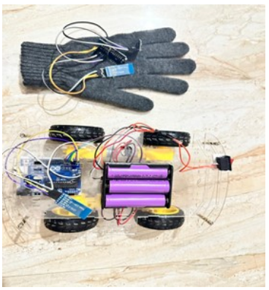
Results
When we change the position of our fist in a downward direction, the mobile robot will respond by moving forward; conversely, if we move our fist upwards, the robot will then move in a backward direction. Furthermore, when we gesture our fist to the left, the robot will initiate a rotation towards the left, and similarly, a movement towards the right will prompt the robot to rotate in the right direction.

Slide 13
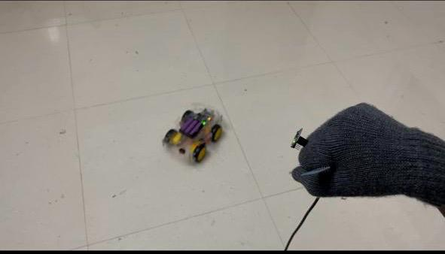
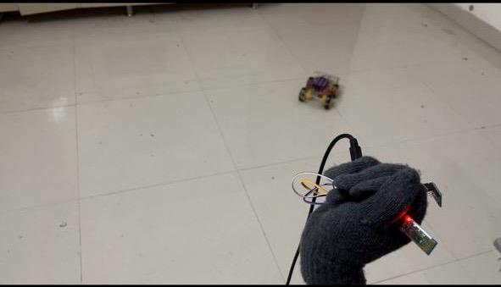
Results
. Gesture Controlled Robot: Forward Motion
. Gesture Controlled Robot: Forward Motion

Slide 14
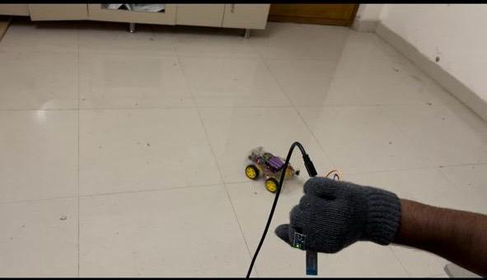
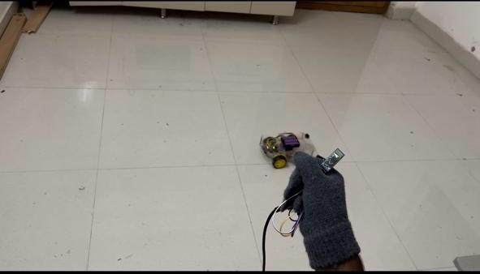
Results
Gesture Controlled Robot: Left Rotation
Gesture Controlled Robot: Right Rotation

Slide 15
Conclusion
The development of gesture-controlled mobile robots is a big step forward in making technology easier to use. By allowing people to control robots with simple hand movements, these robots are more accessible, especially for those who might find traditional controls difficult. This technology combines vision systems, machine learning, and robotics to create useful tools for healthcare, entertainment, and industry. In the future, we can improve these systems to recognize more gestures accurately, use augmented reality for better control, and add advanced sensors to help robots understand their surroundings better. We can also work on controlling multiple robots at once, making human-robot teamwork smoother, and ensuring these systems can work with different devices securely and reliably. These improvements will make gesture-controlled robots even more useful and widespread, benefiting many areas of life and work.

Slide 16
References
[1] Nasution, T.I. and Azis, P.F.A., 2023. MPU-6050 Wheeled Robot Controlled Hand Gesture Using L298N Driver Based on Arduino. In Journal of Physics: Conference Series (Vol. 2421, No. 1, p. 012022). IOP Publishing.
[2] Shruti, S., Verma, S.K., Singh, S. and Gupta, T., 2022. Arduino Based Hand Gesture Controlled Robot. International Research Journal of Engineering and Technology.
[3] Kumar, U., Kintali, S., Latha, K.S., Ali, A. and Kumar, N.S., 2020. Hand Gesture Controlled Laptop Using Arduino
[4] Thivagar, T. and Sriram, A., 2020. Hand Gesture and Voice Controlled Smart Vehicle. International Journal of Modern Science and Technology, 5(6), pp.164-167.
[5] Shah, R., Deshmukh, V., Kulkarni, V., Mulay, S. and Pote, M., Hand Gesture Control Car. In Proceedings to ICSITS-2020 Conference, International Journal of Engineering Research and Technology.
[6] Singh, G. and Kaur, H., 2021. Hand Gesture Controlled Robot Using Arduino. International Journal for Research in Applied Science and Engineering Technology

Slide 17
References
[7] Jessintha, D., Jaisiva, S. and Ananth, C., 2023, March. Social Service Robot using Gesture recognition technique. In Journal of Physics: Conference Series (Vol. 2466, No. 1, p. 012020). IOP Publishing
[8] Wadaye, D., Nayak, Y., Yadav, V. and Ansari, D.V., 2023. Hand GestureControlled Robotic Arm with All-Terrain Surveillance Car. International Journal for Research in Applied Science and Engineering Technology, 11, pp.1718-1722.
[9] Simion, M.B., Selis¸teanu, D. and S, endrescu, D., 2020, October. Dc motor control using hand gestures. In 2020 24th International Conference on System Theory, Control and Computing (ICSTCC) (pp. 149-153). IEEE.
[10] Agarwal, D., Rastogi, A., Rustagi, P. and Nijhawan, V., 2021, March. Real time RF based gesture controlled robotic vehicle. In 2021 8th International Conference on Computing for Sustainable Global Development (INDIACom) (pp. 848-852). IEEE

Slide 18
THANK YOU!

