Slide 1
TRIP ADVISOR
ADARSH GANGADHARAN
04/02/2019

Slide 2
PROBLEM STATEMENT
The system helps users to put reviews to places they visit. So that other users would be able to decide whether the place is worth visiting based on the reviews.

Slide 3
CLASS DIAGRAMS

Slide 4
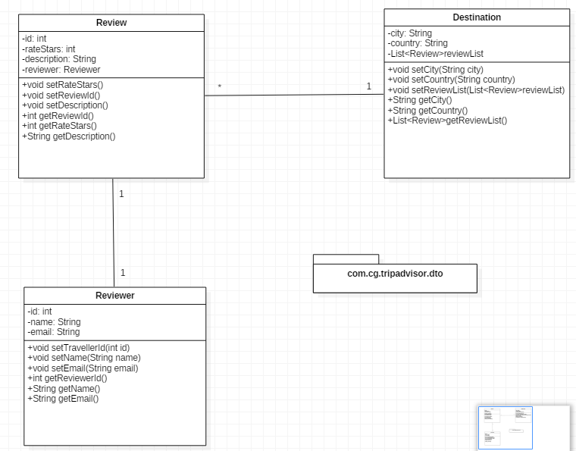
POJO CLASS

Slide 5
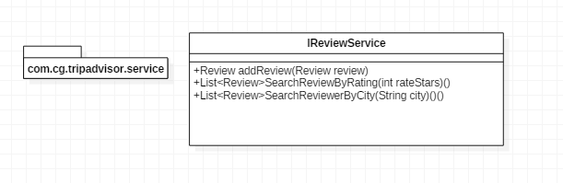
SERVICE CLASS

Slide 6
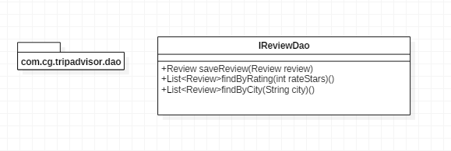
DAO CLASS

Slide 7
THANK YOU

