Slide 1
Sales Dashboard Analysis
Adarsh Kumar
adarshkumarkn7@gmail.com

Slide 2
Introduction
This presentation showcases a Power BI sales dashboard created as part of an internship project.
The dashboard provides insights into sales performance, trends, and key metrics using interactive visuals.

Slide 3
Data Sources & Tools Used
- Data Source: Sales data from e-commerce platform (Excel/CSV format)
- Tools: Power BI Desktop for data modeling and visualization
- Key Features: DAX measures, slicers, KPIs, bar/line charts

Slide 4
Dashboard Overview
The sales dashboard includes the following elements:
- Total Sales & Orders KPIs
- Sales by Region and Category
- Monthly Sales Trend
- Top Performing Products
- Interactive filters and slicers

Slide 5
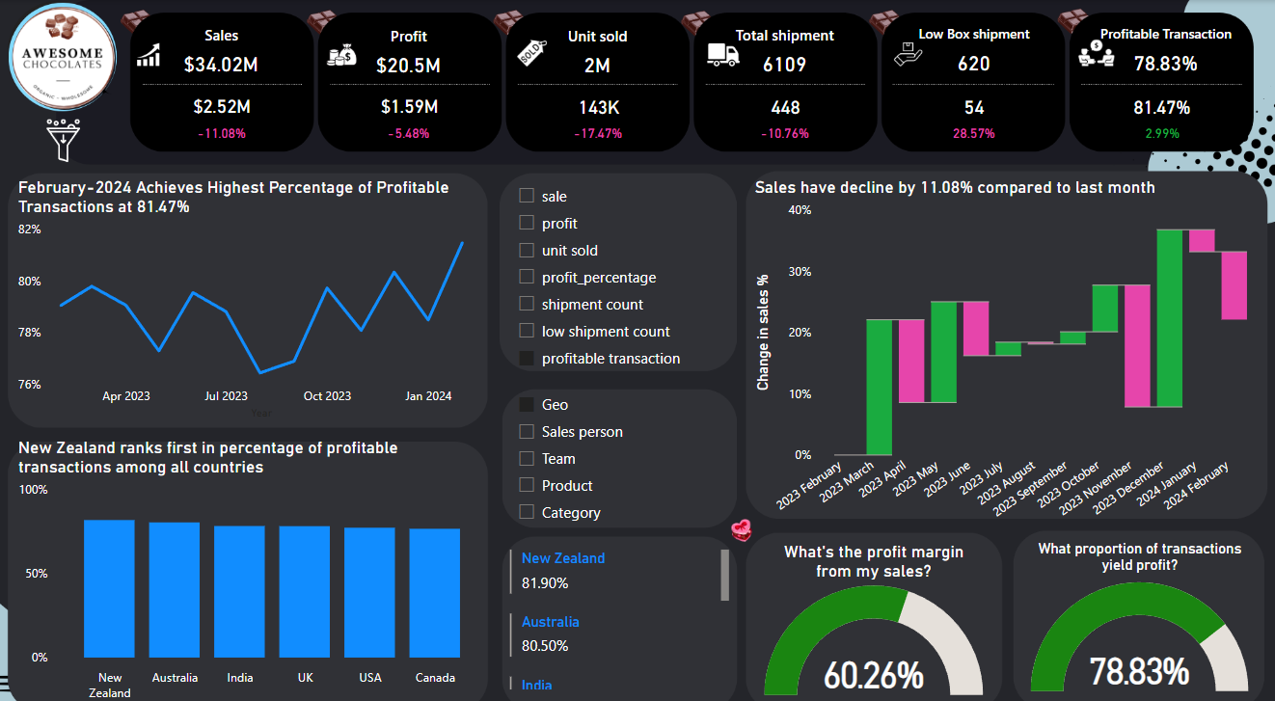

Slide 6
Key Insights
Peak sales occurred in the month of December
New Zealand generated the highest revenue
Top product category: Bars
Seasonal trends observed in monthly sales
Opportunities identified in underperforming categories

Slide 7
Conclusion
The Power BI dashboard provides a comprehensive view of sales performance.
It enables better decision-making through data-driven insights and helps identify trends and areas for improvement.

