Slide 1
Direct-Mail Prospect Data
EDA Readiness Review — All 5 Phases
100,000 mailed prospects • 79 columns • 3 mailing waves • July 2026
Phase 1 — Business & Data Understanding
Phase 2 — Data Quality Checks
Phase 3 — Univariate & Distribution Analysis
Phase 4 — Relationship & Target Analysis
Phase 5 — Time-Based Trends

Slide 2
PHASE 1 — BUSINESS & DATA UNDERSTANDING
One row = one mailed prospect in the campaign
• 100,000 prospects mailed across 3 waves (Jan, Feb, Mar 2026) — the complete campaign file, not a sample.
• 79 columns per prospect: credit scores, income, and credit-history snapshots from three bureaus (Equifax, Experian, TransUnion) across multiple product types and time windows.
• Column naming convention: {BUREAU}_{PRODUCT}_{METRIC}_{WINDOW} — e.g. EFX_BC_UTIL_1 = Equifax, Bankcard, Utilisation, Window 1.
• No pre-built "did they respond?" column exists — we derived it: responded = 1 when BCP_APPLICATION_ID is filled in (an application was submitted).
• Column definitions sourced from the BEST Data Dictionary (847 entries) — no guesswork on field meaning.
100,000
Prospects mailed
79
Columns
3
Mailing waves
410
Responded (derived target)
84
Booked a card

Slide 3
PHASE 2 — DATA QUALITY CHECKS
Clean file — hidden sentinel codes needed correcting
• Zero full-row duplicates — no double-counting of prospects.
• No type mismatches, no broken columns, no out-of-range FICO or utilisation values.
• Date columns (drop date, application date) parse cleanly — no future-dated records.
• Credit-bureau fields use sentinel codes (e.g. 999, 9,999,999) to mean "no trade on file" — not actual large values.
• 239,312 sentinel-coded cells across 69 columns were converted to true blanks — without this step they would look like extreme data points.
• 74 of 79 columns have some missing values after this correction — expected and by design (not every prospect has every trade type).
• Only 3 columns are >50% blank: BCP_APPLICATION_ID, BCP_ACCOUNT_ID, BCP_APPLICATION_RECEIVED_DATE — all leakage fields excluded from modeling anyway.

Slide 4
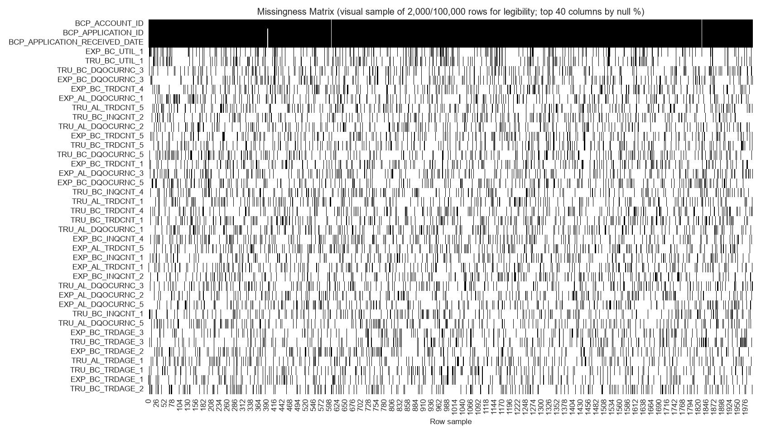
PHASE 2 — DATA QUALITY CHECKS (CONTINUED)
Three bureaus, one signal — largely redundant data
• 23 metric families each appear three times — once from Equifax (EFX), once from Experian (EXP), once from TransUnion (TRU).
• 12 of 23 families: near-perfect agreement (avg r ≥ 0.95). Safe to collapse to one representative column.
• 11 of 23 families: partial agreement (avg r 0.63–0.93) — especially delinquency-occurrence fields. Bureau disagreement may carry real signal; review before collapsing.
• Missingness is systematic: if a prospect has no trade on file at Equifax, they typically have none at Experian or TransUnion either (dark horizontal bands in the chart).
Dark bands = missing values across all three bureau copies for the same prospect.

Slide 5
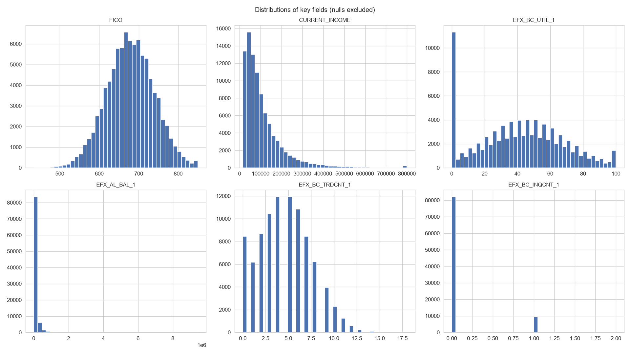
PHASE 3 — UNIVARIATE & DISTRIBUTION ANALYSIS
Credit scores are normal; balances and income skew right
Each bar chart shows how values are spread for one key field (sentinel-cleaned; blanks excluded).
• FICO (credit score): bell-shaped, mean 679, range 434–850. No entry errors.
• Income & balances: strong right skew (skew 3–13). A small fraction of prospects carry very high balances. Log transform recommended before linear modeling.
• Delinquency fields: zero-inflated — ~78% of prospects have zero late payments; ~22% of values are flagged as outliers by standard IQR rules (all legitimate, not errors).

Slide 6
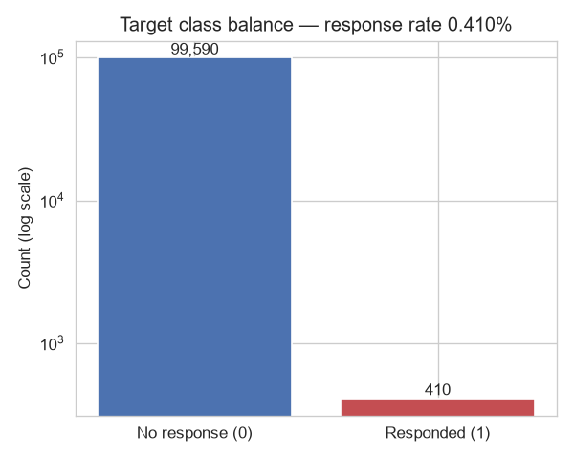
PHASE 4 — RELATIONSHIP & TARGET ANALYSIS
Response is rare: 243 non-responders per 1 responder
• 0.41% response rate: 410 of 100,000 prospects submitted an application.
• 0.084% booking rate: only 84 of 100,000 opened a card — 4.9× rarer than even responding.
• Imbalance ratio: 243:1 (non-responders to responders).
• Standard accuracy is meaningless here — a model that predicts "never responds" for everyone would be 99.59% accurate but completely useless.
• Correct approach: measure success using lift/ranking (how many times better than random?) and use class-weighted or resampling methods during training.
Log scale needed to show both bars — the gap between 99,590 and 410 is that large.

Slide 7
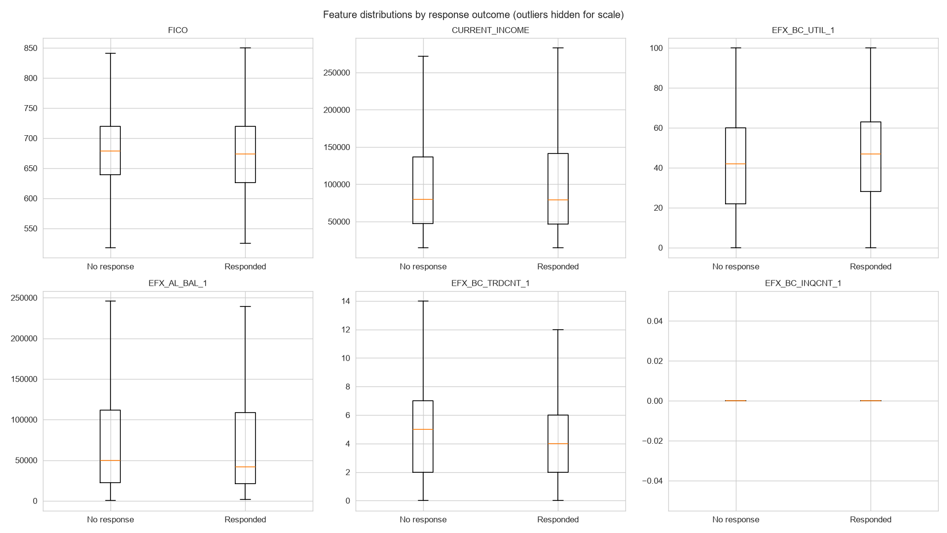
PHASE 4 — RELATIONSHIP & TARGET ANALYSIS (CONTINUED)
Responders carry more debt and shop more actively
Box plots comparing key fields for responders (right) vs. non-responders (left); extreme values trimmed for scale.
• Responders show higher credit utilisation (+4.1 percentage points) and more recent credit inquiries — both signs of active credit-market participation.
• Responders have slightly lower FICO (−3.6 pts) and lower income (−$4,375) than non-responders — the differences are subtle relative to within-group spread.
• Takeaway: utilisation and inquiry activity are more promising early signals than credit score alone.

Slide 8
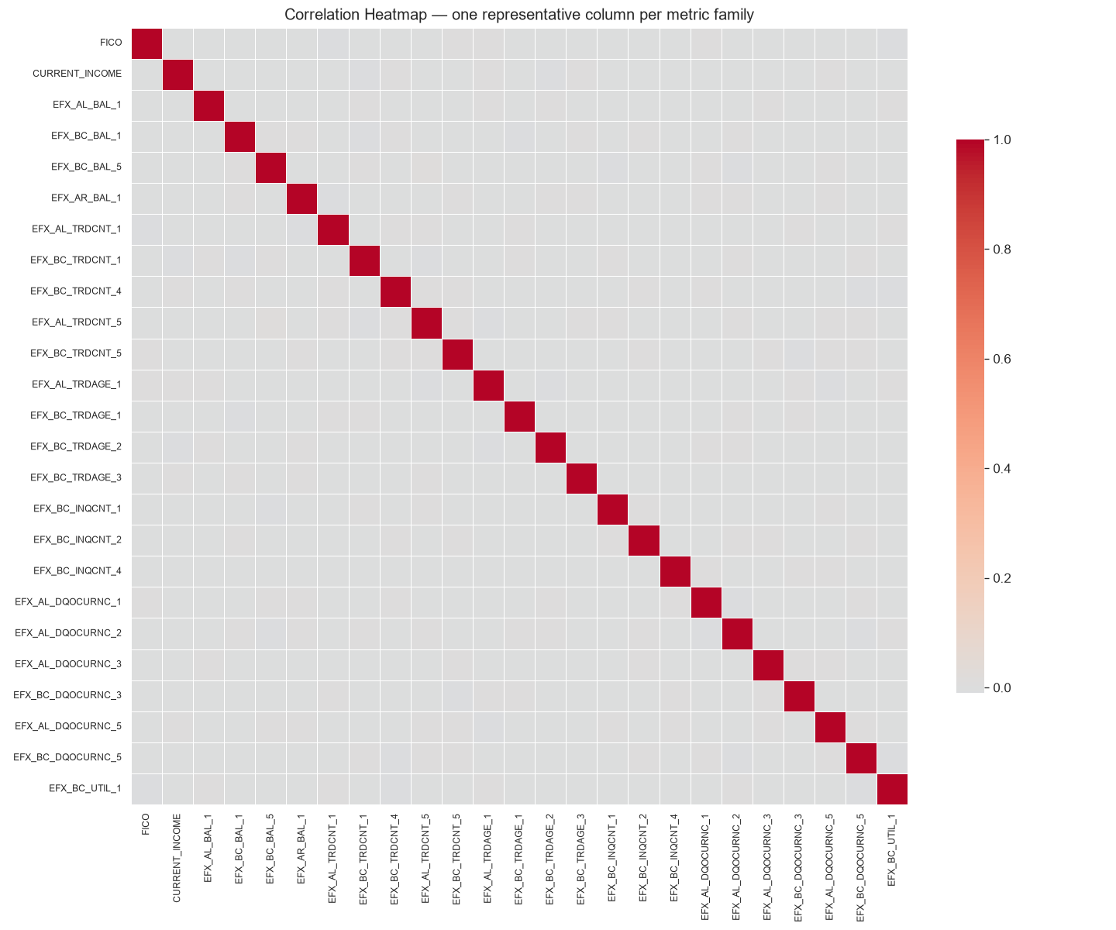
PHASE 4 — RELATIONSHIP & TARGET ANALYSIS (CONTINUED)
Each metric family adds unique, non-redundant signal
• After removing the known bureau triplet repetition, the remaining metric families are essentially unrelated to each other.
• Strongest cross-family correlation: r = 0.011 (near-zero) — balance, age, utilisation, inquiry count, and delinquency each capture a genuinely different dimension of credit behaviour.
• Candidate engineered features:
– Cross-bureau average per family (fills gaps when one bureau is missing)
– Has-credit-file flag (thin-file vs. established credit)
– Utilisation-to-income ratio (affordability proxy)
– Inquiry trend across time windows (credit-shopping acceleration)
One representative per family (bureau siblings excluded). Near-zero correlations confirm independent signal per family.

Slide 9
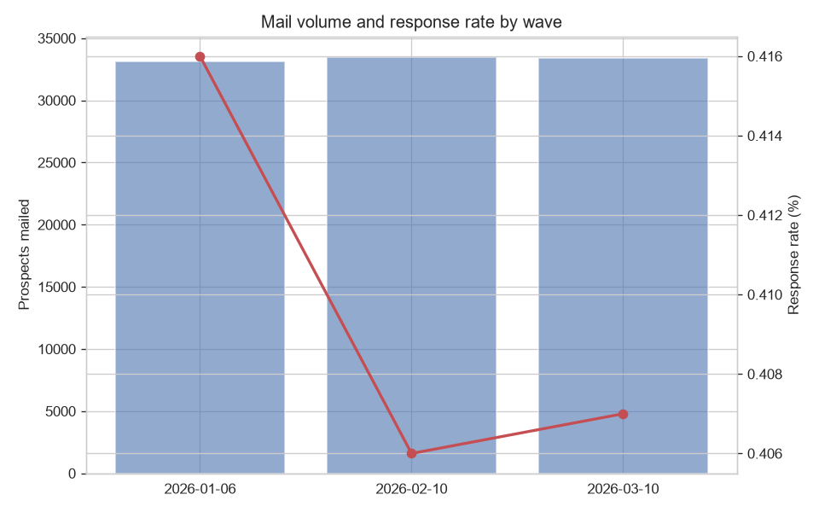
PHASE 5 — TIME-BASED ANALYSIS
Response rates are stable across all three mailing waves
Bars = volume mailed (left axis). Red line = response rate % (right axis). All three waves near-identical.
• Jan 6: 33,143 mailed → 138 responded (0.416%) Feb 10: 33,481 mailed → 136 responded (0.406%) Mar 10: 33,376 mailed → 136 responded (0.407%)
• Tight range of 0.406%–0.416% across 3 months — consistent list quality and offer. Time-series deep-dive not applicable (only 3 data points).

Slide 10
SYNTHESIS — PRE-MODELING CHECKLIST
Seven things to resolve before building a response model
• Remove 7 leakage columns (BCP_APPLICATION_ID, BCP_ACCOUNT_ID, BCP_APPLICATION_RECEIVED_DATE, SOLICITATION_ID, PV, SRC_ID, ACCT_ID) — these only exist after a prospect has already responded and would give the model the answer.
• Decide how to handle "no trade on file" codes — keep as blank, add a has-trade flag, or impute. This analysis blanked them out (correct for stats); production models need a deliberate strategy.
• Collapse the 12 high-agreement bureau triplets (r ≥ 0.95) into one column each — reduces 36 redundant columns to 12.
• Review and test the 11 lower-agreement bureau triplets (r 0.63–0.93) before collapsing — the delinquency fields in particular may contain bureau-specific signal.
• Apply log transform to income and balance fields before any linear model — their extreme right skew distorts distances and coefficients.
• Plan the model for extreme rarity (243:1) — use lift/PR-AUC as the success metric, not accuracy; use stratified cross-validation.
• Engineer cross-bureau averages, a has-credit-file flag, and recency-window trend features to boost signal before model training.

Slide 11
Recommended next steps
→ Clean & simplify first: Apply the sentinel-handling strategy and collapse the 12 safe bureau triplets. This alone reduces the feature space from 71 to ~47 cleaner columns.
→ Build a rare-event propensity model: Train a response model using stratified cross-validation and PR-AUC. Evaluate with a lift chart — target the top decile for future mailings.
→ Explore the delinquency signal: The 11 lower-agreement bureau triplets (especially DQOCURNC fields) may reveal bureau-specific late-payment patterns. Test whether keeping all three adds lift.
→ Check with the campaign team on wave stability: The 0.406%–0.416% wave range is tight but worth a quick conversation — confirm it reflects natural variation, not a list-pull or timing artefact.
Data is structurally clean and ready — complete the pre-modeling checklist, then proceed to modeling.

