Slide 1
Domain : E-Commerce
Project Name : Olist Store Analysis
Presented by : Adarsh JS

Slide 2

AGENDA
1️⃣ KPI Overview
2️⃣ Chart-wise Insights 3️⃣ Observations & Key Findings
4️⃣ Improvement Areas & Action Plan

Slide 3
PURPOSE OF CREATING THIS DASHBOARD
To monitor key business performance indicators in one place.
To identify top-selling categories and high-value customer segments.
To understand delivery efficiency and review performance.
To support data-driven decisions for sales growth and operations improvement.

Slide 4
KPIS OVERVIEW
KPI
Payment Value – 16.47M
Total Price – 12.94M
Total Deliveries – 1.31M
Total Profit – 3.53M
Insight
High sales volume achieved
Strong order revenue
Delivery operations are active & scaled
Business generating good profit margin
📌 Conclusion: The business is financially strong, but improving efficiency could increase profits further.

Slide 5
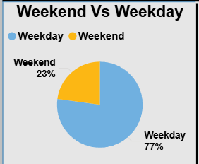
Weekend vs Weekday Orders
Weekdays = 77% of orders
Weekend orders only 23%
This shows customers are more active during weekdays.
📌 Suggestions
Launch weekend-specific discount campaigns to increase weekend traffic.
Promote flash sales on Saturdays/Sundays to balance the weekly distribution.
Use push notifications and targeted ads on weekends to increase engagement.

Slide 6
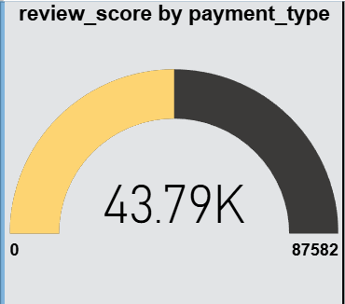
REVIEW SCORE BY PAYMENT TYPE
Most reviews come from Card & Credit Card payments
Indicates customers prefer trusted and easy payment methods
This means credit card users often give higher satisfaction ratings.
Cash-based payment users provide fewer reviews → less feedback insight
📌 Suggestion:
Promote secure and fast credit card checkout.
Provide reward points or EMI options for credit-card users

Slide 7
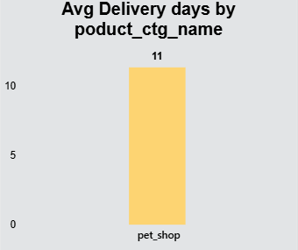
AVERAGE DELIVERY DAYS FOR PET SHOP CATEGORY
pet_shop has the longest delivery time at 11 days, much higher than other categories.
This indicates a logistics delay—possibly due to stock issues or slower supplier dispatch.
Longer delivery impacts customer satisfaction and review scores.
📌 Bottleneck identified → Improve logistics in pet category to boost satisfaction.
Partner with faster logistics providers for this category.
Maintain buffer stock for frequently purchased pet items.

Slide 8
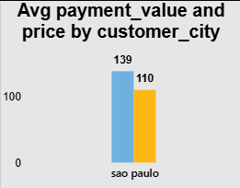
Avg Payment & Price by City
São Paulo customers pay the highest average order value, showing strong spending capability.
Indicates a high-value customer segment that should be prioritized in marketing and retention.
Higher spending may reflect better product availability or stronger brand trust in this region.
Other cities show lower averages, revealing potential markets for targeted promotions.
📌 Suggestions:-Retain high-value customers with loyalty programs.
introduce premium delivery options since high-value buyers prefer convenience.
Recommend personalized product bundles for customers in this region.

Slide 9
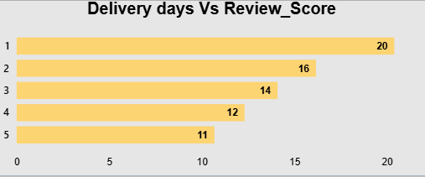
DELIVERY DAYS VS REVIEW SCORE
Fast delivery (1–3 days) receives consistently higher review scores.
Delays above 5 days lead to noticeable drops in customer ratings.
Shows a clear link: delivery speed directly influences customer satisfaction.
📌Suggestions:-
Reduce delivery delays by improving warehouse-to-customer routing.
Enable real-time shipment tracking to reassure customers.
Provide customers with expected delivery dates and delay notifications.
Offer priority shipping for urgent orders.

Slide 10
KEY FINDINGS
These are business gaps highlighted by the dashboard:
Issue Detected from Data
Late delivery in pet_shop
Very low weekend sales
Many cities have small order share
Some categories low profit
Reviews mostly from card/boleto
What It Means
Customers unhappy → rating & repeat purchase drop
Missing sales opportunities
Market expansion needed
Poor pricing or high cost structure
Weak feedback from other users

Slide 11
IMPROVEMENT PLAN
Area of Concern
Slow shipping in pet category
Low weekend orders
Profit gaps in product categories
Limited customer locations
Limited review feedback
Suggested Action
Improve logistics: faster couriers, better inventory placement, or local warehouses
Launch weekend-only discounts, flash sales, and limited-time offers
Re-evaluate pricing, reduce supplier costs, and optimize product mix
Run geo-targeted ads and expand marketing in smaller/emerging cities

Slide 12
SUGGESTIONS
Weekend promotions and push notifications (increase weekend share).
Add in-checkout incentives for non-card payments (small cashback/instant coupon).
Improve tracking & proactive customer notifications (reduce anxiety).
City warehouses/3PL partnerships in São Paulo and Rio to cut delivery days.
Payment UX overhaul for wallets and boleto — aim for parity with card flow.
Introduce priority shipping and premium bundles for high-value customers.
Build predictive inventory / demand forecasting for categories (reduce delays).
Implement a loyalty & tiered subscription (faster shipping for subscribers).
Integrate seller performance KPIs into marketplace onboarding.
Create a data-driven personalization engine (recommendations and dynamic price bundling).

Slide 13
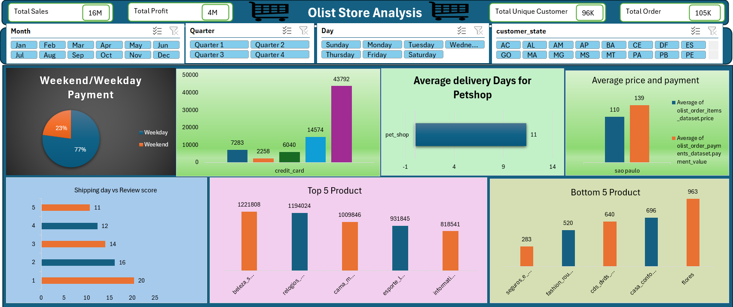
Excel Dashboard

Slide 14
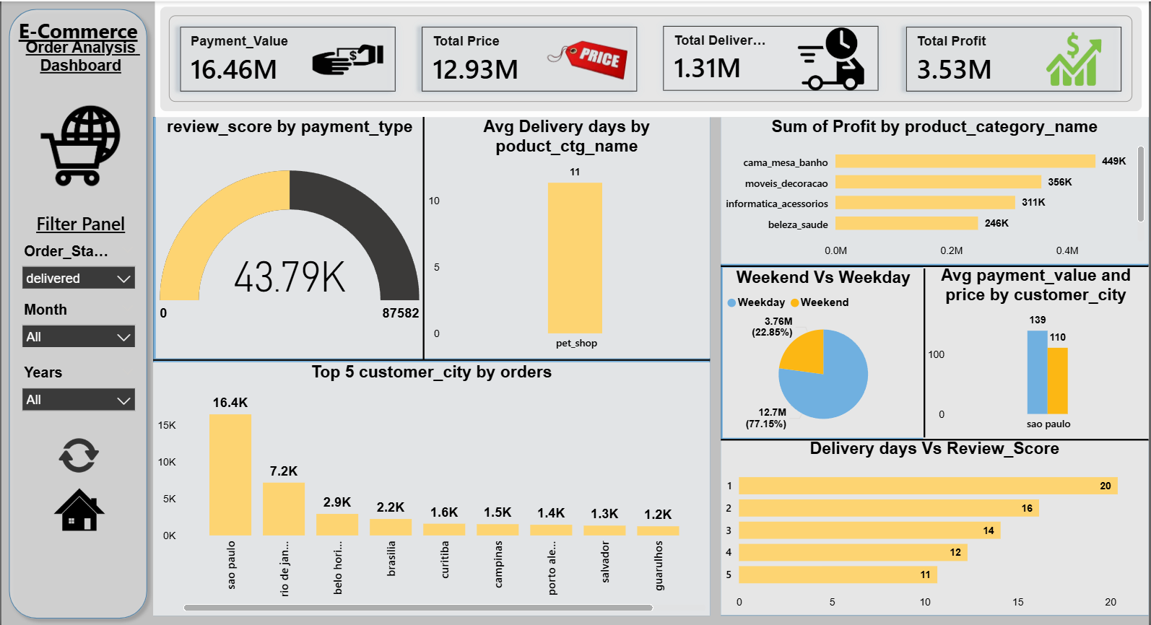
POWER BI DASHBOARD

Slide 15
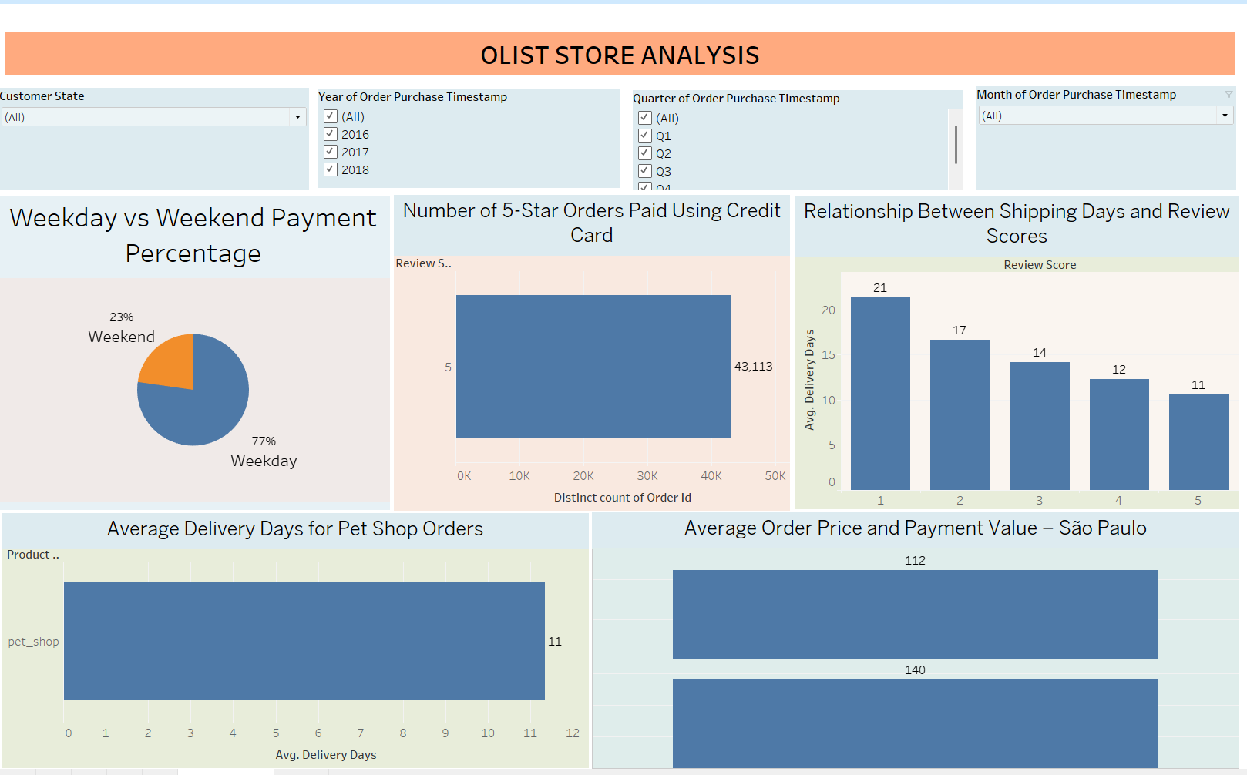
Tableau Dashboard

Slide 16
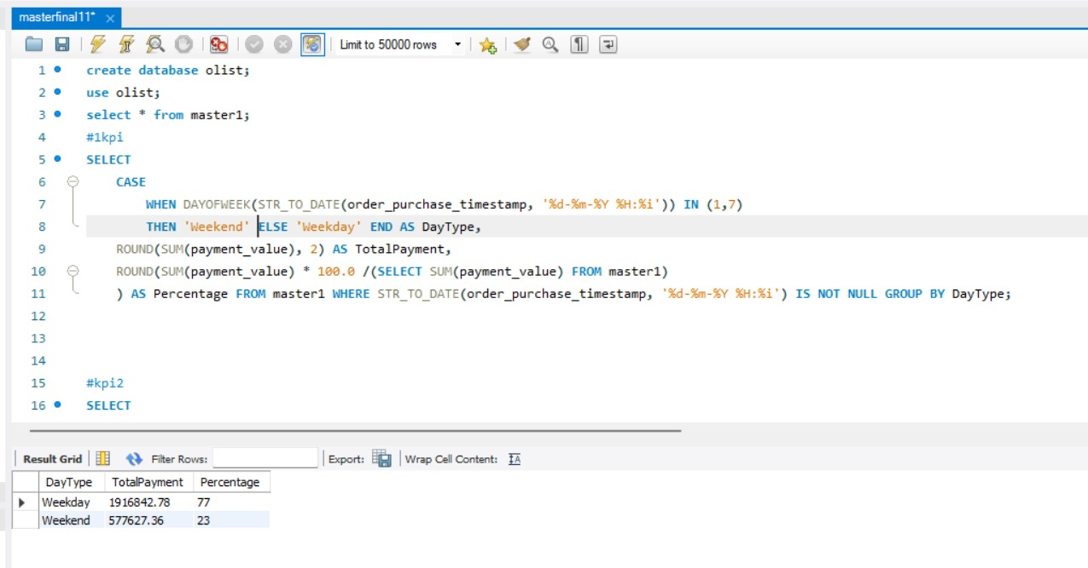
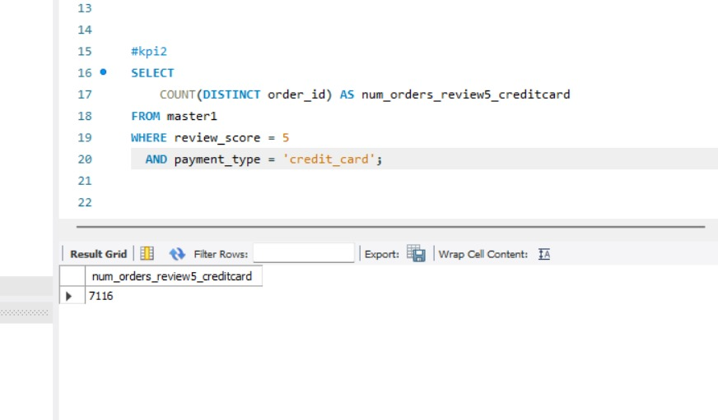
SQL Queries
KPI-1
KPI-2

Slide 17
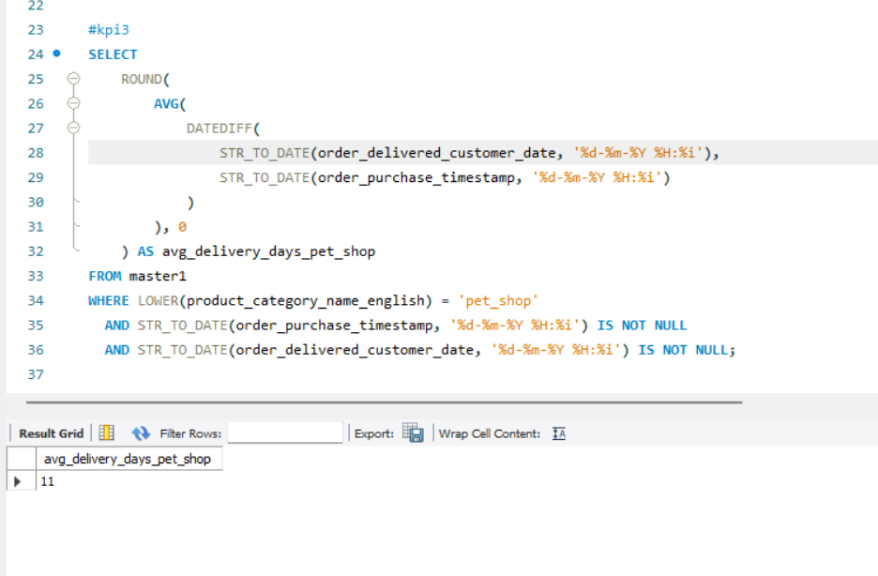
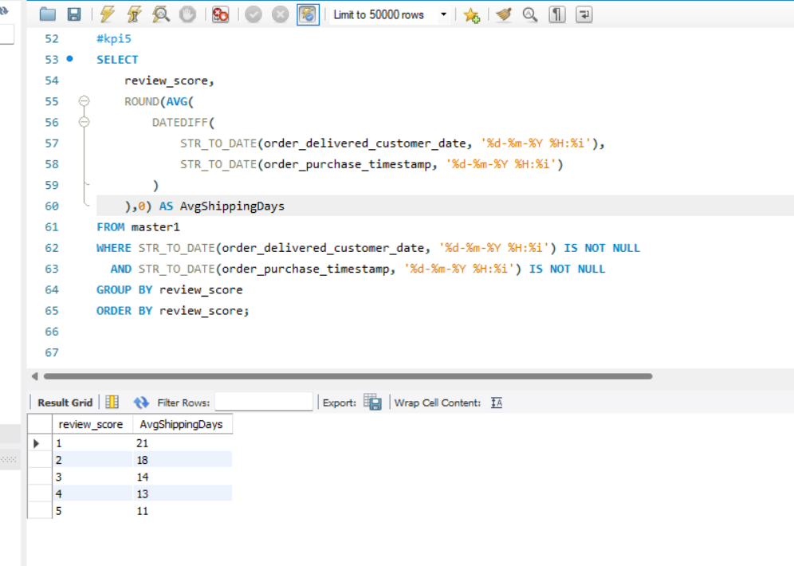
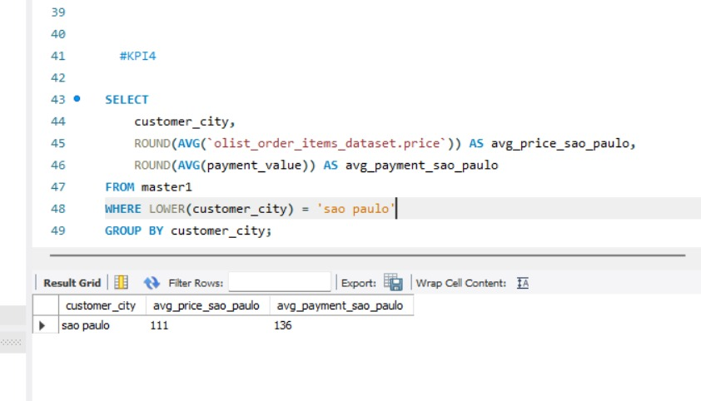
KPI-3
KPI-5
KPI- 4

Slide 18
CONCLUSION
The business shows strong revenue, solid profit margins, and a large active customer base, especially in top cities like São Paulo.
Delivery speed remains a major factor influencing customer satisfaction, ratings, and repeat purchases.
Expanding market reach beyond dominant cities can unlock new growth opportunities.
By improving logistics efficiency and strengthening targeted marketing, the business can achieve higher sales, better customer retention, and overall sustainable growth.
Enhance Payment Experience Across All Methods.
Olist can launch weekend-exclusive discounts, flash sales, and targeted ads. This will help balance order volume across the week and increase total revenue.

Slide 19
Thank You

