Slide 1

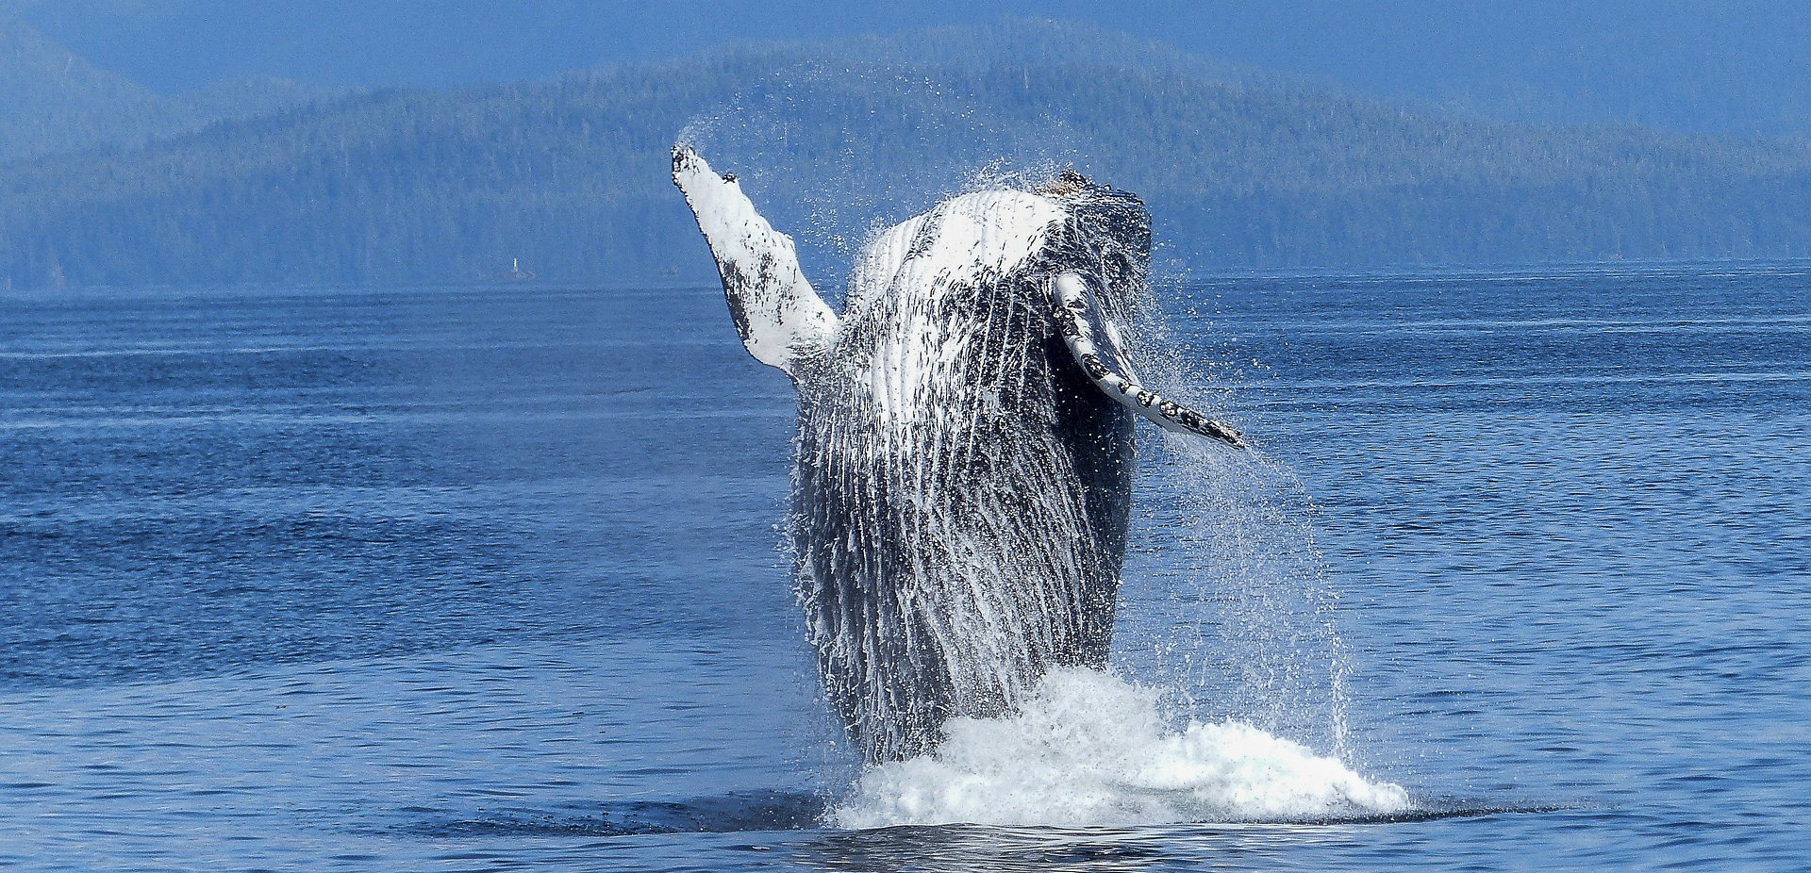
Whale Detection
No attribution required
Identifying endangered right whales in aerial photographs

Slide 2
Right Whale recognition
Our aim is to automate the identification process using the dataset of aerial images provided.
The advantages of the same is twofold: It will reduce the identification time and give the researchers more time to focus on their conversation efforts. This would also allow researchers to identify whale species in real time over water.
Ashutosh

Slide 3
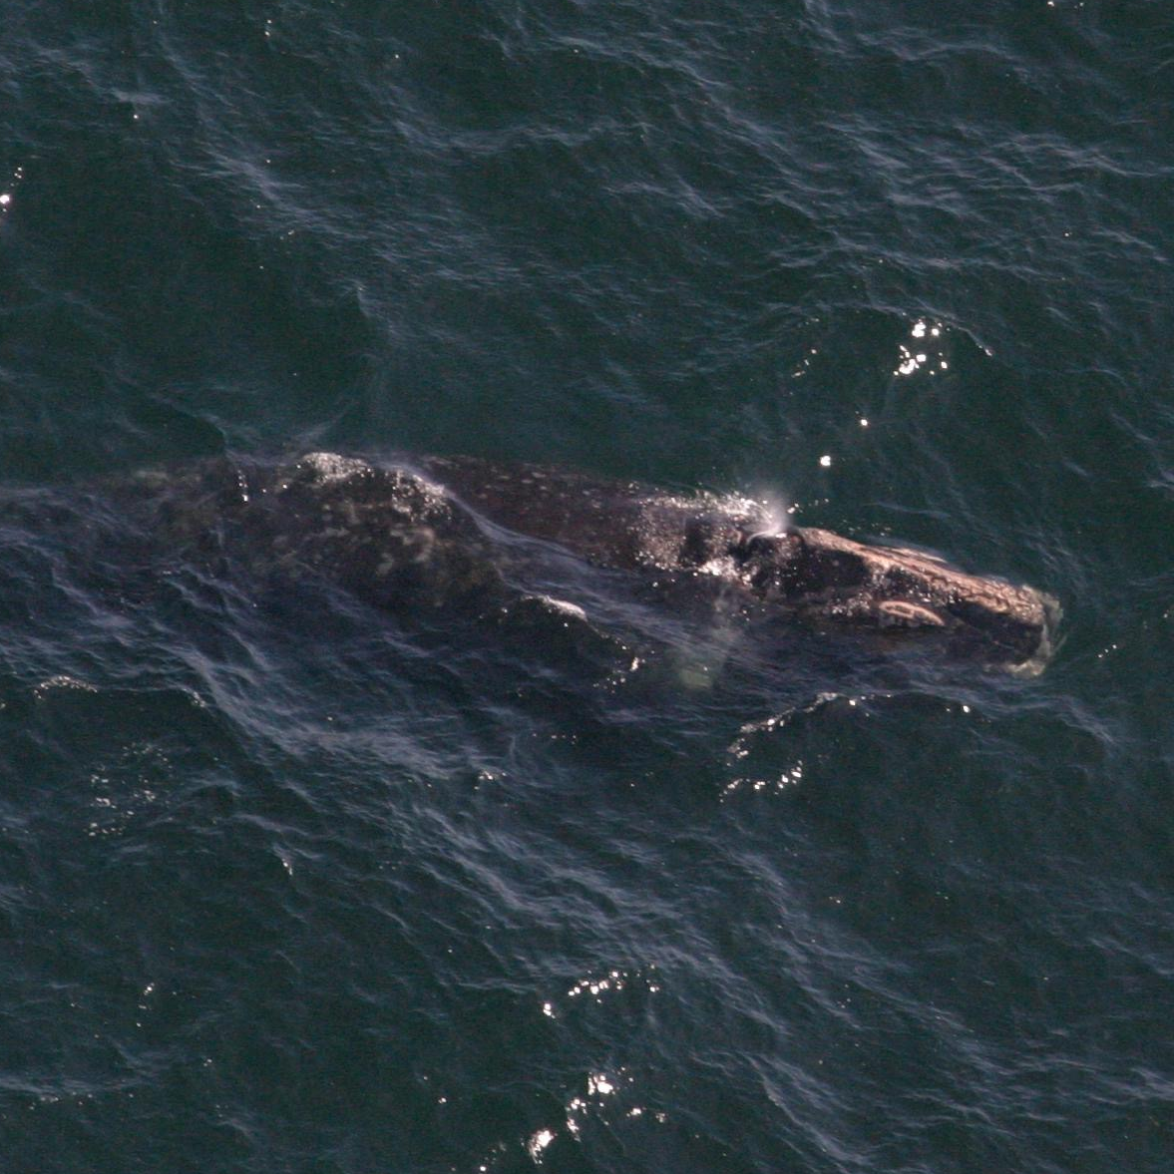
Right Whale recognition
We intend to make a web portal where the user (Researcher) can upload an aerial image and
then our algorithm can identify whether the image contains a right whale or not.

Slide 4
User Case
As a user the product should be able to identify the Whale and provide its Id number and other
As a user the product should provide facilities for me to enter data regarding the particular Whale detected as well as access the past data
As a user I should be able to have a search box to retrieve specific data
As a user the product should map the locations of a particular whale such that data regarding whale locations and time stamps are got at a glance.
Shibhani

Slide 5
USER CASES FOR GENERAL PUBLIC
The user is able to upload images of whales.
The user can access general information on endangered species of whales and the experts in the field.
The user has access to a social media interface wherein the user is encouraged to upload more and more images of whales which in turn helps the scientists and us.
The user has access to a forum wherein he/she can discuss about different topics on whales and also have their queries answered by scientists and experts.
Varshith

Slide 6
Restrictions for a Public user
A public user will not have access to information on individual whales or the database containing information about their status.

Slide 7
User Cases (For scientists)
As a user
Tutorials & aware of App’s features.
Login ID, Password & Authority No.
Uploading pictures & detecting whale’s appearance.
Mubing

Slide 8
Technologies used
Image Processing OpenCV
Cloud Service Amazon AWS
Webpages Bootstrap
Backend Java + Apache(Tomcat 7.0) + MySQL
Sprint Trello
Chen

Slide 9
Q&A Session

