Slide 1
Detecting Linguistic & Rhetorical Change on Reddit
Vector Space Embeddings, Content Analysis 2020
Adarsh Mathew

Slide 2
Overview & Data Sources
Right-wing subreddits and the 2016 election
An alt-right takeover of the r/The_Donald subreddit: Move from traditional Conservative rhetoric to alt-right rhetoric?
Immigration
Media ‘bias’
Traditional
Social Media
3 years of data from select subreddits:
r/The_Donald, r/Incels, r/altright
Start: May 2015
Announced candidacy in Republican primary
End: Nov 2018

Slide 3
Overview & Data Sources
Right-wing subreddits and the 2016 election
An alt-right takeover of the r/The_Donald subreddit: Move from traditional Conservative rhetoric to alt-right rhetoric?
Immigration
Media ‘bias’
Traditional
Social Media
3 years of data from select subreddits:
r/The_Donald, r/Incels, r/altright
Start: May 2015
Announced candidacy in Republican primary
End: Nov 2018

Slide 4
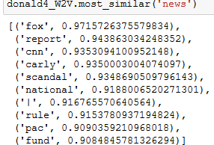
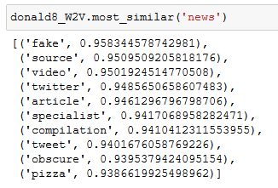
News – Fake or Fox?
T4, Super Tuesday (GOP Nomination):
Popular media outlets closely associated with ‘news’
T8, General Election month:
‘Fake news’
Twitter makes an appearance, Fox and CNN don’t show up
‘Pizzagate’ reference

Slide 5
News – Fake or Fox?
T4, Super Tuesday (GOP Nomination):
Popular media outlets closely associated with ‘news’
T8, General Election month:
‘Fake news’
Twitter makes an appearance, Fox and CNN don’t show up
‘Pizzagate’ reference

Slide 6
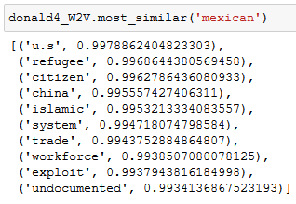
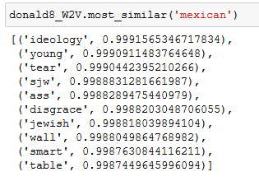
Mexican – Immigration vs Identity Politics
T4, Super Tuesday (GOP Nomination):
Discourse seems economic
T8, General Election month:
Discourse seems more closely related to identity & ideology
Ideology, SJW, Jewish (?)

Slide 7
Mexican – Immigration vs Identity Politics
T4, Super Tuesday (GOP Nomination):
Discourse seems economic
T8, General Election month:
Discourse seems more closely related to identity & ideology
Ideology, SJW, Jewish (?)

Slide 8
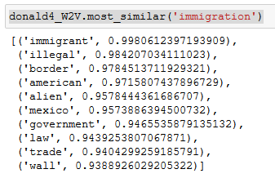
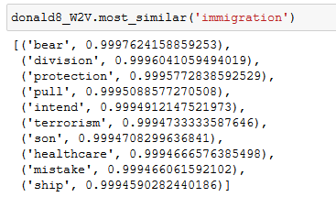
Immigration – Economic vs Security
T4, Super Tuesday (GOP Nomination):
Discourse seems around illegal immigration, trade, and the wall
T8, General Election month:
More ‘fear’-related words: division, protection, terrorism, healthcare, mistake

Slide 9
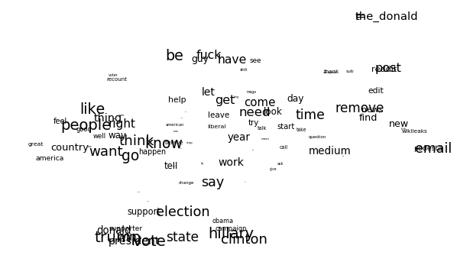
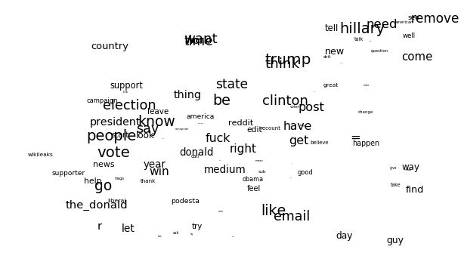
tSNE Word Distributions
T4: Super Tuesday, 2016
T8: Election Month, 2016

Slide 10
Ex4b: Linguistic Change/Difference
Adapted from Hamilton, Jurafsky, Lescovec paper
Three key functions:
`intersection_align_gensim`:
Intersects two word2vec models.
Keeps shared vocab only. Does it lose out on new words that enter the corpus?
`Procrustes_align_gensim`: Aligns Model 2 to Model 1 after intersection
`getDivergence`:
Pairwise Cosine Dissimilarity of a word for a category (time, true class, topic, etc.)

Slide 11
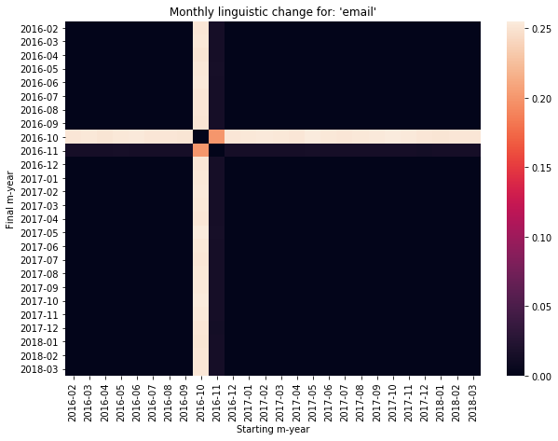
Clinton’s Emails mattered*
Vastly different meaning in October 2016 and reversion to old meaning right after
Wedge issue only in that one month
Oversized reportage

Slide 12
Clinton’s Emails mattered*
Vastly different meaning in October 2016 and reversion to old meaning right after
Wedge issue only in that one month
Oversized reportage

Slide 13
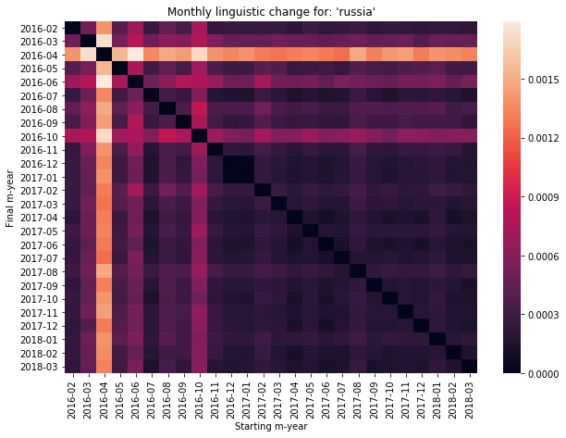
Changing Nature of ‘Russia’
April 2016: First news of DNC hack
October 2016: Election month – email hack takes centre-stage
After October 2016: Minimal change => some consensus about Russia’s role? (even if the interpretation may vary)

Slide 14
Changing Nature of ‘Russia’
April 2016: First news of DNC hack
October 2016: Election month – email hack takes centre-stage
After October 2016: Minimal change => some consensus about Russia’s role? (even if the interpretation may vary)

Slide 15
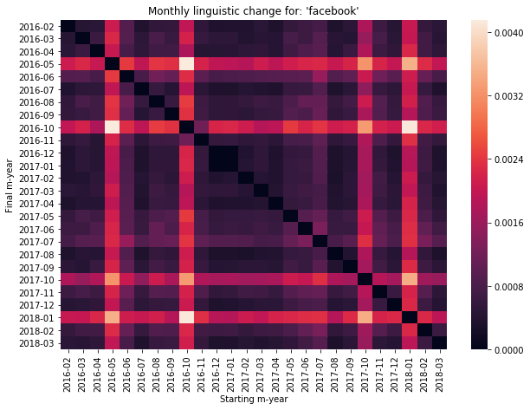
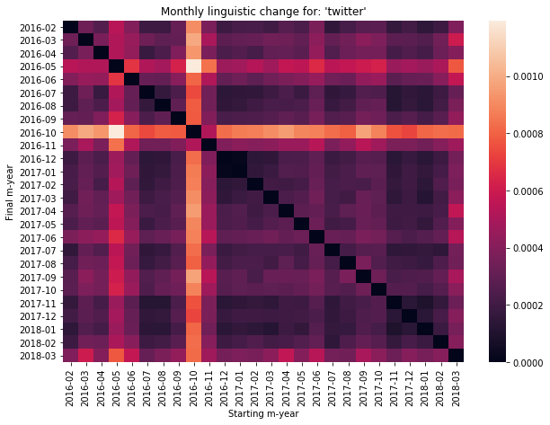
Role of Facebook
Greater change in the linguistic context surrounding Facebook over Twitter
Higher scale
Starker changes
Trump’s Twitter usage as unsurprising
Early 2018: Cambridge Analytica scandal

Slide 16
Role of Facebook
Greater change in the linguistic context surrounding Facebook over Twitter
Higher scale
Starker changes
Trump’s Twitter usage as unsurprising
Early 2018: Cambridge Analytica scandal

Slide 17
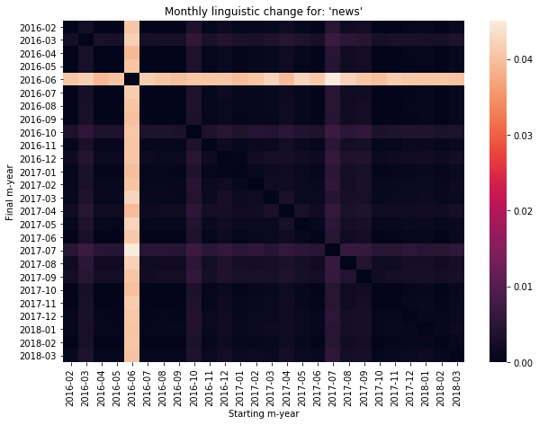
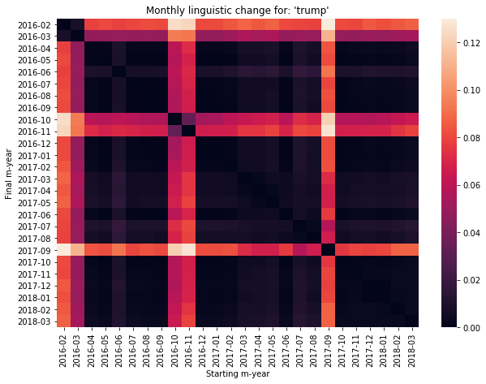
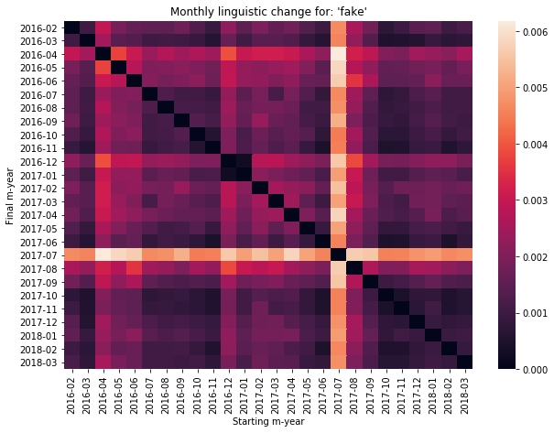
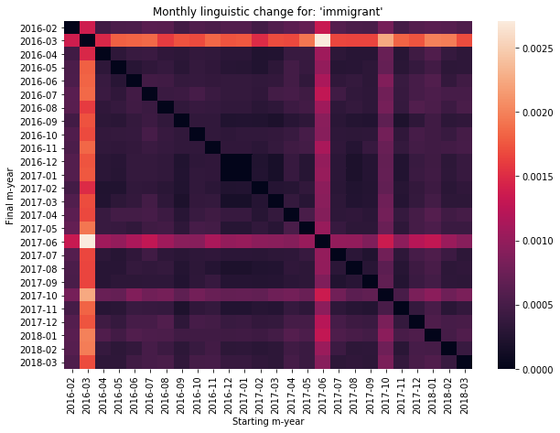
Selective Stability?

Slide 18
Selective Stability?

Slide 19
Next Steps
Good initial results, but how to make the narrative of linguistic/rhetorical change more robust?
Larger time scales for each embedding? (3 month-period)
Event-driven analysis? (Super Tuesday, October 2016, Charlottesville, Muslim ban)
How to account for change in vocabulary over time?
Complete subreddit discussions (submission + comments) as documents for Doc2Vec?

Slide 20
Next Steps
Good initial results, but how to make the narrative of linguistic/rhetorical change more robust?
Larger time scales for each embedding? (3 month-period)
Event-driven analysis? (Super Tuesday, October 2016, Charlottesville, Muslim ban)
How to account for change in vocabulary over time?
Complete subreddit discussions (submission + comments) as documents for Doc2Vec?

