Slide 1
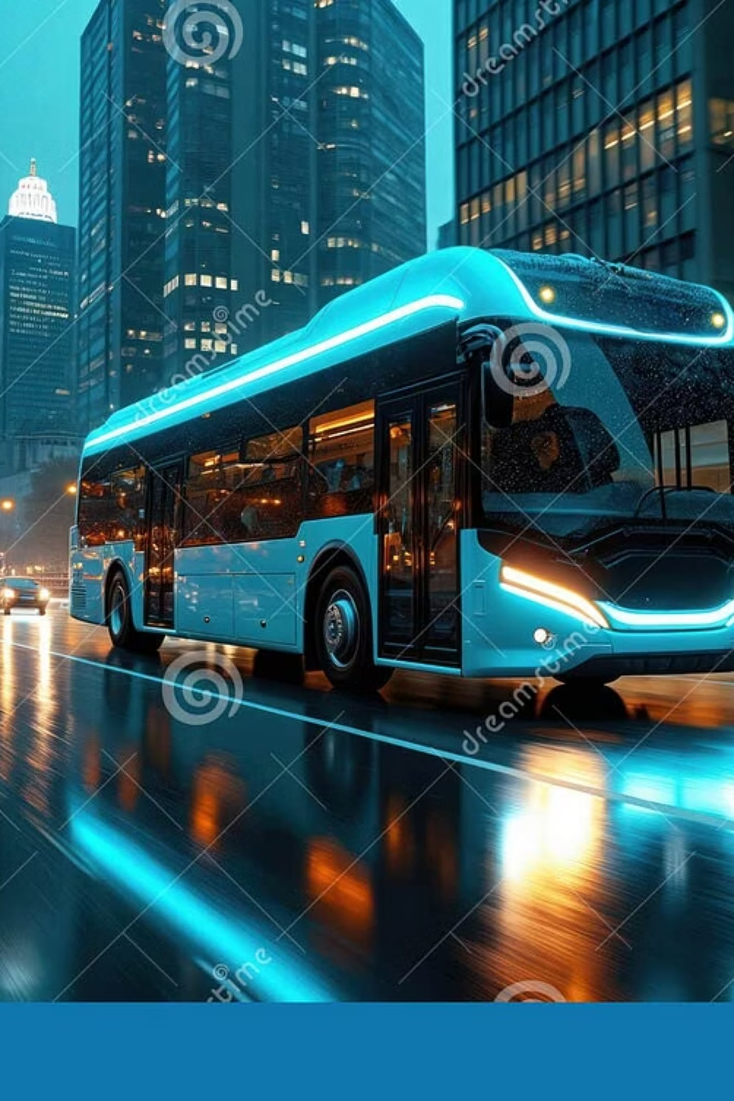
NEXORA

Slide 2
NEXORA
Next-generation Explainable Route Optimization & Retrieval Assistant
AI-Powered Smart Public Transport Assistant Using Machine Learning, RAG & LLM
Presented By
Dhanushya B
Adarsh Menon
Department of Artificial Intelligence & Machine Learning (AIML) Sri Shakthi Institute of Engineering and Technology

Slide 3

Introduction
Many passengers face difficulties while using public transport due to delayed buses, route confusion, and lack of real-time information.
NEXORA is an AI-powered transport assistant that helps users with live bus tracking, route guidance, bus arrival prediction, and instant travel assistance using Artificial Intelligence.

Slide 4
Problem Statement & Objectives
Problem Statement
Objectives
No real-time bus tracking
Long waiting time
Inaccurate bus arrival prediction
Route confusion
Limited passenger guidance
Provide live bus tracking
Predict bus arrival time
Suggest the best travel route
Answer passenger queries using AI
Provide women's safety through optional live location sharing and SOS alerts to nearby police stations
Improve public transport experience

Slide 5
Existing System vs Proposed System
Feature
MTC Chennai
TNSTC
CUMTA
NEXORA
Bus Route Information
✅
✅
✅
✅
Bus Timetable
✅
✅
Limited
✅
Live Bus Tracking
❌
❌
❌
✅
AI Chat Assistant
❌
❌
❌
✅
ML-Based Bus Arrival Prediction
❌
❌
❌
✅
Conversational Route Guidance
❌
❌
❌
✅
Personalized Route Recommendation
❌
❌
❌
✅
Women's Safety (SOS + Optional Live Location Sharing)
❌
❌
❌
✅
Real-Time Passenger Assistance
❌
❌
❌
✅

Slide 6
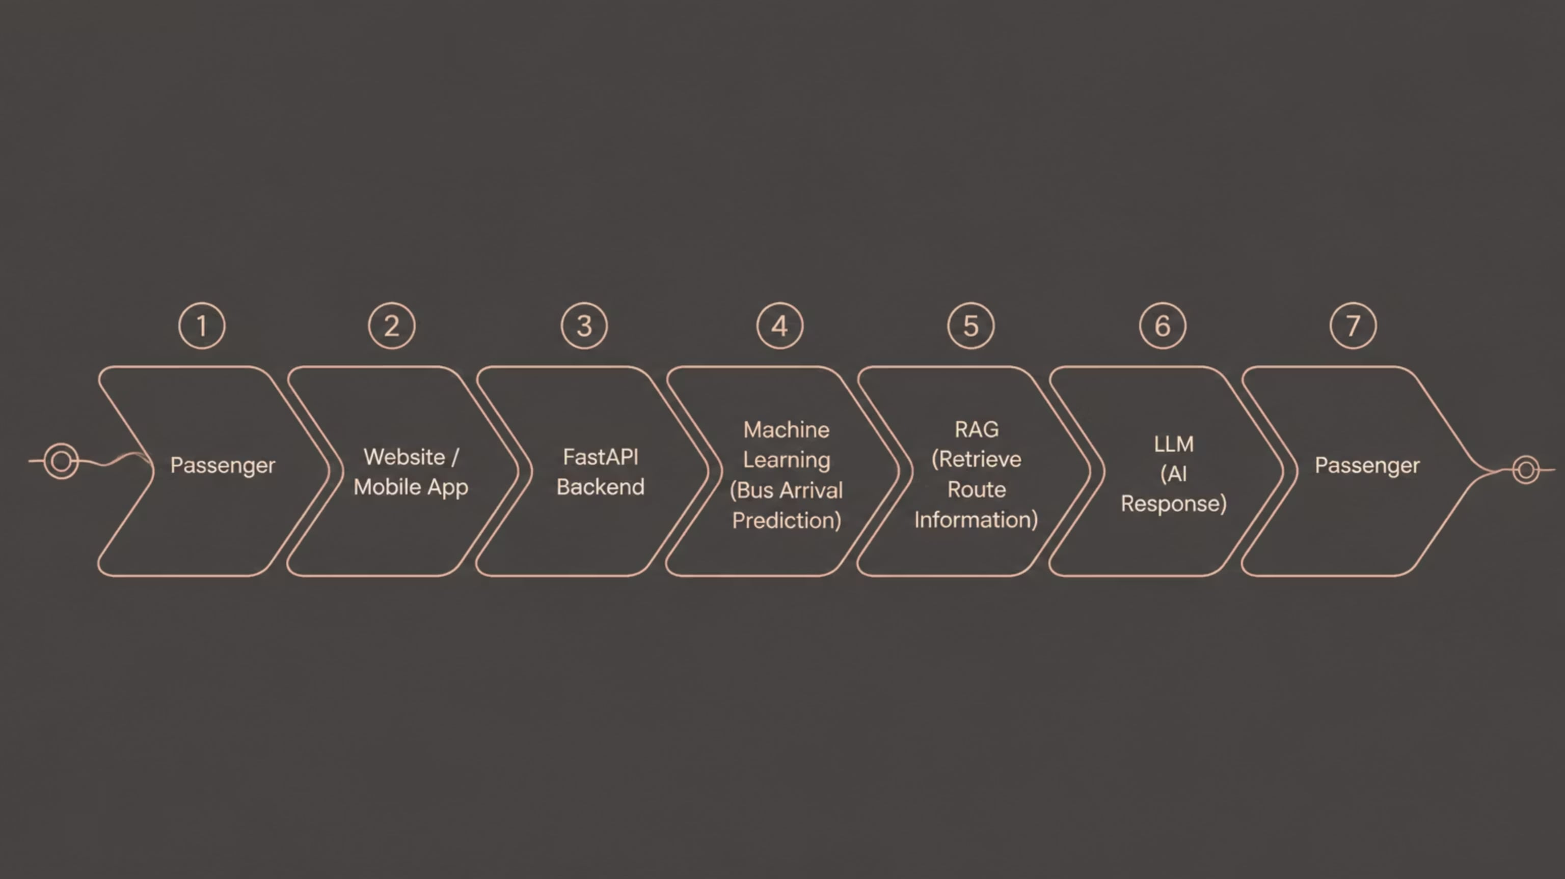
System Architecture
Module Usage
Machine Learning
RAG
LLM
Predicts bus arrival time.
Retrieves route and bus information.
Answers passenger questions in simple language.

Slide 7
Tools Used
Component
Technology
Frontend
React.js
Backend
FastAPI
Machine Learning
Scikit-learn
LLM
Llama 3
RAG
LangChain + ChromaDB
Database
PostgreSQL
Maps
Leaflet
Charts
Chart.js

Slide 8
Advantages & Future Scope
Advantages
Future Scope
Live bus tracking
Accurate bus arrival prediction
Smart route guidance
AI-powered chat assistant
Reduced waiting time
Better passenger experience
Women's safety emergency alert with optional live location sharing
Voice assistant
Multi-language support
Crowd prediction
Traffic optimization

Slide 9
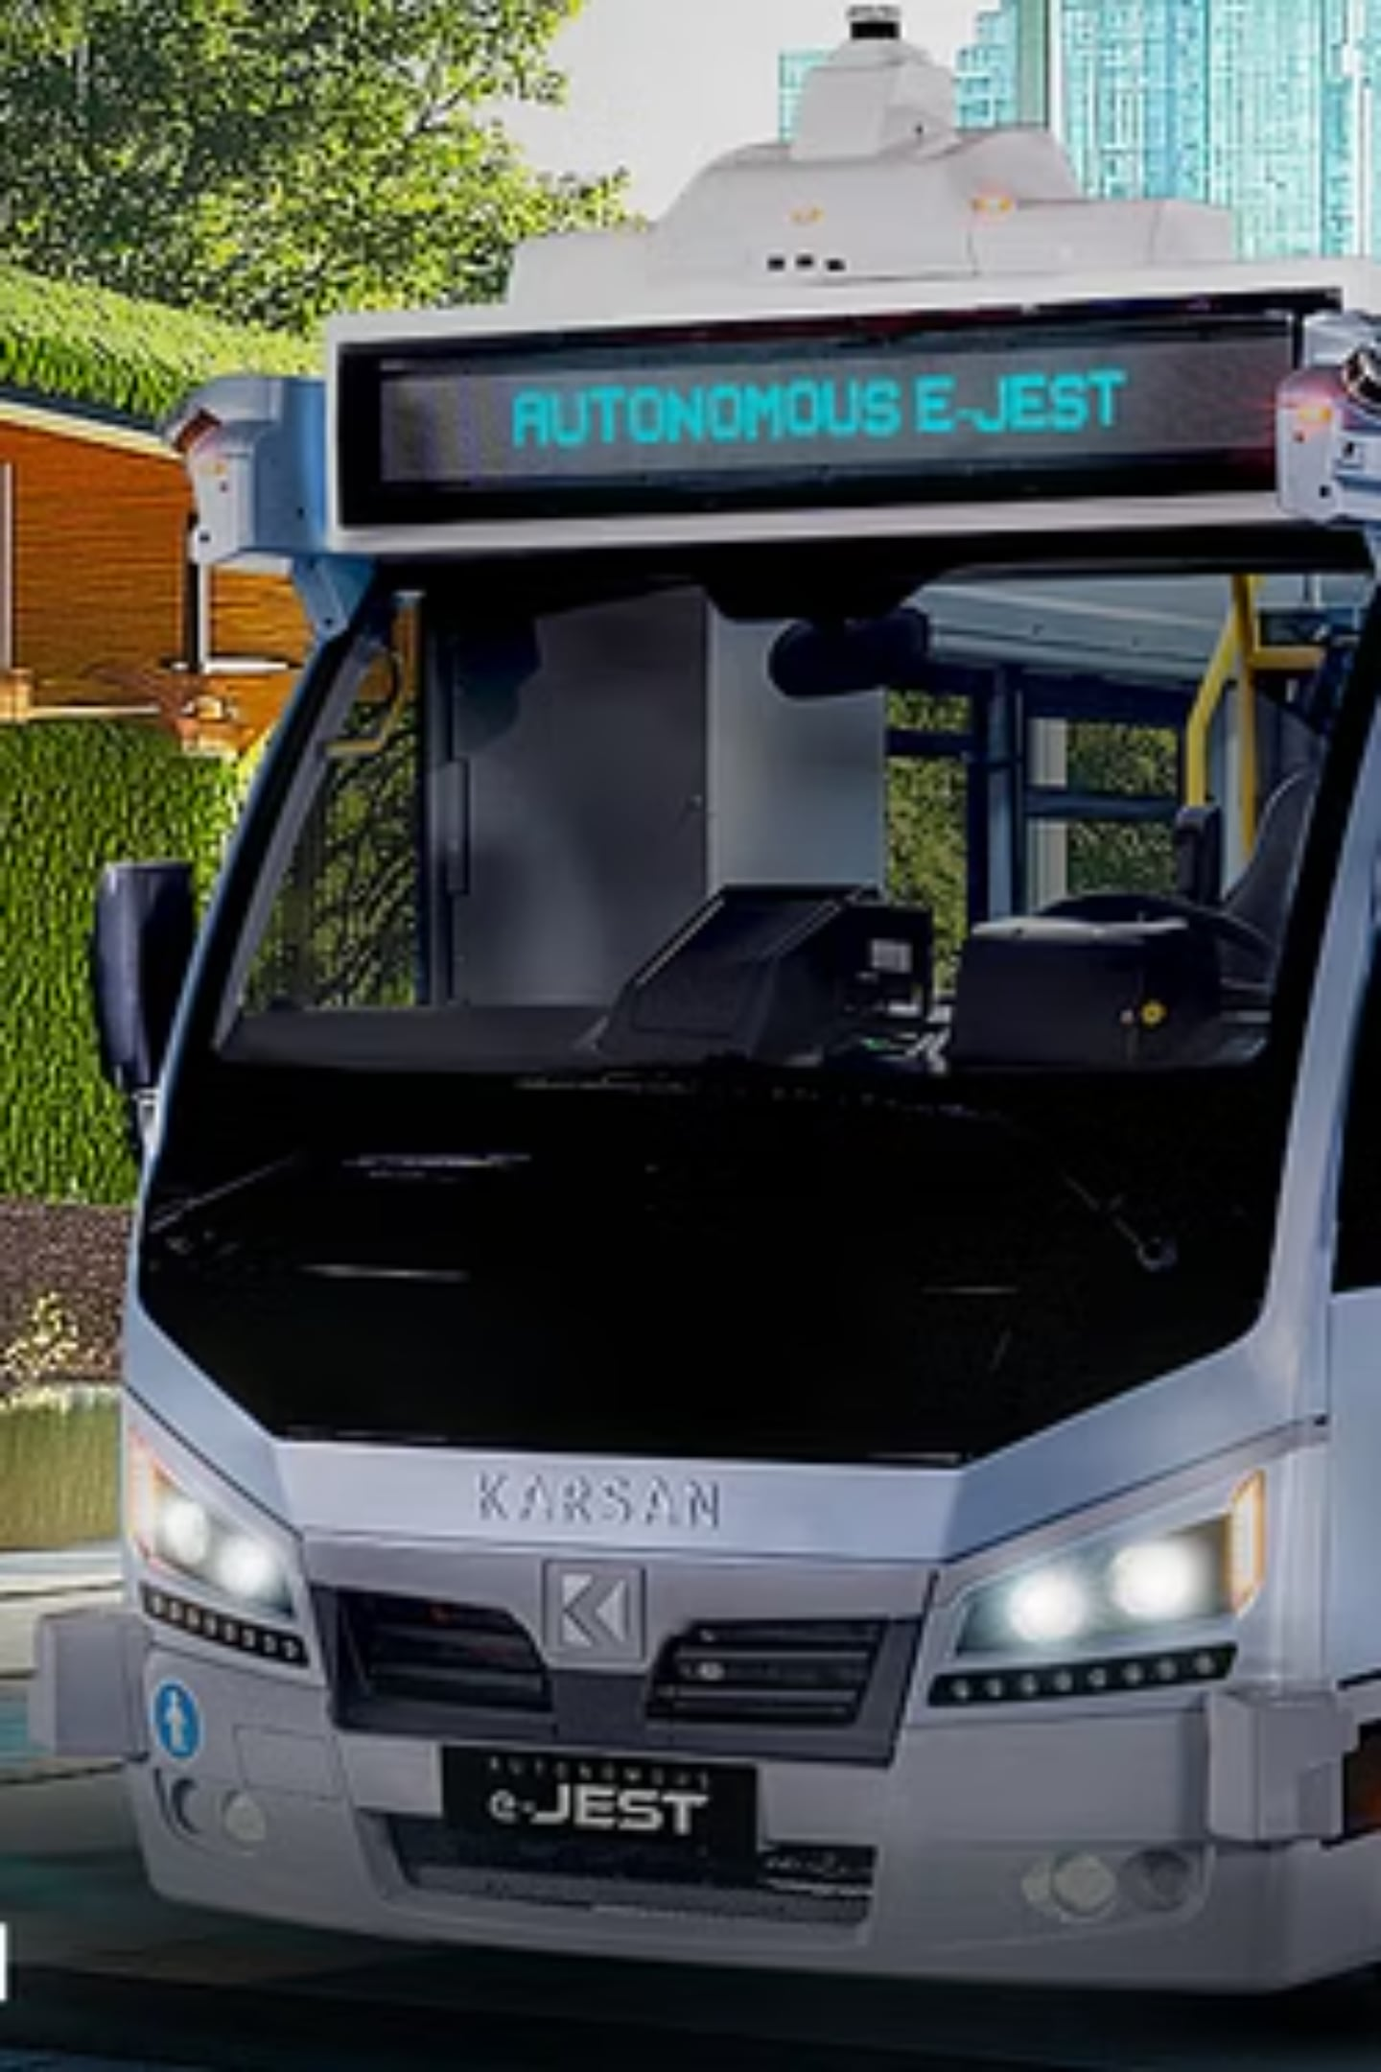
Conclusion
NEXORA combines Machine Learning, RAG, and LLM to provide a smarter public transport experience.
It helps passengers with bus tracking, route guidance, bus arrival prediction, and AI-powered travel assistance, making public transportation more efficient and convenient.

Slide 10


THANK YOU
Presented By
Dhanushya B
Adarsh Menon

