Slide 1
CI/CD Pipeline
Gerrit Code Review & Jenkins Automation
John Soft Technologies LLP Confidential

Slide 2






Agenda
01
02
03
What is Gerrit?
Gerrit Access Control
Gerrit Workflow
Code review tool & local server setup
Roles: +2 approvals, Verified, user permissions
Clone, push, code review & merge process
04
05
06
What is Jenkins?
Gerrit + Jenkins Integration
Build Notifications
CI/CD automation server & architecture
Auto-trigger builds on code review events
Automated email on build success/failure

Slide 3
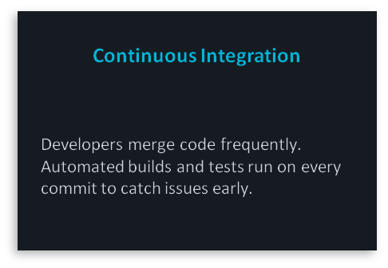
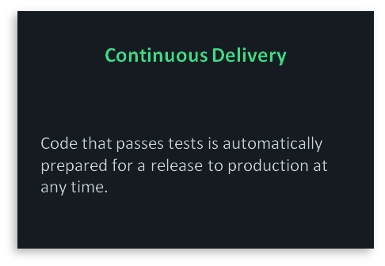
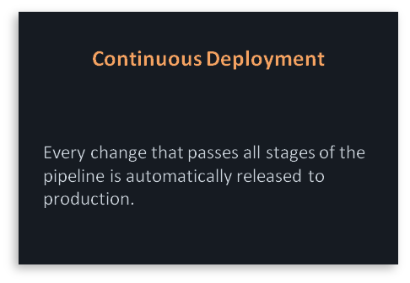






What is CI/CD ?
Prerequisites & Requirements
John Soft Technologies LLP Confidential

Slide 4

▶ Web-based code review tool built on top of Git ▶ Acts as a gatekeeper between developers and the main repository ▶ Every change goes through review before merging ▶ Ensures code quality and team collaboration
SECTION 01
What is
Gerrit?

Slide 5
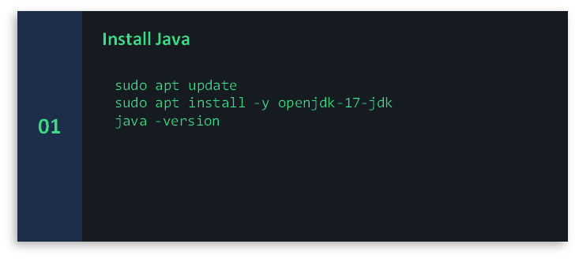
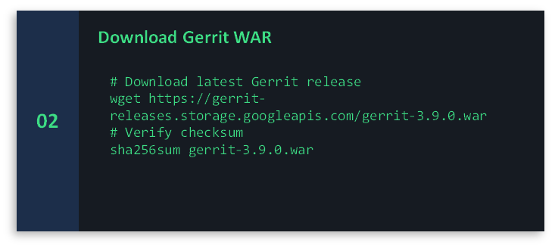
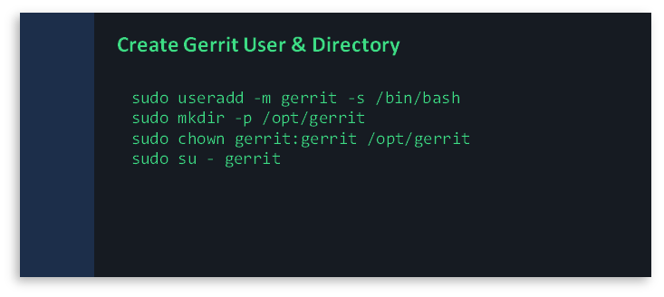
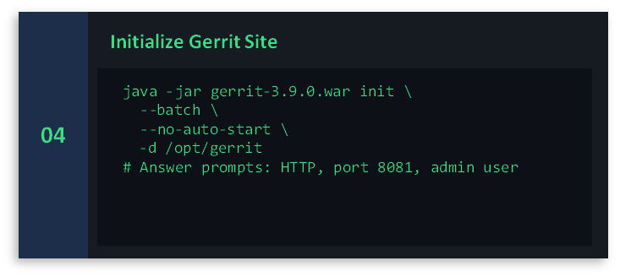
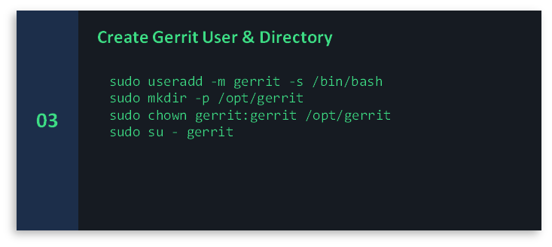
Gerrit Standalone
01
Install Java
#sudo apt update
#sudo apt install -y openjdk-21-jdk
#java -version
John Soft Technologies LLP Confidential

Slide 6
Gerrit as a Local Server
How Gerrit Works as Local Server
Architecture Overview
🔧
Installation
Developer Workstation
Reviewer / Approver
(Web UI)
Run on Linux server using Java (JDK 11+). Download gerrit.war and init with `java -jar gerrit.war init -d /srv/gerrit`
git push
🌐
Web UI
Gerrit Server
(SSH :29418 HTTP :8443)
Git Repository
(Bare Clone)
Accessible at http://your-server:8443 — manage repos, users, and reviews via browser
stores
🔑
SSH Access
Developers push code via SSH on port 29418 — configured during setup
# Init Gerrit server java -jar gerrit.war init -d /srv/gerrit # Start the server /srv/gerrit/bin/gerrit.sh start
📦
Git Repos
All Git repositories are stored on the server under /srv/gerrit/git/

Slide 7
Gerrit Access Control & Permissions
+2
Project Owner / Tech Lead
Approves code for merge. Only senior members can grant +2. This is the final approval gate.
+1
Reviewer / Developer
Code looks good but needs another reviewer. Developer peers can give +1 — not sufficient to merge.
0
No Score
Reviewed but no opinion or in progress. Used when still looking at the change.
-1
Reviewer
Code has issues. Would prefer it not to be merged but won't block if others approve.
-2
Project Owner / Admin
Hard block. Change cannot be merged until the -2 is removed. Used for serious issues.
⚡ Verified (+1 / -1): Set automatically by Jenkins CI — confirms the build passed or failed before reviewers see it

Slide 8
Gerrit Workflow:
Clone → Push → Review→ Merge

Slide 9
1
Clone Repository
2
Make Changes & Push
git clone ssh://user@gerrit-server:29418/project.git
cd project
git review -s # installs commit-msg hook
git checkout -b feature/my-feature
# ... make code changes ...
git add . && git commit -m "feat: my change"
git push origin HEAD:refs/for/main
Developer clones the project via SSH. The commit-msg hook adds a Change-Id to every commit automatically.
Push to refs/for/<branch> — this creates a new Change in Gerrit for review, NOT a direct merge.
3
Code Review & Approval
4
Submit & Merge
# Reviewers open Gerrit Web UI
# Give Code-Review: +2 (approve)
# Jenkins gives Verified: +1 (build pass)
# All checks must pass
# In Gerrit Web UI, click SUBMIT
# Gerrit merges into main branch
# Change status → MERGED
Reviewer gives +2 on Code-Review. Jenkins auto-gives Verified +1 after build. Both needed to merge.
Once all votes are satisfied, the Submit button is activated. Project Owner or Author clicks Submit to merge.

Slide 10

▶ Open-source automation server for CI/CD pipelines ▶ Builds, tests, and deploys code automatically on every change ▶ Integrates with hundreds of tools — Git, Gerrit, Docker, ▶ Pipeline as Code using Jenkinsfile (Groovy DSL)
SECTION 04
What is
Jenkins?

Slide 11
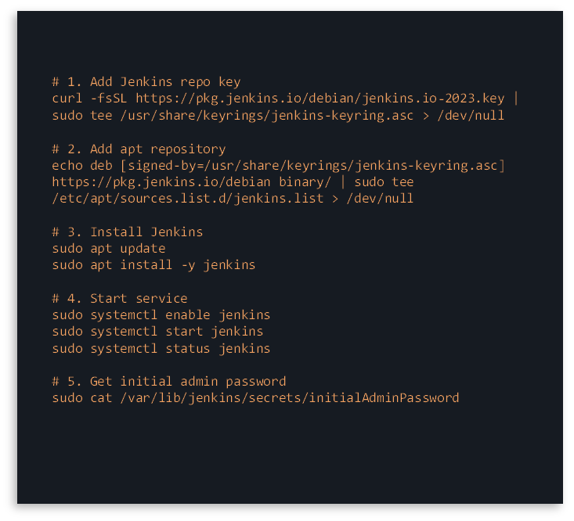
Jenkins
Installation
John Soft Technologies LLP Confidential

Slide 12
How Jenkins Works

Slide 13





▶
▶
▶
▶
Source
Code
Build
Test
Deploy
Notify
Jenkinsfile (Pipeline as Code)
Key Jenkins Features
pipeline { agent any stages { stage('Build') { steps { sh 'mvn clean install' }
}
stage(
'Test') { steps { sh 'mvn test' }
}
}
}
🔌
Plugin Ecosystem:
1800+ plugins for tools, SCM, notification
🏗️
Master-Agent:
Distribute builds across multiple machines
📜
Pipeline as Code:
Jenkinsfile stored in repo alongside code
🔁
Parallel Stages:
Run tests and builds concurrently
🔐
Credentials Mgmt:
Secure storage for passwords, SSH keys, tokens

Slide 14
Connecting Gerrit with Jenkins

Slide 15
🔗 Setup Steps
🔄 Integration Flow
1
Install Gerrit Trigger Plugin
Developer pushes to
refs/for/main
In Jenkins → Manage Plugins → search 'Gerrit Trigger' → install
▼
2
Configure Gerrit Server
Gerrit fires event:
Patchset Created
Jenkins → Manage Jenkins → Gerrit Trigger → Add New Server → enter hostname, SSH port 29418
▼
Add Jenkins SSH Key to Gerrit
Jenkins detects event
via Gerrit Trigger Plugin
3
Generate SSH keypair on Jenkins. Add public key to Gerrit user account (service account)
▼
Jenkins runs build
& tests
4
Create Jenkins Job
New Item → Freestyle or Pipeline Project. Under 'Build Triggers' check 'Gerrit Event'
▼
Jenkins sets Verified
+1 (pass) / -1 (fail)
5
Configure Trigger Events
Select events: Patchset Created, Draft Published. Set project filter and branch filter

Slide 16
Auto-Trigger & Build on Gerrit Events​

Slide 17
Gerrit Events That Trigger Jenkins:
Patchset Created
// Jenkinsfile – Gerrit Trigger Config
Every new commit pushed to Gerrit
triggers { gerrit { events { patchsetCreated() changeMerged() }
project(
'my-repo',
branches(
'main'))
}
}
Draft Published
Draft change is ready for review
Change Merged
After +2 and submit — trigger deploy pipeline
Comment Added
When specific keyword triggers a rebuild (e.g. 'recheck')
Jenkins Reports Back to Gerrit:
Build PASSED
Verified: +1
Build FAILED
Verified: -1
Jenkins marks Verified +1, change is eligible for human review and merge
Jenkins marks Verified -1, blocks merge until the issue is fixed and rebuilt

Slide 18
Automated
Email Notifications After Build​

Slide 19
📧 Email Setup in Jenkins
// Email notification in Jenkinsfile
post { failure { emailext( subject: 'Build Failed: ${JOB_NAME}', body: 'Check: ${BUILD_URL}', to: '${GERRIT_CHANGE_OWNER_EMAIL}' )
}
success {
emailext(subject:
'✅ Build OK', ...)
}
}
Plugin
Install 'Email Extension Plugin' (Email-ext) from Jenkins Plugin Manager
SMTP Config
Manage Jenkins → Configure System → E-mail Notification → Enter SMTP server, port, credentials
From Address
Set sender address e.g. jenkins@yourcompany.com
❌ Build FAILED: project/main #42
FAILURE
From: jenkins@company.com
Recipients
Build #42 for project 'my-repo' failed.
Branch: main | Change: 1234
Error: Test failures in 3 cases
View logs: http://jenkins:8080/job/my-repo/42
Configure: developer who made the change, reviewers, team mailing list
✅ Build SUCCESS: project/main #43
SUCCESS
Triggers
From: jenkins@company.com
Send on: Build Failure, Unstable, Back to Normal, Success (optional)
Build #43 for project 'my-repo' succeeded.
Branch: main | Change: 1235
All tests passed ✓
Verified +1 set on Gerrit change.

Slide 20
End-to-End CI/CD Flow Summary

Slide 21




1
2
3
4
5
6
7
8
›
›
›
›
›
›
›
Developer
Code Change
Push to
Gerrit Review
Jenkins
Auto-Trigger
Build &
Test Run
Verified
Score Set
Human
Code Review
Submit &
Merge
Email
Notification
Key Takeaways
Gerrit enforces mandatory code review — no code merges without a +2 approval, ensuring quality gates
Jenkins auto-triggers on every Gerrit patchset, providing instant build feedback without manual intervention
The Verified label from Jenkins and Code-Review +2 must both pass before any merge is allowed
Automated email notifications keep developers and reviewers informed of build status in real-time
The entire workflow is auditable — every change, vote, build, and merge is tracked and logged

Slide 22

Thank You!
Questions & Discussion
Gerrit Code Review · Jenkins CI/CD · Automated Pipelines

