Slide 1
Scanning Tunneling Microscopy
Adarsh Pyarelal
Department of Physics
Reed College
Portland, Oregon, USA

Slide 2
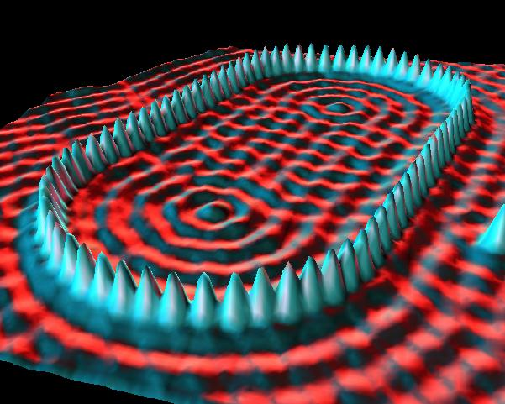
Introduction
STM: technique used to obtain atomic-scale resolution (on the order of angstroms)
Based on quantum tunneling effects
Quantum ‘Corral’: Iron atoms on a Copper Surface. (Created at IBM)

Slide 3
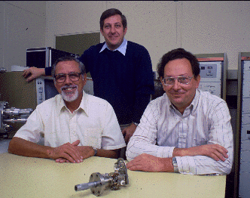
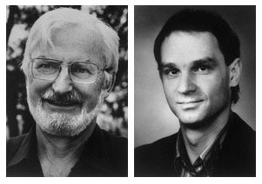
History
Descendant of ‘Topografiner’ from early 70’s. (R. Young, J. Ward, and F. Scire)
~Ten years later - Gerd Binning and Heinrich Rohrer win 1986 Nobel Prize in Physics for creating the first STM in 1981.
Notes:
Topografiner: electron transport occurs through field emission
GB and HR incorporate tunneling effects and precision scanning capabilities

Slide 4
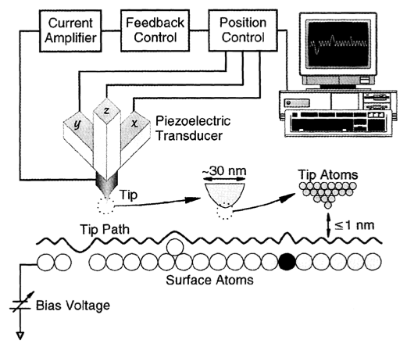

Slide 5
Key Features
Exponential dependence of tunneling current on gap
Piezoelectric mechanism for tip movement
Vibration damping using eddy currents
Fabrication of sharp tunneling tip through electrochemical etching

Slide 6
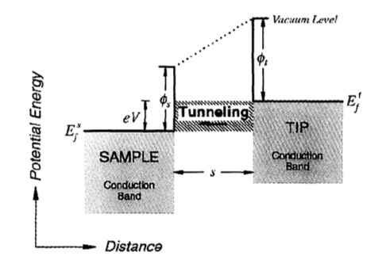


Theory
Probability of tunneling:
For small bias voltage:

Slide 7

Theory
Net tunneling current:

Slide 8
Limitations
Sample has to be conducting
Can only examine the surface
Sensitive to external vibrations and contaminations

Slide 9
Applications
Structure of crystal surfaces (metals, semiconductors)
Atom manipulation and nanolithography
Positioning single atoms
Study of friction (Tribology)

Slide 10
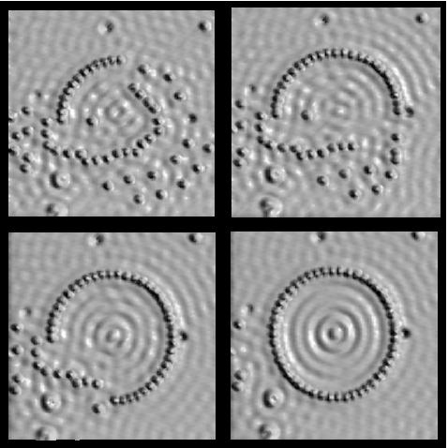

Slide 11
Conclusion
Highly versatile
Highly useful
Highest magnification available

Slide 12
Acknowledgements
Encyclopedia of Physical Science and Technology (Third Edition): Scanning Probe Microscopy by C. Daniel Frisbie
Tunneling Microscopy and Spectroscopy by L.J. Whitman, Encyclopedia of Applied Physics (Wiley Interscience)

