Slide 1

Visualization and Analysis – Tutorial Presentation for Feedback Date: 18/11/2024
Group Id: A230 Name of Student Presenting: Adarsh Prakash

Slide 2
Proportion of fatal shark attack among different different countries
Part 1: VISUALISATION

Slide 3
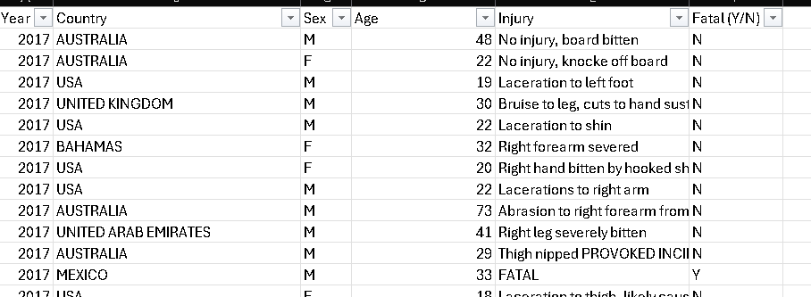
We are using the dataset DS201 - shark attacks to answer our Research Question “Is there a difference in proportion of fatal shark attack between different countries?” ¹

Slide 4
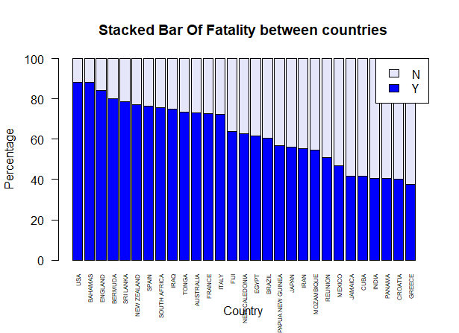

Slide 5
Part 2: Analysis (building on your Visualizations)

Slide 6
Here is a table (matrix/cross tabulation) showing our dependent variable as rows, and our independent variable as columns. We have at least two values for both variables that are independent of each other (no overlap).
Our RQ is about Differences in proportions
Status (%) | USA | BAHAMAS | AUSTRALIA | ENGLAND | BERMUDA | BRAZIL | CROATIA | MEXICO | CUBA | INDIA | EGYPT | FIJI
N (%) | 88.26 | 88.12 | 72.99 | 84.21 | 80 | 60.4 | 40 | 46.99 | 41.46 | 40.63 | 61.76 | 63.93
Y (%) | 11.74 | 11.88 | 27.01 | 15.79 | 20 | 39.6 | 60 | 53.01 | 58.54 | 59.38 | 38.24 | 36.07
6
Notes:
6

Slide 7
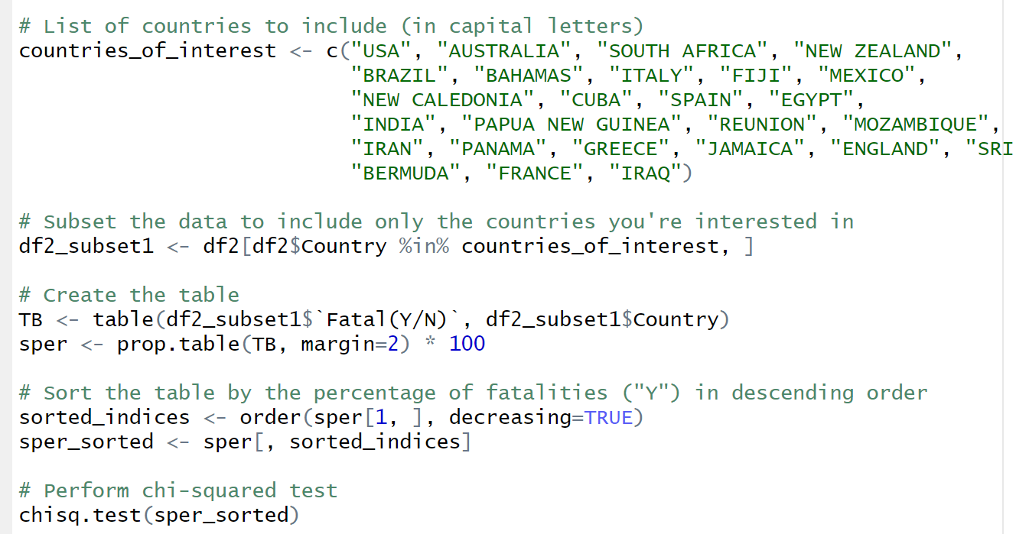
R Script and Results (For ALL types of test) – The Analysis
Pearson's Chi-squared test data:
sper_sorted X-squared = 302.42, df = 28, p-value < 2.2e-16

Slide 8
Results (For ALL types of test) – The Analysis
PRE 7COM1079-2022 Student Group No: ?????
8
P value is less than 2.2e -16
The result is statistically significant
we reject the null hypothesis
Countries like the USA, Bahamas, England, and Spain have higher fatality rates compared to countries like Mexico, Jamaica, Cuba, and India. Therefore, it's essential to examine the safety measures in these high-fatality regions and identify what can be improved by learning from the safer counterparts.
Notes:
8

Slide 9
Thank you

