Slide 1
Emotion intensity prediction
Week -2 Presentation
Professor :
Sanasam Ranbir Singh
Assigned TA :
Ankit Agarwal
Members :
Pooja
Vinay Kumar
Hemant Regar
Navjot Singh
Team :
Hashtag Analyst

Slide 2
Contents :
Introduction
Intuition
Goal
Flow Chart for components of Model
Mathematical Details
Conclusion

Slide 3
Introduction :
We communicate emotions with different intensity
Aim is to predict the intensity of emotion in the tweet by the user
Regression instead of classification
The emotion intensity dataset and the corresponding task are helping improve our understanding of how we convey more or less intense emotions through language.
We use supervised learning approach in which tweets were mapped into feature vectors that were then used for training regression models.

Slide 4
Goal :
Specifically, given a tweet and an emotion X, the goal is to determine the intensity or degree of emotion X felt by the speaker—a real-valued score between 0 and 1. A score of 1 means that the speaker feels the highest amount of emotion X. A score of 0 means that the speaker feels the lowest amount of emotion X. We first ask human annotators to infer this intensity of emotion from a tweet. Later, automatic algorithms are tested to determine the extent to which they can replicate human annotations.

Slide 5
Intuition :
Tweets are often used to convey one’s emotion, opinion, and stance. Thus, automatically detecting emotion intensities in tweets is especially beneficial in applications such as tracking brand and product perception, tracking support for issues and policies, tracking public health and well-being, and disaster/crisis management.

Slide 6
Dataset :
Tweets are annotated and best-worst technique is used
For example, for a 4-tuple with items A, B, C, and D, if A is the best, and D is the worst, then A > B, A > C, A > D, B > D, and C > D.
Three annotators do best worst and are notified if they are opposite to each other
About 5% of the data was annotated internally beforehand (by the authors). These questions are referred to as gold questions. 70% accuracy is must on gold otherwise rejected.
intensity(t) = %most(t) − %least(t)

Slide 7
Word2vec :
We use word2vec for representing the tweets in mathematical form
Word2vec takes each word and convert it into a 300 dimension vector
Word with similar meaning have vectors which are close to each-other and vice-versa
Each tweet length is fixed to 50 words so we get 50*300 matrix
Now we have commonly used words for each emotion and their word to vec
We also find average word2vec for each tweet and try to compare with average of commonly used words and find relation to get intensity value

Slide 8
Intensity regression :
In similar manner as previous simple model we select few features and in combination to already given features to get the intensity value of emotion
Now we compare it with testing data(GOLD) using pcc(Pearson correlation constant) and try to get accuracy of more than .6

Slide 9
Application :
Tweets are often used to convey one’s emotion, opinion, and stance. Thus, automatically detecting emotion intensities in tweets is especially beneficial in applications such as tracking brand and product perception, tracking support for issues and policies, tracking public health and well-being, and disaster/crisis management.

Slide 10
FLOW CHART COMPONENTS :
Tweets
Parsing
NLP Rule based model
Output

Slide 11
Flow Chart :
Parsing
Tweets
NLP Rule – based Model
Filtering
CNN_LSTM Regression Model
Vocabulary
Output Value
[0-1]
Input file for weka
Optimized Vocabulary
Add baseline feature from affective tweets
Lexicons
Random forest
Vectors

Slide 12
Mathematical details:
Convolutional neural network(CNN):
=>2D Convolution operation
In a nutshell, the convolution operation boils down to taking a given input and re-estimating it as
a weighted average of all the inputs around it.
The above definition is easy to visualise in 1D, but what about 2D?
In 2D, we would consider neighbors along the rows and columns, using the following formula

Slide 13
K refers to kernel or weights and I refers to the input. And * refers to the convolution operation
Let a be the number of rows and b be the number of columns
m & n specify the size of the matrix, in this case we consider them to be 2 each. So it’s a 2x2
matrix. Therefore a & b range from 0-1 each.
Now, to calculate the new value at a particular pixel I i, j , we simply need to fill in the values into
the formula.
Here is a pictorial representation

Slide 14
This is how the convolutional operation looks like in 2D
Instead of only choosing successive points, we must also consider previous points, on both
sides of the reference pixel.
Output Of CNN :

Slide 15
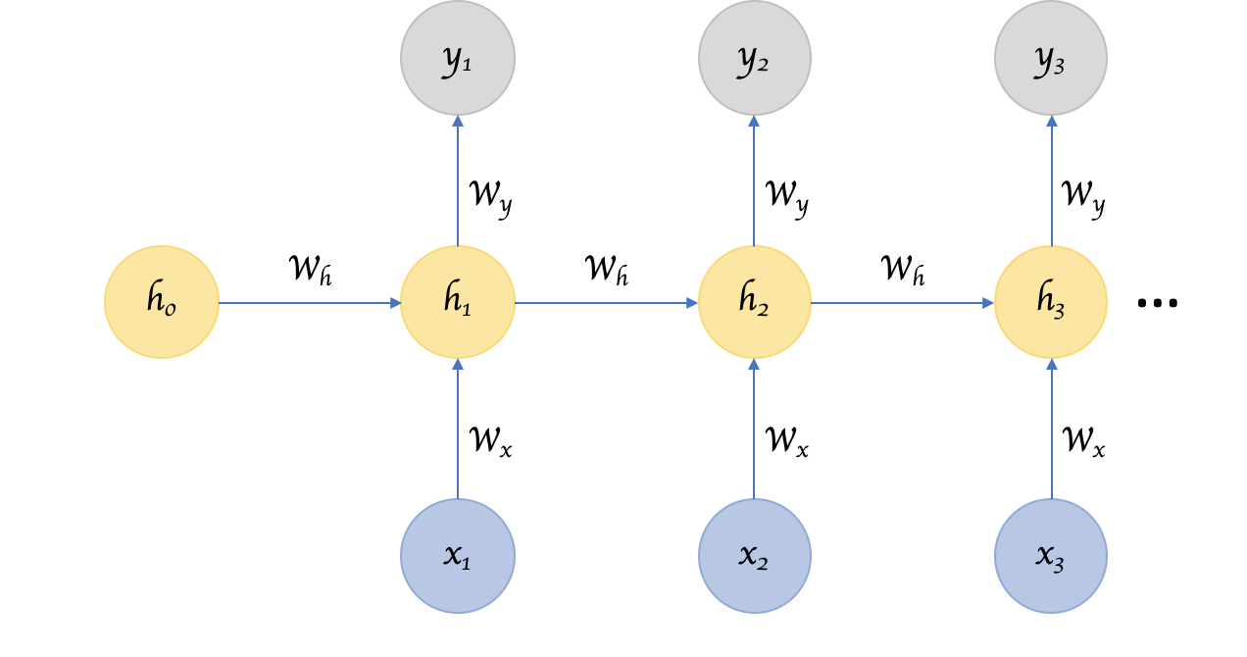
Recurrent neural Network :
ht = f(ht-1, Xt) ; ht = tanh(Wh ht-1 + Wx Xt) ; Yt = Wy ht

Slide 16
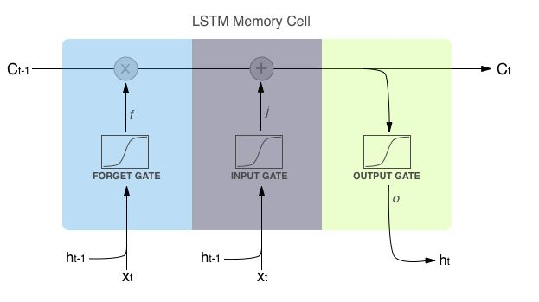
However, RNNs suffer from the problem of vanishing gradients,
which hampers learning of long data sequences. The gradients carry information used in the RNN
parameter update and when the gradient becomes smaller and smaller, the parameter updates become
insignificant which means no real learning is done then we use LSTM
Long short term memory (LSTM) :

Slide 17
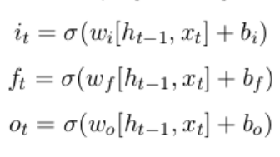
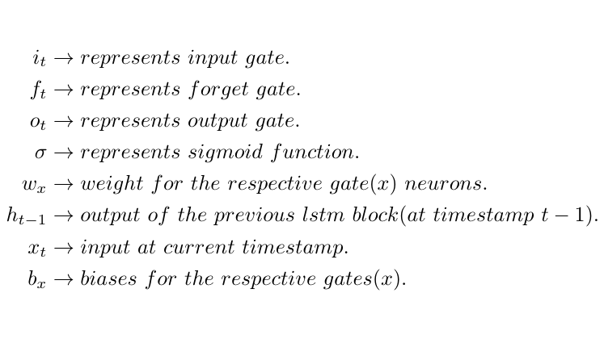

Slide 18
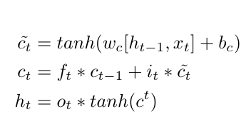
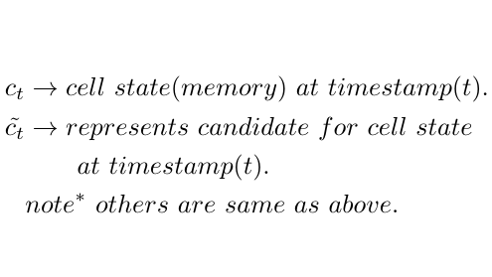
The equations for the cell state, candidate cell state and the final output:

Slide 19
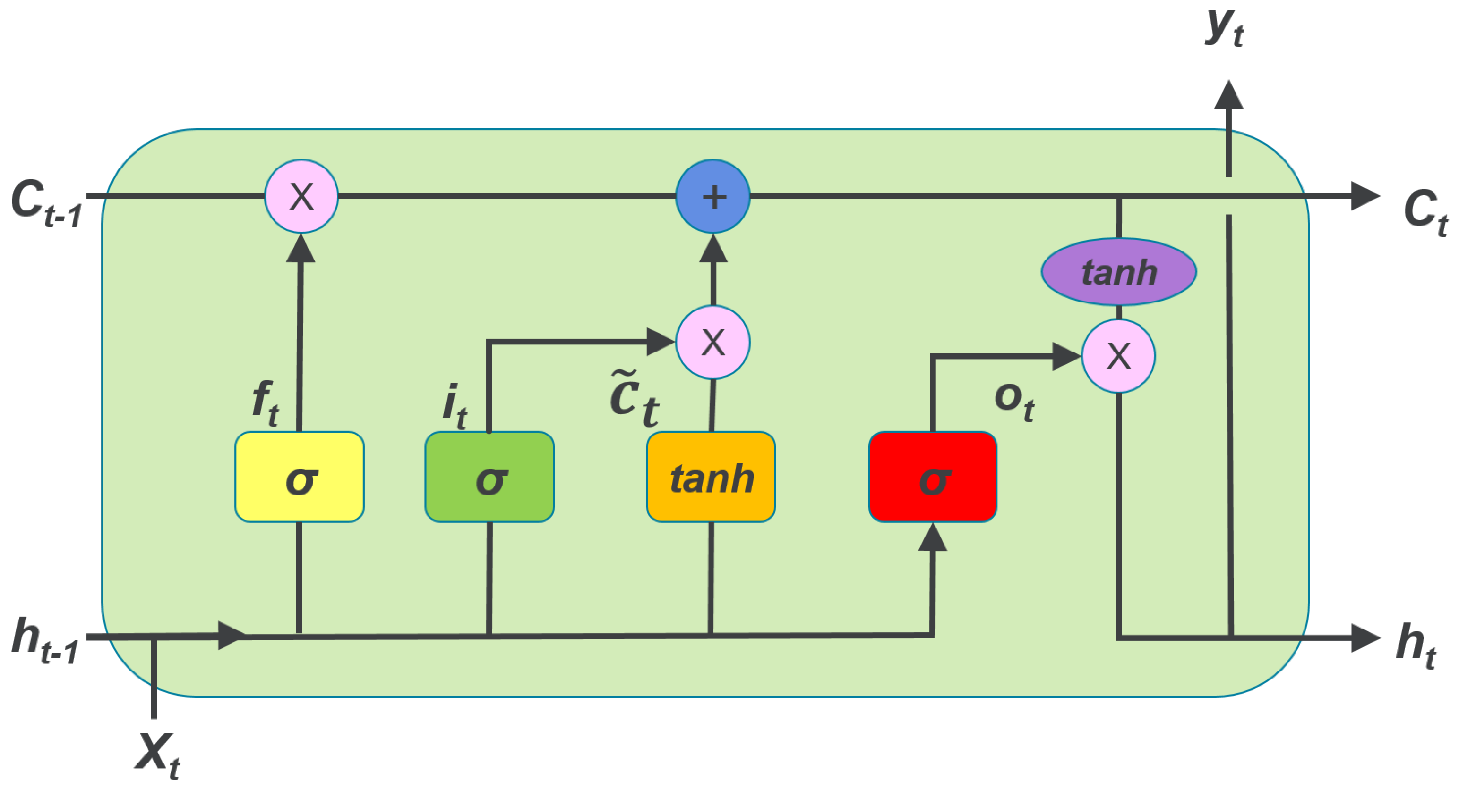

Slide 20
Conclusion :
Our task combines existing lexicons with automatically extended norms and a CNN-LSTM neural network based on embeddings.
Highest performance is achieved in combination.
In addition, we found that extending existing emotion lexicons and affective norms improves performance over the original resources.
A particularly interesting observation is that providing word embedding in intensity predictions beneﬁts the performance.

Slide 21
Thank you!!

