Slide 1
Team 15: [PointNet based Object Detection and Classification in Autonomous Driving]
Members: ADARSH PURI
ECE 542 – Neural Networks
Spring, 2020

Slide 2


Autonomy Required
In past few years autonomous driving industry has seen significant rise in popularity and hence rise in investment.
With rise in investment, the technology is no longer just a distant dream and some companies have even launched their self driving cars in market.
Source : https://algorithmxlab.com/blog/worlds-top-33-companies-working-on-self-driving-cars/
Source : https://www.cleantech.com/how-autonomous-vehicles-drive-technological-innovation/
Notes:
In past few years autonomous driving has seen significant rise in popularity which is complemented by the rise of significance of Neural Networks.
Even though Autonomous vehicles are more real now than ever Designing one is not a trivial task.

Slide 3
Autonomous Driving Approaches
Even though Autonomous vehicles are more real now than ever Designing one is not a trivial task.
There are usually two schools of thought for designing an autonomous driving system:
Module Based Approach
End-to-End Deep Learning based approach

Slide 4
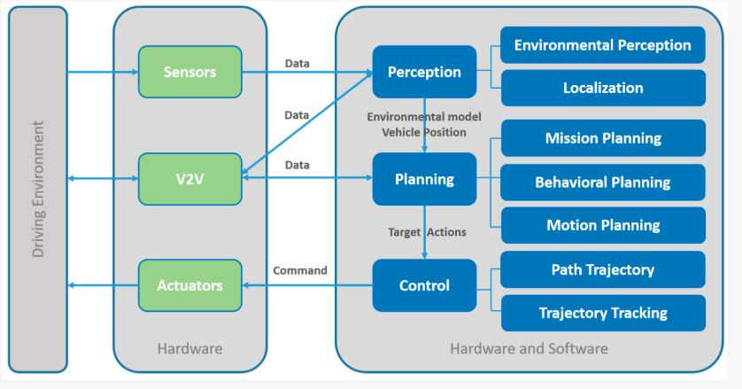
Module-Based-Approach and Object Detection
In Module based approach the task of driving is divided into several different modules such as perception, mapping and motion planning.
Source: https://venturebeat.com/2015/08/19/here-are-the-five-most-over-hyped-technologies-of-2015-according-to-gartner/

Slide 5
Need for Speed
In this project we are trying to design an object detection and classification system for the perception module.
Driving is a complex task and sometimes require decision making in seconds but most of the modern object detection systems are either slow with high accuracy or fast with relatively low accuracy.
The reason this issue exist is because processing 3-D data by projecting it to 3-D convnet is an unnecessarily laborious task.
One approach to solve this problem is by directly processing point clouds which are relatively sparse data structures.

Slide 6
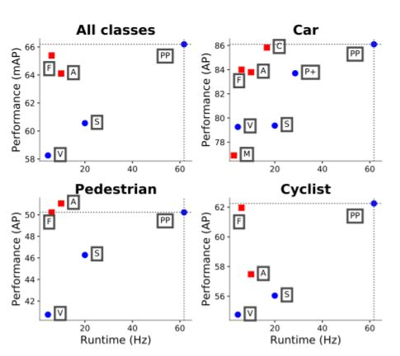
Need for Speed
PointPillars use point-cloud processing to maximize both accuracy and speed.
Performance comparison of PointPillars with other state-of-the art techniques:
F -> Frustum PointNet
PP -> PointPillars
A -> AVOD
C -> ContFuse
V -> VoxelNet
S -> SECOND
P+ -> PIXOR++
M -> MV3D
Source : https://arxiv.org/pdf/1812.05784.pdf

Slide 7


Problem Statement
On a higher level pointpillar can be divided into three parts:
First part of this network being Pillar Feature Net. In this project we replaced it with a pretrained PointNet based autoencoder and trained the entire network on the famous KITTI Data Set.
PILLAR FEATURE NET
BACKBONE 2D CNN
DETECTION HEAD (SSD)
POINT CLOUD
PREDICTIONS

Slide 8
Model Architecture
POINT PILLARS NETWORK OVERVIEW
PointPillars accept point clouds as input and estimates oriented 3D boxes for cars, pedestrians and cyclists
Consists of 3 main stages:
Feature encoder: Point cloud to sparse pseudo image
2D Convolutional Backbone: Pseudo Image to High Level Representation
Detection Head: Detects and Regresses 3D boxes
Removes expensive 3D Convolutional Layers
PILLAR FEATURE NET
BACKBONE 2D CNN
DETECTION HEAD (SSD)
POINT CLOUD
PREDICTIONS

Slide 9
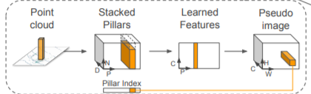
Feature Encoder
SIMPLIFIED POINTNET
DENSE TENSOR OF SIZE(D,P,N)
Parallel MLP
BATCH NORM
RELU
L(x,y,z)
Limit to P Non empty pillars, N points per Pillar and D dimensions
Feature Dimesion of C extracted from point pillars
TENSOR OF SIZE (C,P,N)
PILLAR FEATURE NET
L: Each point in the point cloud
Represented by D=9 dimensions
(x,y,z):Coordinates of L from origin
(x_{c} ,y_{c} ,z_{c}),c: Distance to arithmetic mean of all points in a pillar
(x_{p} ,y_{p}),p: offset from the pillar centre
Max operation over
N channels
TENSOR OF SIZE(C,N)
Source : https://arxiv.org/pdf/1812.05784.pdf

Slide 10
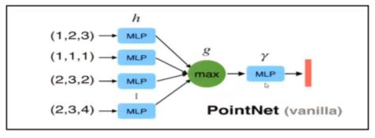
PointNet: A Neural Network for Point Clouds
PointNet is a Deep Learning Network that directly consumes point cloud as input.
The biggest issue with doing deep learning with point cloud is that it deep learning requires ordered input whereas pointclouds are unordered set.
PointNet get arounds this problem by providing an architecture which uses a symmetric function.
The below structure is known as PointNet Vanilla:
Source: https://www.youtube.com/watch?v=Cge-hot0Oc0
POINT NET VANILLA ARCHITECTURE

Slide 11
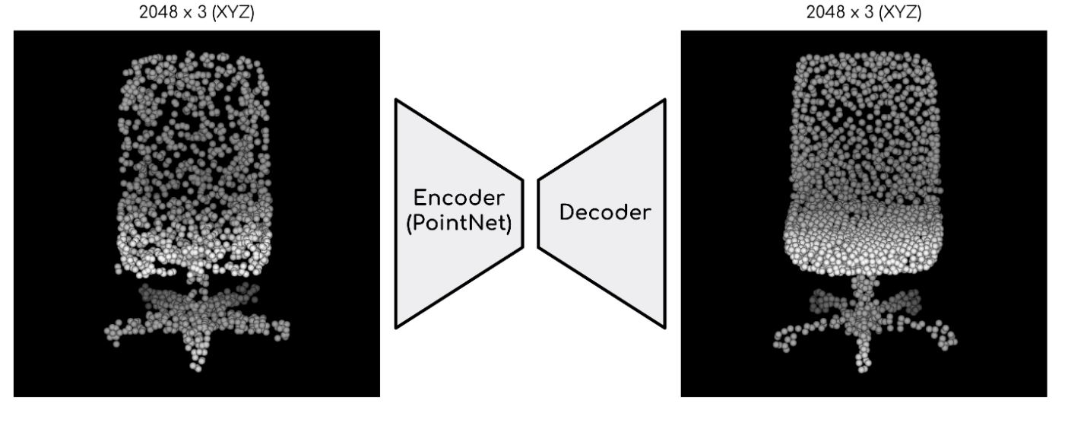
PointNet: A Neural Network for Point Clouds
Here we are using a pre trained PointNet network which is the encoder part of a PointNet based autoencoder available at https://github.com/charlesq34/pointnet-autoencoder
Source: https://github.com/charlesq34/pointnet-autoencoder

Slide 12
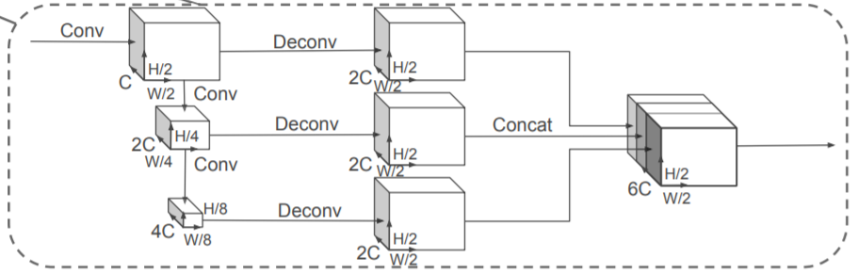
2D Convolutional Backbone
Soure: https://arxiv.org/pdf/1812.05784.pdf
The backbone has 2 sub-networks
Top Down Network:
Produces features at increasingly small spatial resolution.
Consists of a series of blocks (S,L,F)
S: Stride of Block, L: 3X3 2D Conv layers, F:Output Channels
First Convolution has a stride S/Sin, all subsequent convolutions have stride 1.
.
Second Network:
Upsampling and concatenation of top down features
Features upsampled, Up(Sin, Sout, F) from initial stride Sin to final stride Sout, using transposed 2D convolution
BatchNorm and ReLU applied to upsampled features
All features from different strides concatenated to give final output feature

Slide 13
Detection Head : SSD (Single Shot MultiBox Detector)
The approach is a feed-forward convolutional network that produces a fixed-size collection of bounding boxes and scores for the presence of object class instances in those boxes, followed by a non-maximum suppression step to produce the final detections.
Discretizing the output space of bounding boxes into a set of default boxes over different aspect ratios and scales per feature map location.
Scores for the presence of each object category in each default box.
Adjusting the box to better match the object shape.
Combining predictions from multiple feature maps with different resolutions for objects of various sizes.
Eliminates proposal generation and pixel or feature resampling stages.
Encapsulates all computation in a single network.

Slide 14
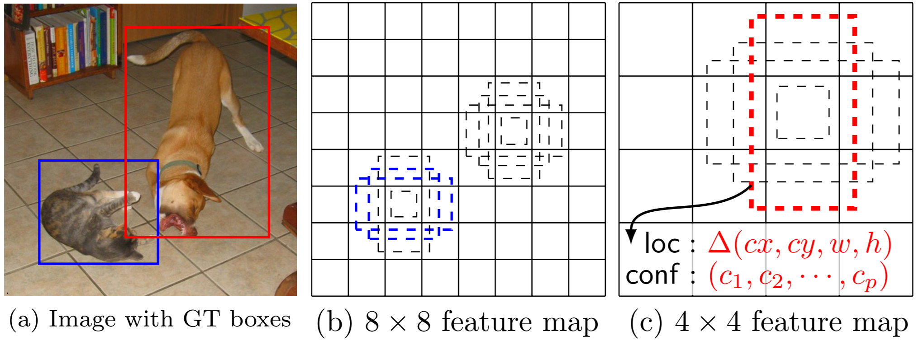
SSD Framework
In a convolutional fashion, evaluate a small set (here 4) of default boxes of different aspect ratios at each location in several feature maps with different scales (e.g. 8 × 8 and 4 × 4 in (b) and (c)).
For each default box, we predict both the shape offsets and the confidences for all object categories ((c1, c2, · · · , cp)).
At training time, we first match these default boxes to the ground truth boxes.
The model loss is a weighted sum between localization loss and confidence loss.
Source: https://arxiv.org/pdf/1512.02325.pdf

Slide 15
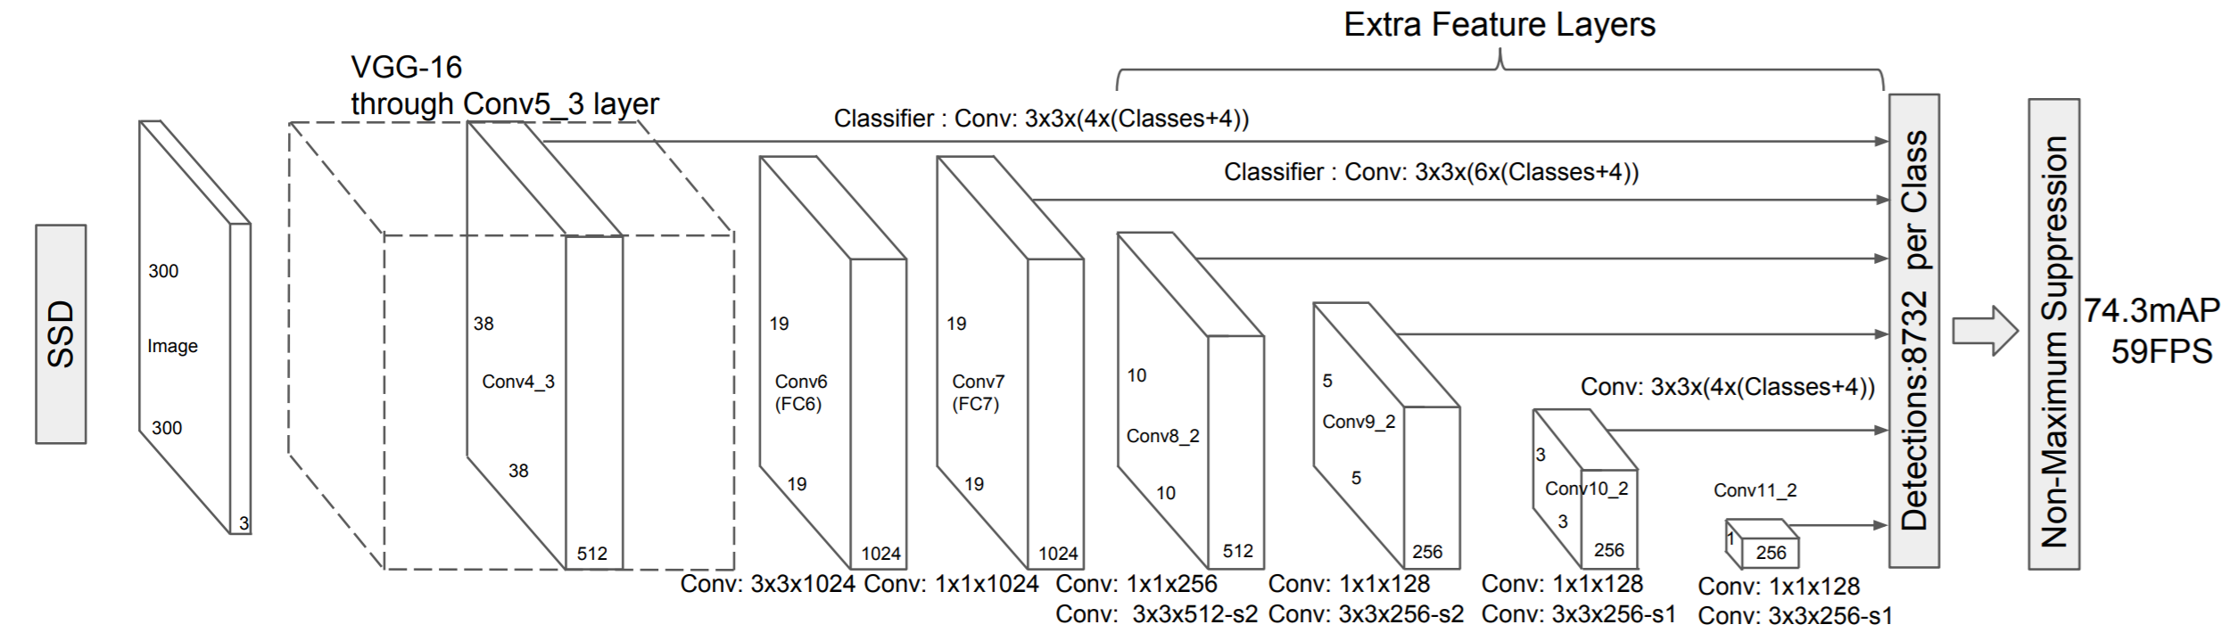
SSD Architecure
SSD model adds several feature layers to the end of a base network, which predict the offsets to default boxes of different scales and aspect ratios and their associated confidences.
Source: https://arxiv.org/pdf/1512.02325.pdf

Slide 16
Experiment Details: Dataset description
We are using KITTI object detection benchmark dataset.
It contains both pointcloud and images although we are only using pointcloud for training.
The dataset contains bounding boxes and labels for cars, pedestrians and bicycle.
The Dataset is divided into 7481 training samples and 7518 testing samples.
We have further divided the training sample into 6733 training to 748 validation samples

Slide 17
Experiment Details
Network Details:
We are using a pretrained autoencoder as our feature encoder which has C = 64 output features.
The car and pedestrian/cyclist backbones are the same except for the stride of the first block (S = 2 for car, S = 1 for pedestrian/cyclist).
Both network consists of three blocks, Block1(S, 4, C), Block2(2S, 6, 2C), and Block3(4S, 6, 4C).
Each block is upsampled by the following upsampling steps: Up1(S, S, 2C), Up2(2S, S, 2C) and Up3(4S, S, 2C). Then the features of Up1, Up2 and Up3 are concatenated together to create 6C features for the detection head.
PILLAR FEATURE NET
BACKBONE 2D CNN
DETECTION HEAD (SSD)
POINT CLOUD
PREDICTIONS

Slide 18
Results: 3D Detection Benchmark
Method | Modality | Speed | mAP | Car |  |  | Pedestrian |  |  | Cyclist
 |  |  |  | Easy | Mod. | Hard | Easy | Mod. | Hard | Easy | Mod. | Hard
VoxelNet | Lidar | 4.4 | 49.05 | 77.47 | 65.11 | 57.73 | 39.48 | 33.69 | 31.5 | 61.22 | 48.36 | 44.37
SECOND | Lidar | 20 | 56.69 | 83.13 | 73.99 | 66.22 | 51.07 | 42.56 | 37.29 | 70.51 | 53.85 | 46.90
PointPillars | Lidar | 62 | 59.20 | 79.05 | 74.99 | 68.30 | 52.08 | 43.53 | 41.49 | 75.78 | 59.07 | 52.92
PointPillars(Our) | Lidar | 62 | 59.45 | 81.05 | 71.99 | 67.23 | 54.89 | 42.00 | 43.01 | 73.28 | 60.00 | 51.00

Slide 19
Final Words
To conclude it is evident that pointpillar outperforms every other approach in terms of both speed and accuracy.
Adding a pretrained autoencoder reduces the training time while still maintaining the state of the accuracy to match the original PointPillars.

