Slide 1
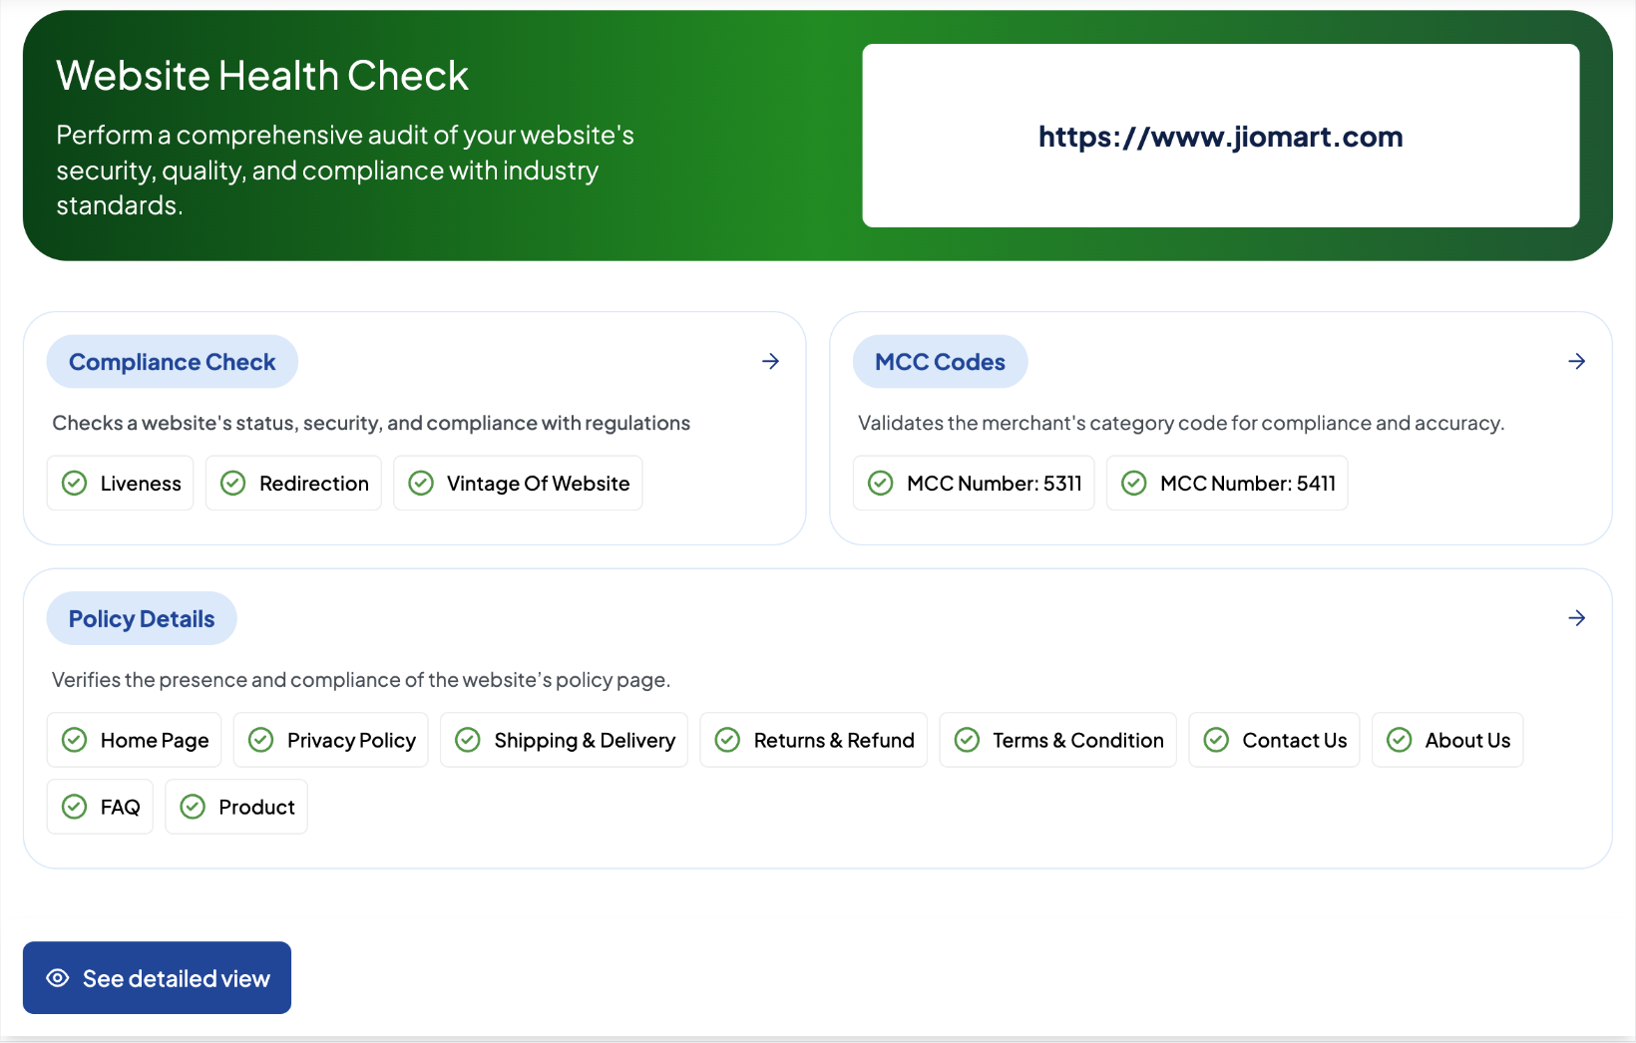
Online Merchants : Risk Signals through Website Scan
Input
Output
Merchant to share website link
IDfy’s Decisioning Model
Website Compliance checks
As per IT Act, check for liveness,
Redirection
MCC Prediction
Establish Line of Business - top 2 MCC from directory of 400+ codes
Risk Checks
Basics of Website : Home Page, Contact Us, Policy etc.
Business Specific context on website
Restricted words and contraband items
Potential impersonation

