Slide 1
IDfy Transaction Intelligence Platform
Eliminate Fraud. Establish Trust.

Slide 2



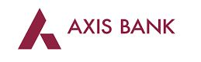
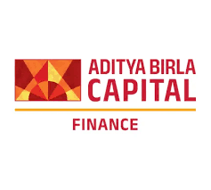





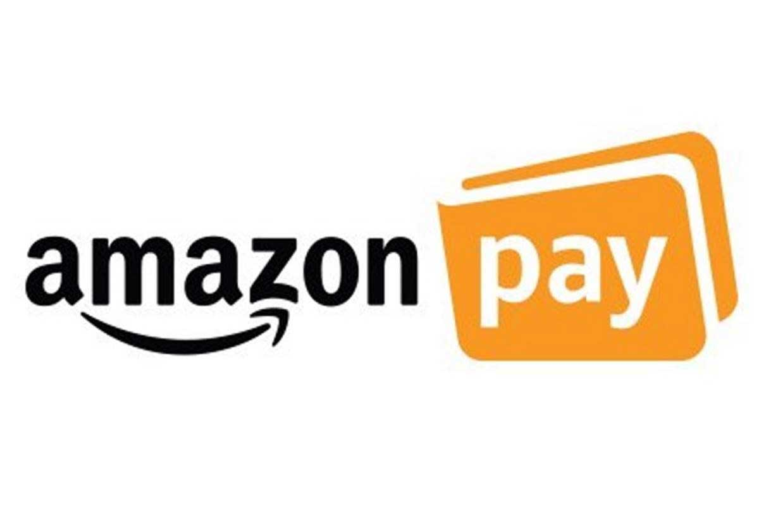
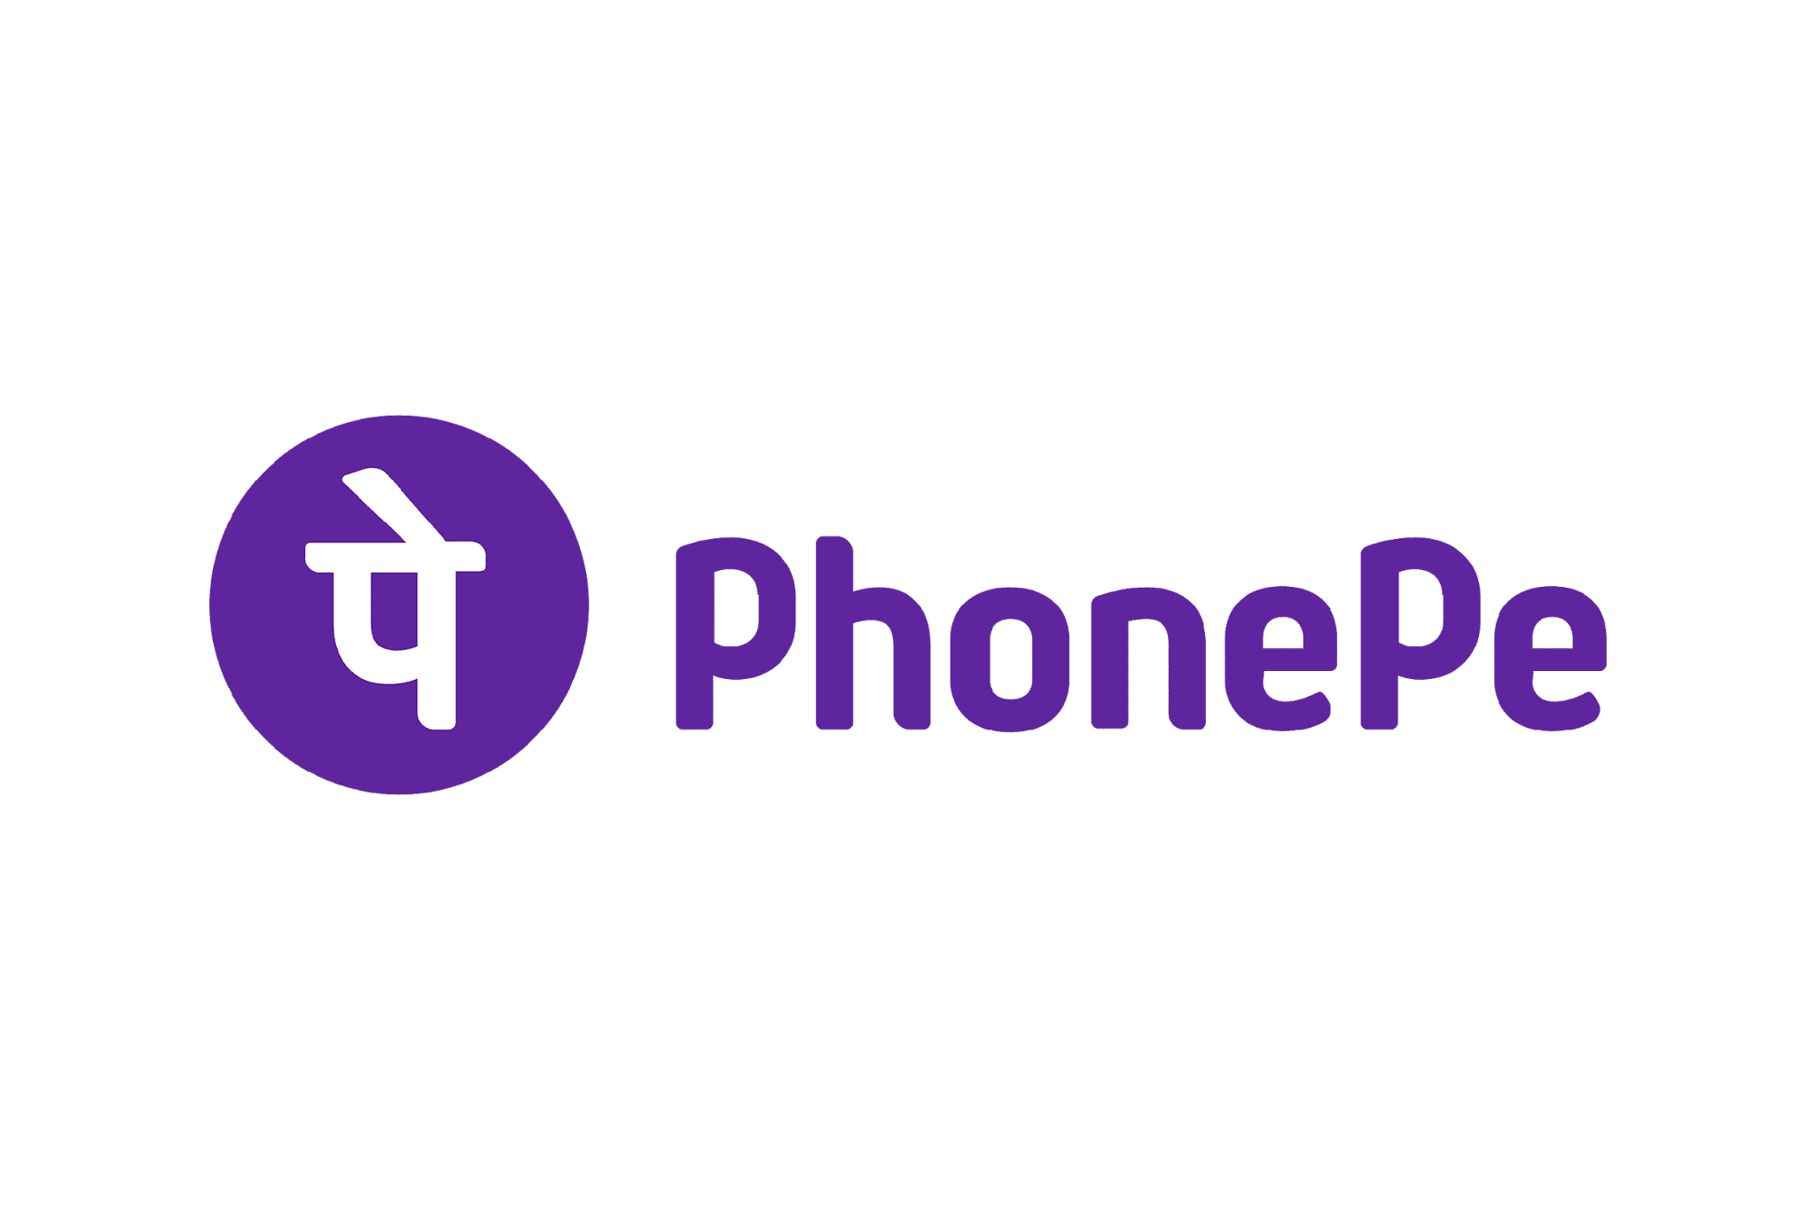












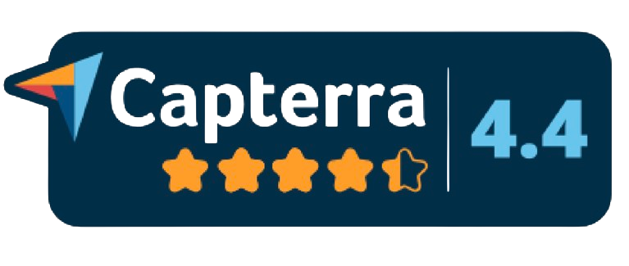
We work with industry leaders across multiple sectors
Banks
Fintechs / NBFCs
1500+
60Mn+
CLIENTS SERVED
VERIFICATIONS PER MONTH
Insurance
1000+
5+
Payments
SIGNALS TO DETECT FRAUD
COUNTRIES
E-Com & Logistics
Misc.

Slide 3


Our offerings are within 3 pillars
SOLUTIONS
Onboarding
Risk & Fraud Prevention
Privacy
Account Opening by RBI, SEBI and MeitY regulated clients through our API solutions, Journey Orchestration and Video KYC platforms
Database Verifications, Tampering Checks, Liveness Detection, Injection Prevention, Document Extraction through OCR, Legal History checks, Enhanced Due Diligence Checks, Transaction Intelligence
India’s First Consent Governance Suite in compliance with the DPDP Act for Data principal, Data Fiduciary and Data processors
WHAT WE DO
CUSTOMERS
COMPANIES
MERCHANTS
EMPLOYEES

Slide 4

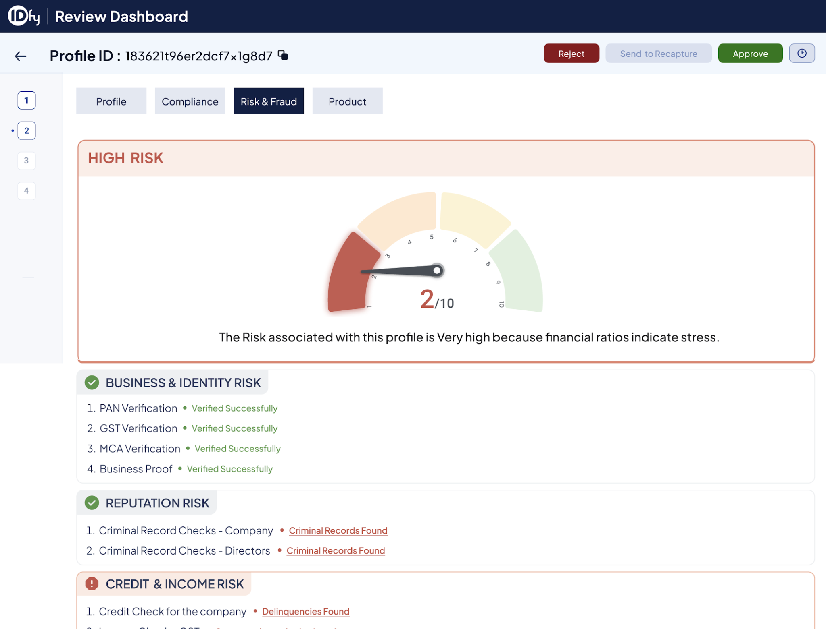

Together they digitize and augments intelligence within financial operations
Operations Platform
Datasets
2
3
1
India Stack (Aadhar,PAN,GST, AA)
Credit Bureau
Court Records
CERSAI
EPFO database
MCA
RTO
Decision Scores
Smart Search
IDfy Intelligence Platform
(Proprietary AI models)
Transaction intelligence
Reports for CAM
Identity Verification
Legal Checks
Fraud Detection
Risk Registry
Risk Signals
IDfy Onboarding Platform (omnichannel)
FI LOS/LMS
Consent management
Video service
Doc. service
Prospect/Channel Partner
IDfy
FI Systems
Ecosystem Platforms

Slide 5




Tools overcome the limitations within credit operations due to outdated tools
Current Challenges | Possibilities in Current Time
Legacy Fraud Detection: Missing out on sophistication of fraudsters Visual checks and against fraud registries | Review metadata of documents for detecting tampering
Sub-optimal Underwriting: heavily reliant on bureau Overlooking 90% additional data being generated via transactions | Advanced profiling of application to check if fits with target risk vs reward equation for product
Constrained analytics: Macro trends driven - demographic/Industry Datasets available with teams limits effectiveness of scorecards/models | Scorecards build on granular data with better categorized actions (advanced tracking, reject etc.)
Rigid Infrastructure: work with what leading players offer Customer journeys/assessment done under heavy constraints | Raw data available to create your own risk triggers

Slide 6
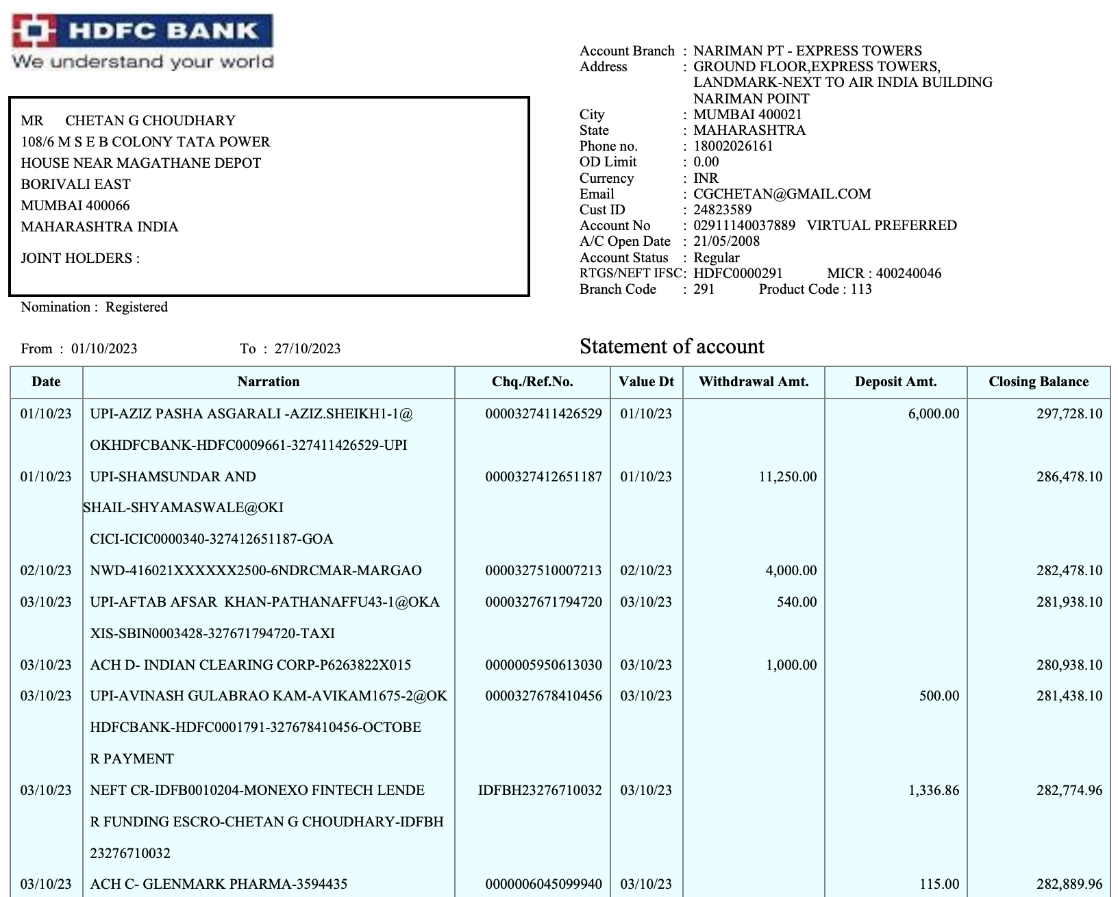
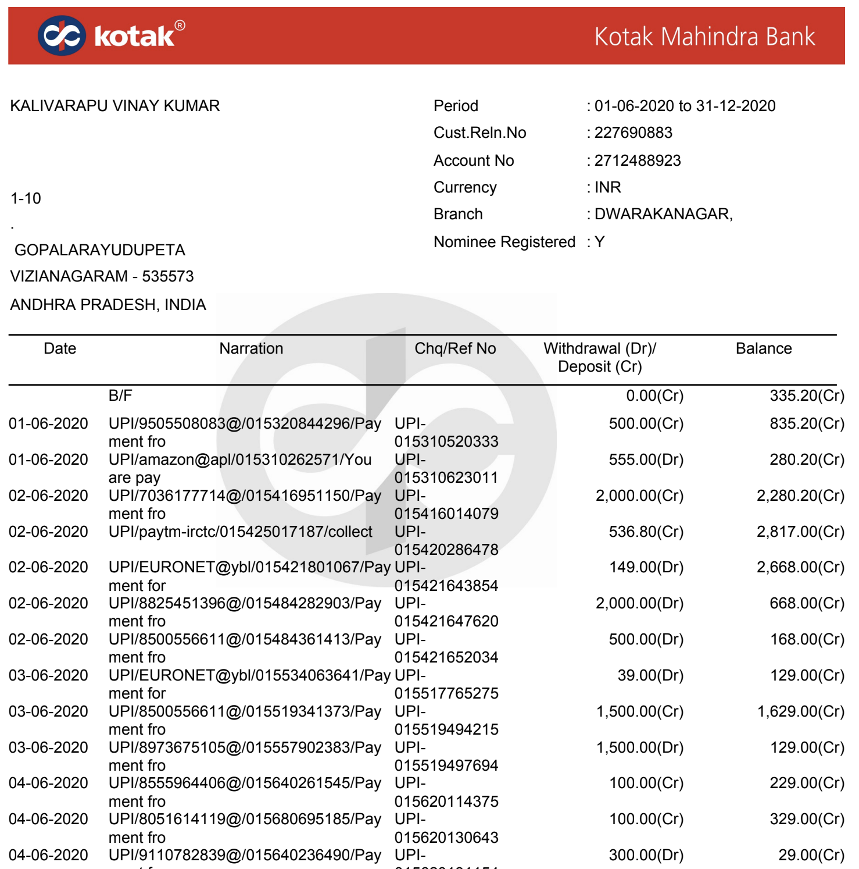
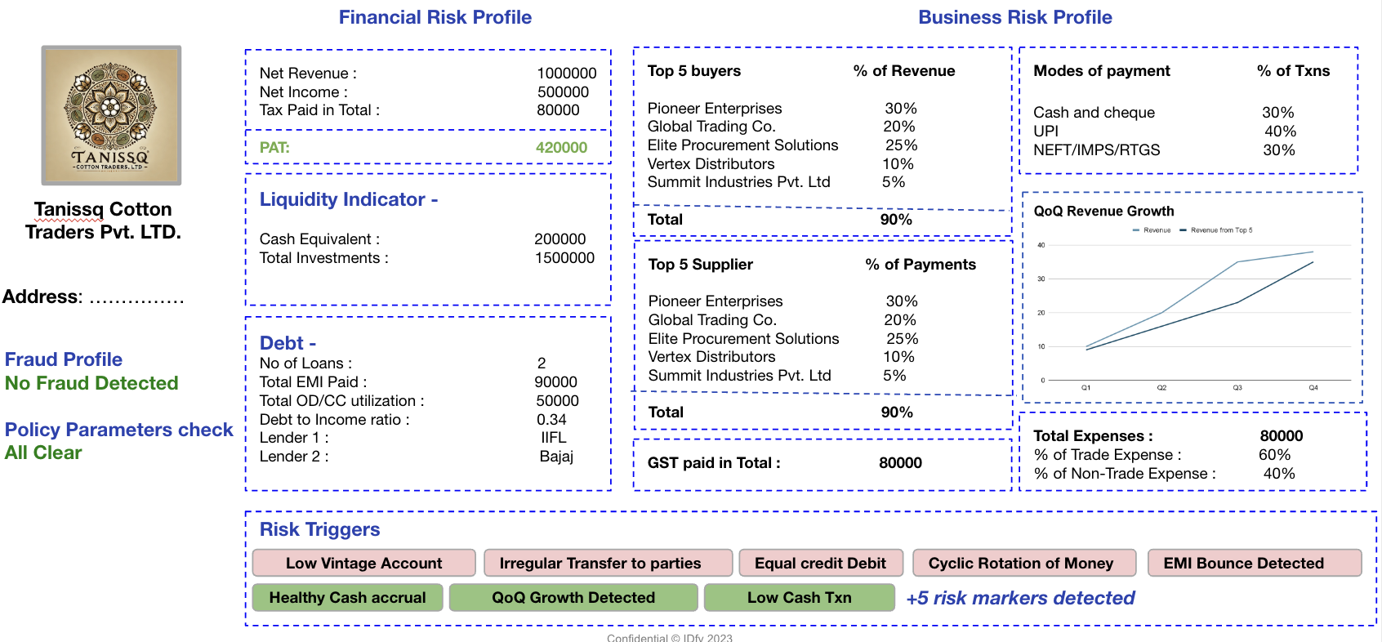
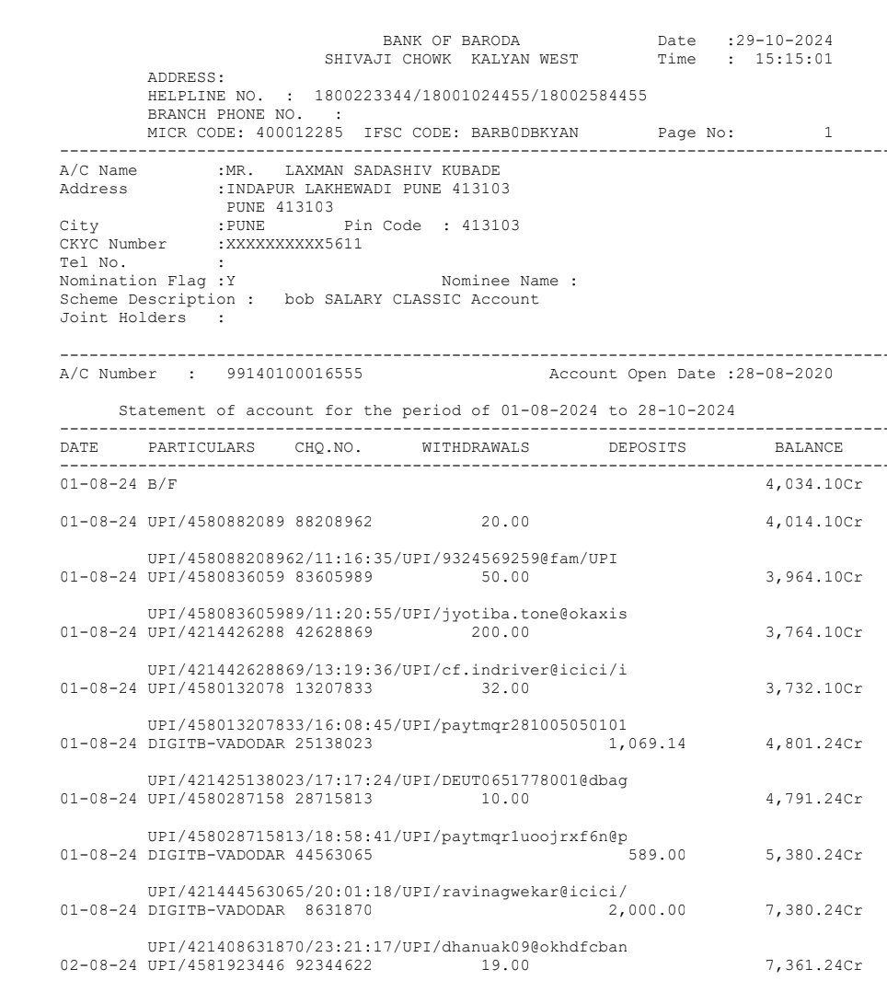

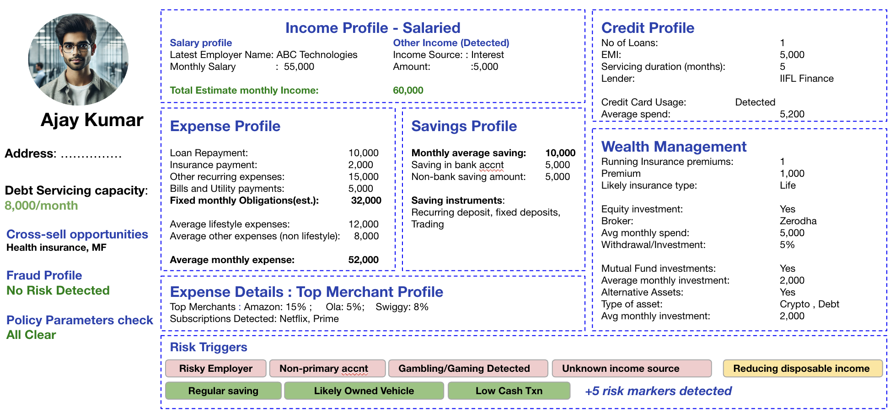

IDfy’s Intelligence Platform: Expanding realm of digital data for smarter underwriting
Receive Data from journey endpoint
Intelligence Engine processing
Profile & Insights for Decision making
India Stack (Aadhar,PAN,GST)
Transaction INTELLIGENCE
Bank Statement Data
(PDF, AA)
Lender policy Parameters
Specific Application Data
Customize output as per your Risk Appetite/Lending Strategy

Slide 7

Platform extracts, interprets and transforms data across multiple data sources into actionable insights on credit application or trade line
Income Profile - Salaried
Salary profile Other Income (Detected)
Latest Employer Name: ABC Technologies Income Source: : Interest
Monthly Salary : 55,000 Amount: :5,000
Total Estimate monthly Income: 60,000
Credit Profile
No of Loans: 1
EMI: 5,000
Servicing duration (months): 5
Lender: IIFL Finance
Credit Card Usage: Detected
Average spend: 5,200
Ajay Kumar
Expense Profile -
Loan Repayment: 10,000
Insurance payment: 2,000
Other recurring expenses: 15,000
Bills and Utility payments: 5,000
Fixed monthly Obligations(est.): 32,000
Average lifestyle expenses: 12,000
Average other expenses (non lifestyle): 8,000
Average monthly expense: 52,000
Savings Profile
Monthly average saving: 10,000
Saving in bank account 5,000
Non-bank saving amount: 5,000
Saving instruments: Recurring deposit, fixed deposits, Trading
Fraud Profile
No Risk Detected
Wealth Management
Running Insurance premiums: 1
Premium 1,000
Likely insurance type: Life
Equity investment: Yes
Broker: Zerodha
Avg monthly spend: 5,000
Withdrawal/Investment: 5%
Mutual Fund investments: Yes
Average monthly investment: 2,000
Alternative Assets: Yes
Type of asset: Crypto , Debt
Avg monthly investment: 2,000
Crime Check
1 Case (low severity)
Policy Parameters check
All Clear
Debt Servicing capacity:
8,000/month
Expense Details : Top Merchant Profile
Top Merchants : Amazon: 15% ; Ola: 5%; Swiggy: 8%
Subscriptions Detected: Netflix, Prime
Cross-sell opportunities
Health insurance, MF
Risk Triggers
4 detected
Risk Triggers
Risky Employer
Non-primary accnt
Gambling/Gaming Detected
Unknown income source
Reducing disposable income
Regular saving
Likely Owned Vehicle
Low Cash Txn
+5 risk markers detected

Slide 8

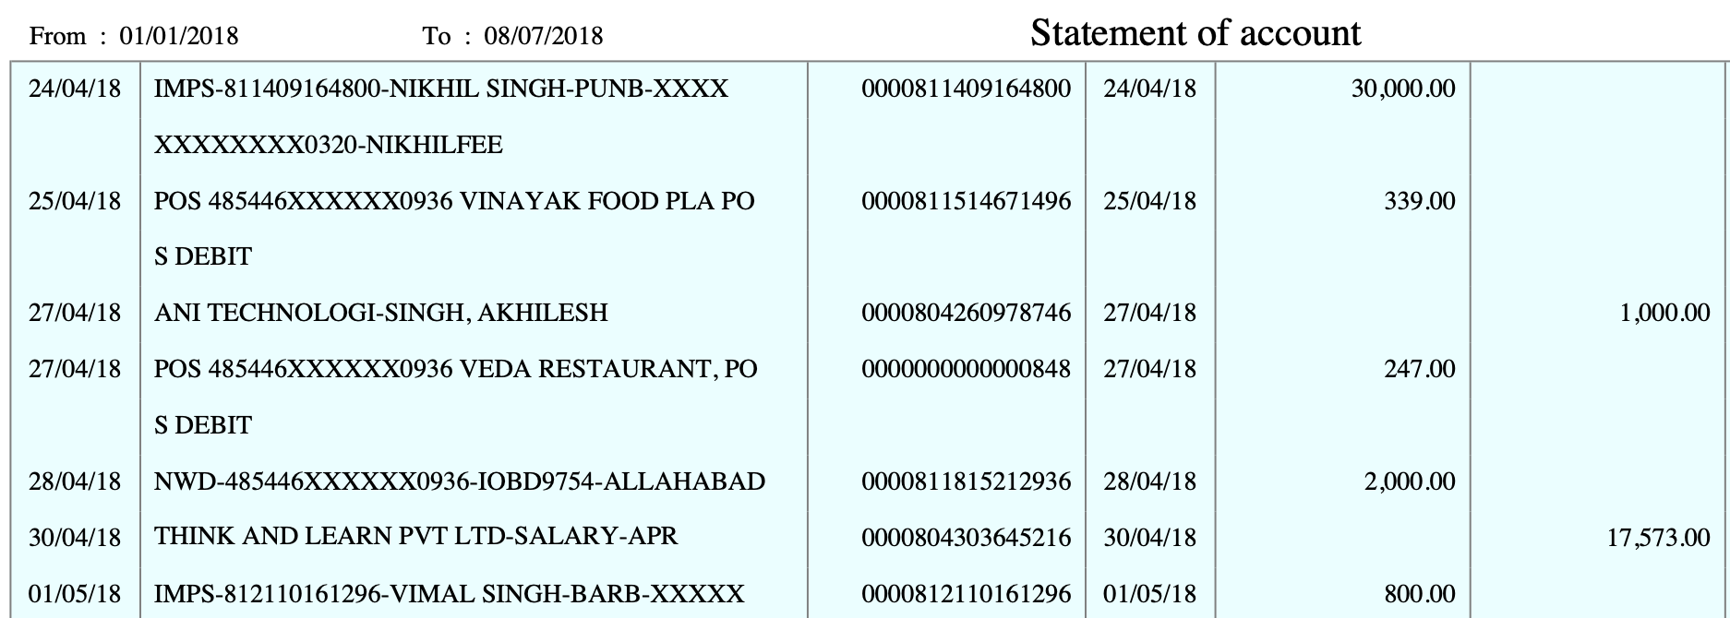
Our algorithms catch underlying risks within seemingly safe transactions
Illustration
STP / Hybrid Loan Journey
Salary Issuer Name Think and Learn Private Limited (Byju’s)
Salary Issuer Alert
High Risk Detected Based on EPFO Data

Slide 9
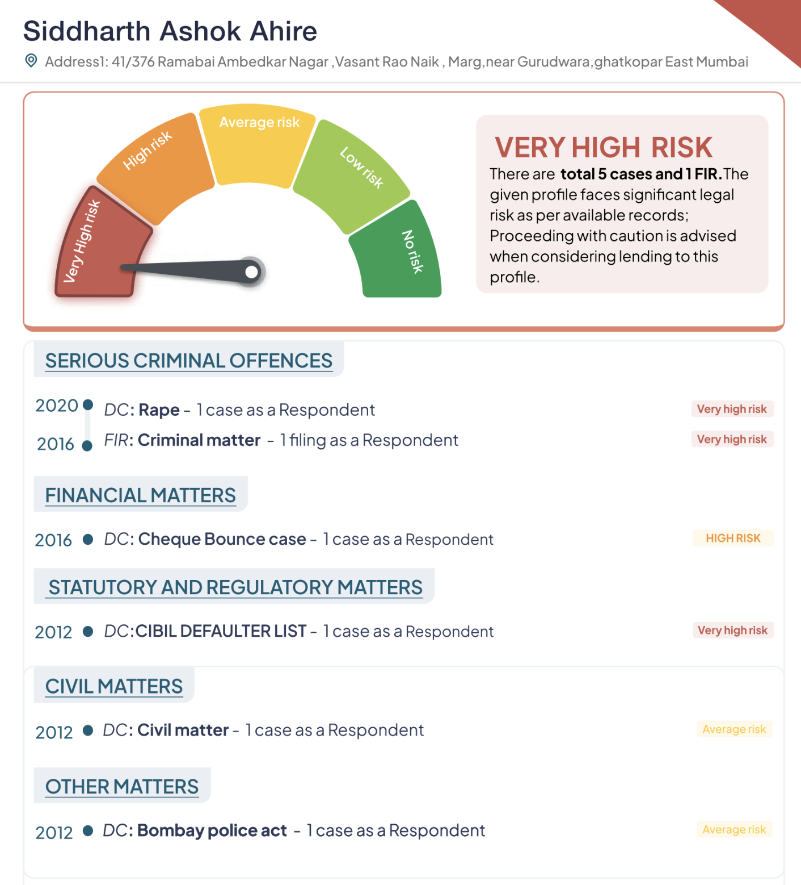
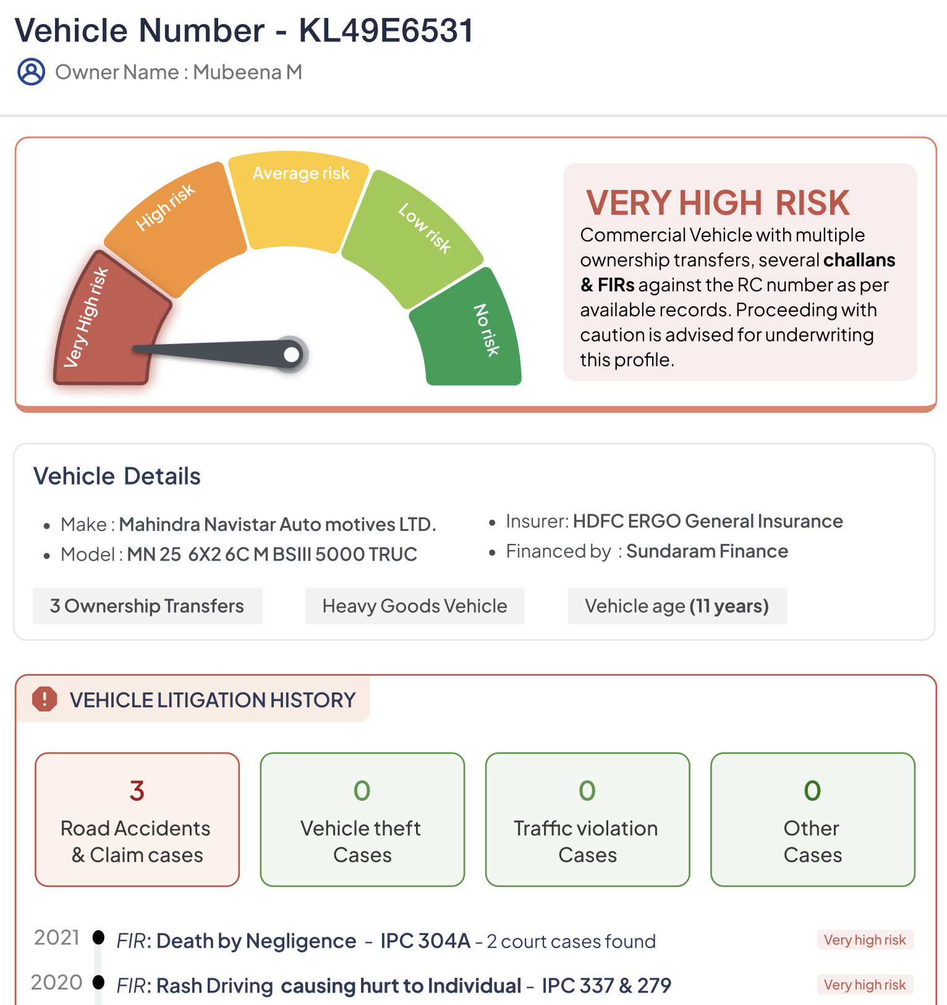
Our infrastructure enables to catch legal risks on applications from unstructured court records

Slide 10
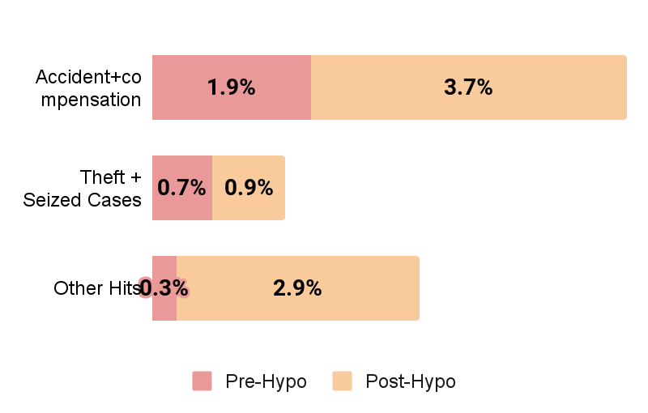
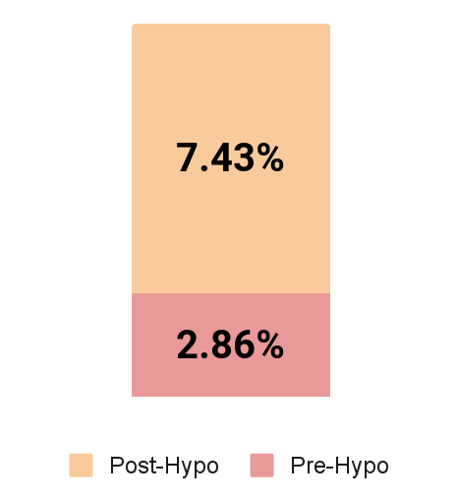
Awareness of risk can help lender manage portfolio risk better: Example of Vehicle loan
10%+ Vehicles can have legal footprints in a portfolio…
…Of which 7% have high severity with likely impact on underlying loan
Post disbursement risk of credit has increased (Early warning signal)
Bank engaged in credit for vehicles which had associated risk (collateral value under question)
Note: Sample size of 700 vehicles were taken where bank had an active hypothecation

Slide 11
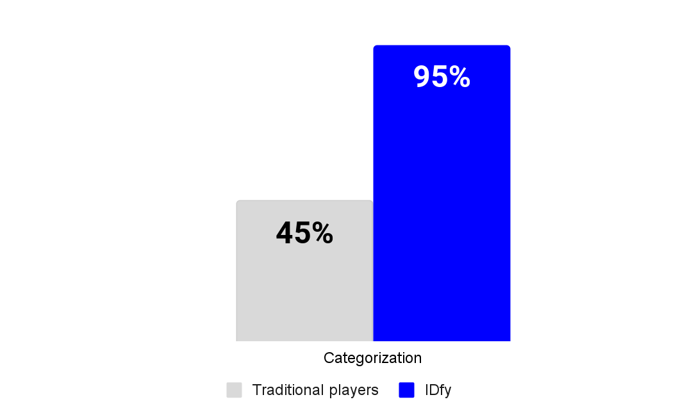
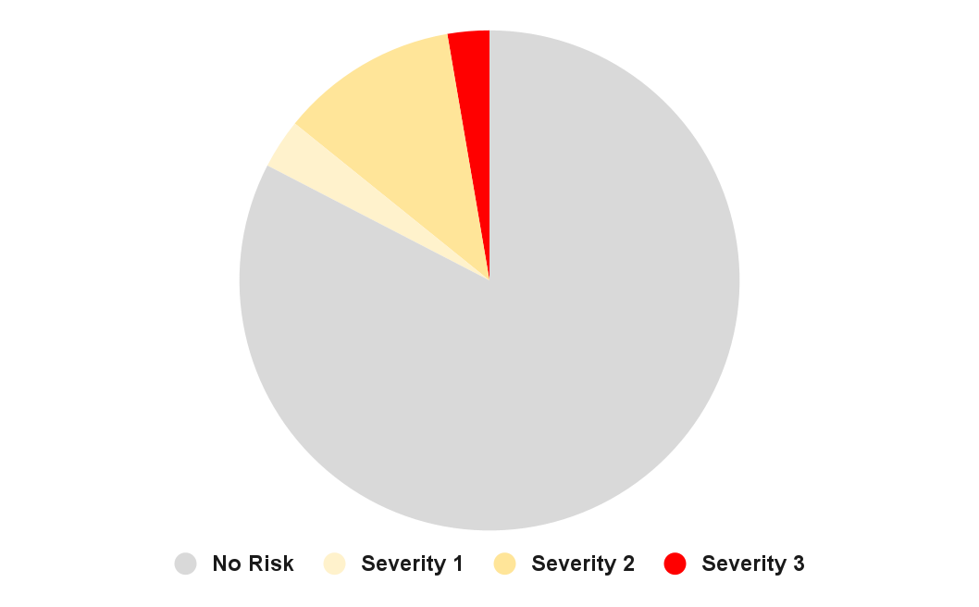
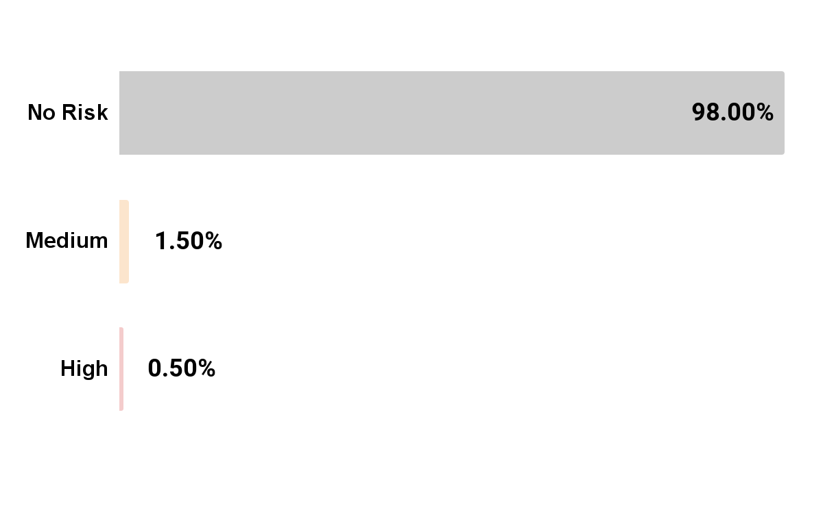
Our study indicates upto 2% of portfolio have risks which can be proactively identified and mitigated
Catching Fraud
Categorization Efficiency
High Risk Earnings
2%+ severely tampered
(document used for underwriting)
Earnings & obligations identification unlocked
Despite salaried, might behave like unstable income cases
IDfy unlocks power of cross-database information triangulation and interpretation
Source: Results based on sampling of 10,000 real bank statements considered for personal loan applications

Slide 12
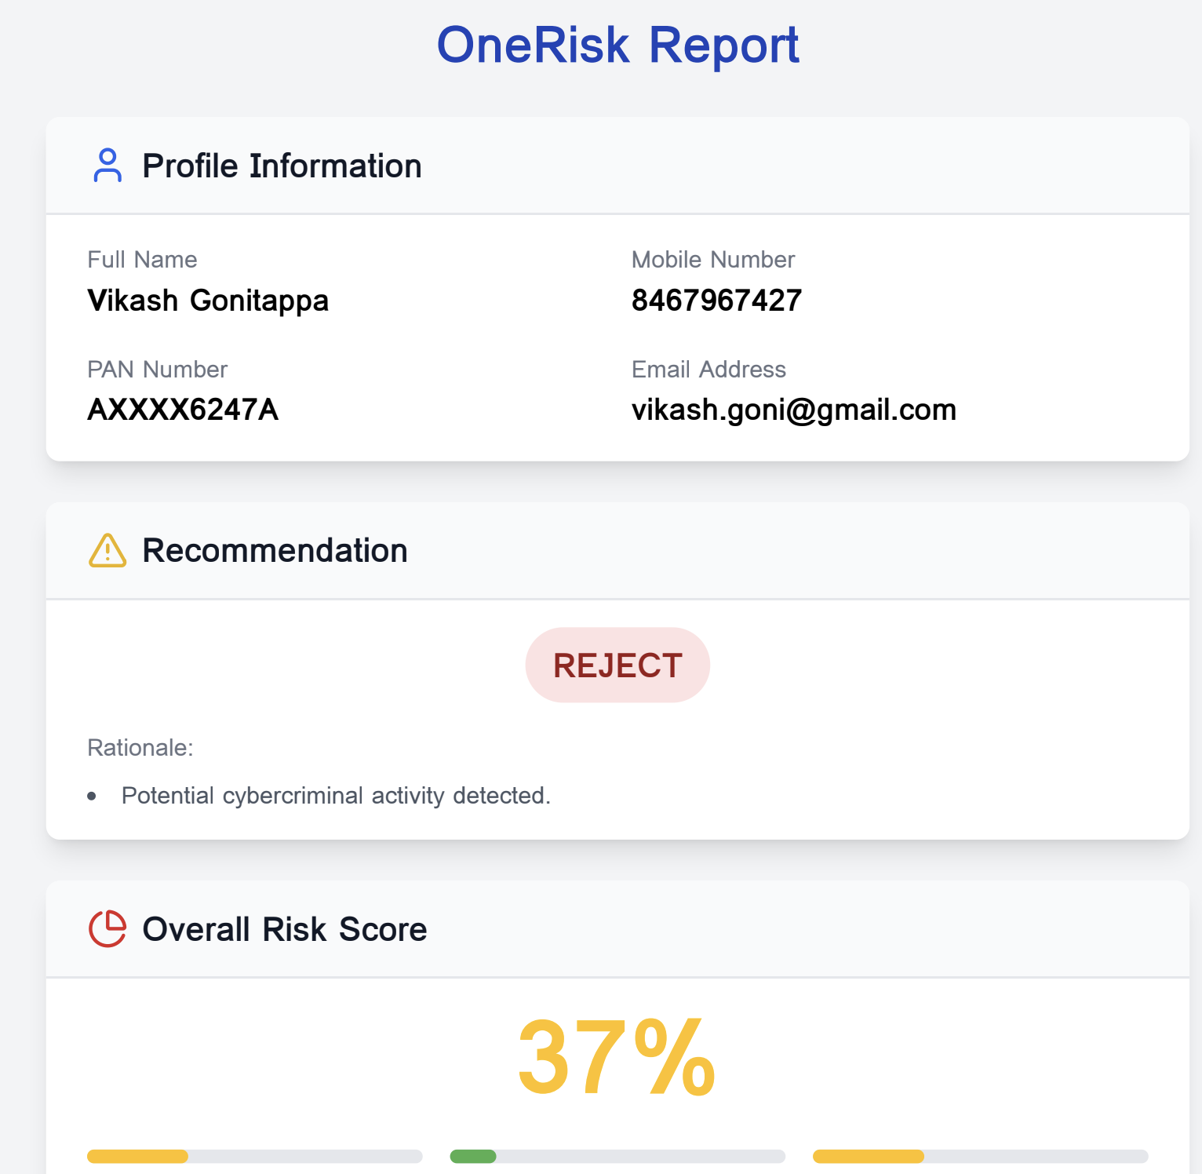
Our output is consumable as per your preferred information architecture
Report for Underwriters
Data to Internal Systems
Transaction INTELLIGENCE
API interaction
LOS/LMS

Slide 13
We are able to deliver this because our Stack is built as multi data and AI models at its core
Traditional
IDfy
Why this is crucial!
Template based
Inhouse LLM based
No disruption if source document changes
Search for numbers
Make sense of data
Draw insights instead of finding numbers to fill templates
Fixed risk checks
Evolving risk library
Model learns with each new datapoint
Lower accuracy
Higher accuracy
Feedback ensures increasing accuracy against static model
Static
Configurable
Granular analysis enables configure as per your risk appetite
Standalone checks
Cross database analysis
Multi-data source profiling instead of single point

Slide 15
We heard multiple pain points that lenders face while using bank statement analysis tools
Scenario | Implications
Statement issuing bank changes its template | False positives flagged - increased rejections
Fraudster uses advanced tools to modify statement ensuring all numbers reconcile | Will pass the document
There are specific checks on statement you need (e.g. statement should be 12 months) | No changes allowed, need to check manually
Portfolio specific additional risk check bank wants to do for specific borrower segment/portfolio (e.g. txn with gambling apps) | No bespoke risk signals
Want to triangulate values with outside systems | Take more inputs from user and handle in LOS and risk drop-offs
Integrate statement analysis in DIY journey | High latency and low first time right - fueling drop-offs and manual follow-ups

Slide 16
Gaps in market led us to rethink bank data analyzer from modern assessment context
Transaction intelligence
1
2
3
Let only genuine statements enter funnel
Scan all transactions & identify risky ones
As per risk appetite take decision
Document Fraud Identification
Fraudulent/Suspicious Transactions
Risk Registers for decision making
Looks beyond visual markers but within metadata to identify fraud
Safeguard against online tools making it easy to forge statement
Catches suspicious transactions via multi-dimensional model covering mode-counterparty-timing-txn size-frequency etc.
Most elaborate and expanding risk library enriched by risk signals observed & tested in market
We are building an data intelligence Co-pilot for your credit decision

Slide 17
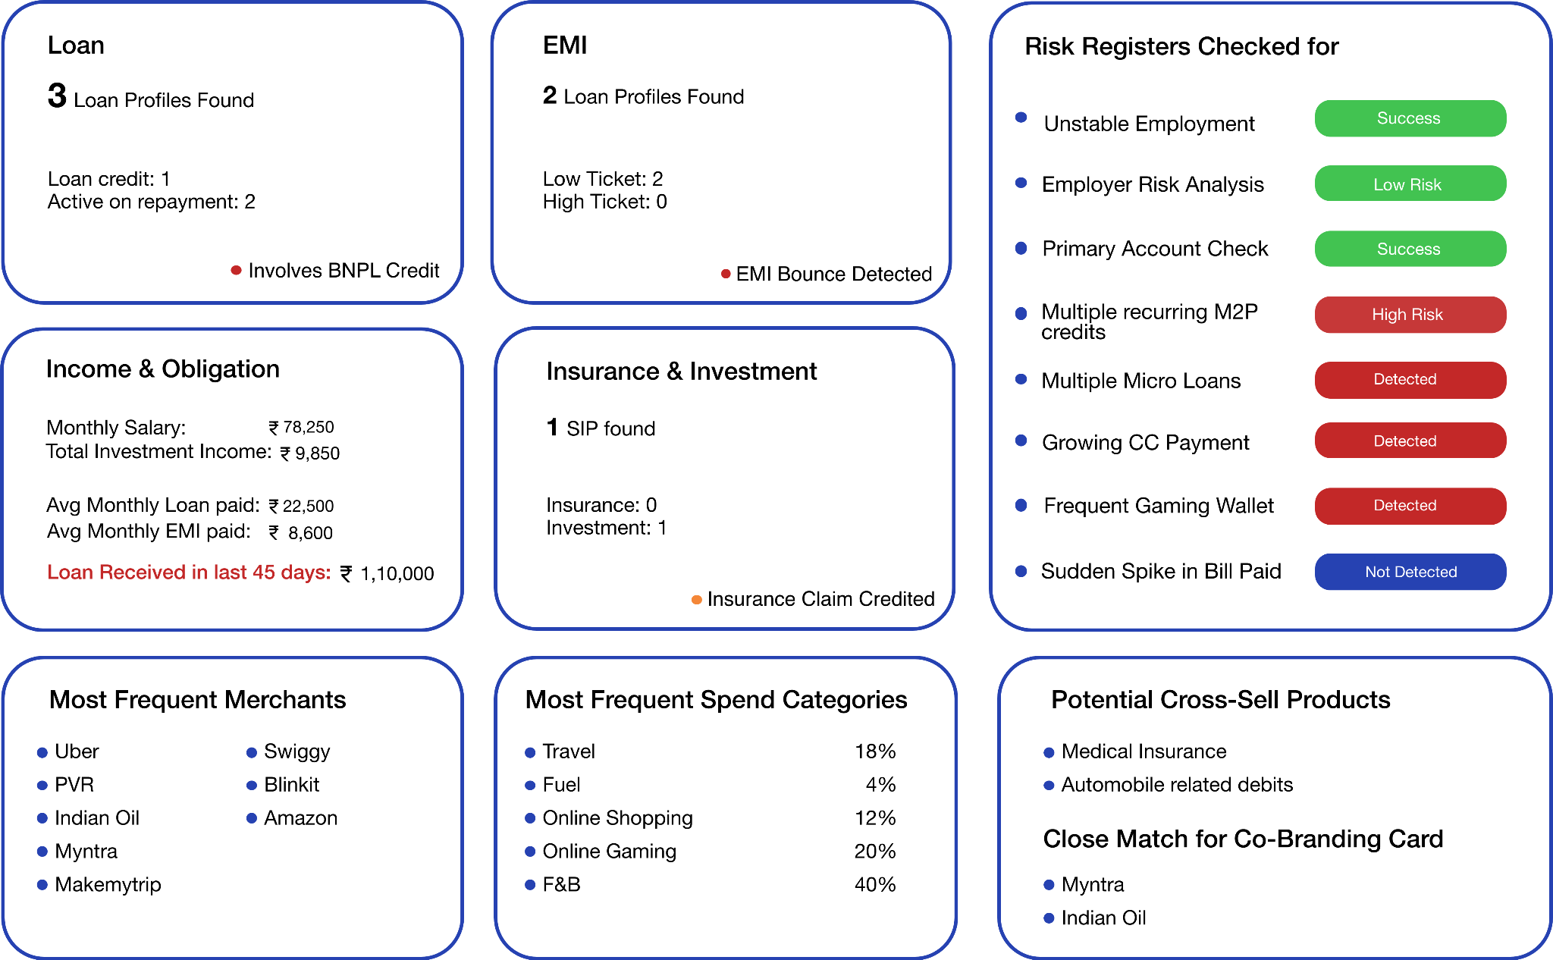

We will be able to profile the customer across dimensions to take credit decisions as well as cross-sell prioritization
Acc Hol Name: Rahul Mohan
Acc No: XXXXXX8907
Bank Name: KMB
Tampering Check: Not Tampered
Statement Duration: 14 Months
Total Txns: 185

Slide 18
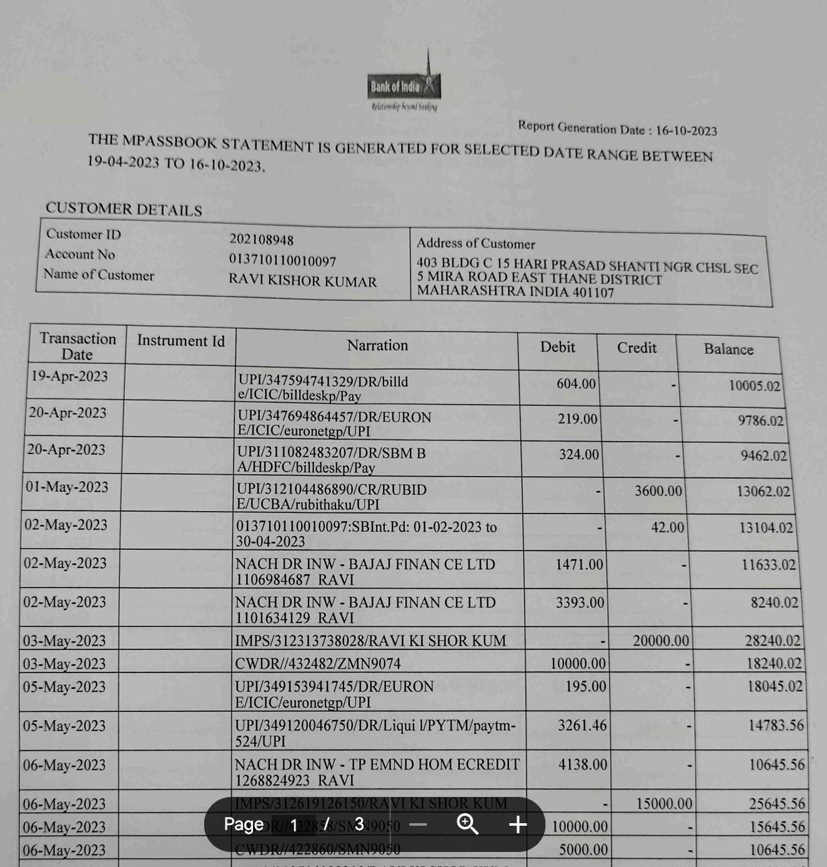


Ensuring seamless extraction of data from non-standard documents without breaking the STP flows
Template Library
AI Based OCR Service
Advanced Tampering Check
Type
E-statement
Non-Standard
Scanned Copy
IDfy
Others

Slide 19
Txn Categorisation Funnel
Extracted Transaction Details
UPI/DR/D419285150508/ Google Ind/okpa/ gpayrecharge@okpayaxis/UPI/ HDFe10ba35eac8e46889b
Entity Labelling
Framework matched: <mode>/<txn-type>/<txn-id>/<beneficiary-name>/<beneficiary-upi-id>/<mode-note>/<txn-note> Mode: UPI Bank: Axis Bank
Type: Debit Txn Note: HDFe10ba35eac8e46889b0fdb
Beneficiary Name: Google Ind UPI ID: gpayrecharge@okpayaxis
Beneficiary Name evaluation
Beneficiary Name : Google Ind Model Result: Business
Categorisation
Beneficiary Name : Google Ind Model Result: Utilities

Slide 20
Traditional approach extracts only 30% of information from bank statements
Type | Narration | Leading BSA
Credit | IMPS-IN/401708671090/6364888137/Creditvi | Transfer from Creditvi
Credit | ATM WDL-ATM CASH 40522 MG ROAD RAGHOGARH GUNA-- | Cash Withdrawal
Credit | IMPS-IN/401517699734/9999999999/SI CREVA | Transfer from SI CREVA
Credit | Recd:IMPS/407812092421/EARLYSALARY/KKBK/X7475/ESLOA IMPS-407812771632 | Transfer from EARLY SALARY
Debit | UPI-PHONEPE-BBPSBP@AXL-UTIB0AXLUPI-453526009365-PAYMENT FROM PHONE | Transfer to PHONEPE
Credit | IIFL FINANCE L-SL4664881 | Loan Received
Credit | UPI-S A MEDICAL AND GENE-GPAY-11240268361@OKBIZAXIS-UTIB0000000-412041958456-NA | Others
Debit | IMPS-416717877422-BRANCH INTERNATIONAL-ICIC-XXXXXXXX0890-38641472 CF | Others
Credit | Salary Credited for Arjun for March 2024 | Salary Credit
Debit | UPI/mPokket/409291435023/UPI UPI-409270798326 | Transfer to mPokket
Debit | UPI/Pocketly/419158313734/Easebuzz UPI-419114887558 | Transfer to Pocketly
Debit | TO TRANSFER-UPI/DR/415797371785/RUMMY TIME/RATN | Others
Debit | TO TRANSFER-UPI/DR/414721366088/Dream11/YESB/dream11@ye/ | Others
Only Traditional keywords are classified
Income with Salary as narration
Loans from traditional NBFCs
Cash withdrawal from ATMs
No Classification for majority due to hard coded keyword approach

Slide 21

IDfy enables better customer profiling and risk assessment, empowering smarter decision making
Keyword Match
AI Model based categorisation
New age signals
Type | Narration | IDfy BSA
Credit | IMPS-IN/401708671090/6364888137/Creditvi | Loan Received
Credit | ATM WDL-ATM CASH 40522 MG ROAD RAGHOGARH GUNA-- | Cash Withdrawal
Credit | IMPS-IN/401517699734/9999999999/SI CREVA | Loan Received
Credit | Recd:IMPS/407812092421/EARLYSALARY/KKBK/X7475/ESLOA IMPS-407812771632 | Personal Loan
Debit | UPI-PHONEPE-BBPSBP@AXL-UTIB0AXLUPI-453526009365-PAYMENT FROM PHONE | Utilities & Bill Payments
Credit | IIFL FINANCE L-SL4664881 | Loan Received
Credit | UPI-S A MEDICAL AND GENE-GPAY-11240268361@OKBIZAXIS-UTIB0000000-412041958456-NA | Medical Expense
Debit | IMPS-416717877422-BRANCH INTERNATIONAL-ICIC-XXXXXXXX0890-38641472 CF | International Wire Transfer
Credit | Salary Credited for Arjun for March 2024 | Salary Credit
Debit | UPI/mPokket/409291435023/UPI UPI-409270798326 | Pocket Loan Credit
Debit | UPI/Pocketly/419158313734/Easebuzz UPI-419114887558 | Pocket Loan Credit
Debit | TO TRANSFER-UPI/DR/415797371785/RUMMY TIME/RATN | Online Gaming
Debit | TO TRANSFER-UPI/DR/414721366088/Dream11/YESB/dream11@ye/ | Online Gaming
Additional Category Data Available for Risk Evaluation
Cash Withdrawal
Loan Received
Salary Credit
Pocket Loans
Medical Expense
Online Gaming
International Wire Transfers
Enhanced Risk Evaluation

Slide 22








Evolving risk library relevant for profiling of customer in present times
Frequent Txns with Gaming Platforms
Crypto & Trading Activity
Credit & Debits with BNPL platforms
Employer Risk Analysis
Inflow from multiple Merchant sources
P2P credits more than salary amount
High value P2M recurring debit (e.g. Rent)
Verify Primary Account

Slide 23
Building strongest risk/profiling library in the market to drive smart underwriting
Existing Fraud and Risk Triggers : 36
Roadmap Fraud and Risk Triggers : 29
Document quality check
Document Edited By Online Editors
Advanced Metadata Checks
Salary Fraud Indicator
Irregular Salary Credit
Salary Credit On A Holiday
Suspicious Mode Of Salary Credit
Salary Issuer Authenticator Check
EMI Fraud Indicator
Irregular Emi Transactions
Emi Bounce
Transaction Behaviour Check
Credit Percentage Of Round Number Transactions
Cheque Bounce (Inward/outward)
Suspicious Cash Transactions
Suspicious Rtgs Transactions
Overlimit Upi Transactions
Data Duplicity
Transaction Conflict (Top-10)
Cheque Transactions On Sunday
High value non categorized P2M debits
Cash Deposit On Holidays
Negative Eod Balance
Cheque Transactions On Holiday
Round Figure Tax Payments
Debit Percentage Of Round Number Transactions
Crypto / Trading activity detected
Credit/Debit with BNPL platform
P2P Credits more than salary amount
Transaction Behaviour Check
Suspicious ATM Withdrawals
NEFT transactions on holiday
Atm Cash withdrawal
Account with Low vintage
Account Number Mismatch
Neft Imps with cheque number
No Transactions in the Expected Range
Cheque number in series
Only ATM debits seen in any of the last three months
Debit transactions to employer is seen
NEFT/RTGS Deposits greater than twice the AMB
Imps Transactions Above Threshold
Salary Xns With Same Narration
Majority of transactions in round figures
Discontinuity in credits/ receivables
Huge Balances
Credit Interest not reflecting
Debit Interest not reflecting
Unusual Activity Of OD/CC Account
Credit EOD Balances
Irregular Transactions
Lifestyle Check
Rotation of Money
Irregular Transfers to Parties
Low Transactions
More and frequent Cash Deposits than Salary
Credit followed only by cash withdrawal
Immediate cash withdrawals after cash deposit
Parties present in both debits and credits
POS Credit Transaction in Savings Account
Multiple P2M credit sources (Moonlighting indicator)
Lifestyle Check
More Than 50 Percent Cash Transactions
Big Debit After Salary
Checking Account Detected
Cash Deposit More Than Salary
International Payments Detected
Frequent Txn with gaming platform
Available Now
Available by Q4

Slide 24
Solution is structured in modules to satisfy various digital journeys and swim lanes
LOS/BRE
PDF Extraction
Analysis
Fraud flag
Tampering etc.
Tuner
Statement
Collection
Data Fetch via NetBanking
Risk Flags
Pre-Check
Check bounce etc.
Data Fetch via AA
Direct metric
AMB, closing balance etc.
XML from existing AA
Fraud Triggers
Derived metric
Fixed obligation, income variability etc.
Note: The pre-check response includes document verification details such as the account holder's name, account number, bank name, tampering check results, and statement duration.

Slide 25
Case Study: Personal loan fintech embedded IDfy TIPs to drive digital underwriting for New to Credit customers
Customer context
IDfy Solution
Outcomes Delivered
~80k/month
NTC Applications processed without underwriter’s involvement
Customer Profile
Company provides small ticket, unsecured, instant loan through their app to individuals
Risk factors codification
Eliminate all fraud and non-target segment with balance information.
For Target segment compute all scorecard parameters for decisions
Smart Product decision
Rule engine recommends limits based on cashflow information of applicant
1.5X
Improvement in funnel conversion due to modular implementation resulting in faster response
Key Challenge
Majority of customers had no bureau presence, ticket size didn’t justify manual underwriting cost
Existing vendor had poor accuracy in identifying salary and had limited computation capability
~40%
Cost reduction in running analysis due to limited signal subscription

Slide 26
Case Study: NBFC used IDfy’s smart profiling to underwrite high ticket personal loan digitally
Customer context
IDfy Solution
Outcomes Delivered
Customer Profile
Customer is a NBFC which recently started started personal loan for self employed and salaried individuals
360 customer profiling
Sourced data across multiple data sources to create applicant profile
Created income profile and employer profile using bank statement and EPFO footprint
Identified high risk triggers from transaction statement
Quick integration with LOS
Enabled product specific checks within existing LOS within weeks for quick go live
<5 min
Credit decision using IDfy enabled risk profiling for large ticket personal loan
Key Challenge
Customer wanted to launch this new product with limited underwriting resources hence was looking for digital processing without changing existing LOS
~Xx
xxxxxx

Slide 27
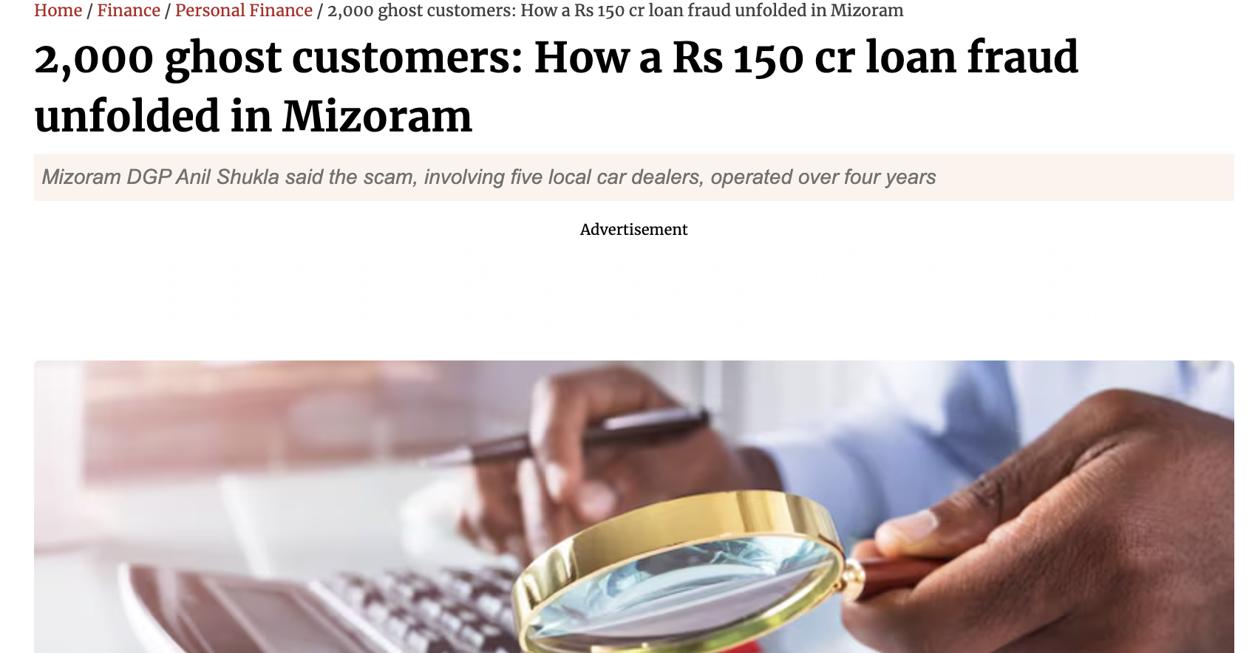
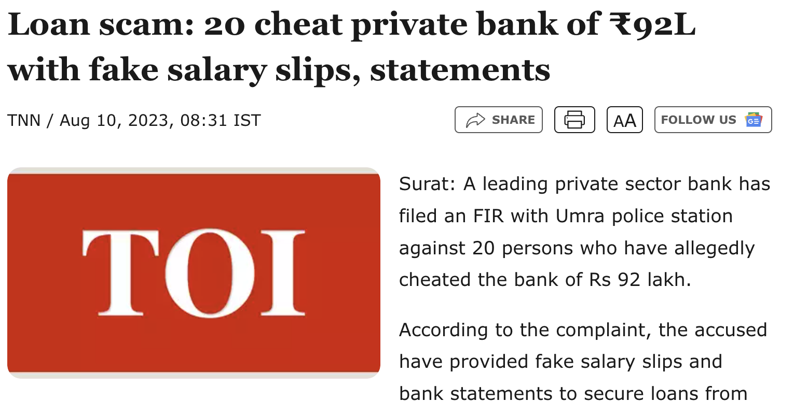
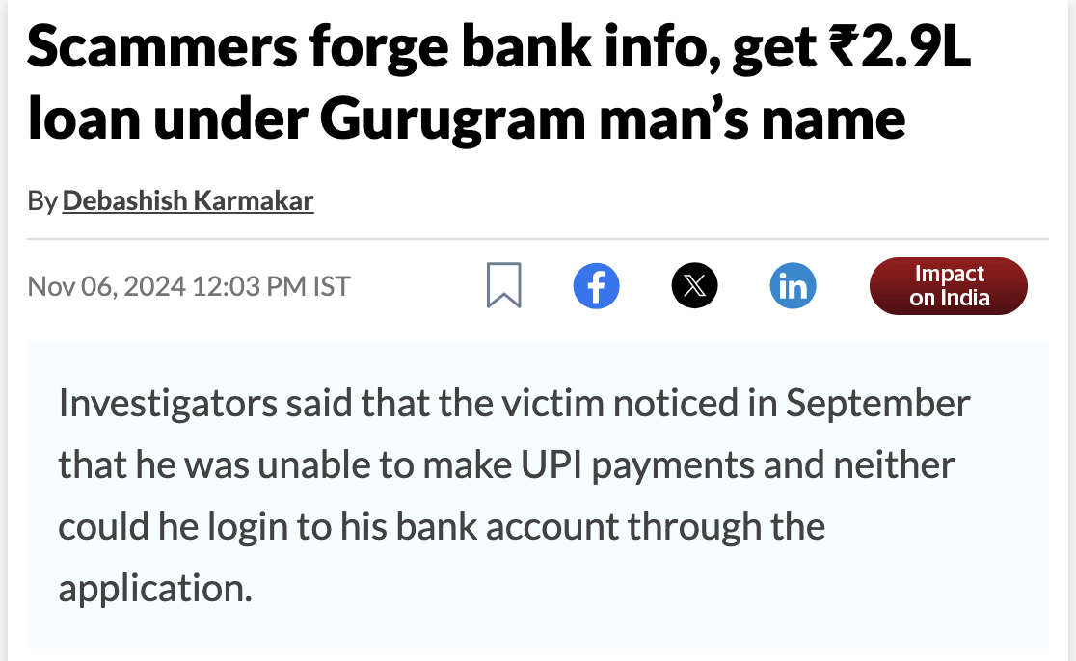
With fraudsters getting sophisticated, systems need to level up
Notes:
Links: https://www.business-standard.com/finance/personal-finance/2-000-ghost-customers-how-a-rs-150-cr-loan-fraud-unfolded-in-mizoram-124042900201_1.html https://timesofindia.indiatimes.com/city/noida/-gang-opens-salary-accounts-with-forged-docus-cheats-banks-of-23cr/articleshow/100290300.cms https://www.hindustantimes.com/india-news/2000-ghost-customers-a-fake-bank-account-150-cr-vehicle-load-fraud-in-mizoram-101714201547930.html

Slide 28
IDfy’s intelligence system converts account statement data into actionable insights on applicant profile
Risk & Product parameters
Profiling & Risk output
INTELLIGENCE
Risk Checks: Pass
Income Category: Non-MFI
Max EMI serviceability: 8k
Cross-sell Opportunity: Yes
Additional Diligence required: No

Slide 29
Profiling is done across multiple parameters to understand financial well being and lifestyle habits of an individual
Income Profile - Salaried
Salary profile Other Income (Detected)
Latest Employer Name: ABC Technologies Income Source: : Interest
Monthly Salary : 55,000 Amount: :5,000
Total Estimate monthly Income: 60,000
Credit Profile
No of Loans: 1
EMI: 5,000
Servicing duration (months): 5
Lender: IIFL Finance
Credit Card Usage: Detected
Average spend: 5,200
Ajay Kumar
Expense Profile -
Loan Repayment: 10,000
Insurance payment: 2,000
Other recurring expenses: 15,000
Bills and Utility payments: 5,000
Fixed monthly Obligations(est.): 32,000
Average lifestyle expenses: 12,000
Average other expenses (non lifestyle): 8,000
Average monthly expense: 52,000
Savings Profile
Monthly average saving: 10,000
Saving in bank accnt 5,000
Non-bank saving amount: 5,000
Saving instruments: Recurring deposit, fixed deposits, Trading
Address: ……………
Wealth Management
Running Insurance premiums: 1
Premium 1,000
Likely insurance type: Life
Equity investment: Yes
Broker: Zerodha
Avg monthly spend: 5,000
Withdrawal/Investment: 5%
Mutual Fund investments: Yes
Average monthly investment: 2,000
Alternative Assets: Yes
Type of asset: Crypto , Debt
Avg monthly investment: 2,000
Debt Servicing capacity:
8,000/month
Cross-sell opportunities
Health insurance, MF
Fraud Profile
No Risk Detected
Expense Details : Top Merchant Profile
Top Merchants : Amazon: 15% ; Ola: 5%; Swiggy: 8%
Subscriptions Detected: Netflix, Prime
Policy Parameters check
All Clear
Risk Triggers
Risky Employer
Non-primary accnt
Gambling/Gaming Detected
Unknown income source
Reducing disposable income
Regular saving
Likely Owned Vehicle
Low Cash Txn
+5 risk markers detected

Slide 30




Besides intelligence we do outperform on all parameters which existing bank statement analyzer tools offer
Input Mode | Key Differentiator | TAT¹ | Hit Rate | Accuracy
E-Statements | - LLM models to analyze transactions | 10-12 secs* | 99% | 99%
Scanned Statements | - Intelligent document processing algorithms to deliver superior extraction | 1-1.5 mins* | 90% | 95%
Net Banking | - Agent assisted journey supported; All major banks (24+) integrated | 6-8 secs | 99% | 99%
Via AA | - Live with 60+ banks | 6-8 secs | 85%² | 99%
Seamless Integration
Modular Design
Ability to precisely match your current response
Pre - Check Module
Advanced Metadata Module
No additional training required
Fraud Check Module
Analysis Module
Detailed access to overall funnel with dashboard
Advanced Risk Registers module
Pre-integrated with leading LOS platforms
Module wise pricing - Pay only for modules which are being used

Slide 31
Next Steps
Comprehensive report containing
Total Salary Identified
Total Loan/EMI Identified
Count of Statements by each Fraud and Risk Category
POC (This will involve analyzing 200-300 statements provided by the client)
Providing the client with access to the Dashboard link to conduct the POC independently
Bulk upload of Statements
The Market Development team is conducting a POC using the Dashboard

Slide 32
Enable without disrupting any of the existing flows and go live within 3 weeks
Typical implementation plan
Milestones/Activities | Week 1 | Week 2 | Week 3 | Week 4 | Week 5
Share signals and current input file
IDfy configures JSON to deliver required keys
UAT of the output
Parallel run (Optional)
Live
Ability to consume inputs from your Account aggregator pipeline and tailor our output as per your LOS accepted schema, ensuring zero bandwidth consumption from your teams

Slide 33









Our platform is structured for insights, against traditional approach of optimizing for data feeds to LOS
Input
Delivering Intelligence
Output Modules
Data Consolidation
Insight Generation
IDfy Exclusive Data
(Shell Companies, Demographic Risk Indicators et al)
Proprietary AI/ML Layer
“Insights OS” by IDfy
Upload PDF
Dashboard
Scoring Engines
Bank Statement Transaction Data
Excel Response
Netbanking Fetch
Consolidated IDfy Data Platform
Data Triangulation
ML Layer
API Connectors
JSON Integration
Account Aggregator
Unstructured Public Data
(Court Records, e-FIR, Socials)
Structured
Public Data
(EPFO, GST, Aadhaar, PAN)
Deep Analysis

Slide 34
Our fraud check library looks beyond just number based reconciliations and summarization
2
Illustrative list of Design Parameters checked for
3
1
Image Blueprint Altered
PDF Author/Producer
Severity : 1 to 3
Textual Styling Inconsistent
Image Position & Color Space
Severity 1: Document shows modified timestamp but no signs of processing post creation.
Severity 2: Document shows signs of processing but no signs of data tampering.
Severity 3: Document shows overall tampering performed, due to mismatch of crucial design aspects throughout the statement
Encryption Not Found
Table Coordinates & Layout
User Access Changed
Font Alignment
Trailer Keys Not Matching
PDF Version

Slide 35
Our algorithms catch underlying risks within seemingly safe transactions
Illustration
STP / Hybrid Loan Journey
Salary Issuer Name Think and Learn Private Limited (Byju’s)
Salary Issuer Alert
High Risk Detected Based on EPFO Data

Slide 36
Bring Agility to credit operations - Changes in BRE/LOS handled within days
IDfy
LOS/BRE
Compute proxies via bank statement for various scorecard parameters
Triangulate self declared data and estimated from statement to make faster and more confident decision making
Derived numbers enabled at the time of setup and can be further modified using our admin tuner
Fraud checks
Fraud flag
Tampering etc.
Statements
Risk Checks
Risk Flags
Tuner
Check bounce etc.
Direct metric
AMB, closing balance etc.
Metric
Derived metric
Fixed obligation, income variability etc.
Output can be tweaked as per the use case/scorecard requirement

Slide 37
Our service standards have converted our customers into fans
We partner in your transition to the new system
Personalized Support
Scalable implementation
Support Strategic changes
Optimized for your end customers
Direct involvement of product team to solution your use case
Dedicated customer success manager - not just email support, call the person if you need
2 week hypercare mode - We review operations and make need based tweaks
Quarterly business review - touchbase on quarterly basis with IDfy leaders to evaluate service standards

Slide 38
Have peace of mind on compliance front - We do forward looking compliance

Slide 39
Have peace of mind on compliance front - We do forward looking compliance

Slide 40
Lets see platform in action

Slide 41
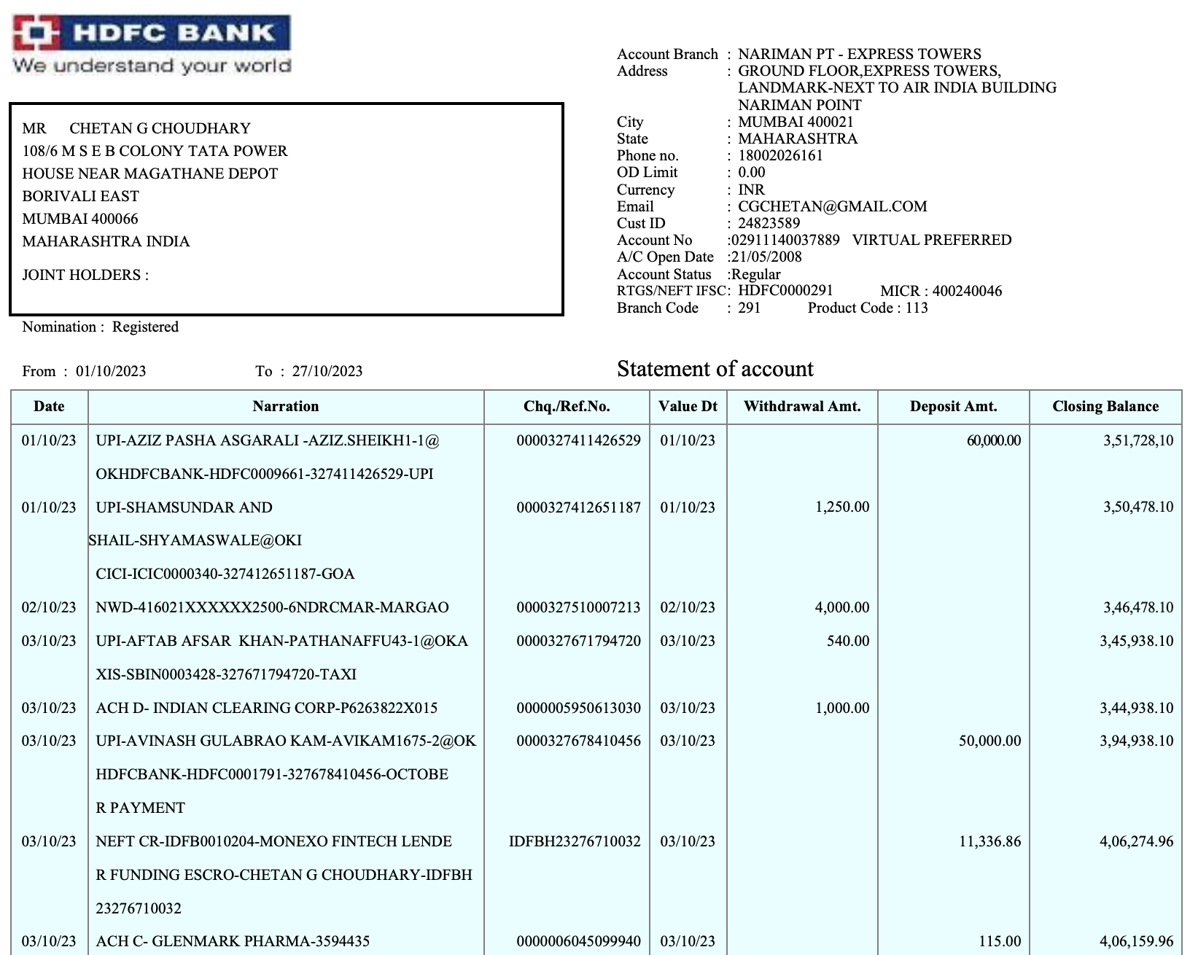
Case – I: One of the below documents is tampered. Which one?

Slide 42
Case - I : Did you get it right?

Slide 43
Case - I : Key signals and impact of fraud
Properties not matching with genuine document
Producer Different
PDF Timestamp Not same
Encryption is missing
User access changed
Trailer Keys & ID Altered
Textual alignment Inconsistent
Checked currently, but inconclusive in tampering detection
Missing from all solutions in the market today

Slide 44


Case - II : Which profile is more risky?
Statement 1 - Salary Detected
DATE | NARRATION | TYPE | MODE | CATEGORY | AMOUNT
29/03/2018 | THINK & LEARN PVT LTD SALARY - APR | CREDIT | INT | SALARY | 18000
30/04/2018 | THINK & LEARN PVT LTD SALARY - MAY | CREDIT | INT | SALARY | 17573
29/05/2018 | THINK & LEARN PVT LTD SALARY - JUN | CREDIT | INT | SALARY | 18000
Statement 2 - Salary Detected
DATE | NARRATION | TYPE | MODE | CATEGORY | AMOUNT
29/03/2018 | GUPTA LOGISTICS SALARY - APRIL | CREDIT | INT | SALARY | 16000
30/04/2018 | GUPTA LOGISTICS SALARY - MAY | CREDIT | INT | SALARY | 15680
29/05/2018 | GUPTA LOGISTICS SALARY - JUN | CREDIT | INT | SALARY | 16000

Slide 45
Employment Risk Analysis
M/L Risk
Verified for active presence of the entity
High Risk
No Risk
Checked for PF payments for last 4 months
Green : No Risk Found with the income issuer.
Amber: Low to Medium risk found with employer (Decline/ partial default in PF payments)
Red: High Risk employer (Missed PF payments/ Inactive entity)
Evaluated the employees count stats for last 4 months
Checked against shell company database
On an average every one in 100 salary issuers are found to be between low-high risk based on their PF payment data

Slide 46
Sweeten the deal - Don’t just believe us, it by yourself and than pay us

Slide 47
As fraud and risk experts, we see a need for a massive update in the current lending journeys
Investing in better risk assessment and fraud mitigation will deliver
disproportionate value and unlock new segments
Fraud is becoming more organized and dynamic
AI-powered deep fake documents
Fraud payslips and statements
On the other hand, the current tools are static, outdated, and offer very basic analysis
Traditional risk signals insufficient for new segments
High competition in vanilla segments forcing need for sharper risk assessment
New segments have low formal footprints
Consumer Expectations
Rapidly Evolving
Expecting fully digital journeys
Market moving towards rapid disbursals

Slide 48
Case - I

Slide 49
Case – I: One of the below documents is tampered. Which one?

Slide 50
Case - I : Did you get it right?

Slide 51
Process of catching a sure shot fraud
2
Key Design Parameters checked for
3
1
Image Blueprint Altered
PDF Author/Producer
Severity : 1 to 3
Textual Styling Inconsistent
Image Position & Color Space
Severity 1: Document shows modified timestamp but no signs of processing post creation.
Severity 2: Document shows signs of processing but no signs of data tampering.
Severity 3: Document shows overall tampering performed, due to mismatch of crucial design aspects throughout the statement
Encryption Not Found
Table Coordinates & Layout
User Access Changed
Font Alignment
Trailer Keys Not Matching
PDF Version

Slide 52
Case - I : Key signals and impact of fraud
Properties not matching with genuine document
Producer Different
PDF Timestamp Not same
Encryption is missing
User access changed
Trailer Keys & ID Altered
Textual alignment Inconsistent
Checked currently, but inconclusive in tampering detection
Missing from all solutions in the market today

Slide 53
As seen on one of the Education loan & PL journey
Journey: Education Loan Client Type: NBFC
Statements Considered | 10000
Severity - 1 | 320
Severity - 2 | 1150
Severity - 3 | 270
On an average 2.2% PDF cases are found to be of severity 3
in a lending funnel

Slide 54
Case - II

Slide 55
Case - II : Which profile is more risky?
Statement 1 - Salary Detected
DATE | NARRATION | TYPE | MODE | CATEGORY | AMOUNT
29/03/2018 | THINK & LEARN PVT LTD SALARY - APR | CREDIT | INT | SALARY | 18000
30/04/2018 | THINK & LEARN PVT LTD SALARY - MAY | CREDIT | INT | SALARY | 17573
29/05/2018 | THINK & LEARN PVT LTD SALARY - JUN | CREDIT | INT | SALARY | 18000
Statement 2 - Salary Detected
DATE | NARRATION | TYPE | MODE | CATEGORY | AMOUNT
29/03/2018 | GUPTA LOGISTICS SALARY - APRIL | CREDIT | INT | SALARY | 16000
30/04/2018 | GUPTA LOGISTICS SALARY - MAY | CREDIT | INT | SALARY | 15680
29/05/2018 | GUPTA LOGISTICS SALARY - JUN | CREDIT | INT | SALARY | 16000

Slide 56
Case - II : High Risk Salary Issuer
Statement 1
STP / Hybrid Loan Journey
Salary Issuer Name Think and Learn Private Limited (Byju’s)
Salary Issuer Alert
High Risk Detected Based on EPFO Data

Slide 57
Employment Risk Analysis
M/L Risk
Verified for active presence of the entity
High Risk
No Risk
Checked for PF payments for last 4 months
Green : No Risk Found with the income issuer.
Amber: Low to Medium risk found with employer (Decline/ partial default in PF payments)
Red: High Risk employer (Missed PF payments/ Inactive entity)
Evaluated the employees count stats for last 4 months
Checked against shell company database
On an average every one in 100 salary issuers are found to be between low-high risk based on their PF payment data

Slide 58
As seen on one of the Education loan & PL journey
Journey: Personal Loan
Status | Salary Issuer Name
High Risk | PLANET PCI INFOTECH DUTTA AUTOMOBILE TVISHI SERVICES PRIVATE LIMITED MACLEODS PHARMACEUTICALS LTD MAURER STANFIELD INDIA LIMITED
Medium Risk | VISIPAK PRIVATE LIMITED A K G T GINGER TRADERS RVM DIGITAL KALAMANDIR JEWELLERS LIMITED S V SANKARALINGA NADAR
Low Risk | RANJIT BUILDCON LIMITED KANAKA FOOD MANAGEMENT SERVICES PRIVATE LIMITED AUTHENTIC OCEAN TREASURE THE MONTANA GROUP OM SAINATH PRESSTECH
Statements Considered | 5000
High Risk | 128
Medium Risk | 300
Low Risk | 65

Slide 59
There are many such issues that current tools are completely missing
Process Step | Key Gaps | Impact
1. Documents Collection | Tampered bank statements accepted Illegible documents sent for processing | Multiple steps required for customers Fraud accepted in system
2. Bank Statement - Extraction | Up to 4 hours required to process Involves manual support | Limited STP journeys Poor customer experience
3. Bank Statement - Analysis | Only basic analysis - No deep insights Incorrect assessment of income and debt | Leaving value on the table by not leveraging insights Incorrect risk assessment

Slide 60
The current solutions are fundamentally limited by architecture and cannot support any dynamic intelligence
Input
Current Solutions - Completely Static Process
Output Modules
Upload PDF
Dashboard
Bank Statement Transaction Data
Basic Pre-defined Variable Calculator
Excel Response
Netbanking Fetch
JSON Integration
Account Aggregator

Slide 61
IDfy’s fundamental architecture is based on highly enriched data from a wide variety of sources
Input
Step - 1: Enriching Data
Output Modules
Data Consolidation
IDfy Exclusive Data
(Shell Companies, Demographic Risk Indicators et al)
Upload PDF
Dashboard
Bank Statement Transaction Data
Basic Predefined Variable Calculator
Excel Response
Netbanking Fetch
Consolidated IDfy Data Platform
ML Layer
API Connectors
JSON Integration
Account Aggregator
Unstructured Public Data
(Court Records, e-FIR, Socials)
Structured
Public Data
(EPFO, GST, Aadhaar, PAN)

Slide 62
Our proprietary AI/ML layer is designed to give unparalleled insights
Input
Step 2: Delivering Intelligence
Output Modules
Data Consolidation
Insight Generation
IDfy Exclusive Data
(Shell Companies, Demographic Risk Indicators et al)
Proprietary AI/ML Layer
“Insights OS” by IDfy
Upload PDF
Dashboard
Scoring Engines
Bank Statement Transaction Data
Excel Response
Netbanking Fetch
Consolidated IDfy Data Platform
Data Triangulation
ML Layer
API Connectors
JSON Integration
Account Aggregator
Unstructured Public Data
(Court Records, e-FIR, Socials)
Structured
Public Data
(EPFO, GST, Aadhaar, PAN)
Deep Analysis

Slide 63
Introducing IDfy’s Transaction Intelligence Platform

Slide 64
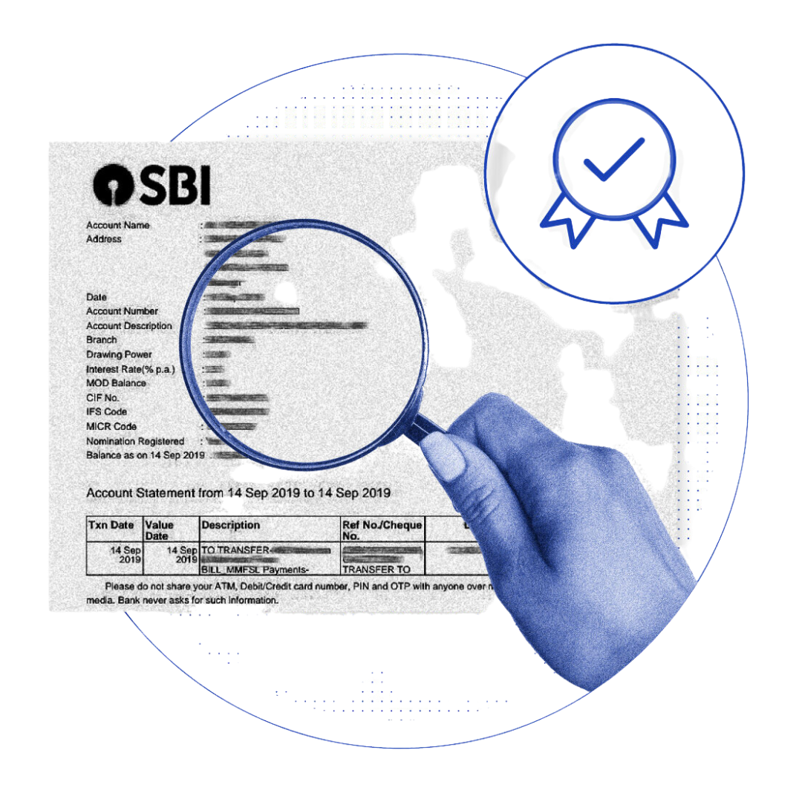
A complete overhaul of bank statement analysis in your journey!
End-to-end platform with enhanced capabilities at each stage
Unparalleled insights - Above and beyond the bank statement
Industry leading coverage and hit rate
Seamless integration and modular pricing

Slide 65
1. End-to-end platform with advanced capabilities at each stage
Enhanced Bank Statement Analysis
Onboarding Module
Extraction Module
1. Document Collection
2. KYC Completion
1. Support for Net Banking & Account Aggregator
2. Format agnostic mode of data extraction for PDF upload
3. AI based extraction for Scanned documents leading to lower TAT
1
2
3
4
Validation Module
Analysis Module
1. Document Fitness Check
2. Advanced Tampering Check (Classify inconclusive cases to fraud and genuine)
1. Consolidated Analysis with 120+ signals
2. Fraud checks
3. Deep insights across fraud, risk, and persona mapping
4. Trigulated information against multiple public and IDfy exclusive databases

Slide 66
2. Get deep actionable insights for better underwriting decisions
Insight Categories
Credit Risk
Fraud Signals
Intent
Capability
Rejection
Suspicious
1. Cheque Bounces
2. High Cash Activity
3. Undisclosed debt obligations
4. Irregular EMI/Loan payment
5. EMI Bounces
1. Salary Burnout Signal
2. Account Activity
3. Cashflow score
4. Overdraft Usage
5. High Risk Salary Issuer
1. Adv. tampering Check
2. Triangulation of Income
3. Fraudulent employer
1. Transactions on bank holidays
2. Transactions crossing the bank prescribed limits
3. Income Irregularities

Slide 67
3. We offer comprehensive coverage of statements and highest accuracy in detection
Input Mode | Key Differentiator | TAT¹ | Hit Rate | Accuracy
E-Statements | - Largest repository of standard statements for comparison | 10-12 secs* | 99% | 99%
Scanned Statements | - LLM powered OCR algorithms | 1-1.5 mins* | 90% | 95%
Net Banking | - Agent assisted journey supported; All major banks (24+) integrated | 6-8 secs | 99% | 99%
Via AA | - Live with 60+ banks | 6-8 secs | 85%² | 99%
Seamless Integration
Modularly Designed
Ability to precisely match your current response
Pre - Check Module
No additional training required
Advanced Metadata Module
Detailed access to overall funnel with CRO dashboard
Extract All
Fraud Check Module
Pre-integrated with leading LOS platforms
Analysis Module

Slide 68


Take the
IDfy Challenge!
Complete a free POC with 500 statements, and we guarantee better accuracy and deeper insights!

Slide 70
3. We offer comprehensive coverage of statements and highest accuracy in detection
With our AI powered extraction, we eliminate all manual intervention and offer the fastest processing times in the industry enabling high STP rates
Input Mode | Key Differentiator | TAT¹ | Hit Rate | Accuracy
E-Statements | - Largest repository of standard statements for comparison | 20-30 secs* | 99% | 99%
Scanned Statements | - LLM powered OCR algorithms | 2 - 3 mins* | 90% | 95%
Net Banking | - Agent assisted journey supported; All major banks (24+) integrated | 10 - 15 secs | 99% | 99%
Via AA | - Live with 60+ banks | 10 - 15 secs | 85%² | 99%
Notes: 1. For a statement of 80 pages 2. Bank Uptime Dependence

Slide 71
Seamless Integration
Ability to precisely match your current response
Modularly Designed
Pre - Check Module
No additional training required
Advanced Metadata Module
Extract All
Detailed access to overall funnel with CRO dashboard
Fraud Check Module
Analysis Module
Pre-integrated with leading LOS platforms

Slide 72
Appendix

Slide 73
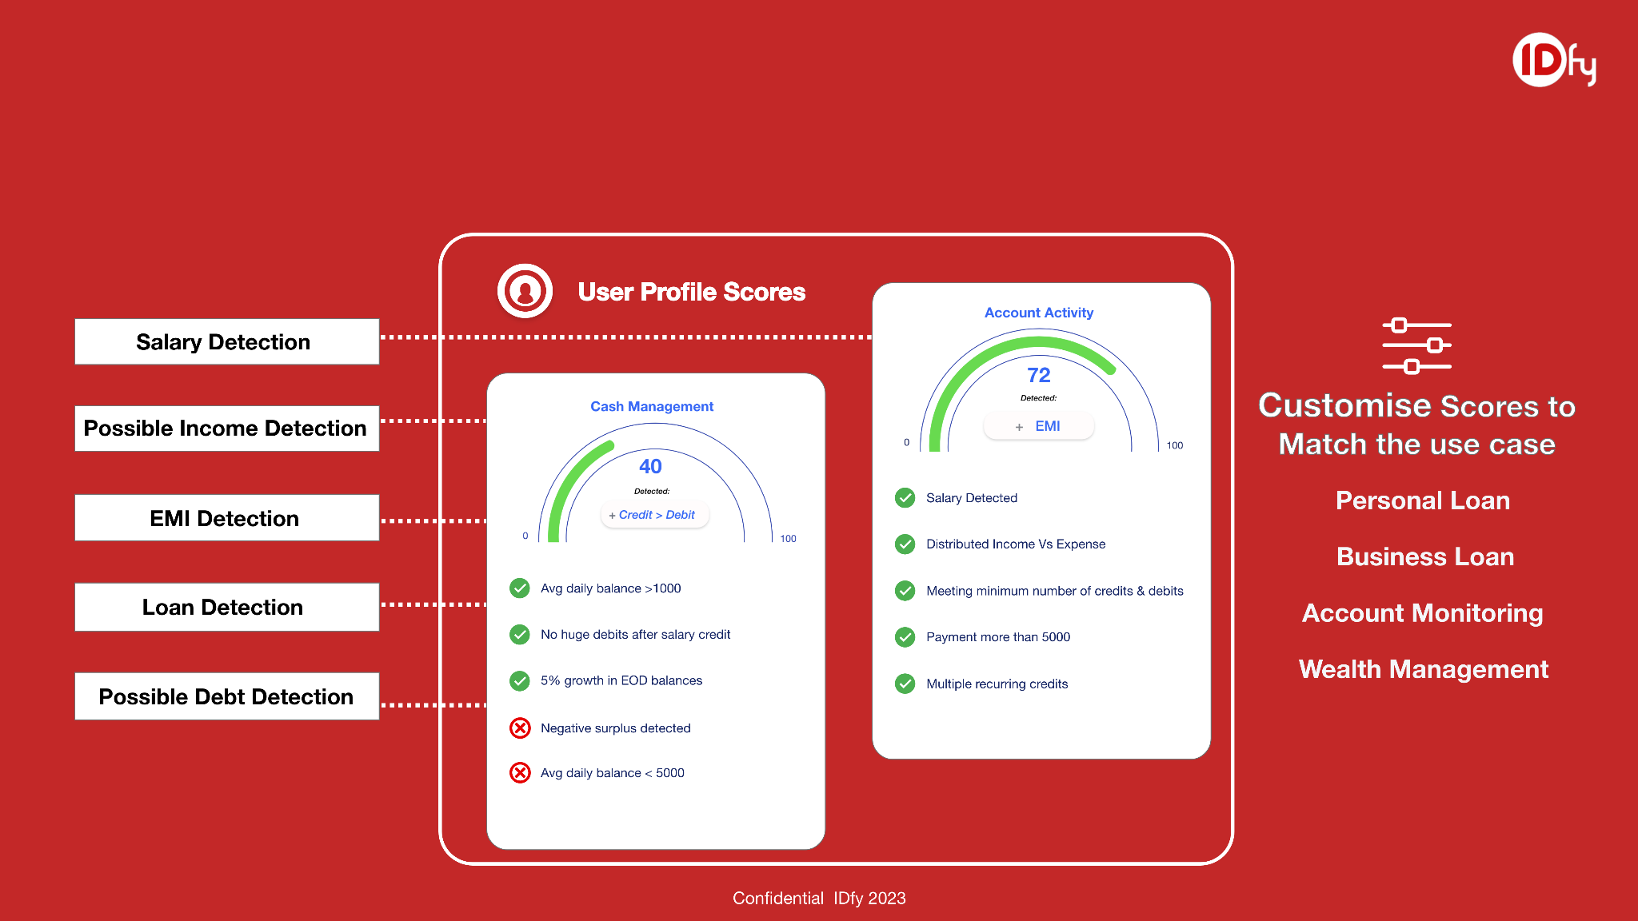
3. Quick View Scores to analyse the income & debt of the profile intelligently
3. Analyse Income & Debt and consume with quick view scores

Slide 74



Fraud is getting organized & more equipped everyday
Document Fraud
Transaction Fraud
Fraud Rings are getting more organized, it is not individuals but organizations
Advanced Gen-AI led tools used to create hyper-realistic documents
Slow Evolution of existing tools to be able to detect the rapid advances in editing / tampering tools

Slide 75
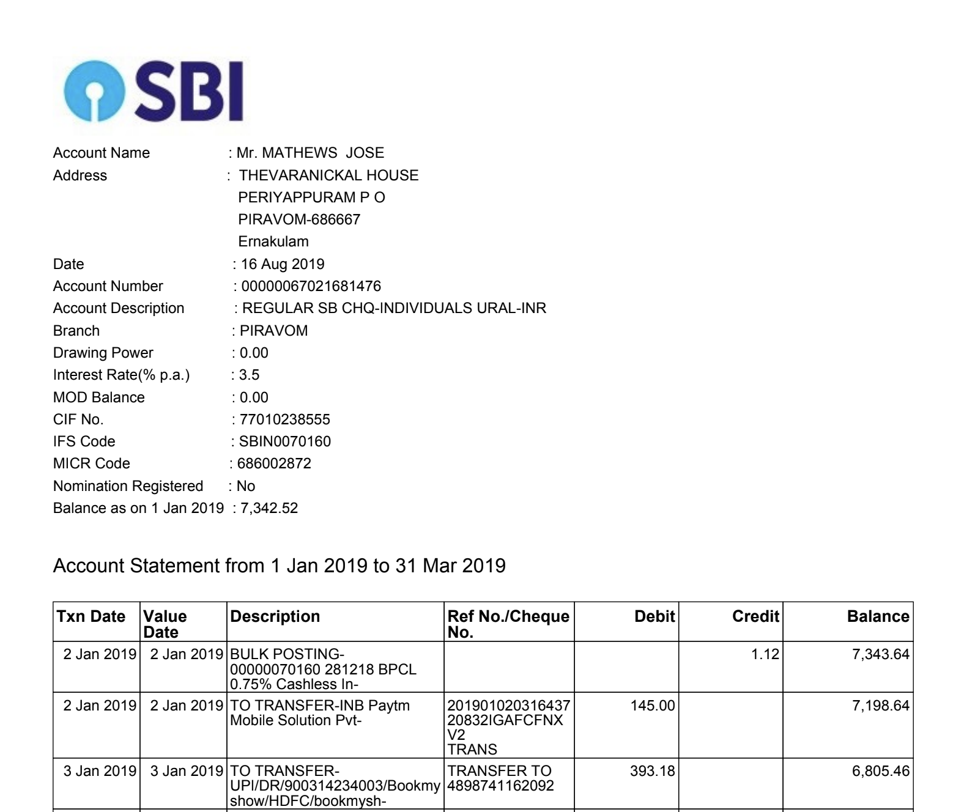
Document Fraud

Slide 76
There are significant externalities that affect underwriting journey - but current tools remain outdated

Slide 77
Persona
Targeted Analysis
Scope for personalised engagement
Enhanced Marketing

Slide 78
3. We offer highest coverage of sources and accuracy in detection
Input Mode | Key Differentiator | TAT (for a statement of 80 pages) | Hit Rate | Accuracy
E-Statements | - Largest repository of standard statements for comparison | 20-30 secs* | 99% | 99%
Scanned Statements | - LLM powered OCR algorithms | 2 - 3 mins* | 90% | 95%
Net Banking | - Agent assisted journey supported; All major banks (24+) integrated | 10 - 15 secs | 99% | 99%
Via AA | - Live with 60+ banks | 10 - 15 secs | 85%* (Bank Uptime Dependence) | 99%

Slide 79



1. BSA Pre-Check API: Run initial checks on statements before performing analytics
On average, ~12% users submit incorrect documents the first time during the loan application process
IDfy’s BSA Pre-Check API runs initial checks on the document has been submitted before getting into analysis
All these within a TAT of 5-7 Sec
Document Filter for non statement uploads
Check for E-statement or Scanned PDF
Cost Savings otherwise spent on Analysis of Incorrect Documents
Document Tampering Checks
Reduce Drop-Offs & Improve Overall Customer Experience
Account Holder Information
Bank Details
Statement Start & End date

Slide 80
1. End-to-end platform with advanced capabilities at each stage
Enhanced Bank Statement Analysis
Onboarding Module
Extraction Module
1. Document Collection
2. KYC Completion
1. Support for E-statement & Scanned documents
2. AI based format detection
3. LLM based scanned document extraction
1
2
3
4
Validation Module
Analysis Module
1. Document Fitness Check
2. Document Tampering Check
3. Advanced Metadata Check
1. Consolidated Analysis with 120+ signals
2. FCU checks
3. Pattern based deep scan
4. Risk Profiling
5. Triangulation

Slide 81



2. BSA Extract-All API: Transaction Level Data from Scanned Statements
Everything in Pre-check API
Transaction Tabulation
LLM powered OCR Algorithms to extract data from scanned statements within minutes
Support all custom bank statement templates to enable data extraction for e-statements
Tampering Checks on PDF Documents to identify document irregularities

Slide 82
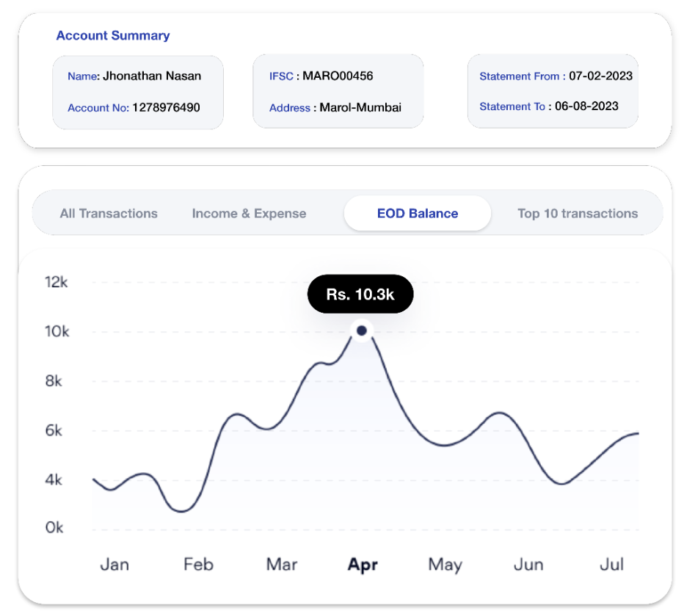
3. BSA Analytics API: Perform Comprehensive Analytics on Extracted Transaction Data
Accurate Salary Detection using Keyword + Pattern recognition
Accurate Detection of EMI / Obligations
Cash Flow Analysis
Advanced Fraud Triggers
Customize the output parameters & risk-scores as per your existing integrations & use-case requirements

Slide 83
Product Specifications - Core
Sl no. | Functionality | Details
1 | Consumption | Via API Suite OR via Dashboard
2 | Modes of Data Collection | E-Statement Scanned Document Net-Banking Account Aggregator
3 | Offerings | Pre-Check Extract-All FCU Checks Analysis
Notes:
Bring your underwiring processes to the AI century
Enable 1st level of document fit & fraud check at the top of the funnel even before processing the data.
Format agnostic LLM based models to get extraction done within seconds compared to manual ops led extraction.
Perform deep scans for pattern based insights inplace of keyword match for derived analysis
Solution designed with frauds and technology of tomorrow by understanding & taking feedback from credit teams
We work with the industry leaders to constantly detect fraud very early in the journey and release security updates OTA

Slide 84
Product Specifications - Core
Sl no. | Functionality | Details
4 | Fraud Signals covered to detect | Document Fraud Income / Salary Fraud User Persona / Lifestyle based Triggers
5 | Analysis Capabilities | Month-wise ratios & EOD - based data-points Income analytics Loan, EMI & Debt transaction detection Transaction categorisation Credit & Debit Profiling Scoring
Notes:
Bring your underwiring processes to the AI century
Enable 1st level of document fit & fraud check at the top of the funnel even before processing the data.
Format agnostic LLM based models to get extraction done within seconds compared to manual ops led extraction.
Perform deep scans for pattern based insights inplace of keyword match for derived analysis
Solution designed with frauds and technology of tomorrow by understanding & taking feedback from credit teams
We work with the industry leaders to constantly detect fraud very early in the journey and release security updates OTA

Slide 85
Spectrum from risk to sure shot fraud..
Fraud severity scale
1 2 3
Metadata Failure
Advanced metadata Failure
Font & Format Mismatch
Balance Recon Failure
Irregular or Multiple Salary detected
Salary Issuer Authenticity Failure
Associated party transactions check
Multiple Cheque Bounce detected
Multiple EMI Bounce detected
Lifestyle Checks
Transaction Behaviour Checks
Cash Activity Checks

Slide 87
Case - I : Document Fraud Detected
Properties not matching with genuine document
Producer Different
PDF Timestamp Not same
Encryption is missing in second doc
User access update
Trailer Keys & ID Altered
Image Blueprint Altered
Textual alignment Inconsistent
Media Layout Modified

Slide 88
Our proprietary AI/ML layer is designed to give unparalleled insights
Input
Data Enrichment
Intelligence Layer
Output Modules
Bank Statement Extraction
Upload PDF
Dashboard
Scoring Engines
Excel Response
Netbanking Fetch
Data Triangulation
Data Enrichment
Deep Analysis
JSON Integration
Account Aggregator
< 20 Secs

