Slide 1

Lending Club Case Study
Group Members:
Adarsh Kumar Ray
Shuchi Jain

Slide 2

Table Of Contents
PROBLEM STATEMENT AND OBJECTIVE
ANALYSIS
SUMMARY & CONCLUSION
DATA UNDERSTANDING, CLEANING & MANIPULATION

Slide 3
PROBLEM STATEMENT AND OBJECTIVE

Slide 4
As a Consumer finance company which specializes in lending various types of loans to urban customers. When the company receives a loan application, the company must decide for loan approval based on the applicant’s profile.
PROBLEM STATEMENT AND OBJECTIVE
The company wants to understand the driving factors (or driver variables) behind loan default, i.e. the variables which are strong indicators of default. The aim is to identify patterns which indicate if a person is likely to default which may be used for taking actions such as denying the loan, reducing the amount of loan, lending (to risky applicants) at a higher interest rate, etc.

Slide 5
DATA UNDERSTANDING, CLEANING & MANIPULATION

Slide 6
DATA UNDERSTANDING, CLEANING & MANIPULATION
Original data set contains 39717 rows and 111 columns
Dropped 54 Empty Columns
Dropped 9 columns with Single Valued throughout the rows
Dropped 3 columns which had Unique value for all rows
Dropped 2 fields which had more than 90% missing values
Dropped 4 fields which had most numbers at 0 and remaining were outliers
Dropped 18 unnecessary fields which wont help in analysis (e.g. “title”, “zip_code”)

Slide 7
DATA UNDERSTANDING, CLEANING & MANIPULATION
After cleaning data, our final data set contains only 21 columns/fields
NEXT STEPS
UNIVARIATE ANALYSIS
BI-VARIATE ANALYSIS
MULTI VARIATE ANALYSIS
SUMMARY & CONCLUSION

Slide 8
ANALYSIS

Slide 9
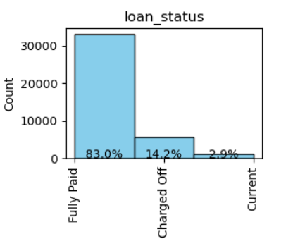
Loan Status
14.2% of loans get defaulted. Considering the charged off data

Slide 10
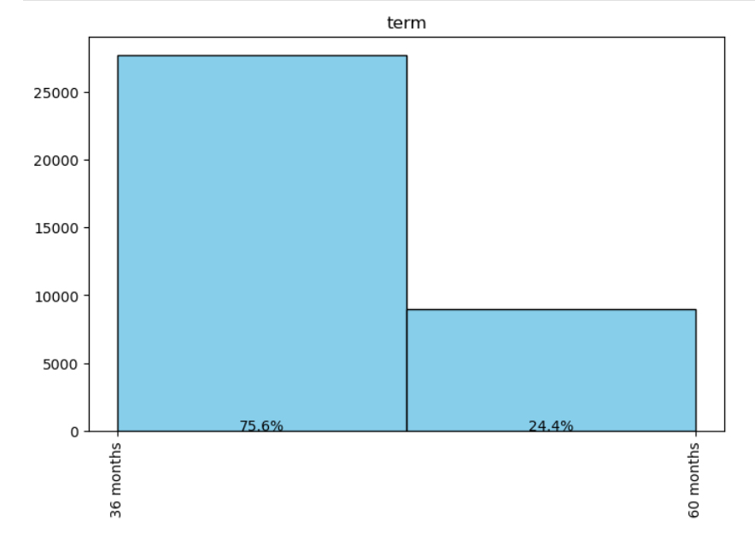
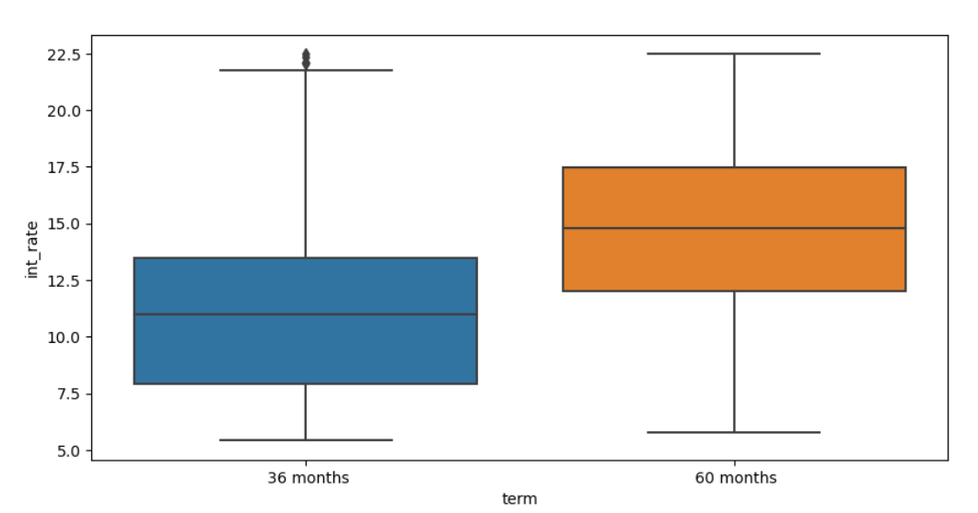
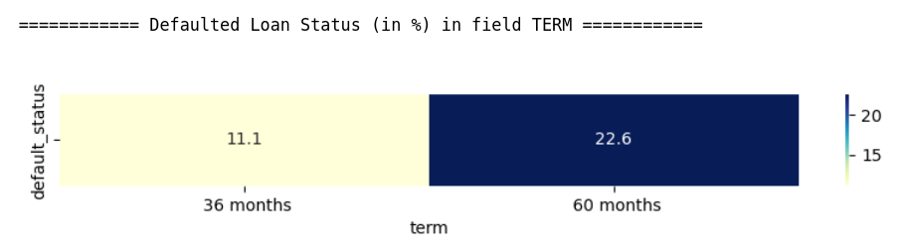
Term, Interest rate, Default Status
75.6% of loans have 36 months tenure where as only 24.4% loans have 60 months tenure.
Loans with 60 month tenure have higher interest rate than loans with 36 months
Loans with 60 months tenure have double chance (22.6%) of getting defaulted than that of 36 months (11.1%)
% of defaulted loans for different terms

Slide 11
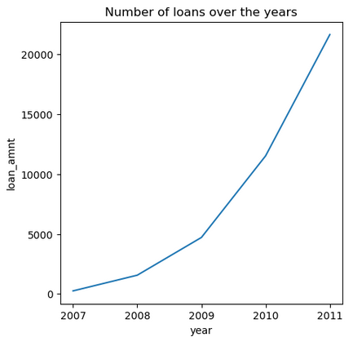
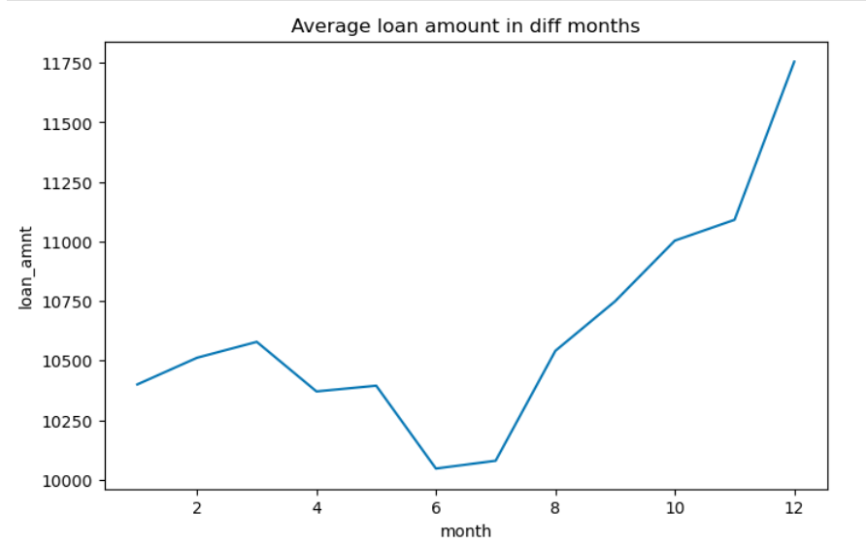
Loan vs Time Period
Number of loan applicants are increasing over the period of time.
Total borrowers in 2011 is highest i.e. 21K
On an average loan amount given to the borrowers is high in 2nd half of the year

Slide 12
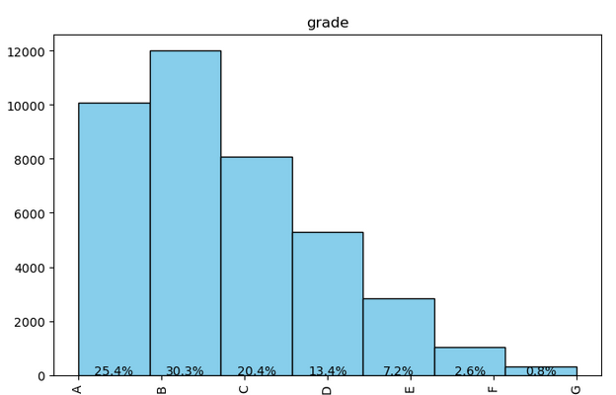
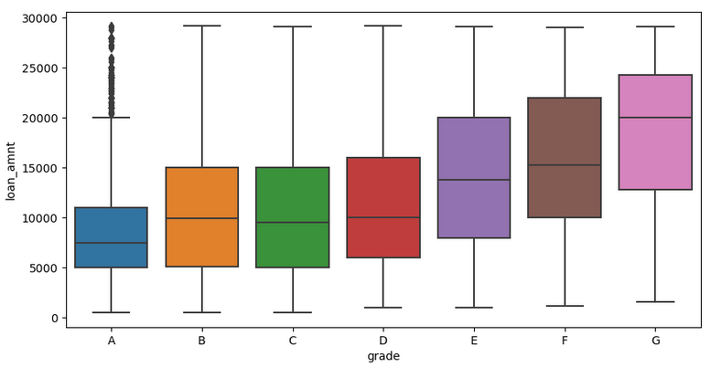
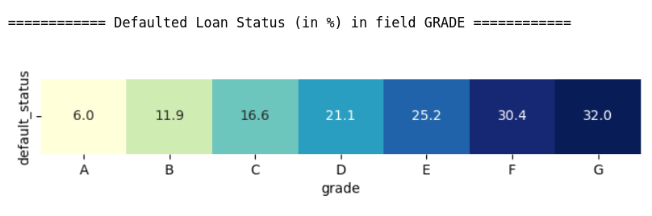
Grade, Interest rate, Default Status
75% loans are of grade A(25%), B(30%), C(20%)
Interest rates and default rates are low for A, B, C grades.
Interest rate is gradually increasing for the loans with grades A, B, C, D, E, F, G
There is a 32% chance of G grade loans getting defaulted.
Higher the grade, higher is the interest rate, higher chance of getting defaulted

Slide 13
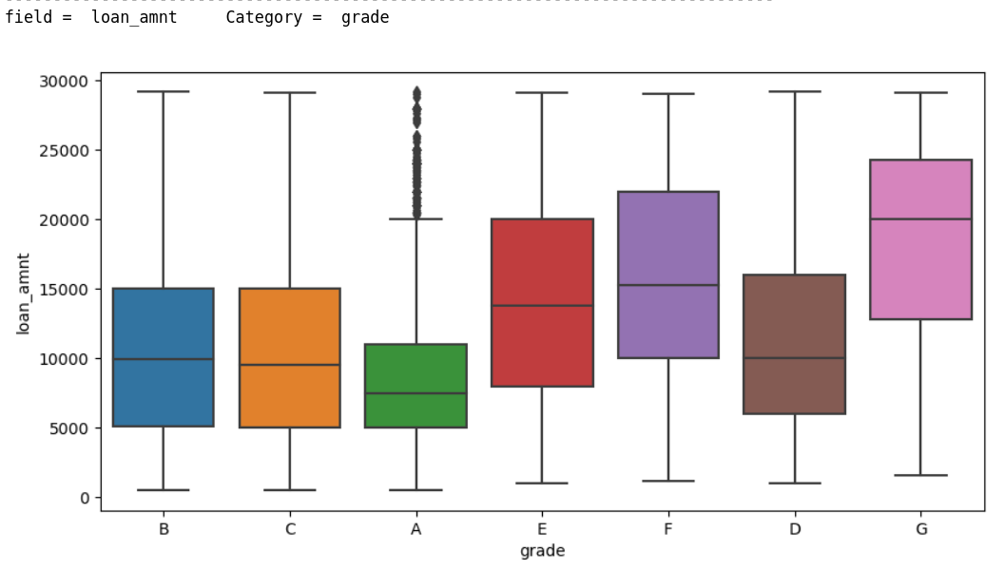
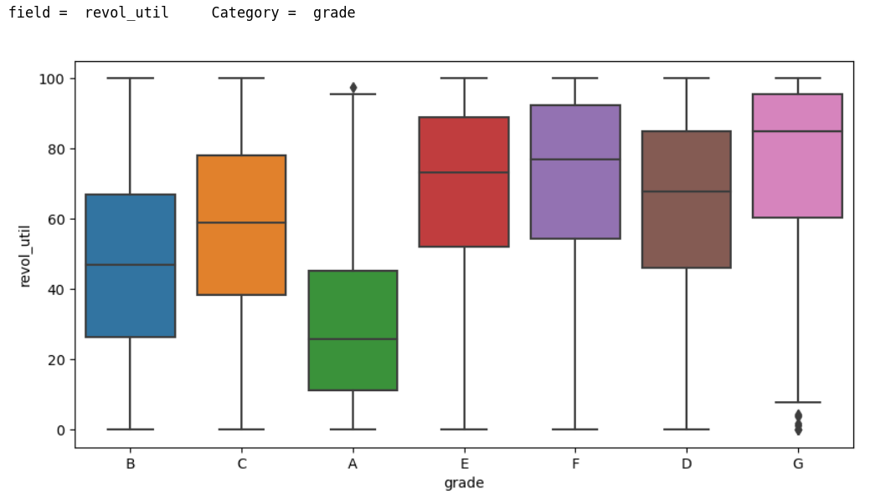
Loan amount, Grade & Revolving line utilization rate
Loan amount applied by the borrower for G grade loans is highest where as for A grade Loans is lowest.
For upper grade loans possess high loan amount applied by borrowers - loss is high if a loan is defaulted
Upper grade loans have higher line utilization rate and that correlates with higher % of defaults

Slide 14
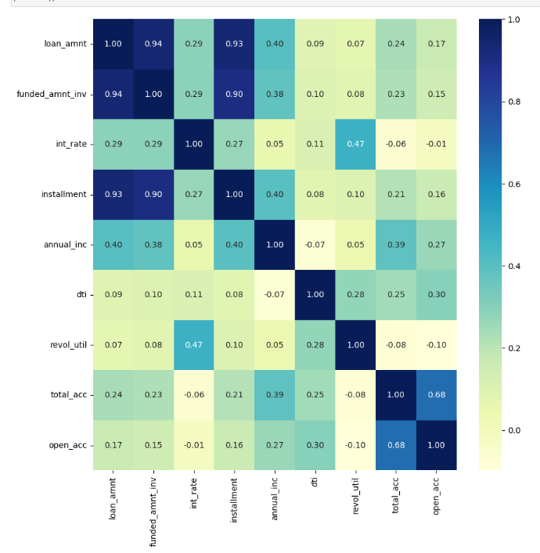
Bivariate Analysis
On Continuous/ Quantitative Variables

Slide 15
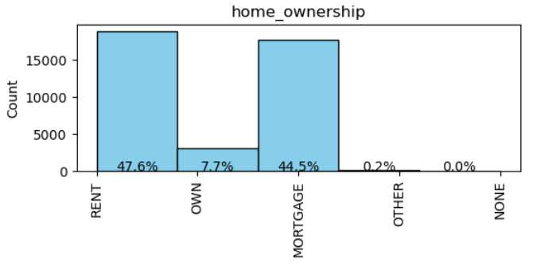
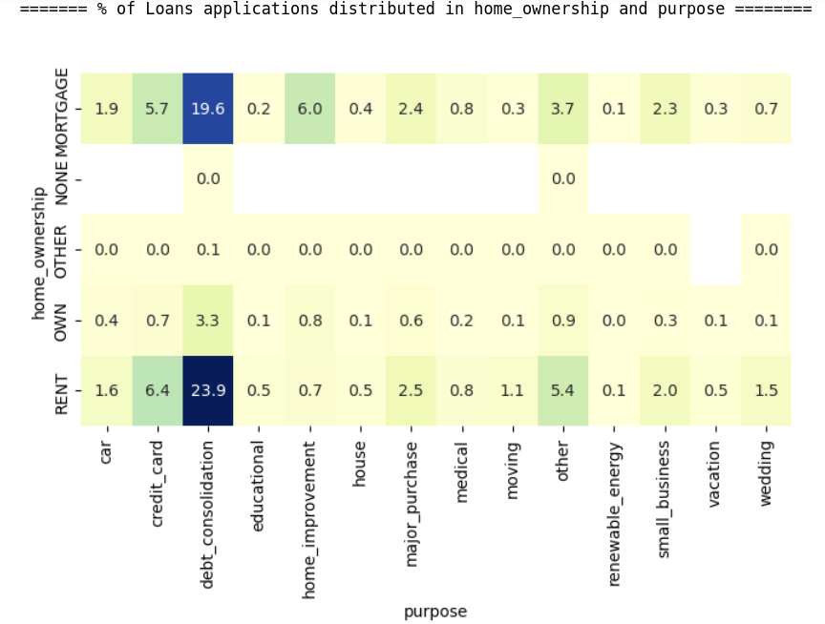
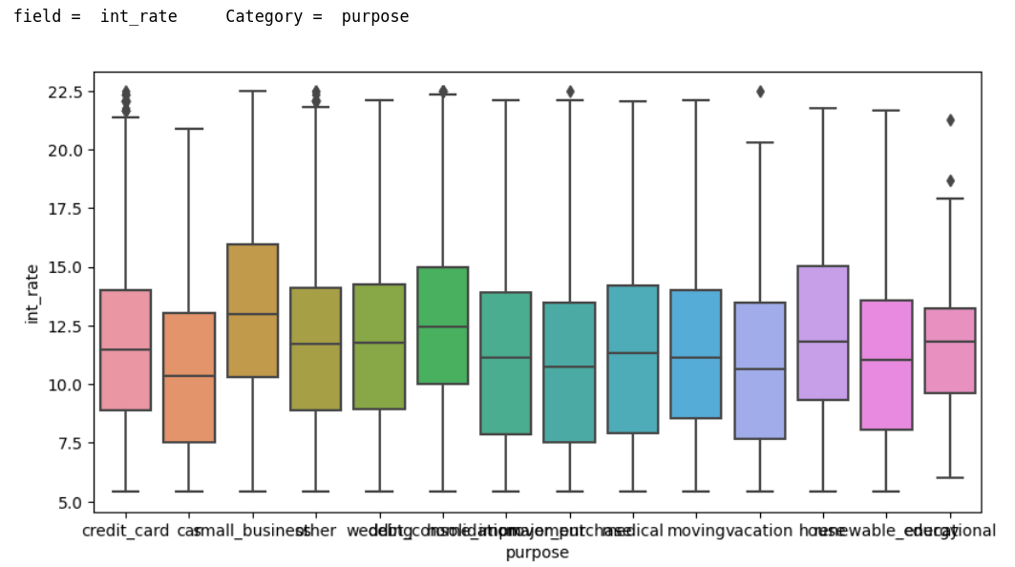
Home Ownership
47% of the borrowers don’t have house (paying rent) but only 1% of loans are home loans.
home loans are not getting sold effectively. maybe because of higher interest rate
And 47% borrowers' purpose is 'debt_consolidation'.

Slide 16
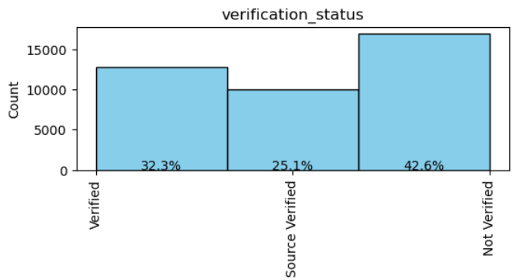
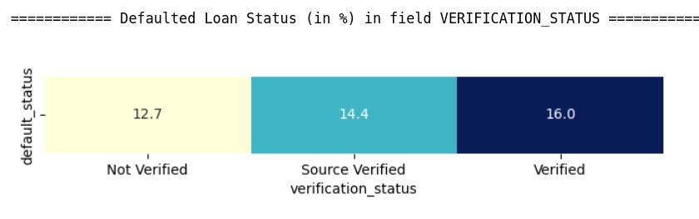
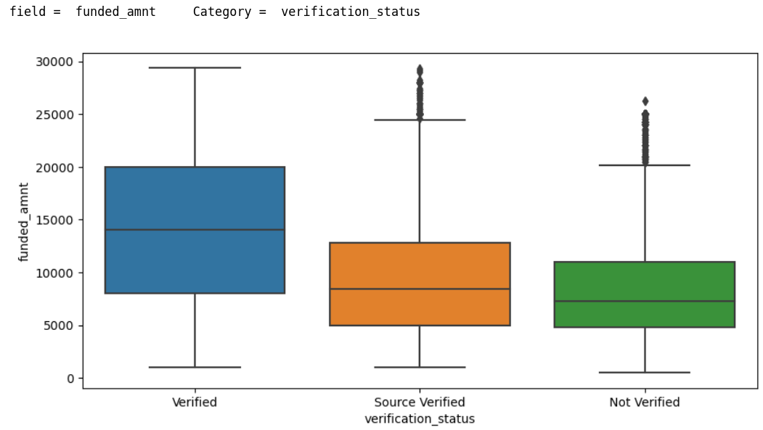
Verification Status
42% of the borrowers' income is 'not verified' which is risky.
Chance of non-verified loan getting defaulted is 12 %
Total amount funded by the company to non-verified loans is less compared to verified loans

Slide 17
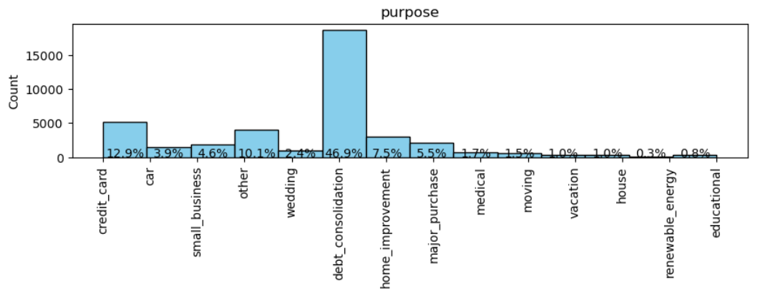
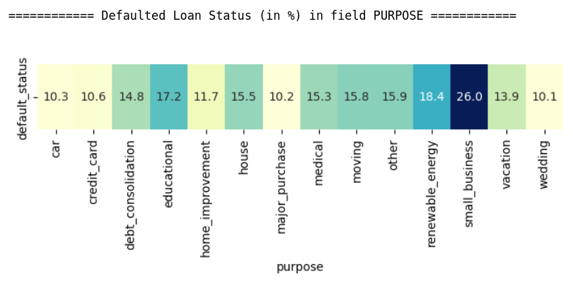
Purpose
Debt_consolidation is the most common pupose of the loan (47%) and has 14.8% chances of getting default.
Loans with small business purpose have highest chances (26%) of getting defaulted.
Whereas loans for wedding, car or major purchase have lowest chances (only 10%) of getting defaulted.

Slide 18
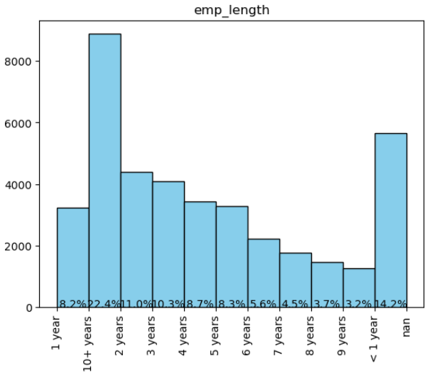
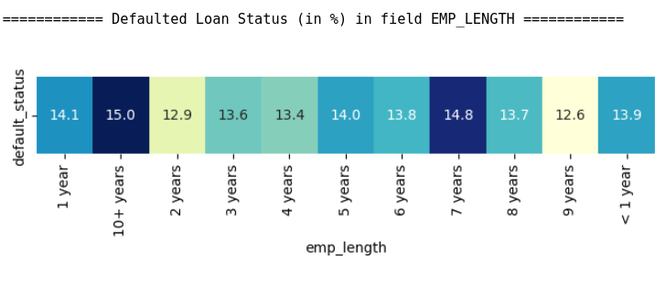
Employment Length
Majority of the borrowers (22.4%) have 10+ years of employment length.
There is a 15% chance of loan getting default when employment length of the borrower is 10+ years.

Slide 19
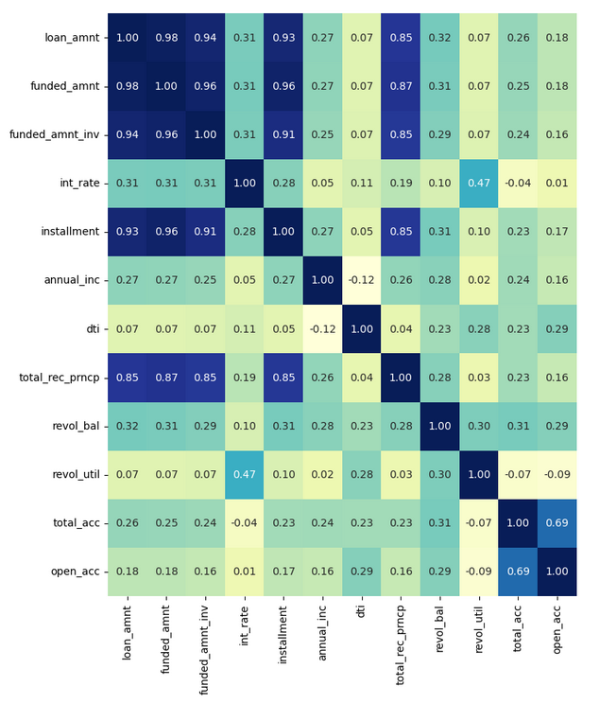
Correlation Between the fields
Very high correlation between loan amount applied by the borrower and funded amount committed by the investor. We can say that if loan application of the borrower gets passed by company, then he gets almost full amount of the loan applied.
Certainly loan amount, monthly installment and principal received are highly correlated. Higher the loan amount, higher is monthly installment and and higher is principal received vice versa.
Number of open credit lines is also highly correlated with total number of credit lines in the borrower's credit file.
Revol_util, int_rate - Moderately high correlation
Higher the amount of credit the borrower is using, higher is the risk of loan repayment. Thats why higher is the interest rate, and vice-versa.

Slide 20
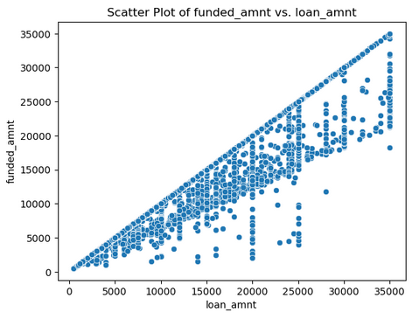
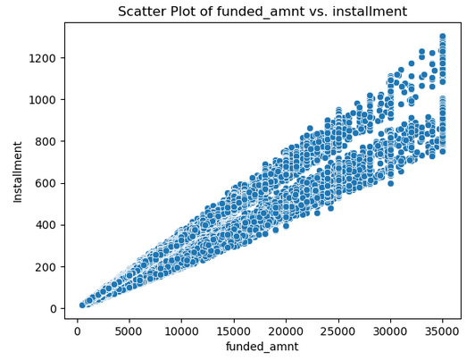
Loan Amount, Funded Amount, Installment
Funded amount by the company is always less than or equal to loan amount applied by borrower.
Funded amount by the company is highly correlated with monthly installment paid by the borrower.
There is a high correltion between loan amount, funded amount and installment

Slide 21
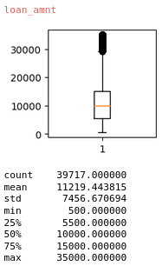
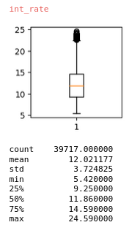
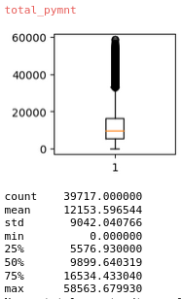
Loan Amount, Interest rate, Total Received principal
Avg loan amount applied by the borrower is 11.2K
Avg interest rate for the loan is 12%
Avg payment received by the LC is 12.2k. Ideally it should be (11.2 * 1.12 =) 12.5k but because of some default loans, company is getting 12.2k payment.
If the company reduces the default loans in future, then LC can make more profits.

Slide 22
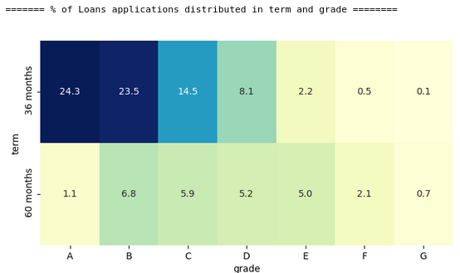
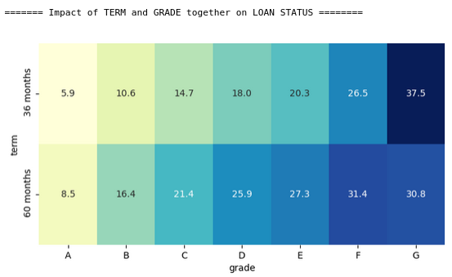
Impact of Term and Grade - Loan Status
Highest number of loans (24%) have 36 months tenure with grade A and have lowest default rate (5.9%). This is very good for company.
The company has only 0.1% of total loans with 36 months tenure and G grade. And these loans have highest risk of 37.5% of default rate.

Slide 23
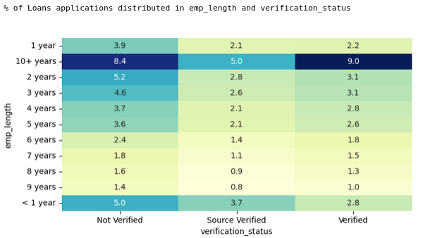
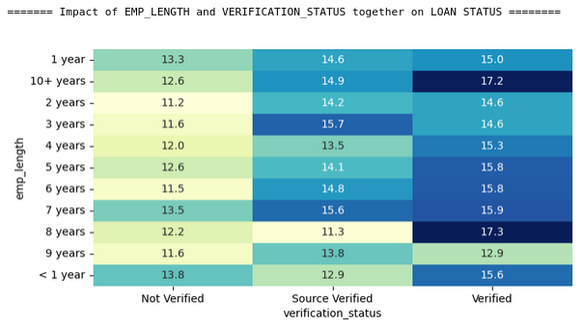
Impact of Emp_length and Verification Status - Loan Status
Borrowers who have 10+ years of employment years and whose income is verified by lending company are highest 9%. And thier default rate is maximum i.e. 17.2%.
This is not a good situation for the company.
This is the criteria where company should look into it.

Slide 24
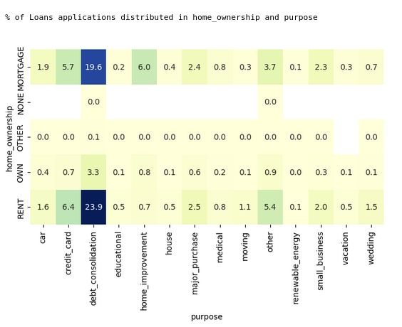
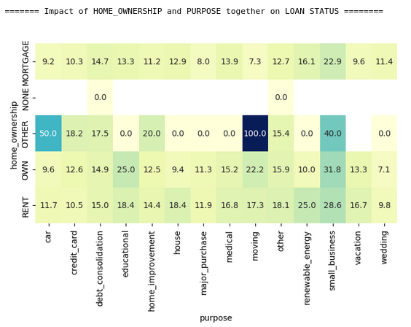
Impact of Home_ownership & Purpose - Loan Status
High chunk of loans (23.9% + 19.6% = 43.5%) are taken for debt_consolidation purpose and the borrowers of these loans stay in rented house or Mortgaged their house.
And there is almost 15% chance of loan getting defaulted which is high and serious.

Slide 25
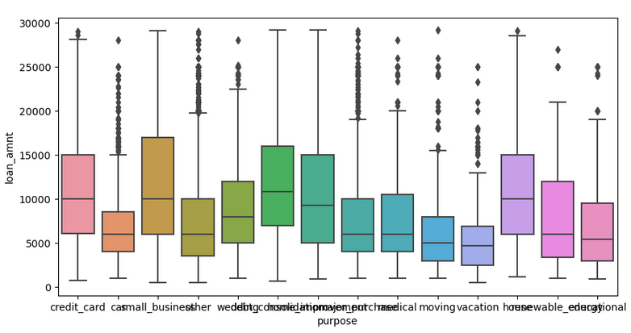
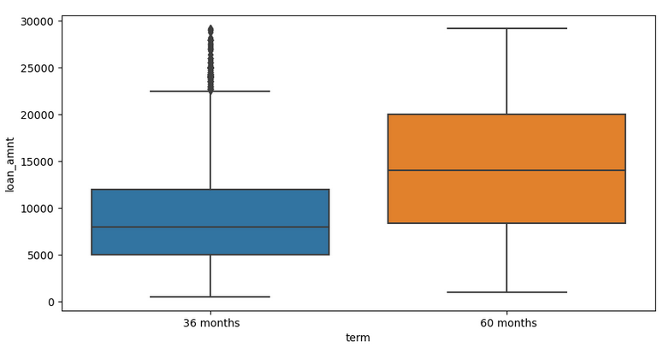
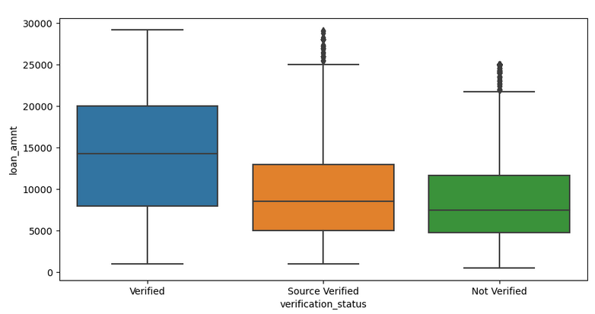
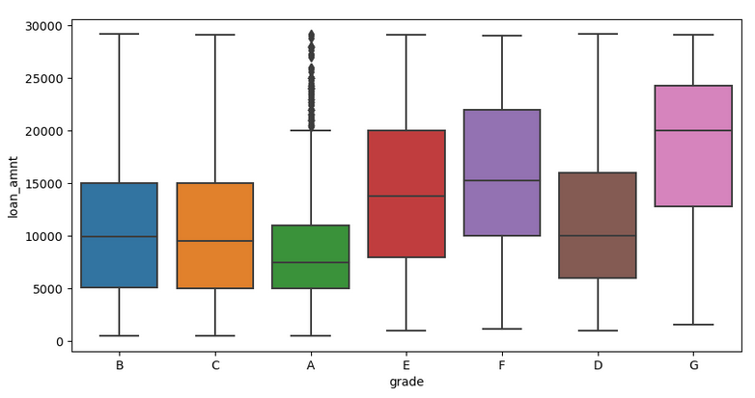
Loan Amount for different types of loans
On an average loan amount is high for :
60 month tenure loans
Verified borrower’s income loans
upper grade loans
small business, house, debt consolidation purpose loans

Slide 26
SUMMARY & CONCLUSION

Slide 27
Sumarry
Major Driving factor which can be used to predict the chance of defaulting and avoiding Credit Loss:
1. DTI
2. Grades
3. Verification Status
4. Annual income
5. Pub_rec_bankruptcies
Other considerations for 'defaults' :
1. Burrowers not from large urban cities like California, new york, texas, florida etc.
2. Burrowers having annual income in the range 50000-100000.
3. Burrowers having Public Recorded Bankruptcy.
4. Burrowers with least grades like E,F,G which indicates high risk.
5. Burrowers with very high Debt to Income value.
6. Burrowers with working experience 10+ years.

Slide 28
Conclusion
On an average 14% of the loans gets defaulted.
Small business loans are defaulted more. Borrowers with mortgage home ownership are taking higher loans and defaulting the approved Loans.
Driving Factors for Loan Default are:
Lengthy tenure Loans - Chances of getting dafaulted is double (22%) that of less tenure loans (11%).
Upper Grade Loans - Higher the grade, higher is the interest rate, and high chances of getting default
High Revol_util - Higher the amount of credit the borrower is using, higher is the risk of loan repayment.
Inferences :
High loan amount is given to 60 months tenure loans, upper grade loans, small business loans where chance of getting defaulted is very high.
Default rate for the borrowers, who have 10+ years of employment years and their income is also verified, is high
For upper grade loans possess high loan amount applied by borrowers - loss is high if a loan is defaulted
High Interest rates - Interest rate for 60 months tenure loans is higher than that of 36 months loan.

