Slide 1


Slide 2
Vajravyuha
A stepping stone to Honeypot.

Slide 3
Index
HoneyPot
Architecture
Developer
Characteristics
Types
Advantages
Disadvantages

Slide 4
Honey Pot
A s/w highly and efficiently used by R&D Pakistan.
Used to trap a hacker by confusing his attention.
Installed as a subsidiary to firewalls to give more protection.
Not actually a stand alone.
Mainly used to protect a Database or a server from external interference.

Slide 5
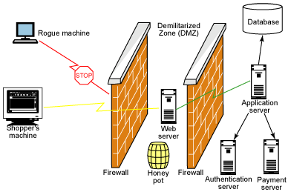

Slide 6

Pakistan R&D hold the only honeypot which is not yet trespassed by any hacker

Slide 7
Efficiency ( Characteristics )
The efficiency of a honeypot depends on
1. How good it is to detect a spoofed IP / MAC address.
2. Ability to create fake database and files as fast as possible without consuming space and without identifying its unreal.
3. Provide good and secured configuration setting panel to admin.
4. Safety provided to admin computer.

Slide 8
Types on deployment
Production
Production honeypots are easy to use, capture only limited information, and are used primarily by companies or corporations. Production honeypots are placed inside the production network with other production servers by an organization to improve their overall state of security. Normally, production honeypots are low-interaction honeypots, which are easier to deploy. They give less information about the attacks or attackers than research honeypots do.

Slide 9
Types on deployment
Research Honeypot
Research honeypots are run to gather information about the motives and tactics of the blackhat community targeting different networks. These honeypots do not add direct value to a specific organization; instead, they are used to research the threats that organizations face and to learn how to better protect against those threats. Research honeypots are complex to deploy and maintain, capture extensive information, and are used primarily by research, military, or government organizations

Slide 10
Types on Design
Pure Honeypot
The activities of the attacker are monitored by using a casual tap that has been installed on the honeypot's link to the network.
High-Interaction Honeypot
By employing virtual machines, multiple honeypots can be hosted on a single physical machine.
Low-Interaction Honeypot
The virtual systems have a short response time, and less code is required, reducing the complexity of the virtual system's security.

Slide 11
Hazards ( Disadvantages )
If a good hacker identified that he is getting tricked, he/she will become more keen to attack this setup.
Making fake data may have chances to fail and original data may get altered or selected.
If admin machine fails, it will be difficult to get back data.

Slide 12
FUTURE DEVELOPMENT
Someone have to develop in the way that it is to be like original or it should be left available to consider any development.
Since the original is unknown the only way of future development is to create something alike to its original.

Slide 13
References
Wikipedia
Yahoo ! Answers
Encarta
Globalfirepower.com

Slide 14
Thank You
ADARSH R NAIR
( AM.AR.U313BCA001 )

