Slide 1
University Management
Database System
BATCH NUMBER:04
Presented by:
25B11AI428 - JOJATI BHAKAT 25B11AI009 - ADARSH SIDDHARTH
25B11AI044 – ANIKET KUMAR 25B11AIA46 – SACHIN KUMAR MAHTO
Academic Year: 2026-2027
Under esteemed guidance of
Mr.M Sudheer
Assistant Professor
Department of AIML
Aditya University

Slide 2
Project Overview
The University Management Database System is designed to store and manage important college information in a structured way.
Problem Statement
Managing college information manually or using separate files can create several problems:
Duplicate student and faculty information
Difficulty in finding records
Data inconsistency
Time-consuming updates
Difficult relationship management
Higher chance of errors
Proposed Solution
We propose a centralized relational database that connects students, departments, faculty, courses, enrollment and examination information.

Slide 3
Objectives
Manage student information
Manage department and faculty details
Store course information
Track student enrollment
Manage examination details
Store student results
Reduce duplicate data
Make data easy to access and manage
Our goal is to create a centralized and organized database for college management.

Slide 4
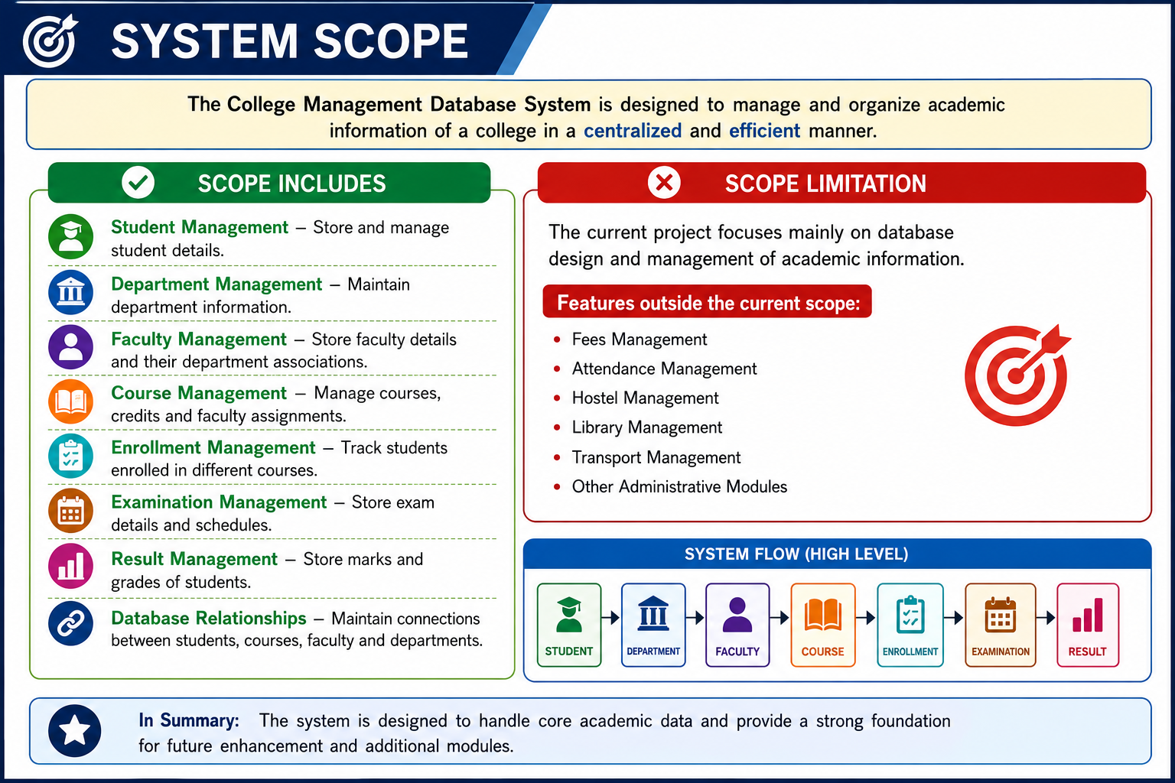

Slide 5
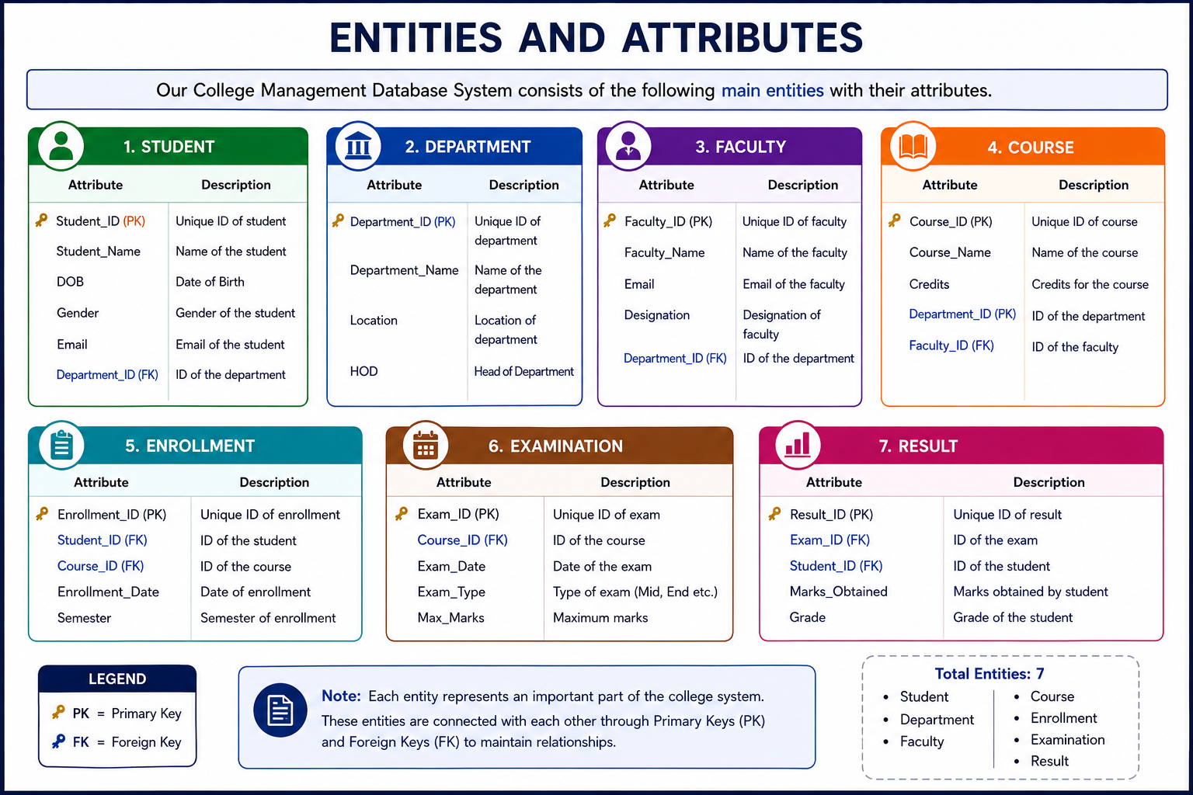

Slide 6
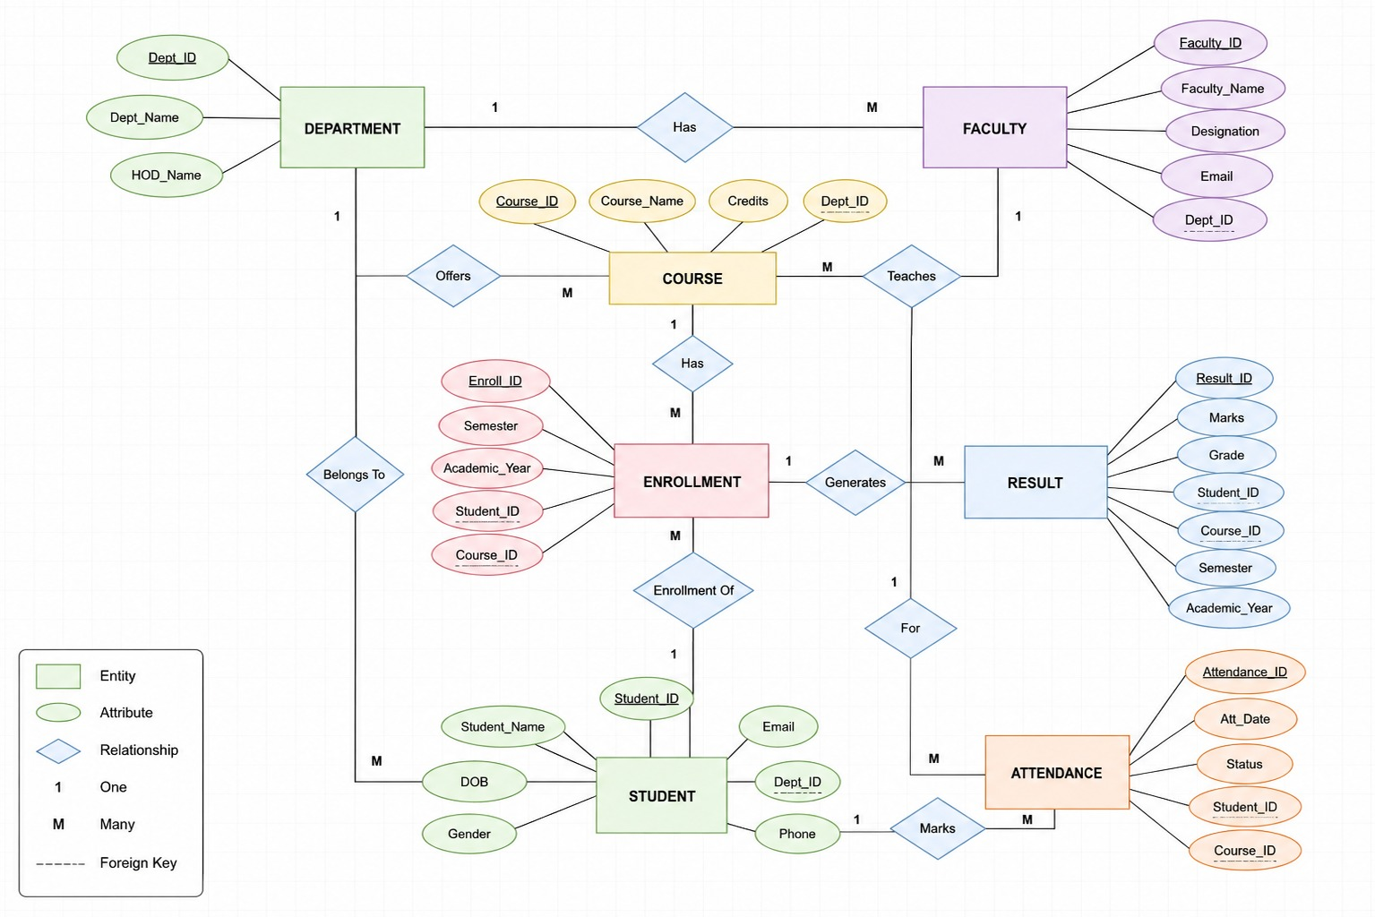

Slide 7
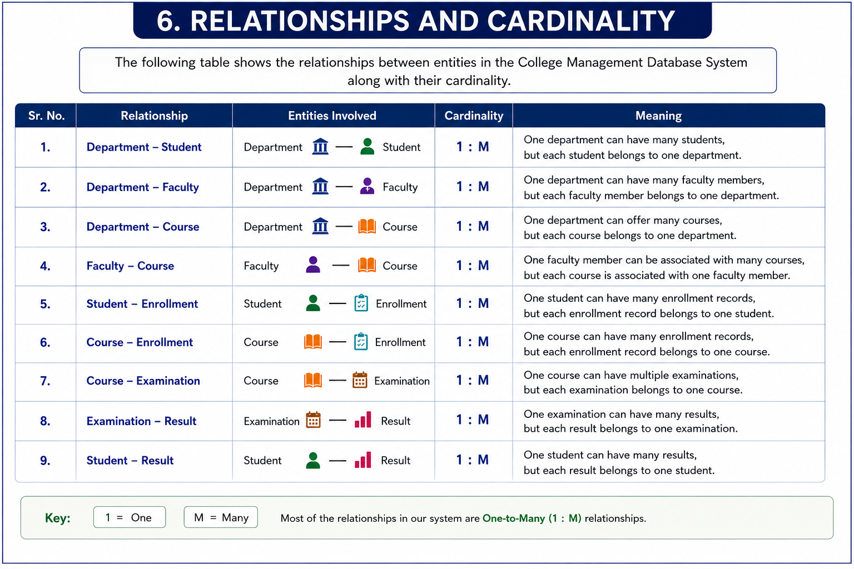

Slide 8
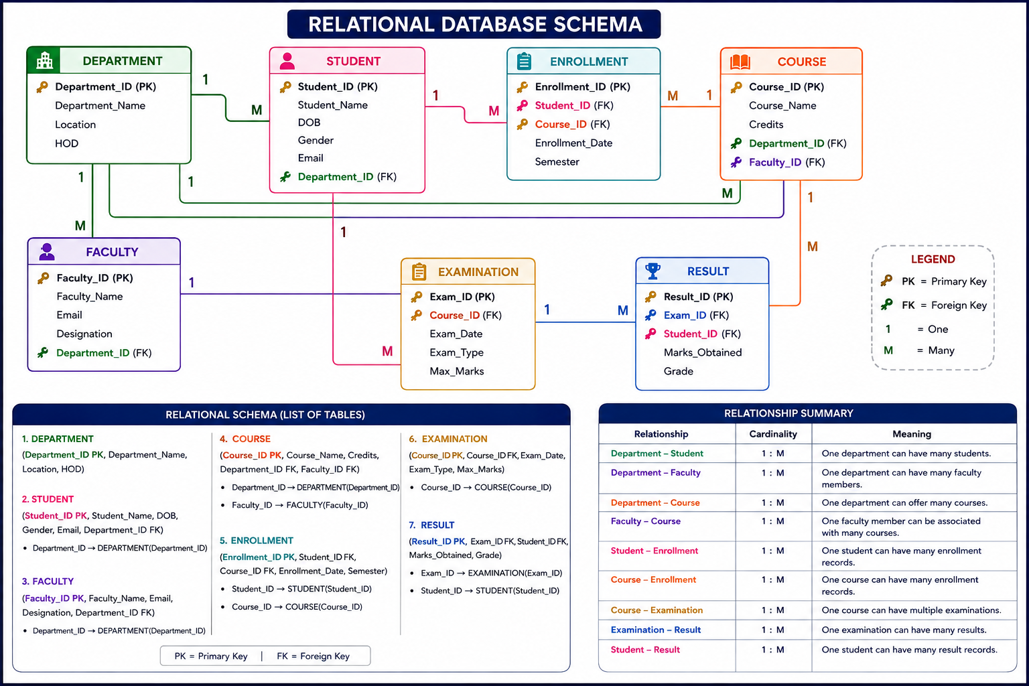

Slide 9
NORMALIZATION (UNF TO 3NF)
Normalization removes redundancy and prevents insert, update and delete anomalies.
UNF
1NF
2NF
3NF
One big record
Student_ID, Student_Name,
Dept_Name, HOD, {Course_ID,
Course_Name, Faculty_Name,
Exam_Type, Marks} repeated
Problem: repeating groups and duplicate department / faculty data
Atomic values only
One row per student, course
and exam.
Key: (Student_ID, Course_ID,
Exam_Type)
Fixed: repeating groups.
Still: student, course and department data repeat on every row.
No partial dependency
Student_ID → Name, Email, Dept
Course_ID → Name, Credits, Faculty
(Student_ID, Course_ID) →
Enrollment_Date, Semester
Split into: Student, Course, Enrollment, Examination, Result
No transitive dependency
Department_ID → Name, Location, HOD
Faculty_ID → Name, Designation
Exam_ID → Course, Date, Type, Max
Separated: Department and Faculty stored once, referenced by foreign keys.
Final design: 7 relations, all in 3NF. Every non-key attribute depends on the key, the whole key and nothing but the key.
Anomalies prevented: Insert: add a department without students. Update: change a HOD in one place only. Delete: remove an enrollment without losing the student or course.

Slide 10
DATABASE CONSTRAINTS
Constraints enforce data integrity inside the database itself, whatever the application does.
Table | Primary Key | Foreign Key | NOT NULL / UNIQUE | CHECK / DEFAULT
Department | Department_ID | — | Department_Name (NOT NULL, UNIQUE) | —
Student | Student_ID | Department_ID → Department | Student_Name, Email, Department_ID (NOT NULL); Email UNIQUE | Gender IN (Male, Female, Other)
Faculty | Faculty_ID | Department_ID → Department | Faculty_Name, Department_ID (NOT NULL); Email UNIQUE | —
Course | Course_ID | Department_ID → Department; Faculty_ID → Faculty | Course_Name, Department_ID (NOT NULL) | Credits BETWEEN 1 AND 6
Enrollment | Enrollment_ID | Student_ID → Student; Course_ID → Course | Student_ID, Course_ID (NOT NULL); UNIQUE (Student_ID, Course_ID) | Semester BETWEEN 1 AND 8; Enrollment_Date DEFAULT SYSDATE
Examination | Exam_ID | Course_ID → Course | Course_ID (NOT NULL) | Exam_Type IN (Mid, End); Max_Marks > 0
Result | Result_ID | Exam_ID → Examination; Student_ID → Student | Exam_ID, Student_ID (NOT NULL); UNIQUE (Exam_ID, Student_ID) | Marks_Obtained >= 0
7 Primary Keys
9 Foreign Keys
5 UNIQUE rules
6 CHECK rules

Slide 11
DDL: CREATE TABLE (1 OF 2)
Parent tables are created first so that foreign keys always have a table to reference.
CREATE TABLE Department (
Department_ID NUMBER PRIMARY KEY,
Department_Name VARCHAR2(60) NOT NULL UNIQUE,
Location VARCHAR2(30),
HOD VARCHAR2(50)
);
CREATE TABLE Student (
Student_ID NUMBER PRIMARY KEY,
Student_Name VARCHAR2(60) NOT NULL,
DOB DATE,
Gender VARCHAR2(10)
CHECK (Gender IN ('Male','Female','Other')),
Email VARCHAR2(80) NOT NULL UNIQUE,
Department_ID NUMBER NOT NULL
REFERENCES Department(Department_ID)
);
CREATE TABLE Faculty (
Faculty_ID NUMBER PRIMARY KEY,
Faculty_Name VARCHAR2(60) NOT NULL,
Email VARCHAR2(80) UNIQUE,
Designation VARCHAR2(40),
Department_ID NUMBER NOT NULL
REFERENCES Department(Department_ID)
);
CREATE TABLE Course (
Course_ID NUMBER PRIMARY KEY,
Course_Name VARCHAR2(80) NOT NULL,
Credits NUMBER(1)
CHECK (Credits BETWEEN 1 AND 6),
Department_ID NUMBER NOT NULL
REFERENCES Department(Department_ID),
Faculty_ID NUMBER
REFERENCES Faculty(Faculty_ID)
);
Inline constraints: PRIMARY KEY, NOT NULL, UNIQUE, CHECK and REFERENCES (foreign key) are declared with each column.

Slide 12
DDL: CREATE TABLE (2 OF 2)
Transaction tables come last: Enrollment, Examination and Result.
CREATE TABLE Enrollment (
Enrollment_ID NUMBER PRIMARY KEY,
Student_ID NUMBER NOT NULL REFERENCES Student(Student_ID),
Course_ID NUMBER NOT NULL REFERENCES Course(Course_ID),
Enrollment_Date DATE DEFAULT SYSDATE,
Semester NUMBER(1) CHECK (Semester BETWEEN 1 AND 8),
UNIQUE (Student_ID, Course_ID)
);
CREATE TABLE Examination (
Exam_ID NUMBER PRIMARY KEY,
Course_ID NUMBER NOT NULL REFERENCES Course(Course_ID),
Exam_Date DATE,
Exam_Type VARCHAR2(10)
CHECK (Exam_Type IN ('Mid','End')),
Max_Marks NUMBER(3) CHECK (Max_Marks > 0)
);
CREATE TABLE Result (
Result_ID NUMBER PRIMARY KEY,
Exam_ID NUMBER NOT NULL
REFERENCES Examination(Exam_ID),
Student_ID NUMBER NOT NULL
REFERENCES Student(Student_ID),
Marks_Obtained NUMBER(5,2)
CHECK (Marks_Obtained >= 0),
Grade VARCHAR2(2),
UNIQUE (Exam_ID, Student_ID)
);
Creation order
1. Department 2. Faculty 3. Course
4. Student 5. Enrollment
6. Examination 7. Result
Drop order is the reverse of this.
Composite UNIQUE keys stop a student enrolling twice in one course, or getting two results for one exam.

Slide 13
SAMPLE DATA INSERTION (DML)
One row shown per table; 55 rows were inserted in total, parents before children.
INSERT INTO Department
VALUES (1, 'Computer Science & Engg', 'Block A', 'Dr. R.
Venkatesh');
INSERT INTO Faculty
VALUES (201, 'Dr. R. Venkatesh', 'venkatesh@aditya.edu.in',
'Professor', 1);
INSERT INTO Course
VALUES (301, 'Database Management Systems', 4, 1, 202);
INSERT INTO Student
VALUES (101, 'Ravi Teja', DATE '2005-03-14', 'Male',
'ravi.teja@aditya.edu.in', 1);
INSERT INTO Enrollment
VALUES (401, 101, 301, DATE '2026-01-12', 4);
INSERT INTO Examination
VALUES (601, 301, DATE '2026-04-22', 'End', 100);
INSERT INTO Result
VALUES (701, 601, 101, 88, 'A');
COMMIT;
Department 4 rows
Faculty 6 rows
Course 6 rows
Student 10 rows
Enrollment 12 rows
Examination 5 rows
Result 12 rows

Slide 14
SAMPLE DATA: MASTER TABLES
Output of SELECT * FROM <table> for the Department, Faculty and Course tables.
DEPARTMENT 4 rows
FACULTY 6 rows
Department_ID | Department_Name | Location | HOD
1 | Computer Science & Engg | Block A | Dr. R. Venkatesh
2 | AI & Machine Learning | Block B | Dr. S. Lakshmi
3 | Electronics & Comm. | Block C | Dr. K. Prasad
4 | Mechanical Engineering | Block D | Dr. P. Narasimha
Faculty_ID | Faculty_Name | Email | Designation | Department_ID
201 | Dr. R. Venkatesh | venkatesh@aditya.edu.in | Professor | 1
202 | A. Sravani | sravani@aditya.edu.in | Asst. Professor | 1
203 | Dr. S. Lakshmi | lakshmi@aditya.edu.in | Professor | 2
204 | T. Kiran Kumar | kiran@aditya.edu.in | Asst. Professor | 2
205 | Dr. K. Prasad | prasad@aditya.edu.in | Assoc. Professor | 3
206 | Dr. P. Narasimha | narasimha@aditya.edu.in | Professor | 4
COURSE 6 rows
Course_ID | Course_Name | Credits | Department_ID | Faculty_ID
301 | Database Management Systems | 4 | 1 | 202
302 | Data Structures | 4 | 1 | 201
303 | Machine Learning | 3 | 2 | 203
304 | Python Programming | 3 | 2 | 204
305 | Digital Electronics | 3 | 3 | 205
306 | Thermodynamics | 3 | 4 | 206
How the tables link
Faculty.Department_ID → Department
Course.Department_ID → Department
Course.Faculty_ID → Faculty
Every foreign key value above exists in its parent table.

Slide 15
SAMPLE DATA: STUDENT AND EXAMINATION
Ten students across four departments, and five scheduled examinations.
STUDENT 10 rows
EXAMINATION 5 rows
Student_ID | Student_Name | DOB | Gender | Email | Department_ID
101 | Ravi Teja | 14-MAR-2005 | Male | ravi.teja@aditya.edu.in | 1
102 | Sneha Reddy | 22-JUL-2005 | Female | sneha.reddy@aditya.edu.in | 2
103 | Karthik Varma | 05-NOV-2005 | Male | karthik.varma@aditya.edu.in | 1
104 | Divya Sri | 18-JAN-2006 | Female | divya.sri@aditya.edu.in | 2
105 | Arjun Naidu | 30-SEP-2005 | Male | arjun.naidu@aditya.edu.in | 3
106 | Pooja Chowdary | 12-MAY-2005 | Female | pooja.chowdary@aditya.edu.in | 1
107 | Harsha Vardhan | 08-DEC-2005 | Male | harsha.vardhan@aditya.edu.in | 2
108 | Meghana Rao | 27-FEB-2006 | Female | meghana.rao@aditya.edu.in | 4
109 | Anil Kumar | 16-APR-2005 | Male | anil.kumar@aditya.edu.in | 3
110 | Lakshmi Prasanna | 09-AUG-2005 | Female | lakshmi.p@aditya.edu.in | 1
Exam_ID | Course_ID | Exam_Date | Exam_Type | Max_Marks
601 | 301 | 22-APR-2026 | End | 100
602 | 302 | 24-APR-2026 | End | 100
603 | 303 | 27-APR-2026 | End | 100
604 | 305 | 29-APR-2026 | End | 100
605 | 301 | 25-FEB-2026 | Mid | 50
Exam_Type
End = 100 marks
Mid = 50 marks
Grades use marks / Max_Marks.

Slide 16
SAMPLE DATA: ENROLLMENT AND RESULT
Twelve enrollments and twelve results; Grade is derived from marks / Max_Marks.
ENROLLMENT 12 rows
RESULT 12 rows
Enrollment_ID | Student_ID | Course_ID | Enrollment_Date | Semester
401 | 101 | 301 | 12-JAN-2026 | 4
402 | 101 | 302 | 12-JAN-2026 | 4
403 | 102 | 303 | 13-JAN-2026 | 4
404 | 103 | 301 | 12-JAN-2026 | 4
405 | 103 | 302 | 12-JAN-2026 | 4
406 | 104 | 303 | 13-JAN-2026 | 4
407 | 105 | 305 | 14-JAN-2026 | 4
408 | 106 | 301 | 12-JAN-2026 | 4
409 | 107 | 303 | 13-JAN-2026 | 4
410 | 108 | 306 | 14-JAN-2026 | 4
411 | 109 | 305 | 14-JAN-2026 | 4
412 | 110 | 301 | 12-JAN-2026 | 4
Result_ID | Exam_ID | Student_ID | Marks_Obtained | Grade
701 | 601 | 101 | 88 | A
702 | 601 | 103 | 76 | B
703 | 601 | 106 | 91 | A+
704 | 601 | 110 | 45 | F
705 | 603 | 102 | 82 | A
706 | 603 | 104 | 69 | C
707 | 603 | 107 | 94 | A+
708 | 604 | 105 | 58 | D
709 | 604 | 109 | 73 | B
710 | 602 | 101 | 79 | B
711 | 605 | 101 | 41 | A
712 | 605 | 103 | 36 | B

Slide 17
DDL, DML AND DQL OPERATIONS
The three SQL sub-languages used in this project, with live results from our database.
DDL: Define
DML: Manipulate
DQL: Query
Defines the structure
CREATE ALTER DROP
Add a column to Student:
ALTER TABLE Student
ADD Phone_No VARCHAR2(15);
Table altered.
Changes the data
INSERT UPDATE DELETE
UPDATE Course SET Credits = 4
WHERE Course_ID = 303;
1 row updated.
DELETE FROM Enrollment
WHERE Enrollment_ID = 412;
1 row deleted.
Reads the data
SELECT
Count all students:
SELECT COUNT(*)
FROM Student;
Result: 10
Joins, GROUP BY, HAVING and subqueries follow on the next slides.
In this project: DDL = 7 CREATE TABLE statements DML = 55 rows inserted DQL = 6 query outputs verified

Slide 18
SQL QUERIES AND OUTPUT (1 OF 3)
Queries executed on the sample data; outputs below are the actual result sets.
SELECT Student_ID, Student_Name, Email
FROM Student
WHERE Department_ID = 1
ORDER BY Student_Name;
Q1 Filter + Sort
Student_ID | Student_Name | Email
103 | Karthik Varma | karthik.varma@aditya.edu.in
110 | Lakshmi Prasanna | lakshmi.p@aditya.edu.in
106 | Pooja Chowdary | pooja.chowdary@aditya.edu.in
101 | Ravi Teja | ravi.teja@aditya.edu.in
4 rows selected.
SELECT s.Student_Name, c.Course_Name,
e.Semester
FROM Enrollment e
JOIN Student s ON e.Student_ID = s.Student_ID
JOIN Course c ON e.Course_ID = c.Course_ID
WHERE c.Course_ID = 301
ORDER BY s.Student_Name;
Q2 Join: DBMS enrollments
Student_Name | Course_Name | Semester
Karthik Varma | Database Management Systems | 4
Lakshmi Prasanna | Database Management Systems | 4
Pooja Chowdary | Database Management Systems | 4
Ravi Teja | Database Management Systems | 4
4 rows selected.

Slide 19
SQL QUERIES AND OUTPUT (2 OF 3)
Queries executed on the sample data; outputs below are the actual result sets.
SELECT s.Student_Name, c.Course_Name,
r.Marks_Obtained, r.Grade
FROM Result r
JOIN Student s ON r.Student_ID = s.Student_ID
JOIN Examination x ON r.Exam_ID = x.Exam_ID
JOIN Course c ON x.Course_ID = c.Course_ID
WHERE x.Exam_Type = 'End'
AND r.Marks_Obtained >= 80
ORDER BY r.Marks_Obtained DESC;
Q3 Result report (4-table join)
Student_Name | Course_Name | Marks_Obtained | Grade
Harsha Vardhan | Machine Learning | 94 | A+
Pooja Chowdary | Database Management Systems | 91 | A+
Ravi Teja | Database Management Systems | 88 | A
Sneha Reddy | Machine Learning | 82 | A
4 rows selected.
SELECT d.Department_Name,
COUNT(s.Student_ID) AS Total_Students
FROM Department d
LEFT JOIN Student s
ON d.Department_ID = s.Department_ID
GROUP BY d.Department_Name
ORDER BY Total_Students DESC,
d.Department_Name;
Q4 GROUP BY: students per dept
Department_Name | Total_Students
Computer Science & Engg | 4
AI & Machine Learning | 3
Electronics & Comm. | 2
Mechanical Engineering | 1
4 rows selected.

Slide 20
SQL QUERIES AND OUTPUT (3 OF 3)
Queries executed on the sample data; outputs below are the actual result sets.
SELECT c.Course_Name,
ROUND(AVG(r.Marks_Obtained), 2) AS Avg_Marks
FROM Result r
JOIN Examination x ON r.Exam_ID = x.Exam_ID
JOIN Course c ON x.Course_ID = c.Course_ID
WHERE x.Exam_Type = 'End'
GROUP BY c.Course_Name
HAVING AVG(r.Marks_Obtained) > 70
ORDER BY Avg_Marks DESC;
Q5 HAVING: course average
Course_Name | Avg_Marks
Machine Learning | 81.67
Data Structures | 79
Database Management Systems | 75
3 rows selected.
SELECT Student_Name
FROM Student
WHERE Student_ID IN
(SELECT Student_ID FROM Result
WHERE Grade IN ('A', 'A+'))
ORDER BY Student_Name;
Q6 Subquery: A / A+ students
Student_Name
Harsha Vardhan
Pooja Chowdary
Ravi Teja
Sneha Reddy
4 rows selected.

Slide 21
DATA INTEGRITY AND VALIDATION
Invalid data is rejected by the database. All six tests below were executed and rejected.
# | Invalid operation attempted | Constraint | Oracle error raised | Result
1 | Insert Student with an existing Student_ID (101) | Primary Key | ORA-00001: unique constraint violated | Rejected
2 | Insert Student with Department_ID = 9 (no such dept) | Foreign Key | ORA-02291: parent key not found | Rejected
3 | Insert Student with Student_Name = NULL | NOT NULL | ORA-01400: cannot insert NULL | Rejected
4 | Insert Student with an existing Email | UNIQUE | ORA-00001: unique constraint violated | Rejected
5 | Insert Course with Credits = 9 | CHECK | ORA-02290: check constraint violated | Rejected
6 | Delete Department 1 that still has students | Foreign Key (parent) | ORA-02292: child record found | Rejected
Validation queries (cross-table rules that a CHECK constraint cannot express)
SELECT r.Result_ID
FROM Result r
JOIN Examination x
ON r.Exam_ID = x.Exam_ID
WHERE r.Marks_Obtained > x.Max_Marks;
0
rows
(no invalid
data)
SELECT s.Student_ID
FROM Student s
LEFT JOIN Department d
ON s.Department_ID = d.Department_ID
WHERE d.Department_ID IS NULL;
0
rows
(no orphan
students)
Query 1 checks Marks_Obtained against Max_Marks; query 2 checks every student has a valid department.

Slide 22
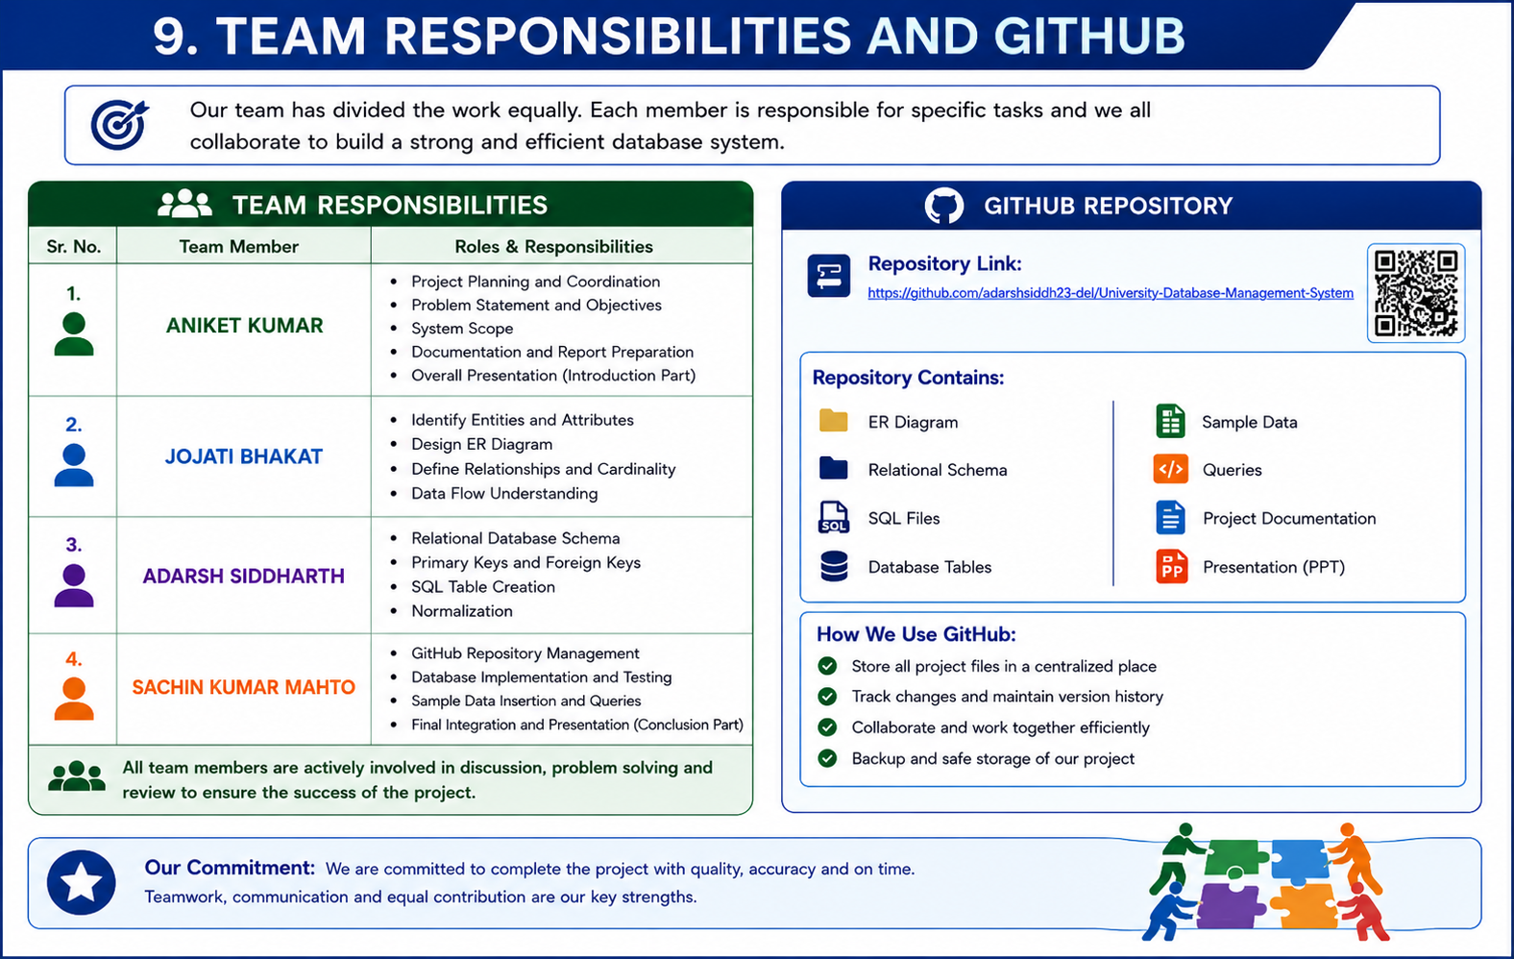

Slide 23
