Slide 1
DATA ANALYSIS ON SUICIDES IN INDIA
(Project Semester August-December 2019)
Submitted by
Adarsh Kumar Singh
Registration No. 11716553
Section: KM067
Course Code: INT217

Slide 2
Introduction
Suicide refers to the act or an instance of intentionally killing oneself. According to the World Health Organization, every 40 seconds, a person commits suicide somewhere in the world.
While most countries with high suicide rates are poor, there are also a surprising few, highly-developed and rich nations which rank very high in this sad statistics. Generally, committing suicide is about three times more common in men than in women, with poisoning, hanging and firearms being the most common methods.
The official estimates of how many Indians take their lives annually vary greatly but according to some sources, it might be as many as 200,000 people. In India, poisoning is the most common suicide method, followed by hanging and self-immolation. Almost half of the suicides committed in this country are motivated by family and health reasons.

Slide 3
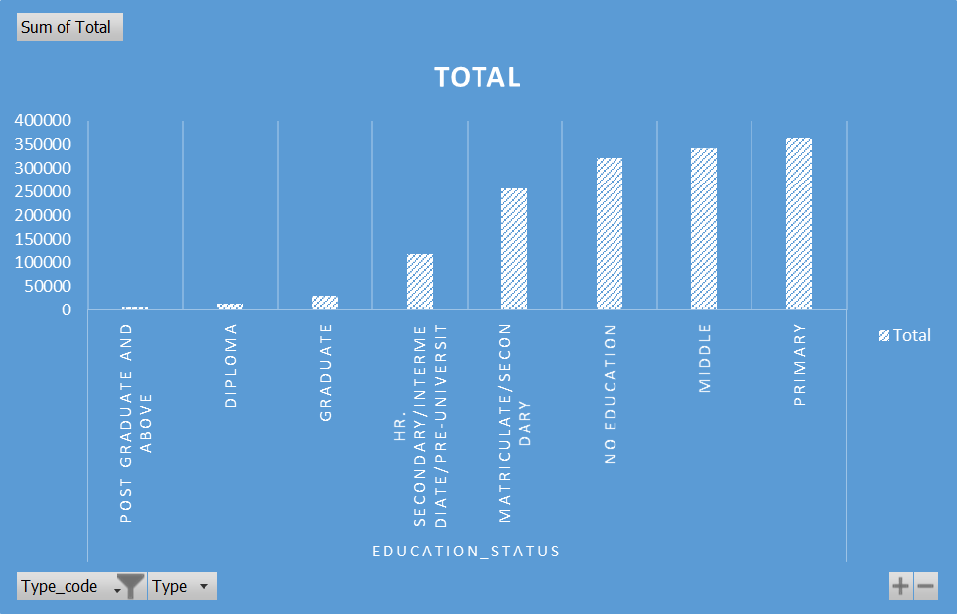
Relationship between suicide and Education

Slide 4
Objectives/Scope of the Analysis
State wise Suicide data analysis of India
Age group wise Suicide data analysis of India
Cause wise Suicide data analysis of India
Profession wise Suicide data analysis of India
Year wise Suicide data analysis of India
Union Territories wise Suicide data analysis of India
Current and Future Predication (till 2020) Suicide of India

Slide 5
The dataset contains the following features
State: It represents the states whose suicide data was measured.
Year: The year when the data was recorded.
Type: The type or causes of suicide where data measurement was made.
Type Code: The reasons of suicide where the data measurement was made.
Gender: The gender of people whose suicide data was recorded.
Age Group: It represent the age group of people whose data was measured
.
Total: The total value of suicide committed

Slide 6
State wise Suicide data analysis of India
Description:
In this we are comparing number of suicide between different states and union territories of India. For that we have made the pivot table from the original dataset. Pivot table contains state in row and total number of suicide in each year. In chart area we’ve added data labels to each value which makes easy for the viewer to see.
Conclusion:
According to this pivot chart:
Suicide in Maharashtra is highest as compared to other states. Lakshadweep has least suicide among others.

Slide 7
Union Territory wise Suicide data analysis of India
Description:
In this we are comparing number of suicide between different union territories of India. For that we have made the pivot table from the original dataset. Pivot table contains union territories in row and total number of suicide in each year. In chart area we’ve added data labels to each value which makes easy for the viewer to see.
Conclusion:
According to this pivot chart:
Suicide in Delhi is highest as compared to other union territories.
Lakshadweep has least Suicide among others.

Slide 8
Current and Future Predication (till 2030) Suicide data analysis of India
Description:
In this we are making the future predication based on previous data from 2001 to 2012. Pivot table contains year in row area and sum of total number of suicide in each year. In chart area we’ve added data labels to each value which makes easy for the viewer to see.
Formula used in predication =TREND( )
Conclusion: According to this pivot chart, Suicide is increasing rapidly year by year. It be at peak in 2030 which is not good.

Slide 9
Age group wise Suicide data analysis of India
Description:
In this we are showing the Suicide of India age group wise by plotting the pie chart. For that we have made the pivot table from the original dataset. Pivot table contains age group in row area, Suicide values as columns. In chart area we’ve added data labels to each value which makes easy for the viewer to see.
Conclusion:
According to this pivot chart:
Age group between 15 to 29 are committing maximum number of suicides shown in the pie chart.
Age group between 0 to 14 are committing minimum number of suicides shown in the pie chart.

Slide 10
Cause wise Suicide data analysis of India
Description:
In this we are showing the Suicide of India cause wise by plotting the pie chart. For that we have made the pivot table from the original dataset. Pivot table contains cause in row area, Suicide values as columns. In chart area we’ve added data labels to each value which makes easy for the viewer to see.
Conclusion:
According to this pivot chart:
Around 3, 50, 0000 people commit suicide due to family problem which is the highest one.
766 Suicides are committed due to not having children.
In around 2, 37,000 cases of suicide cause is not known.

Slide 11
Year wise Suicide data analysis of India
Description:
In this we are finding the year having highest Suicide. For that we have made the pivot table from the original dataset. Pivot table contains year in row area and sum of Suicide values as columns. In chart area we’ve added data labels to each value which makes easy for the viewer to see.
Conclusion:
According to this pivot chart:
Year 2011 is having the maximum number of suicide in India.
Year 2001 is having the minimum number of suicide in India.

Slide 12
Profession wise Suicide data analysis of India
Description:
In this we are finding the top profession having highest Suicide. For that we have made the pivot table from the original dataset. Pivot table contains profession in row area and sum of Suicide values as columns. In chart area we’ve added data labels to each value which makes easy for the viewer to see.
Conclusion:
According to this pivot chart:
In most of the suicide cases profession of the people is not known.
Housewives have the second profession committing maximum number of suicide.
Least number of suicide is committed by retired person.

Slide 13
Conclusion
Suicide is a very crucial topic that should taken very seriously when intervening in a people’s life. People’s suicide can be triggered my many things and it is important to be able to recognize the warning signs that can lead to an attempted or successful taking of one's life. People take their own lives for numerous reasons including feeling depressed and hopeless. There are several ways that you can help a people if you feel that they are at risk at attempting suicide: call the physician, remove any harmful items from the house, and talk to them openly about their problems! Teens suicide is the leading in the suicide data of India. Together, hopefully, we can decrease that statistic and save lives! For a country like India, suicide is an extremely worrying situation and it certainly is a national problem which demands immediate solution. Take an example of farmers, The government should run more effective welfare schemes for the poor and landless farmers, some of which may be like crop insurance and providing loans to the farmers on minimal interest rates. If such welfare schemes can be offered immediately and without losing time any further, only then the farmers can be prevented from committing suicides.

Slide 14
Bibliography
Dataset from www.kaggle.com
Dataset from www.data.gov.in
Information from Wikipedia
Used Tableau Prep
Used MS-Excel 365 Pro Plus
Used MS-Word 365 Pro Plus
Information from Google.com
Learnt some things from Tutorial Point YouTube channel

