Slide 1
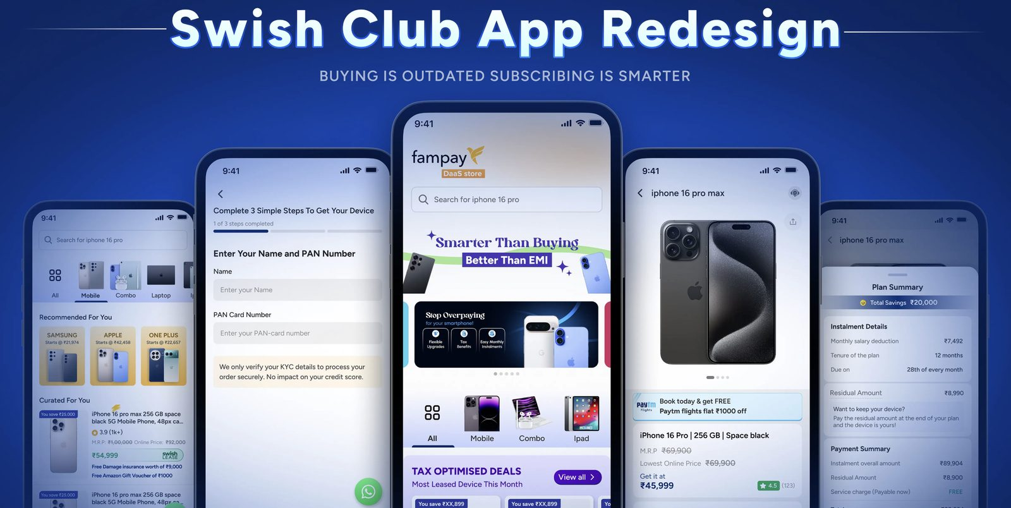
DaaS — Device as a Service
Product Case Study · Built 0 to 1 · Swish Club
Adarsh · Product Manager, SwishX

Slide 2
Context
What is DaaS and what was my role?
My Ownership
The Product
Swish Club's DaaS lets corporate employees lease premium devices — phones, laptops — with zero upfront cost. The EMI comes straight out of salary before it's credited, and because it's structured as an HRA-linked deduction, users save on tax too. It's not a loan. No credit check. HR signs off, payroll handles the rest.
Problem framing
Mapped drop-off data, identified 3 root causes
Journey redesign
Restructured 6-step user flow end to end
Feature specs
Wrote PRDs for home, PLP, PDP, request flow, KYC
The problem: DaaS was live. Nobody knew it existed.
Stakeholder alignment
Presented to CXO, aligned design + dev
Launch
Coordinated ClearTax enterprise go-live

Slide 3
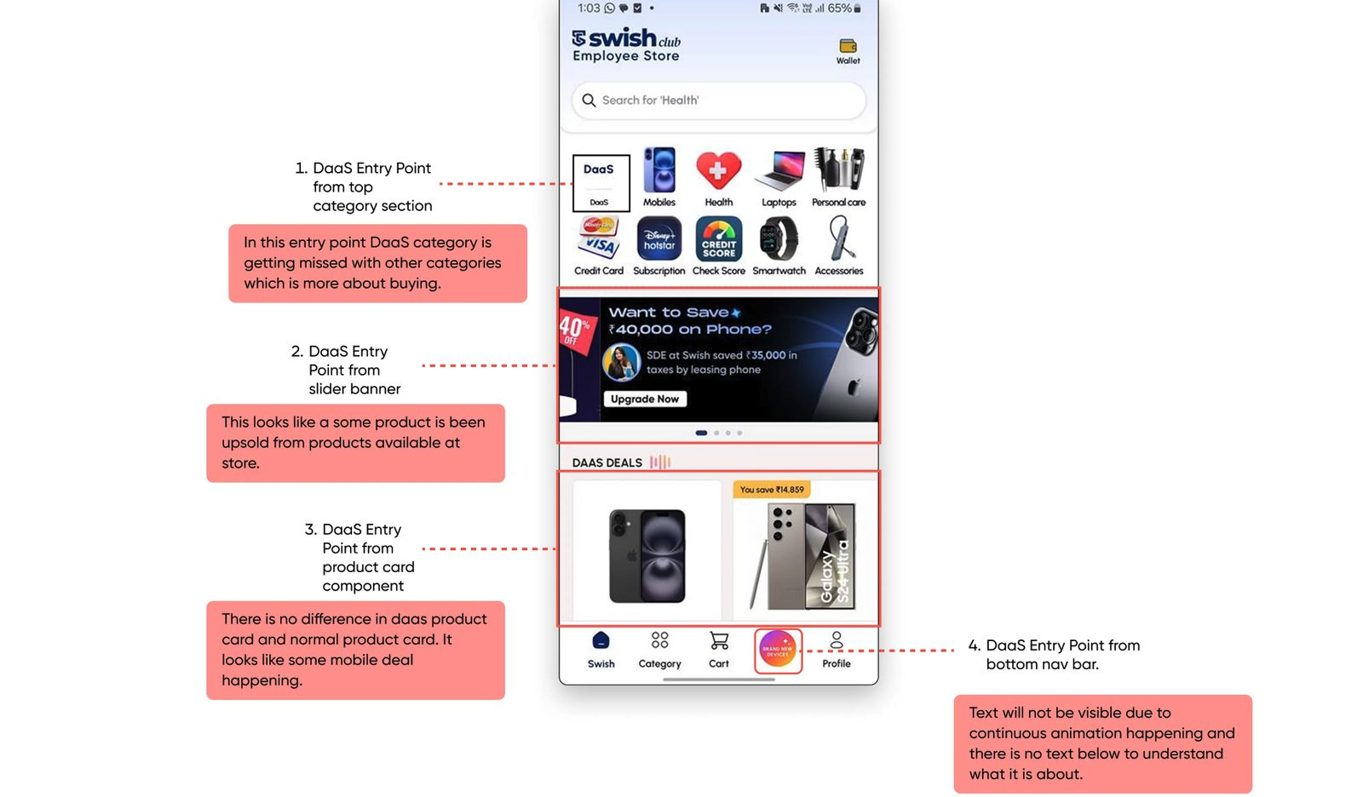
The Problem
DaaS was live. Users couldn't find it. And those who did, dropped off.
62%
2 / 100
4
2%
drop-off rate
completed KYC
DaaS entry points
actual conversion
at critical stages
rest abandoned
all confusing or invisible
vs 10% target

Slide 4
Root Cause Analysis
I asked one question: why are users not converting?
What was happening
Root cause
Impact
DaaS was one icon in a 10-item category row, mixed with shopping categories like Mobiles, Health, Laptops
No dedicated entry point. No visual differentiation. No education about what DaaS even is.
Most users scrolled past it. DaaS was never in their mental model.
First screen after clicking DaaS asked for PAN card number — before showing any product or value
Compliance requirement was placed at the wrong moment: before trust was established.
62% of users who found DaaS immediately dropped off at step 1.
Only 4 devices shown on the DaaS listing page. Just 1 was fully accessible to view in detail.
Catalogue wasn't built out yet. UX made no attempt to manage this expectation.
Users who passed step 1 had nothing to browse — no reason to commit.
Takeaway: the problem wasn't the product — it was where we placed friction in the journey.

Slide 5
The Product Decision
We couldn't remove verification. So we moved it.
Constraint: Verification (PAN + Aadhaar) is legally mandatory — users lease devices without upfront payment, so HR and payroll must validate identity before deduction begins. We cannot skip this step.
Decision
Move PAN collection from Step 1 (entry) to the checkout stage — after the user has already selected a device and confirmed intent. In its place, ask users to select their tax slab upfront, which immediately unlocks personalised device pricing without any personal data being collected.
Before
After
Home → DaaS icon (hidden in categories)
Home → DaaS section (dedicated, with education)
→ Step 1: Enter PAN number ← Drop-off here
Step 1: Select tax slab → see personalised price
Step 2: Verification
Step 2: Browse full catalogue
Step 3: See 4 devices
Step 3: Select device + request
Step 4: Request device
Step 4: HR approval
Step 5: HR approval
→ Step 5: PAN + Aadhaar KYC at checkout ← moved here

Slide 6
User Journey Map
Refined flow — 6 stages, structured to build intent before asking for commitment
1. Discover
2. Engage
3. Explore
4. Decide
5. Verify
6. Commit
SCREEN
Home Page
(DaaS section)
Tax Slab
Selection
Product
Listing (PLP)
Product Detail
+ Request
HR Approval
Notification
KYC + Address
at Checkout
USER ACTION
Sees DaaS hero section, understands it's not a purchase
Picks 10%, 20%, or 30% slab. Prices unlock instantly.
Browses Mobile / Combo / iPad. Filters by brand.
Reviews plan summary. Monthly EMI + savings shown.
Request sent. HR gets notification. User tracks status on Home.
Completes PAN + Aadhaar. Picks delivery address. Confirms.
PM DECISION / NOTE
Dedicated DaaS section added. Not buried in categories.
Key PM call: tax slab replaces PAN as first ask.
3 PLP types built: category, campaign, search.
EMI shown first, not total price — reduces sticker shock.
HR loop is async — user doesn't wait or get blocked.
PAN moved here — user already committed. Dropout lower.
OLD DROP-OFF POINT
—
Was here (PAN). Removed.
—
—
—
Now here. User committed.

Slide 7
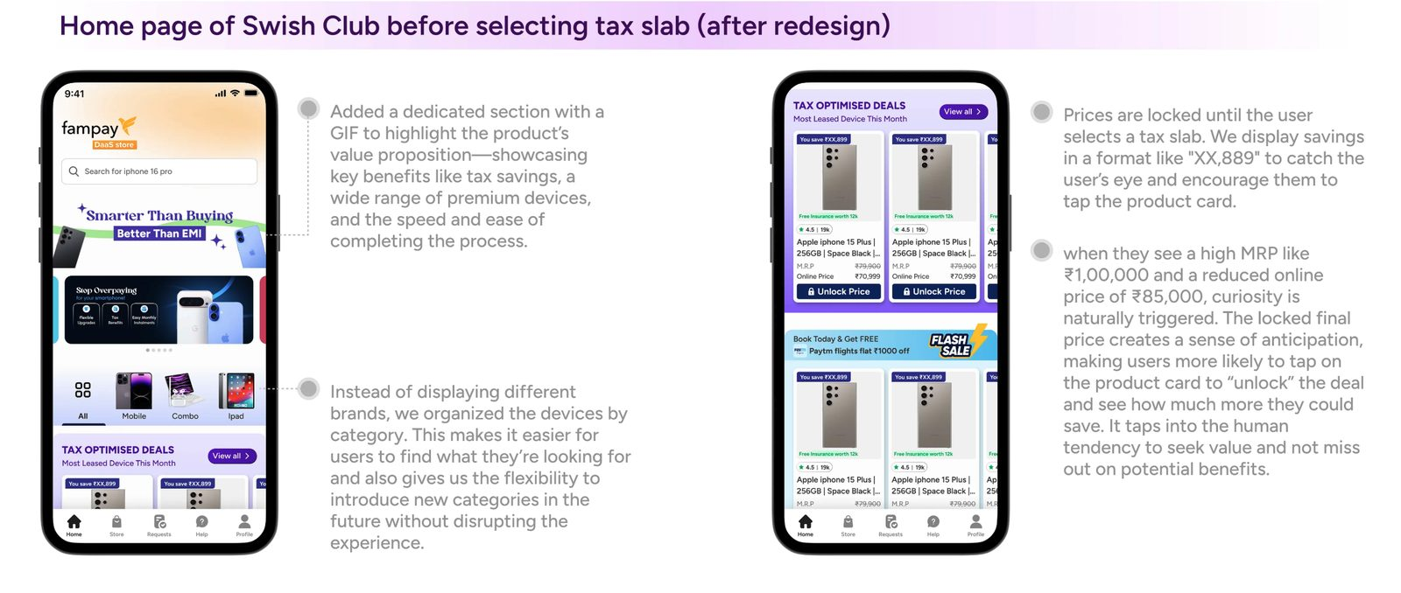
What We Built — Home Page
One job: educate the user about DaaS before asking for anything.
DaaS gets its own section
Not an icon in a row. Dedicated hero with value prop visible before user scrolls.
'Unlock Price' is the activation hook
Prices show XX,899 until tax slab is selected. Drives the one step we need users to take.
Category-first, not brand-first
Mobile / Combo / iPad — organised by use case. Easier to navigate, scalable to new categories.
Section naming does product work
'Tax Optimised Deals' tells the user exactly why DaaS is different from regular shopping.

Slide 8
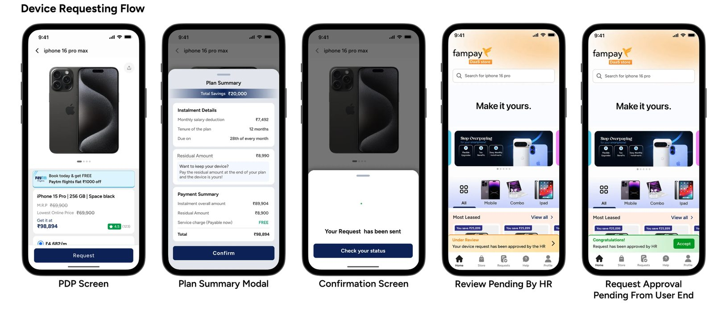
What We Built — Device Request Flow
5 screens. Each built around a specific user anxiety.
PDP
Plan Summary
Confirmation
HR Review
Accept
Show ₹4,682/m first, not ₹98,894 total. Monthly frame reduces sticker shock.
Full breakdown before confirm. Savings ₹20K shown prominently — anchors the value.
'Request sent' — minimal, no clutter. One CTA to track status. No dead end.
Status shown on home screen passively. User doesn't need to chase.
One tap accept post HR approval. No re-entry, no repeat form.

Slide 9
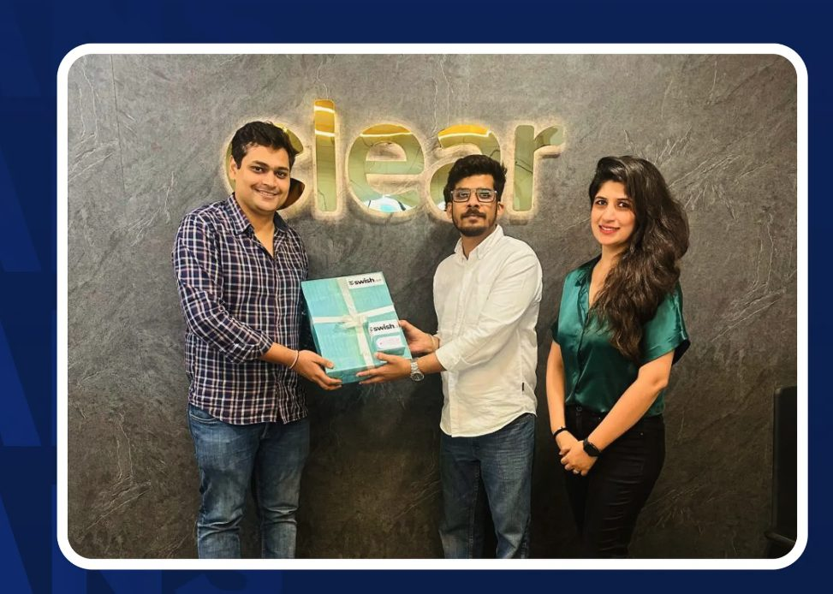
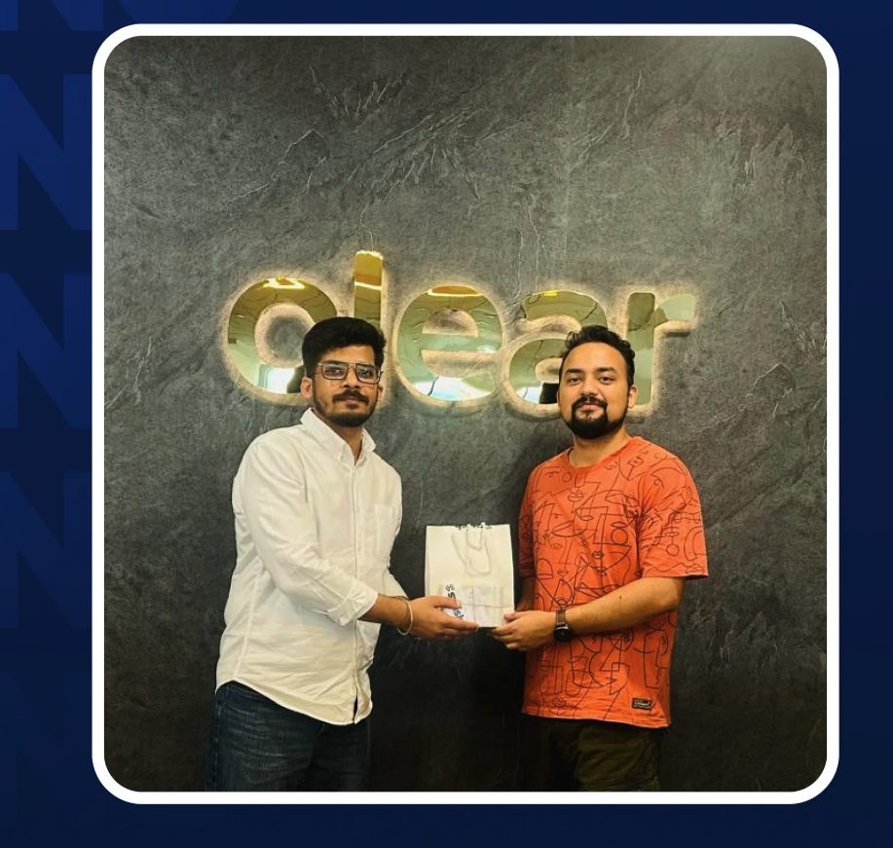
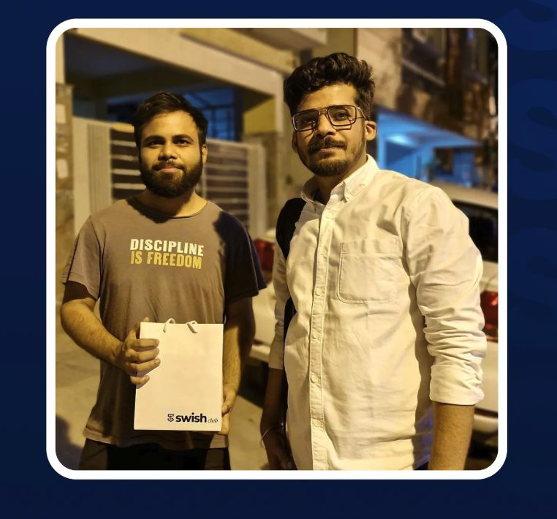
Launch & Outcome
ClearTax — first enterprise to go live on DaaS
Outcome
Detail
Platform status
DaaS live and functional end-to-end for the first time
Enterprise launched
ClearTax onboarded as first partner, devices delivered to employees
Journey improved
PAN moved to checkout; homepage redesigned with dedicated DaaS section
Phase 2 input
Learnings from first cohort fed directly into next roadmap cycle

Slide 10

What I Did — As a PM
DaaS · 0 → 1 · SwishX
Discovery
Activation
Catalogue
Before DaaS buried in category icon row
Before PAN collected at step 1 → 62% abandon
Before 4 devices, 1 viewable
After Dedicated section on home with value prop
After Tax slab collected at step 1 → prices unlock
After Full catalogue: Mobile, Combo, iPad, Laptop PLPs
Post-request
Verification
Launch
Before No status visibility after submitting
Before KYC asked before user saw value
Before No enterprise live on DaaS
After Status shown on home screen passively
After KYC at checkout — user is already committed
After ClearTax live. Devices delivered.

