Slide 1
POP Shop Fulfillment
Post-Order Experience Redesign
Adarsh Raj

Slide 2
Task 1: The Support Data
50,000 monthly orders across fashion, beauty, and electronics. 18% of users who place an order never come back.
34%
28%
12%
WISMO
Return / Refund
Wrong / Damaged
Where is my order
Return or refund status
Wrong item or damaged delivery
The obvious move is to pick WISMO because it is the biggest number. But I wanted to check if this actually matches what real users are saying.

Slide 3
Task 1: What Real Users Are Saying
I went through around 70 recent Play Store reviews for POP. Most of them were 1-star.
Every review, regardless of the actual issue, had the same underlying frustration: the user had no visibility into what was happening and POP was not communicating anything.
Orders marked undelivered without any delivery attempt or call to the customer
Refunds pending for weeks with no timeline given by support
Support sending the same copy-paste reply every time without actually solving anything
No updates at all when an order was delayed or stuck
Picking WISMO. Not because it is the biggest number, but because this is where the problem starts. Fix this first and the rest becomes easier.

Slide 4
Task 1: Validating the Hypothesis
Before building, I would check three things
Are users complaining before the delay even happens?
1
Check when WISMO tickets are raised compared to the expected delivery date. If a lot of them are coming in before the delivery window has even passed, it means users do not trust POP to begin with. The problem is not the delay, it is the lack of confidence.
Are users checking the tracking page multiple times before calling support?
2
If someone is opening the tracking page 3 or 4 times and still ending up calling support, it means the tracking page is not answering their question. It is giving them nothing useful.
Do these users come back and order again?
3
Compare repeat orders between two groups: users who raised a WISMO ticket, and users who had a delayed order but never complained. If there is a big gap, the support experience itself is driving users away, not just the delay.
When would I change my pick: If sending proactive updates does not reduce complaints, then communication is not the real problem. Shift focus to delivery partners.

Slide 5
Task 2: What Is Happening Today
Scenario A — Delayed order, no communication
1
Order gets delayed
POP does not say anything to the user
What should happen
Order gets delayed. POP detects it on its own and messages the user first. User already knows what is going on before they even open the app.
2
User opens the app
Sees the same Ordered and Shipped steps with no movement
3
Taps Track Order
Push notification:
Gets a red banner saying "Tracker not available at this moment"
Hi Adarsh, your order is running a bit late. New expected delivery: tomorrow by 8 PM. We will keep you updated.
4
Contacts support
Support sends a copy-paste reply
The user gets context and a new ETA before they have to ask.
5
User is now frustrated
Trust is broken. They may never come back.

Slide 6
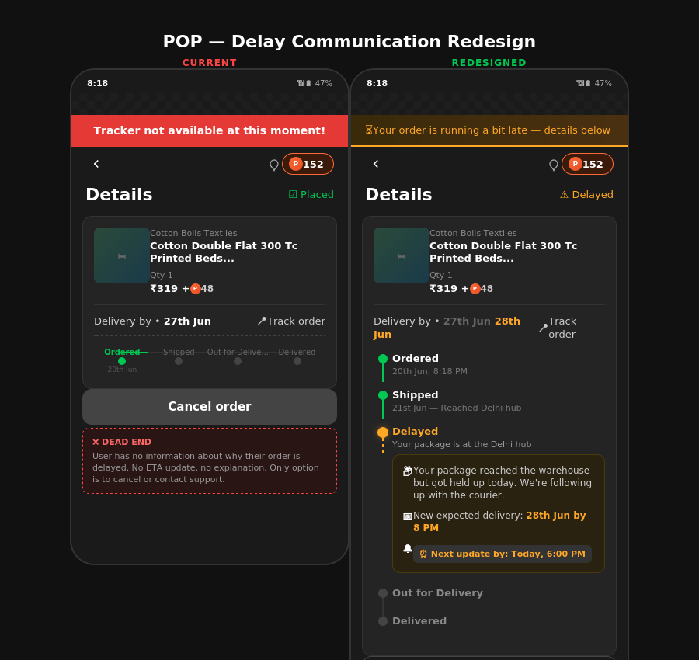
Task 2: Redesigned Tracking Page
Current red error banner replaced with proactive delay state, context, and a "next update by" commitment.

Slide 7
Task 2: When the Notification Fires
The message goes out only when all three of these are true at the same time:
The order has not been delivered even after 4 hours past the promised date
1
The courier has not scanned or moved the package in the last 6 hours
2
POP has not already sent a delay message for this order before
3
Why wait 4 hours and not send immediately?
Most delivery partners in India do two rounds in a day, one in the morning and one in the evening. If someone is supposed to get the order by afternoon and it does not come, there is a good chance it is coming in the evening round. Sending a panic message at hour one worries the user for no reason. I would test 4 hours vs 6 hours vs 8 hours in the first week to see which results in fewer support calls.

Slide 8
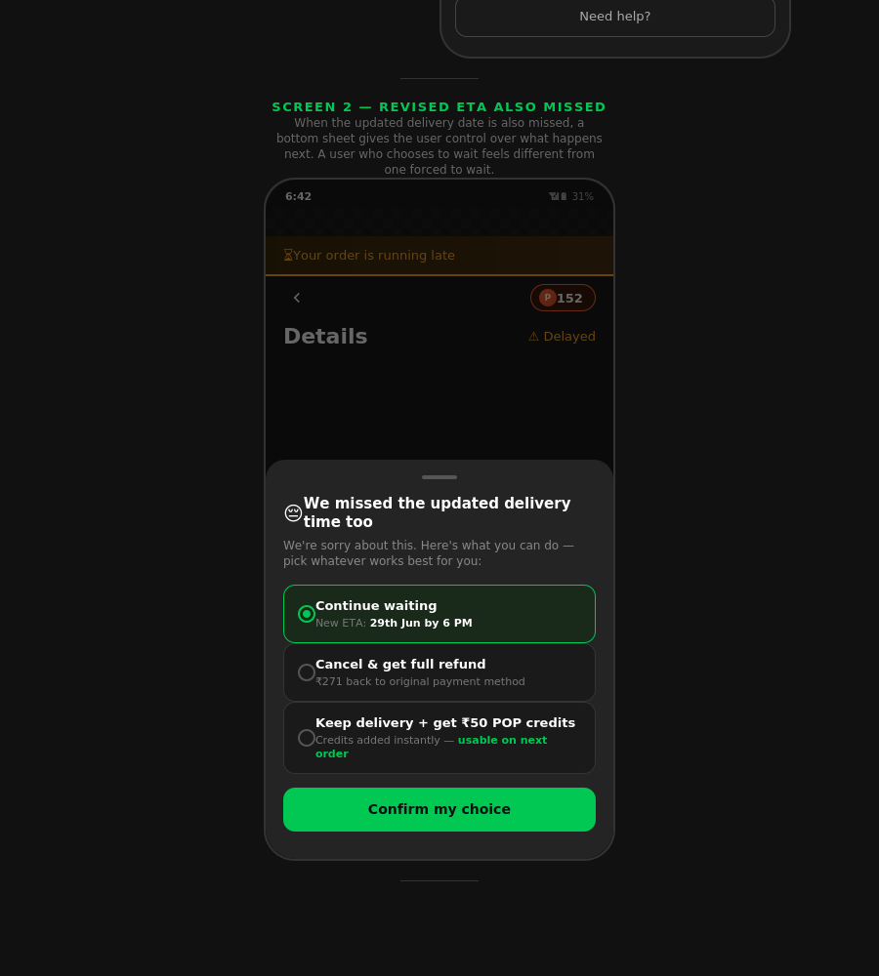
Task 2: Resolution Path & Edge Cases
If the revised ETA is also missed
Edge Cases
Second notification goes out with clear options:
No delivery update at all
Continue waiting with a new ETA
If courier goes dark for 12+ hours, do not message the user until our team has checked. Sending wrong info is worse than nothing.
Cancel the order and get a full refund
Keep the delivery and get Rs.50 POP credits
Revised date also missed
Connect user to a real person, not another automated message. Cancel + refund option clearly visible.
A user who chooses to wait feels very different from one who is forced to wait with no information. The credits option keeps the order alive without needing a full refund.
Too many delay messages
Cap at 3 delay updates per order. After the third, a real person reaches out.
Resolution bottom sheet gives the user control over what happens next.

Slide 9
Task 2: What I Would Not Build Yet
Live courier map
Needs real-time GPS from carrier partners. In India this data is unreliable. If the map shows courier is 2 km away when they are at a different hub, it destroys trust faster than having no map. Revisit when GPS reliability crosses 95%.
Auto-compensation for every delay
If every late order gets credits automatically, users learn that delays equal free money. That changes behaviour and can be gamed. Keep compensation for repeated failures only.
ML-based ETA prediction
We do not have clean route-level or pincode-level data to train on right now. Building better communication first will actually generate the structured data needed for ML later.

Slide 10
Task 3: Where AI Genuinely Helps
Status Code Translation
Delivery companies like Delhivery or Shadowfax update their systems with internal status codes written for warehouse staff, not customers. Most apps either show this confusing text directly or hide it behind a generic "In Transit" which tells the user nothing.
AI reads the delivery company's internal update and rewrites it in simple words before showing the user.
Delivery system says:
Delivery system says:
"Shipment exception, hub sorting delay"
"FM attempt failed, customer unavailable"
User sees:
User sees:
"Your package reached the warehouse but got held up today. It should move in the next 12 to 24 hours."
"Our delivery partner tried to deliver but could not reach you. They will try again tomorrow. You can also update your available time here."
AI is not making things up here. It is taking a fixed set of delivery status codes and converting each one into a readable message. It works within a defined set, it does not generate random explanations.

Slide 11
Task 3: Where AI Would Make Things Worse
Guessing Delay Reasons
If POP tries to explain WHY an order is delayed, the AI is just looking at patterns and making a guess. It has no real information about what is happening with that specific order.
Real example of how this goes wrong
Multiple orders in Bangalore are getting delayed. The AI looks at this and guesses it must be because of rain or bad weather.
AI tells users: "your order is delayed due to weather conditions in your area"
The user steps outside and it is a completely sunny day.
The actual reason was that the delivery company did not have enough staff that day. Now the user knows the app just made something up. Whatever little trust they had left is gone.
Simple rule: AI should only tell the user what is happening right now and what will happen next. It should never try to explain why, because it does not actually know why.

Slide 12
Measuring Success
Primary Metric
Repeat purchase rate among users who experienced a delivery delay
Not overall repeat rate because too many other things affect it. Isolate whether proactive communication changes if delayed-order users come back.
Test: Cohorted A/B — 50% of delayed orders get new notifications, 50% get current experience. Measure over 60 days.
WISMO ticket rate
Support contact rate
25-40% reduction on delayed orders
Within 48 hours of a missed ETA
CSAT score
Update coverage
On delayed orders specifically
85%+ in month one — delayed orders caught and notified
WISMO is not a tracking problem. It is the first place where POP's post-order visibility breaks. Start where the trust breaks first.

