Slide 1
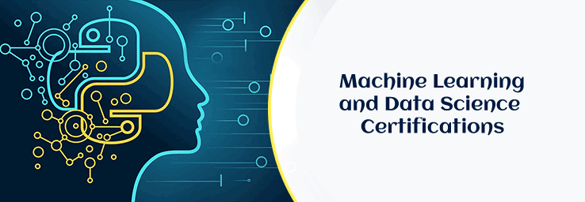
Priyadarshini College of Engineering, Nagpur
Department of Artificial Intelligence And Data Science
HAIR DISEASES IDENTIFICATION and ANALYSIS
PROJECT BY –
ADARSH SONKUSRE

Slide 2
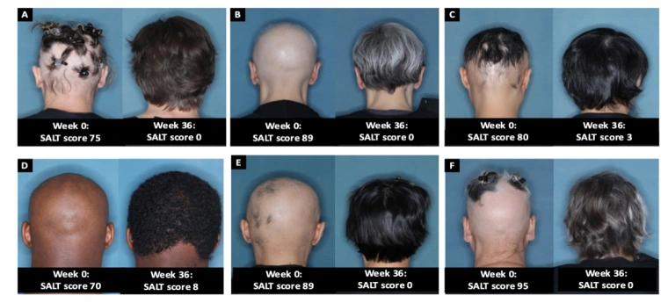
INTRODUCTION
This is to build a machine learning model in order to identify the hair related diseases ,to analyze the data to identify the major hair problems among the people around the world

Slide 3
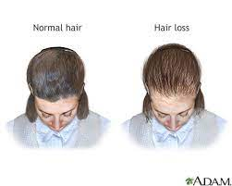
OBJECTIVE
Hair diseases are very common problems nowadays. Mostly hair loss due to:
Family history (heredity)
Hormonal changes
Medical conditions etc.

Slide 4
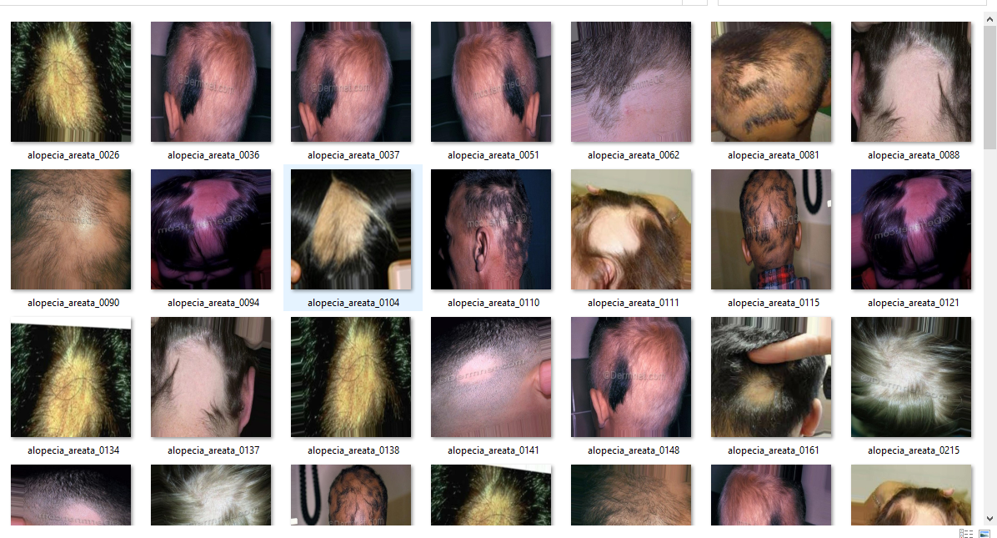
Data Collection Train Data

Slide 5
Problem Statement
The problem statement for hair disease identification using AI is to develop a system that can accurately and efficiently identify various hair diseases from images of a patient's scalp or hair. The system should be able to differentiate between different types of hair diseases, such as alopecia, dandruff, psoriasis, and fungal infections, among others. It should also be able to detect the severity of the disease and provide appropriate treatment recommendations. The goal is to improve the accuracy and speed of diagnosis, reduce misdiagnosis and improve patient outcomes.

Slide 6
Methodology
Collect and prepare a dataset of images: The first step is to gather a large dataset of high-quality images of different hair diseases.
Annotate the images: The next step is to annotate the images with labels indicating the type of hair disease that is present in each image.
Train the AI algorithm: Once the images have been annotated, they can be used to train an AI algorithm.
Test and refine the algorithm: After training the algorithm, it is important to test it on a separate dataset of images that it has not seen before.
Deploy the algorithm: Once the algorithm has been trained and refined, it can be deployed for use in identifying hair diseases in real-world settings.

Slide 7
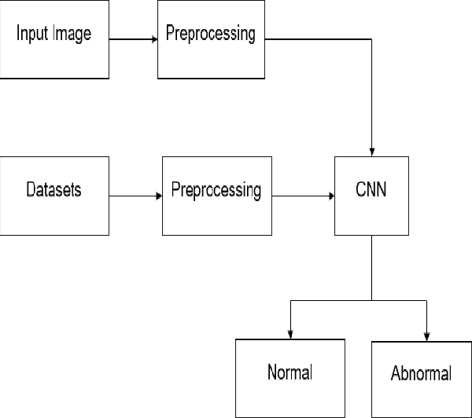
Flowchart

Slide 8
Future Scope
In future our project has ability to cure the human as well as animal hair detection too.
It is used in villages that are not socially connected to the current environment.
In future we will create an application through which anyone can easily detect the whatever disease

Slide 9
Result
There have been several developments in using artificial intelligence (AI) for hair disease identification.
The system was trained on a dataset of over 1,000 images and achieved an accuracy rate of 98.00 % in diagnosing the condition.
However, further research and validation are needed before these technologies can be widely adopted in clinical settings.

Slide 10
References
The Hundred-Page Machine Learning Book by Andriy Burkov.
Internet form the datasets .
Data science Learning book by Data Science Projects with Python: A case study approach to gaining valuable insights from real data with machine learning, 2nd Edition.

