Slide 1


 | PRIYADARSHINI COLLEGE OF ENGINEERING, NAGPUR DEPARTMENT OF ARTIFICIAL INTELLIGENCE AND DATA SCIENCE
Seminar on
“MORSE CODE DETECTOR”
By: -
ADARSH SONKUSARE

Slide 2
Contents
Introduction
Aim and Objective
Literature Survey or Literature Review
Problem Statement
Block Diagram
Methodology
Work plan
References

Slide 3
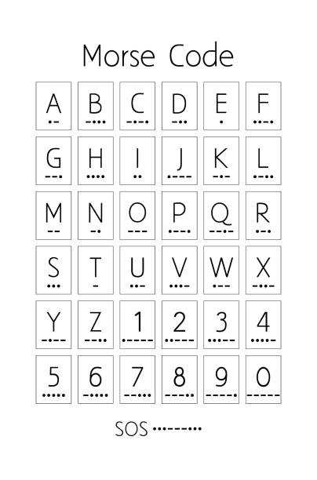
Introduction
What is Morse code? Morse code is a system of communication that uses a series of dots and dashes to represent letters, numbers, and punctuation. Each letter is represented by a unique combination of dots and dashes, with the length of the dot or dash indicating the duration of the signal.

Slide 4
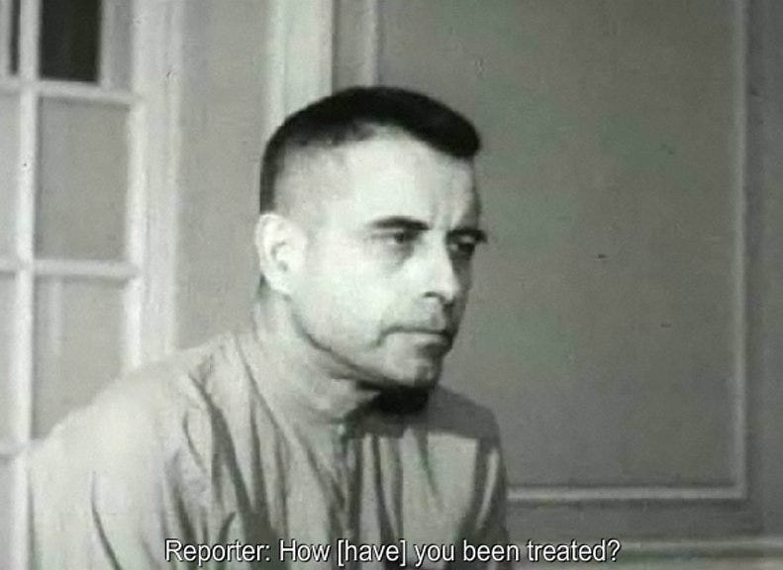
Literature Survey
How Blinking the Word T-O-R-T-U-R-E on TV Saved the Life of this PoW
Jeremiah Denton, an American prisoner of war in Vietnam blinked the word “torture” using morse code in a TV interview.
Courtesy:- New York times May 17,1966

Slide 5
Problem Statement
Morse code can’t be understood by a common person
Task is to build a Machine Learning model to
understand and translate morse code
The model needs to have maximum accuracy

Slide 6
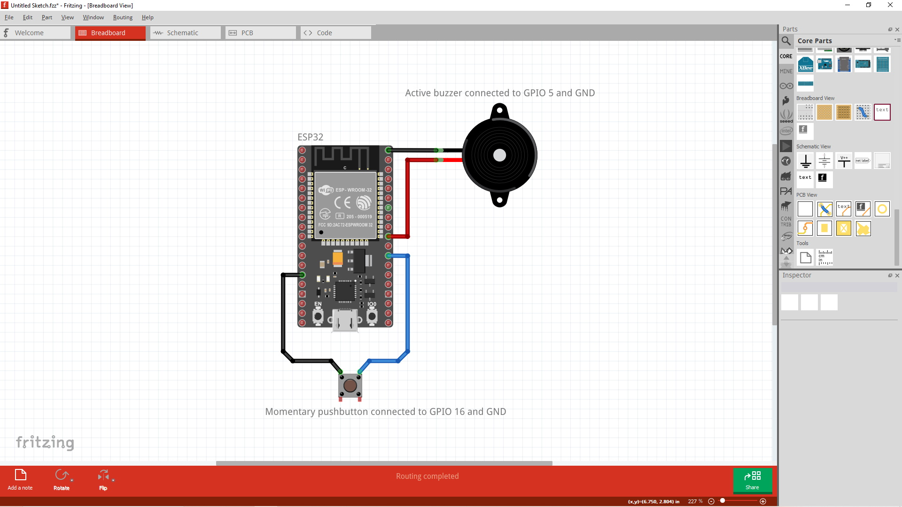
System Description
Block Diagram
HARDWARE REQUIRED:-
MORSE CODE DETECTOR:-
ESP32
5V BUZZER
TAP SWITCH
SOFTWARE REQUIRED :-
ARDIUNO IDE
PYTHON IDLE

Slide 7
Work plan and Methodology
Build The Algorithm
Compatibility issue
Creating header files
Programming the hardware
Contents Title
We are required to build an machine learning algorithm with maximum accuracy.
The algorithm is required to have the highest accuracy possible since we are dealing with the confidential data
Since this is an machine learning algorithm we have no other choice but to use python as our primary programming language but the hardware that we are aiming for the build is using the c,c++ language
So we are required to find a way to convert the python code into c,c++ code
Get a modern PowerPoint Presentation that is beautifully designed. I hope and I believe that this Template will your Time, Money and Reputation. Easy to change colors, photos and Text. You can simply impress your audience and add a unique zing and appeal to your Presentations.
After the process of creating header files
We are required to build another code to program the hardware also by summarizing the header files
After the conversion we have to create header files of the converted code.
In order to import the algorithm inside the arduino ide code
01
02
03
03
04

Slide 8
Expected Outcomes
A header file containing code that is converted from python program
The header format should support the syntax provided by Arduino.cc
The final program should be able to dump the algorithm to the hardware
Esp32 model should be able to convert morsecode input into English characters

Slide 9
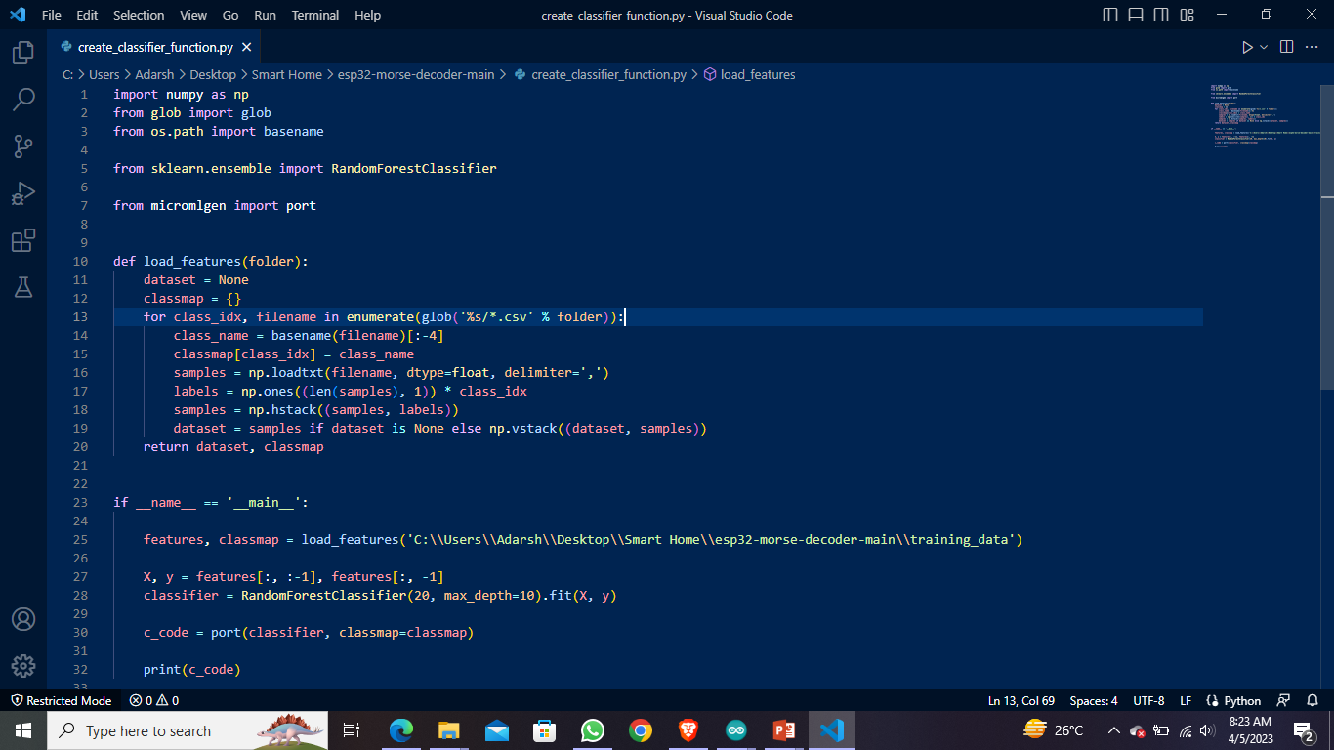
Python Algorithm

Slide 10
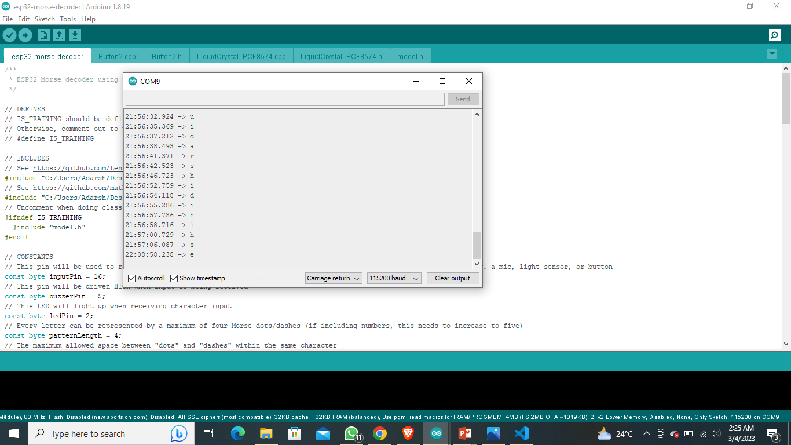
Output

Slide 11
References
[1] The Hundred-Page Machine Learning Book by Andriy Burko 1096-1101.
[2] Hands-On Machine Learning with Scikit-Learn, Keras, and TensorFlow by Geron Aurelien
[3]Scikit-Learn Documentation: - Documentation scikit-learn: machine learning in Python — scikit-learn 0.21.3 documentation
[4]Arduino Documentation: - Arduino Docs | Arduino Documentation

Slide 12
Thank you !

