Slide 1
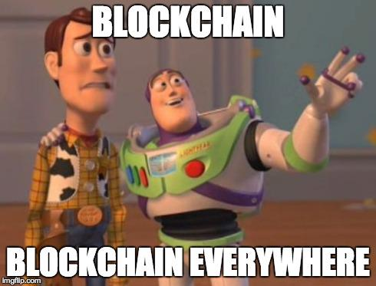
Block Chain Based Complaint Mangement System
Presented By
Adarsh.S
RegNo: 963820104005
CSE,3rd Year

Slide 2
Objectives
Develop a secure and transparent complaint registration system using blockchain technology, ensuring that users can register complaints and track their status accurately
Strengthen data security by leveraging blockchain's tamper-proof nature, protecting sensitive information while allowing authorized parties to access necessary details for complaint resolution.
Streamline the complaint handling process by providing an efficient admin panel for administrators to respond promptly, resulting in improved complaint resolution times and customer satisfaction

Slide 3
Abstract
Users can easily register their complaints by providing relevant details such as name, email,mobile no,complaint and date of occurrence. This simplifies the process and ensures that complaints are properly recorded
Users can track the progress of their complaints by updating the status from pending to resolved. This feature fosters transparency and keeps users informed about the resolution process.

Slide 4
Blockchain technology ensures complaint data security and immutability.
Only the registered wallet associated with a complaint can modify its status.
The system allows searching for complaints using wallet addresses while protecting personal data.
Complaint details accessible include ID, description, registration time, admin response, response time, and status.
An authentication-based admin panel restricts access to authorized administrators.
The admin panel offers functions like total complaint count, last responded complaint ID, responding to complaints, and viewing updated statuses.

Slide 5
Existing System
Centralized platform: An existing complaint management system typically operates on a centralized platform where all complaints are gathered and processed.

Slide 6
Disadvantages
Lack of Transparency
Data Security Risks
Potential for Manipulation
Single Point of Failure
Lack of User Empowerment

Slide 7
Propsed System
The proposed complaint registration system is a secure and transparent platform utilizing blockchain technology. Users can easily register complaints, update their status, and administrators have access to an authenticated panel for managing and responding to complaints. It provides an efficient solution for effective complaint management

Slide 8
Advantages
Security
Transparency
Accountability
Efficiency
Improved User Experience:

Slide 9
LITERATURE REVIEW
S NO | TITLE | AUTHOR | PUBLISHED YEAR | ALGORITHM | ADVANTAGE | DISADVANTAGE
1 | Blockchain application in food supply information security | Daniel Tse; Bowen Zhang; Yuchen Yang; Chenli Cheng; Haoran | 2017 | No specified | Blockchain allows for transparent and immutable record-keeping of every transaction and movement in the supply chain. | Implementing blockchain technology requires significant technical expertise and investment

Slide 10
S NO | TITLE | AUTHOR | PUBLISHED YEAR | ALGORITHM | ADVANTAGE | DISADVANTAGE
2 | Police Complaint Management System Using Blockchain technology. | Ishwarla Hingorani,Rushabh Khara,Deepika Pomendkar,Nataasha raul, | 2020 | No specified | Blockchain technology secures data through cryptographic techniques, making it difficult for unauthorized individuals to alter or manipulate complaint records | Implementing a blockchain-based complaint management system introduces a dependency on the underlying technology.

Slide 11
S NO | TITLE | AUTHOR | PUBLISHED YEAR | ALGORITHM | ADVANTAGE | DISADVANTAGE
3 | Smart Complaint Management System | Pattamporan Kormphol,Pandia Liawsomboon,Narut Phongoen,Siripen Pongpaichent | 2018 | No specified | Intelligent Routing and Prioritization: By using AI and NLP algorithms, a Smart Complaint Management System can automatically categorize and prioritize complaints based on their content and severity. | Implementing a Smart Complaint Management System can involve significant upfront costs, including software development, infrastructure upgrades, and training expenses

Slide 12
Problem Statement
This project aims to create a secure and transparent complaint registration system using blockchain technology, allowing users to register and update complaint status while ensuring data security, transparency, and efficient resolution.

Slide 13
Methodology
The methodology for this project involves gathering requirements, designing the system architecture, implementing blockchain technology using Solidity, developing the user interface, conducting testing and quality assurance, deploying on the Polygon network, creating the admin panel, providing user training and documentation, and ensuring ongoing maintenance and support.

Slide 14
Modules
Admin Module => functionalities such as complaint response, status tracking, and authentication based on the wallet
user module => for complaint registration, updates, and search functionalities using blockchain technology for transparency and data security.

Slide 15
Requirements
Hardware Requirement
Laptop
Minimum 100GB HD
Minimum 4GB RAM
Standard Keyboard and Serial Mouse
Sotfware requirements
VS Code
Foundry
Polygon Matic

Slide 16
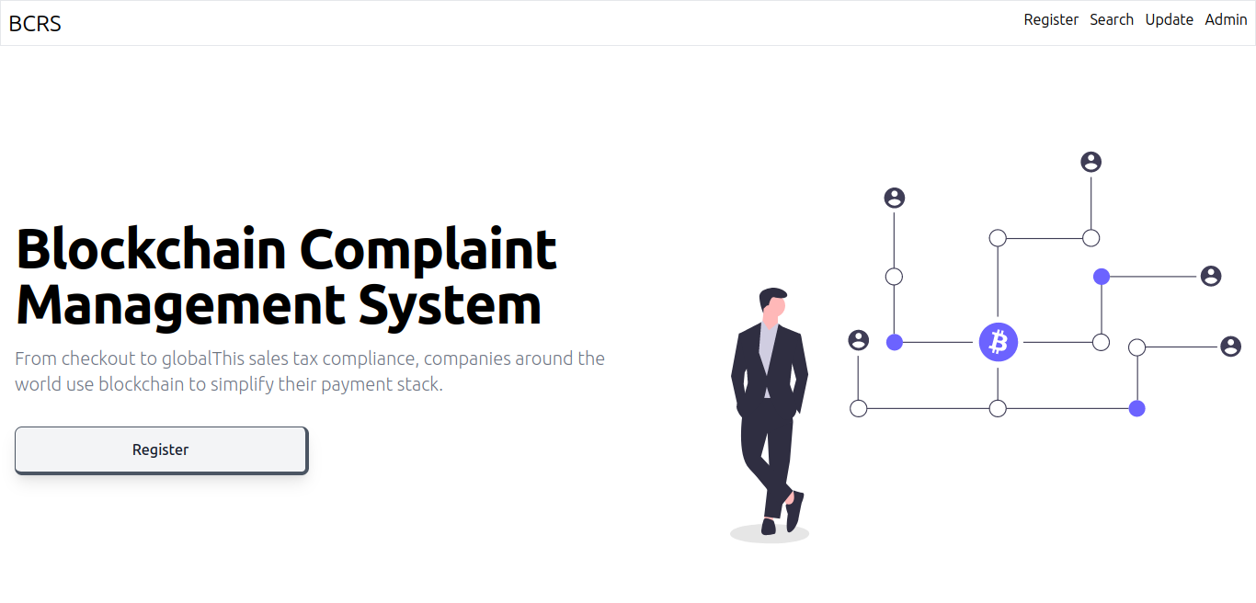
RESULT

Slide 17
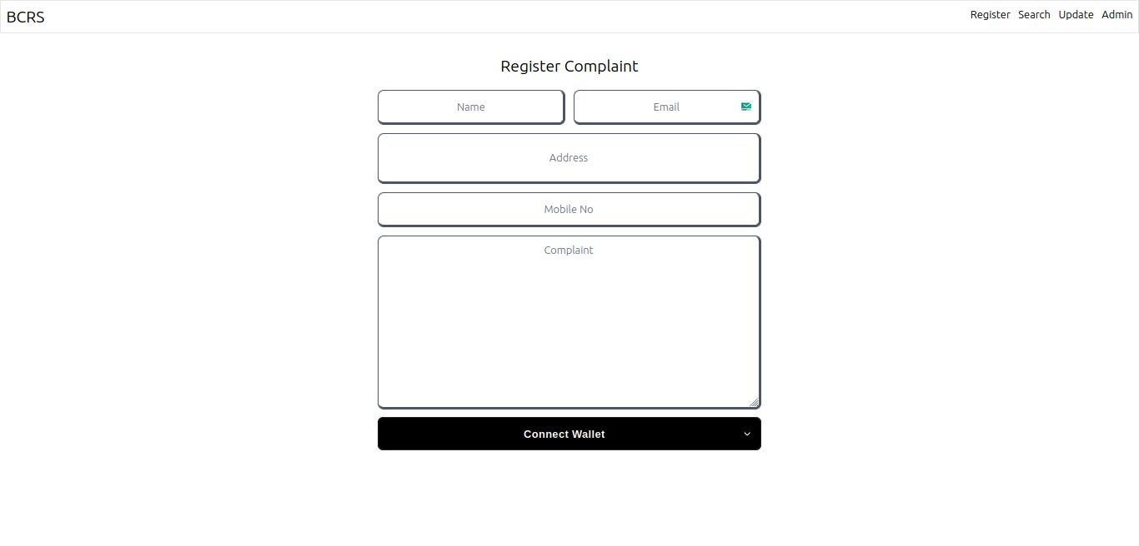

Slide 18
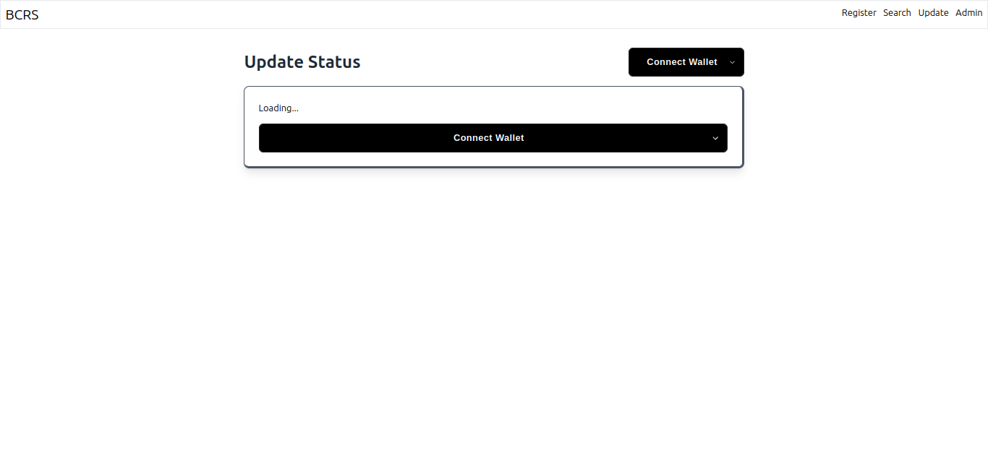

Slide 19
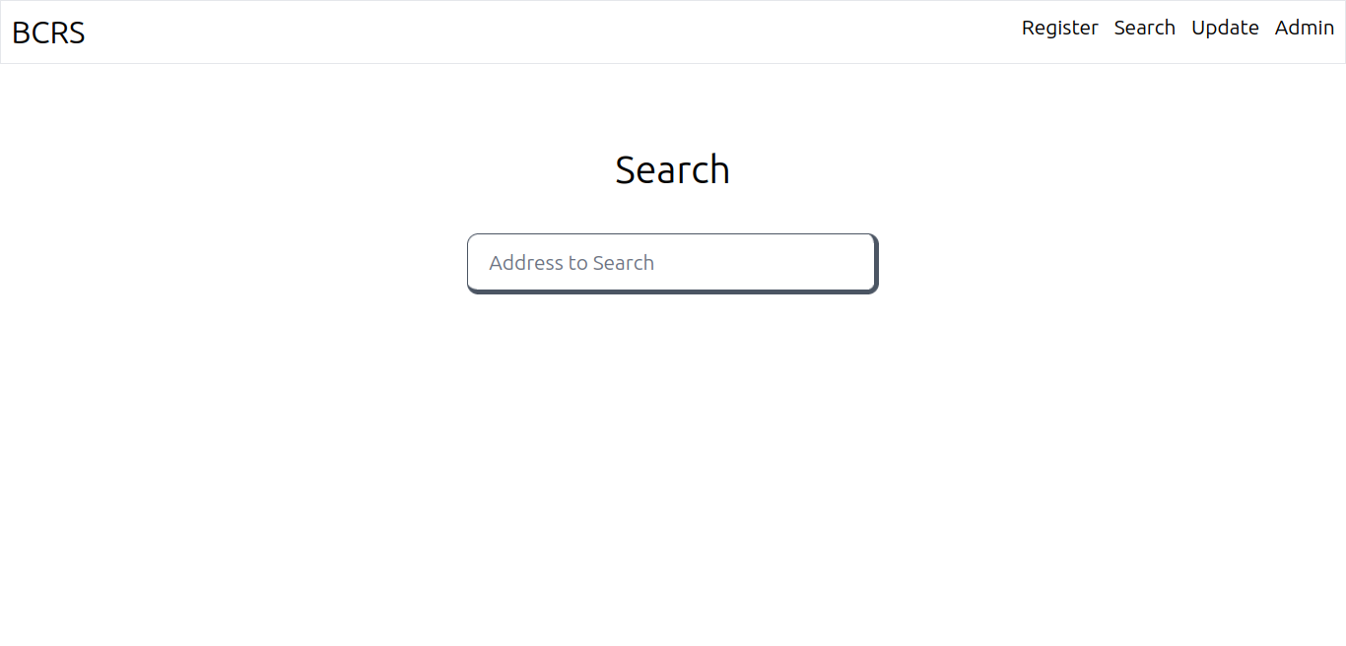

Slide 20
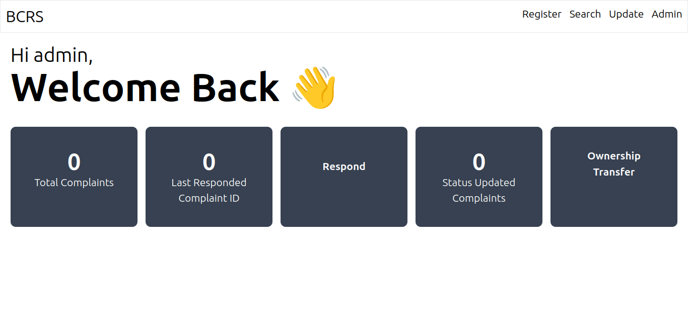

Slide 21
Scope Of The Project
The scope of the project involves designing and implementing a complaint registration system using blockchain technology, allowing users to register complaints, update complaint status, and enabling administrators to manage and respond to complaints, while ensuring data security, transparency, and user-friendly functionalities.

Slide 22
Conclusion
In the conclusion,the implementation of a blockchain-based complaint registration system offers a secure, transparent, and efficient solution for handling complaints. By leveraging technologies such as React.js, TailwindCss, Solidity, and the Foundry Polygon network, the project enables users to register complaints, update their status, and access transparent information while maintaining data security and privacy. The admin module empowers administrators with the necessary tools to manage and respond to complaints effectively. Overall, this project addresses the limitations of traditional complaint registration systems and provides a reliable and accountable approach to handling complaints.

Slide 23


