Slide 1


DA- Hospitality Analytics
Project Mentor :
Mr. Mahendra Singh
Group 6 – Team Members
Muttamma
Gargi Hrishikesh Sawant
Mrs. Arati Gaurav Gujrathi
Divya Jagdish Pukale
Raj Rajoli
Niraj Pradip Patil
Mr. Adarsh Krishnadev Tiwari

Slide 2

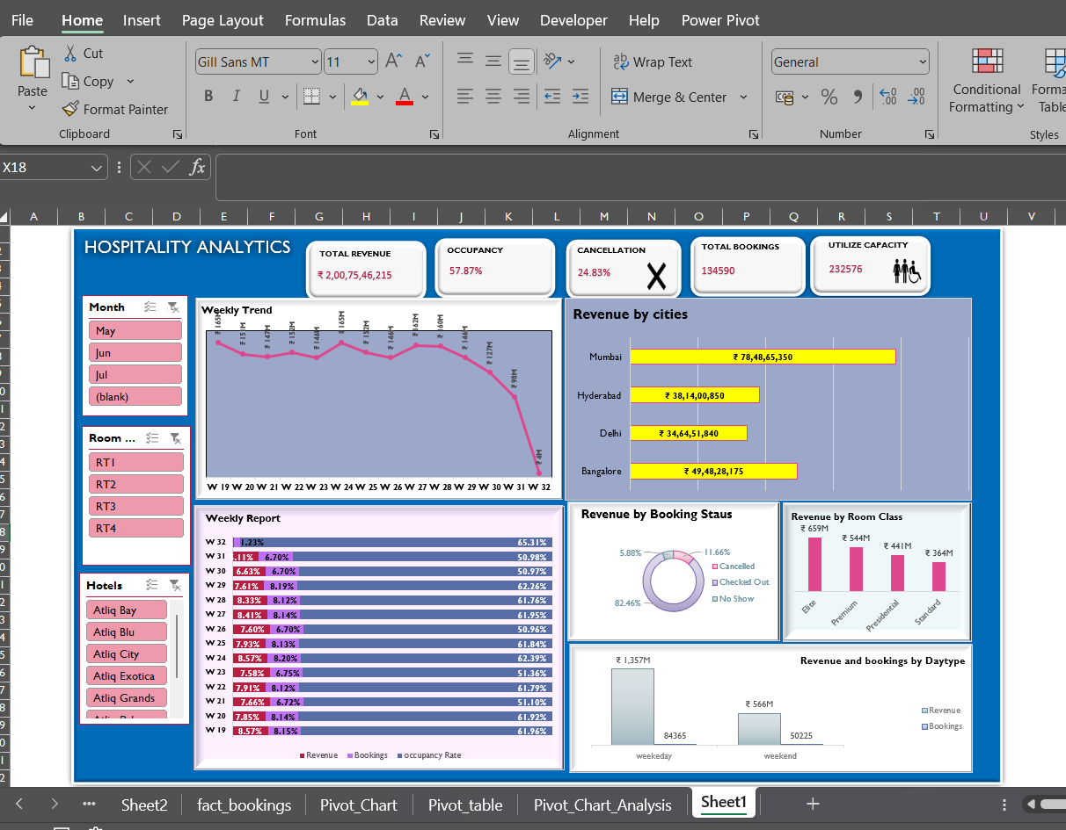

Slide 3
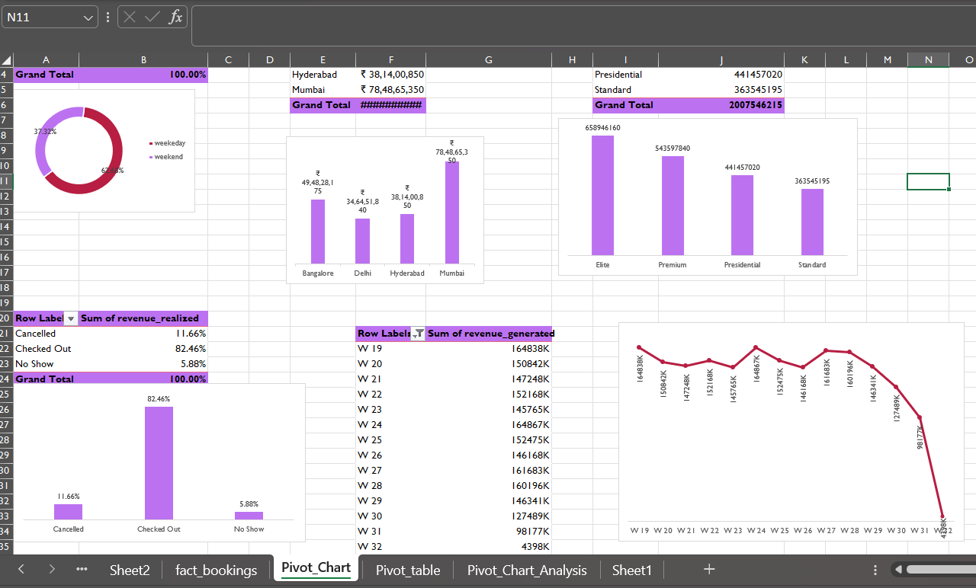
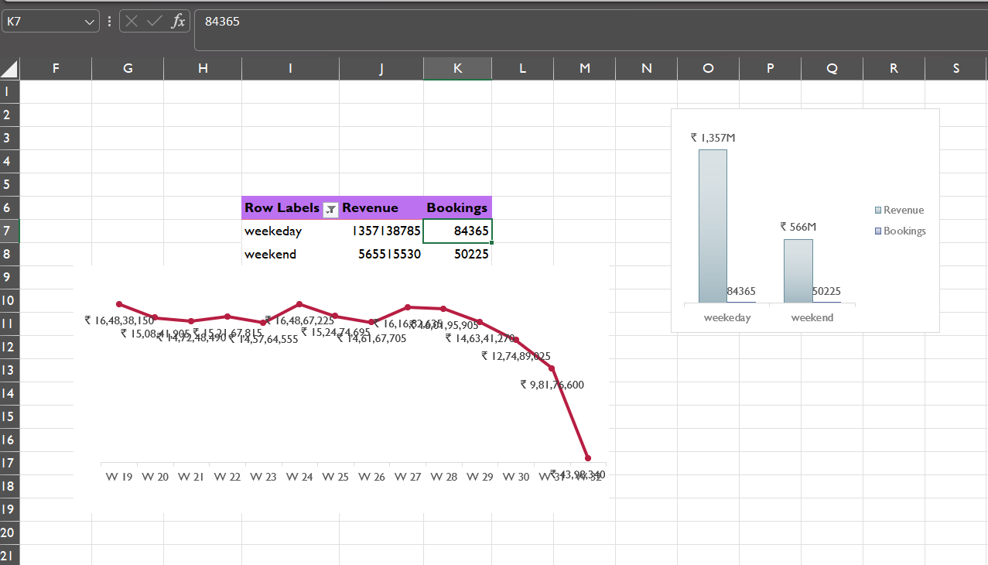
Description :
Designed and developed a comprehensive Hotel Booking Analysis Dashboard using Advanced Excel to monitor and analyze key metrics including occupancy rates, revenue trends, and guest demographics.
In Advanced Excel, utilized advanced functions, pivot tables, and dynamic charts to manipulate and visualize data effectively.
Skills Demonstrated:
Proficiency in Advanced Excel features for data manipulation, analysis, and visualization.
Problem-solving and critical thinking in leveraging data to drive business decisions.

Slide 4

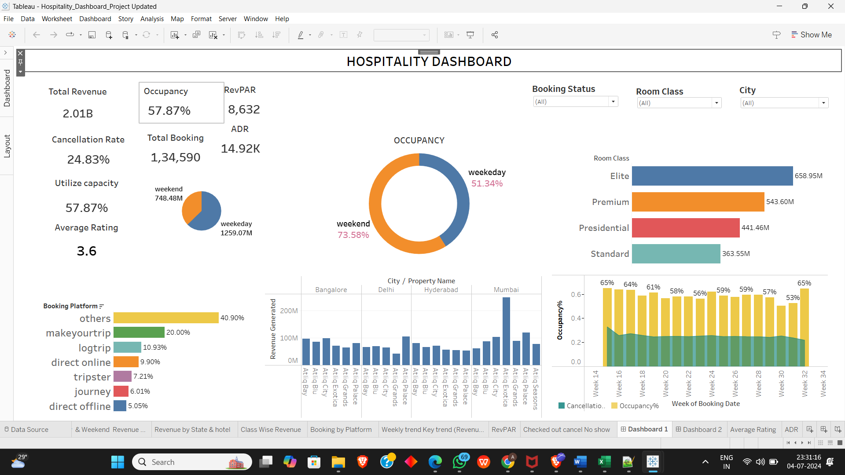

Slide 5
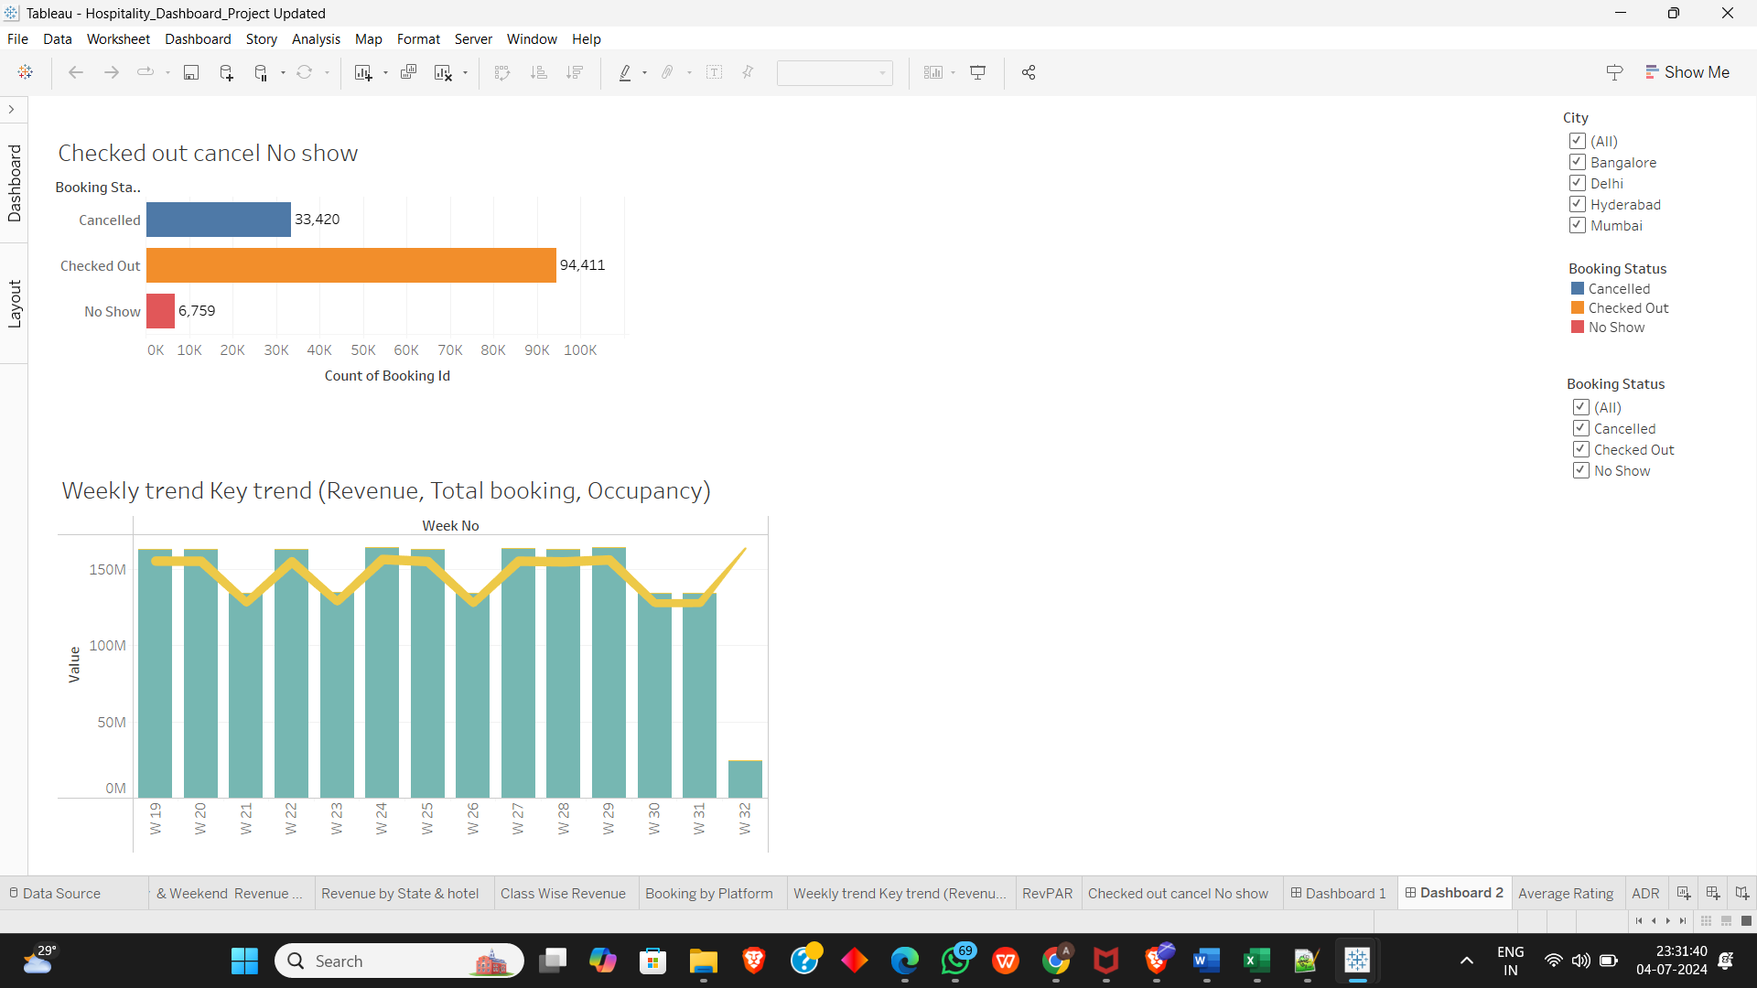

Slide 6
Description:
Developed a Hotel Booking Analysis Dashboard using Tableau to visualize and analyse key metrics such as occupancy rates, revenue trends, and guest demographics.
Extracted data from multiple sources and prepared it for analysis using Tableau’s data preparation tools.
Designed interactive dashboards and reports in Tableau to provide insights into booking patterns, occupancy trends, and revenue performance.
Implemented filters, parameters, and actions to allow for dynamic exploration and deeper analysis of the data.
Skills Demonstrated:
Proficiency in data visualization and dashboard development using Tableau.
Experience in data preparation, blending, and connecting data sources within Tableau.
Analytical thinking and problem-solving in using data to drive business decisions.

Slide 7

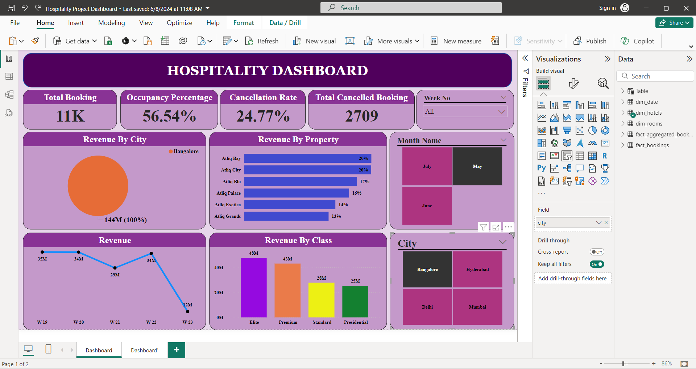

Slide 8
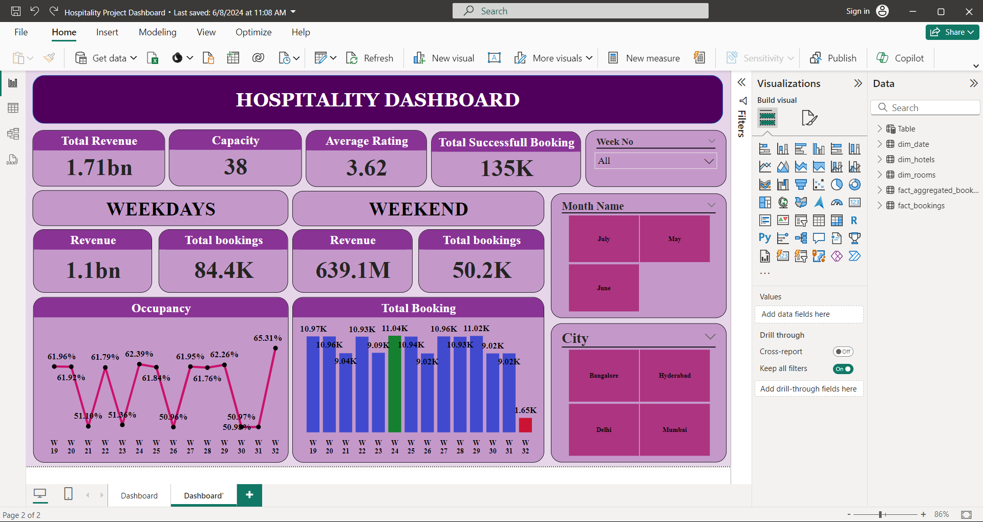

Slide 9
Power BI :
Designed and developed a Hotel Booking Analysis Dashboard using Power BI to track and analyze key metrics such as occupancy rates, revenue trends, and guest demographics.
Extracted and transformed data from multiple sources into Power BI using queries and data modeling techniques to create a unified dataset for analysis.
Developed interactive visualizations including charts, graphs, and KPIs to provide insights into booking patterns, occupancy trends, and revenue performance.
Implemented slicers, filters, and drill-down functionalities to enable detailed exploration of data and facilitate decision-making.
Skills Demonstrated:
Proficiency in data extraction, transformation, and visualization using Power BI.
Experience in data modeling, creating relationships between datasets, and optimizing query performance.
Problem-solving and analytical thinking in leveraging data-driven insights to address business challenges.

Slide 10

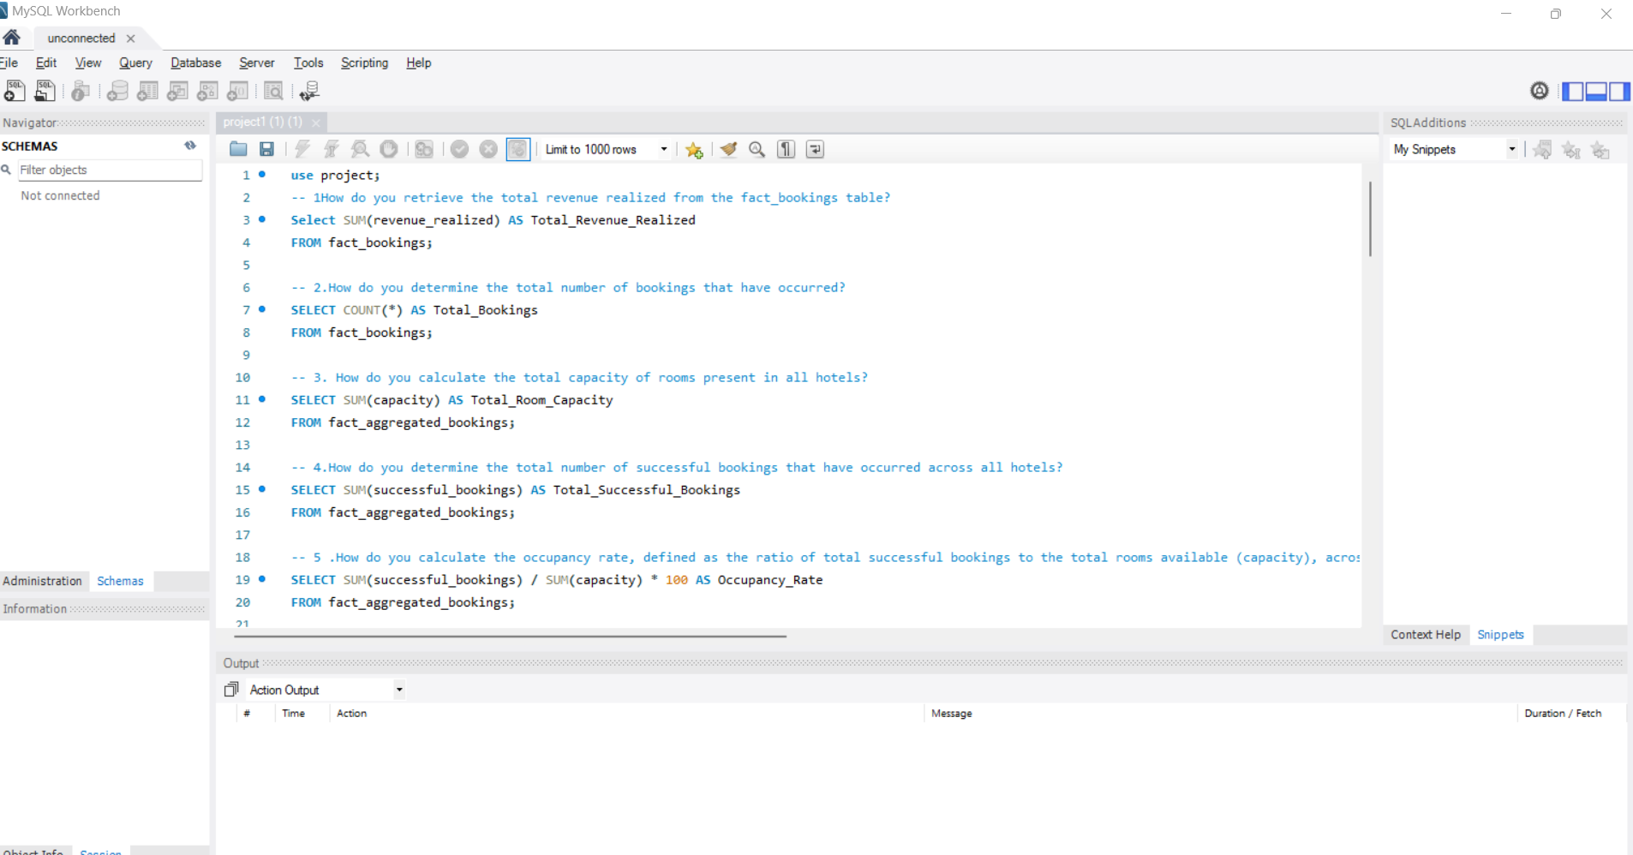

Slide 11
SQL : (Structured Query Language)
Description:
Developed and implemented a Hotel Booking Analysis system using SQL to analyze and extract insights from booking data.
Designed SQL queries to retrieve and manipulate data from the database, focusing on key metrics such as occupancy rates, booking trends, and revenue analysis.
Utilized SQL functions and joins to aggregate data and perform calculations necessary for analysis.
Created views and stored procedures to streamline data extraction and reporting processes.
Skills Demonstrated:
Proficiency in SQL querying, data manipulation, and database management.
Experience in optimizing SQL queries for performance and efficiency.
Analytical thinking and problem-solving in leveraging SQL data to derive actionable insights.

Slide 12



