Slide 1
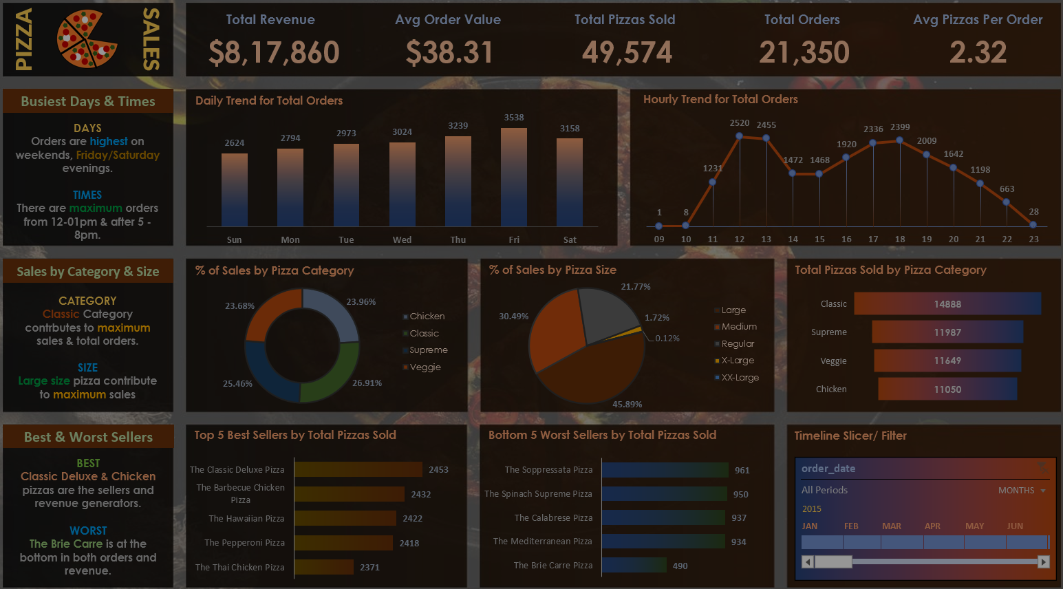



DATA ANALYST PORTFOLIO PROJECT
Tableau_Pizza_Sales_Report
TABLEAU

Slide 2
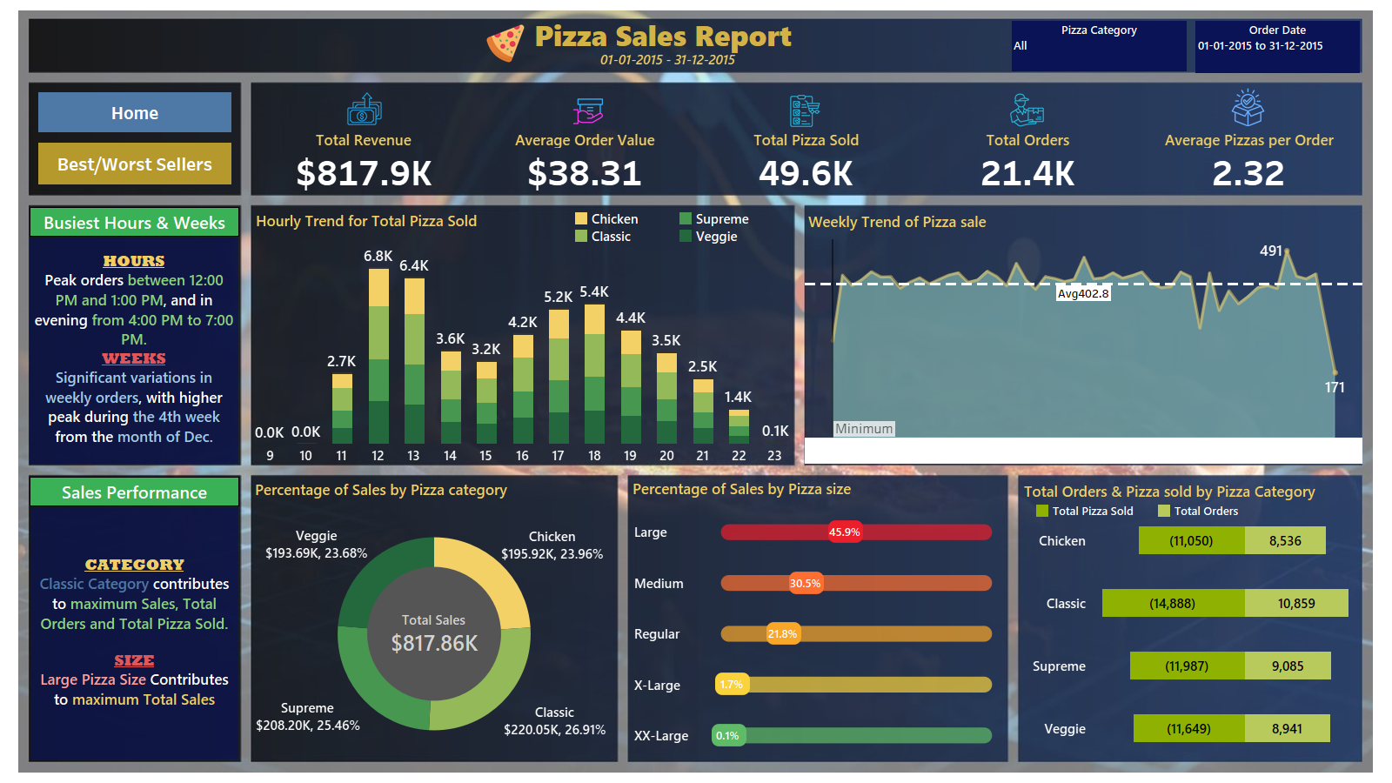

Slide 3
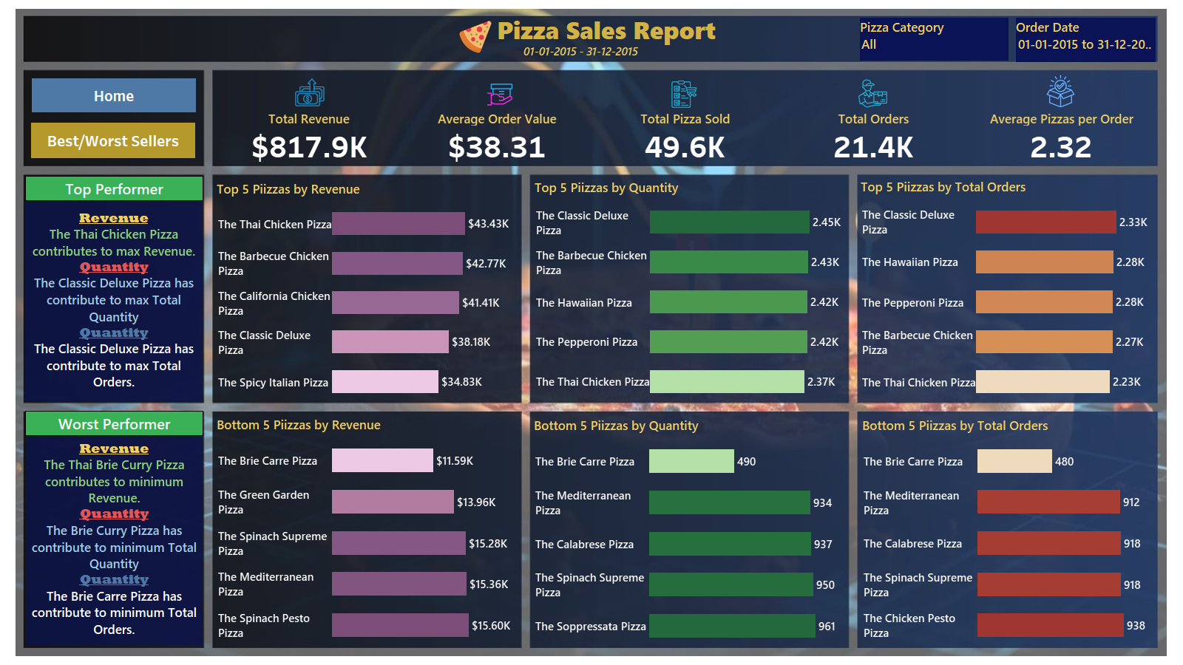

Slide 4
Thank You

