Slide 1
Intermediate Code Generator
By:Adarsh Vardhan Singh

Slide 2
Abstract
In the analysis-synthesis model of a compiler, the front end of a compiler translates a source program into an independent intermediate code, then the back end of the compiler uses this intermediate code to generate the target code (which can be understood by the machine). The benefits of using machine-independent intermediate code are:
Because of the machine-independent intermediate code, portability will be enhanced. For ex, suppose, if a compiler translates the source language to its target machine language without having the option for generating intermediate code, then for each new machine, a full native compiler is required. Because, obviously, there were some modifications in the compiler itself according to the machine specifications.
Retargeting is facilitated.
It is easier to apply source code modification to improve the performance of source code by optimizing the intermediate code.

Slide 3
Introduction
Intermediate code generator receives input from its predecessor phase, semantic analyzer, in the form of an annotated syntax tree.That syntax tree then can be converted into a linear representation, e.g., postfix notation. Intermediate code tends to be machine independent code.
Code generator is used to produce the target code for three-address statements. It uses registers to store the operands of the three address statement.

Slide 4
Methodology and Technique
It is basically a python program for generating an intermediate three address code.
It takes .csv file format for input.
In this there is left and right columns indicates the "left" and "right" values respectively.
The csv file doesn't contains "=" sign.

Slide 5
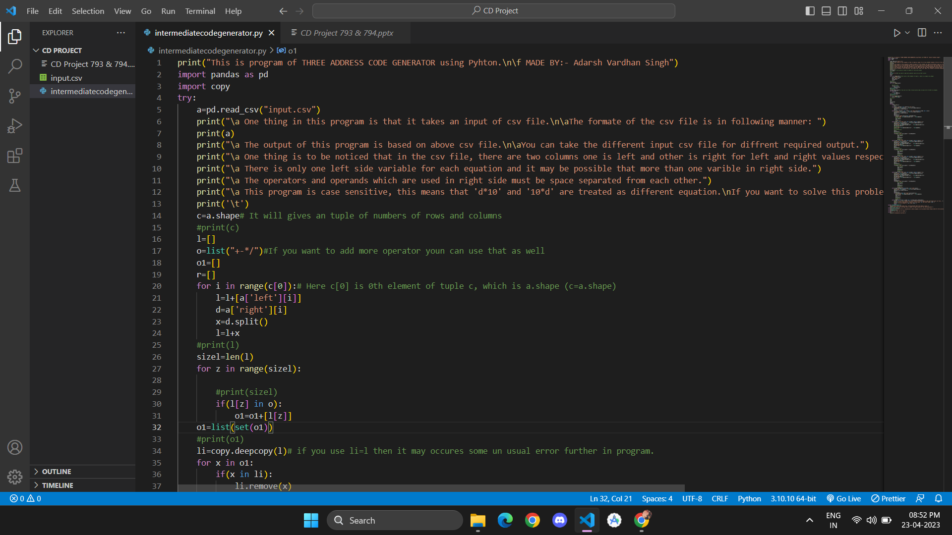
Implementation

Slide 6
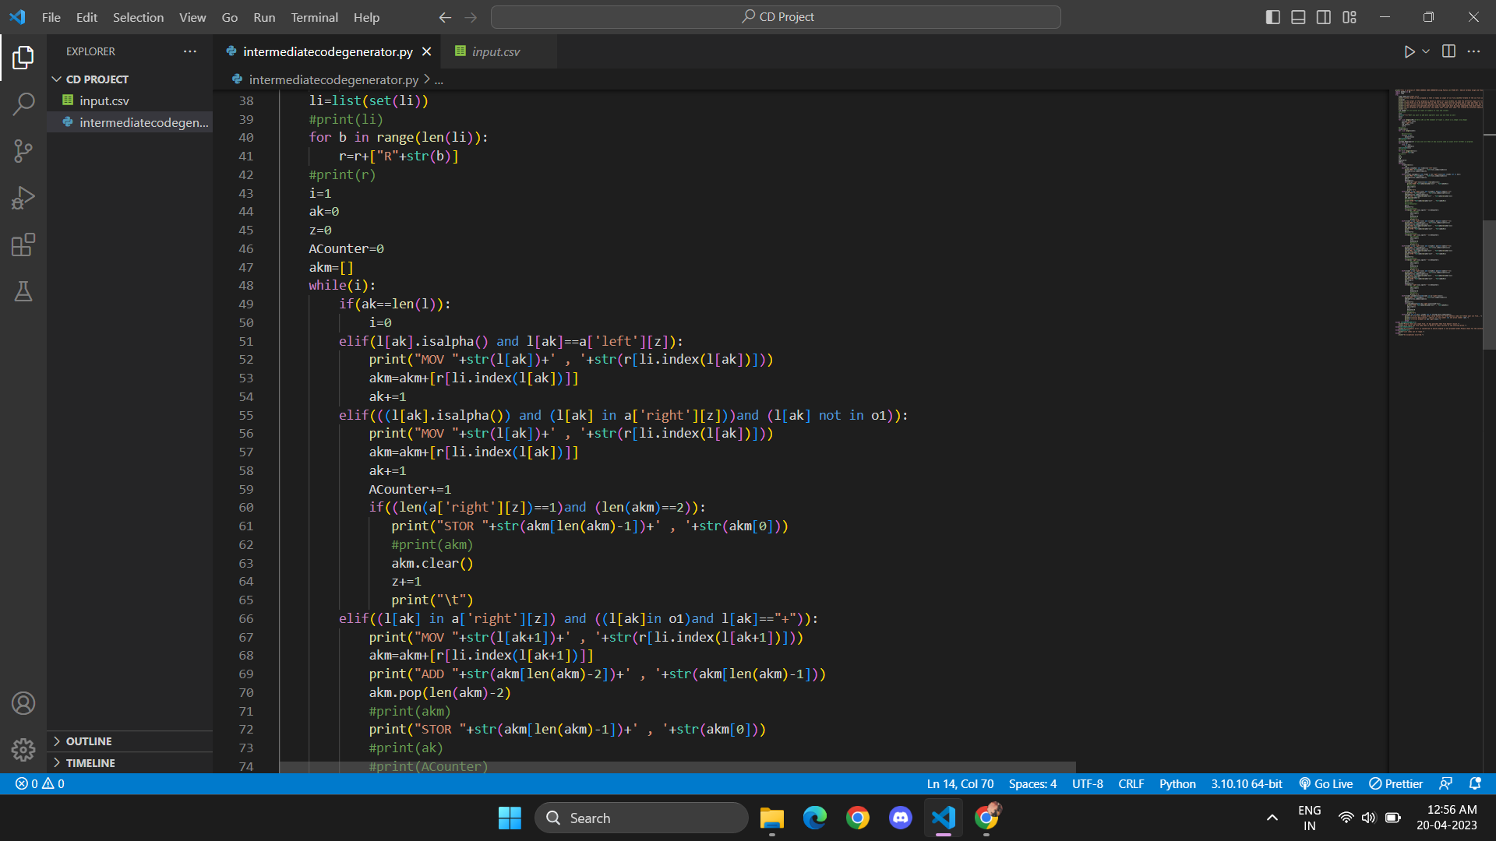

Slide 7
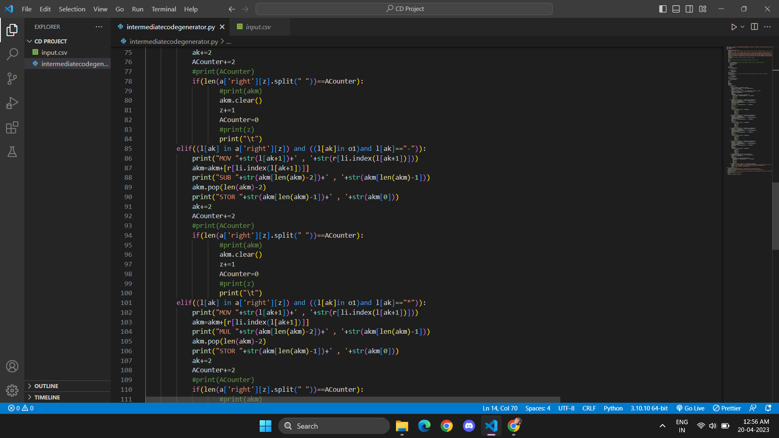

Slide 8
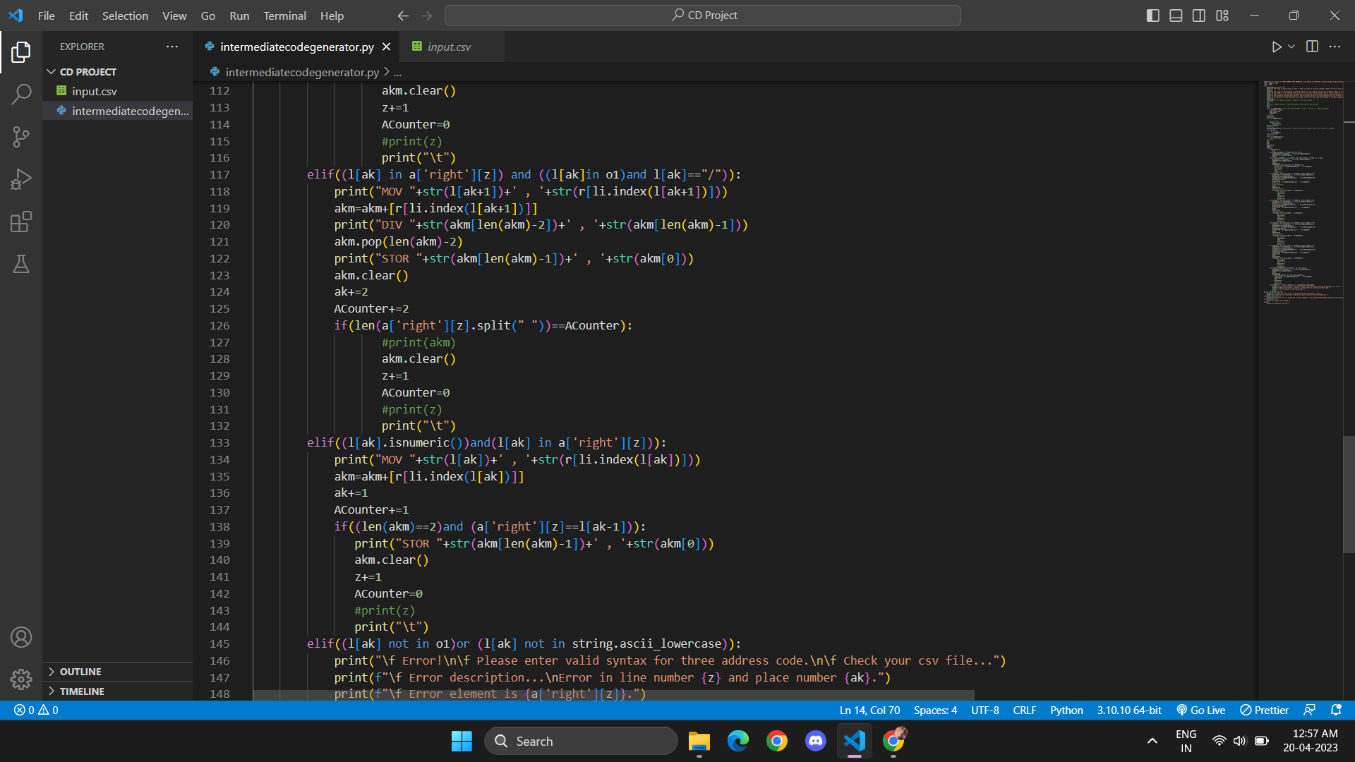

Slide 9
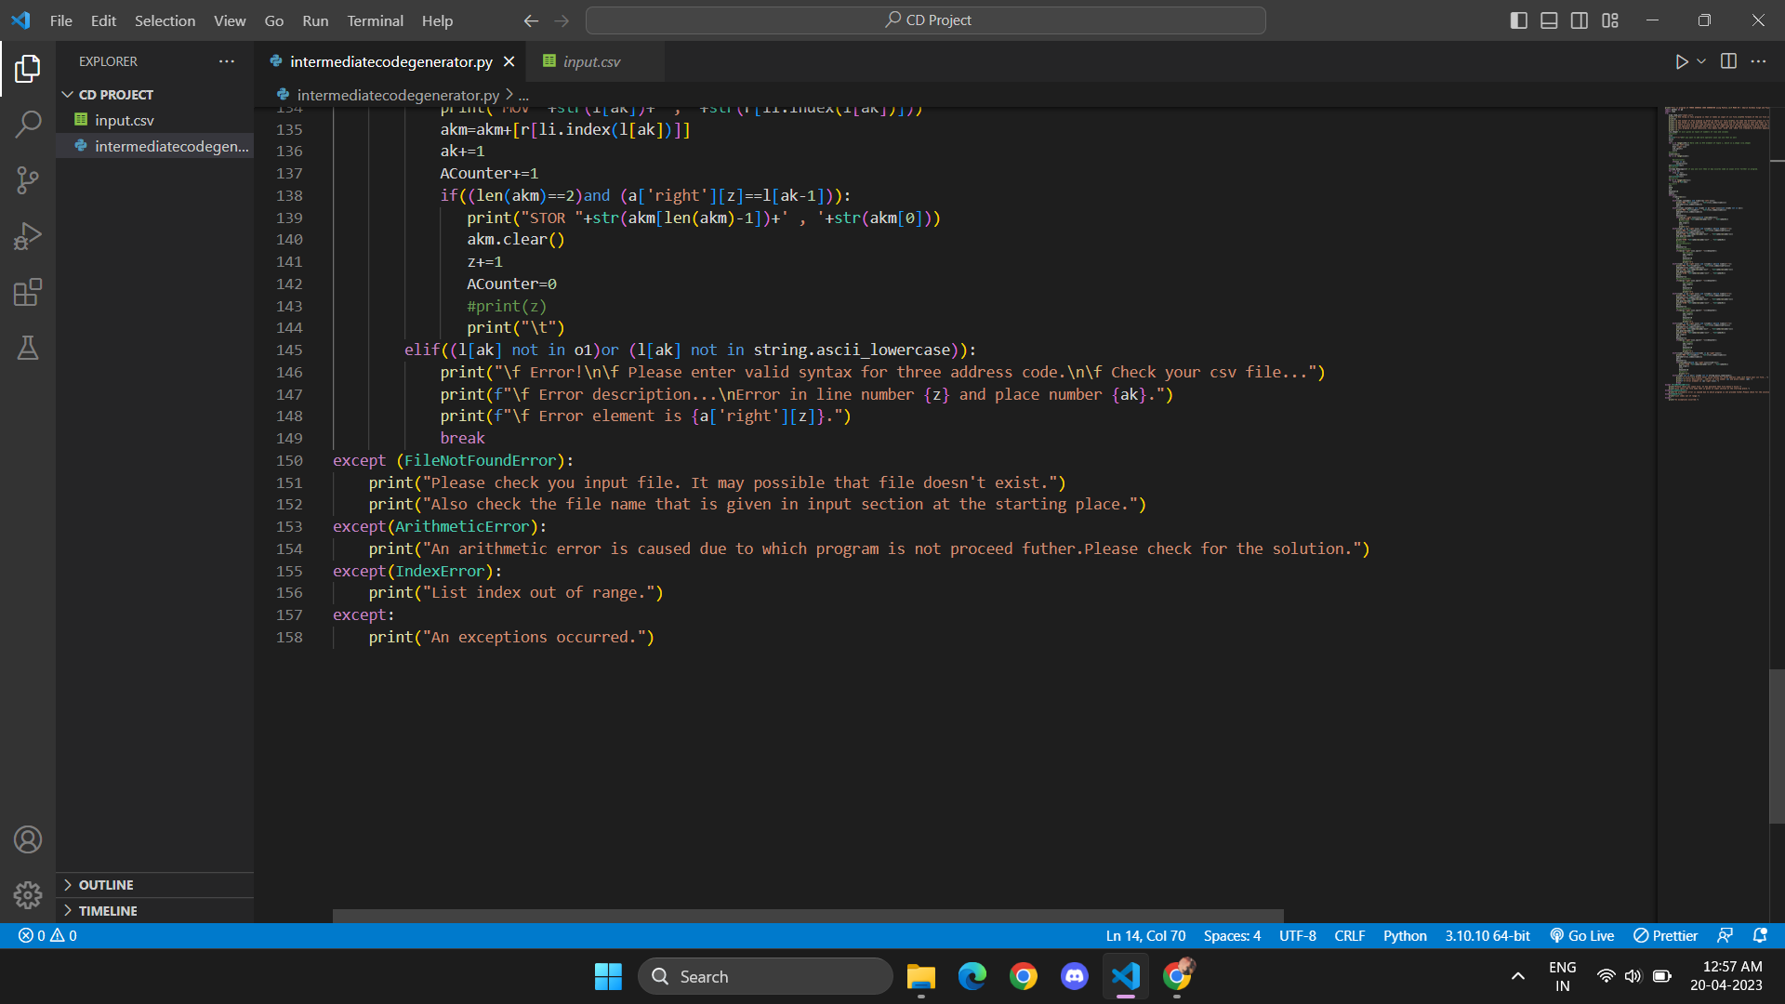

Slide 10
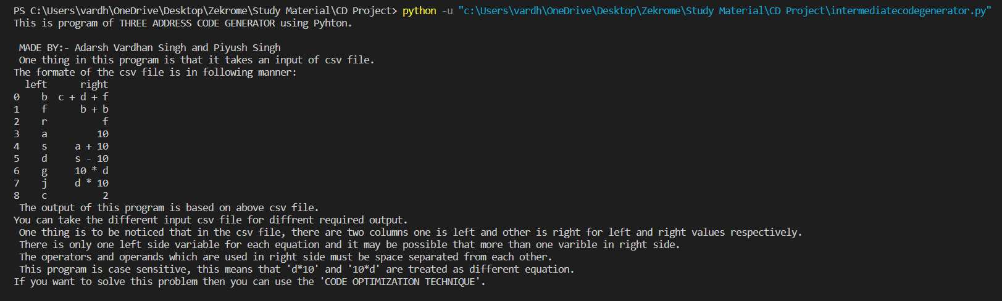
Output:

Slide 11
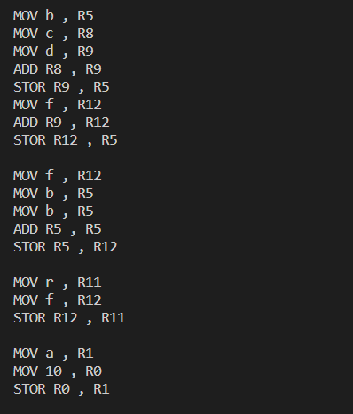
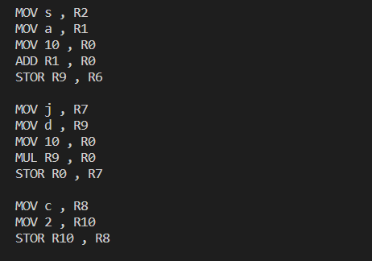

Slide 12
Conclusion
Hence, Code is Optimised
Source Program Converted into Intermediate code.

Slide 13
Reference
https://www.tutorialspoint.com/what-is-intermediate-code-generation
https://www.geeksforgeeks.org/intermediate-code-generation-in-compiler-design/amp/

