Slide 1

University Career Fair
Business Data Management
Fall - 2017 Final Project
Submitted by : - Palak Hemant Patel
- Harshal Patel
- Adarsh Vijayaraghavan

Slide 2
Contents
System Description
Database Model
Constraints – A few samples
Participation
Integrity
Cardinality
Covering and Overlap
Queries
What are the 5 most popular skills?
What kind of food to order?
Which organizations are visiting only on the first day?
Siri, what’s my interview schedule?
Show me some active, open roles.
Assumptions
Limitations
Unique Value Proposition
Challenges Faced
Future Scope

Slide 3
System Description
The requirement is to model the database for a career fair similar to the one hosted by Rutgers University Career Services
The career fair is conducted over a fixed time-frame, say 2 days. The duration is divided into 60-minute/30-minute slots
Each organization has some representatives who add roles to the system
Some of these representatives visit the fair as recruiters
To do this, they must book time-slots at the fair, and be allocated to a stall
The system should persist the details of the candidates, including their skills, expertise and experience
Candidates should be able to see roles matching their skill-set, and shortlist a few roles
The system should be able to track basic information on the actual recruitment process, such as interview schedules
All user credentials captured in the system must follow standard security requirements
The system should be scalable, and must be capable of accommodating future changes without major restructuring of the Database

Slide 4
Contents
System Description
Database Model
Constraints – A few samples
Participation
Integrity
Cardinality
Covering and Overlap
Queries
What are the 5 most popular skills?
What kind of food to order?
Which organizations are visiting only on the first day?
Siri, what’s my interview schedule?
Show me some active, open roles.
Assumptions
Limitations
Unique Value Proposition
Challenges Faced
Future Scope

Slide 5
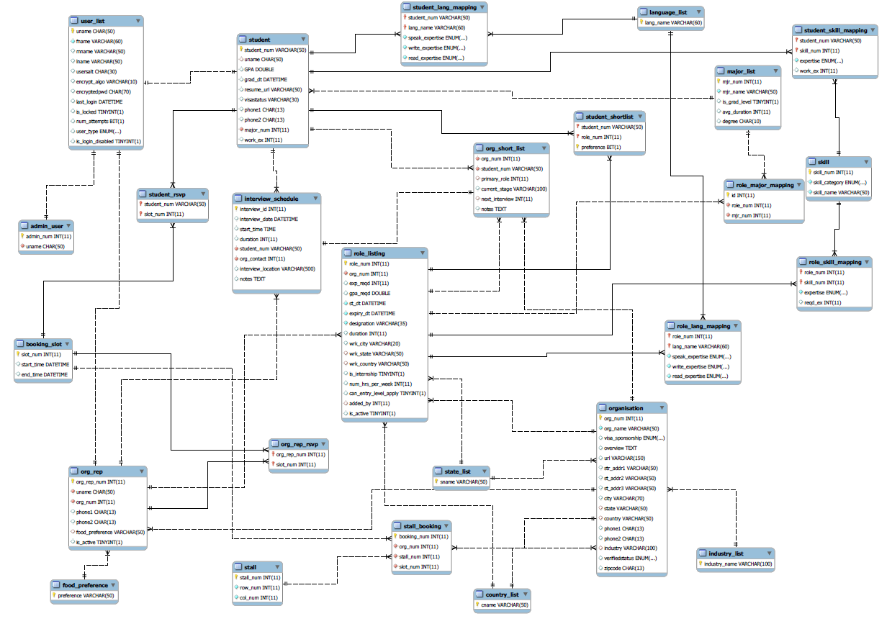

Slide 6
Contents
System Description
Database Model
Constraints – A few samples
Participation
Integrity
Cardinality
Covering and Overlap
Queries
What are the 5 most popular skills?
What kind of food to order?
Which organizations are visiting only on the first day?
Siri, what’s my interview schedule?
Show me some active, open roles.
Assumptions
Limitations
Unique Value Proposition
Challenges Faced
Future Scope

Slide 7
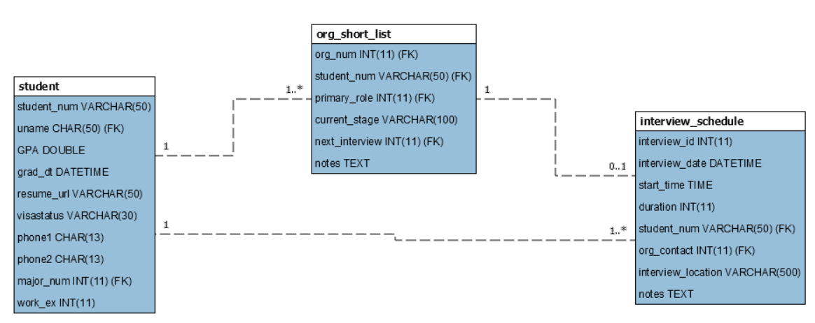
Participation constraints
Mandatory participation
Optional participation

Slide 8
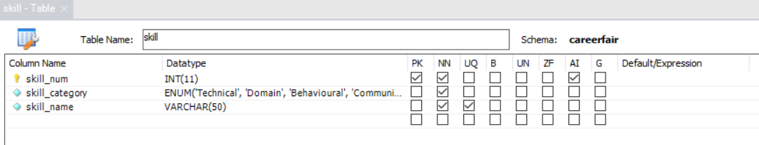
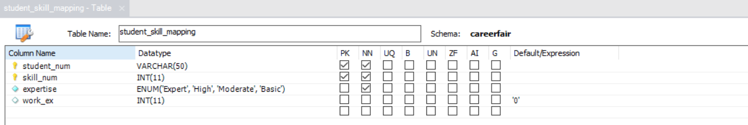
Integrity Constraints
Integrity constraints - Domain
Skill
Student_skill
_mapping

Slide 9
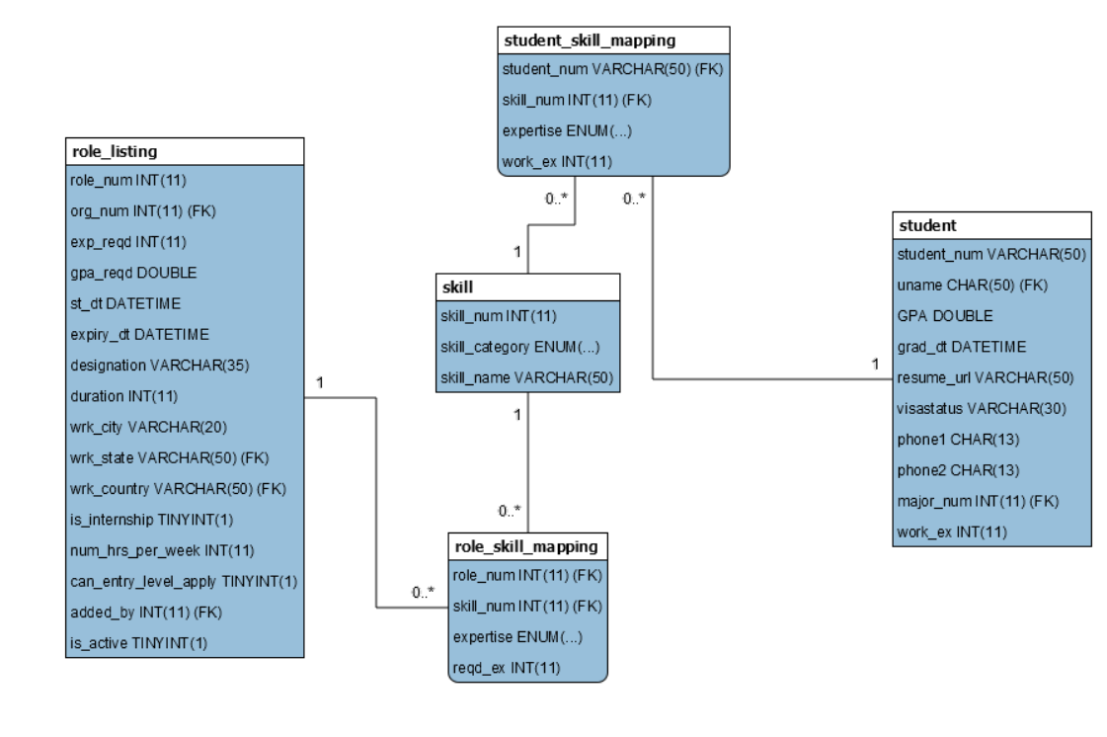
Cardinality

Slide 10
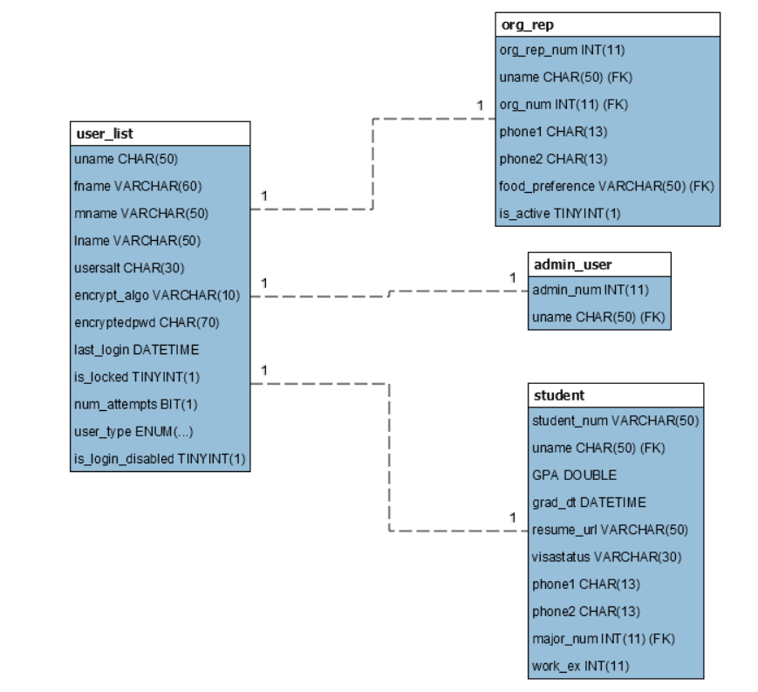
Covering and overlap constraints
No overlap
Org_rep, admin_user and student cover user_list

Slide 11
Contents
System Description
Database Model
Constraints – A few samples
Participation
Integrity
Cardinality
Covering and Overlap
Queries
What are the 5 most popular skills?
What kind of food to order?
Which organizations are visiting only on the first day?
Siri, what’s my interview schedule?
Show me some active, open roles.
Assumptions
Limitations
Unique Value Proposition
Challenges Faced
Future Scope

Slide 12
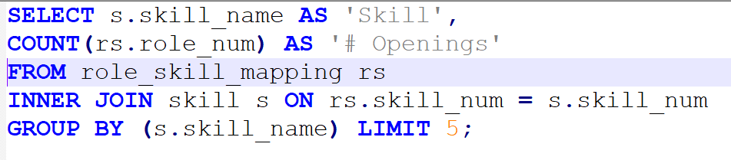
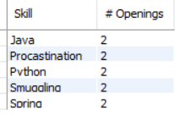
Queries – what are the 5 most popular skills?

Slide 13
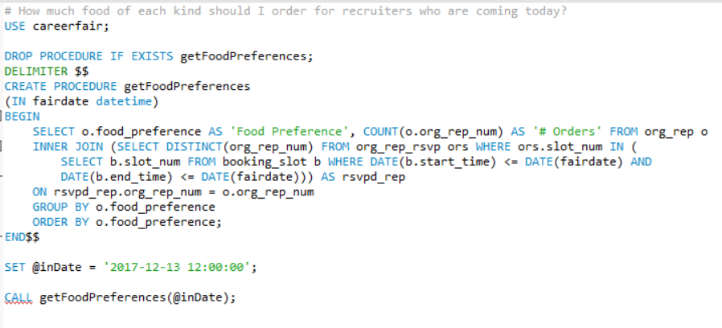

Queries – what kind of food to order?

Slide 14
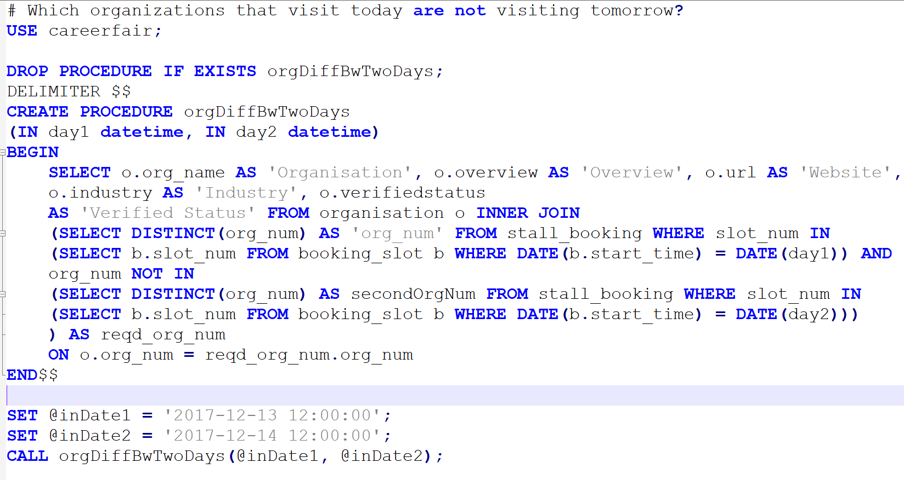
Queries – Which organizations are visiting only on the first day?

Slide 15
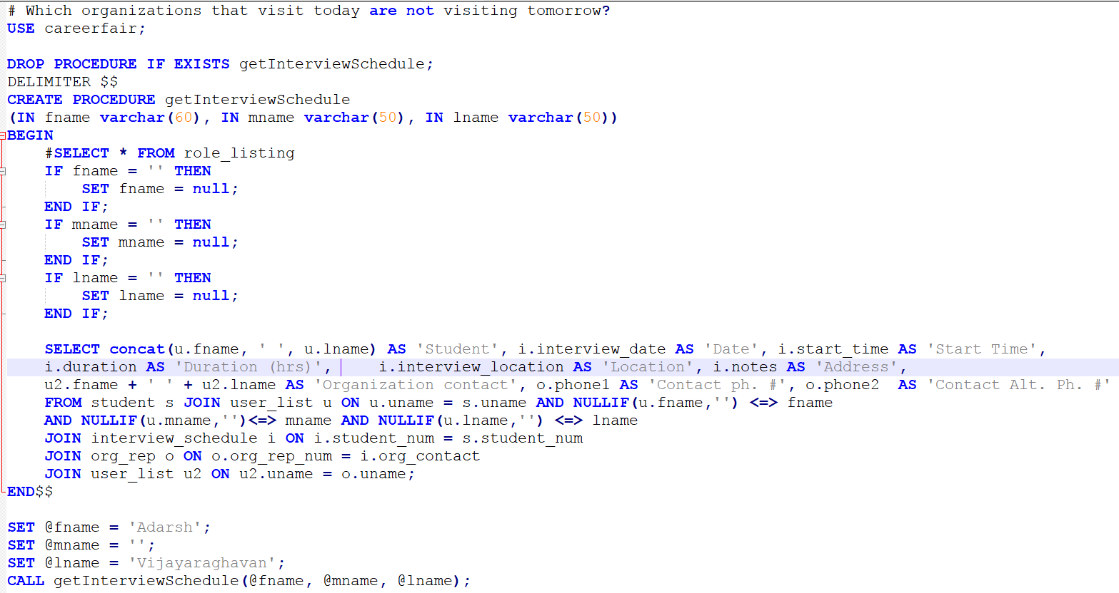
Queries – Siri, what’s my interview schedule?

Slide 16
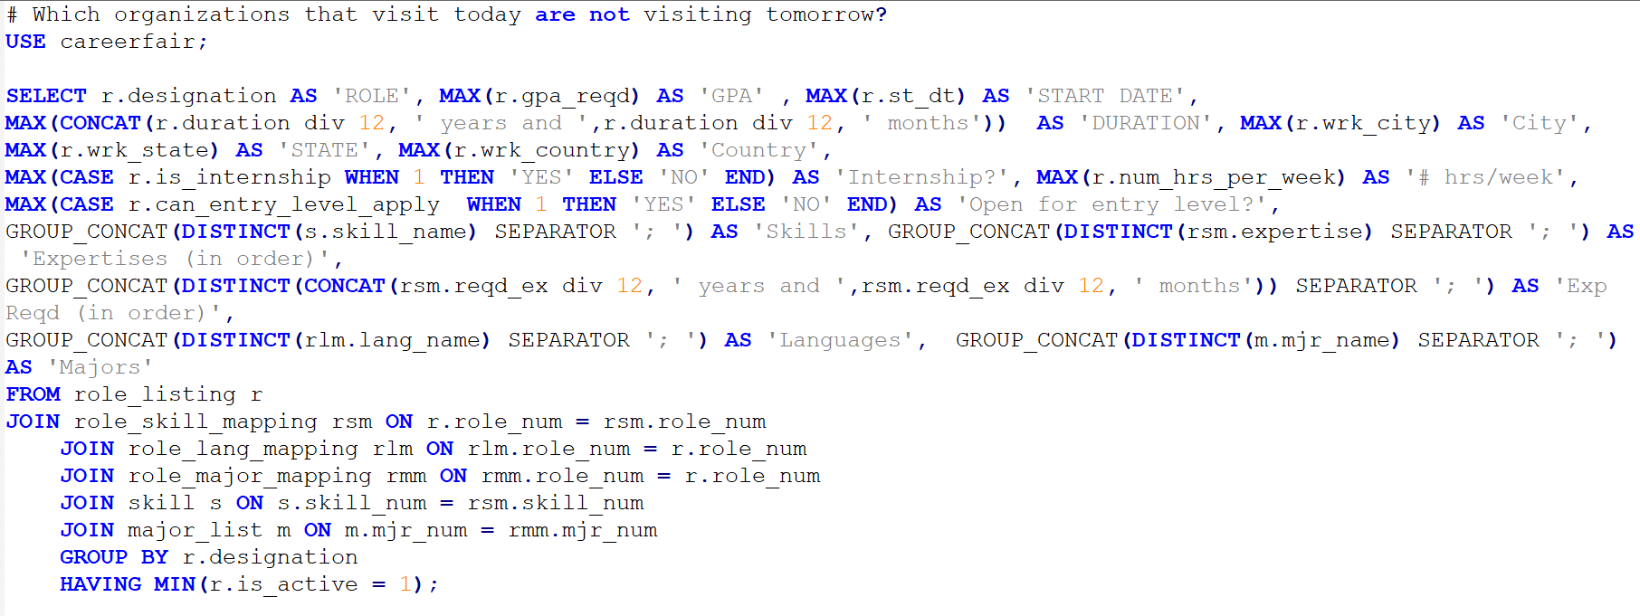
Queries – Show me some active, open roles

Slide 17
Contents
System Description
Database Model
Constraints – A few samples
Participation
Integrity
Cardinality
Covering and Overlap
Queries
What are the 5 most popular skills?
What kind of food to order?
Which organizations are visiting only on the first day?
Siri, what’s my interview schedule?
Show me some active, open roles.
Assumptions
Limitations
Unique Value Proposition
Challenges Faced
Future Scope

Slide 18
Assumptions
An organization can book only one stall at a fair for a given time-slot
Students can shortlist up to a fixed number of roles, say 10. This constraint will have to be implemented in the application layer
The system need not capture information from an organization’s perspective. For eg., historic information of interviews conducted by an organization can not be retrieved easily
An organization may short-list students independent of role. A primary role may be optionally mentioned. Technically, primary_role in org_short_list table is a NULLable column
A company belongs only to one primary industry

Slide 19
Contents
System Description
Database Model
Constraints – A few samples
Participation
Integrity
Cardinality
Covering and Overlap
Queries
What are the 5 most popular skills?
What kind of food to order?
Which organizations are visiting only on the first day?
Siri, what’s my interview schedule?
Show me some active, open roles.
Assumptions
Limitations
Unique Value Proposition
Challenges Faced
Future Scope

Slide 20
Limitations
Care has been taken to use Enum datatype only for columns where a change of domain is unlikely. However if there is a change, modifying the Enum in a Production system would be relatively complex
Some integrity constraints have not been handled by the Database, and need to be implemented in the application layer
Autoincrement values used as Primary Key columns in a few tables. In case an application connects to the database using a Object Relational Mapping (ORM) framework and Hi-Lo algorithm, this will cause a performance degradation

Slide 21
Contents
System Description
Database Model
Constraints – A few samples
Participation
Integrity
Cardinality
Covering and Overlap
Queries
What are the 5 most popular skills?
What kind of food to order?
Which organizations are visiting only on the first day?
Siri, what’s my interview schedule?
Show me some active, open roles.
Assumptions
Limitations
Unique Value Proposition
Challenges Faced
Future Scope

Slide 22
Unique Selling Proposition
User credentials stored as per Open Web Application Security Project (OWASP) recommendations
Application can be scaled up to capture requirements of a Career Portal without significant restructuring
Use of Enum datatypes for selected columns to impose integrity constraints
Captures interview information, allows flagging of fraudulent organizations, accommodates internships as well as full-time roles, and more.

Slide 23
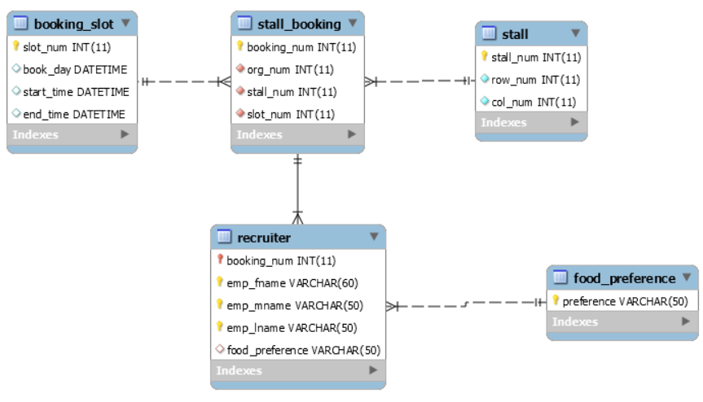
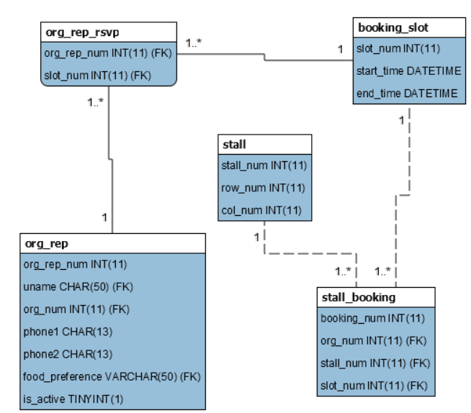
Challenges Faced
The initial data model consisted of a Recruiter entity, which was a weak entity entirely dependent on Stall_booking
However since booking_slot entity breaks down a day into around 9 booking slots, this would cause a huge redundancy in Recruiter table.
Using org_rep entity directly also causes an issue, since we would not know which organization representative is actually attending the fair
This issue was resolved by adding a new entity org_rep_rsvp

Slide 24
Questions?

Slide 25
Thank You

