Slide 1


ValETL: AI-Powered ETL Validation
Presented by:
Adarsh Vishwakarma
Raushan Kumar Harsh Dubey Kushagra Anand

Slide 2

u
Problem Statement:
The current ETL QA process is largely manual, requiring analysts to cases and SQL queries, execute them against databases, and capture results as proof. This approach is time-consuming, error prone and limits test coverage. There is a need for an automated Data Validation Agent that can interpret business rules in natural language, perform end-to-end ETL validation, and generate detailed, auditable test results with minimal manual effort.
write test

Slide 3
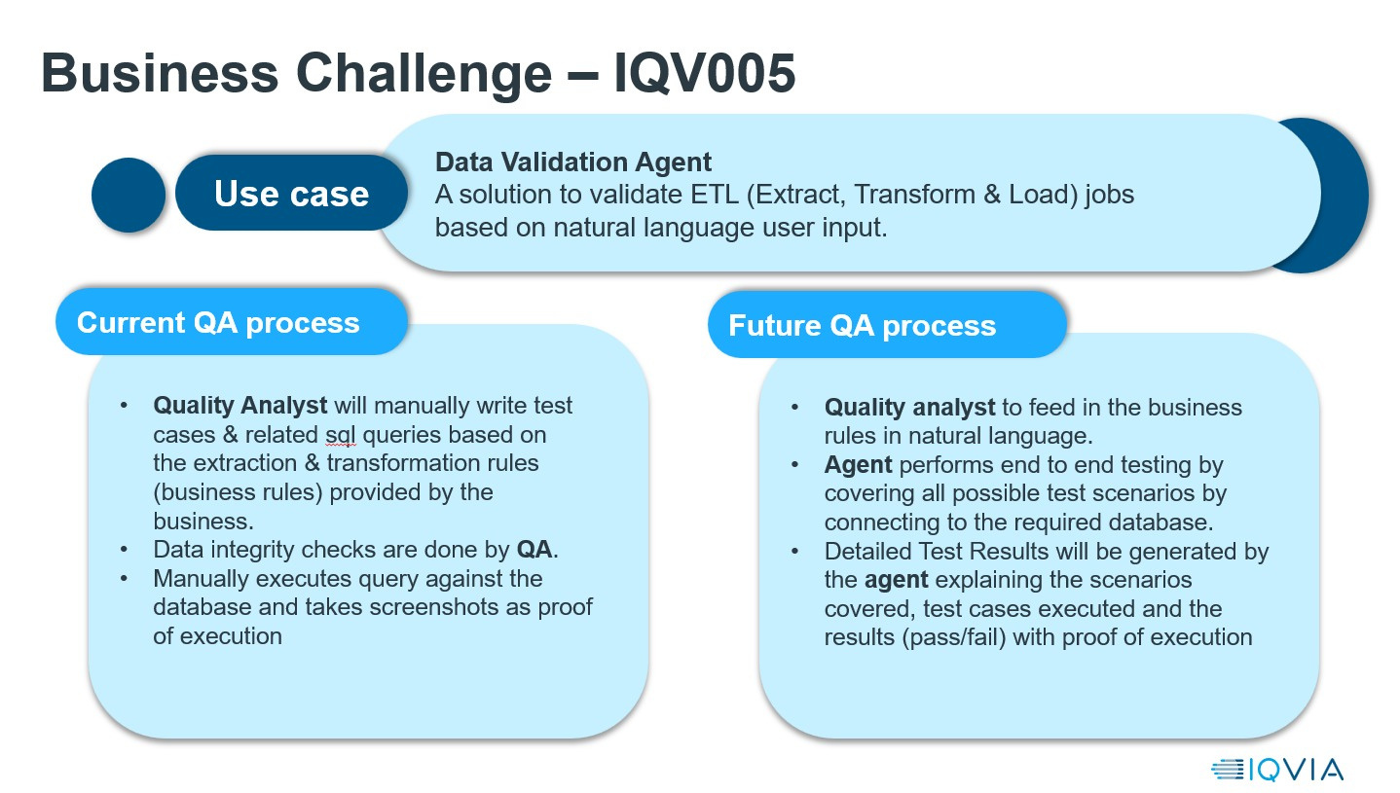

Slide 4

uuuuuuuuuuuuuuuuu
Solution:ValETL
ValETL is an intelligent Data Validation Agent that automates end-to-end ETL QA by using natural language business rules as input. Instead of manually writing test cases and SQL queries, QA analysts describe validation requirements in plain English, which ValETL converts into executable data validation logic. ValETL connects securely to source and target databases, performs comprehensive checks such as data completeness, accuracy, transformation validation, and data integrity, and ensures all critical scenarios are covered. It generates detailed, explainable test reports with executed test cases, pass/fail results, and proof of execution. This significantly reduces manual effort, improves consistency, and accelerates ETL validation cycles.

Slide 5
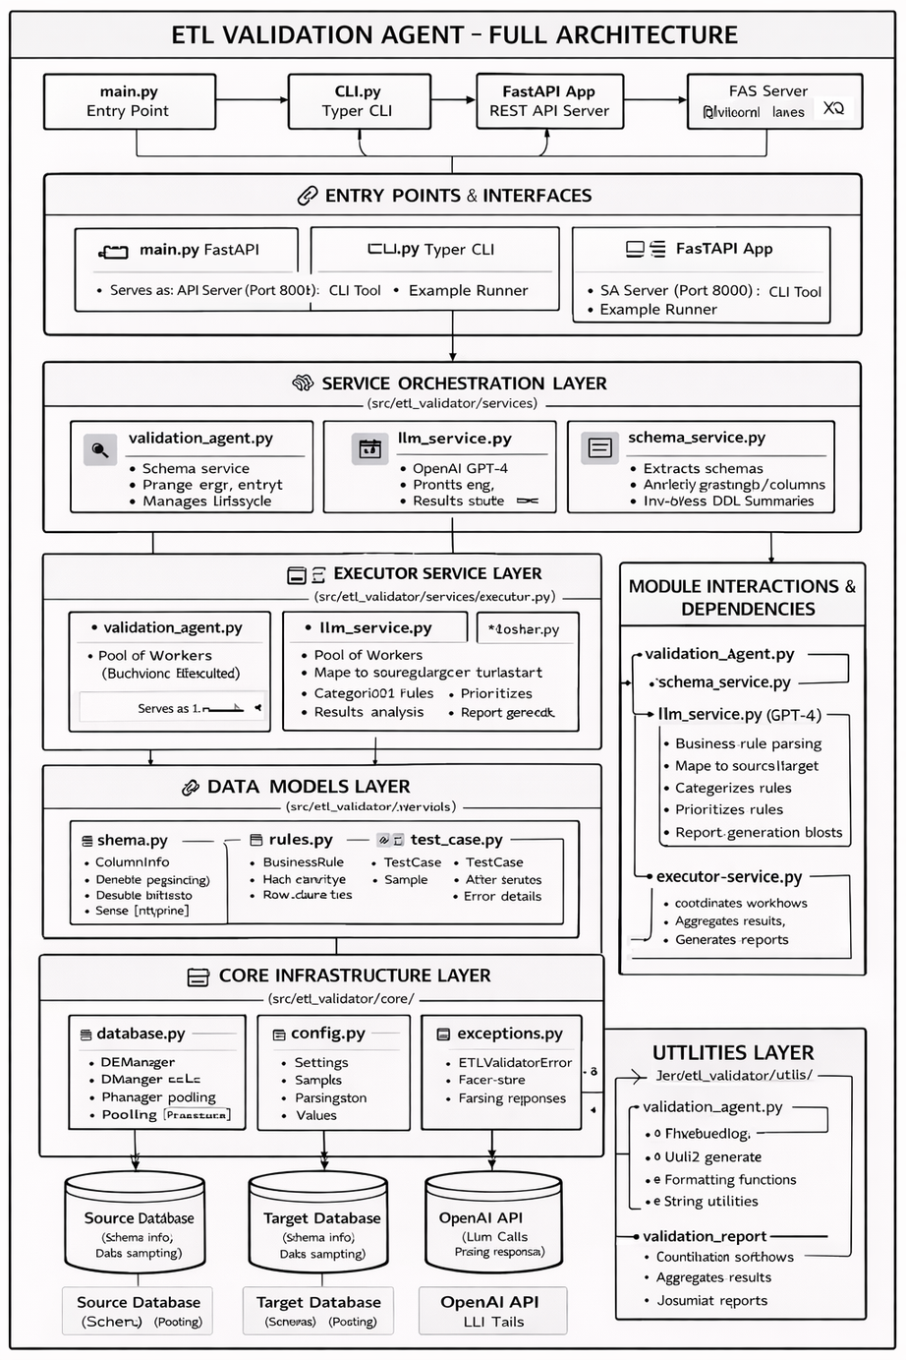

WorkFlow diagram:

Slide 6

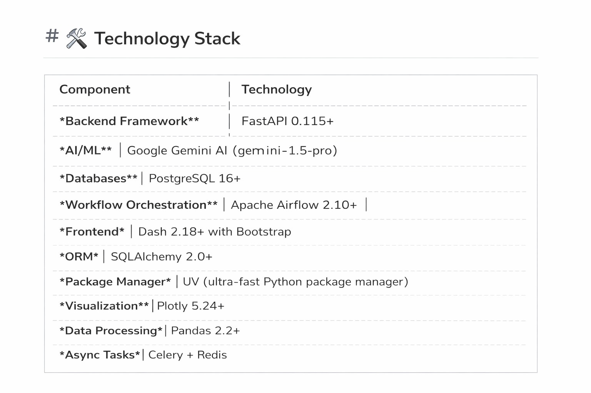
TECHNOLOGIES AND TOOLS

Slide 7
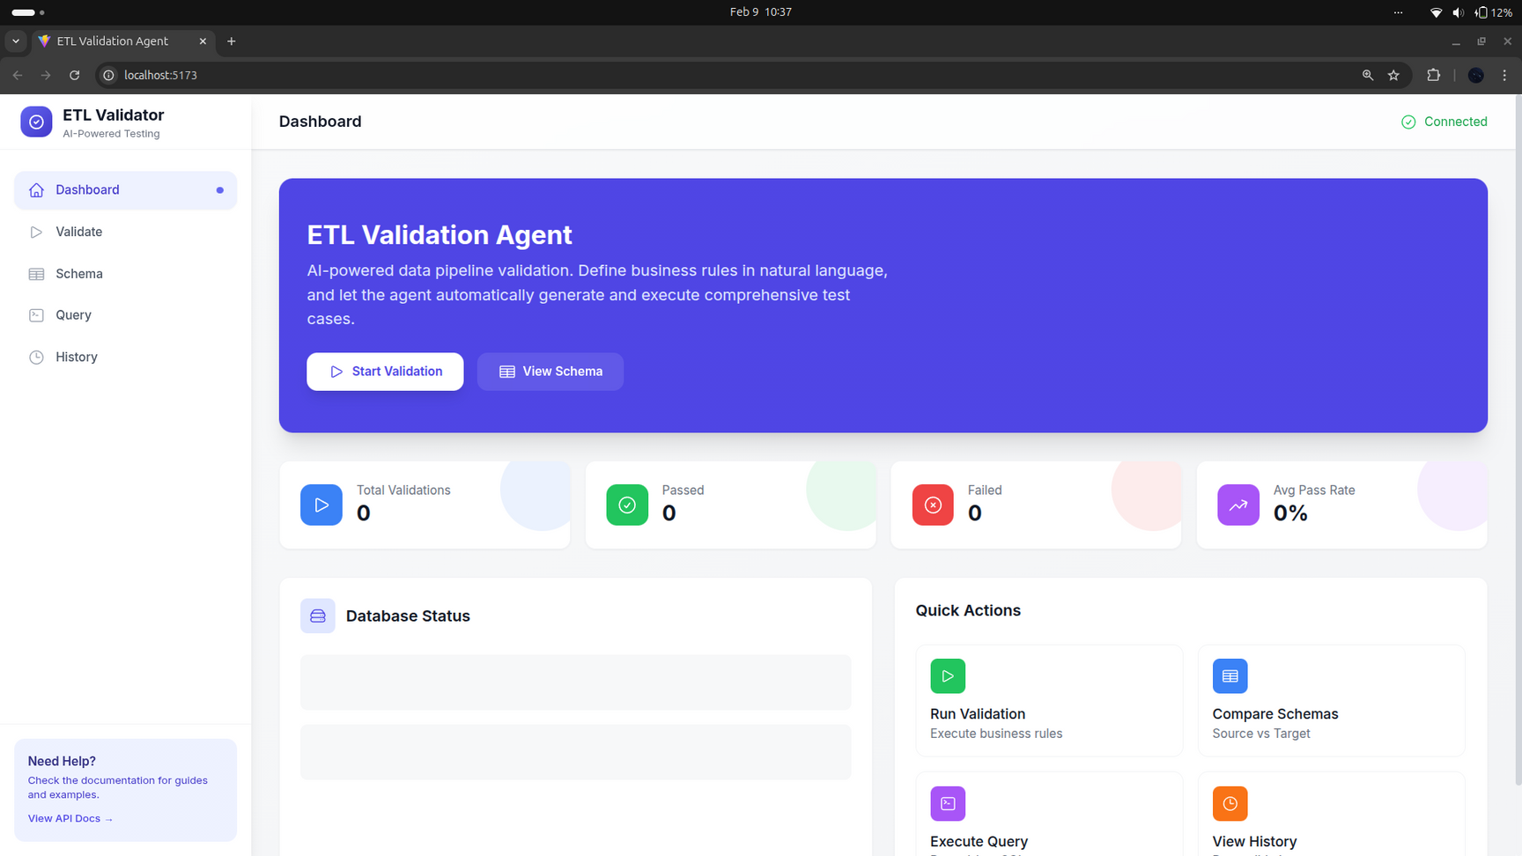
Sample Output:

Slide 8
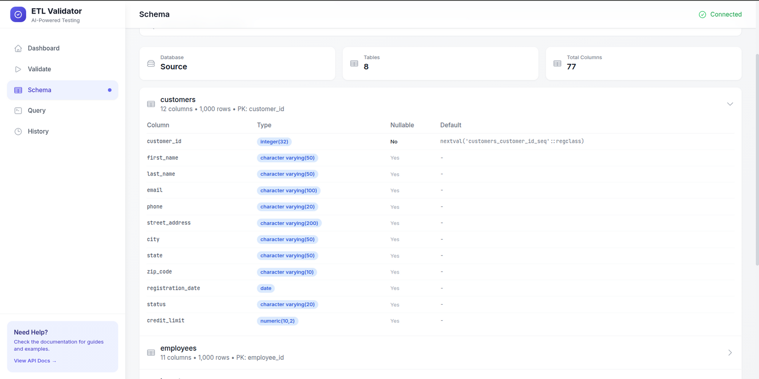
Link: https://youtu.be/IYcQQX21MV8

Slide 9
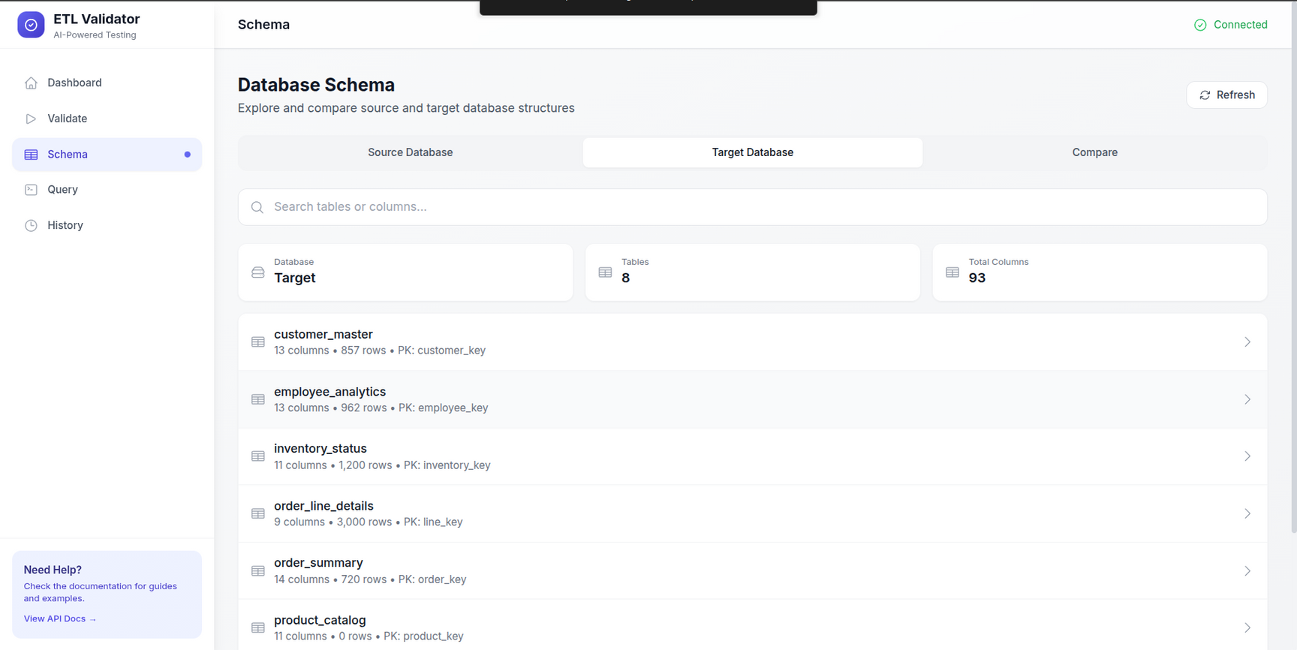

Slide 10
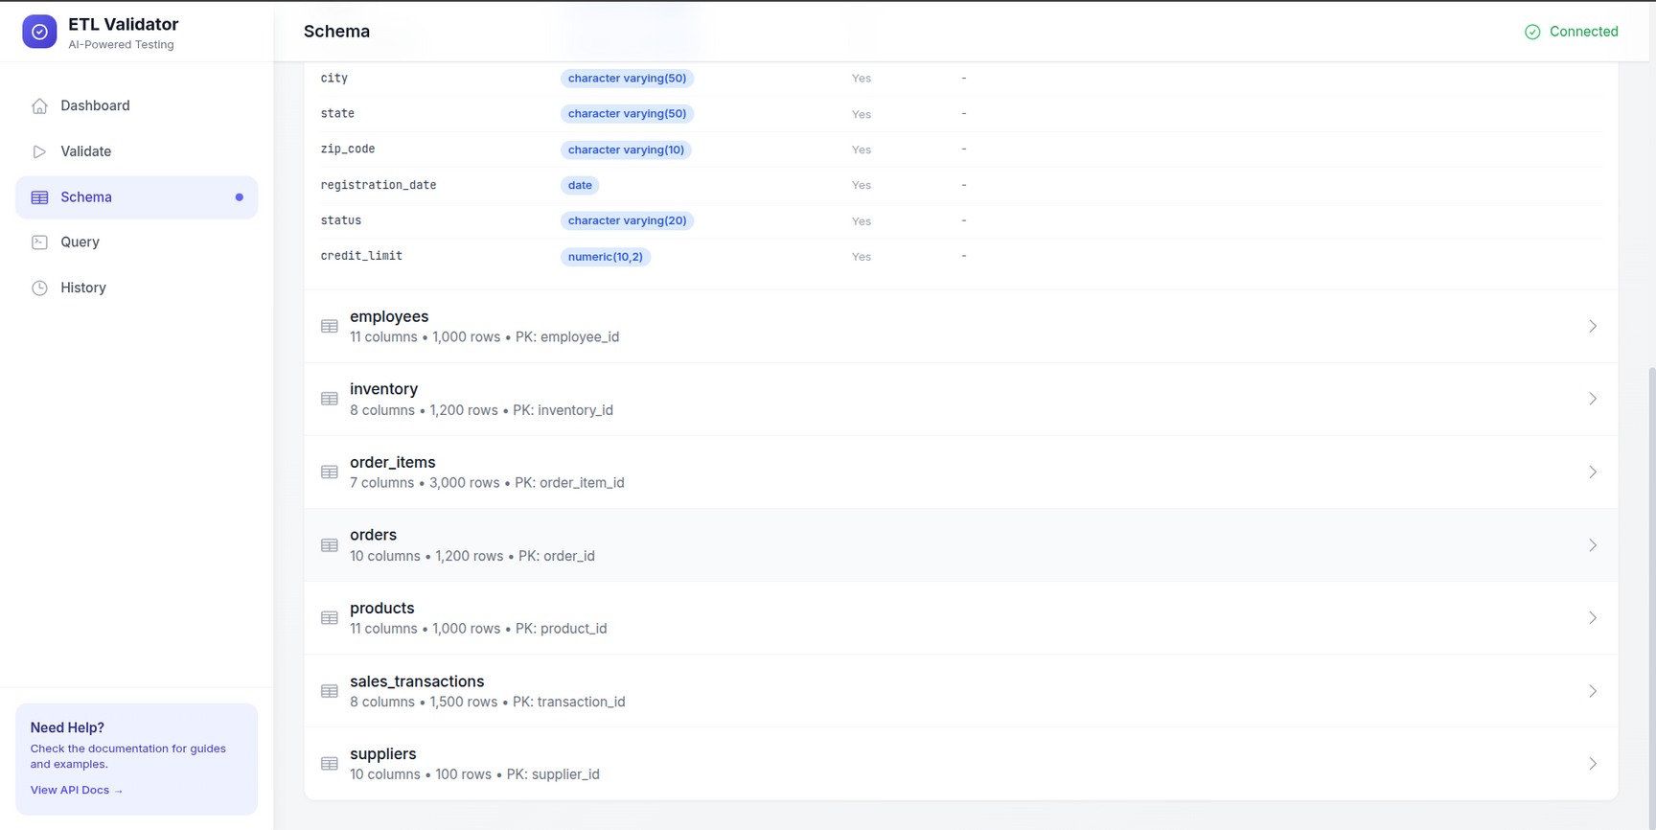

Slide 11
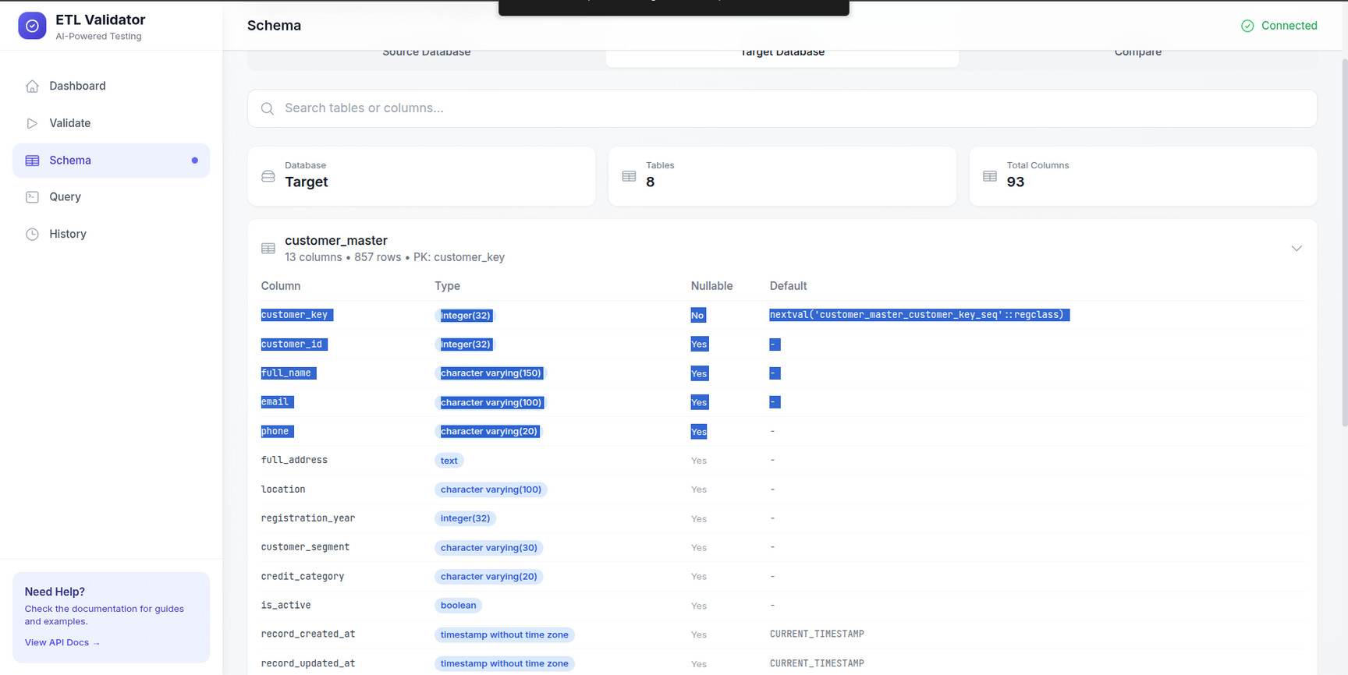

Slide 12

Thank you.

