Slide 1

(2) Find available datasets
(3) Data Cleaning
(4) Data Integration
(1) Find an interesting problem
(5) Define a data mining task
(6) Task-based data selection
(7) Formally define a machine learning problem
(8) Develop a
machine learning model to solve the problem
Knowledge/Patterns

Slide 2
Predicting Formation Energy of Interesting Chemical Compounds using Latent Vector Embedding
Abhishek Das, Yifan Ding
Abstract:
Inorganic materials are increasingly used in all areas of modern life. Since their production is expensive, predicting their features in advance can save time and resources. Our project focuses on finding element properties represented by high-dimensional vectors and predicting the formation energy of a class of chemical compounds – elapsolites – as an example.
Project Accomplish:
Get data from the Materials Project Database and Inorganic Crystal Structure Database
Clean and pre-process the data(data cleaning, matrix building, main group selection)
Learn the vectors of the elements from element-environment matrix(SVD, autoencoder)
2D-mapping of main group elements’ vector matrix(arrange elements in family)
Predict the formation energy of elapsolites (2 and 5 layers’ neural network)
Future work
More methods of learning the element vectors and evaluation
Aapplication in predicting unknown compound
Physical meaning of element vector
Embedding more element properties in the raw data(structure and so on)

Slide 3
Search potential compounds(stable)
(8) Develop a
machine learning model to solve the problem
Stable=
low formation energy
Estimate
formation energy
Goal

Slide 4
Extract element’s high-dimensional vectors (*1.knowledge gain)
Verified by known elements’
or compounds' properties. (*2.validation)
Use vectors to predict reliable unknow properties. (3.application)
Process

Slide 5
1.Knowledge gain:
Fe2(SO4)3
= Fe2S3O12
Tons of chemical formulas(~84,000)
[Fe,2O12S3] [S,3Fe2O12] [O,12Fe2S3]
more (element, environment) pairs
 | 2O12S3 | 3Fe2O12 | 12Fe2S3
Fe | 1 | 0 | 0
S | 0 | 1 | 0
O | 0 | 0 | 1
build [element, environment] matrix
{80*83131}
Extract element property vectors
{80*20}
Fe:{Fe1,Fe2…..Fe20}
O:{ O1, O2….. O20}
S:{ S1, S2….. S20}

Slide 6
1.Knowledge gain:
build [element, environment] matrix
{80*83131}(called Matrix)
Method 1: SVD
u,s,vt=SVD(Matrix,k=20)
vector_matrix{80*20}=
u{80*20}*matrix_diag(s){20*20}
Extract element property vectors
{80*20}
Matrix’
Method 2: Autoencoder
Matrix->encoder->
vector_matrix{80*20}->decoder->Matrix’
Method 3: Autoencoder+SVD
pair_matrix->encoder->Intermedia{80*600}
->decoder->pair_matrix’
Intermedia->SVD->Element_vector_matrix{80*20}
vector_matrix
Matrix

Slide 7
2. Validation:
PCA analysis:
Similar elements tend to form clusters(Periodic law of elements)
Method 1
Method 2
Method 3

Slide 8
2. Validation:
Formation energy prediction:
5628 unique Elapsolites (ABC2D6) and formation energy(from VASP calculation)
Method 1
Method 2
Method 3

Slide 12
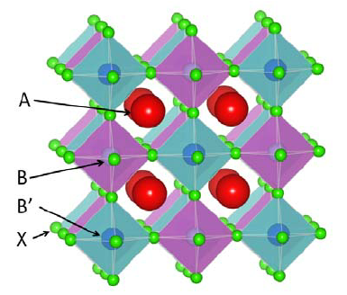
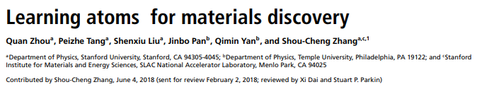
Predicting Formation Energy of Interesting Chemical Compounds using Latent Vector Embedding
Abhishek Das, Yifan Ding, Lee Mordechai
Abstract:
Inorganic materials are increasingly used in all areas of modern life. Since their production is expensive, predicting their features in advance can save time and resources. Our project focuses on predicting the formation energy of a class of chemical compounds – elapsolites – as an example.
Project Plan:
Generate data from the Materials Project Database
Clean and pre-process the data
Learn the features of the atoms in the dataset
Predict the formation energy of chemical compounds
Stretch goal: predict additional properties of compounds
Evaluation
Encoder-decoder reproduce the actual input
Similarity to known features of elements
(e.g. periodic table, former research)
Reproduction of Zhou et al. 2018’s results
Structure of an elapsolite compound
Zhou et al. 2018’s attempt to predict compound features

