Slide 1
Predicting Formation Energy of Interesting Chemical Compounds using Latent Vector Embedding
Yifan Ding, Abhishek Das
Abstract:
Inorganic materials are increasingly used in all areas of modern life. Since their production is expensive, predicting their features in advance can save time and resources. Our project focuses on finding element properties represented by high-dimensional vectors and predicting the formation energy of a class of chemical compounds – elapsolites – as an example.
Project accomplish:
Get data from the Materials Project Database and Inorganic Crystal Structure Database
Pre-process the data(data cleaning, matrix building, main group selection)
Learn the vectors of the elements from element-environment matrix(SVD, autoencoder)
2D-mapping of main group elements’ vector matrix(arrange elements in family)
Predict the formation energy of elapsolites (2 and 5 layers’ neural network)
Future work
More methods of learning the element vectors and evaluation
Add more convincing validation method

Slide 2
Search potential compounds(stable)
(8) Develop a
machine learning model to solve the problem
Stable=
low formation energy
Estimate
formation energy
Goal

Slide 3
Extract element’s high-dimensional vectors (*1.knowledge gain)
Verified by known elements’
or compounds' properties. (*2.validation)
Use vectors to predict reliable unknow properties. (3.application)
Process

Slide 4
1.Knowledge gain:
Fe2(SO4)3
= Fe2S3O12
Tons of chemical formulas(~84,000)
[Fe,2O12S3] [S,3Fe2O12] [O,12Fe2S3]
more (element, environment) pairs
 | 2O12S3 | 3Fe2O12 | 12Fe2S3
Fe | 1 | 0 | 0
S | 0 | 1 | 0
O | 0 | 0 | 1
build [element, environment] matrix
{80*83131}
Extract element property vectors
{80*20}
Fe:{Fe1,Fe2…..Fe20}
O:{ O1, O2….. O20}
S:{ S1, S2….. S20}

Slide 5
1.Knowledge gain:
build [element, environment] matrix
{80*83131}(called Matrix)
Method 1: SVD
u,s,vt=SVD(Matrix,k=20)
vector_matrix{80*20}=
u{80*20}*matrix_diag(s){20*20}
Extract element property vectors
{80*20}
Matrix’
Method 2: Autoencoder
Matrix->encoder->
vector_matrix{80*20}->decoder->Matrix’
Method 3: Autoencoder+SVD
pair_matrix->encoder->Intermedia{80*600}
->decoder->pair_matrix’
Intermedia->SVD->Element_vector_matrix{80*20}
vector_matrix
Matrix

Slide 6
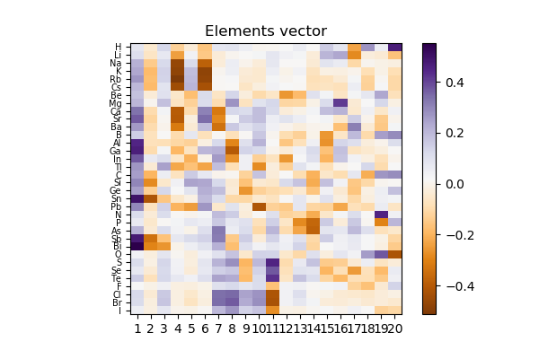
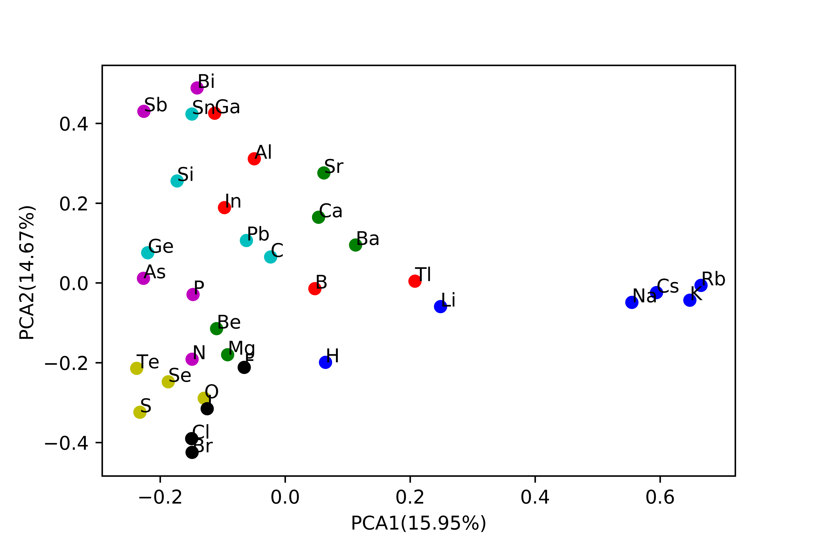
2. Validation:
2D mapping of vector matrix and PCA analysis:
Similar elements tend to form clusters(Periodic law of elements)
SVD

Slide 7
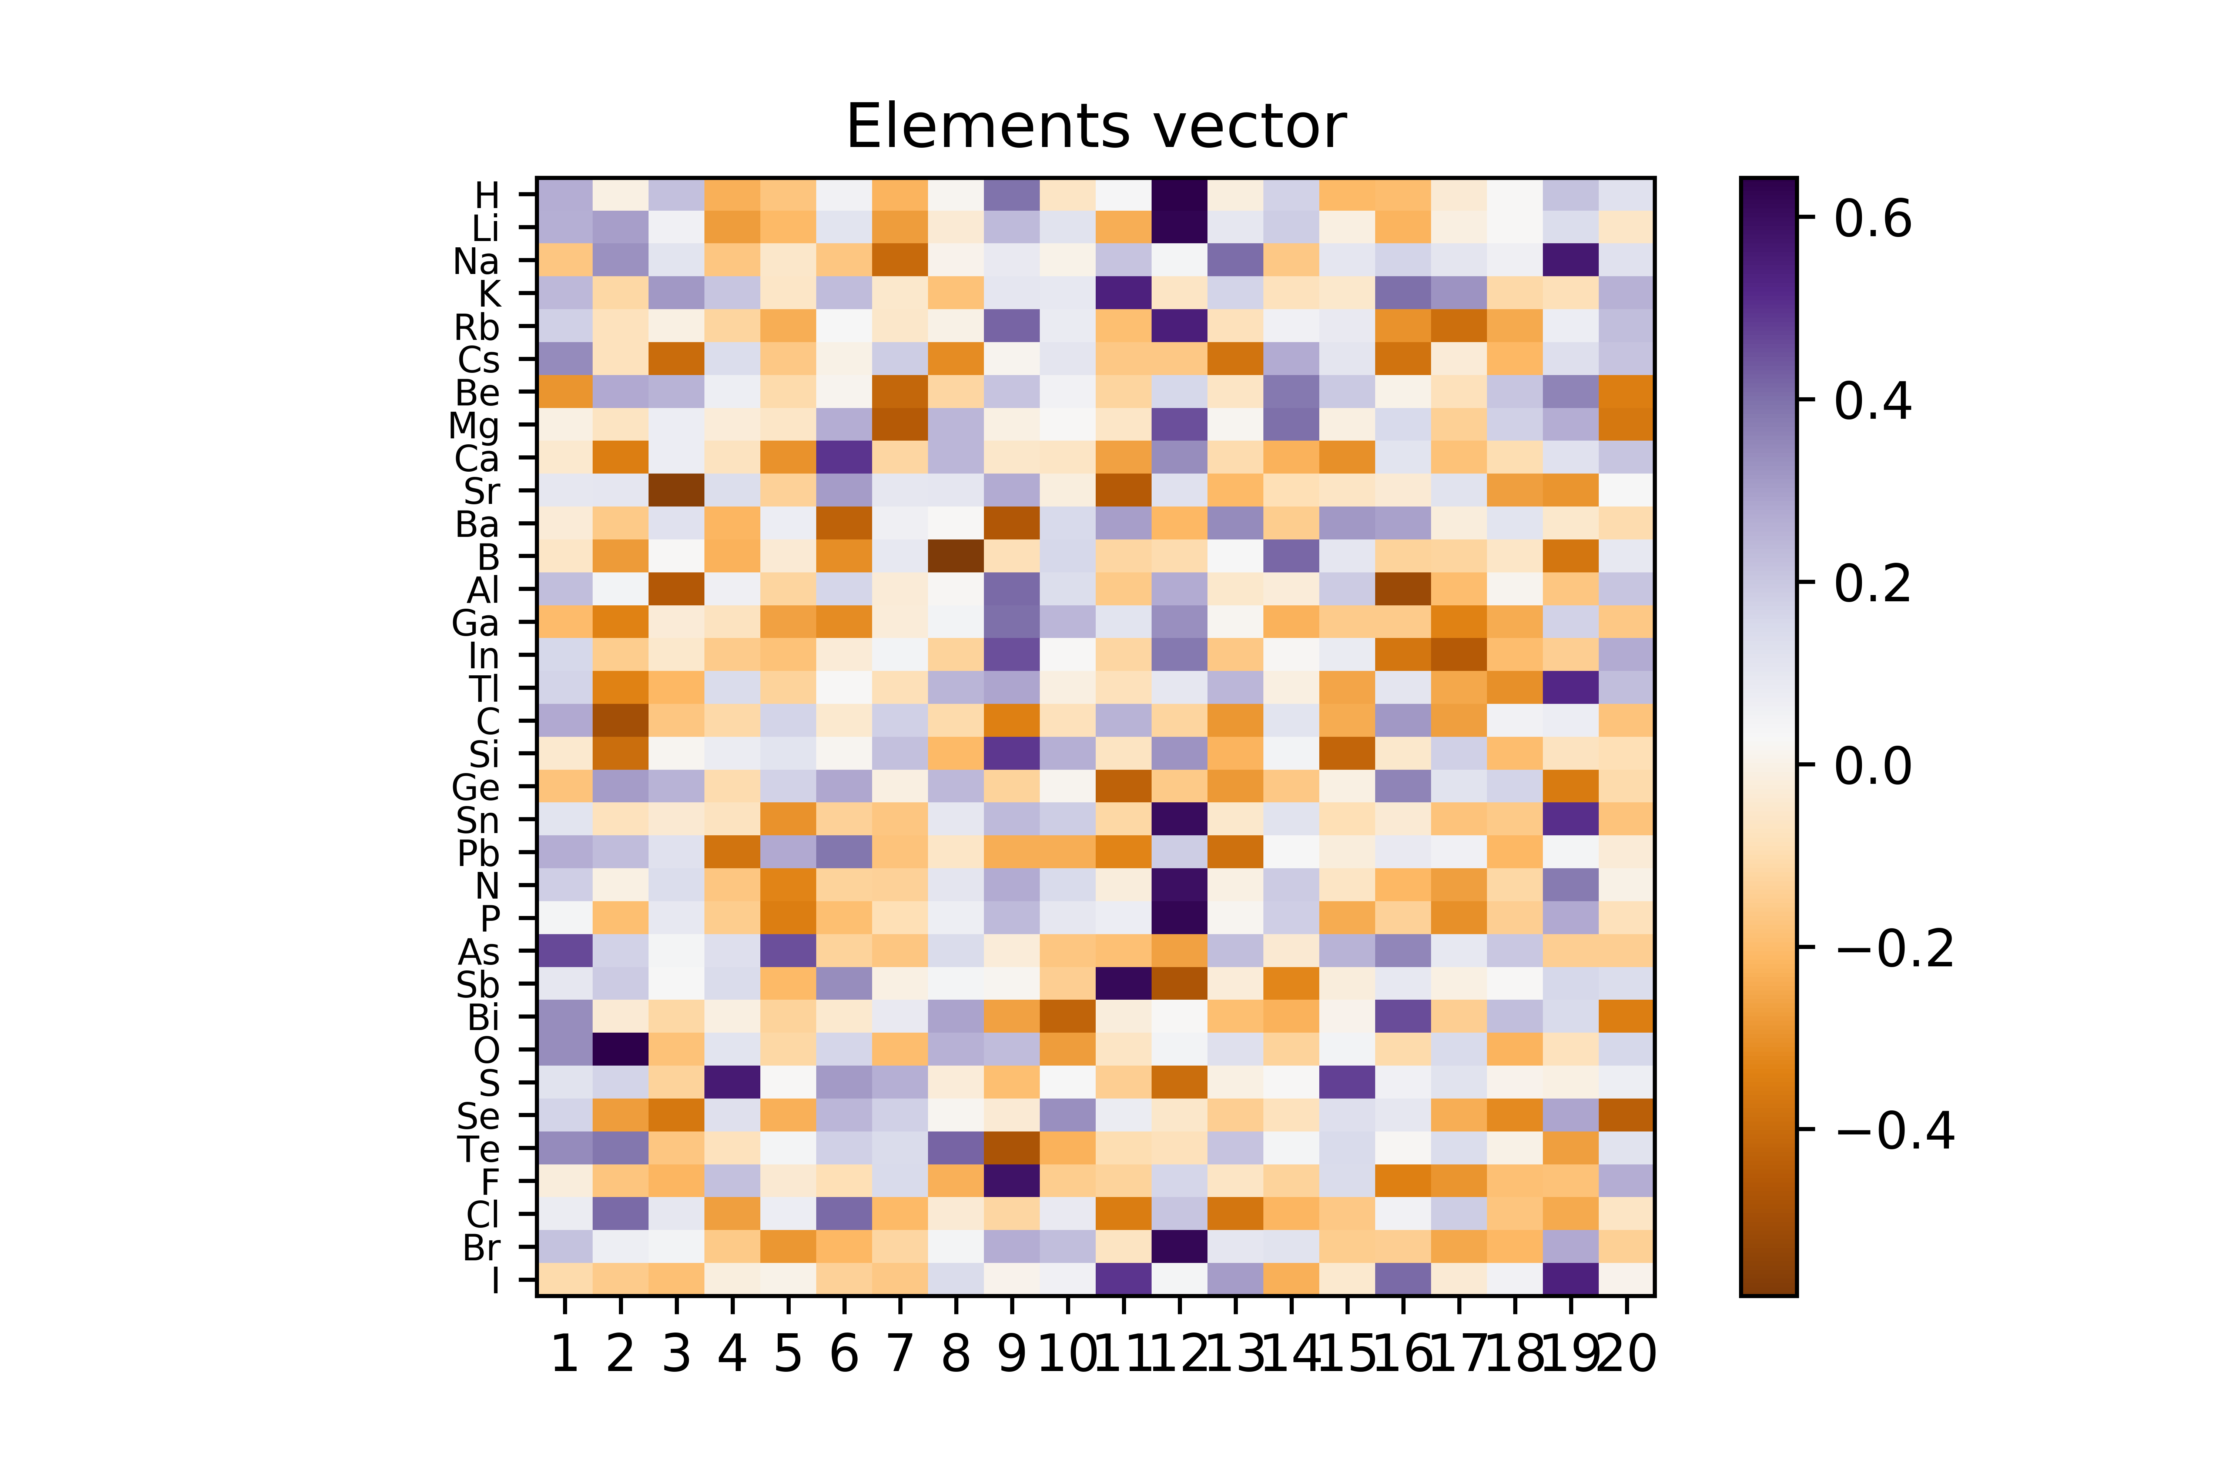
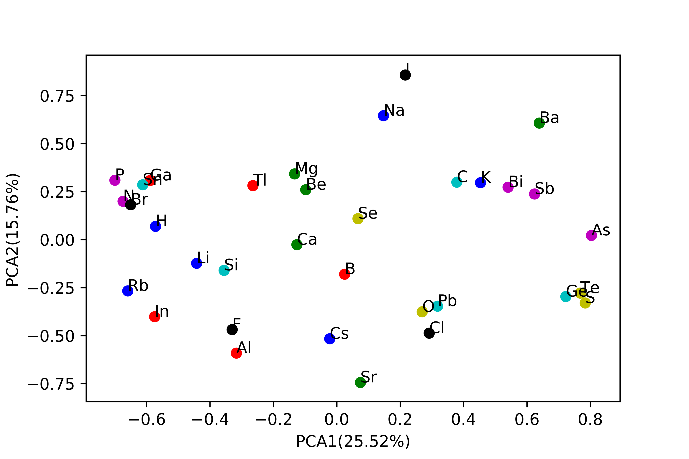
2. Validation:
PCA analysis:
Similar elements tend to form clusters(Periodic law of elements)
Autoencoder

Slide 8
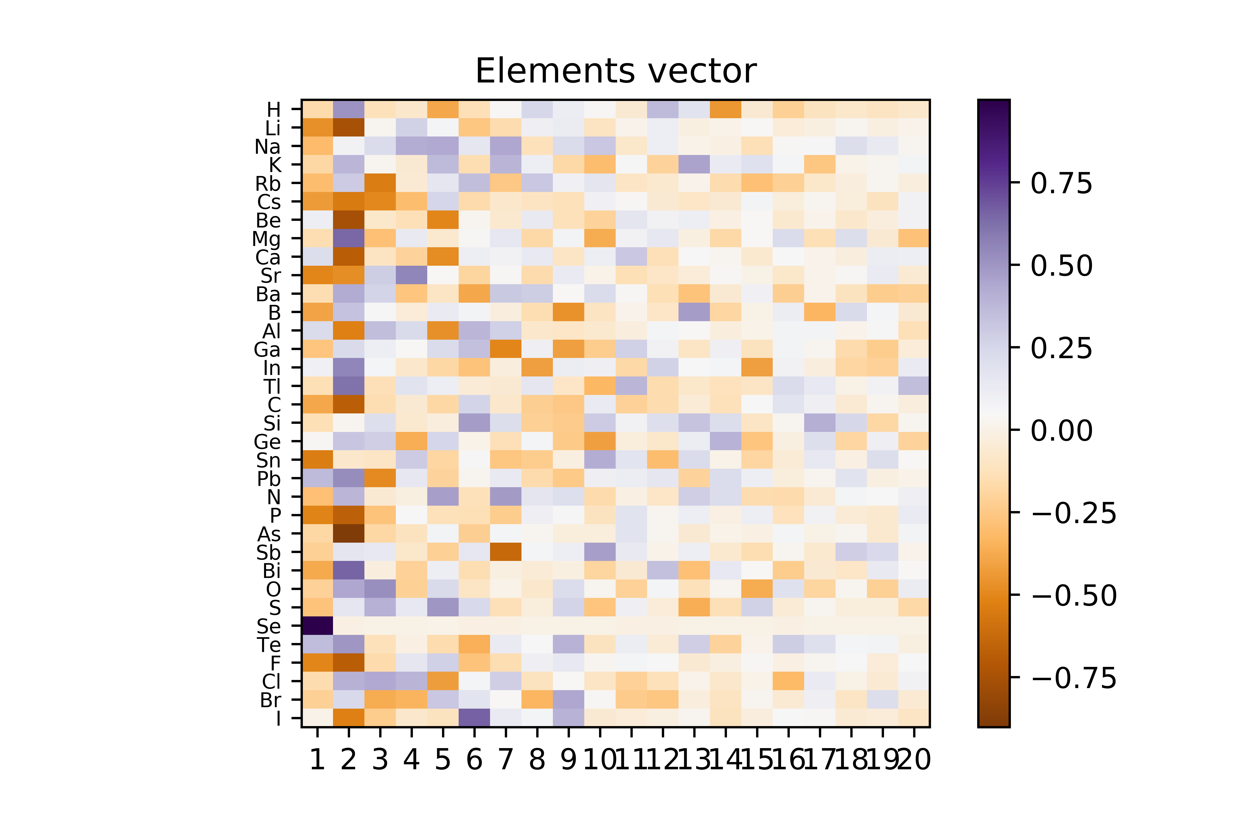
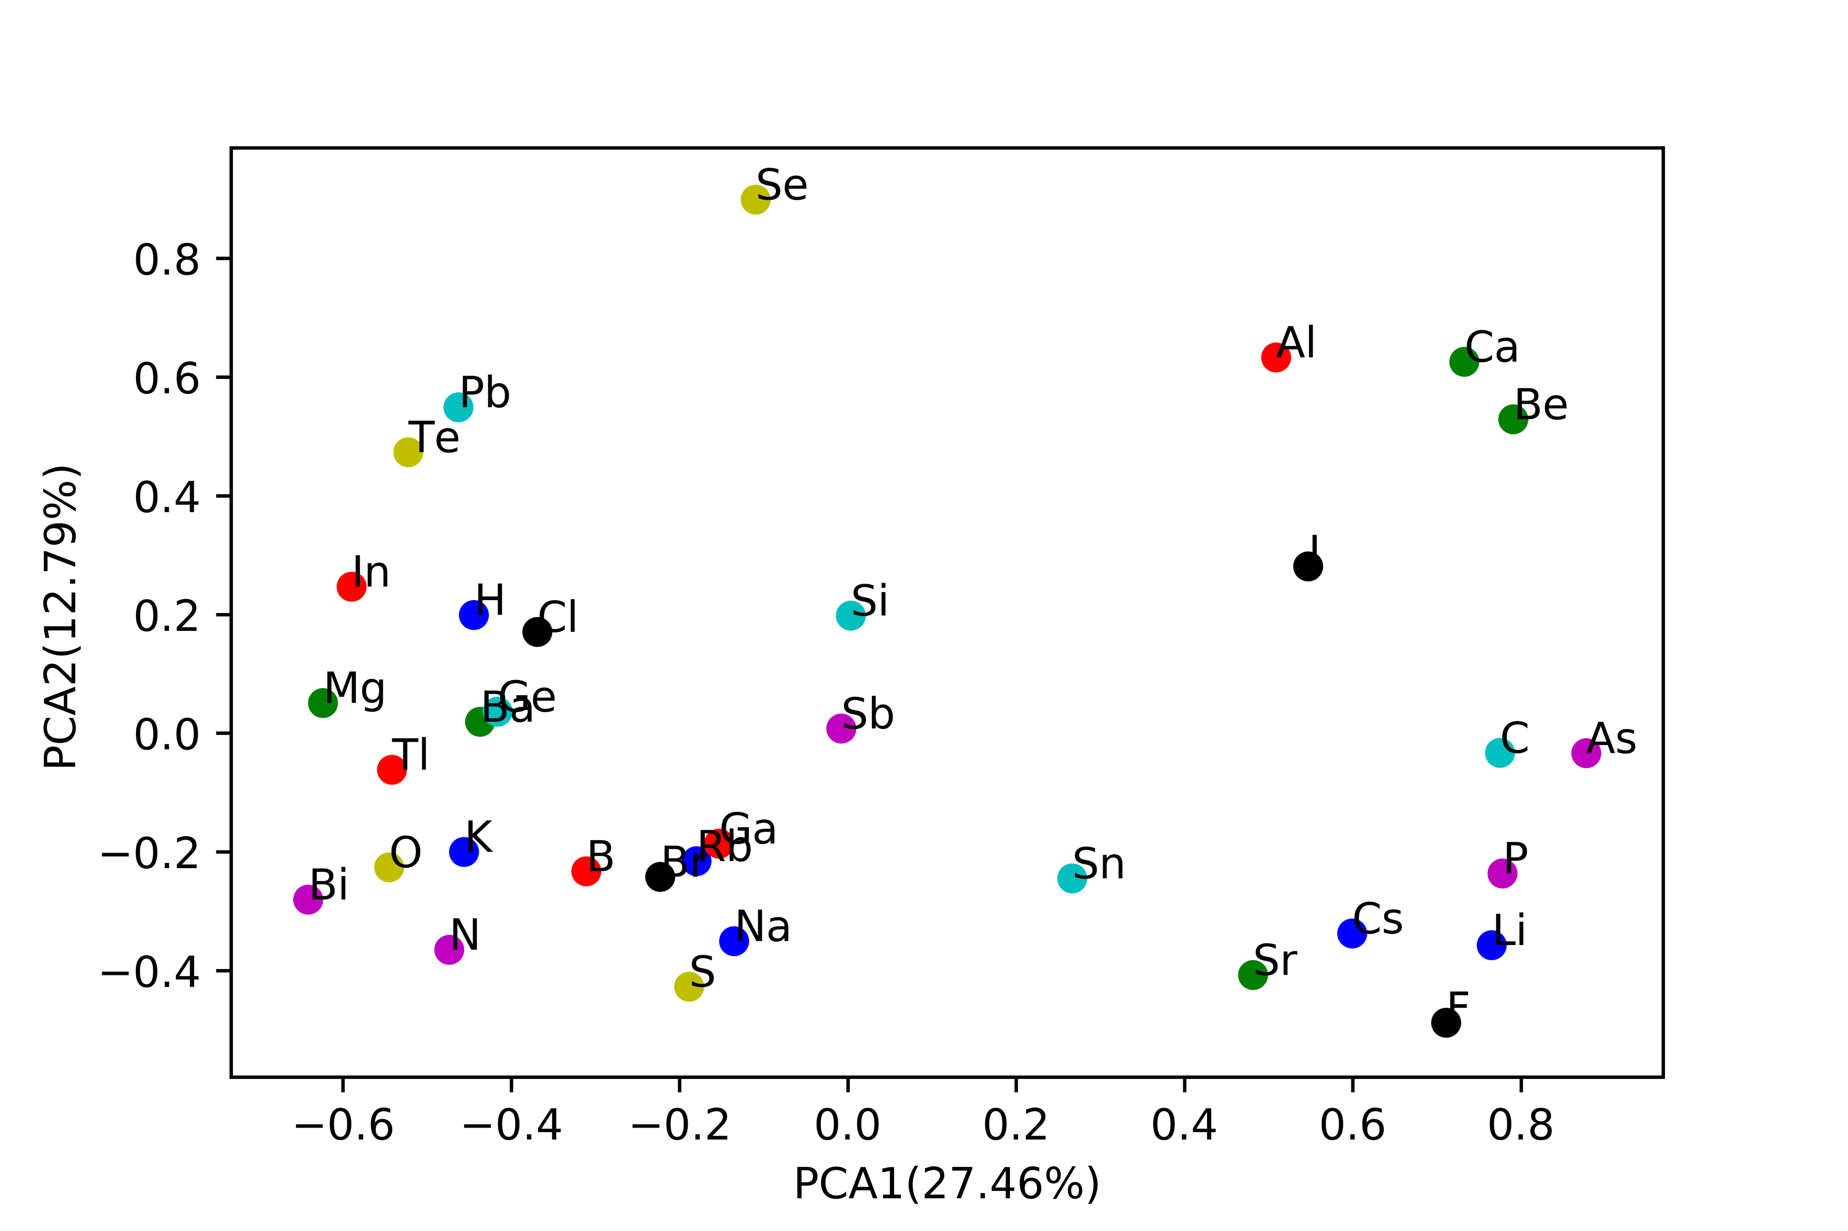
2. Validation:
PCA analysis:
Similar elements tend to form clusters(Periodic law of elements)
Autoencoder+SVD

Slide 9
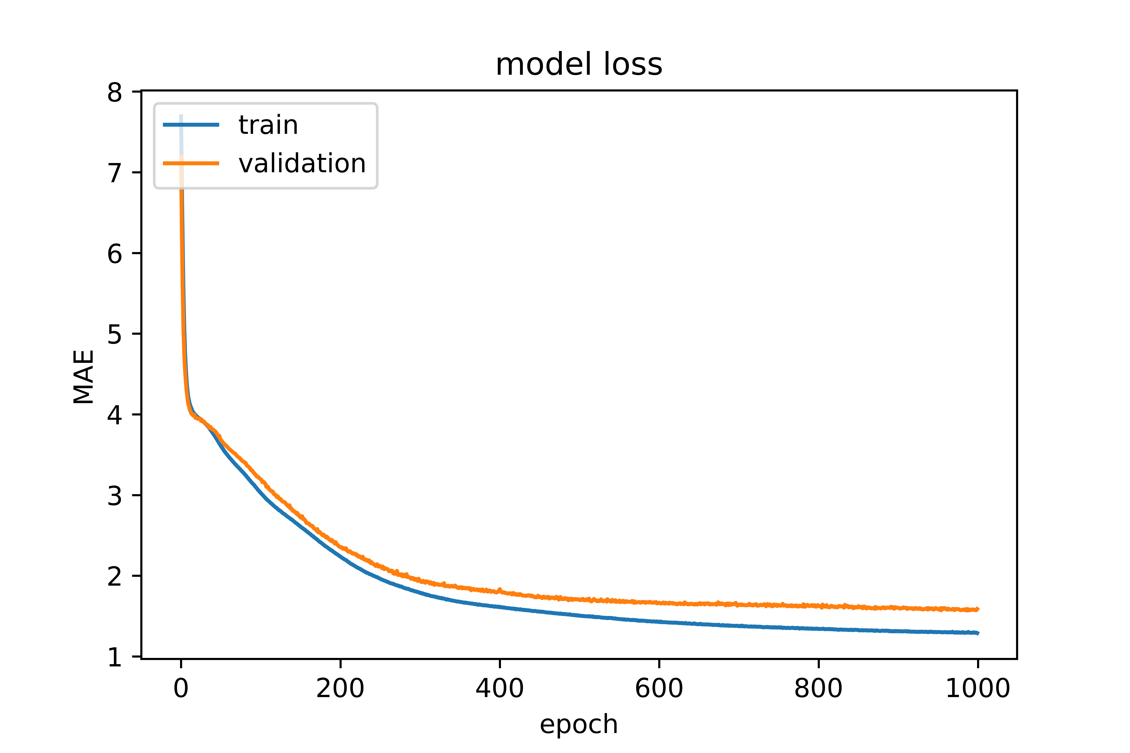
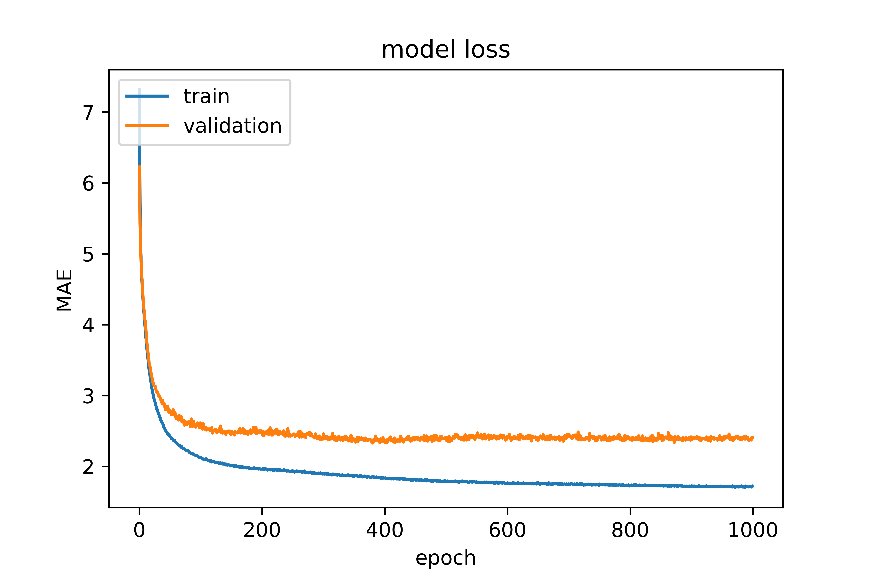
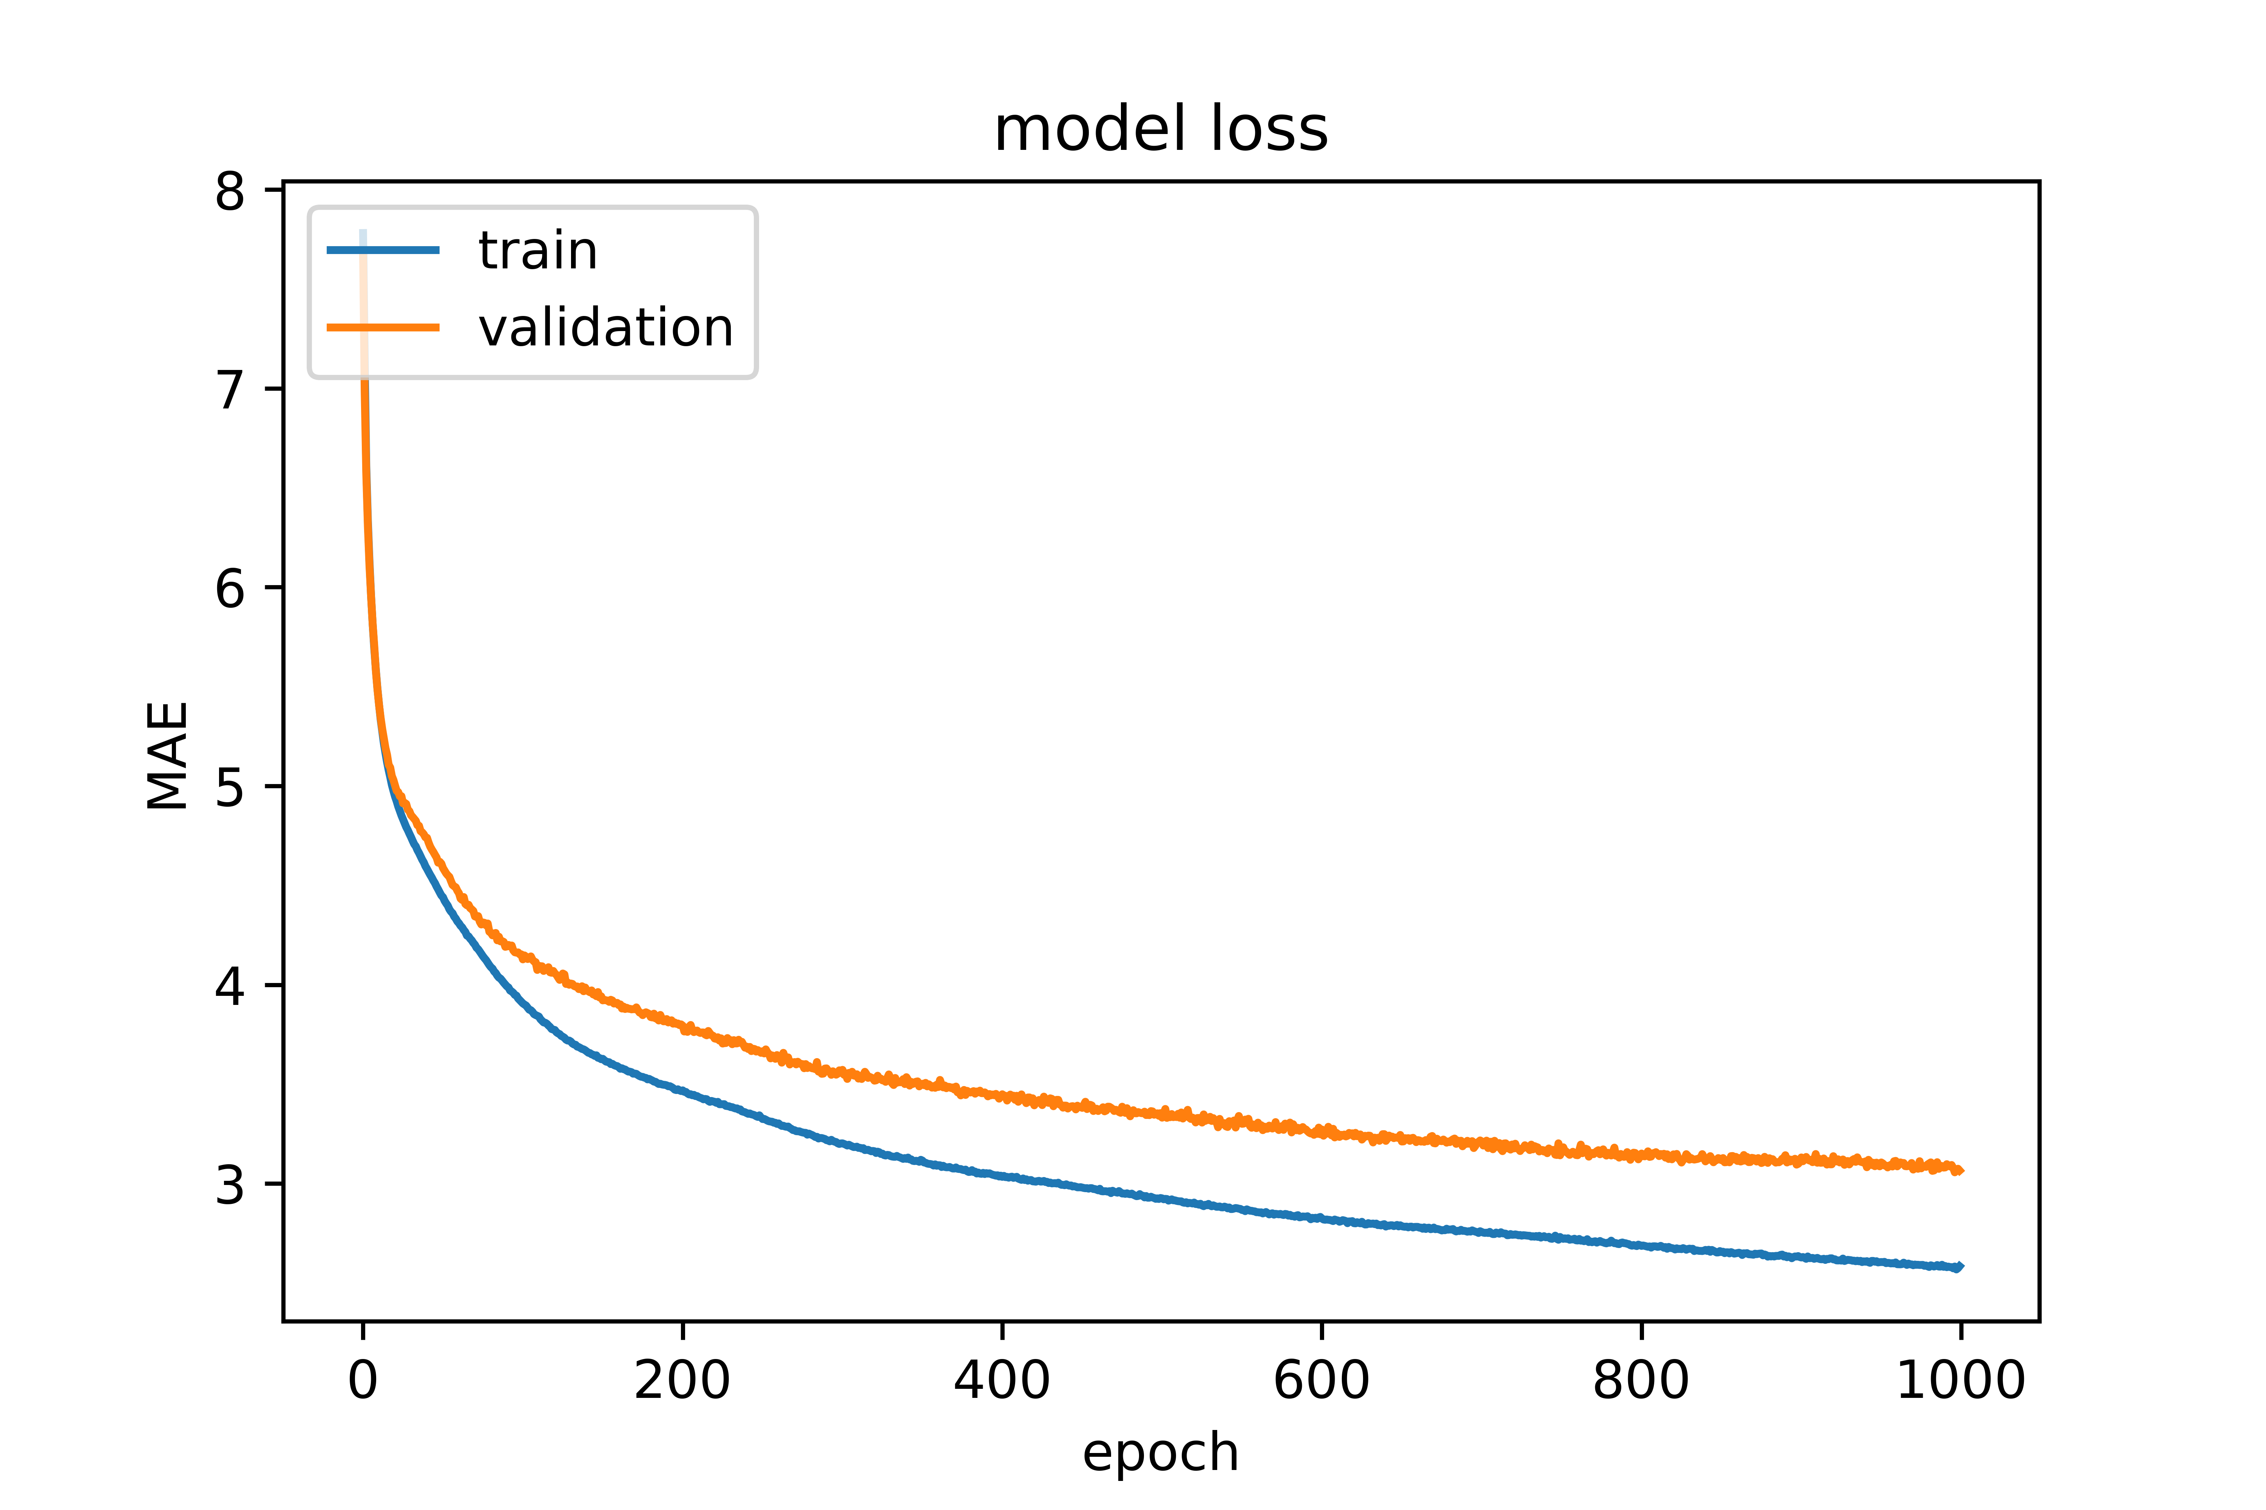
2. Validation:
5628 unique Elapsolites (ABC2D6) and formation energy(from VASP)s
Use 2 layer NN: Sequential{.Dense(10, relu),Dense(1)} optimizer='adam', loss='mae',
Autoencoder+SVD
SVD
Autoencoder

Slide 10
2. Validation:
5628 unique Elapsolites (ABC2D6) and formation energy(from VASP)
Use 4 layer NN
Autoencoder+SVD
SVD
Autoencoder

Slide 11
Summary and future work:
Summary
SVD works better than Autoencoder and Autoencoder+SVD(loss in Autoencoder)
More data(~60000->~80000) shows better performance in PCA analysis(10%->16%)
Easy method to gain element vector and show great performance in predicting energy
Validation is not enough:
PCA analysis does not have a numerical standard
Formation energy training does not show overfitting
Future work
*More methods of learning the element vectors and evaluation
*Add more convincing validation method
Mining more data(chemical formulas)
Embedding more element properties in the raw data(structure and so on)
Application in predicting unknown compound
Physical meaning of element vector

