Slide 1

Web scrapping with EDA (OYO Hotel Accommodation)
Name-Anwesha Das
Batch no-223(Data Science)
Degree-M.SC in Data Science
Email- anweshadas754@gmail.com

Slide 2
PROJECT LIFECYCLE
BUSINESS UNDERSTANDING
DATA COLLECTION FROM OYO WEBSITE
DATA CLEANING
DATA ANALYSIS
DATA VISUALIZATION

Slide 3
LIBRARY IN PROJECT
NUMPY
PANDAS
MATPLOTLIB
SEABORN
REQUESTS
BEAUTIFULSOUP
REGEX

Slide 4
DATA COLLECTION
COLLECT DATA THROUGH WEB SCRAPPING
Web scrapping is the process of extracting meaningful and useful data from website using different technique
Using Beautiful Soup user can scrap data from website
Website for scrapping data – oyorooms.com

Slide 5
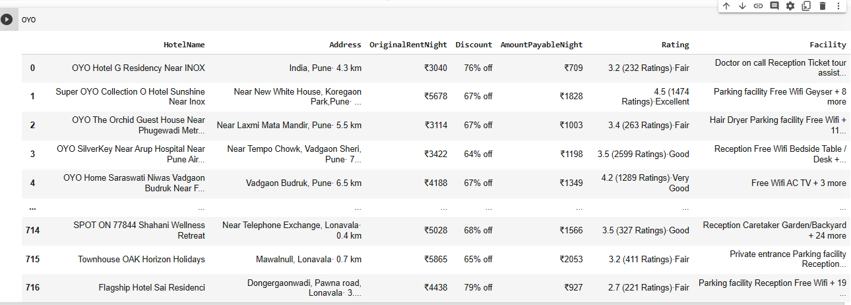
Scrapped data

Slide 6
Challenges
Difficult to finding proper html tag where to scrap data .
Scrapping only proper format of text data rather than scrapping small Images .

Slide 7
Data cleaning
Using library REGEX developer can clean the data
Using mean , median and mode fill the none value
Those null value is not required simply drop that value using drop function
Removing some special character those is not useful

Slide 8
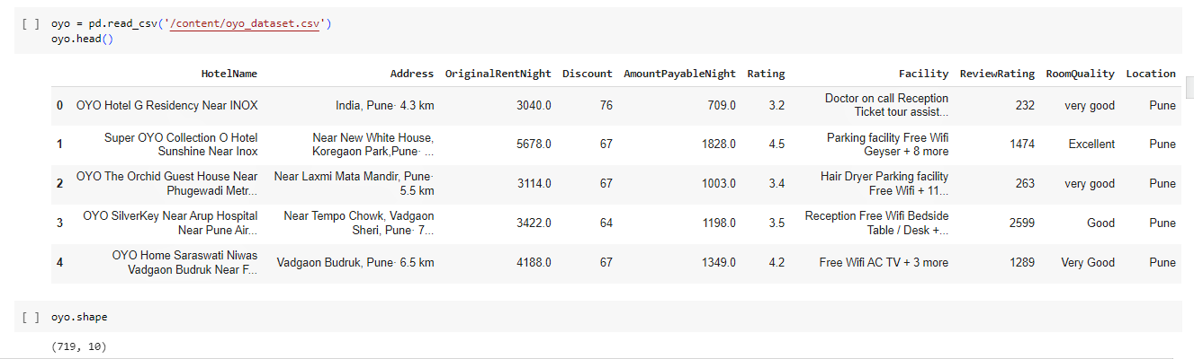
Cleaned data

Slide 9
Challenges
Appling regex library to get meaningful data
Removing the special character those are \n,%, ₹
Assuming the null value and replace and drop those null values

Slide 10
Data analysis and visualization
Using Matplotlib and Seaborn library visualize the data for proper understanding
Analysis univariate ,bivariate and multivariate data

Slide 11
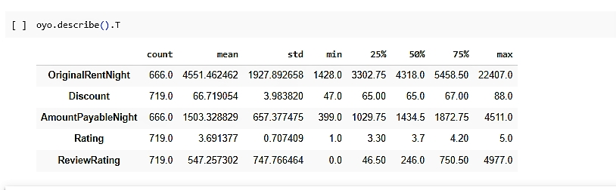

Slide 12
Insight
The cheapest hotel rent is 399
The highest rent of hotel is INR 4511
75% of hotel rent is lies under INR 2000
The lowest discount is 47%
The highest discount is 88%
75% hotel discount lies under 67%

Slide 13
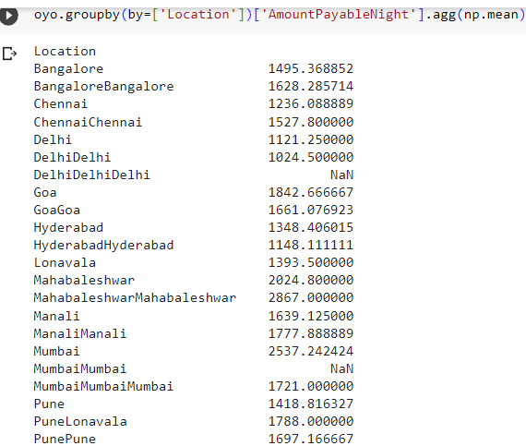
The average amount payable per night for each location

Slide 14
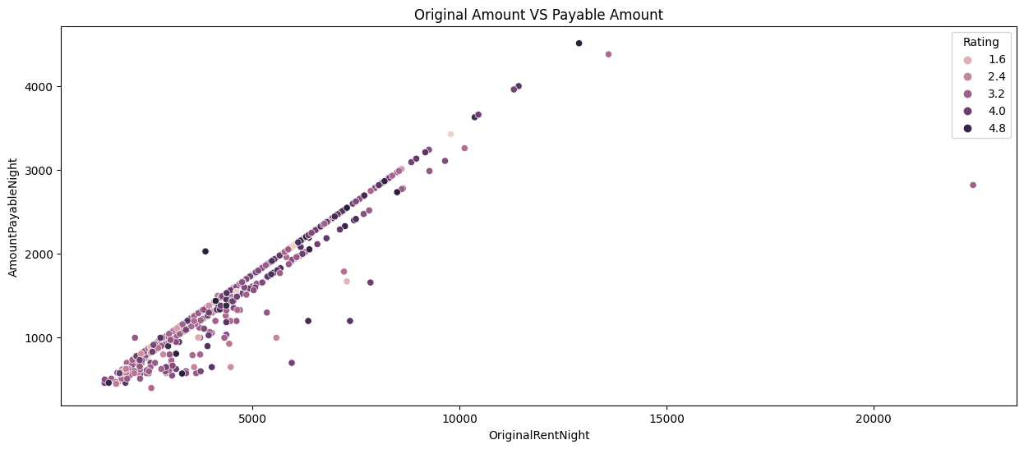
Original vs payable amount

Slide 15
Insight
original rent is high, Amount payable per night is also high
one outlier , whose original rent is Approx 25000 but amount to pay is approx 3000 with 3.2 star rating it seems that gives approx 12%
original rent is 5000 ,amount payble per night is 2000,with 4.8 rating is another outlier.
maximum hotel whose original rent lies between approx 1000 to 9000 and discount rent is in between 500 to 3000

Slide 16
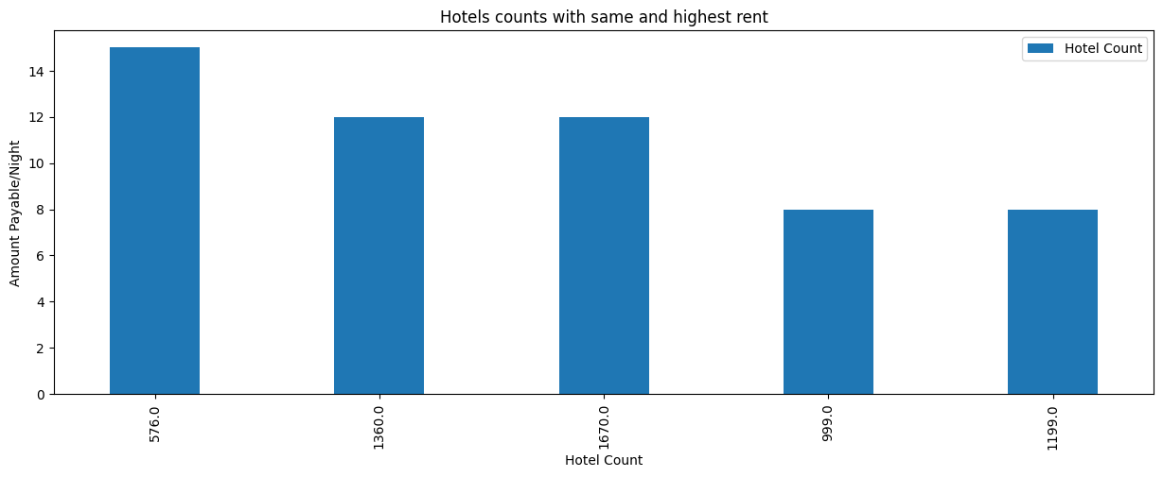
Hotel count vs amount payable per night

Slide 17
Insight
using this plot we realize that more than 14 hotels having same rent of INR 576 and around 12 hotels having same rent of INR 1360 and so on
around 8 hotels which are mostly affordable with rent of INR 999 and 14 hotel are also very affordable with INR 576

Slide 18
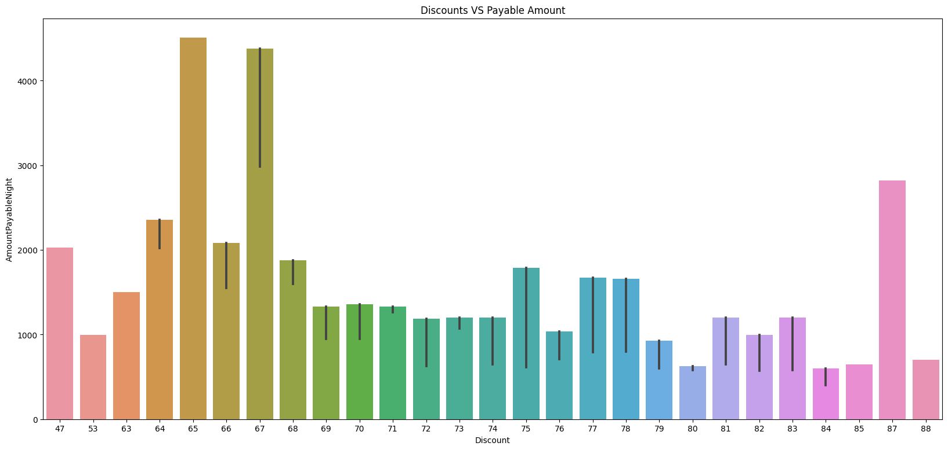
Discount vs payable amount

Slide 19
Insight
For highest rent there is 65% discount
for least rent there is 84 % and 85% discount
Maximum rent is lies between 500 to 2500
only two hotel is there , of rent approx 4500.

Slide 20
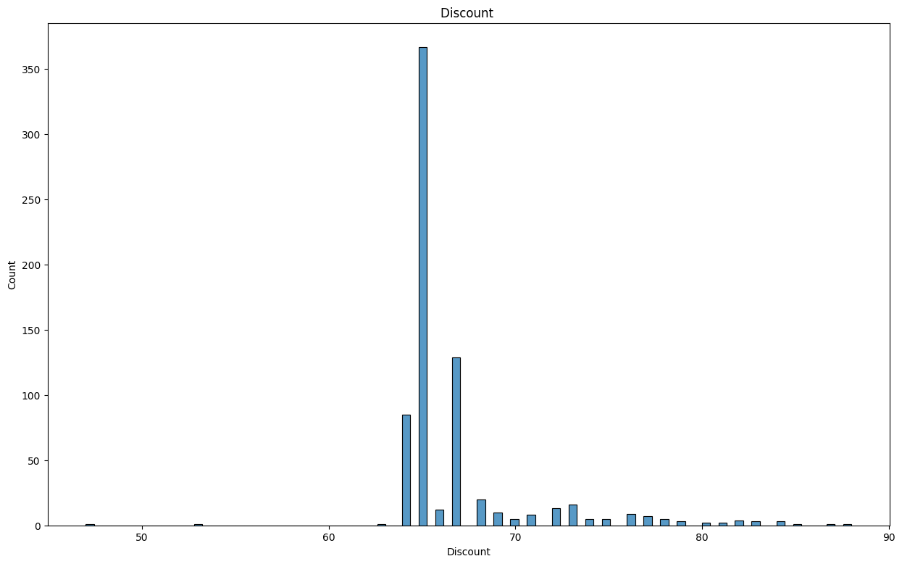
Discount vs hotel count

Slide 21
Insight
by seeing plot we can say that more than 350 hotels having discount of more than 60%,and around 120 hotel having discount of 65%
The lowest discount rent is 70 and around 45 hotels with this discount

Slide 22
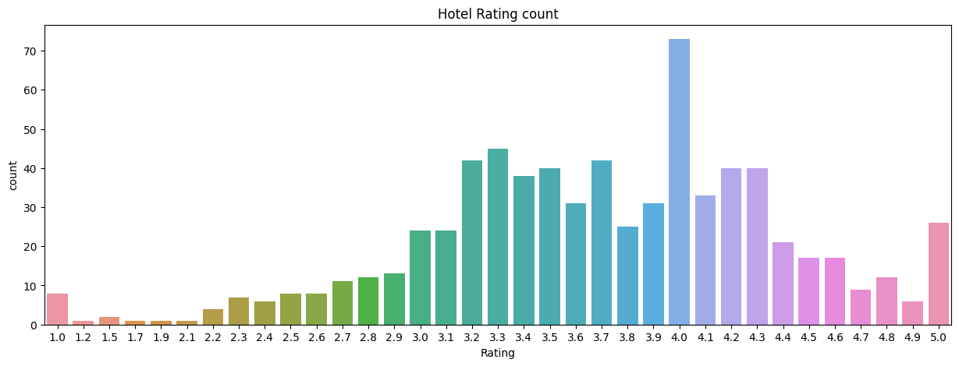
Hotel Rating vs hotel count

Slide 23
Insight
by seeing plot there are around 70 hotels having the rating of 4 star
The remaining rating is normally distributed except 4 star
around 10 hotels rating is 1.0 ,1.2,1.5,1.7,1.9,2.2,2.3,2.4,2.5,2.6 upto 2.9
for 5 star there are around 30 hotels

Slide 24
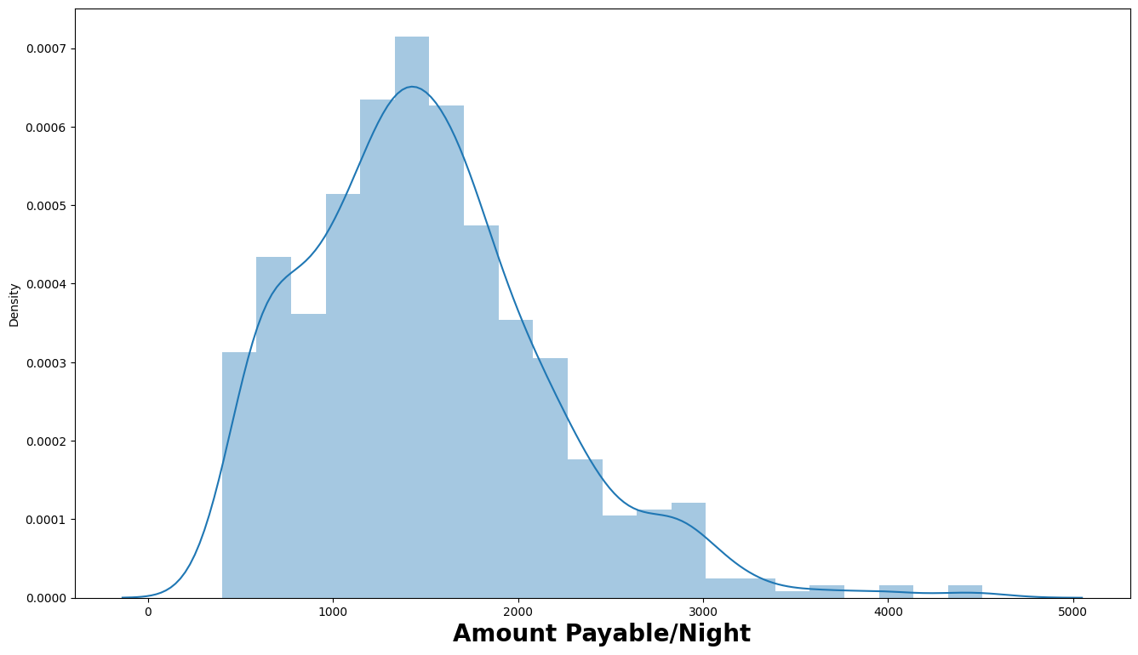
Payble Amount per night

Slide 25
Insight
Maximum hotel rent lies 1500
Highest rent is approx 1500.
Minimum hotels having rent between 3500 to 4500

Slide 26
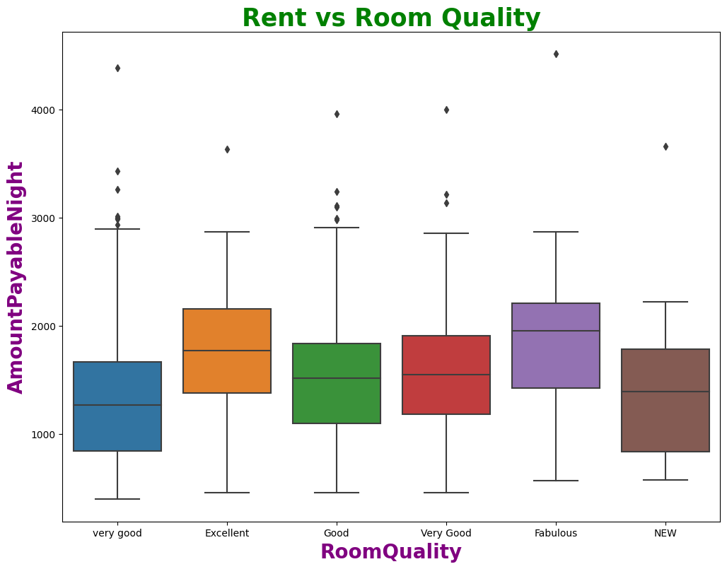
Rent vs Room Quality

Slide 27
insight
From graph it seems that rent is normally distributed as per room quality.
There are some outliers, in room quality(Fabulous) one of the hotels rent is approx 5000.

Slide 28
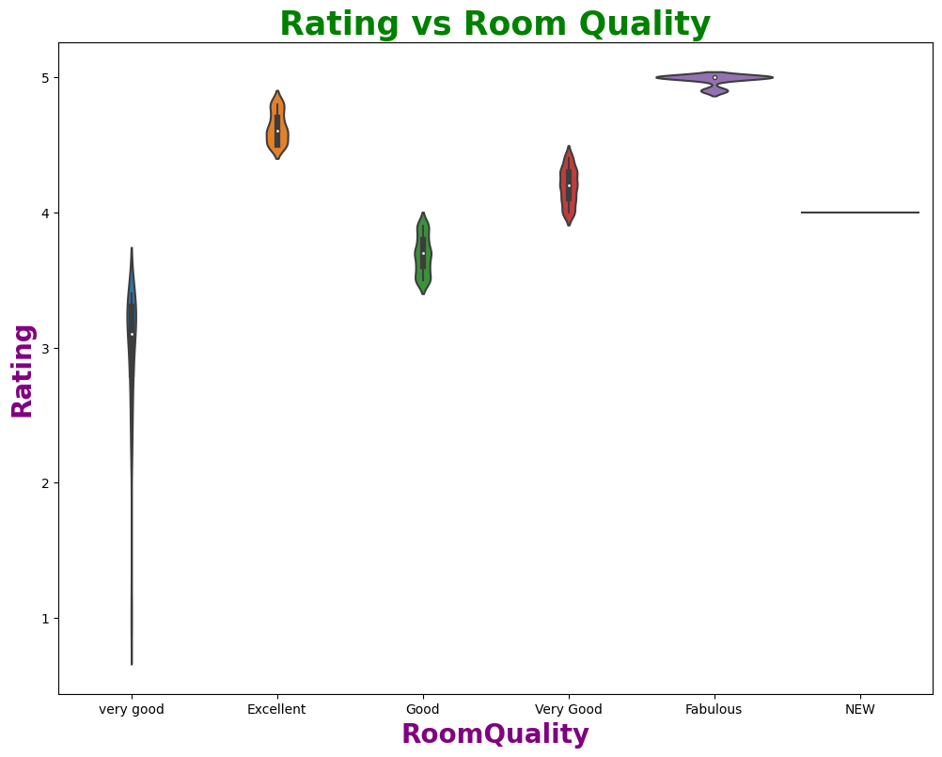
Rating vs Room Quality

Slide 29
Insights
For very good room quality rating is outlier , which is almost 0.
For very good room quality rating is starting from 2 to 3.5 .
For fabulous room quality rating is starts from 4.5 to 5 stars that is highest rating

Slide 30
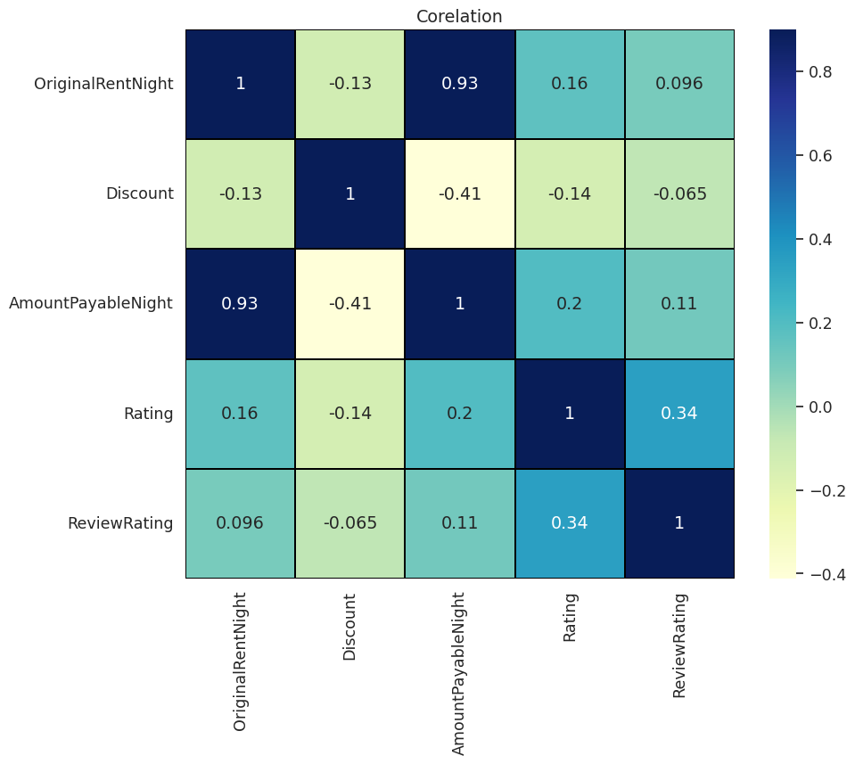
Co-relation

Slide 31
insights
original rent and review rating is highly co-related
Payble amount and original amount is also highly co-rellated
Review and original rent also highly positive co-related

Slide 32
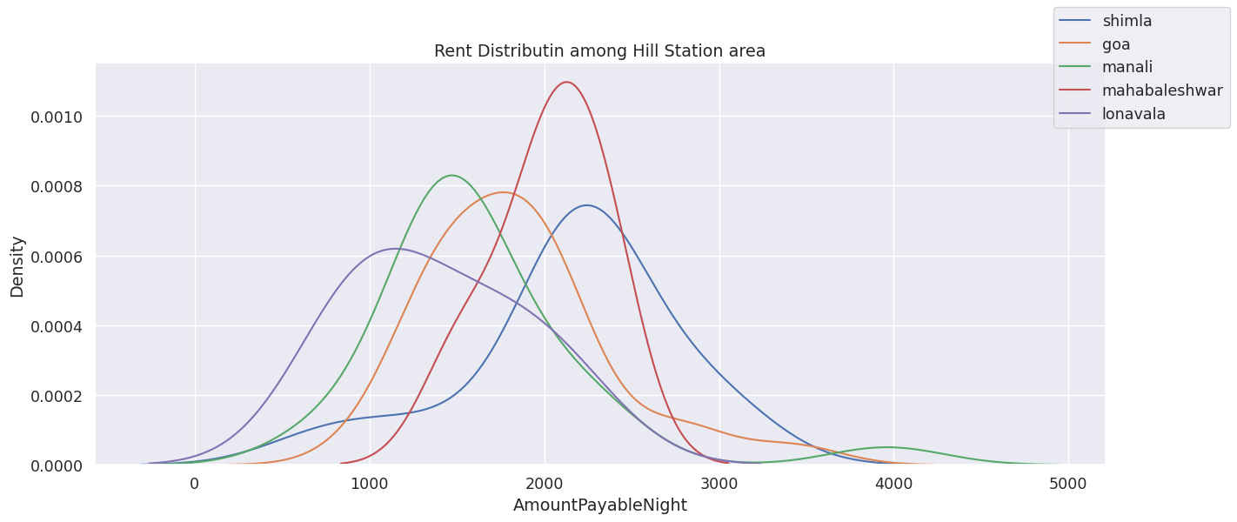
Rent distribution among hill station area

Slide 33
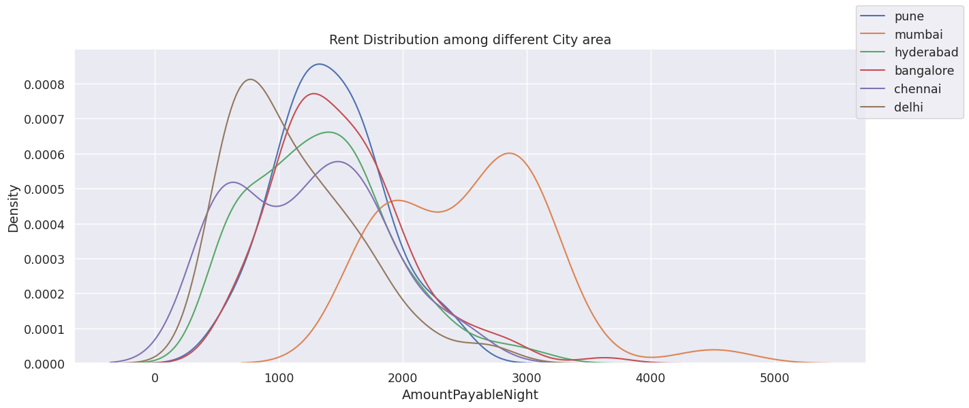
Rent distribution among different city

Slide 34
Insight
the highest rent of city area from pune
1000 to 5000 is the minimum rent which is affordable
in manali the range is normally distributed
the rent of hotels except mahabaleswar are some what same

Slide 35
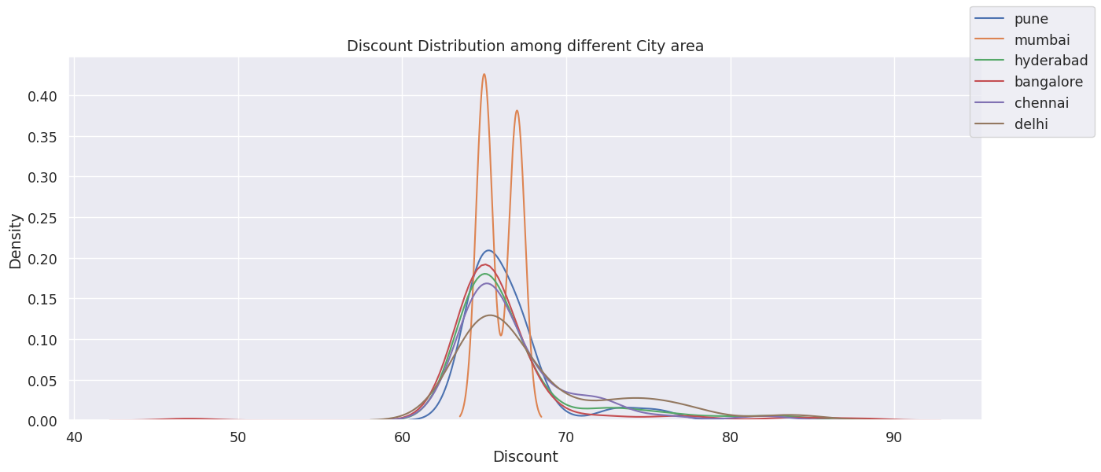
Discount distribution among different city area

Slide 36
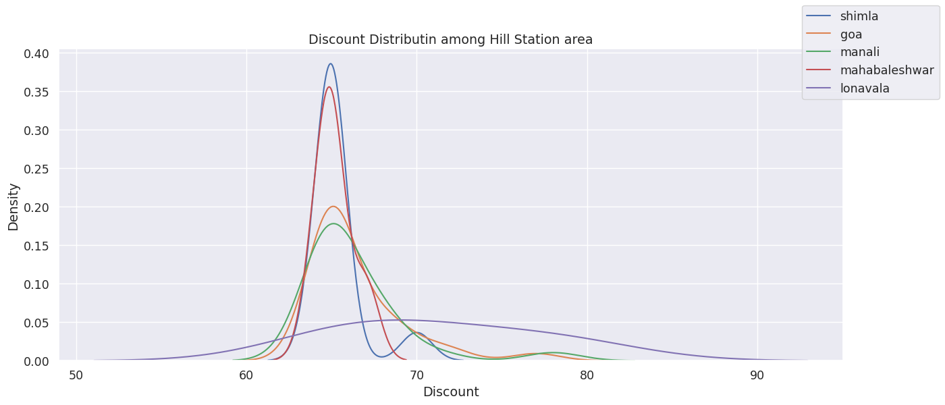
Discount distribution among hill station area

Slide 37
Insights
In goa the rent is normally distributed , but here some hotels have highest rent .
In shimla the rent is normally distributed , but here some hotels have highest rent .

Slide 38
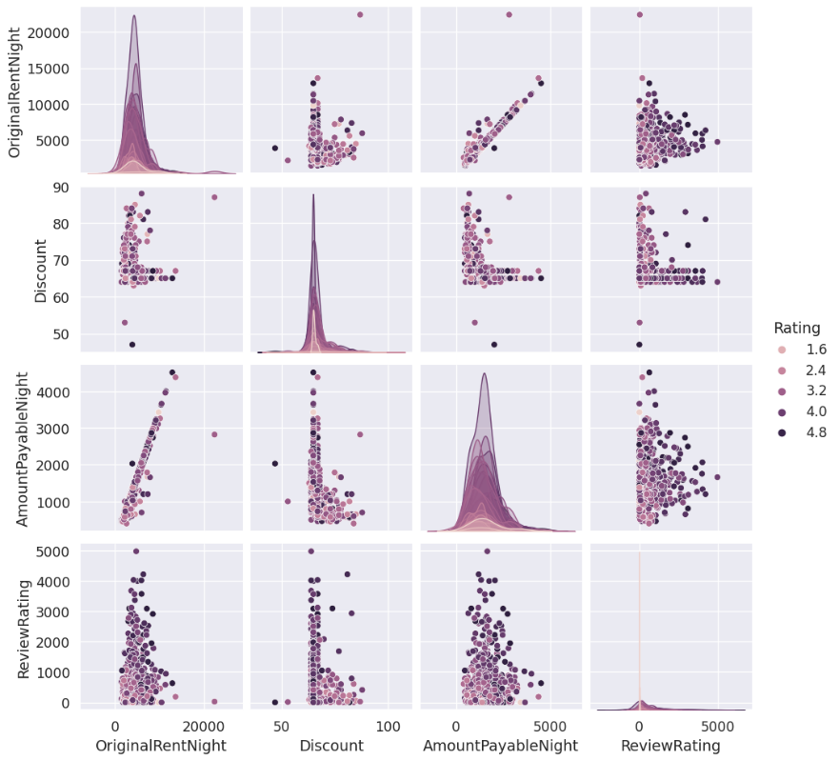
Pair plot

Slide 39
Insights
However, it is important to note that there is a linearly increasing trend based on this observation. we cannot conclude when the higher rent, the rating is high. The rating is completely independent.

Slide 40
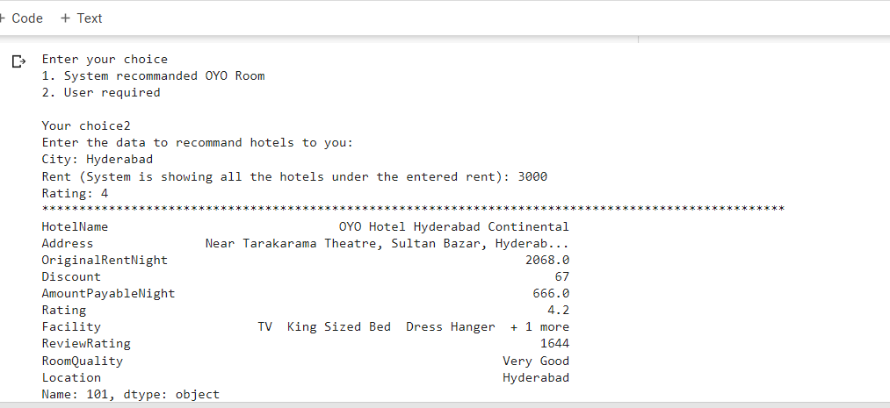
Small recommender system

Slide 41
conclusion
City area rent is affordable in hill area
Using this whole data developer make recommender system location wise

Slide 42


Slide 43


