Slide 1

Web scrapping with EDA (OYO Hotel Accommodation)
Name-Anwesha Das
Batch no-223(Data Science)
Degree-M.SC in Data Science
Email- anweshadas754@gmail.com

Slide 2
PROJECT LIFECYCLE
BUSINESS UNDERSTANDING
DATA COLLECTION FROM OYO WEBSITE
DATA CLEANING
DATA ANALYSIS
DATA VISUALIZATION

Slide 3
LIBRARY IN PROJECT
NUMPY
PANDAS
MATPLOTLIB
SEABORN
BEAUTIFULSOUP
REGEX

Slide 4
DATA COLLECTION
COLLECT DATA THROUGH WEB SCRAPPING
Web scrapping is the process of extracting meaningful and useful data from website using different technique
Using Beautiful Soup user can scrap data from website
Website for scrapping data – oyorooms.com

Slide 5
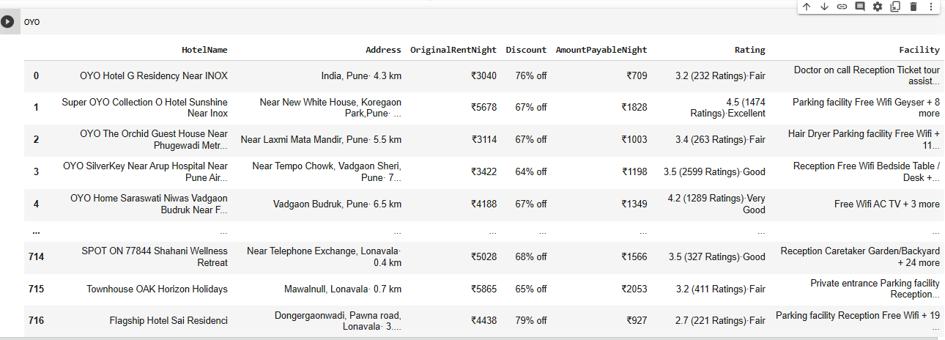
Scrapped data

Slide 6
Challenges
Difficult to finding html tag where to scrap data .
Scrapping only proper format of text data rather than scrapping small Images .

Slide 7
Data cleaning
Using library REGEX user can clean the data
Using mean , median and mode fill the none value
Those null value is not required simply drop that value using drop function
Removing some special character those is not useful

Slide 8
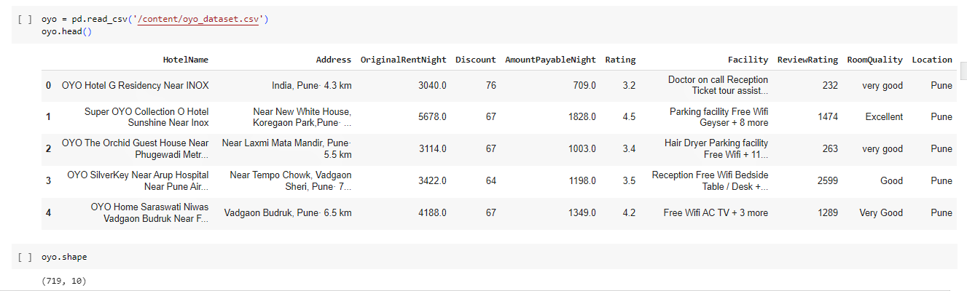
Cleaned data

Slide 9
Challenges
Appling regex library to get meaningful data
Removing the special character those are \n,%, ₹
Assuming the null value and replace and drop those null values

Slide 10
Data visualization
Using Matplotlib and Seaborn library visualize the data for proper understanding
Analysis univariate ,bivariate and multivariate data

Slide 11
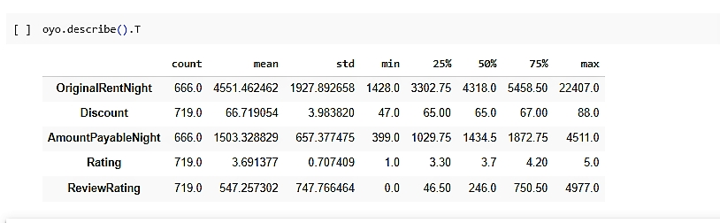

Slide 12
Insight
The cheapest hotel rent is 399
The highest rent of hotel is INR 4511
75% of hotel rent is lies under INR 2000
The lowest discount is 47%
The highest discount is 88%
75% hotel discount lies under 67%

Slide 13
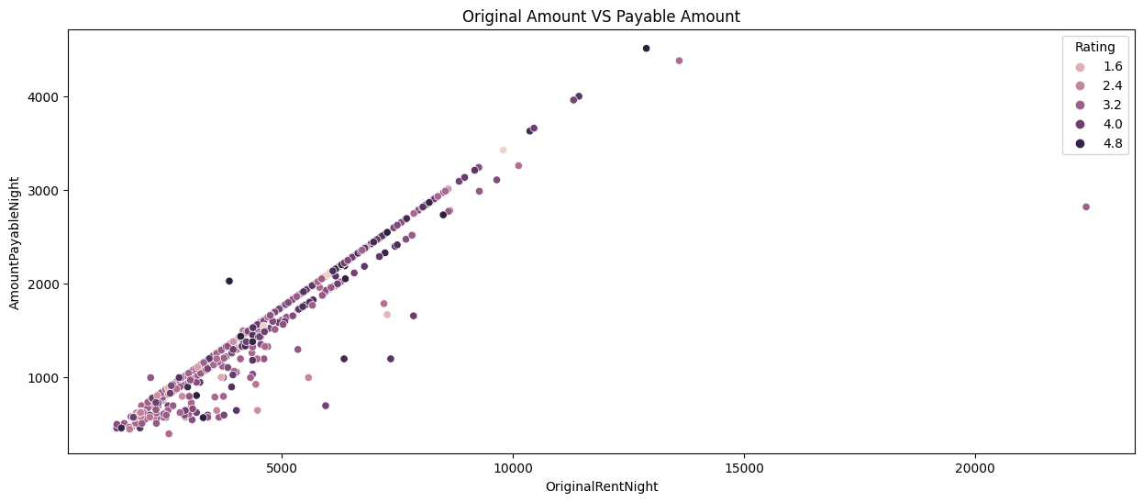
Original vs payable amount

Slide 14
Insight
original rent is high, Amount payable per night is high
one outlier whose original rent is approx 25000 but amount to pay is approx 3000 with 3.2 star rating it seems that gives approx 12%
original rent is 5000 ,amount payble per night is 2000,with 4.8 rating is another outlier.
maximum hotel whose original rent lies between approx 1000 to 9000 and discount rent is in between 500 to 3000

Slide 15
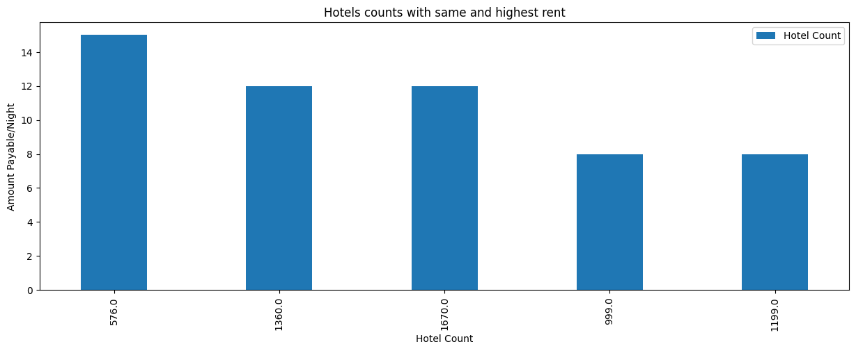
Hotel count vs amount payable per night

Slide 16
Insight
using this plot we realize that more than 14 hotels having same rent of INR 576 and around 12 hotels having same rent of INR 1360 and so on
around 8 hotels which are mostly affordable with rent of INR 999 and 14 hotel are also very affordable with INR 576

Slide 17
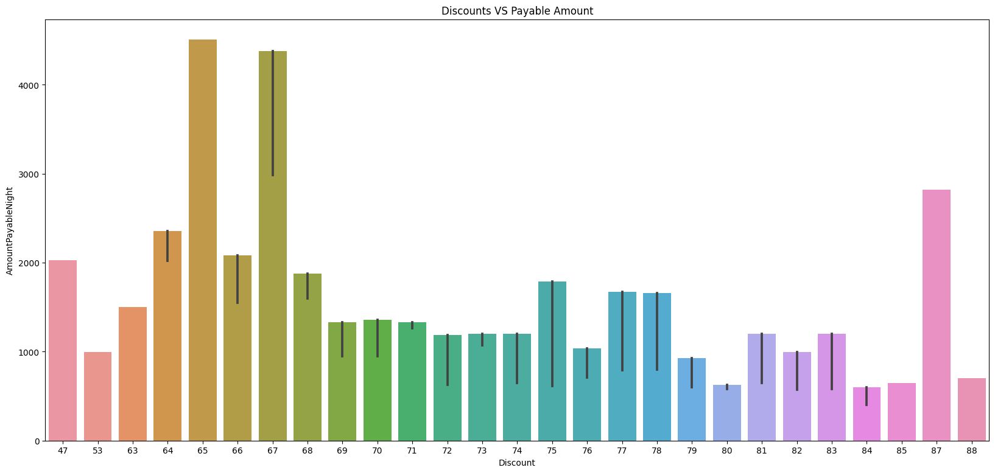
Discount vs payable amount

Slide 18
Insight
By seeing this graph who pay high those discount is low but also exceptional case is there

Slide 19
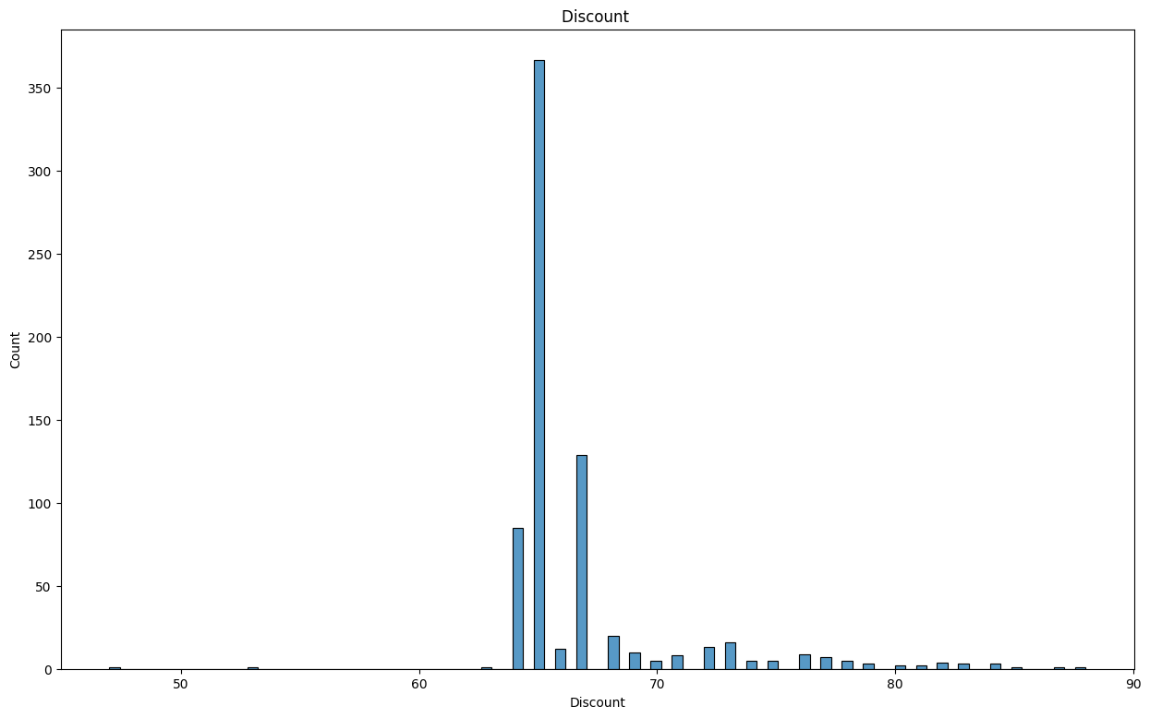
Discount plot with count

Slide 20
Insight
by seeing above plot we can say that more than 350 hotels having discount of more than 60%,and around 120 hotel having discount of 65%
The lowest discount rent is 70 and around 45 hotels with this discount

Slide 21
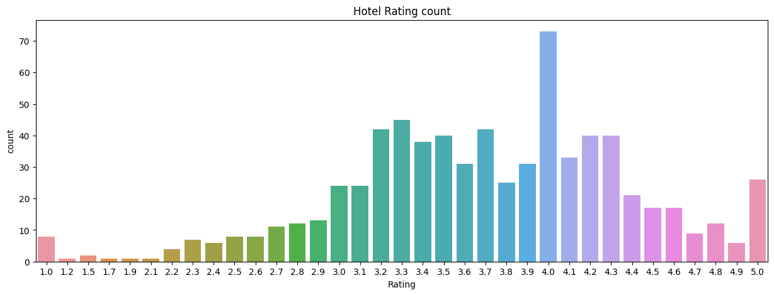
Hotel Rating count

Slide 22
Insight
by seeing plot there are around 70 hotels having the rating of 4 star
The remaining rating is normally distributed except 4 star
around 10 hotels rating is 1.0 ,1.2,1.5,1.7,1.9,2.2,2.3,2.4,2.5,2.6
for 5 star there are around 30 hotels

Slide 23
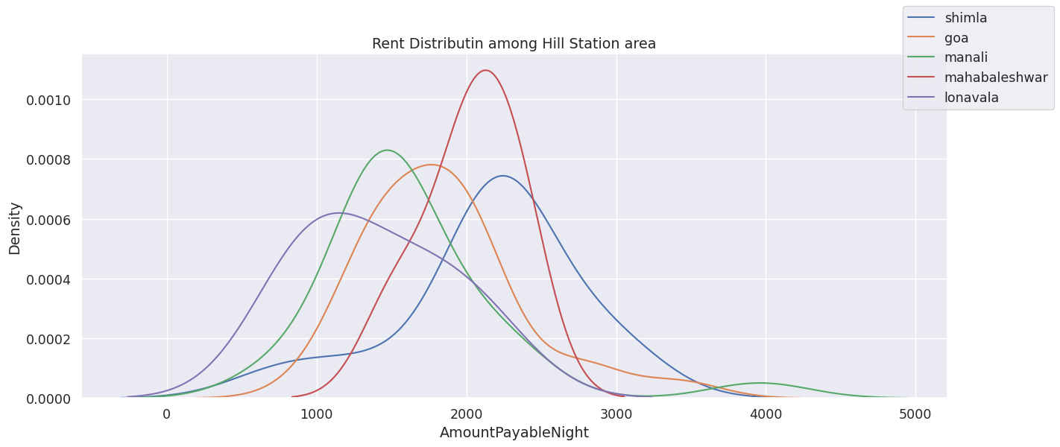
Rent distribution among hill station area

Slide 24
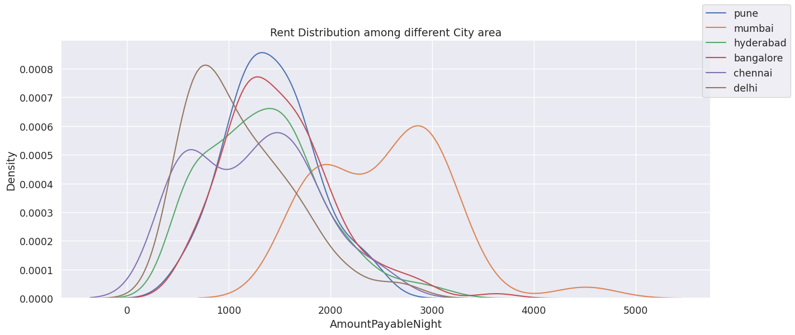
Rent distribution among different city

Slide 25
Insight
the highest rent of city area from pune
1000 to 5000 is the maximum rent which is affordable
in manali the range is normally distributed

Slide 26
conclusion
City area rent is affordable in hill area
Using this whole data developer make recommender system location wise

Slide 27


