Slide 1

Analysis of AMCAT Data

Slide 2
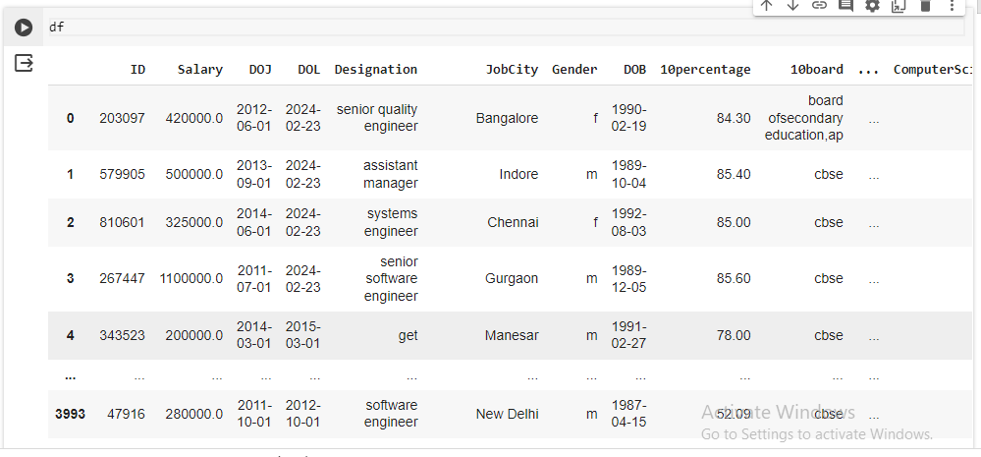
Uncleaned Data

Slide 3
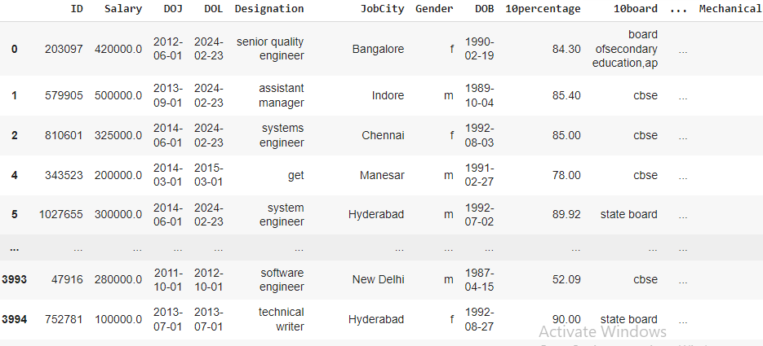
Cleaned Data

Slide 4
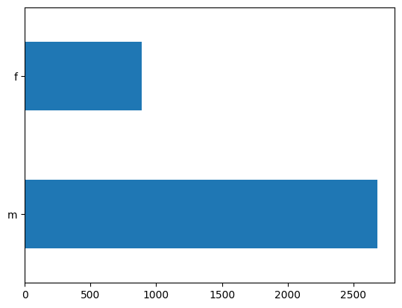
Univariate Analysis
From the bar plot we can say that the count of males is larger than female

Slide 5
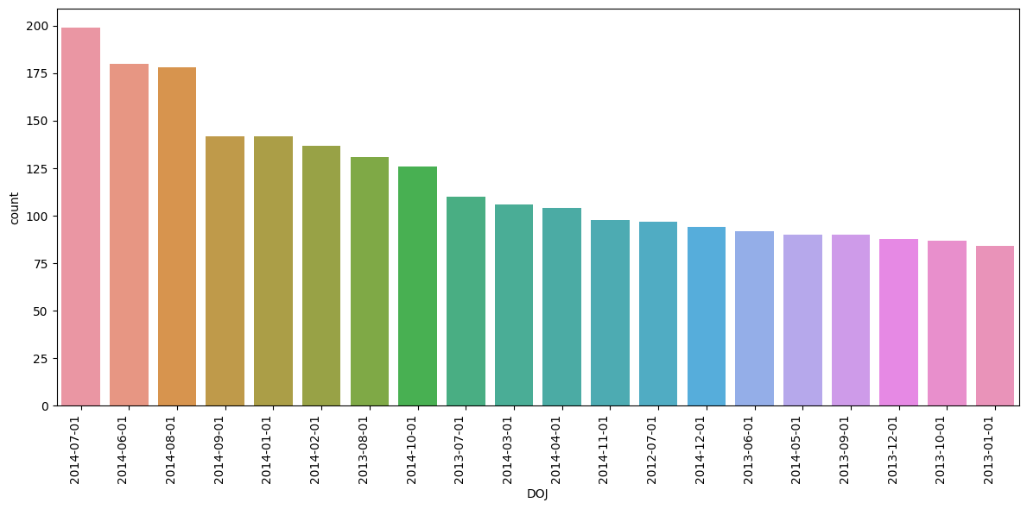
We can say that the count of data is more on 2014-07-01

Slide 6
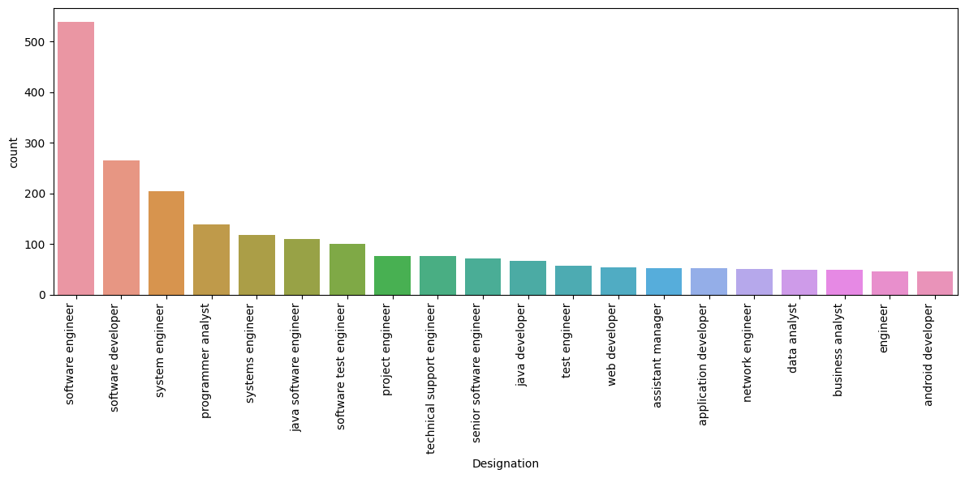
The count of software engineer is more as compared to other designations

Slide 7
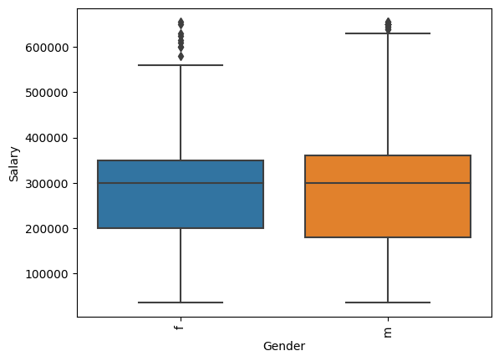
Bivariate Analysis
The plot shows about how the salary getting affected due to gender and there are some outliers present in the data

Slide 8

THANK YOU

