Slide 1
Tableau

Slide 2
Different types of tableau
Tableau Desktop:
This is the primary product for analysts and data professionals to build interactive visualizations, dashboards, and reports by connecting to various data sources.
Tableau Server:
An enterprise platform for publishing, sharing, and managing content created in Tableau Desktop within an organization's own servers.
Tableau Cloud:
A fully hosted, cloud-based version of Tableau Server, allowing organizations to deploy Tableau without managing their own infrastructure.
Tableau Public:
A free platform that enables users to create and share interactive visualizations publicly online, though content cannot be private.
Tableau Prep:
A tool specifically designed for data preparation, allowing users to clean, shape, and aggregate data from various sources before it's used in analysis within Tableau.
Other important distinctions:
Tableau Creators:
These are the individuals who use Tableau Desktop and Tableau Prep Builder to create and analyze data.
Tableau Explorer and Tableau Viewer:
These are different user roles within Tableau Cloud or Server, providing varying levels of access to data and content.
Tableau Mobile:
A version of the product for viewing and interacting with dashboards on mobile devices.

Slide 3
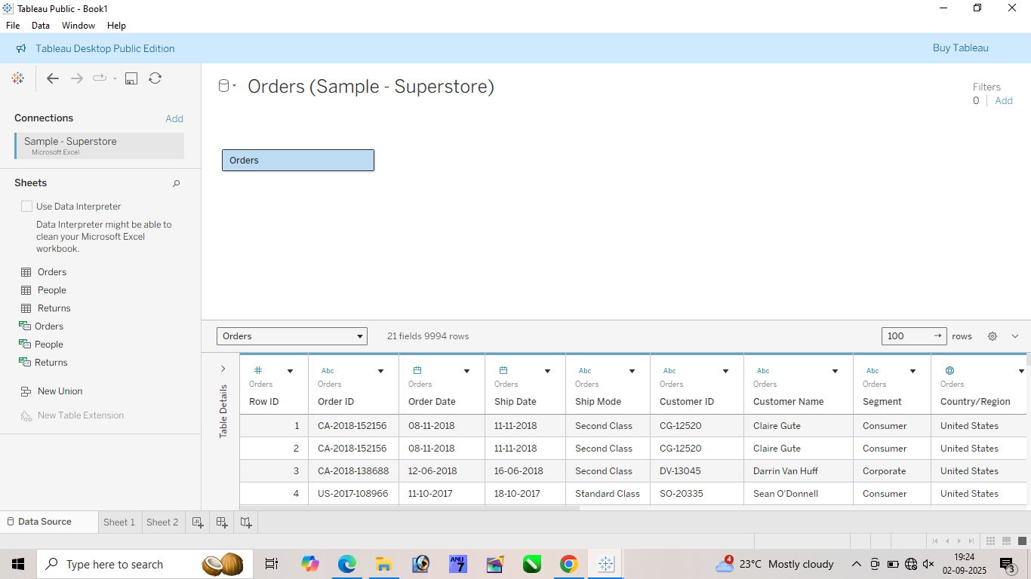
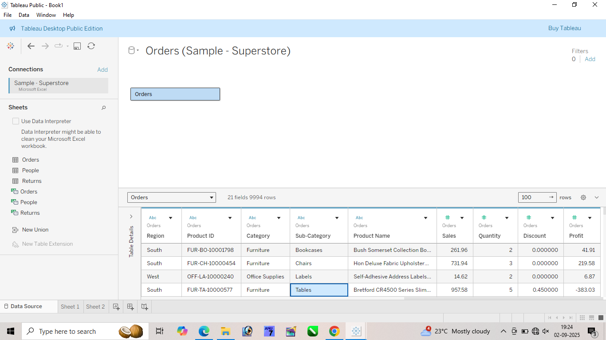

Slide 5
datatype
‘abc’ -> string
# -> numerical(float , int)
Date-> calendar
#(blue) (dimension)-> any column that makes no sense to add / subtraction/ multiplication / division (ordered, pincode,phone number)
# green(measure)-> any column that makes sense to add / subtraction/ multiplication / division (age, profit ,sales)

Slide 6
Data types
Discrete -> anything that can be found on finger tips that is a discrete(whole number)
Continuous-> anything that can not be found on finger tips that is continuous(decimal).
99% dimension is discrete
1% is continuous and as well as a discrete.

