Slide 1
Course Organization:
Neuroimaging and Machine Learning for Biomedicine
Maxim Sharaev
RAIC, ISIP group
Intro Lecture
Notes:
1

Slide 2
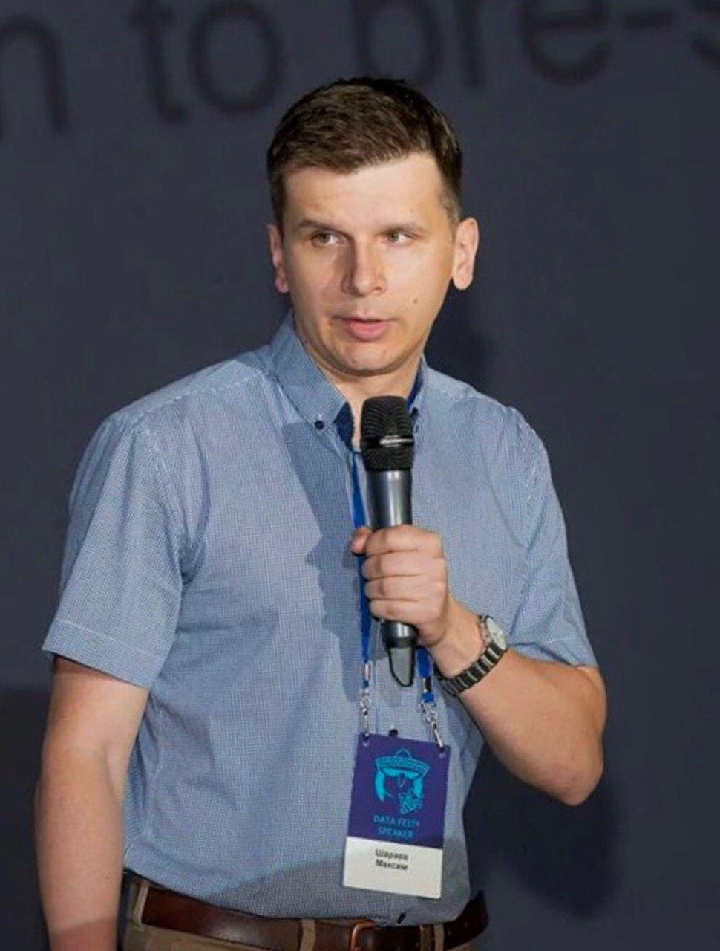
About myself
Maxim Sharaev, Ph.D.
2006—2012 Lomonosov MSU, BioChemical Physics, Dept. of Physics
2009—now Istitute of Higher Nervous Activity and Neurophysiology, RAS
2012—2016 Lomonosov MSU, Ph.D. BioChemical Physics
2014—2018 NRC “Kurchatov Institute” Neuroimaging methods / MRI
2018—now Skoltech, Machine Learning in Neuroscience and neuroimaging
Core: biophysics, statistics and data analysis, mathematical modelling

Slide 3
Agenda
Why study neuroimaging at a Data Science program?
Course outline
Course project
Course assessment
Notes:
3

Slide 4
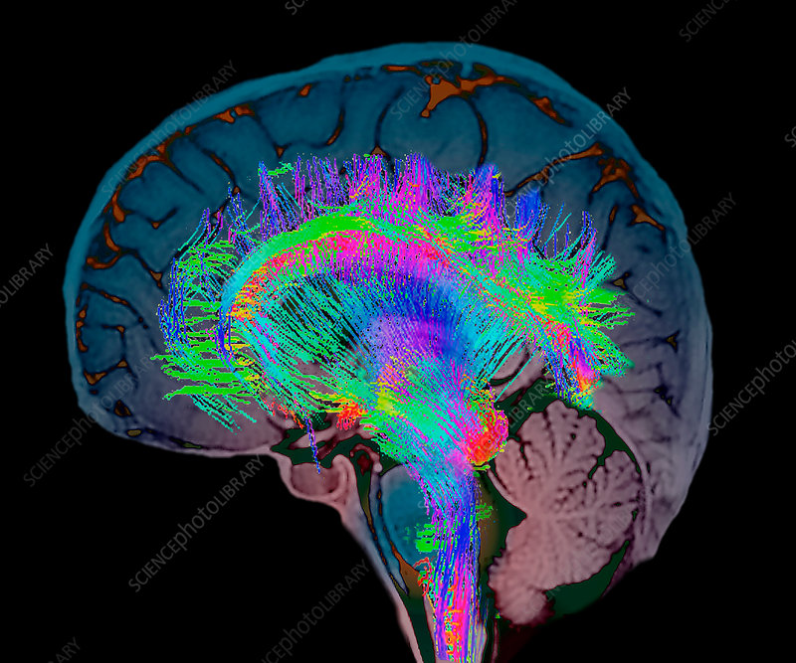
Why study neuroimaging at a Data Science program?
Neuroscience is cool! ☺
Different research questions:
how the brain works
why we behave in one way or another
can we decode our thoughts…
Different applied questions:
can we build artificial neural systems?
how can we communicate with brain?
can we effectively diagnose severe brain diseases and help the doctor to treat them?
From sciencephoto.com
Notes:
4

Slide 5
Why study neuroimaging at a Data Science program?
Unique opportunities to collect measurements
We measure extremely complex processes and thus get complex data
All this requires skills in data analysis + knowing the data
In recent years we add ML to neuroscientific problems – so that we can built predictive models, CV systems, …
Notes:
5

Slide 6
Why study neuroimaging at a Data Science program?
An increasing number of startups dedicated to ML in biomedicine with focus on neuroscience, see for example: sbermed.ai neuralink.com ira-labs
Are missing ML engineers with background in neuro
Have to invent their unique solutions – lack of standardization
Notes:
6

Slide 7
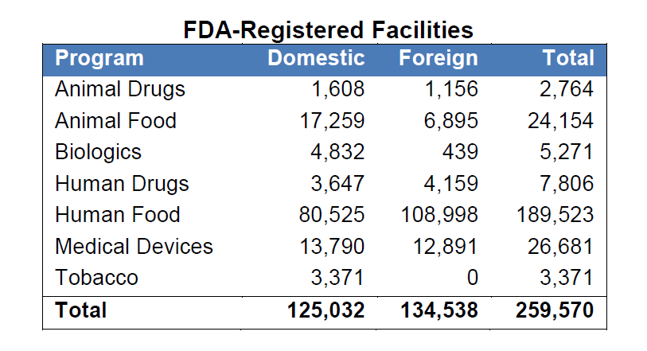
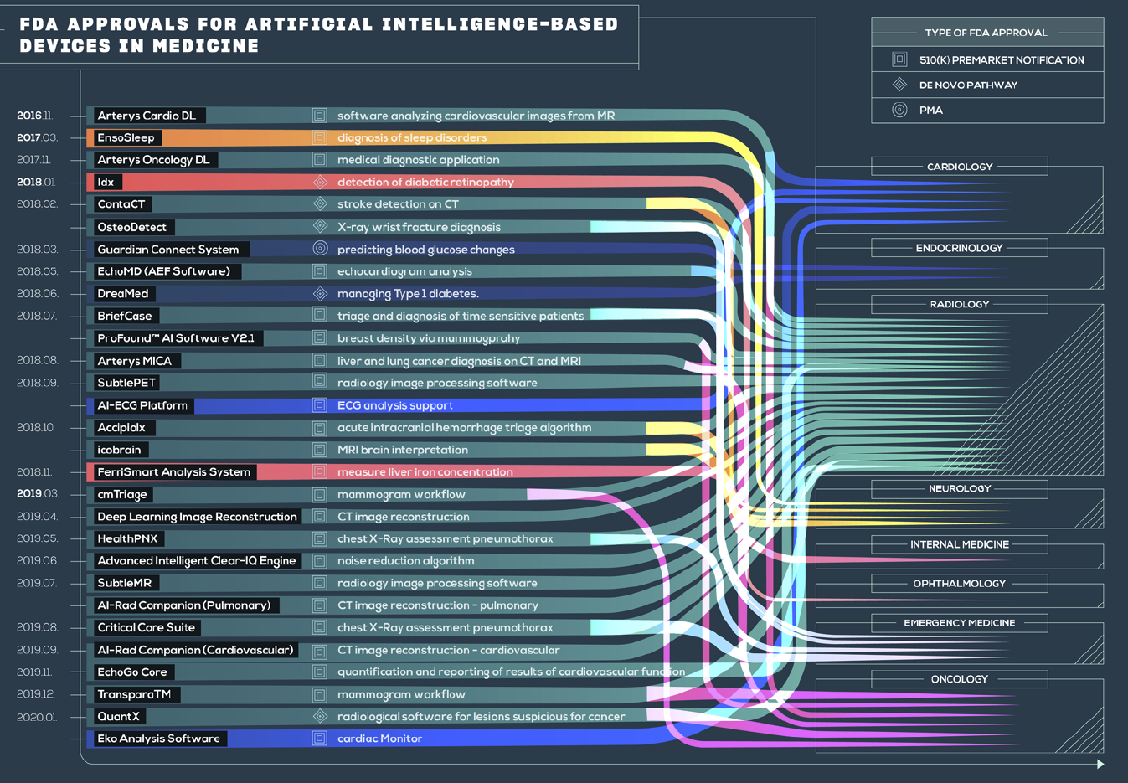
AI systems in medicine: current state
Only 64 AI/ML based, FDA approved medical devices and algorithms
Only 29 (45%) with real AI/ML
Less than ~0,2% of all medical devices
*IMDRF/SaMD WG/N41 (PF): Clinical Evaluation: Software as a Medical Device (SAMD)
(U.S. Food and Drug Administration, FDA)
The number of life science papers describing AI/ML:
596 in 2010
12,422 in 2019
* from (Benjamens et al., 2020)
Notes:
Статистика FDA approv Benjamens, 2020

Slide 8
Course outline
Goals of this course:
Provide an introduction into the ideas behind neuroimaging data analysis
equipment, tasks and methods, data peculiarities, ML in neuroscience, …
Learn the tools for neuroimaging data processing and analysis:
Nilearn, Freesurfer, MNE, …
Gain the skills needed to solve applied clinical and scientific problems
Working with data processing pipelines and neuroimaging databases, creating algorithmic chains (i.e. Docker images)
Immerse into real clinical processes with leading professionals from the field
What you will not learn:
ML methods per se (except for a narrow subset)
Notes:
8

Slide 9
Course outline
Course structure for 2021:
2 parts
Part 1: Neuroimaging experiments, methods, equipment and data analysis (6 lectures + 7 seminars)
Part 2: Work in teams on the Final Project, panel sessions with clinicians/neuroscientists (1 seminar + QA sessions + 2-3 panel sessions)

Slide 10
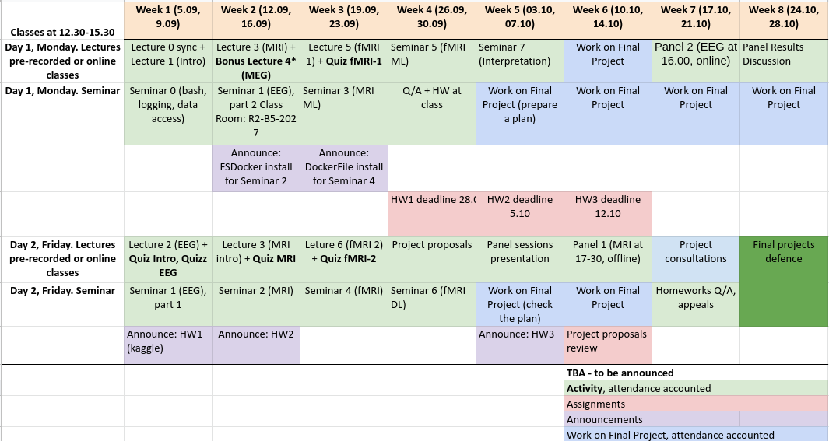
Course outline

Slide 11
Course outline
Structure of a Part 1 typical learning day:
Pre-recorded lecture [60—90 min]
Offline quiz [should take 15 min, is closed 5 min before the seminar]
Offline live seminar [~80 min], attendance is necessarily (70%)
HW announcement [totally 3 HWs] → submit for assessment
Part 2
[Week 5] Project proposals [120–180 min] → submit for assessment [Week 6]
2-3 panel sessions: watch the specialist work and propose a solution
Work on project → final project + peer review [Week 8]
NB! Can be flexible, follow updates in Canvas/TG Group
Notes:
11

Slide 12
Course project
One of the main educational format used in this course
Goal: create your own end-to-end AI system for biomedical use (see the available topics)
IN: lots of Neuroimaging/ML papers, datasets
OUT: an intelligent system for prediction / treatment planning / …
Project is performed individually or in teams of 2~3 people with distinct roles (e.g., requirements/data analyst, data engineer, researcher, developer, …)
Each team implements a particular data processing pipeline (e.g., data collection, cleaning, ML model validation, …)

Slide 13
Course assessment
Total assessment:
20% - quizzes*
45% - HW
30+5**% - Final Project***
Bonus scores:
15% Panel with clinicians
*!Quizzes are counted only if the student is present at the class!
**If there is a paper draft
***(30% - Proposal 70% - final defense)
Participation in the discussion of the progress with TA
during “Work on Final Project” activity is mandatory!
Notes:
13

Slide 14
Questions?
Notes:
14

Slide 15
Let’s begin!
Notes:
15

