Slide 1
Heart-Disease Risk Screening
A Production-Ready MLOps System on AWS SageMaker
AAI-540 Machine Learning Operations · Group 2
Ashis Das · Hanmant Mhalappa Kattimani · Ram Prasanth G
Instructor: Dr. Raj Garg · University of San Diego
Notes:
[PRESENTER: Ashis Das (intro, 0:00-0:45)]
Welcome. We are Group 2. Over the next ~12 minutes we will walk through our Heart-Disease Risk Screening ML system built on AWS SageMaker. I'll cover the business case and architecture, then Hanmant will present the feature store, infrastructure monitoring and the CI/CD pipeline, and Ram will present the monitoring, the model registry and batch inference. Each of us presents an equal portion. Let's start with the business problem.

Slide 2
OVERVIEW
Agenda
• Business use case & success metrics (Ashis)
• System architecture on AWS SageMaker (Ashis)
• Feature Store & feature groups (Hanmant)
• Infrastructure monitoring (Hanmant)
• Model & data monitoring (Ram)
• CI/CD pipeline: successful and failed runs (Hanmant)
• Model Registry (Ram)
• Batch inference outputs (Ram)
• Future improvements, risks & Q&A (All)
Notes:
[PRESENTER: Ashis Das (0:45-1:15)]
Here is our running order. We walk through the full MLOps system: the feature store, infrastructure monitoring, model and data monitoring, the CI/CD pipeline in both a successful and a failed state, the model registry, and the batch-inference outputs. We close with future improvements and risks. Each topic is explained on its slide, and the explanation is also in the notes below each slide.

Slide 3
WHY THIS MATTERS
Business Use Case
• Stakeholder: population-health provider prioritising preventive outreach
• Problem: identify likely CHD/MI from non-invasive data
• Supervised binary classification on CDC BRFSS target _MICHD
• Data: BRFSS 2021 + 2022 (train), 2023 (held-out future year)
• ~1.3M records; ~8.5% positive class (imbalanced)
• Screening aid — not a medical diagnosis
Success metrics tied to goals
• Recall (sensitivity): 0.819
• PR-AUC: 0.321 (baseline 0.085)
• ROC-AUC: 0.836
• ~3.8× lift over majority baseline
• Subgroup recall tracked (sex, age)
• Evaluated on a FUTURE year (2023)
Notes:
[PRESENTER: Ashis Das (1:15-2:15)]
Our hypothetical stakeholder is a population-health provider that wants to prioritise adults for preventive heart-health outreach. Cardiovascular disease is often silent until a serious event. Using only NON-INVASIVE survey data — demographics, lifestyle and general health — our model flags individuals more likely to have coronary heart disease or a prior heart attack, so limited outreach budget targets the highest-risk people first. This is a screening aid, explicitly NOT a diagnosis. Success is measured by recall on a future year and by lift over a naive baseline.

Slide 4
HOW IT FITS TOGETHER
System Architecture on AWS SageMaker
S3 Raw
(XPT)
Processing
Job
Feature
Store
SageMaker
Pipeline
Model
Registry
Batch
Transform
→
→
→
→
→
SageMaker Model Monitor + CloudWatch → data-quality · model-quality · infrastructure dashboards & alarms
Leakage control (CVDINFR4, CVDCRHD4, _MICHD excluded) and train-only fit statistics are enforced in every stage. Temporal split (2021+2022 → 2023) simulates deployment on a future year.
Scope note: architecture designed for AWS SageMaker; components shown here as local equivalents (Learner Lab budget exhausted).
Notes:
[PRESENTER: Ashis Das (2:15-3:30)]
Here's the end-to-end architecture. Raw BRFSS XPT files land in an S3 raw bucket. A SageMaker processing job harmonises them into parquet in a curated bucket and ingests features into SageMaker Feature Store. A SageMaker Pipeline orchestrates processing, training, an evaluation gate, and model registration into the Model Registry. Approved models run as Batch Transform jobs. Model Monitor and CloudWatch watch data quality, model quality and infrastructure. Every topic in this talk corresponds to a box on this diagram. One important note on scope: this architecture is designed for AWS SageMaker. Because AWS access was not available to us, we present each component as a design, and we implemented and validated the same pipeline logic locally — so the results and artifacts are real even though the managed services are presented as the intended design. For each component we explain the SageMaker service and the local implementation that backs it. I'll now hand over to Hanmant for the feature store.

Slide 5
DESIGNED FOR SAGEMAKER FEATURE STORE · SHOWN AS LOCAL EQUIVALENT
Feature Store & Feature Groups
• Feature group: heart-disease-features
• 15 features, shared across 2021 / 2022 / 2023
• Record identifier + event time per row
• Leakage columns excluded by design
• Same features used for training AND inference
• Guarantees train / serve consistency
The 15 features
• Continuous: bmi, mental_health_days, phys_health_days
• Demographics: age_group, sex, income_group, education_group
• Health: gen_health, diabetes, kidney_disease, diff_walk
• Lifestyle: smoked_100, smoker_status, phys_activity
• Access: has_personal_doctor
Notes:
[PRESENTER: Hanmant Mhalappa Kattimani (3:30-5:00)]
This is our feature foundation. In the SageMaker design this is a Feature Store feature group; here we demonstrate the equivalent as the harmonised feature set we build and persist locally. It holds the 15 variables common to all three BRFSS years. It has three continuous features — BMI, poor mental-health days and poor physical-health days — and twelve categorical survey codes such as age band, sex, general health, smoker status, diabetes and difficulty walking. The three target-defining columns (CVDINFR4, CVDCRHD4 and _MICHD) are deliberately kept out to prevent leakage. Because both training and inference read from this same feature set, the features seen at inference are identical to those seen in training — that is how we guarantee train/serve consistency.

Slide 6
DESIGNED FOR CLOUDWATCH · SHOWN AS LOCAL EQUIVALENT
Infrastructure Monitoring
• Job success / failure for every stage
• Runtime / duration per stage
• CPU & memory utilisation (ml.m5.large)
• Error-rate and invocation counts
• Automated alarms on failure or runtime breach
• Answers: did the pipeline run cleanly this cycle?
What we watch & why
• Success/failure → catch broken cycles fast
• Duration → spot slow-downs & cost creep
• CPU / memory → right-size the instance
• Errors → surface data or code faults
• Alarm → notify on-call without manual checks
Notes:
[PRESENTER: Hanmant Mhalappa Kattimani (5:00-6:15)]
In the SageMaker design, infrastructure is monitored with CloudWatch dashboards and alarms; here we show the equivalent using our local job logs and run status. The design tracks whether each job succeeded or failed, how long each stage ran, CPU and memory utilisation on the ml.m5.large instances, and error and invocation counts, with alarms so that if a batch job fails or runs longer than its expected window, the team is notified automatically. The point of this layer is operational confidence: it tells the on-call engineer whether the pipeline ran cleanly in each screening cycle, regardless of how the model itself is performing.

Slide 7
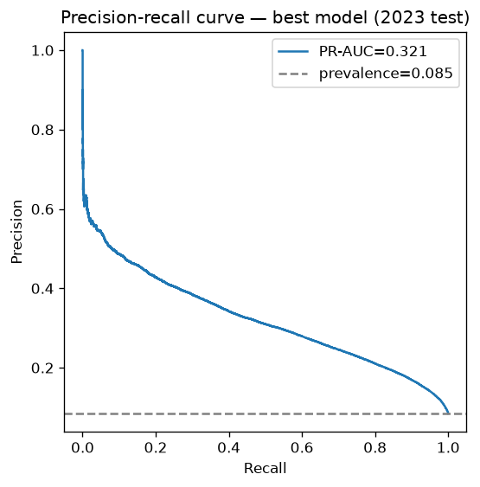
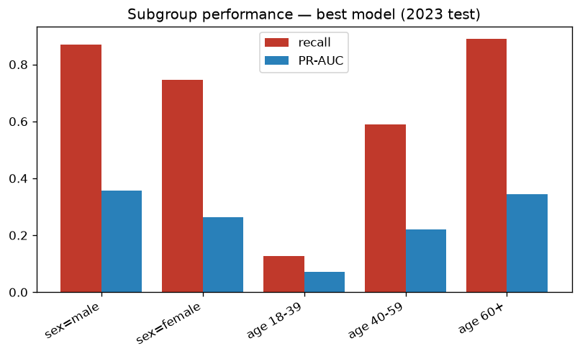
DESIGNED FOR SAGEMAKER MODEL MONITOR · SHOWN AS LOCAL EQUIVALENT
Model & Data Monitoring
• Model quality: recall, PR-AUC, calibration (Brier) vs agreed floor
• Data quality: feature-distribution & missingness drift (PSI) vs baseline
• Fairness drift: subgroup recall by sex and age re-checked each cycle
Notes:
[PRESENTER: Ram Prasanth G (6:15-7:45)]
In the SageMaker design, model and data monitoring run through Model Monitor; here we show the equivalent reports we generate locally. We monitor three things after release. For model quality we track recall, PR-AUC and calibration against an agreed floor and alert if sensitivity drops. For data quality we watch feature distributions and missingness against the training baseline using a population-stability index, so drift is caught before it degrades the model. And for fairness we recompute subgroup recall by sex and age every cycle. The two charts on this slide are our actual outputs: the precision-recall curve on the left shows strong ranking of the rare positive class, and the subgroup chart on the right shows the performance gaps we explicitly track — higher recall for males and older adults, and low recall for younger adults whose prevalence is only about one percent.

Slide 8
DESIGNED FOR SAGEMAKER PIPELINES · SHOWN AS LOCAL EQUIVALENT
CI/CD Pipeline: Successful & Failed Runs
SUCCESSFUL RUN
FAILED RUN
Schema validate ✓
Schema validate ✓
Processing ✓
Processing ✓
Feature ingest ✓
Feature ingest ✓
Training ✓
Training ✓
Evaluation gate ✓
Evaluation gate — FAILS HERE
Register model ✓
Register model (skipped)
Batch transform ✓
Batch transform (skipped)
Notes:
[PRESENTER: Hanmant Mhalappa Kattimani (7:45-9:15)]
In the SageMaker design this is a SageMaker Pipeline; here we demonstrate the equivalent with our local pipeline logic and test gate. The pipeline is a directed graph of stages: schema validation, processing, feature ingest, training, an evaluation gate, model registration, and batch scoring. The left column shows a successful run — every stage passes and the model is registered. The right column shows a failed run that is stopped at the evaluation gate: if the candidate's PR-AUC or recall falls below the current production model, or a required variable is missing for a year, the gate fails and the later stages never run, so a worse model can never be promoted. Our automated test suite — leakage, data-contract, temporal-split and preprocessor checks — runs as the very first step and currently passes five out of five.

Slide 9
DESIGNED FOR SAGEMAKER MODEL REGISTRY · SHOWN AS LOCAL EQUIVALENT
Model Registry
• Model package group: heart-disease-screening
• Versioned models, each with captured metrics
• Selected: XGBoost (PR-AUC 0.321, recall 0.819)
• Approval status gates deployment
• Full lineage: data → features → training → model
• One-click rollback to a prior approved version
Why a registry matters
• Governance: only Approved models deploy
• Traceability: metrics travel with the model
• Auditability: full lineage for each version
• Safety: fast rollback if quality regresses
• Reproducibility: pin the exact artifact
Notes:
[PRESENTER: Ram Prasanth G (9:15-10:15)]
In the SageMaker design this is the Model Registry; here we demonstrate the equivalent with our saved model artifact and its metadata. Every model that passes the evaluation gate is recorded as a version together with the metrics it was approved on. Our selected version is XGBoost, recorded with a PR-AUC of 0.321 and recall of 0.819, and marked approved. Only an approved version is eligible for batch deployment, which gives us governance over what reaches production. The metadata also records lineage — from the data and features through training to the model artifact — so we can audit any prediction and roll back to a previous approved version if a new one misbehaves.

Slide 10
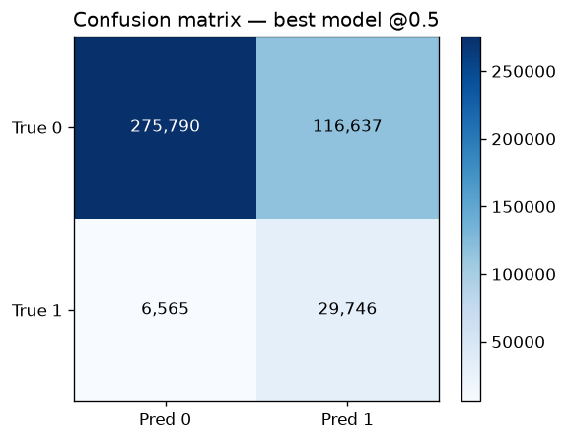
DESIGNED FOR SAGEMAKER BATCH TRANSFORM · SHOWN AS LOCAL EQUIVALENT
Batch Inference Outputs
• Batch Transform scores the 2023 cohort
• Output in S3: risk probability per record
• Threshold → prioritised outreach list
• Recall 0.819 at the chosen operating point
• Scales to hundreds of thousands of rows on ml.m5.large
• Screening prioritisation, NOT a diagnosis
Notes:
[PRESENTER: Ram Prasanth G (10:15-11:30)]
Finally, the system producing value. In the SageMaker design this is a Batch Transform job; here we demonstrate the equivalent with our local batch-inference script (src/batch_inference.py). It scores the entire 2023 cohort and writes an output file where every person gets a heart-disease risk probability. Applying our operating threshold turns those probabilities into a ranked outreach list, so the health team contacts the highest-risk people first. The confusion matrix on the right puts this in context: at our chosen operating point we correctly catch about 82 percent of true cases. The job runs on a modest CPU instance and scales to hundreds of thousands of rows cheaply. And to be clear — this prioritises people for screening; it is not a medical diagnosis.

Slide 11
WHAT'S NEXT
Future Improvements, Risks & Wrap-up
• Calibration + explicit screening-budget threshold
• Odd-year model w/ blood pressure & cholesterol
• Survey-weighted metrics for US-population estimates
• SHAP explainability + automated fairness gate in CI/CD
Risks to manage
• Low recall for younger adults — never use to rule OUT risk
• Self-report / telephone-survey selection bias
• Ethical: no insurance / discriminatory use
• Technical: cross-year schema drift (harmonised)
• Scalability/cost: low — batch on CPU
Notes:
[PRESENTER: Ashis Das (11:30-12:30)]
To close: future improvements include probability calibration with an explicit threshold policy, an odd-year model that adds blood pressure and cholesterol, survey-weighted metrics, and SHAP explanations wired into an automated fairness gate. Key risks: recall is low for younger, low-prevalence adults, so the tool must never be used to rule out risk; self-report and selection bias exist in survey data; and scores must not be misused for insurance or discriminatory decisions. Scalability and cost are low because we use batch scoring on modest CPU instances. Thanks for watching — we're happy to take questions.

Slide 12
Thank You
GitHub: https://github.com/adashis19/AAI-540-Group-2.git
AAI-540 · Group 2 · Heart-Disease Risk Screening MLOps
Ashis Das · Hanmant Mhalappa Kattimani · Ram Prasanth G
Notes:
[PRESENTER: All]
Thank you. Questions welcome. Our GitHub repository link is on this slide and in the design document.

