Slide 1
App development with kivy
Ashley DaSilva
Today's materials:
Github:
Flash drive (floating around the room)
Try running a test kivy app!
Linux: python test.py
Mac: kivy test.py
Windows: right click on test.py, choose send to kivy

Slide 2
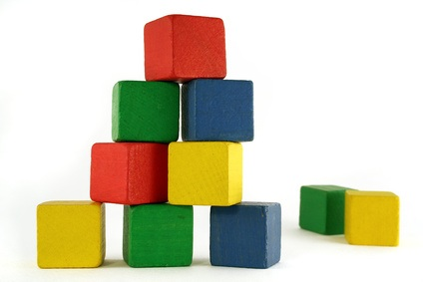
What is kivy?
Framework for cross-platform apps
Logic for how the app looks
Building blocks for designing the app

Slide 3
Theme for today: workout tracker
See your workouts for the week

Slide 4
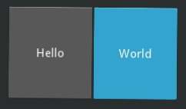

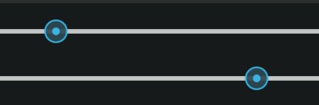

The building blocks of kivy apps
The App class
Widgets
  Layouts
  User interface widgets

Slide 5
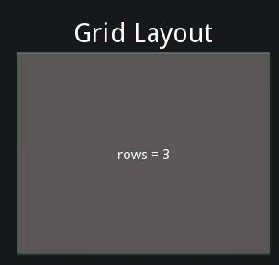
Layouts
Provide overall organization
Can be nested
Available layouts:
  Grid
  Box
  Float
  See more in kivy documentation
http://kivy.org/docs/gettingstarted/layouts.html

Slide 6
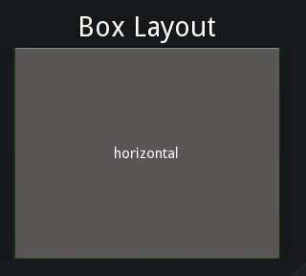
Layouts
Provide overall organization
Can be nested
Available layouts:
  Grid
  Box
  Float
  See more in kivy documentation
http://kivy.org/docs/gettingstarted/layouts.html

Slide 7
Let's start setting up our app!

