Slide 1
Data visualization with matplotlib
Ashley DaSilva
ashley.dasilva.527@gmail.com
Download presentation and sample data:
https://github.com/adasilva/teachingmatplotlib
Have you installed matplotlib and numpy?

Slide 2
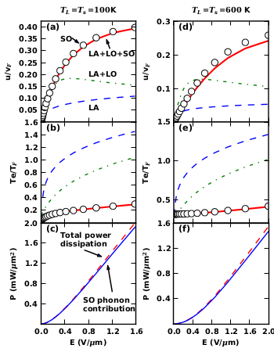
Overview
Straight from calculation or analysis to figures
High-level control
High quality
Examples in the matplotlib cookbook
Figure from: DaSilva et al.
Phys. Rev. Lett. 104, 236601 (2010)

Slide 3
What packages do I need?
Matplotlib – includes plotting functionality through the pyplot module
Numpy – numerical and linear algebra package (including arrays)
Pylab – a separate module installed at the same time as matplotlib; provides both pyplot and numpy (as np)
Ipython – interactive python environment
Scipy – crucial for science!
  Fourier transforms, integration, optimization, etc.
http://matplotlib.org/faq/usage_faq.html#matplotlib-pylab-and-pyplot-how-are-they-related

Slide 4
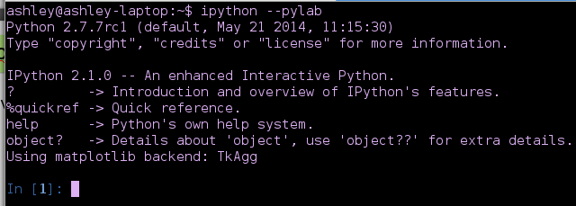
Interactive plotting with IPython
Best thing about Ipython is interactive plotting!
Use pylab option: $ ipython --pylab

Slide 5
Loading data
Many available modules:
  Plain text: loadtxt
  Numpy arrays: numpy.load
  HDF datasets: h5py.File
  Collaborate with matlab users: scipy.io.loadmat

Slide 6

Data and arrays in numpy
Load data from ohm1.npy
Experiment with numpy arrays and array slices

Slide 7

Simple plots with pylab
Numpy included with pylab under the name np
Matplotlib included with pylab under the name mpl

Slide 8
Line properties
Simple combinations are recognized in a single string
  Markers: dot (.), circle (o), triangle (v), square (s), etc.
  Colors: black (k), blue (b), yellow (y), green (g), etc.
  Line styles: solid (-), dashed (--), dash-dotted (-.), etc.
Defaults are used to “fill in” missing info (e.g. 'or' is valid!)
Note: the combination .- is a solid line with dot marker

Slide 9
Line properties: lots of options!
Linewidth: lw=1.5
Color:
  Shortcuts: c='m'
  HTML codes: c='#736AFF'
  RGB triplets: c=(.8,.5,.5)

Slide 10
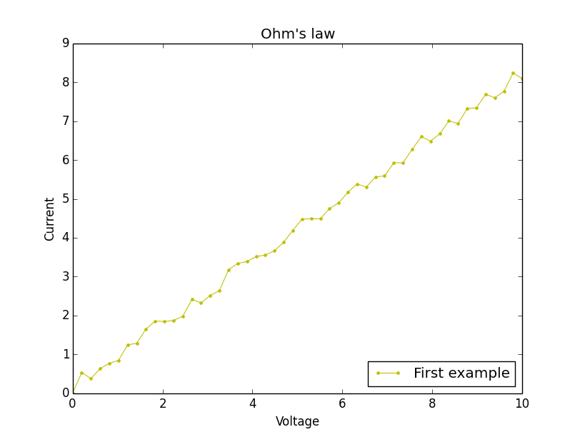
Line properties: lots of options!
Linewidth: lw=1.5
Color:
  Shortcuts: c='m'
  HTML codes: c='#736AFF'
  RGB triplets: c=(.8,.5,.5)

Slide 11

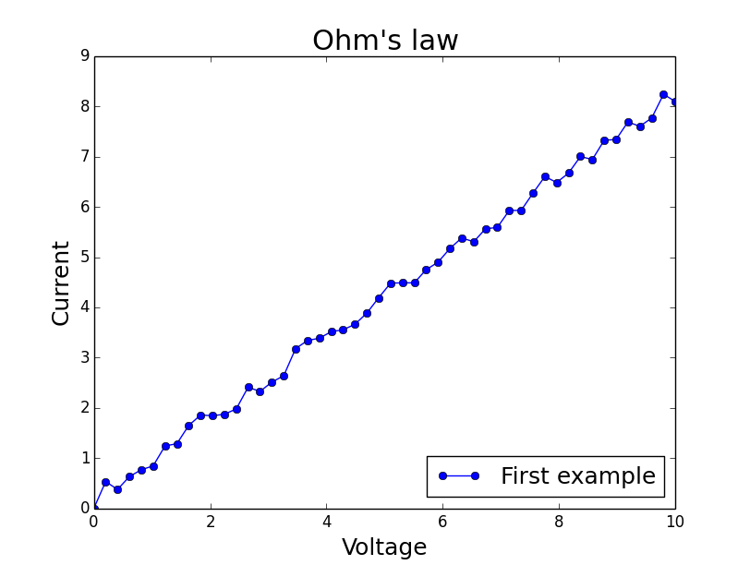
Modifying the font sizes
Optional argument for fontsize

Slide 12


Control of the axes
Control over font size and ticks used

Slide 13

Trendlines
Adding lines – not a problem
Numpy polynomial fits:
x-data
y-data
n

Slide 14
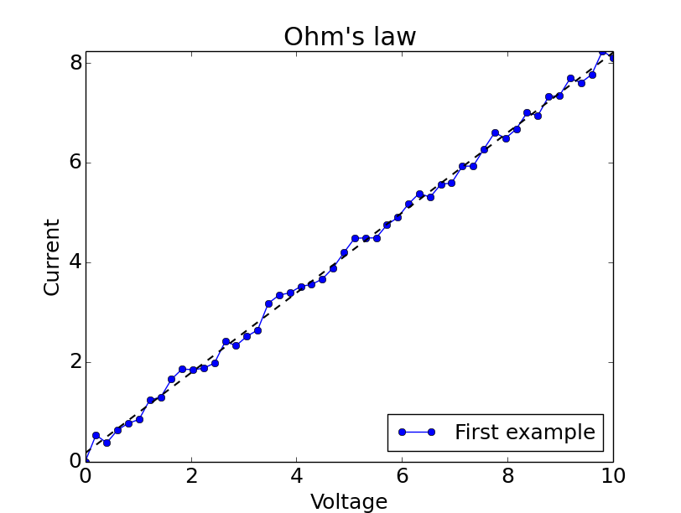
Trendlines
Numpy polynomial evaluation: polyval
List of coefficients
x-points
No new legend item?
Need to recreate legend!
legend(loc=lower right, fontsize=18)

Slide 15
Easy subplots
Set size, figure number
Pylab provides subplot grids
  Easy to use
  But not so versatile
Index of subplot axes
Number of rows
Number of columns

Slide 16
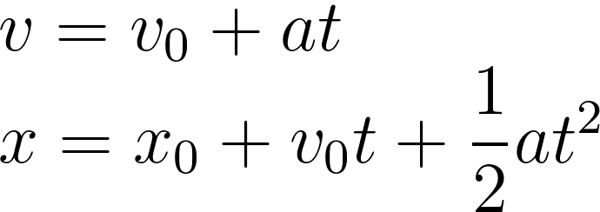
Projectile motion example
Example of projectile motion
  Gravitational acceleration is constant: a = -9.8 m/s²
  Subplots of acceleration, velocity, and position vs time

Slide 17
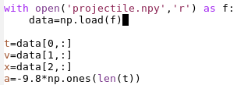

Projectile motion example
Download data: projectile.npy
Set up figure
plot is also a method of the subplot object

Slide 18
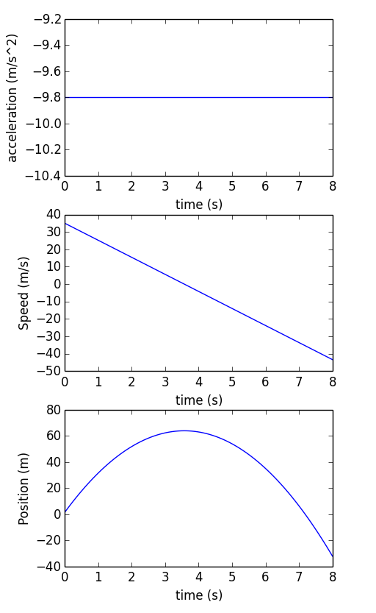
Sample solution

Slide 19
Subplots with matplotlib axes
Why?
  Different sized subplots
  Shared axis
  Insets
How?
  Specify a rectangle: [x, y, dx, dy]
  Normalized units (0=0% of figure width, 1=100% figure width)
  Get current axes: gca()

Slide 20
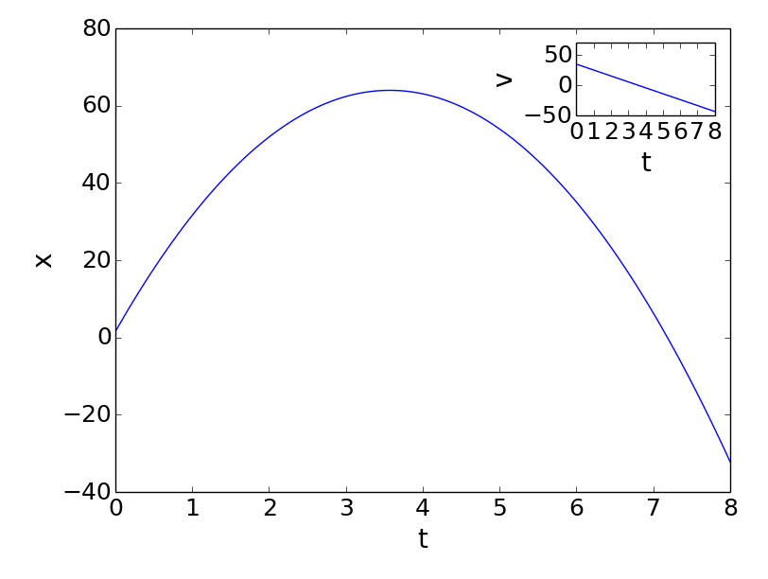
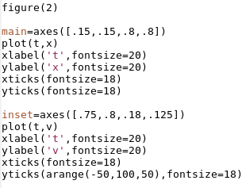
Subplots with matplotlib axes

Slide 21
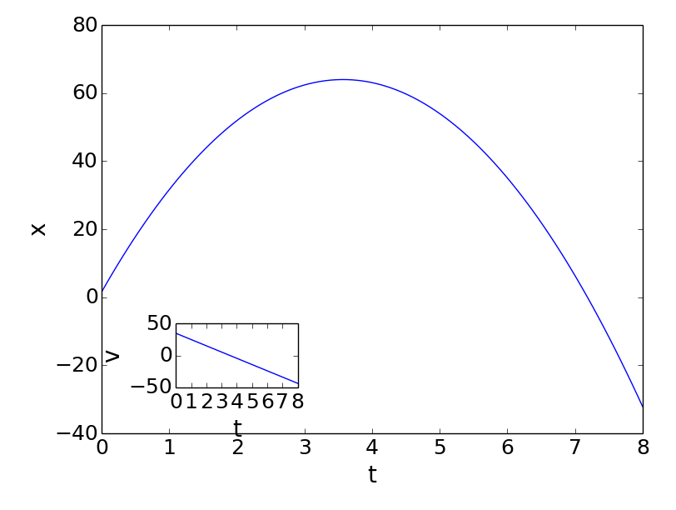
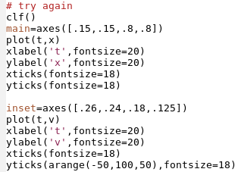
Subplots with matplotlib axes
Clear figure with clf()
Clear axes with cla()

Slide 22
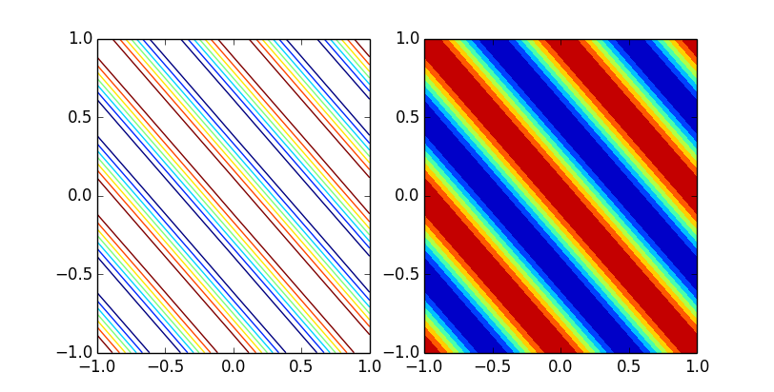
Contour plots
Filled or empty
Built in color maps in matplotlib.cm (see cookbook)
Or make your own
Default is “jet”

Slide 23
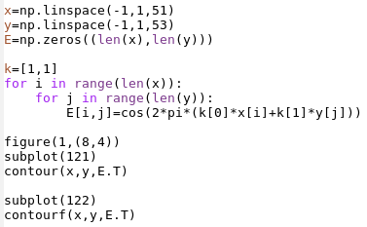
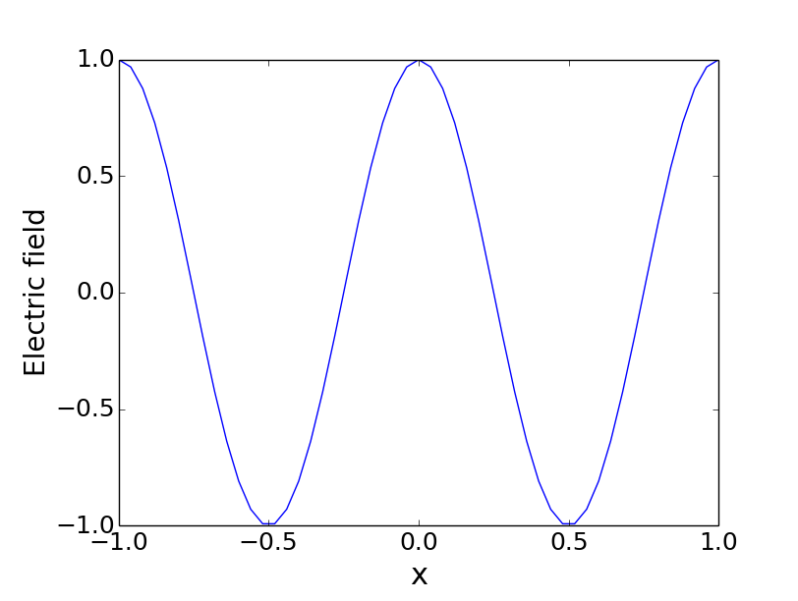
Contour plots: electric field
Electric field is a wave
Emanates from a source (e.g. antennas, flashlight, ...)
Wave vector ~ inverse of wavelength

Slide 24
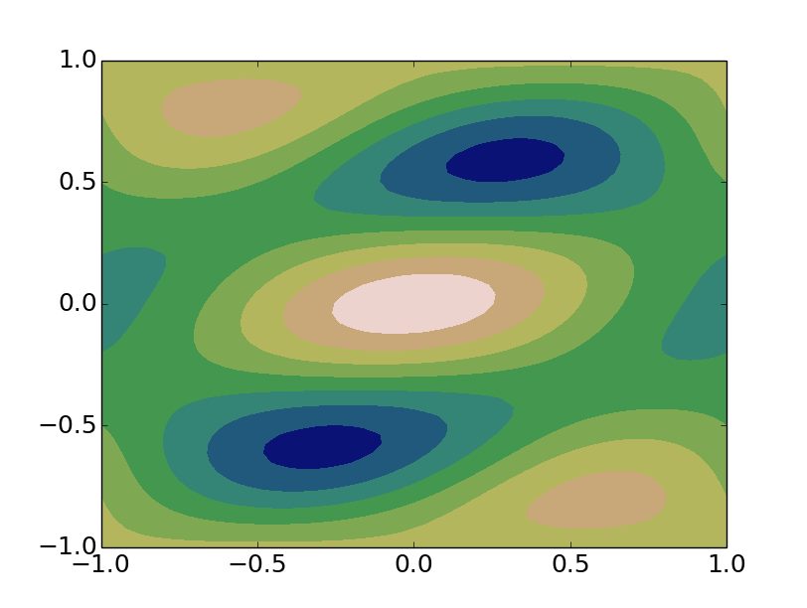
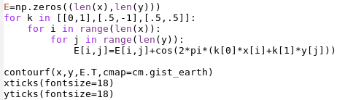
Contour plots: wave interference
Two or more waves of different wavelength will interfere
Try it:
  Reset E to zeros
  Use loop over k's

Slide 25
Going further...
Surface plots
Text
LaTeX (pretty math)
Arrows
Photos
“Zooming in”
Animation
Ipython notebooks (ipython notebook --pylab inline)
Widgets in ipython notebooks (new feature!)

